Slide 1
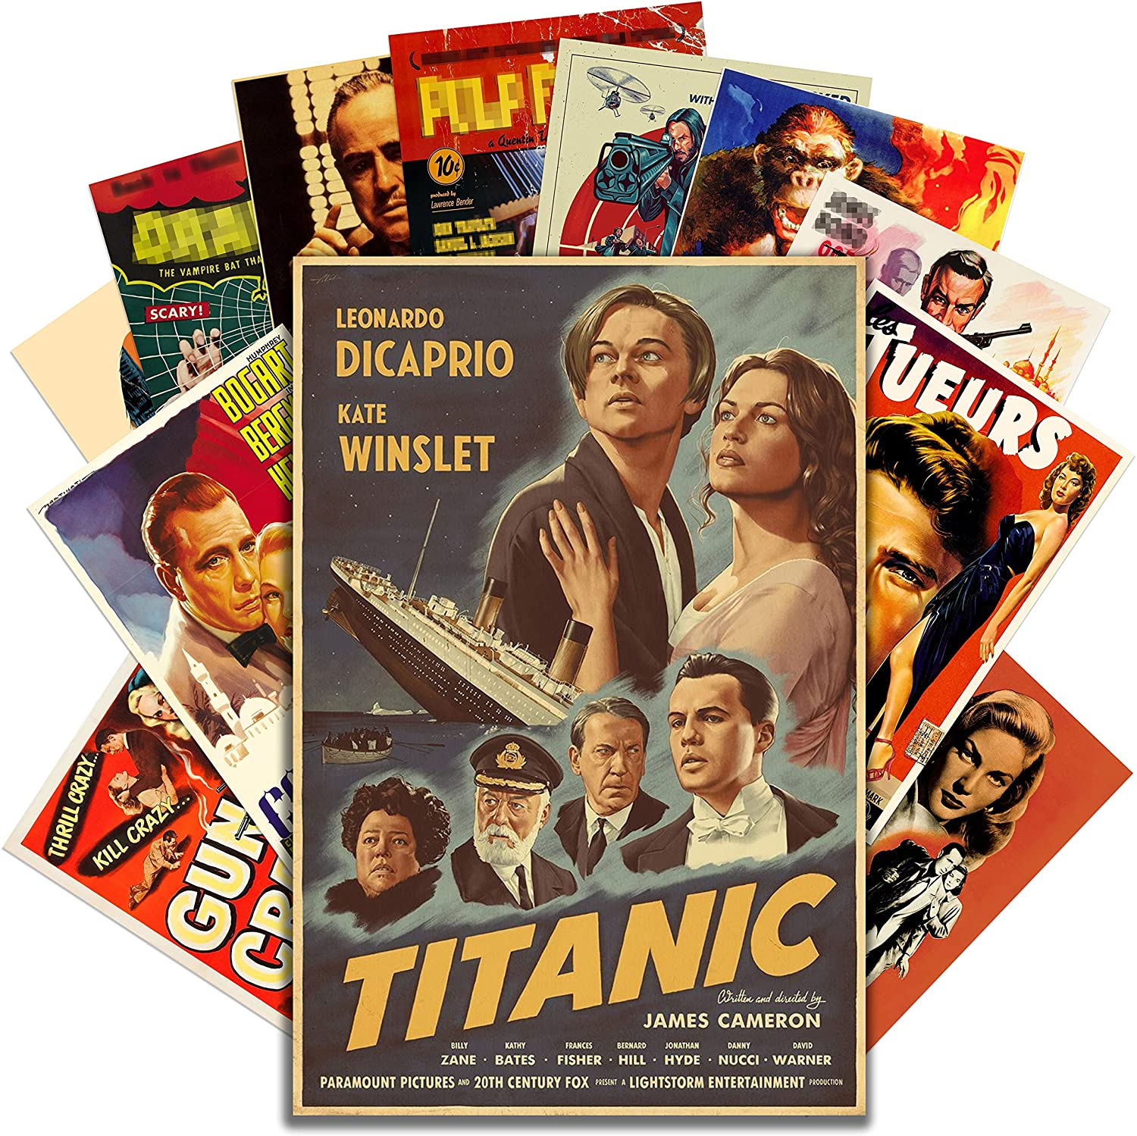
Vintage Movie Shop

Slide 2
Elevator Pitch

Slide 3
Concept
Description
Motivation for development
User story

Slide 4
Process
Technologies Used
Breakdown of tasks and roles
Challenges
Successes

Slide 5
Demo
App URL: https://movie-shop-mern.herokuapp.com/

Slide 6
Directions for Future Development

Slide 7
Links
Deployed at https://movie-shop-mern.herokuapp.com/
GitHub repo: https://github.com/jsun994/movie-shop-mern

