Slide 1
Credit Card Fraud Classification
Christopher Bussen, Duncan Ulman, Dylan Adkison

Slide 2
Topic Overview
Massive problem since invention of credit cards in 1950s
Two main kinds of credit card fraud
Purchase made using card in person, i.e., in a store
Purchase made online or over phone, AKA card-not-present approach
Card-not-present makes fraud more difficult to detect
Criminals constantly adapting to get around security measures - billions of dollars lost every year
Important to identify fraud and try to stop it early on
Can try to use machine learning and classification models

Slide 3
Experiments
Some data exploration - massive dataset, over 550,000 entries, only 0.17% fraudulent
Decision tree, KNN, random forest, logistic regression models
Confusion matrices and statistics
Feature importance and subset data with most relevant features
Recreate models

Slide 4
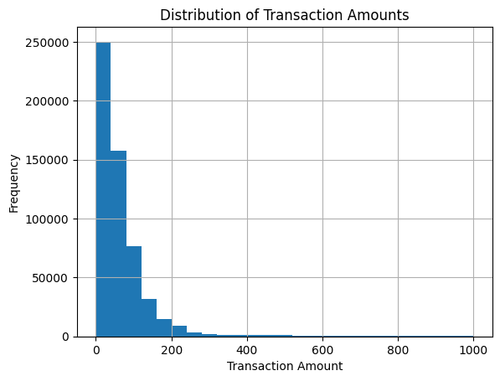
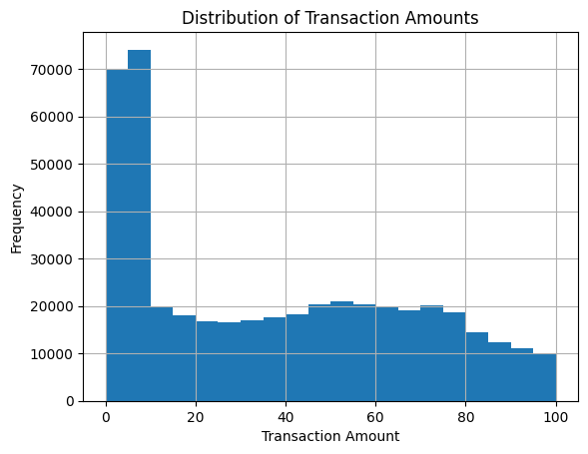
Data Exploration
Histograms of transaction amounts

Slide 5
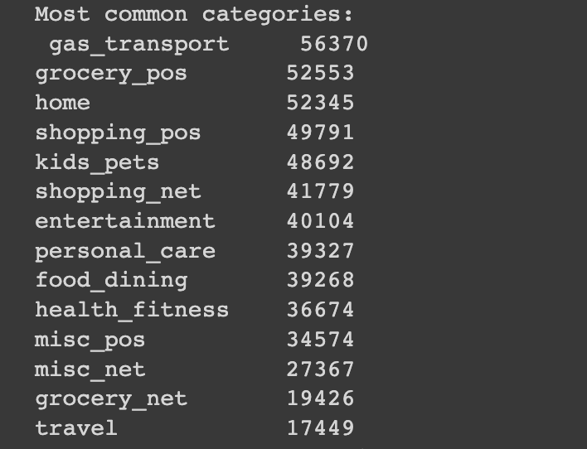
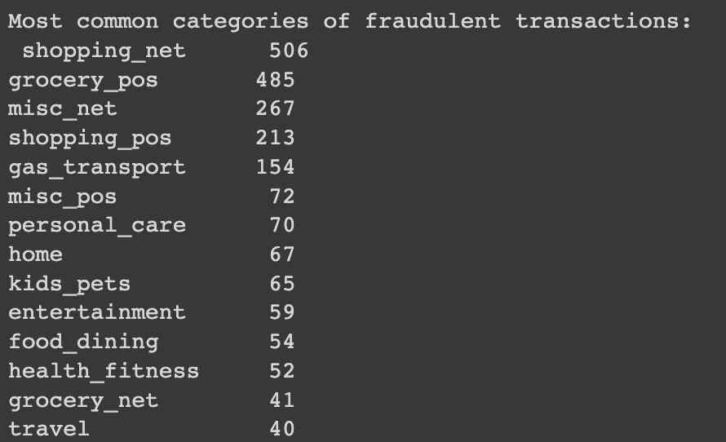
Data Exploration (cont.)
Most common categories (overall and fraudulent)

Slide 6
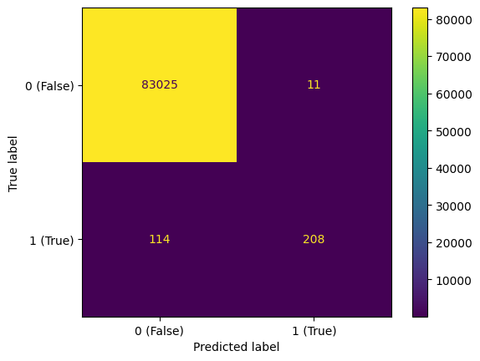
Classification Model Results
All accurate due to large dataset but don’t perform great according to F-measure
Logistic regression did not predict any fraud
KNN and decision tree had F-measure around 0.37
Random forest by far the best with F-measure close to 0.77 (pretty good for how rare fraud is in dataset)
Confusion matrix for random forest model

Slide 7
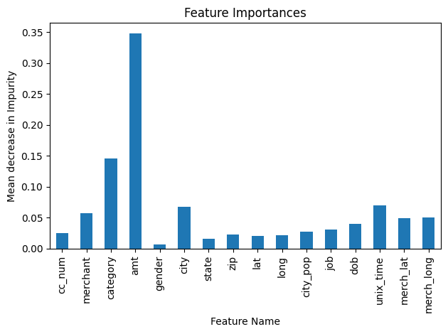
Feature Importance
Found amt, category, city, unix_time, and merchant to be most important features
Created new dataset with just these and target variable to study impact of reducing features
Recreated models

Slide 8
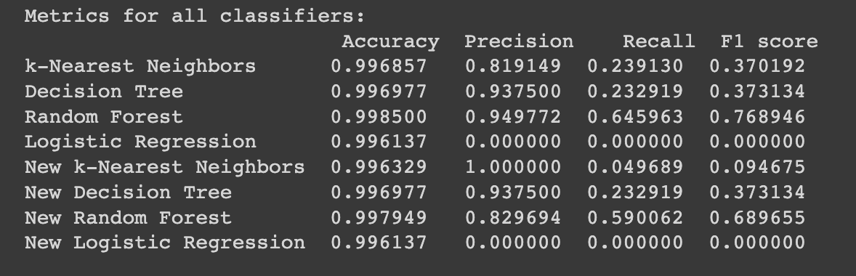
New Results
Model rankings stayed the same
Every individual model’s statistics either stayed the same or got worse
Likely narrowed dataset down too much
Classification models didn’t have enough features to improve performance

Slide 9
Conclusion
Original random forest model was by far the best
Logistic regression was the worst
Credit card fraud extremely difficult to accurately predict (obviously) despite powerful machine learning tools
Huge problem but occurs very rarely in grand scheme of credit card transactions
No one factor consistently gives a good indication of fraud
Every transaction is unique in some way

Slide 10
Thank you!
Any questions?

