Slide 1
Analyzing NFL Offenses from 2003-2023
Christopher Bussen

Slide 2
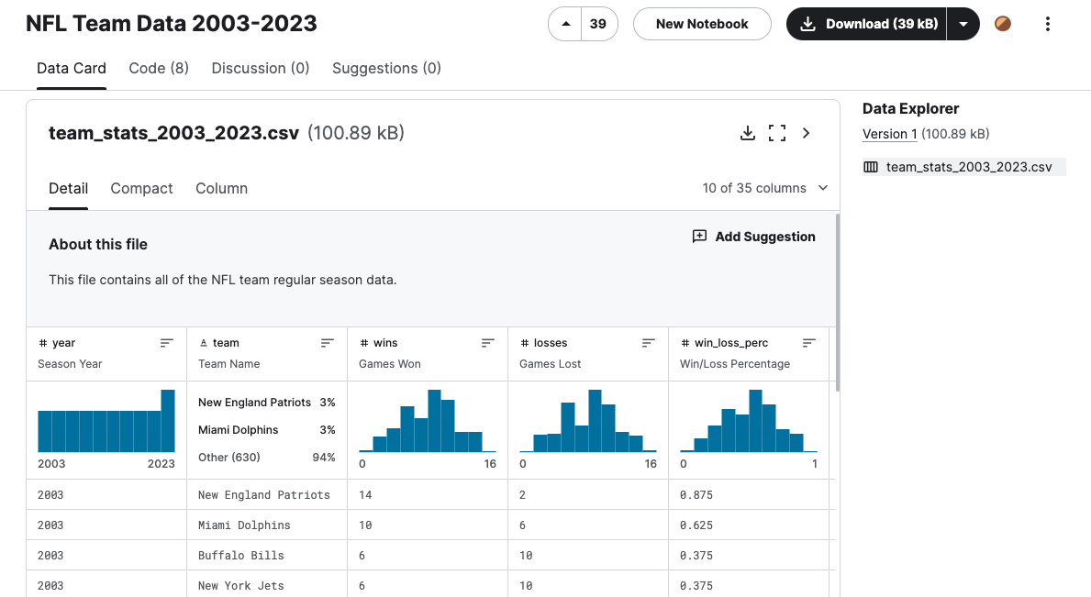
Data
Dataset from Kaggle about NFL offenses from 2003-2023
Original author used web scraper to pull from Pro Football Reference
35 variables, 672 observations with each observation being a team in a given season
Includes team win percentage, passing, rushing, penalties turnovers, and more

Slide 3
Data Cleaning/Preprocessing
Added location using a R script - for loop with if else statements for each team
Changed all instances of Washington to Commanders (have had other names in past 20 years)
Added average attendance up to 2019 by merging with part of another Kaggle dataset
Used Tableau Prep to split location into city and state - Tableau didn’t like City, State format
Planned to add team payroll information - information not readily available to public especially for earlier seasons so moved on without it

Slide 4
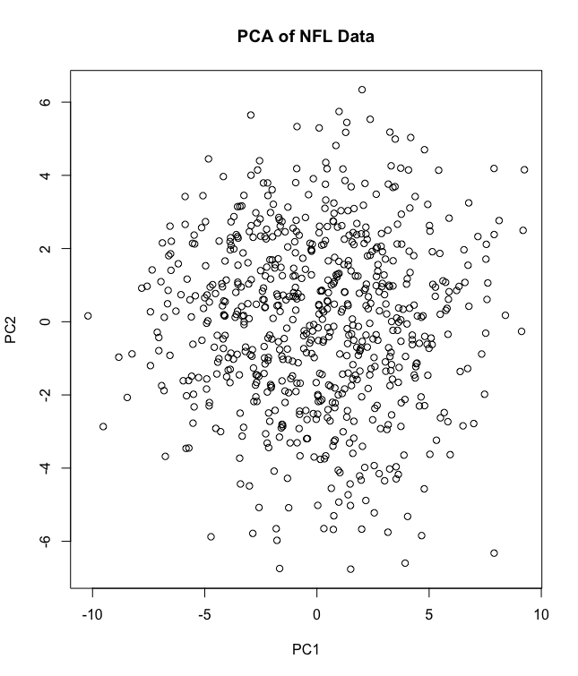
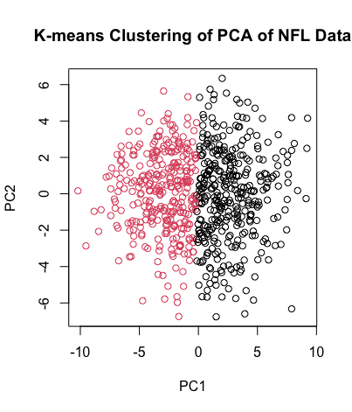
PCA/Clustering
Dropped MOV and Avg Attendance columns due to nulls, scaled data
Reduced to 9 PCs - captured 90% of variance
Hierarchical clustering did not separate data very well
K-means with 2 clusters did best job
PCs made up of combination of offensive stats
Clusters group offenses into above average or below average
Notes:
From rotation matrix (tells how much each variable contributes to each PC): for each of principal components one through nine, the top contributors were points, pass attempts, year, turnovers, penalty yards committed, yards per play on offense, games, first downs by penalty, and fumbles lost respectively

Slide 5
EDA/Time Series Analysis
EDA and analysis on dataset done primarily in Tableau

Slide 6
Thank you!
Questions?

