Slide 1
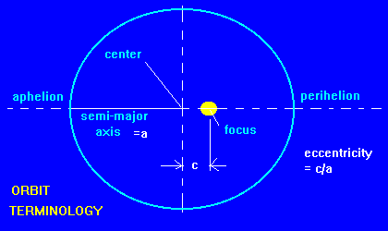
BACKGROUND - Elliptical Orbits
X Colors X Ink ✔️ Comparisons ✔️ Dimensions
Notes:
Kepler’s laws
1 = elliptical orbits
At its perihelion, a comet is closest to the sun (or other orbited object). This is also around where the comet would be closest to us, since the relative distance between Earth and the sun is negligible in relation to the distance between us and the comet. They have a much larger proportion of their orbit within an area/range that we can detect and thus collect information more readily and reliably.
Comets with smaller semi-major axes, half of the longest diameter of the orbit, have shorter orbital periods. An object’s orbital period is the time it takes to complete one orbit. For an elliptically orbiting object, Kepler’s third law directly relates these two variables: period ² = a². As a consequence of this phenomena, short period comets primarily have more circular orbits. This is expected, since a shorter period tends to mean a shorter path that was traveled; due to conservation of energy and momentum.

Slide 2
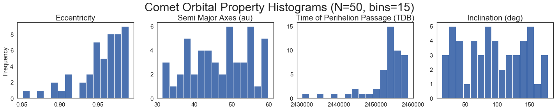
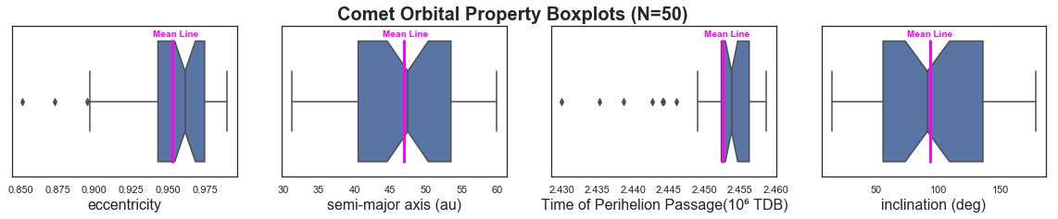
PROCEDURE & DATA EXPLORATION
X Clarity ✔️ Comparisons ✔️ Representation

Slide 3
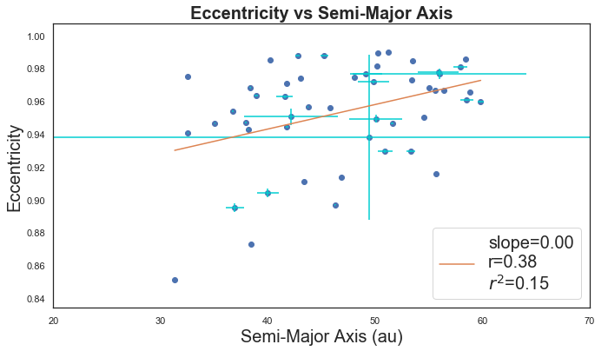
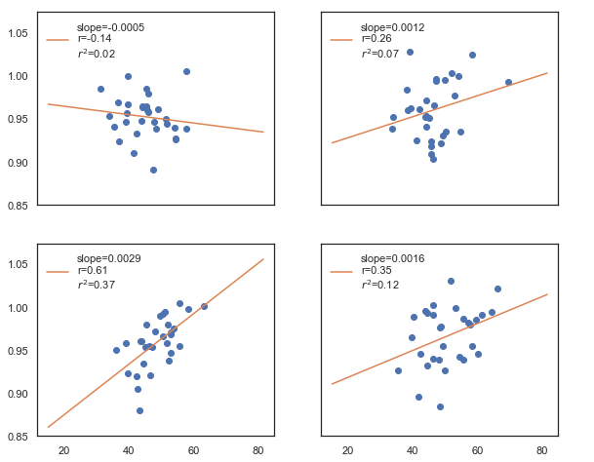
DISCUSSION & ANALYSIS
Eccentricity vs Semi-Major Axis
realizations
X Ink ✔️ Trends
X Labels ✔️ Data set

Slide 4
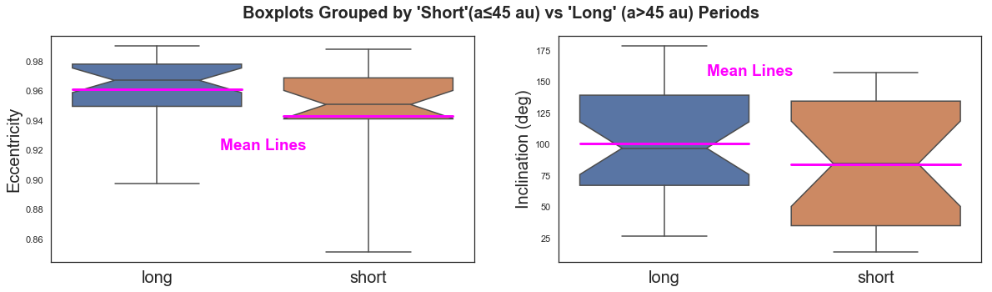
CONT’D
Mood’s Median Test for difference in ECCENTRICITY medians
test statistic = 1.3136 p-value = 0.2517
Mood’s Median Test for difference in INCLINATION medians
test statistic = 0.3284 p-value = 0.5666

