Slide 1
My Digital Life – MyStuff
Technical Perspective

Slide 2



Introduction
Seungwoo Choi
Mark Laney
Cameron Clark

Slide 3
Outline
Business Background
Issues with Old System
Proposal
Schedule
Cost Benefit Analysis
Architecture of New System
Demos

Slide 4
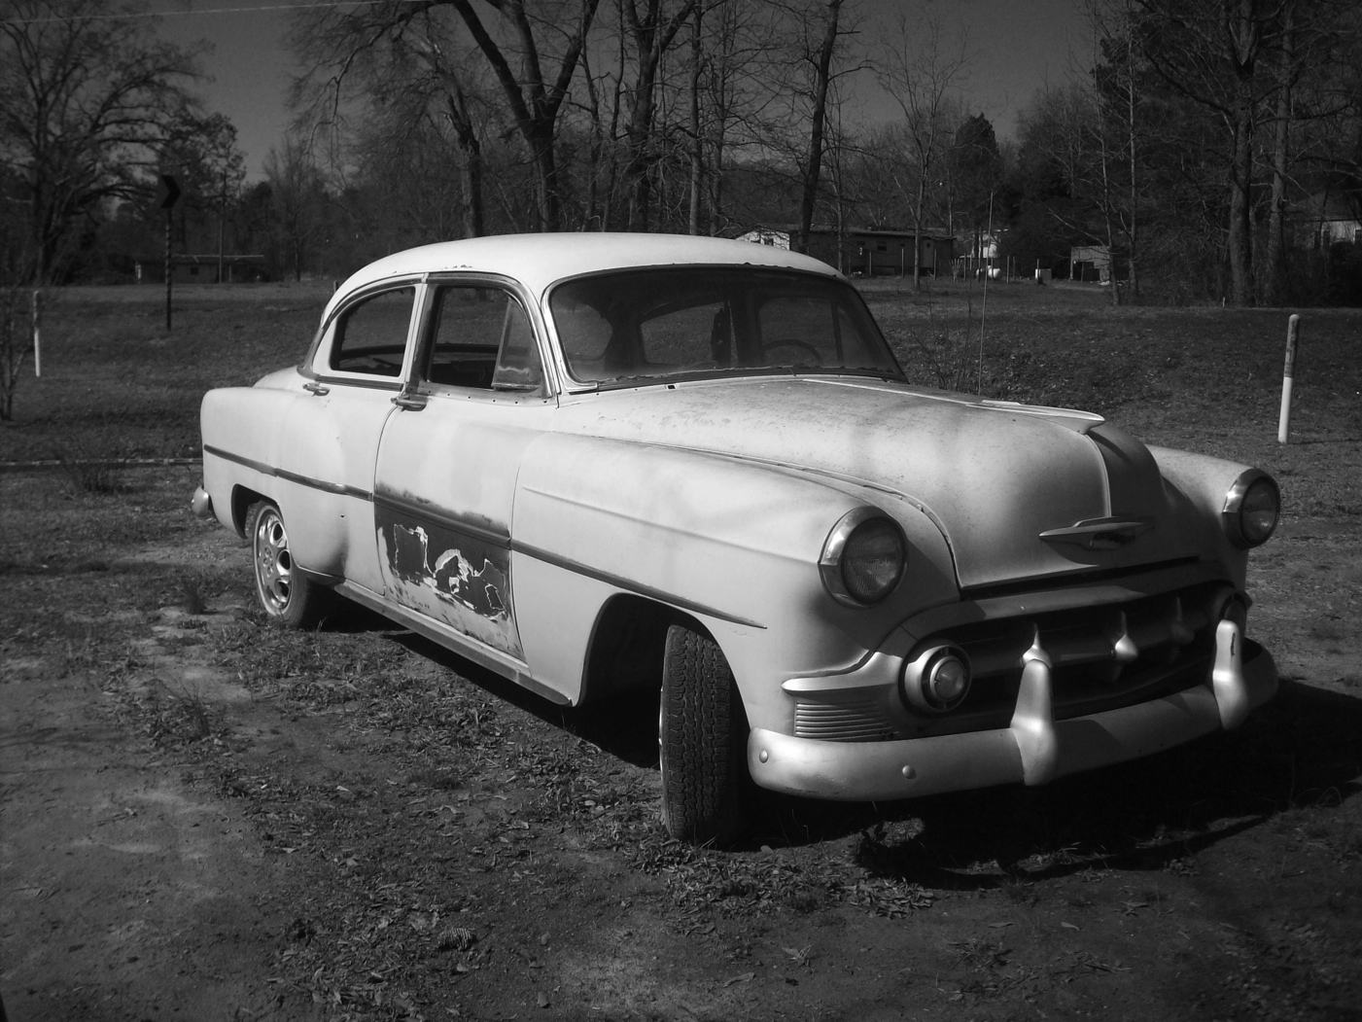
Business Background
Problems
Paradigm Shift
The Transition From Film to Digital
Branding
Apple vs. JC Penney
Lacks Automation
No System Supporting Documents

Slide 5
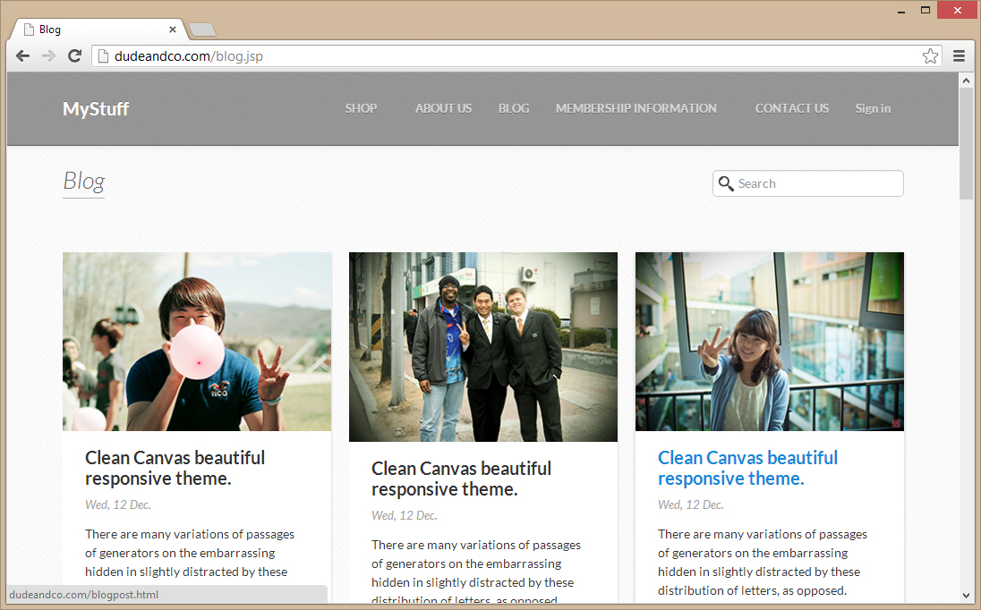
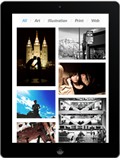
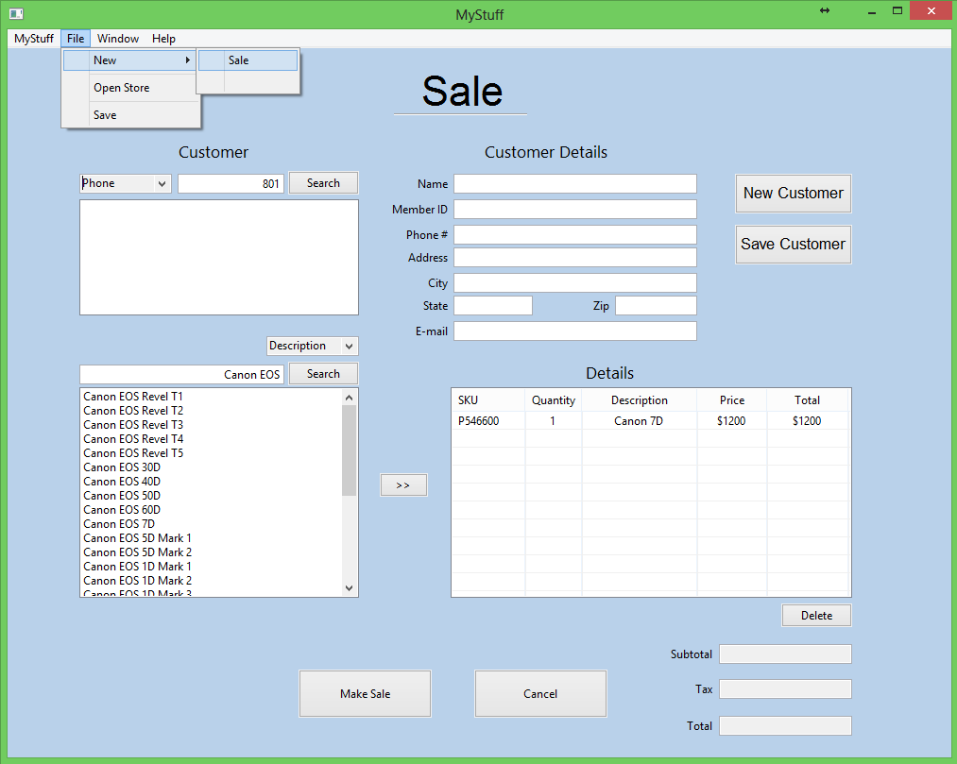
Proposal
Office System
Web System
Mobile System

Slide 6
Cost Benefit Analsis

Slide 7
System architecture
MVC
Cache
Date Access Object
Business Object
Office vs. Web vs. Mobile

Slide 8
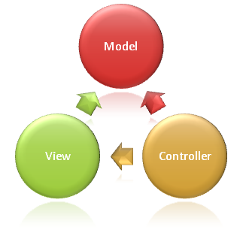
MVC
Makes both interface and data design independent of one another.
Allows for data to be used with different views
Promotes good task defining

Slide 9
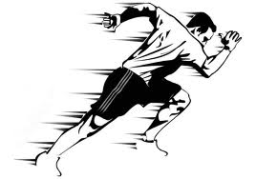
Cache
Stores business objects retrieved from DB
Reduces load on DB
Reduces errors and access time
Removes data from cache:
Data is altered
Data is unused

Slide 10
Data Access Object
A DAO class that has exclusively rights in handling data going to and coming from the database.
Creates standard through out the program for writing to the database
Ensures all information is protected and being updated correctly

Slide 11
Business Object
Java Abstract Class Between Software and Database
Used For Three Things
Dirty – Mark when an object is changed
isAlreadyInDb – New object creation/object read
Business Object Field Interface – what goes in/what doesn’t

Slide 12
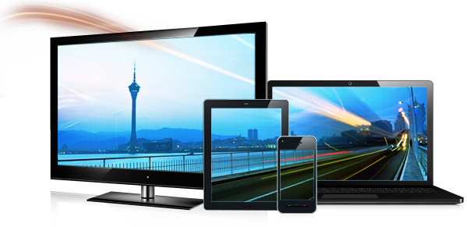
Web. Vs. Mobile vs. Office
App
Backup of Pictures Through Upload
Views Pictures
Shares Pictures with Friends
Purchase Prints
Web
Online Purchases
Blogging
Office
Maintenance (products, employees, stores)
Sales System
Rentals
Batch Systems

Slide 13
DEMO

