Slide 1
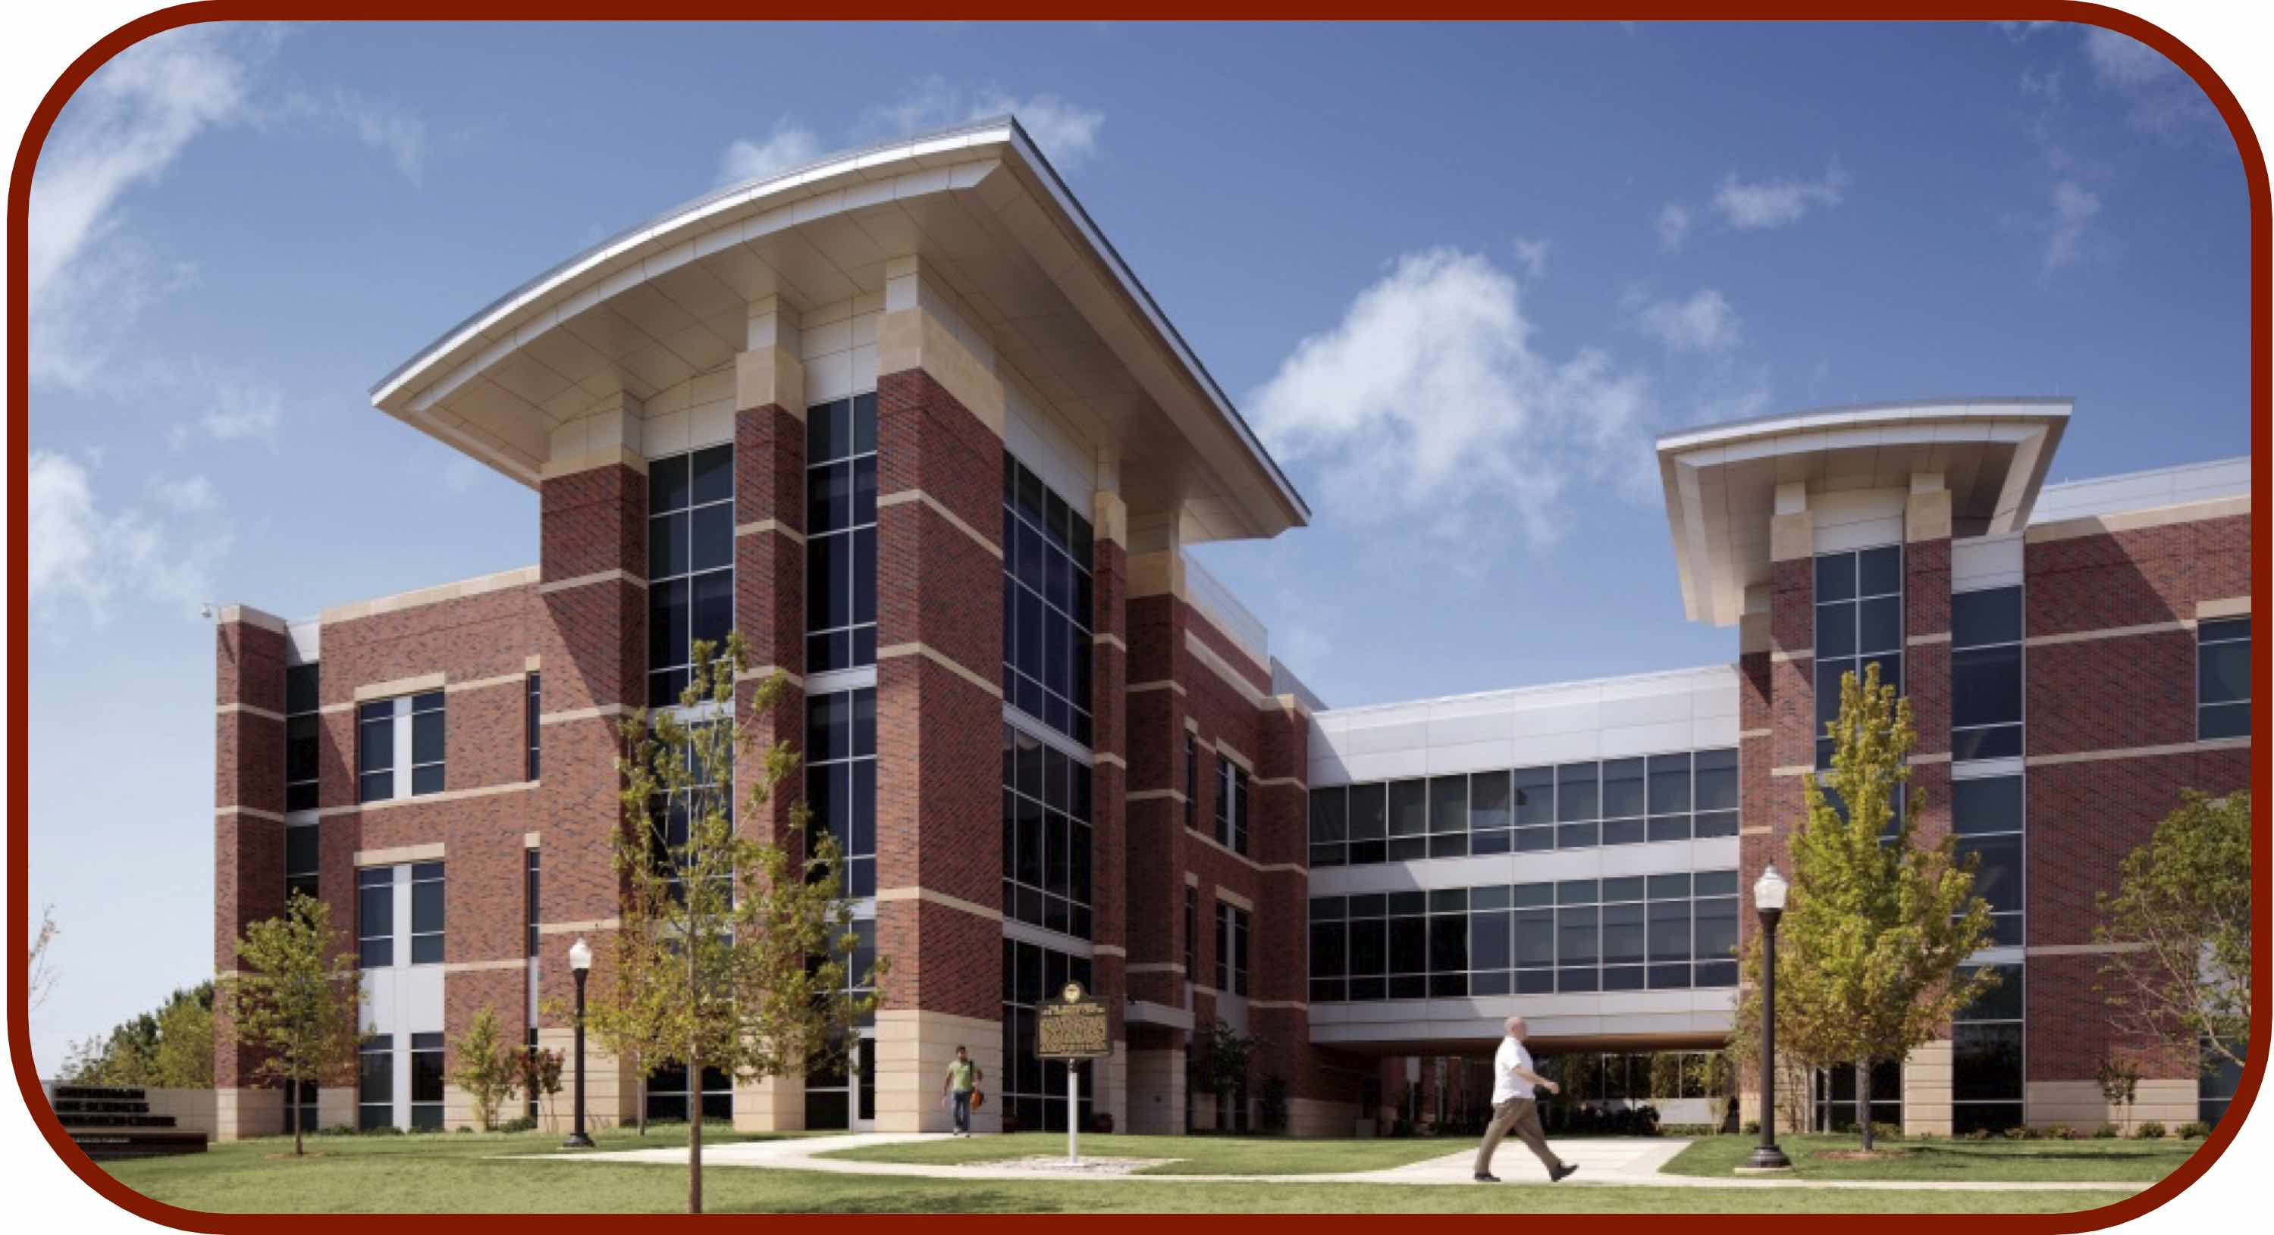
AlphaFold, RoseTTAFold, OmegaFold for Protein Structure Prediction
CCATS Group

Slide 2
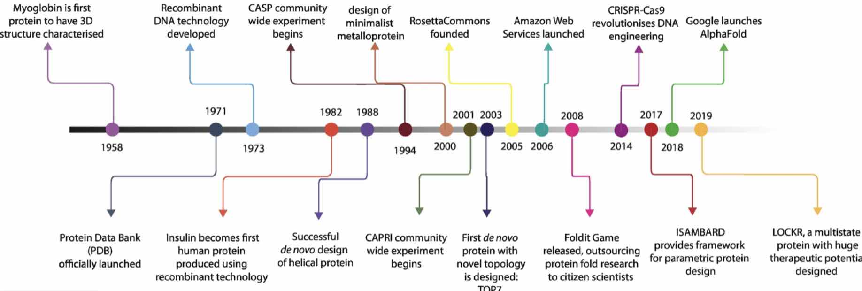
Timeline
Walker, Yallapragada, and Tangney, Trends in Biotechnology, 2020, 39, P651

Slide 3
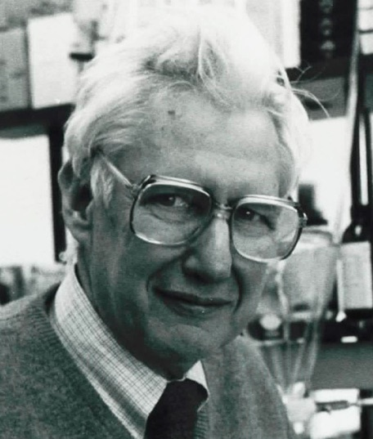
Protein Structure Prediction vs Protein Folding
It is a much harder task to identify the protein folding pathway
Cyrus Levinthal’s Paradox
A protein with 150 amino acids, 298 dihedral angles
If each angle can adopt one of three stable conformations, there are 3²⁹⁸~10¹⁴⁹ possible configurations
If the protein randomly samples the configurations at a rate of 10¹² configurations per second, it would take the age of the universe for this protein to fold
God does not play dice with the universe
https://web.archive.org/web/20110523080407/http://www-miller.ch.cam.ac.uk/levinthal/levinthal.html
Levinthal, Ext. du J. Chim. Phys. 1965, 65, 44

Slide 4
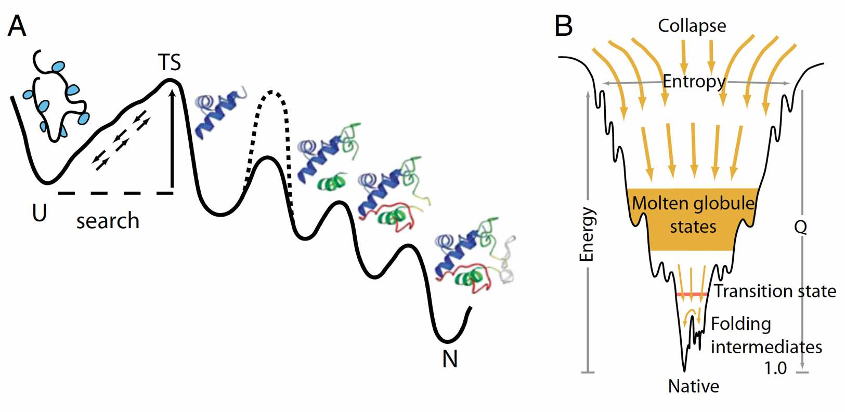
Protein Folding Pathway
Wolynes, Onuchic, Thirumalai, Science, 1995, 267, 1619; Dill and Chan, Nature Struct. Biol. 1997, 4, 10
Englander and Mayne, Proc. Natl. Acad. Sci. USA, 2014, 111, 15873

Slide 5
CASP14
Critical Assessment of Structure Prediction (CASP)
Test systems: 52 proteins or protein complexes. 42 (x-ray), 7 (cryo-EM), 3 (NMR)
Participants: 97 research groups (19 countries), 215 modeling methods
Global Distance Test Total Score (GDT_TS) through Local-Global Alignment
Zelma, Nuc. Acids Res. 2003, 31, 3370
Measures the similarity between structures of the same protein
Kryshtafovych, Schwede, Topf, Fidelis, and Moult, Proteins, 2021, 89, 1607

Slide 6
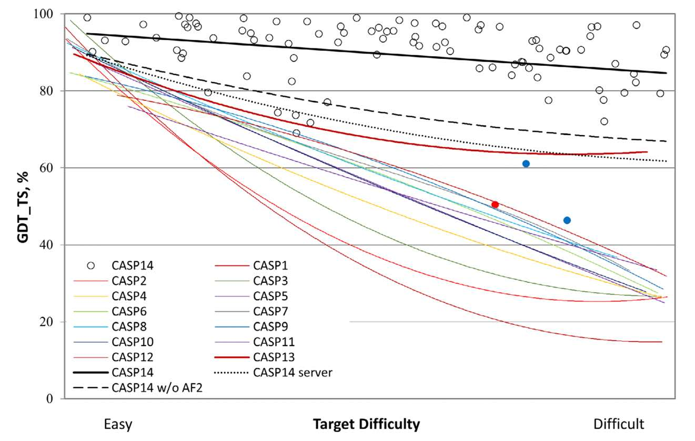
CASP14
Kryshtafovych, Schwede, Topf, Fidelis, and Moult, Proteins, 2021, 89, 1607

Slide 7
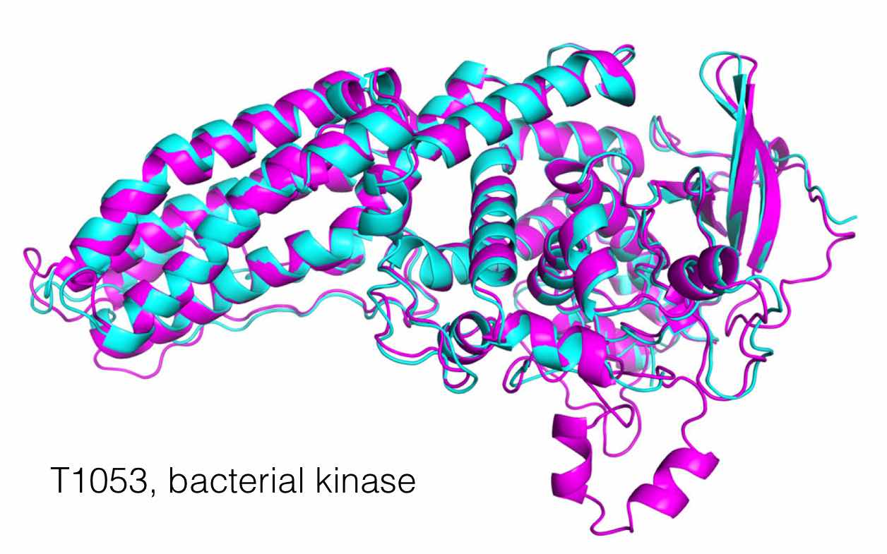
AlphaFold2 Results From CASP14
Jumper, Evans, .., Hassabis, Proteins, 2021, 89, 1711

Slide 8
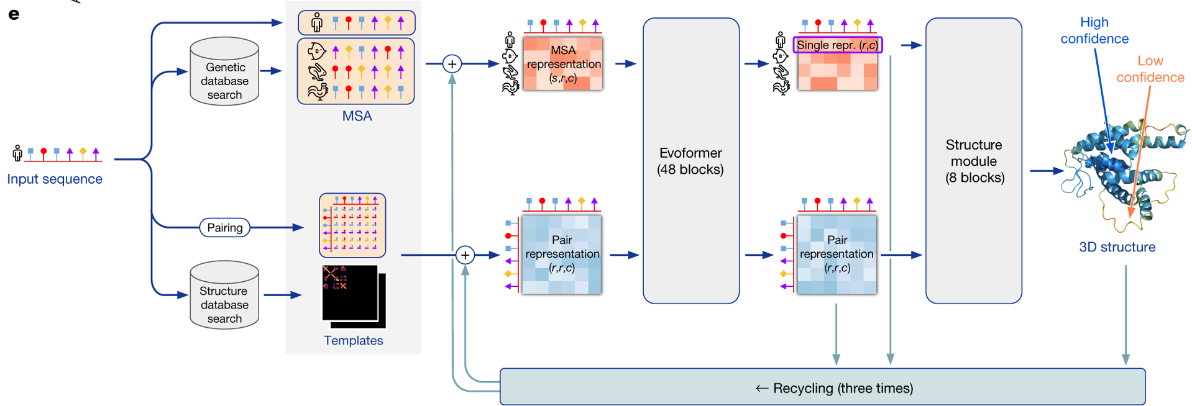

AlphaFold Workflow

Slide 9
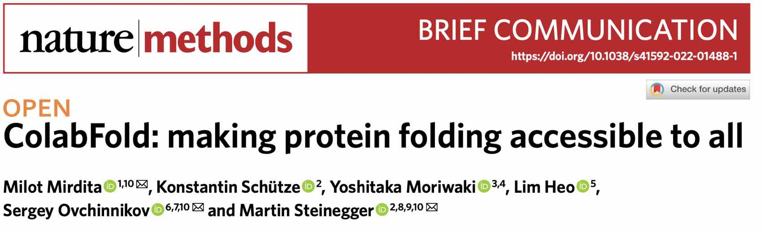
What is ColabFold?
https://github.com/sokrypton/ColabFold

Slide 10
What is ColabFold?
Accelerated and fast prediction of protein structure and complexes with AlphaFold or RoseTTAFold
Predicts up to ~1000 structures/day
Notebook is coupled to Google Colab, so results can be visualized within notebook
Fast homology search (MMseqs2 - UniRef100, BFD/Mgnify, PDB70, and environmental sequences)
HMMer and HHsuite are replaced
Goal: Fast MSA search, Diverse MSA, and Small MSA for limited resources
Python library to generate input features for structure inference

Slide 11
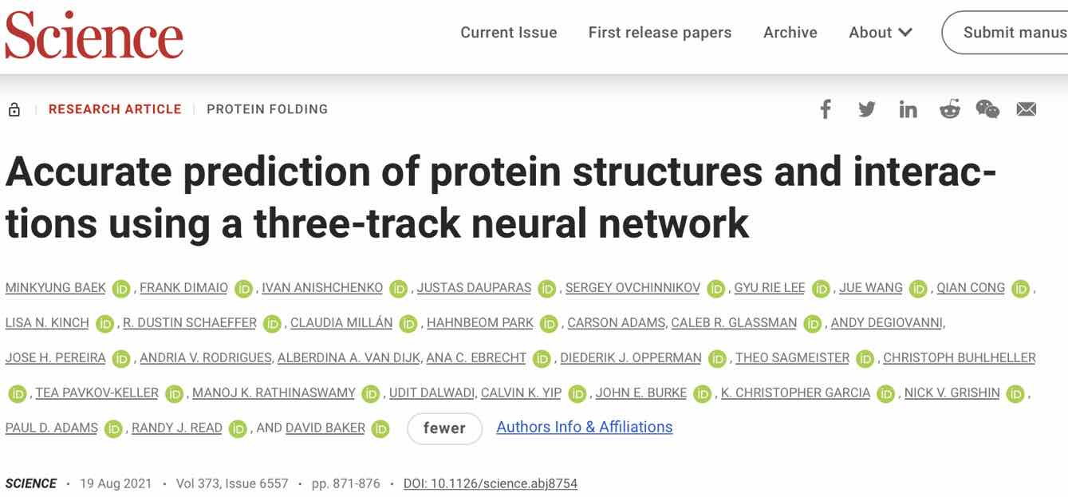
RoseTTAFold
https://github.com/RosettaCommons/RoseTTAFold
Baek et al., Science, 2021, 373, 871

Slide 12
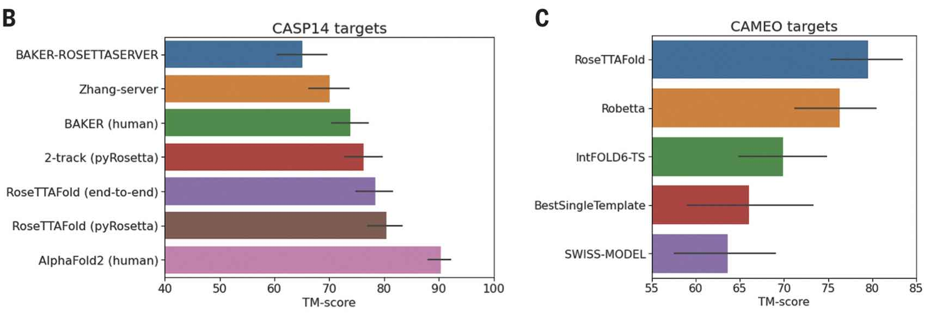
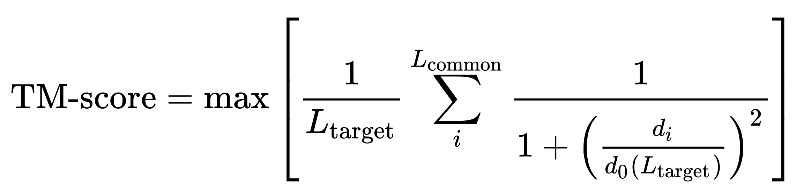
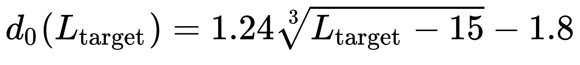
RoseTTAFold Comparison
TM-score (Template Modelling)
Baek et al., Science, 2021, 373, 871

Slide 13
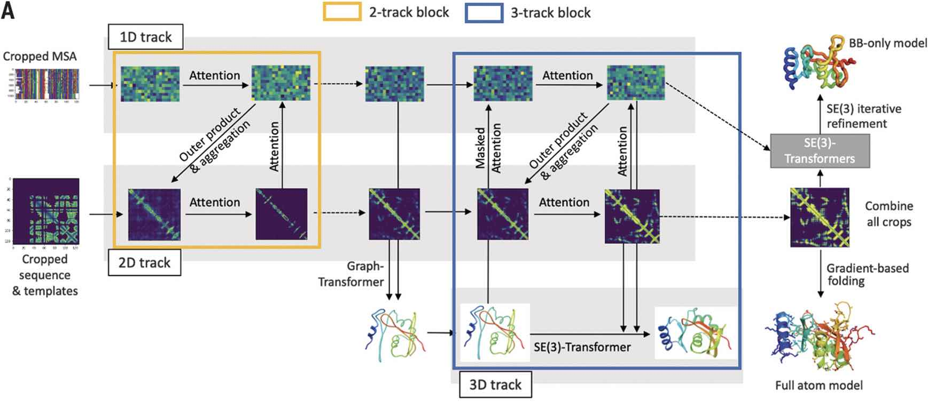
RoseTTAFold Schematic
Baek et al., Science, 2021, 373, 871

Slide 14
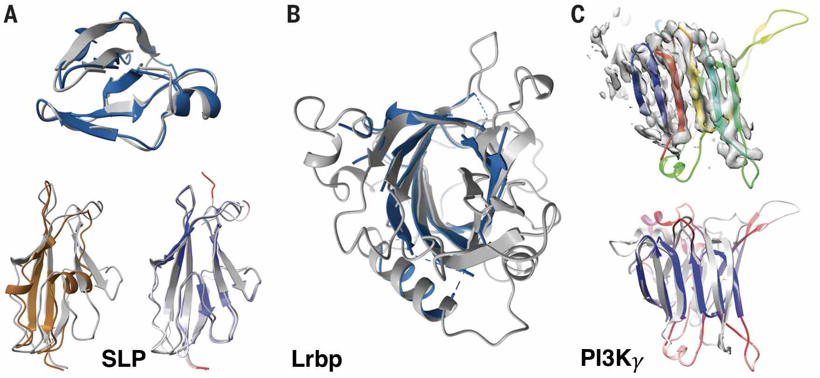
RoseTTAFold Predictions of Protein Structures
Baek et al., Science, 2021, 373, 871

Slide 15
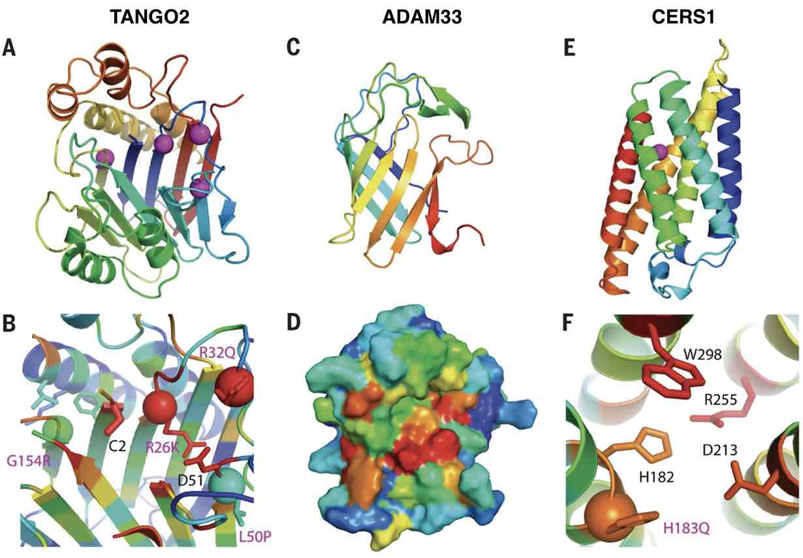
RoseTTAFold-Predicted Protein Functions
Baek et al., Science, 2021, 373, 871

Slide 16
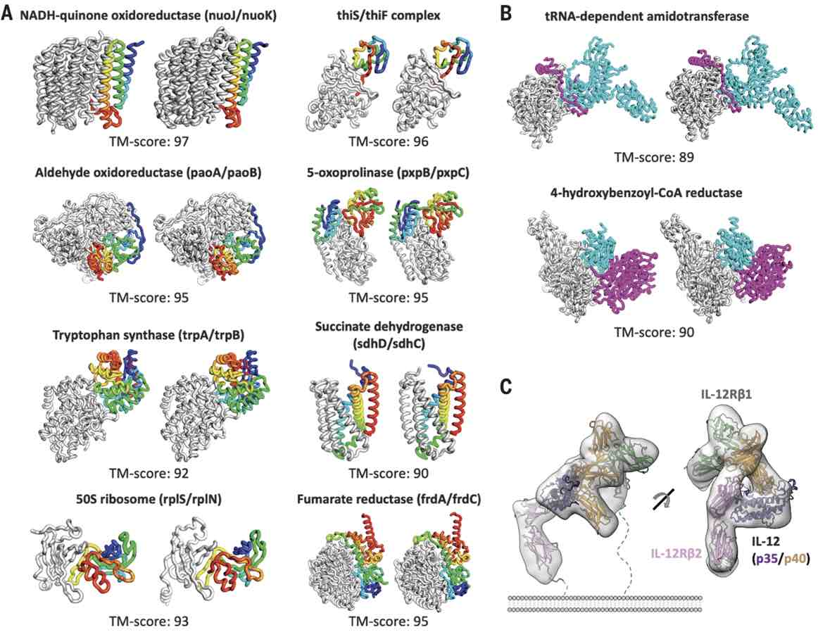
RoseTTAFold-Predicted Structure of Protein Complexes

Slide 17
RoseTTAFold Workflow
Input sequence
Amino Acid Sequence in FASTA format (.fa)
RoseTTAFold Program
Conda Environments (GPU, Folding; ~3.8 Gb)
RoseTTAFold Software (~6.9 Gb)
PyRoseTTA License (https://els2.comotion.uw.edu/product/pyrosetta)
RoseTTAFold Databases (~460 Gb)
Uniref30, Reduced BFD/Mgnify, Structure Templates (RCSB)
If all goes well, you get 5 predicted monomer structures

Slide 18
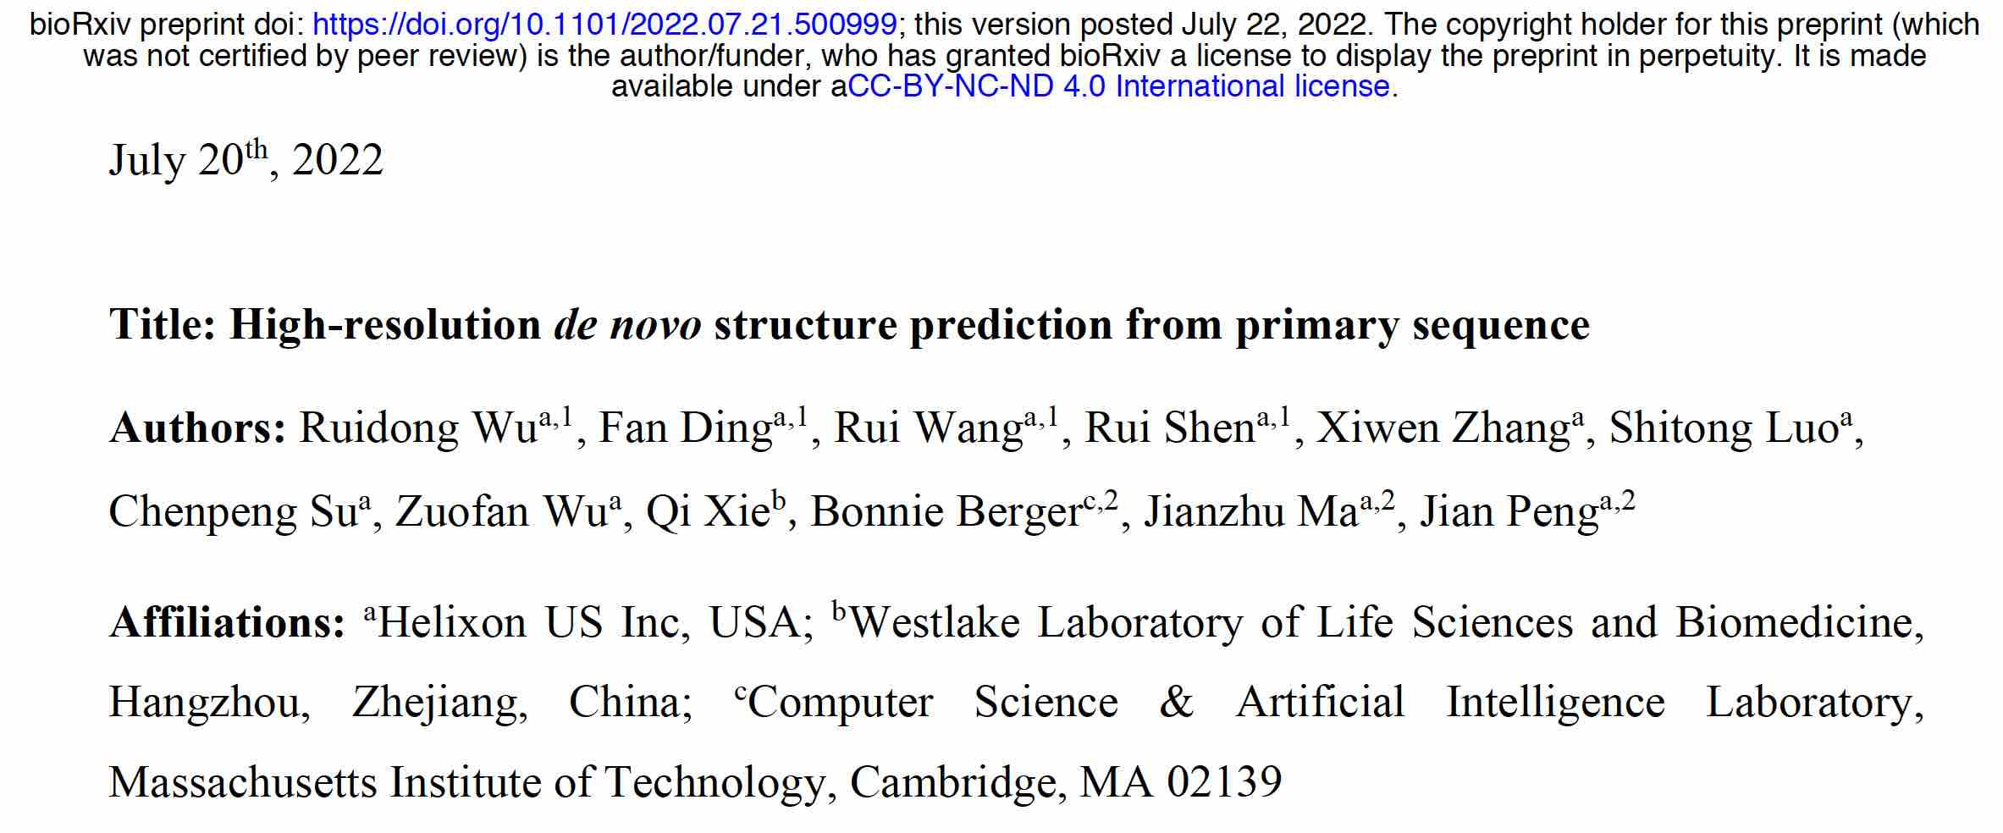
OmegaFold

Slide 19
How is OmegaFold Different?
Based on the understanding that
MSA does not always work, especially for fast-evolving antibodies, and orphan proteins.
Protein folds in a natural setting without exploiting evolutionary information.
OmegaFold predicts protein structure from a single primary sequence alone, i.e. alignment-free
It uses a pre-trained protein language model (PLM) to generate single- and pair-wise embeddings (i.e. representations)
training on a large collection of unaligned and unlabelled protein sequences
fed into Geoformer, which will further distill structural/physical pairwise relationships

Slide 20
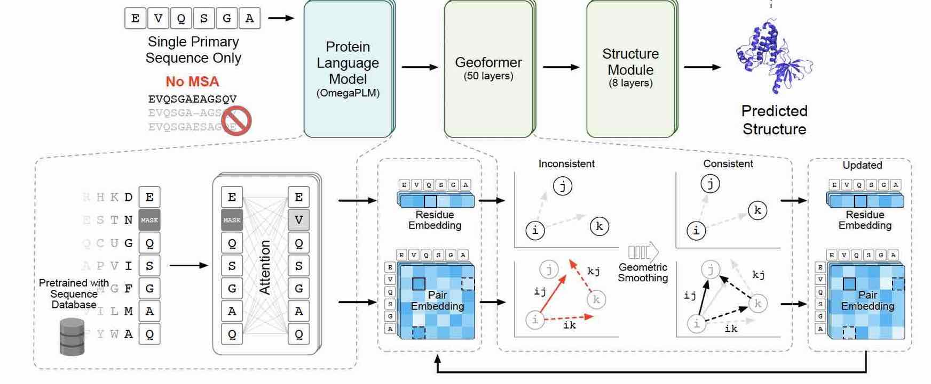
Workflow

Slide 21
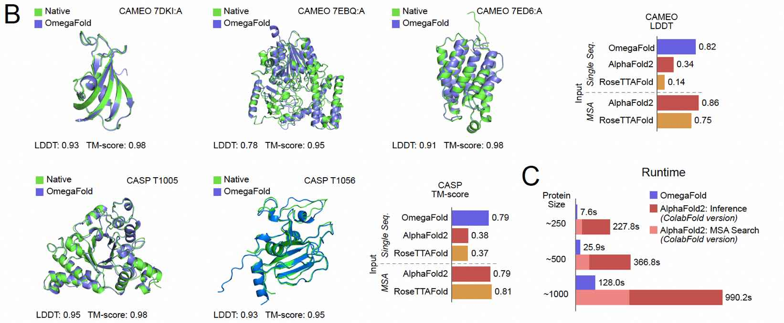
Prediction Results
For CASP and CAMEO proteins, OmegaFold is as accurate as AlphaFold2 and RoseTTAFold.
OmegaFold is much faster.

Slide 22
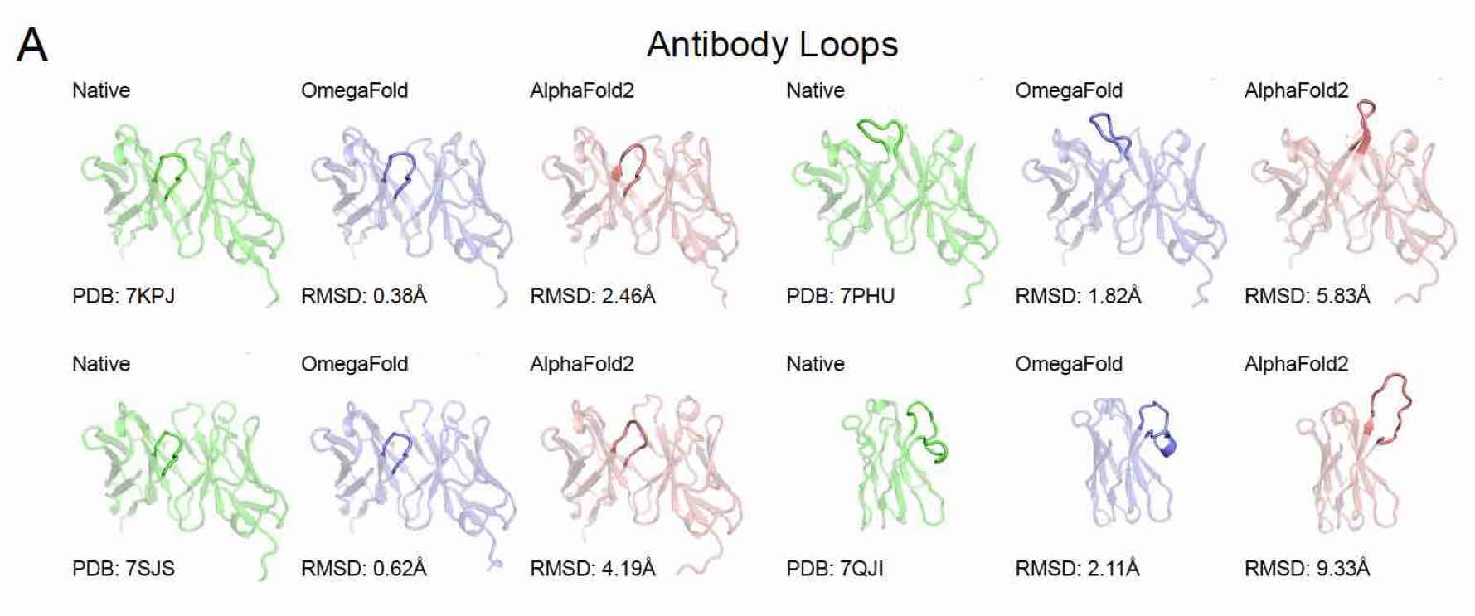
Prediction of Antibody Loops

Slide 23
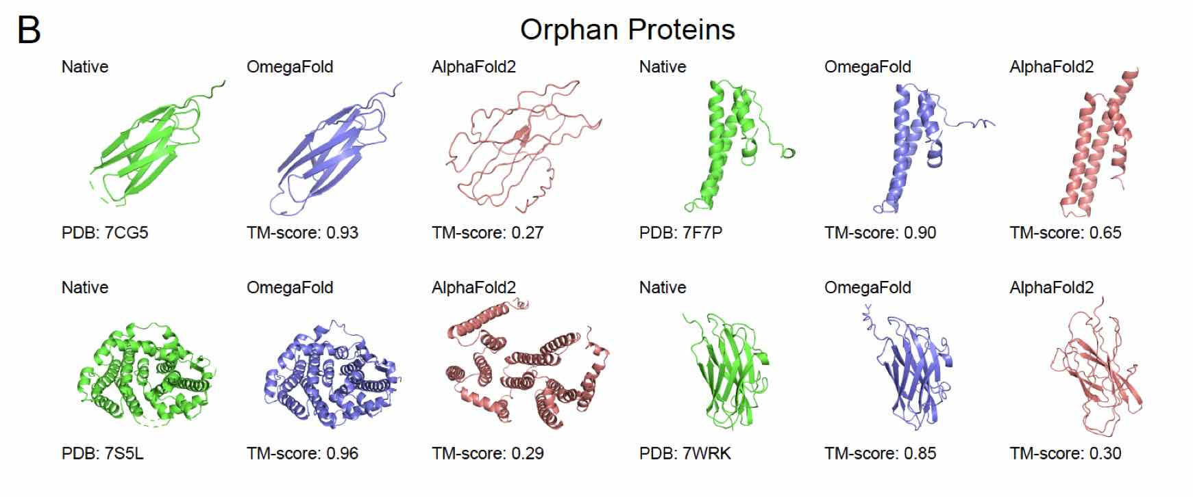
Prediction of Orphan Proteins

Slide 24
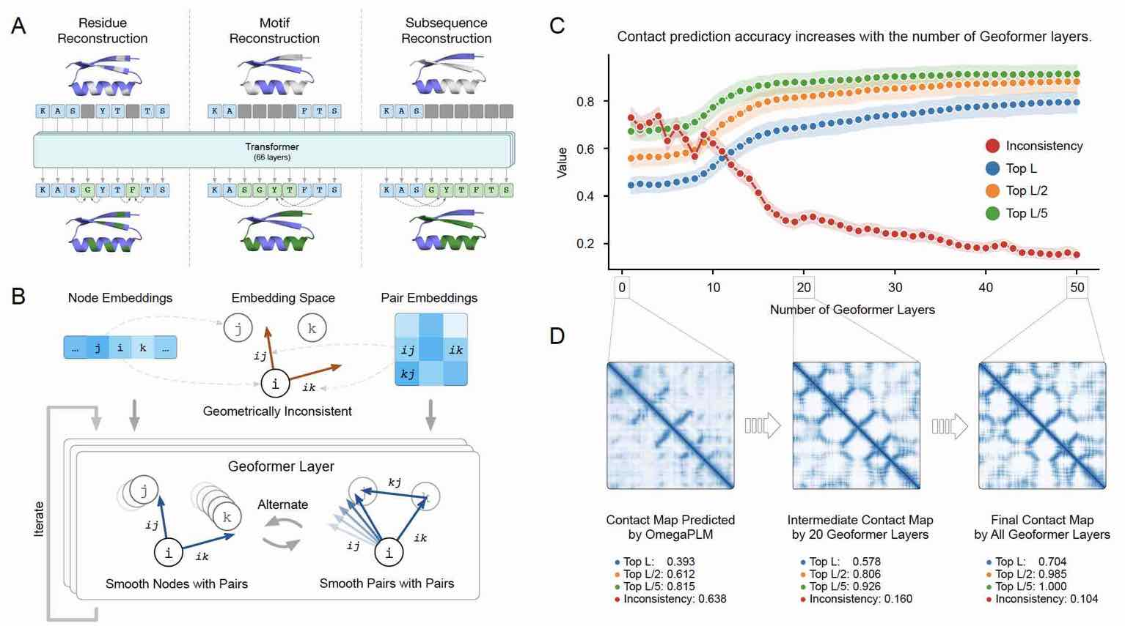
Geoformer

