Slide 1
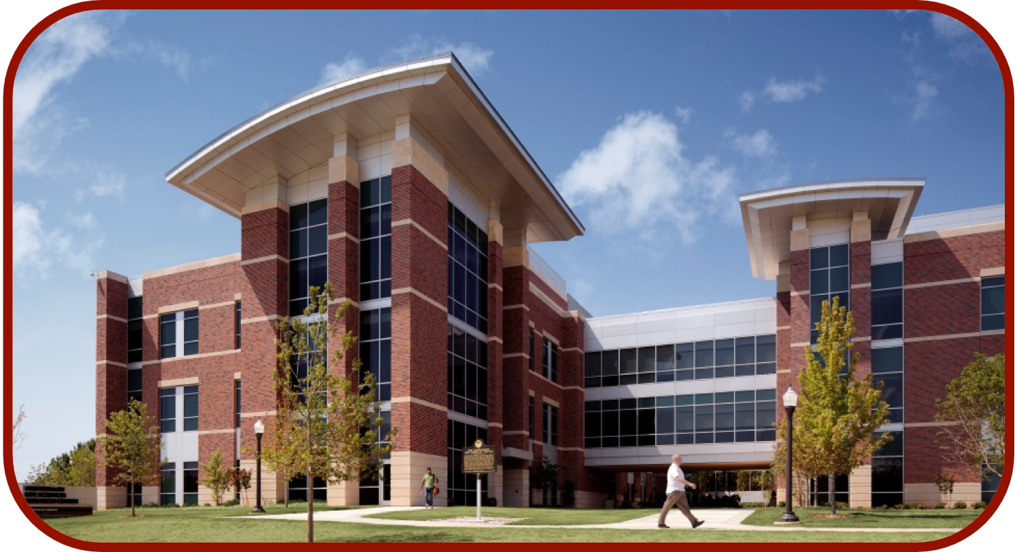
ColabFold
CCATS Group

Slide 2
Plans for Today
Run ColabFold
What is ColabFold?
MMseqs2
Overview of RoseTTAFold

Slide 3
ColabFold Bax Prediction (~20 minutes)
Copy the ColabFold to your Google Drive
https://colab.research.google.com/drive/1KlbP18w3HLg7bTgwrtJXGZIBjiEF8bI4?usp=sharing
The example prepared is Bax protein, but the areas you need to modify before running:
Input Sequence (Query Sequence, Job Name, Minimization, and Templates)
MSA Options (MSA Mode and Pair Mode)
Advanced Settings (Model Type, Save to Drive, and Figure Quality)
After all changes are made, click Runtime > Run All

Slide 4
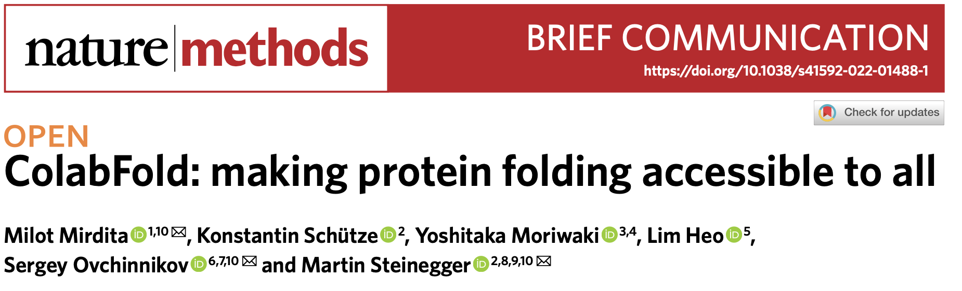
What is ColabFold?
https://github.com/sokrypton/ColabFold

Slide 5
What is ColabFold?
Accelerated prediction of protein structure and complexes with AlphaFold or RoseTTAFold
Predicts up to ~1000 structures/day
How?
Notebook is coupled to Google Colab, so results can be visualized within notebook
Fast homology search (MMseqs2 - UniRef100, BFD/Mgnify, PDB70, and environmental sequences)
HMMer and HHsuite are replaced
Goal: Fast MSA search, Diverse MSA, and Small MSA for limited resources
Python library to generate input features for structure inference

Slide 6
MMseqs2
Goal: Fast MSA search, Diverse MSA, and Small MSA for limited resources
Fast MSA search
Prefilter with MMseqs2 server
Diverse MSA
New workflow with increased sensitivity
Small MSA for limited resources (Max of 3000)
New filter for sampling sequence space evenly

Slide 7
MMseqs2
Query sequence is sent to MMseqs2 server and searches UniRef30 (increases sensitivity)
Each hit with E-value <0.1 are searched against UniRef100
Filtering (HHfilter)
Each UniRef30 cluster pair have no higher similarity than 95%
Minimum column score is 80% regardless of sequence similarity if at least 100 sequences are found
Further filtering is done before MSA generation to not allow removal of redundant sequences by sequence identity “bucket” ([0.0–0.2], (0.2–0.4], (0.4–0.6], (0.6–0.8] and (0.8–1.0]; increases diversity)
Pre-computed index of sequences and alignments with vmtouch (small and fast MSA)

Slide 8
Reduced BFD/MGnify
BFD contains ~2.2 billion proteins in 64 million clusters
MGnify contains ~300 million proteins
To reduce the database:
MMseqs2 filtered MGnify against BFD
Sequence identity >30% and coverage of at least 90% of a MGnify sequence is added to BFD Cluster
182 million clusters
New BFD is filtered, keeping only 10 most diverse sequences
Final number of sequences is ~513 million (84 Gb)

Slide 9
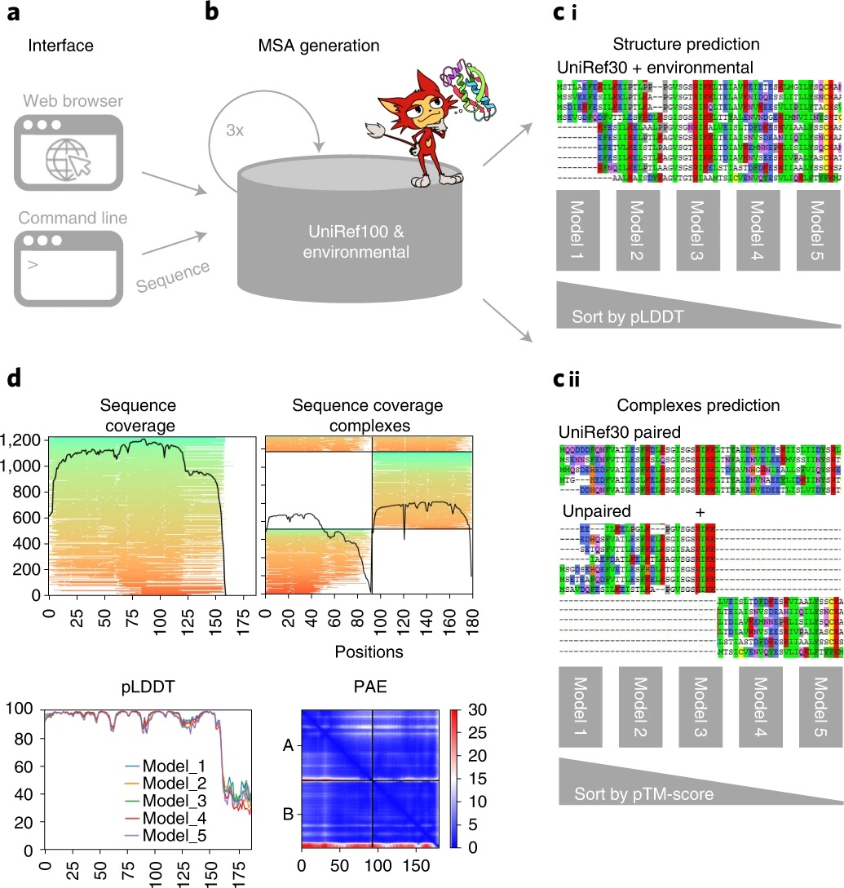
ColabFold Schematic

Slide 10
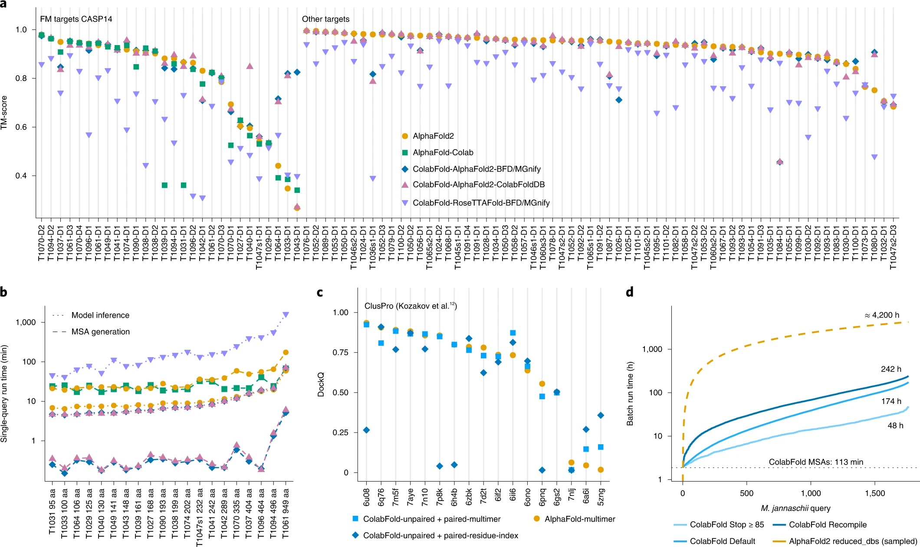
ColabFold Comparison

Slide 11
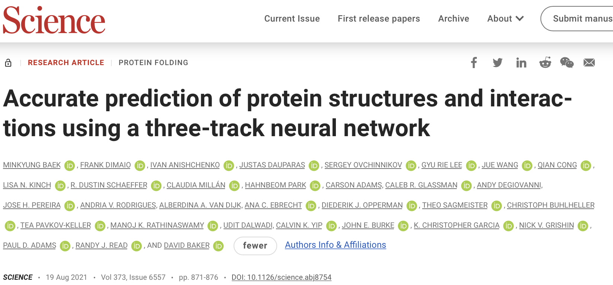
RoseTTAFold
https://github.com/RosettaCommons/RoseTTAFold

Slide 12
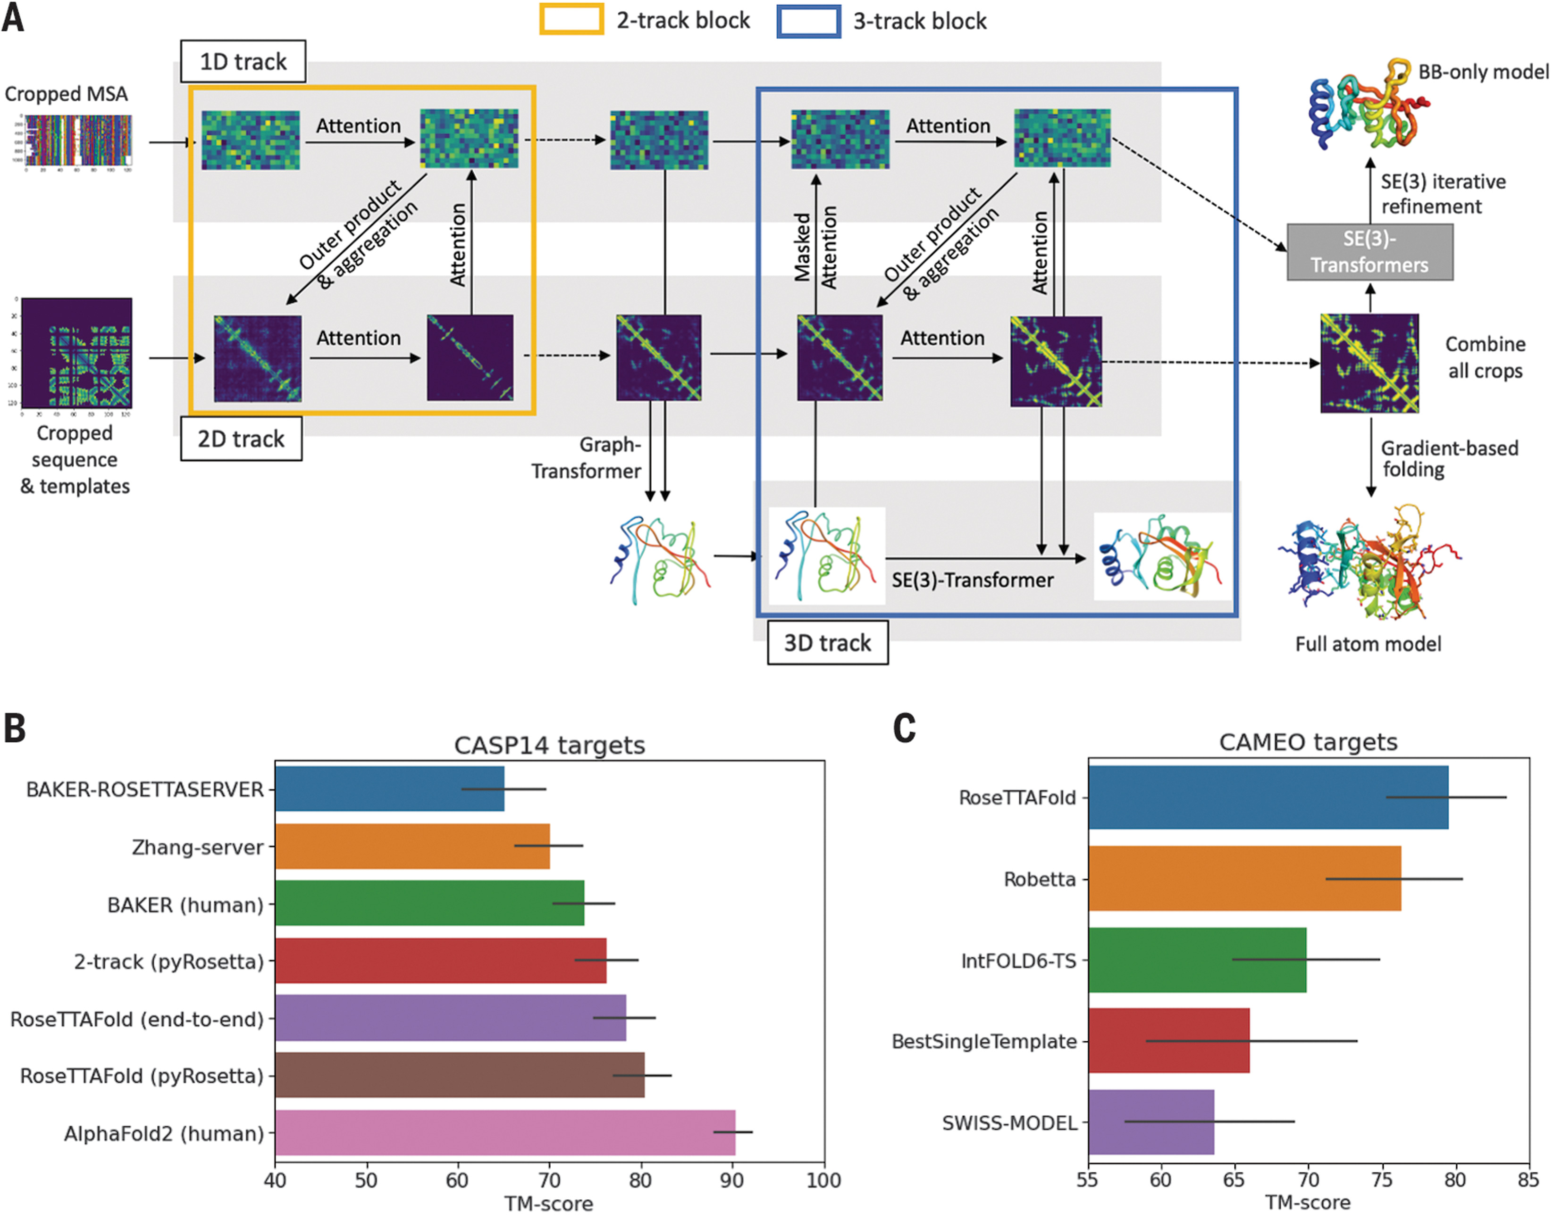
RoseTTAFold Schematic

Slide 13
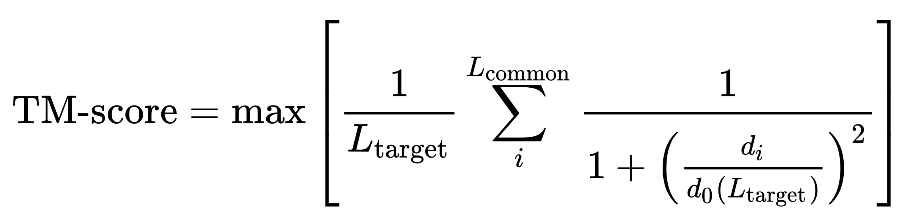
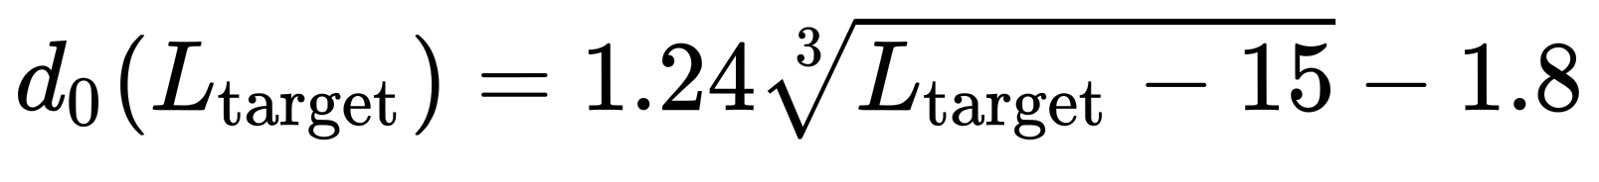
RoseTTAFold Comparison
TM-score (Template Modelling)

