Slide 1
The Agent Framework of SDPA
Dr. Tiberiu Rotaru

Slide 2
Multiagent Systems
  New paradigm for understanding and building distributed systems
  Agent -> no universally accepted definition. Example: “a computer system that is capable of independent action on behalf of its user or owner”
  Agent properties:
    (i) autonomy – agents operate without the direct intervention of humans or others, and have some kind of control over their actions and internal state,
    (ii) social ability – agents interact with other agents (and possibly humans) via some kind of agent-communication language,
    (iii) reactivity – agents perceive their environment and respond in a timely fashion to changes that occur in it,
    (iv) pro-activeness – agents do not simply act in response to their environment, they are able to exhibit goal-directed behavior by taking initiative
  Multiagent system -> complex system composed of autonomous agents
    Ex: Electronic commerce/markets, Road Traffic Management, Energy Management, Environmental Emergency Management, Optimization of industrial production
Notes:
Agent is an autonomus entity that acts in the world, interacting with its environment and with other agents. It can be a human, a robot, a software process etc.
Multi-Agent Systems - systems that may include many such entities – are becoming more and more popular in Computer Science and Artificial Intelligence. First, they offer a metaphor for modeling the reality around us as a world inhabited by such autonomous, active, possibly intelligent elements. Second, they can be used as a methodology that enables design and implementation of large systems in a really modular way. Relatively new field (10 years?)
Microsoft Asynchronous Agent Library -> multicore development built-in support in Visual Studio 2010
(Tony Hey -> Microsoft research former drector of UK e-science intiative and professor od CS in Southampton)
Michael Wooldridge:
Multiagent systems are a new paradigm for understanding and building distributed systems
An agent is a computer system that is capable of independent action on behalf of its user or owner
Bref:
Microsoft released recently
The Asynchronous Agents Library (or just Agents Library) provides a programming model that lets you increase the robustness of concurrency-enabled application development.
Message passing model -> integrated in Visual Studio 2010 ->
An asynchronous agent (or just agent) is an application component that works asynchronously with other agents to solve larger computing tasks.
Think of an agent as a task that has a set life cycle.
For example, one agent might read data from an input/output device (such as the keyboard,
a file on disk, or a network connection) and another agent might perform action on that data as it becomes available. T
he first agent uses message passing to inform the second agent that more data is available. The Concurrency Runtime task scheduler provides
an efficient mechanism to enable agents to block and yield cooperatively without requiring less efficient preemption.
The Agents Library defines the Concurrency::agent class to represent an asynchronous agent. agent is an abstract class that declares the virtual method Concurrency::agent::run. The run method executes the task that is performed by the agent. Because run is abstract, you must implement this method in every class that you derive from agent.

Slide 3
Agent’s definition according to Jacques Ferber:
Basic abstract view of an agent
System
An agent is a physical or virtual entity which
(a) is capable of acting in an environment,
(b) can communicate directly with other agents,
(c) is driven by a set of tendencies,
(d) possesses resources of its own,
(e) is capable of perceiving its environment (to a limited extent),
(f) has only a partial representation of this environment (or none at all),
(g) possesses skills (capabilities) and can offer services,
(h) may be able to reproduce itself,
(i) tends towards satisfying its objectives, taking account of the resources and skills available to it and depending on its perceptions, its representations and the communications it receives.
Input
Output
Environment

Slide 4
Agent architectures
    Reactive:
    focused on fast reactions/responses
    the agent needs to choose its action or behavior as quickly as possible when some change occurs in the environment.
    Deliberative :
    focused on long planning of actions, centered on a set of basic goals.
    the agent should be able to predict the consequences of its actions and take these into account for choosing its behavior.
    when time is available, it should prepare a series of actions to be undertaken in the future.
    planning enables to orient choices towards preset goals enabling the agent to fulfill a useful mission.
    Hybrid:
    combining a reactive and a deliberative side
  SDPA agents are hybrid agents

Slide 5
SDPA as a Distributed Event-Driven Architecture
Software architectural pattern promoting the event
  production
  detection
  consumption
  reaction
Agents react to incoming events and post events in response.
The events are processed/interpreted and some intelligent planning is applied (workflow engine + scheduler)
Events are transported asynchronously (sender doesn’t wait)‏
Applied in the design of loosely coupled software components
Distributed processing, no central control
Advantage: increased responsiveness in unpredictable and asynchronous environments
Staged Event Driven Architecture (thread pools + shared queues)
Notes:
SOA is often used because certain advantages: loose coupling etc BPMN -> GOP
Orchestration? What is BPMN?
SOA
Business Process Model and Notation (BPMN) is a graphical representation for specifying business processes in a business process model.
The most used and suitable architecture for MAS and HPC is EDA
Reactive agent architectures. -> Categories: purely reactive agents, reactive planning agents and sophisticated reactive planning agents
-> apply reactive reasoning to choose between alternative plans
Agent without WE -> reactive agent
Agent with WE -> reactive planning agent
Intelligent agents? What exactly means ? -> discutable
No recepit how to build or to implement such a system reliable!!!!!!!!!!!!!!!!!!!!!!!!!

Slide 6
Other approaches: Microsoft Asynchronous Agents Library
The Asynchronous Agents Library
provides a programming model -> increase the robustness of concurrency-enabled application development.
is a C++ template library that promotes an actor-based programming model and in-process message passing for coarse-grained dataflow and pipelining tasks.
Message blocks and message-passing functions allows writing parallel applications without requiring synchronization mechanisms such as locks. This allows the user to focus on the application logic.
The agent programming model is often used to create data pipelines or networks. Every component in a dataflow pipeline performs work when it receives a message from another component. The result of that work is passed to other components in the pipeline or network.
more fine-grained concurrency: using the Parallel Patterns Library

Slide 7
Original SDPA Architecture
SDPA -> multi-level, event-driven architecture
User
Orchestrator
WE
Aggregator
WE
. . .
Aggregator
WE
NRE
WE
. . .
NRE
WE
NRE
WE
. . .
NRE
WE
PC
PC
PC
PC
FVM/GPI
Notes:
Oriented tree: single master of a node -> inherently a tree, no circuits
The idea with SDPA was to bring expertise from different existing projects (PHASTGrid, GWES, FVM, Kirchoff migration, Seda, etc..) and to build
Something great ☺
With respect to the agent framework is on top of the SDPA -> adopted EDA instead SOA (PHASTGrid)

Slide 8
Agents
Subscriber 0
Master n
Multiple masters
Multiple subscribers
Workers can join and leave dynamically
Configurable communication model: pushing/requesting jobs
Fault-tolerant, recoverable
Have capacities -> reject jobs when full
Configurable:
  Command line parameters
  Configuration files
Subscriber p
Master 0
. . .
. . .
Agent
Worker 0
. . .
Worker m

Slide 9
SDPA New Architecture: flexible, dynamic, fault-tolerant
SDPA -> multi-level, event-driven architecture
User 1
User n
Subscriber 1
Subscriber n
Orchestrator
Agent
Agent
Agent
Agent
Agent
Agent
. . .
Agent
. . .
DRTS
DRTS
DRTS
DRTS
GPI
Notes:
Circuits are possible, multiple masters are allowed
Subscribers -> observers -> notification about job status
Agents -> templetazed factory methods -> it is decided at compile
Time which workflow engine to use
DRTS explained how the drts works: it is responsible for loading GPI plugin, we, plugin and application
Plugins -> can interact with the agents

Slide 10
Topologies
Tree
Line
Diamond
Ring
Mesh
Torus
Hypercube
Butterfly
Agent 0
Agent 1
Agent 2
. . .
Agent n
Agent 0
Agent 1
Agent 2
Agent 3
Dynamically configurable
Advantages: there are classes of algorithms especially designed or suited for certain types of topologies (PRAM algorithms)
Regular topologies -> simpler workflows
Notes:
Hypercube-> one has logarithm of the number of processors dimensions -> efficient
-> a lot of algorithms can be effciently described and implemented (log P complexity, )
Tom Leighton MIT professor: „Introduction to Parallel Algorithms and Architectures: Arrays, Trees, Hypercubes”
Hypercube: n-dimensional analogue of a square and a cube -> 2 nodes are neighbors if their binary
reprsentation differ in exactly one bit/position.

Slide 11
Agent Anatomy
  Job manager -> single pool of jobs
  Jobs have unique ids
  Job types:
    produced by an agent
    produced by an workflow engine
  The jobs are handled in the same way
  The job may have specified requirements (to be matched against worker capabilities)
  Worker manager: management of registered workers
  Persistent
  Thread-safe
Job Manager
Workflow Engine
Backup Service
Scheduler
WorkerManager
Common queue
Worker 1
Worker 2
Pending
Submitted
Acknowled.
Pending
Submitted
Acknowled.
Notes:
Care should be taken: race conditions can easily occur!!!
Implemented as monitors -> a monitor is an object or module intended to be used safely by more than one thread.
The defining characteristic of a monitor is that its methods are executed with mutual exclusion.
That is, at each point in time, at most one thread may be executing any of its methods.

Slide 12
Statecharts and event handling
Inversion of control Principle
Multi-threaded producer-consumer paradigm
Request-response pattern (events are paired)
Generic handlers (double dispatch pattern, no ugly switch)‏
State machines
  SMC (java tool used offline to produce C++ code)
  Boost Statechart Library -> no persistance
  Boost Meta State Machine Library -> persistent
  Design based on CRTP -> “static polymorphism”
Communication model: push or poll
Notes:
Event-driven systems require a distinctly different way of thinking than traditional
sequential programs. When a sequential program needs some incoming event, it waits
in-line until the event arrives. The program remains in control all the time and
because of this, while waiting for one kind of event, the sequential program cannot
respond (at least for the time being) to other events.
In contrast, most event-driven applications are structured according to the Hollywood
principle, which essentially means “Don’t call us, we’ll call you.” So, an event-driven
application is not in control while waiting for an event; in fact, it’s not even active. Only once
the event arrives, the event-driven application is called to process the event and then it quickly
relinquishes the control again. This arrangement allows an event-driven program to wait
for many events in parallel, so the system remains responsive to all events it needs to handle.
This scheme implies that in an event-driven system the control resides within the
event-driven infrastructure, rather than in the application code. In other words, the
control is inverted compared to a traditional sequential program. Indeed, as Ralph
Johnson and Brian Foote observe [Johnson+ 88], this inversion of control gives the
event-driven infrastructure all the defining characteristics of a framework.
Multicore -> event handling in parallell is possible -> start the agent stage with more threads
Request response pattern events are paired (but not RPC!!!!!) [sure that the message reached the destination] -> independence of the communication protovol
UDP or TCP
Double dispatch pattern
CRTP = “Curiously recurring template pattern” -> C++ idiom in which a class X derives from a class template instantiation using X itself as template argument.
Implemets static polymorphism (the binding is done at compile time compared to virtual functions where binding is done at runtime) -> faster
-> longer compilation times

Slide 13
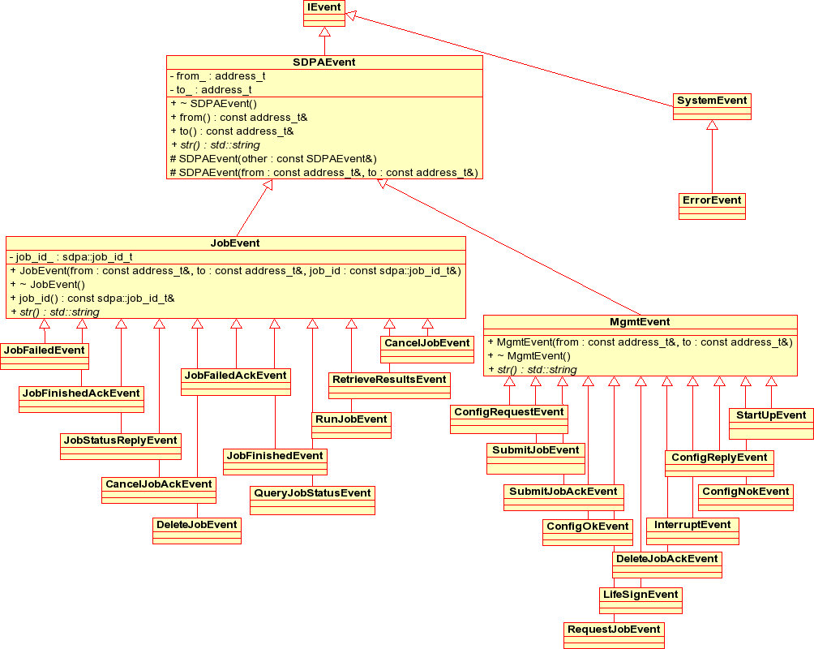
Events
SDPAEvent
JobEvents:
SubmitJobEvent
SubmitJobAckEvent
RunJobEvent
CancelJobEvent
CancelJobAckEvent
DeleteJobEvent
DeleteJobAckEvent
JobFailedAckEvent
JobFailedEvent
JobFinishedEvent
JobFinishedAckEvent
QueryJobStatusEvent
JobStatusReplyEvent
RetrieveJobResultsEvent
JobResultsReplyEvent
ManagementEvents:
StartUpEvent
CapabilitiesGainedEvent
CapabilitiesLostEvent
ConfigNokEvent
ConfigOkEvent
ConfigRequestEvent
ConfigReplyEvent
ErrorEvent
InterruptEvent
LifeSignEvent
RequestJobEvent
SubscribeEvent
SubscribeAckEvent
WorkerRegistrationEvent
WorkerRegistrationAckEvent

Slide 14
Agent Event Handlers
Double dispatch pattern used -> no ugly switch
Inversion of control
handleSubmitJobEvent(const SubmitJobEvent *) ;
handleSubmitJobAckEvent(const SubmitJobAckEvent *) ;
handleCancelJobAckEvent(const CancelJobAckEvent *) ;
handleCancelJobEvent(const CancelJobEvent *) ;
handleConfigNokEvent(const ConfigNokEvent *) ;
handleConfigOkEvent(const ConfigOkEvent *) ;
handleConfigReplyEvent(const ConfigReplyEvent *) ;
handleConfigRequestEvent(const ConfigRequestEvent *) ;
handleDeleteJobAckEvent(const DeleteJobAckEvent *) ;
handleDeleteJobEvent(const DeleteJobEvent *) ;
handleJobFailedAckEvent(const JobFailedAckEvent *);
handleJobFailedEvent(const JobFailedEvent *) ;
handleJobFinishedAckEvent(const JobFinishedAckEvent *) ;
handleJobFinishedEvent(const JobFinishedEvent *) ;
handleJobResultsReplyEvent(const JobResultsReplyEvent *) ;
handleJobStatusReplyEvent(const JobStatusReplyEvent *) ;
handleLifeSignEvent(const LifeSignEvent *) ;
handleQueryJobStatusEvent(const QueryJobStatusEvent *) ;
handleRequestJobEvent(const RequestJobEvent *) ;
handleRunJobEvent(const RunJobEvent *) ;
handleStartUpEvent(const StartUpEvent *) ;
handleSubscribeEvent(const SubscribeEvent*) ;
handleSubscribeAckEvent(const SubscribeAckEvent*) ;
handleErrorEvent(const ErrorEvent *) ;
handleInterruptEvent(const InterruptEvent *);
handleWorkerRegistrationAckEvent(const WorkerRegistrationAckEvent *) ;
handleWorkerRegistrationEvent(const WorkerRegistrationEvent *) ;
handleCapabilitiesGainedEvent(const CapabilitiesGainedEvent*) ;
handleCapabilitiesLostEvent(const CapabilitiesLostEvent*) ;
handleRetrieveJobResultsEvent(const RetrieveJobResultsEvent *) ;

Slide 15
Example: handling of submit job event
SubmitJobEvent: can be triggered by an agent or by the workflow engine
Handling: if the agent is full, reject the job
otherwise, create new job state machine
assign eventually new id
if the job comes from outside, mark it as a master job
set the submitter as the job owner (may have subscribers, too)
add the job to the job manager
schedule the job
if everything was ok
post ack event with the destination submitter
else
post error event with the destination submitter

Slide 16
Event handling examples
WorkerRegistrationAckEvent: triggered by a master upon a worker registration
Handling: update the corresponding info object (set the flag registered on true)
if the agent has masters, resubmit results to the master (in the case they were lost because the master crashed)
JobFinishedEvent: triggered by an worker when a previously submitted job
completed successfully
Handling: send acknowledgement to the worker
tell the job manager to localize the job with the corresponding id
if the job was not found throw an exception and return
otherwise update the correspnding state machine of the job
if doesn‘t have an workflow engine, forward the event to the master
otherwise notify the workflow engine that the corresponding
activity finished and delete the job from the worker manager
and from the job manager

Slide 17
Job Statechart
JobFailed
RetrieveResults
Cancelling
CancelJobAck
Cancelled
CancelJob
JobFinished
DeleteJob
CancelJob
DispatchJob
RetrieveResults
SubmitJob
Pending
Running
JobFinished
Finished
JobFailed
DeleteJob
RescheduleJob
Failed
RetrieveResults
DeleteJob
Notes:
Job statechart -> important for maintaining the consistency
SubmitJobEvent is received -> new job together with the associated state machine is created
Initial state is pending.
The job is afterwards scheduled and may be sent to the workflow engine or assigned to some slave
According to some policy in place (LeastLodaedWorker, BestMatchingWorker, etc)
Once the ack is received from the worker the job is put into the Running state
Expected are JobFailed, job Finished if error occurs -> job failed
The job can be cancelled by the user or by another instance or by
the workflow engine or agen itself -> cancelling until receiving the confirmation
It may happen that in between one gets confirmation that the job failed or finished
(crossed on the road).

Slide 18
Agent Statechart
StartUpEvent
Configuring
ConfigSuccEvent
ConfigFailEvent
WorkerRegistrationEvent
SubmitJobAckEvent
RequestJobEvent
LifeSignEvent
SubmitJobEvent
Down
Up
InterruptEvent
WorkerRegistrationAckEvent
ErrorEvent
DeleteJobEvent
ConfigRequestEvent
DeleteJobAckEvent
ConfigReplyEvent
Notes:
Initially the agent is down
Upon receiving StartUpEvent -> Configurring state
If the configuration succeeds, passes into the Up state -> event handler is invoked
Virtual methods -> different agents may handle in different ways the events
The workers try to register to an agent at regular intervals, until they eventually succeed, if no master -> give up

Slide 19
Scheduling
Scheduler -> matches job requirements against worker capabilities
Agent capabilities:
  {own capabilities} U
  {capabilities of the descendants in the communication/connection graph}
The jobs are submitted with a list of requirements
  requirements: mandatory (constraint) or optional (preference)
  empty requirements list -> can be scheduled anywhere
  Compute the matching degree‏ -> assign the job to the worker with the highest matching degree
  If worker empty -> can steal a job from other workers if he satisfies at least the mandatory requirements of that job
Re-scheduling: timed-out, non-responsive workers or disconnected workers
Capabilities -> dynamically updated (depth=distance to the owner, in the minimum spanning tree rooted by the agent)
Notes:
First and simple variant: a round-robin scheduler
More sophisticated scheduler -> get bestmatchingWoekr -> look
For the worker that best mathches some requirements.
Matching degree
Each component may overload the interface methods
Can be specified if an agent can execute jobs itself or
If it just distributes jobs to the available workers.
Re-scheduling

Slide 20
Load balancing
For groups of workers with similar capabilities -> round-robin method is used. The serving time is taken into consideration. Fairness is guaranteed, starvation is excluded.
Worker feeding -> separate thread, wait on a condition variable, no busy waiting
Alternative methods: diffusive algorithms
  Iteratively migrate load from the overloaded to underloaded workers, so that at the end the load is fairly distributed
  application/dependency graph needed
  work well with fine grained tasks or divisible loads
  useful when the workloads evolve dynamically and unpredictibly.
Re-assignement (or work stealing) to workers with similar capabilities
Future: performance prediction and estimated computation times need to be taken into account
Notes:
The jobs are initially assigned to agents/workers that are best matching the job requirements
If a worker has no assigned job
1) try to find if there are any jobs without requirements
2) he may steal from other workers that are at least mandatory requirements fullfilling.
Load balancing -> getLeastLoaded worker + work stealing
Diffuive methods for fine grain tasks and no requiremets -> high throughput computations
Scheduling and Load balancing la un loc?

Slide 21
Coupling with an workflow engine
Real use cases -> High-level Petri Net based workflow engine
Behavioural properties of PN: reachability, boundedness, liveness (similar to absence of deadlocks), reversibility, coverability
The agent framework works with any workflow engine that respects a minimal interface or may not use a workflow engine at all
Loose coupling between agents and the workflow engine
Separation of concerns principle
The agents are not aware about the workflow description (Petri nets )
The workflow is attached to the job and handed as it is to the workflow engine, which is capable to interprete it
The workflow engine produces jobs (activities) which have attached an encoded workflow description and which are sent to other agents
Simple test engines were also used (for the unit tests)
Notes:
Important: The agent has minimal interface with the workflow engine.
The workflow engine is a kind of black box -> any workflow engine that respects the minial interface
can be used. Ex. Portfolio evaluation example -> was implemented in 2 ways: with PN WE and with
a specific dedicated exactly to that problem workflow engine. The separation of concerns principle is
Petri nets are great but the complexity of the workflow should be hidden to the real user!
Separation of concerns -> light interface -> allow independent development of agents and WE
subject to frequent modifications
The Petri Net workflow engine is highly templetized -> increased computation time => programming unit tests

Slide 22
Backup service
The backup service runs on a separate thread
The backup can be done into a file or into a string (for testing purposes)
The backup is done regularly at configurable time intervals
Orchestrator -> current deployment: without workflow engine
Recovery without problems (job manager, worker manager, finite state machines)
Agent with a Petri Net workflow engine -> partial recovery (the workflow engine cannot entirely recover)
When interrupt, abort, terminate signals are caaught -> perform agent backup before leaving
After recovery -> tell the workers to cancel their pending or running jobs
as the workflow engine most likely will re-generate those activities
After recovery -> reschedule all master jobs
Notes:
Current deployment scheme: the orchestrator is deployed wihout any workflow engine -> it plays more
The role of a dispatcher
Persistence and fault-tolerance: after recovery: I have found a backup file I coud recover the
States and relevant information about some jobs and workers -> inform the masters about the
Status of the jobs recovered -> take correcting measures -> compare with the situation from their
Point of view, it may be possible that in between the job was res-cheduled and eventually executed to/by another agent.
On the other hand, the workers that were registered to a nonresponsive agent and re-connect -> inform the
Recovered agent about past jobs he received from him before dying.
Agent jobs are simply re-sent to the workflow engine, the former worker jobs are cancelled, WE generates new jobs
The behaviour was ok whenever a clean shutdown was performed or an interrupting signal could be caught

Slide 23
Fault tolerance
Common situations:
An worker may go down and eventually reconnect (re-register)
A master may crash and eventually come up after some reasonable time
What to do? Attempt to recover as much information as possible
TCP protocol -> broken connections are immediately recognized
  -> job rescheduling
  -> agents re-registration
  -> master, subscribers notification
Re-transmit to masters/subscribers the status of recovered jobs
Job re-submission when the state cannot be recovered
Lots of tests (stop/restart agents)

Slide 24
Complex agent topologies: 2D torus
Orchestrator
Agent 0
Agent 1
Agent 2
Agent 3
Agent 4
Agent 5
Agent 6
Agent 7
Agent 8
Notes:
Here we have a torus toplogy: everybade has as master either ist left neighbuor or ist upper neighbour.
Each agent has three masters in fact: orchestrator, left and down neighbours (new development).
This means that each agent has registered on all of these agents.
The masters can produce jobs that are sent to the worker agents, etc.
Similar or even more complex topologies can be created. As for example a Hypercube.
Why one would use such topologies? There are algorithms that fit very well on specific
Topologies. Easier to program, standrad parallel algorithms can be use (double pointer jumping etc)

Slide 25
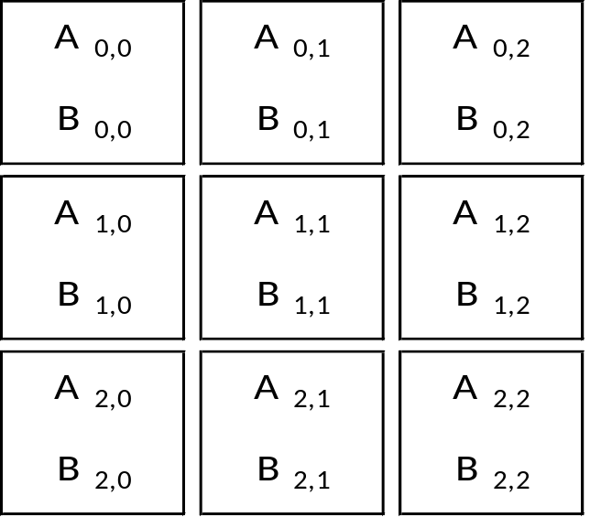
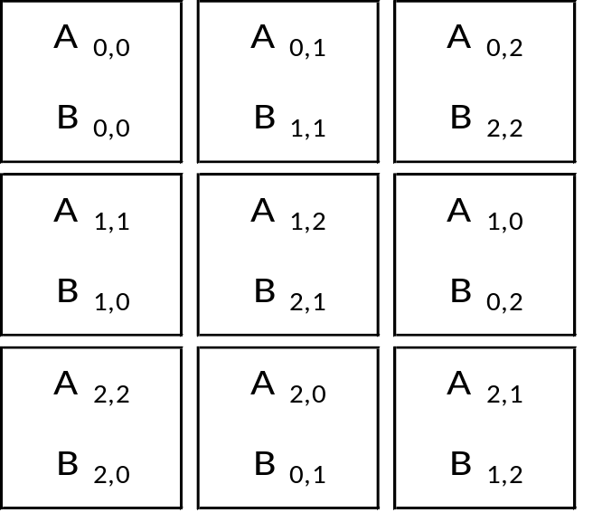
Cannon‘s algorithm for matrix multiplication in parallel
  Given: matrices A, B with NxN elements -> partion each in PxP blocks
  Blocks A_{i,j} : shift i columns to the left,
  Blocks B_{i,j} : shift j rows to up
  Computation: all processors execute a serial Matrix Multiplication
  Agent sends its block A to left and receives a block A from the right
  Agent sends its block B to up and receives from down a block B
Alignement
Notes:
Given: initial matrices matrices A and B of size NxN, partition each in PxP blocks
The idea is: assign initially 2 blocks to each agent and there perform serial matrix multiplication (Strassen)
Initial alignment
PCAM paradigm Jan FosterPCAM( Partition Communicate Agglomerate Map)

Slide 26
Cannon‘s algorithm with the SDPA agent framework
  There are PxP agents registered as workers
  The user sends matrices A and B to the orchestrator
  The orchestrator decomposes A and B into PxP sub-blocks each
  Orchestrator creates PxP tasks
  The orchestrator sends the blocks Ai,k and Bk,j to the agent i*P+j,
  where k = (i+j) mod P
  Agent i*P+j iterates P times:
  compute Ci,j += Ai,k*Bk,j (boost ublas axpy operation used)
  send the block A to left and receive a block A from the right
  send the block B to up and receive a block B from down
  Agent sends to the orchestrator ist block Ci,j
  Orchestrator assembles the C matrix and sends it to the user
  Other topologies are possible: Hypercube, CCC, Cayley graphs
Notes:
Complexity n^3/p^2
Used boost ublas operations for serial matrix multiplication and as matrix data type
Sparse matrices can be use as data type as well

Slide 27
Example: Torus Topology
Orchestrator
Agent 0
A0,0 B0,0
Agent 1
A0,1 B1,1
Agent 2
A0,2 B2,2
Agent 3
A1,1 B1,0
Agent 4
A1,2 B2,1
Agent 5
A1,0 B0,2
Agent 6
A2,2 B2,0
Agent 7
A2,0 B0,1
Agent 8
A2,1 B1,2
  loop
  compute Ci,j += Ai,k*Bk,j (boost ublas axpy operation used)
  send the block A to left and receive a block A from the right
  send the block B to up and receive a block B from down
  endloop
Notes:
Explain the scheme.Úse coloured tokens, red and blue. When a red token and a blue token are inplace -> trigger a new transition -> send the pair of
Blue and red token to the right and down, respectively. When a blue or a red token comes back to ist owner (the one who generated it!), trigger a yellow token and send it to the orchestrator.
Used boost::ublas matrix types
IMPORTANT: there are other approaches investigated -> mobile agents (send the code for computation instead of data?)

Slide 28
Mesh toplogy: Systolic Matrix Multiplication
A2,2
A2,1
A2,0
-
-
A1,2
A1,1
A1,0
-
A0,2
A0,1
A0,0
B0,2 B0,1 B0,0
Agent 0
C0,0
Agent 1
C0,1
Agent 2
C0,2
B1,2 B1,1 B1,0 -
Agent 3
C1,0
Agent 4
C1,1
Agent 5
C1,2
B2,2 B2,1 B2,0 - -
Agent 6
C2,0
Agent 7
C2,1
Agent 8
C2,2
Notes:
Systolic algorithm
Say about complexity

Slide 29
Petri net workflow for an agent

