Slide 1
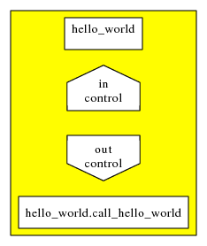
GPI-Space – Hello world
<defun name="hello_world">
<in name="in" type="control"/>
<out name="out" type="control"/>
<module name="hello_world" function="out call_hello_world (in)">
<cinclude href="hello_world.hpp"/>
<link href="lib/hello2.o"/>
<code><![CDATA[
impl_hello_world();
return control();
]]></code>
</module>
</defun>
function, port, types, external module call, build system

Slide 2
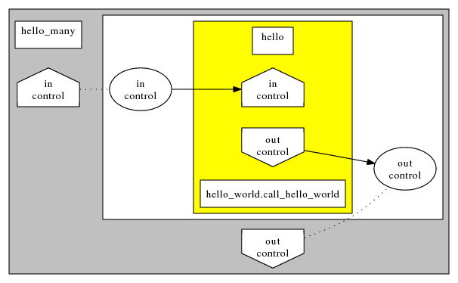
GPI-Space – Hello world, parallel
<defun name="hello_many">
<in name="in" type="control" place="in"/>
<out name="out" type="control" place="out"/>
<net>
<place name="in" type="control"/>
<place name="out" type="control"/>
<transition name="hello">
<include-function href="hello_world.xpnet"/>
<connect-in port="in" place="in"/>
<connect-out port="out" place="out"/>
</transition>
</net>
</defun>
subnet, connection, re-use of existing net, parallel execution, put

Slide 3
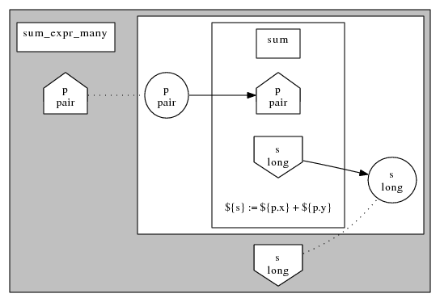
GPI-Space – sum with expression
<defun name="sum_expr">
<include-structs href="pair.xpnet"/>
<in name="p" type="pair"/>
<out name="s" type="long"/>
<expression>
${s} := ${p.x} + ${p.y}
</expression>
</defun>
expressions, user defined types

Slide 4
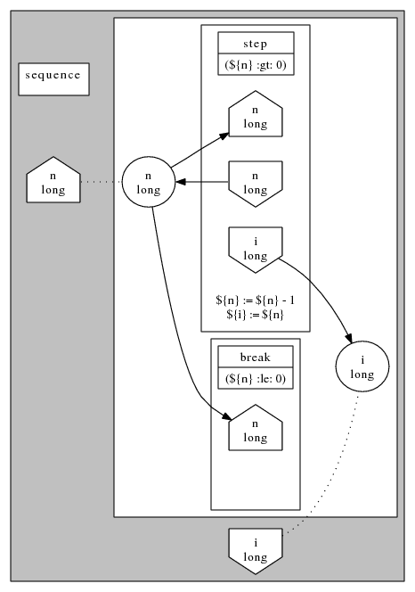
GPI-Space – sequence
conditions, inout

Slide 5
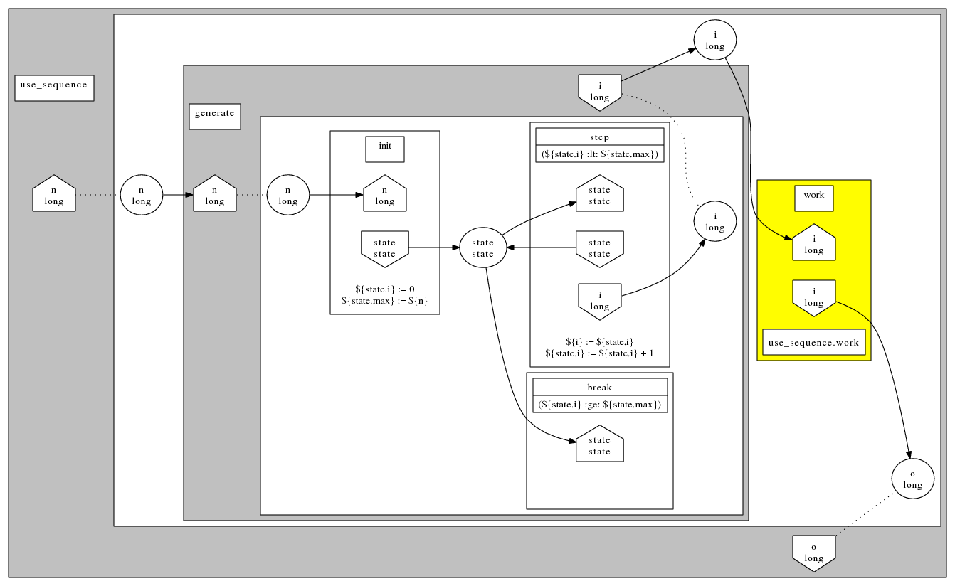
GPI-Space – use sequence
(no)inline

Slide 6
GPI-Space – dup something
<template name="dup">
<in name="x" type="T"/>
<out name="a" type="T"/>
<out name="b" type="T"/>
<expression>
${a} := ${x}; ${b} := ${x}
</expression>
</template>
<include-template href="dup.xpnet"/>
<specialize name="dup_long" use="dup">
<type-map replace="T" with="long"/>
</specialize>
<transition name="dup">
<use name="dup_long"/>
<connect-in port="x" place="n"/>
<connect-out port="a" place="wait"/>
<connect-out port="b" place="n_copy"/>
</transition>
template

Slide 7
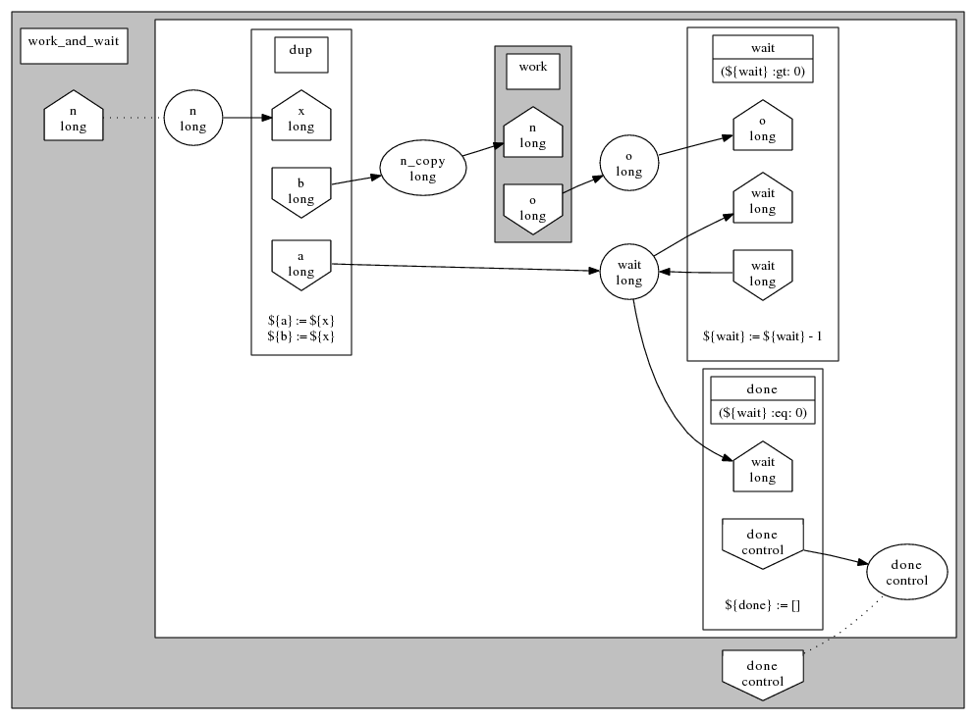
GPI-Space – work and wait
use template

Slide 8
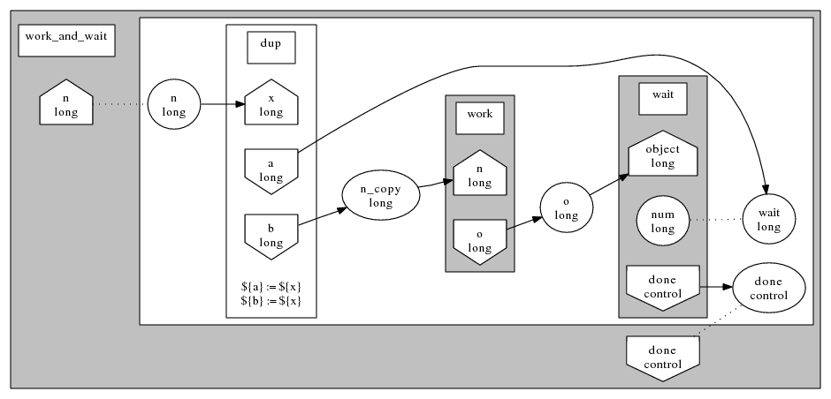
GPI-Space – work and wait, wait as subnet
virtual places

