Slide 1
Model Context Protocol
(MCP) Explained
Connecting AI Agents to Your Tools and Data
Eric Greene · Xebia
eric.greene@xebia.com
Notes:
Welcome and introductions. Ninety minutes: about twenty of slides, seventy of live demos in VS Code with GitHub Copilot. Questions are welcome at any time, in the chat or out loud, and the demos leave plenty of room to answer them. Everything is in the webinar repo. Mention early that the MCP spec moved to a stateless revision, 2026-07-28, and the Python SDK to version 2, so older tutorials may look different.

Slide 2
Agenda
What MCP is, and why it exists
Hosts, clients, servers, and the lifecycle
Tools, resources, and prompts
Ready-made servers you can use today
Building a custom server in Python
Security, trust boundaries, and production audits
Notes:
Six topics, matching the README agenda. Topics one, two and four lead into Demo 1. Topics three and five lead into Demos 2 and 3. Topic six leads into Demo 4. Keep this brief; the slides set up each demo rather than replacing it.

Slide 3
What MCP is
An open protocol connecting AI apps to tools and data
JSON-RPC 2.0 messages over stdio or HTTP
Servers describe their capabilities; hosts discover them at runtime
Supported across VS Code, Claude, Cursor, and more
A versioned specification; 2026-07-28 is current
Builds on function calling rather than replacing it
Notes:
MCP is a standard way for an AI application to find and use tools and data it wasn't built with. Messages are JSON-RPC 2.0. The key idea is runtime discovery: the host asks the server what it offers instead of having it hard-coded. The current revision is 2026-07-28, which made the protocol stateless. Under the hood the model still uses function calling; MCP standardizes where the functions come from.

Slide 4
How MCP compares
Ad-hoc integrations
Function calling
MCP
Every app wires up every tool itself
N apps and M tools means N×M connectors
Tools defined per model API
Schemas and code live inside each app
Build a server once, use it anywhere
Any MCP host discovers it at runtime
Notes:
Left: custom glue code per app per tool, which doesn't scale. Middle: function calling lets a model request a function, but each app defines and implements its functions for one model API. Right: MCP moves the tool into a server that any host can use, so N times M becomes N plus M. Be fair: for one app with two private functions, plain function calling is fine.

Slide 5
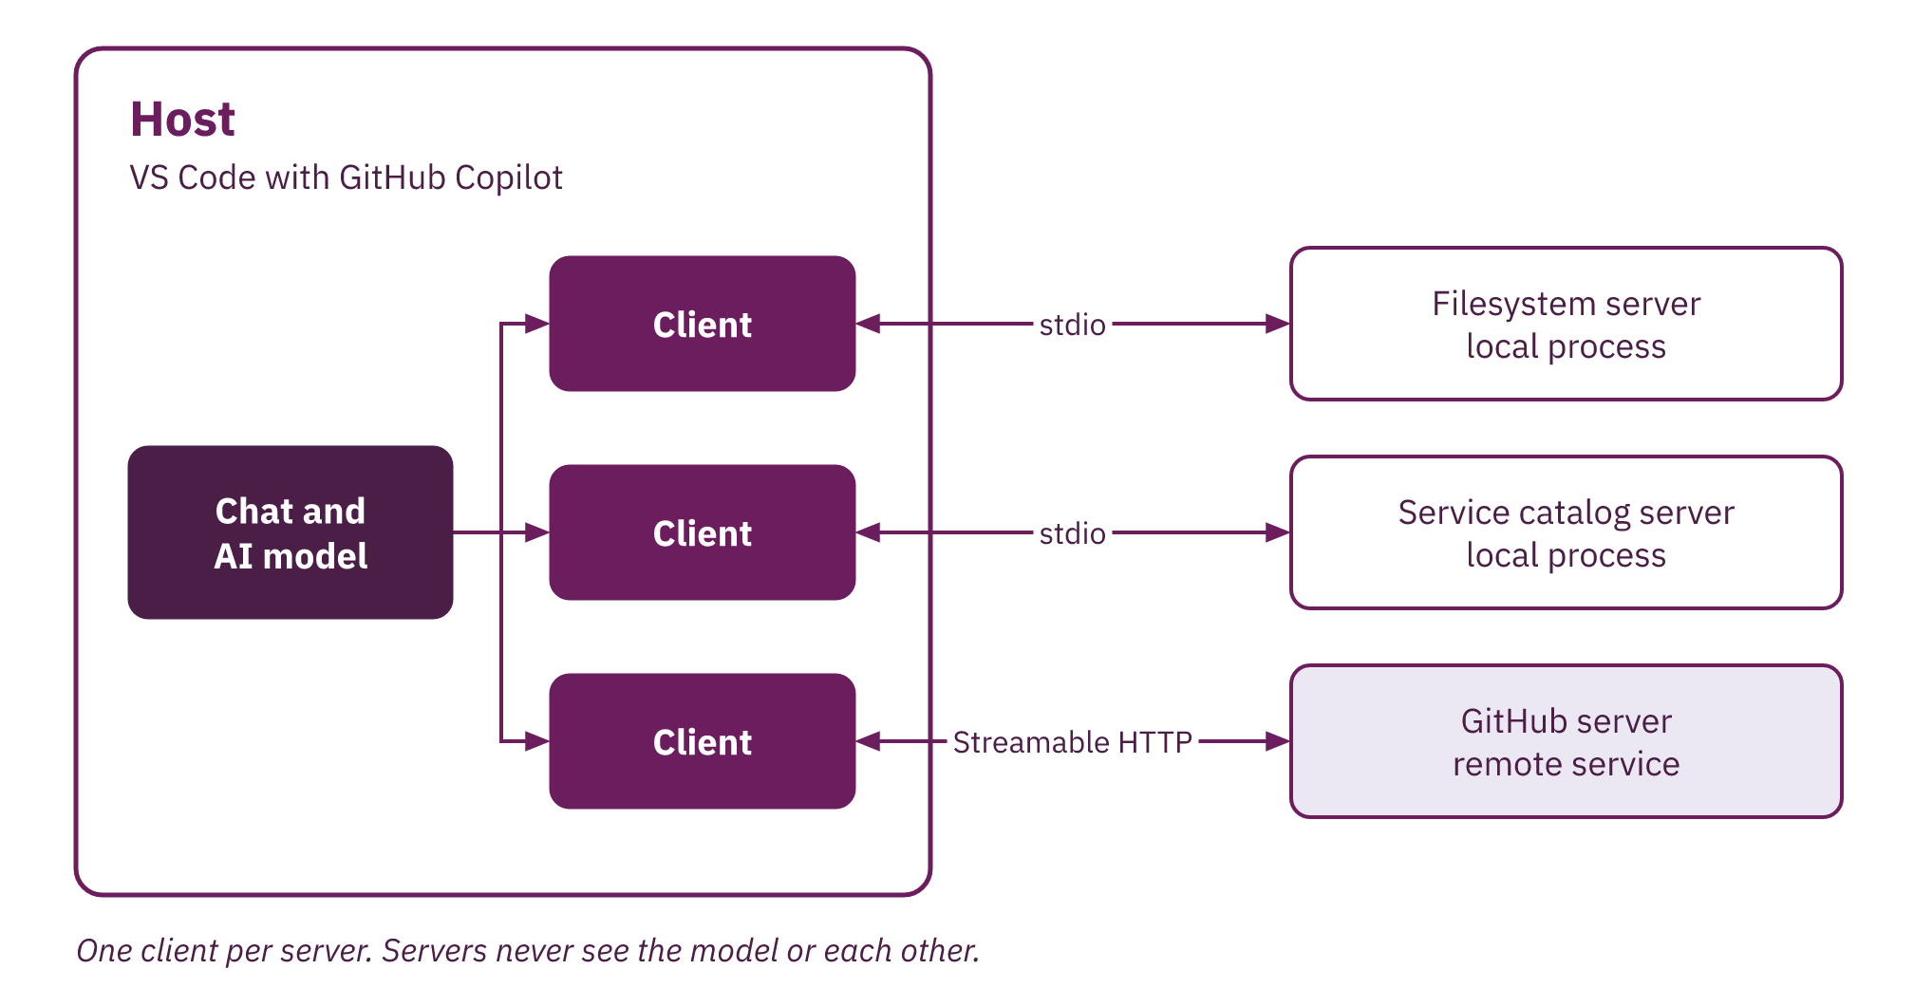
Hosts, clients, and servers
Notes:
Walk the diagram left to right. The host is the application, and it owns the model and the user's trust. Inside it, one client per server holds the connection. Servers expose capabilities and know nothing about the model or about each other. That separation is why one host can combine many servers, and why the host is where approvals belong.

Slide 6
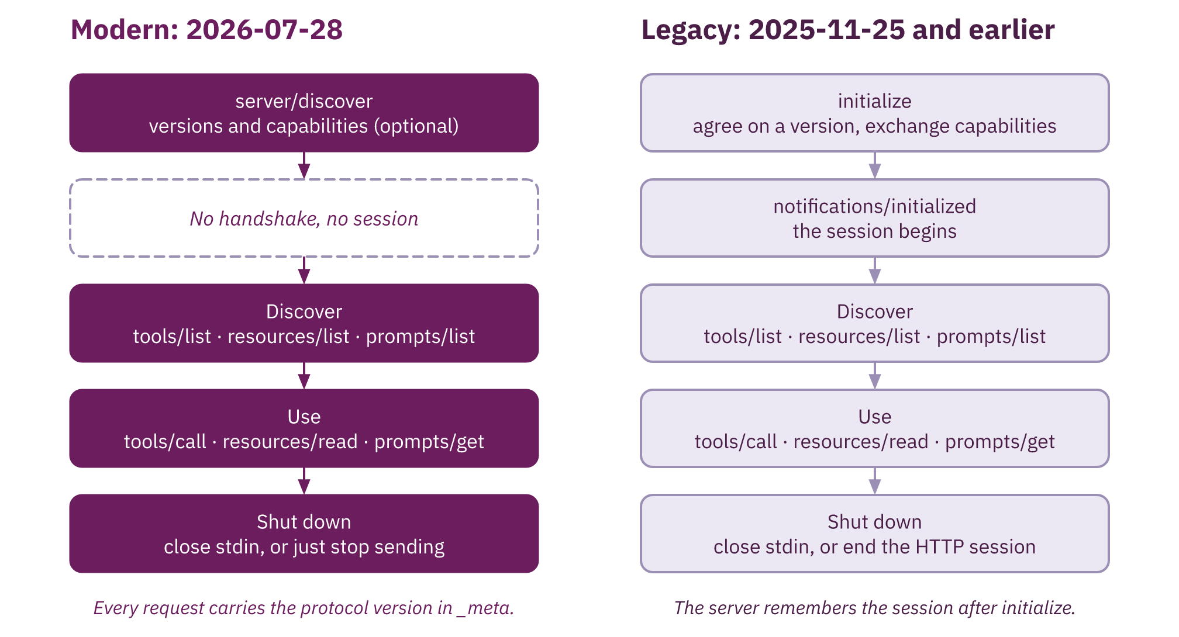
The request/response lifecycle
Notes:
Left lane, modern servers (2026-07-28), are stateless: every request carries the protocol version and client details in _meta, and server/discover replaces the handshake. Right lane, legacy servers (2025-11-25 and earlier), still expect initialize first, and many popular servers are legacy today, including the official filesystem server. Clients probe with server/discover and fall back. Demo 1 shows both on the wire.

Slide 7
Ready-made servers
Local, over stdio
Hosted, over HTTP
Filesystem: read and search project files
Databases: SQLite, Postgres, and others
Git: history, diffs, and branches
GitHub: issues, pull requests, and code
Microsoft Learn: current official documentation
Search and SaaS servers from vendors
Notes:
Before building anything, check whether a server exists. Local servers run as a child process and see your machine. Hosted servers run elsewhere and sign in with OAuth. Demo 1 uses the filesystem server, GitHub's hosted server in read-only mode, and Microsoft Learn as the documentation search example. Database servers exist too; our database example is the custom server in Demo 2.

Slide 8
Demo 1: Meet MCP
demos/01-meet-mcp · about 16 minutes
Notes:
Run lifecycle.py --step against the filesystem server (legacy handshake), then against hello_server.py (modern, stateless), pressing Enter phase by phase. Then .vscode/mcp.json, start the three servers, and use filesystem, GitHub (read-only) and Microsoft Learn, finishing with one prompt that uses two servers. Point out the roots surprise on the filesystem server.

Slide 9
Tools, resources, and prompts
Tools
Resources
Prompts
Actions the model decides to call
search_services, create_incident
Context the user or host attaches
catalog://teams, service runbooks
Templates the user chooses to run
incident_briefing, team_onboarding
Notes:
The difference is who's in control. The model chooses tools. The user or host chooses resources, which are read-only context identified by a URI. The user chooses prompts, which are reusable instructions with arguments. The examples are the real names from Demo 2's service catalog server.

Slide 10
Choosing the right primitive
Make it a tool when
Make it a resource or prompt when
The model should decide when it's needed
It takes arguments or changes something
The answer depends on the question
The user knows which context matters
It's a document, not an action
A team wants one repeatable workflow
Notes:
Most servers start and end with tools, because every host supports them. Use resources for documents the user wants to attach deliberately, like a runbook. Use prompts to package a team workflow so everyone gets the same structure. If you're unsure, start with a tool.

Slide 11
A tool in a few lines of Python
from mcp.server import MCPServer
mcp = MCPServer("service-catalog")
@mcp.tool(annotations=READ_ONLY)
def get_service(name: str) -> Service:
"""Owner, on-call, and dependencies."""
return catalog_db.get_service(name)
mcp.run(transport="stdio")
Notes:
This is the official Python SDK, version 2. MCPServer replaced FastMCP, so older tutorials use a different import. The function name becomes the tool name, the type hints become the input schema, the return type becomes the output schema, and the docstring is what the model reads. Annotations mark it read-only. The run call picks the transport, and that's the only line Demo 3 changes.

Slide 12
Demo 2: A custom server over stdio
demos/02-custom-server-stdio · about 18 minutes
Notes:
Walk catalog_db.py and server.py, run check_server.py, then the Inspector CLI. Connect it in Copilot and ask who's on call for the payments API, attach the catalog://teams resource, run the incident_briefing prompt, and open an incident to show the approval. Reset with uv run catalog_db.py --reset.

Slide 13
stdio or Streamable HTTP
stdio: the host starts the server
Streamable HTTP: the server runs at a URL
# server.py
mcp.run(transport="stdio")
# .vscode/mcp.json
"type": "stdio",
"command": "uv",
"args": ["run", "server.py"]
# http_server.py
mcp.run(transport="streamable-http",
host="127.0.0.1", port=8765)
# .vscode/mcp.json
"type": "http",
"url": "http://127.0.0.1:8765/mcp"
Notes:
Same server, two transports, and this is everything that changes: the run call and the host configuration. stdio suits personal, local tools: the host starts the process, and there's no network. Streamable HTTP suits shared services: one endpoint, each message an HTTP POST, many clients. Since 2026-07-28 there are no sessions, so HTTP servers scale like any stateless web service. HTTP brings web risks with it, and Demo 3 shows two guards: Host checks and a bearer token.

Slide 14
Demo 3: The same server over HTTP
demos/03-streamable-http · about 16 minutes
Notes:
Show server.py is identical with git diff --no-index. Walk http_server.py, start it, point Copilot at the URL. Run http_client.py as a second client and show Copilot sees its incident. Run rebinding_check.py: 200 for the honest request, 421 for the forged Host header. Finish with secure_http_server.py and auth_check.py, then switch Copilot to the token-protected entry.

Slide 15
Where the trust boundaries are
Model
Host
Server
Reads every tool description as guidance
Can be steered by injected text
Approves calls and shows their arguments
Decides which servers are connected
Runs code with your permissions
Reaches your files, data, and networks
Notes:
Every server can put text in front of the model and run code as you. The model can't reliably tell instructions from data, so anything it reads, including tool descriptions and tool results, can steer it. The host is the control point: which servers are connected, and which calls need approval.

Slide 16
Risks to plan for
Tool poisoning: instructions hidden in tool descriptions
Prompt injection through documents, issues, and web pages
Over-broad access: wide roots, tokens, and write tools
Raw query tools that run whatever the model writes
Server updates that change tools after approval
HTTP servers exposed without auth or Host checks
Notes:
Tool poisoning is in the server itself. Prompt injection arrives in data a tool returns, such as an issue body. Over-broad access turns either one into real damage. Raw SQL or shell tools hand the model a blank cheque. A server can change its descriptions after you approve it. And an HTTP server is a web server, with all that implies. Demo 3 shows the last one, and Demo 4 shows the other five: poisoning arriving in an update, injection through data, over-broad access and raw SQL.

Slide 17
Audit before production
Read every tool description, and pin server versions
Grant the narrowest root, scopes, and toolsets
Prefer read-only endpoints and parameterized tools
Keep approvals on for anything that writes
Require OAuth, and bind HTTP servers narrowly
Log tool calls so you can review them
Notes:
Treat an MCP server like a dependency with production access. Review what it tells the model, pin it, and recheck on upgrade. Least privilege everywhere: roots, token scopes, GitHub toolsets and read-only mode. Specific tools beat general ones. Approvals only help if people read the arguments. For shared servers, OAuth and a narrow network exposure are the baseline. Demo 4 ends on a tool-call log. The full list is in docs/mcp-review-checklist.md.

Slide 18
Demo 4: Security and trust boundaries
demos/04-security · about 20 minutes
Notes:
Start all three servers and run audit_tools.py --approve. Change CONVERTER_RELEASE to 1.1, restart it, ask to convert 42 km to miles and watch for the poisoned read. Rerun audit_tools.py to catch the change. List files with the wide root, then scope it to shared-docs and show the traversal refused. Delete resolved incidents through run_sql, then try injection on incidents_for_service. Summarize checkout-web's incidents to show injection through data, then open data/tool-calls.log. Reset at the end.

Slide 19
Next steps
Clone the repo and run the four demos
Connect one ready-made server to your daily work
Wrap one internal API as a small MCP server
Adapt the repo's review checklist for your team
Follow the specification changelog; it moves quickly
Notes:
Point people to demos/README.md for setup. Suggest starting with a read-only server, then wrapping one internal API they already know. The review checklist is linked from the repo README, next to the slides. Mention the Xebia Academy link there too.

Slide 20
Thank you
Eric Greene · Xebia
eric.greene@xebia.com
Notes:
Thank the audience. Leave this slide up while you answer any final questions, and repeat that the slides and demos are in the repo.

