Slide 1
Modernizing Legacy
Code with AI
A Practical Approach to Brownfield Projects
Eric Greene · Xebia
eric.greene@xebia.com
Notes:
Welcome and introductions. Ninety minutes: about twenty of slides and seventy of live demos in VS Code with GitHub Copilot. Questions are welcome at any time, in the chat or out loud. Everything is in the webinar repo. Set the frame: most of us spend our days in code someone else wrote, and that's where AI tools are hardest to use well.

Slide 2
Agenda
Why brownfield is harder for AI
Using AI to understand unfamiliar code
Building a safety net before refactoring
Strangler fig, targeted refactors, and dependency upgrades
Translating, untangling, and rewriting while preserving behavior
Knowing when to trust, intervene, or leave alone
Notes:
Six topics, matching the README agenda, and four demos on one legacy codebase, ShipBill, a courier's billing system from about 2012. Topics one and two lead into Demo 1, topic three into Demo 2, topic four into Demos 3 and 4, and topics five and six into Demo 4. Each demo starts where the last one stopped.

Slide 3
Why brownfield is harder for AI
Missing context
Implicit constraints
Accumulated tech debt
The reasons left with the people
Docs and comments go stale
Other systems need exact output
Quirks already on every invoice
God functions and global state
Old dependencies, few tests
Notes:
On a greenfield project the agent sees everything that matters. In brownfield, the most important facts aren't in the code: why customer 1047 gets 15 percent, which downstream import reads the output, which rounding quirk is now part of every invoice. Tech debt makes it worse, because big functions and globals give the agent no safe place to change one thing. The agent will still sound confident, so our job is to supply the context and the checks.

Slide 4
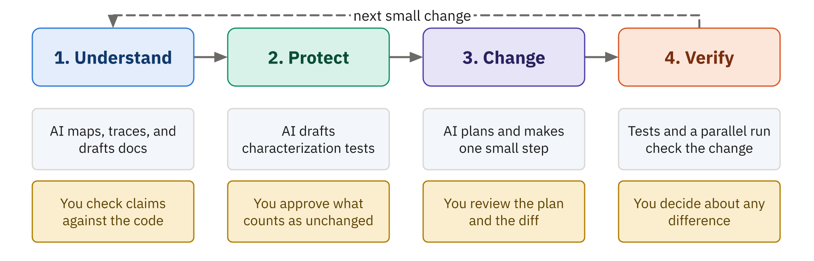
A loop for brownfield work
Notes:
This is the shape of the whole session. Understand the code, protect its behavior, change one small thing, verify, and go round again. In every step the AI does the heavy lifting, and a person does the part that needs judgment: checking claims, approving what counts as unchanged, reviewing the diff, and deciding what to do about a difference. The demos follow the loop in order.

Slide 5
Using AI to understand unfamiliar code
Run it first, and read the real output
Scope the agent to code, not old docs
Map the architecture, then trace one real calculation
Ask for file:line evidence for every claim
Ask what the code can't tell you
Generate docs, then review them like code
Notes:
Start with the running system, because it's the only source that can't be out of date. Tell the agent to work from the code, since old READMEs will mislead it. Mapping gives you the shape; tracing one real number end to end gives you the details that matter. Citations make claims checkable. Asking what the code can't explain produces the list of questions for the business. Generated docs are a draft until someone checks them.

Slide 6
Verify the map, then keep it
Check the claims
Capture the context
A mechanical map: imports, callers, dead code
Open the lines the agent cites
Run the code to confirm a rule
Reviewed architecture notes for people
Custom instructions for every AI session
Open questions with named owners
Notes:
Anything you can check mechanically, check mechanically. Demo 1 uses a small ast-based script to confirm the import graph and find dead code, then opens cited lines and runs a billing month to confirm a rule. Then write it down. Architecture notes are for people, custom instructions are for every future Copilot session, and open questions go to named owners in the business.

Slide 7
Demo 1: Read before you change
demos/01-understand-legacy · about 17 minutes
Notes:
Run billing for September with customer 1047, read the outdated README.txt, glance at calc_invoice. Ask role: architecture, trace 1047's total, unexplained rules. Run codemap.py and compare, including the dead fax code. Show September missing from FUEL_TABLE and the fuel_rate fallback. Agent role: /document-legacy, review three citations, then /capture-context.

Slide 8
Characterization tests
Pin what the code does, not what it should
Expected values come from running the real code
Pin the quirks too, and label them
Find a seam to test without changing code
Bugs become open questions, not fixes
Notes:
Michael Feathers' term. A characterization test records today's behavior so you'll notice when it changes. The expected value comes from running the code, never from the agent's arithmetic or anyone's idea of correct. Quirks get pinned with a comment saying it's deliberate. A seam is a place to change behavior from outside, like ShipBill's database setting. Bugs found now go on the open-questions list, because fixing them mid-refactor hides what changed.

Slide 9
Pinning a quirk, on purpose
# tests/test_util.py
def test_round2_rounds_down_a_half_cent_produced_by_float_math():
# 6.95 + 0.95 * 8.5 is 15.024999... in floats,
# so customers were billed 15.02, not 15.03.
assert util.round2(rates.base_charge("ECO", 4, 9.5)) == 15.02
Notes:
A real test from the demos. Exact arithmetic says this parcel costs 15.025, which rounds to 15.03. The legacy float math lands a hair below and bills 15.02, and that's what customers have paid for years. The test pins it and the comment says it's deliberate. Note the exact equality: no approx, because a one-cent change is the whole point. This exact quirk comes back in Demo 4.

Slide 10
Two layers of safety net
Golden master
Focused characterization tests
A whole month's output, compared byte for byte
Fast to build, but only says something changed
A person reviews it before it's approved
One rule per test, named after the rule
A failure names the rule that broke
Coverage shows the gaps, not the safety
Notes:
A golden master runs the system end to end and compares the output with a reviewed, approved copy. In Demo 2 four tests reach 88 percent coverage, but a failure only tells you something moved. Focused tests tell you which rule. Coverage is a map of what ran: the one skipped legacy test still reports 18 percent. Use it to find gaps worth closing, not as a target.

Slide 11
Demo 2: Build the safety net
demos/02-safety-net · about 18 minutes
Notes:
Coverage of the skipped test: 18 percent. Read conftest.py, the seam, and test_golden_master.py. Run pytest, review tests/received, run approve.py, rerun. Coverage: 88 percent. Read the prompt and instruction files, then /characterize rates.py and billing.py. Close the weekend due-date gap. Break RETURN_RATE and watch both layers fail, then put it back.

Slide 12
Incremental modernization patterns
Targeted refactor
Dependency upgrade
Strangler fig
Change structure, never behavior
One step, tests before and after
Warnings show what will break
One package, fix by cause
Grow new code behind a seam
Move one slice at a time
Notes:
Three patterns, all small steps under green tests. A targeted refactor reshapes code without changing what it does, so the tests prove which one you did. A dependency upgrade starts from the warnings you already have, one dependency at a time. The strangler fig replaces a component slice by slice behind a seam, with no big switchover. Demo 3 does the first two; Demo 4 does the third.

Slide 13
Refactors and upgrades with an agent
Plan first, and read the plan for behavior changes
Prompt files make the safe workflow repeatable
The agent runs the tests; you review each diff
Never let the agent edit a test to pass
Group failures by cause before fixing anything
Finish with warnings treated as errors
Notes:
The Plan role is where you catch an agent that wants to tidy up the rules while it refactors. Prompt files package the safe workflow: run the tests, make one change, undo if it fails. The agent does the running; you do the reviewing. The one rule that's never negotiable is that tests don't change to make code pass. For upgrades, group failures by cause; Demo 3's 32 failures come from one removed feature.

Slide 14
Demo 3: Modernize in small steps
demos/03-small-steps · about 17 minutes
Notes:
72 tests green, point at the arrow warnings. Plan role for extracting price_shipment, then /refactor-step in the Agent role; rerun tests and billing, total still 3,348.55. Then pytest with deprecations as errors: 32 fail. uv add arrow==1.4.0, same 32 fail differently. /upgrade-dependency, watch for the timestamp second wave. Finish green with warnings as errors.

Slide 15
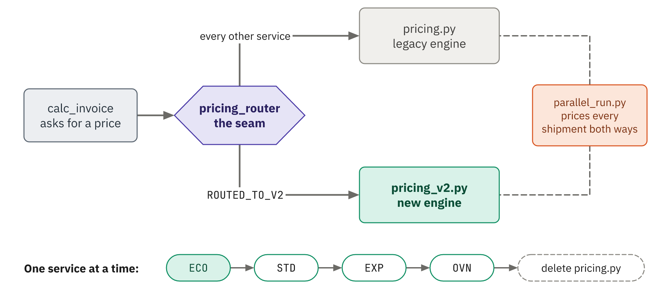
The strangler fig
Notes:
Named for a fig that grows down around its host tree and eventually replaces it. calc_invoice asks the router for a price and never knows which engine answered. Services in ROUTED_TO_V2 go to the new engine, everything else to the legacy one. The parallel run prices every shipment both ways before a service moves. One service at a time, and when nothing routes to the old code, delete it.

Slide 16
Translate, untangle, or rewrite
Translate
Untangle
Rewrite
New language, same results
Recorded runs become the test
Find seams, extract pure functions
Same arithmetic, same order
New code beside the old code
A parallel run on real data decides
Notes:
Three workflows, one principle: behavior is preserved and proved. Translating COBOL, VB, or old Java to something modern works like a golden master across languages: record what the old system does and replay it. Untangling is Demo 3's refactor. Rewriting is Demo 4: the new engine lives beside the old one, and a parallel run on every real shipment decides when it's ready.

Slide 17
Knowing the limits
Trust the agent
Intervene
Leave it alone
Reading, mapping, drafting tests
Changes under a strong safety net
Even a one-cent change
Edits to tests or external contracts
Works, stable, has a contract
Guard it with a golden master
Notes:
Let the agent run where mistakes are cheap and caught fast. Step in when the evidence shows a behavior change, when the agent wants to edit a test, or when a change touches another system's contract; those are people's decisions, and they get written down. Some code should be left alone: ShipBill's export works, rarely changes, and a mistake fails accounting's import. Demo 4 shows all three.

Slide 18
Demo 4: Strangle, rewrite, and know when to stop
demos/04-strangler-fig · about 18 minutes
Notes:
Read pricing_router.py, the changed call in billing.py, and parallel_run.py. /strangle-pricing, review pricing_v2.py, read the parallel run: about 15 one-cent disagreements. Ask why: float math. Decide to keep legacy cents, record D-002, rerun to 272 of 272. Route ECO, tests and billing unchanged. Ask to modernize export.py and watch Copilot push back.

Slide 19
Next steps
Clone the repo and run the four demos
Pick one legacy module and map it first
Put a golden master around it before changing it
Write your team's rules into custom instructions
Adapt the repo's modernization checklist for your team
Notes:
Point people to demos/README.md for setup. Suggest starting small: one module, mapped and documented, with a golden master around it, before any change. The checklist in docs/legacy-modernization-checklist.md follows the same loop as the session. Mention the Xebia Academy link in the README too.

Slide 20
Thank you
Eric Greene · Xebia
eric.greene@xebia.com
Notes:
Thank the audience. Leave this slide up while you answer any final questions, and repeat that the slides, demos, and checklist are in the repo.

