Slide 1
Development of computational methods for vessel segmentation from mice brain images
Cecilia Xue
2020.2.9

Slide 2
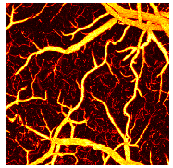
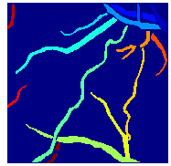
Motivation & Goal
Motivation:
Previous approach—Label by hands (Time consuming)
Current approach— Develop an automated process to segment separate vessels
Requirements:
The segmentation process should be totally automatic, from the raw data to the final results.
Goal 1: Generate accurate segmentation masks automatically for vessels in PAM images.
Goal 2: The same vessel should be present in all images of a set of the same mouse but acquiring at different time.
Raw data
Results

Slide 3
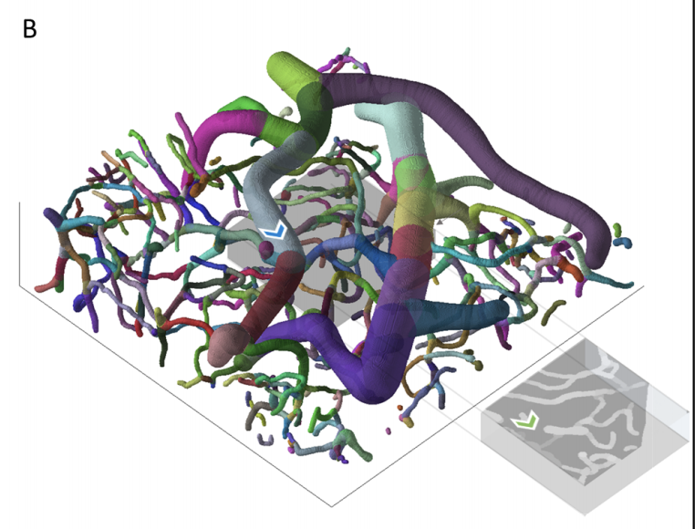
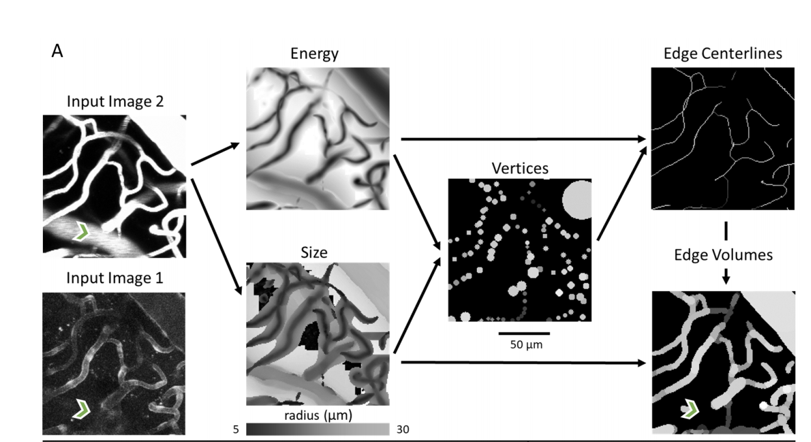
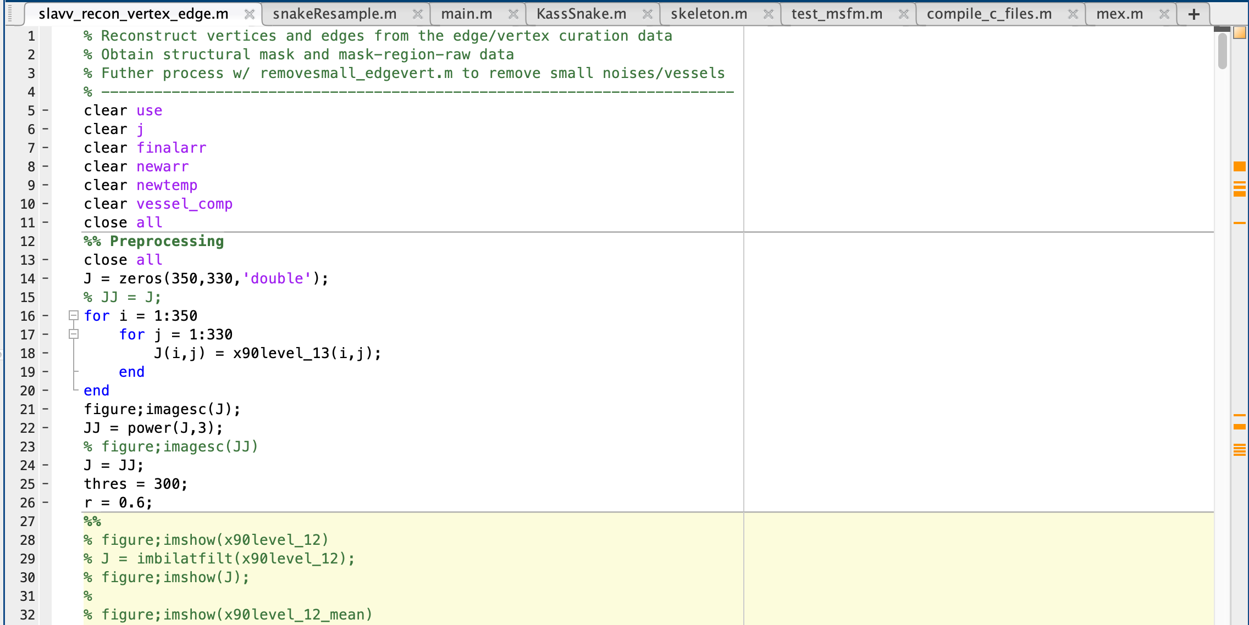
Method
2D Projection
Pre-processing
Layers Stacking
SLAVV interface
Vertices & volumes
Vessel centerlines
Find vessel around each centerline
Generate masks
Segmentation-less, automated vascular vectorization robustly extracts neurovascular network statistics from in vivo two-photon images. Samuel A. Mihelic, William A. Sikora, Ahmed M. Hassan, Michael R. Williamson, Theresa A. Jones, Andrew K. Dunn

Slide 4
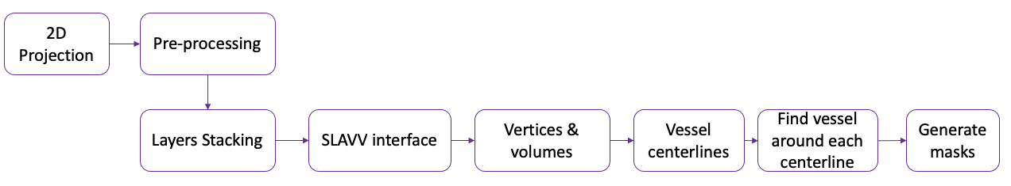
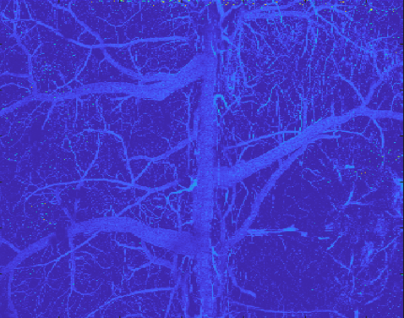
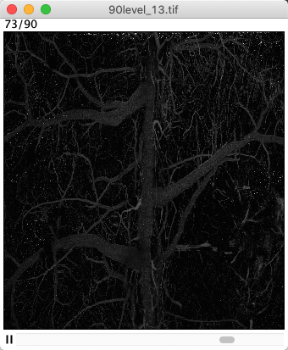
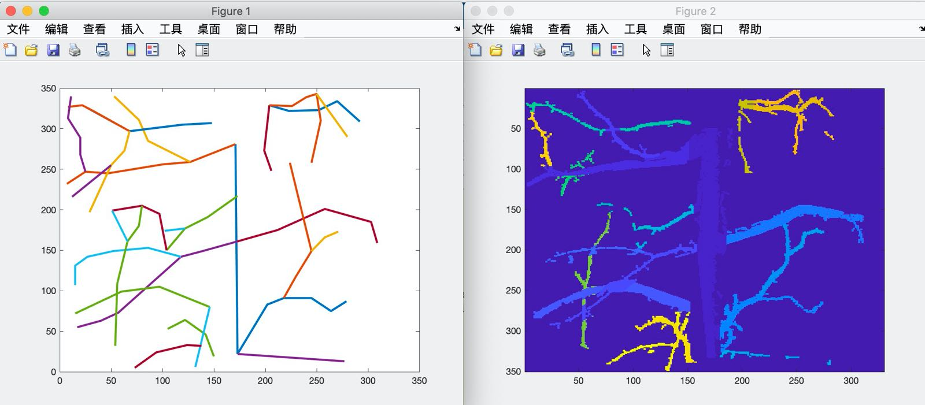
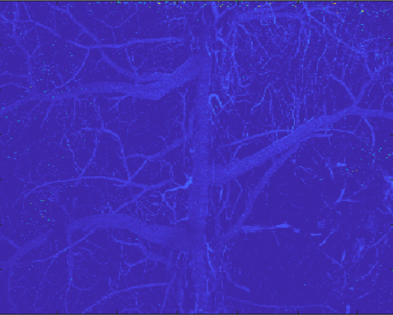
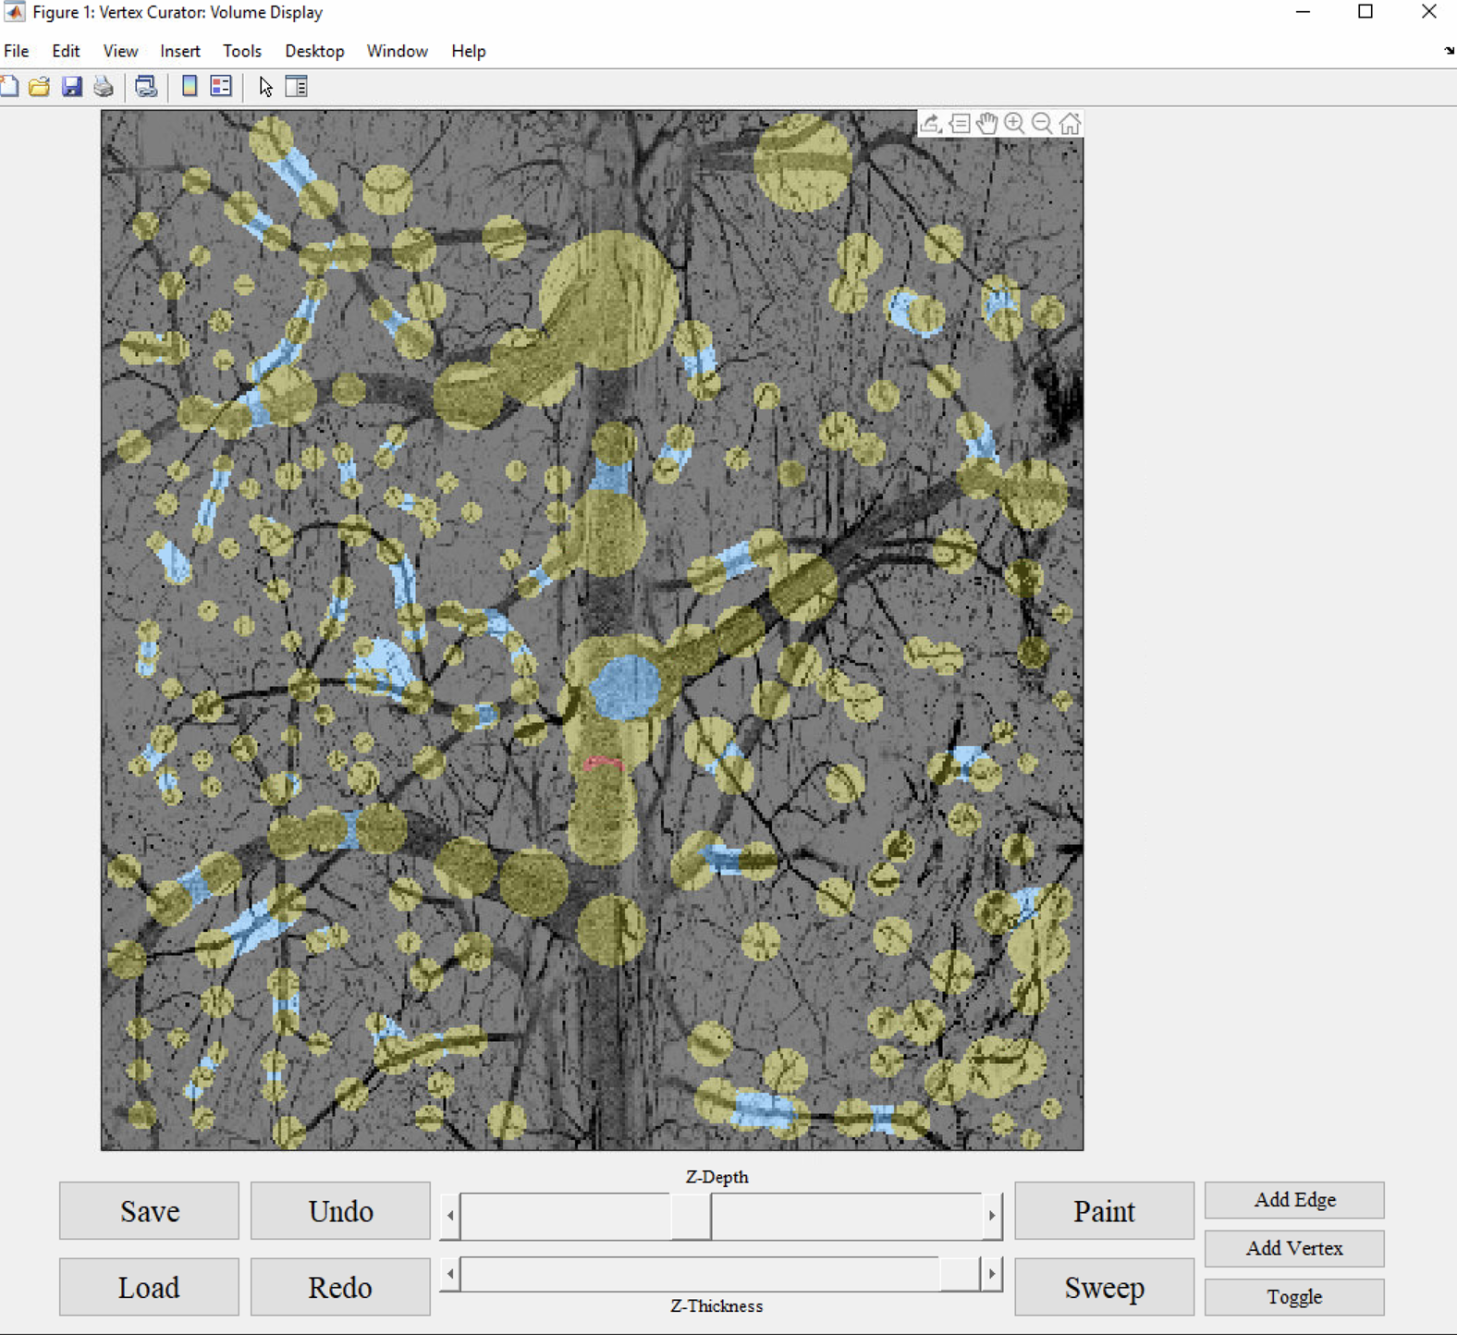
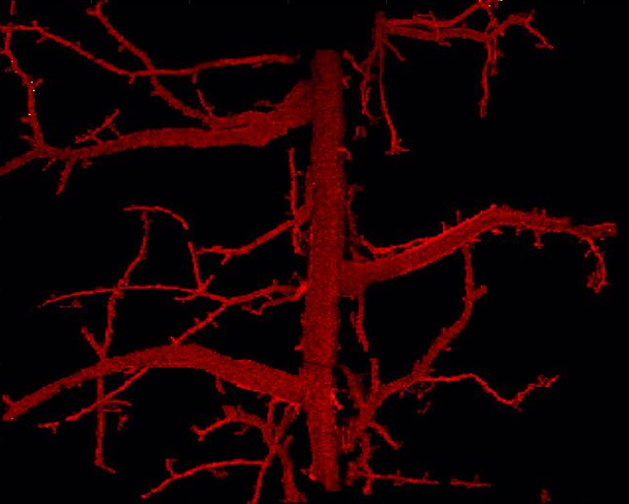
Results
1
Pre-processing
2
Layers Stacking
4
Vessel centerlines
Pixel
Value
^(1.5)
3
SLAVV Interface
5
Generate masks
Segmented Vessels
(Hot Colormap)

Slide 5
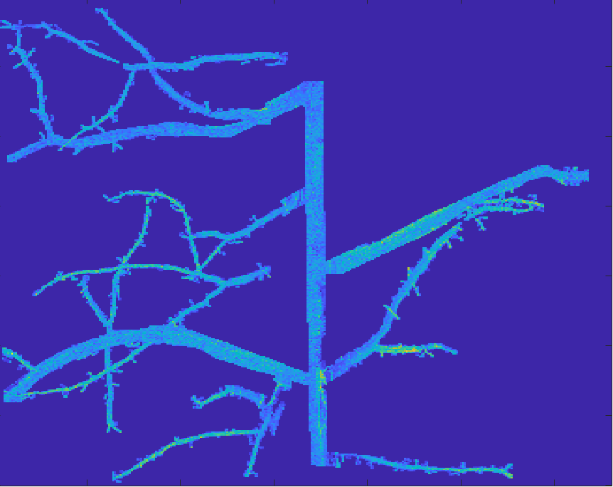
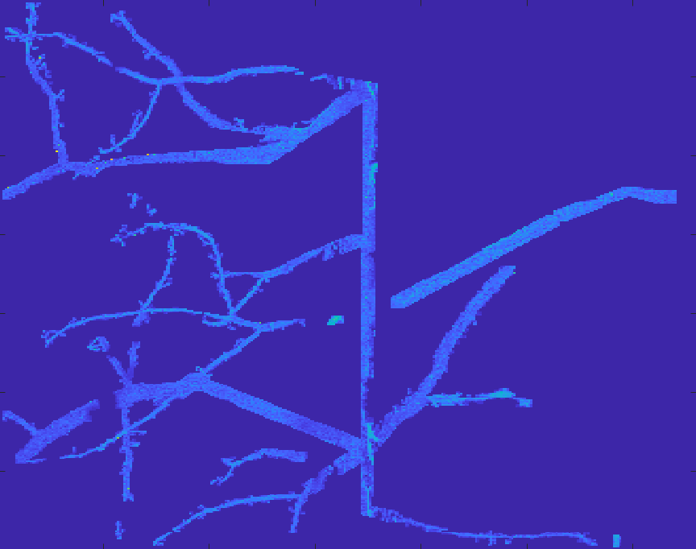
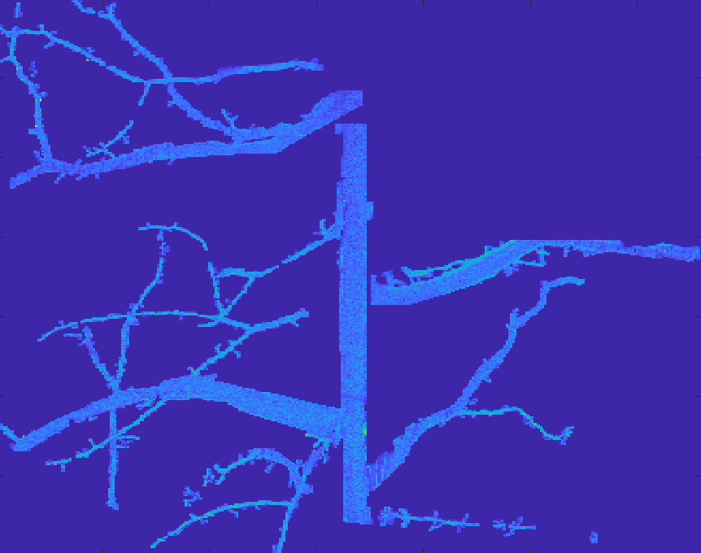
Results
Input 1
Input 2
Input 3
Each input corresponds with a different PAM image of the same mouse brain at different days.
The process creates different but highly similar centerlines (’skeleton’) for each input.

Slide 6
Future Steps & Directions
Integrate & Optimize
Quantitative analysis ---> Compare the effect of diseases (stroke) on those parameters in mice brain

Slide 7
Takeaways
Critical thinking and learn to make wise & informed decisions
Order of solving the problems doesn’t necessarily follow the order of the project workflow.

Slide 8
Question from previous chat
Dimension
--300 x 36,000/350 x 39,600 (Y range, X range)
--100 um/pixel & 0.833 um/pixel (Y resolution, X resolution)
--~3cm x 3cm/3.5cm x 3.3cm
Why noise?
----Thermal noise from the medium/transducer or electromagnetic interference
----Intrinsic thermal noise from optical fiber
How the data is obtained √
Depth √
Goal of the project √
36,000/39,600
300/350

Slide 9
Issues encountered
Focus on the specific image content--->over focus on what the image had (Start from nothing and add things)
New approach (SLAVV): Base on image content, discover some features and extract useful things (Start from
1. U-Net model prediction approach:
Input: raw data & divided into 9 subparts for each input + augment each input with 2 transformation.
Issue:
--cannot work well for time series images (the images in a series that are acquired at different time only have minor morphology differences in vessels)
--some tiny vessels/noises in the background decreases the prediction accuracy during the training process.
--no accurately segmented labels available (use simulated image to train models and try to apply transfer learning approach, but the accuracy is still low).
2. Vessel diameter calculation & thresholding by a value
Issue:
--Across different time series images, the diameter might change and might cause problematic/not consistent segmentation results.

Slide 10
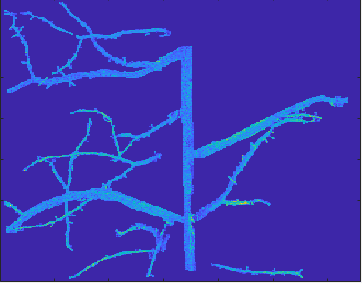
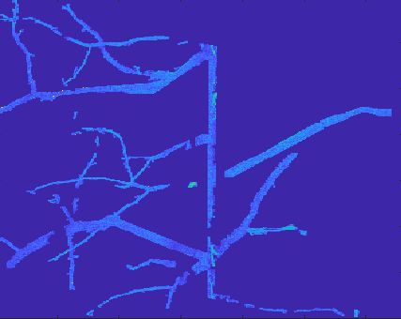
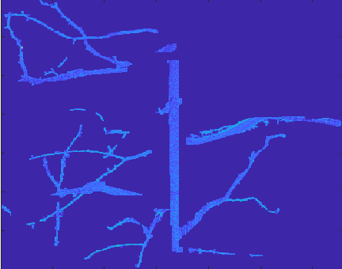
Input 1
Input 2
Input 3
Output from raw data
Output from powered data

