Slide 1
Datathon Case Competition

Slide 2
Case Overview
Business Objectives:
Business Assumptions:
01
Make recommendation for 2 drugs and 2 alternatives to maximize treatment effectiveness.
03
All Drugs cost relatively the same and readmission is the main reason of costs.
02
Lower readmission rate of less than 30 days
04
Readmission < 30 days will be penalized by government oversight and insurance agency.

Slide 3
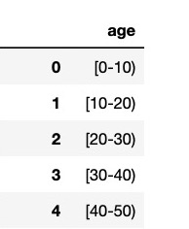
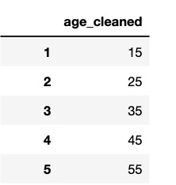
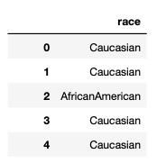
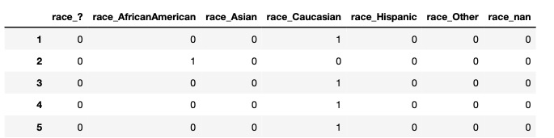
Data Cleaning Process
Remove patients who did not have medical treatments.
Remove medicines that are no longer used, recently approved or rarely used. (Acetohexamide, Troglitazone, Sitagliptin)
Change Age Column from intervals to numbers by picking median of the interval.
Use Dummy Variable to categorize Race

Slide 4
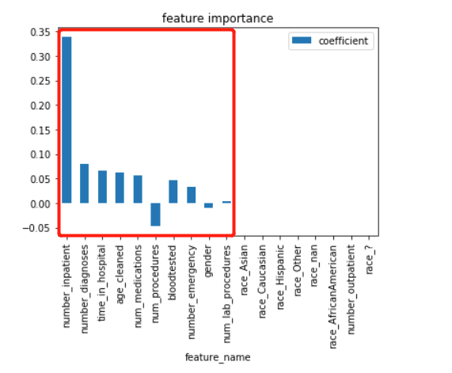
Modeling Process: Building Logistic Regression
Standardized Numerical Features
Baseline Model Using All Features
Selected Top 10 Features
Study Of Each Drug With Selected Feature
Evaluate Strength Of Each Drug
Selected Features

Slide 5
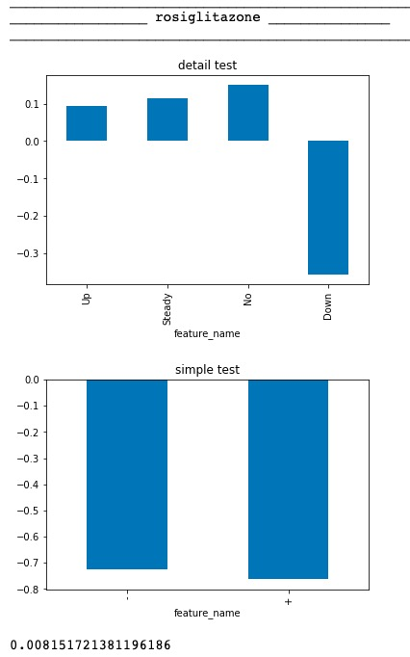
Example Of Study Of Drug
Detail Test:
Relationship Between Readmission And Drug Dosage.
Simple Test:
Take following 2 scenario into consideration
“-”=down & no
“+”=up & steady
Strength Of Drugs = P(-)-P(+)
P(-): Probability of Patients readmitted less than 30 days taking less or none medication.
P(+): Probability of Patients readmitted more than 30 days taking more or steady medication.
HIGHER Strength Of Drugs leads to Lower probability of readmission.
Strength of drug

Slide 6
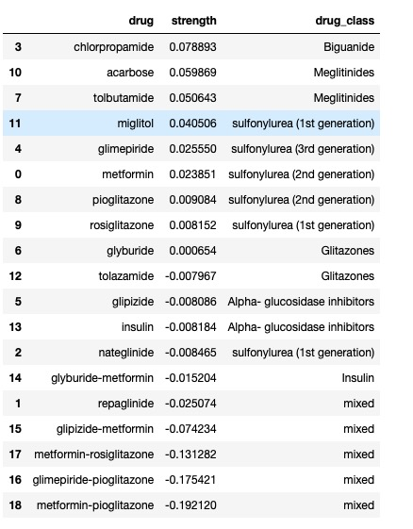
Final Ranking
Higher strength
More effective
Lowest P(readmitted < 30)
Our Hospital Formulary:
Chlorpropamide
Acarbose
Alternative Formulary:
Tolbutamide
Miglitol

Slide 7
THANK YOU

