Slide 1
C++ Part I (INFO1-CE9264) New York University School of Professional and Continuous Studies Fall 2014
Yedidiah Solowiejczyk
Class Notes # 3

Slide 2
Synopsis
Review of Functions
Function prototype declaration
Function definition
Parameters
Call-by-Value Parameters
A First Look at Call-by-Reference Parameters
Call-by-Reference Mechanism in Detail
Constant Reference Parameters
Example: The swapValues Function
Tip: Think of Actions, Not Code
Mixed Parameter Lists
Tip: What Kind of Parameter to Use
Pitfall: Inadvertent Local Variables
Tip: Choosing Formal Parameter Names
Overloading Arguments
Introduction to Overloading
Pitfall: Automatic Type Conversion and Overloading
Rules for Resolving Overloading
Example: Revised Pizza-Buying Program
Default Arguments
Testing and Debugging Functions
The assert Macro
Stubs and Drivers
Summary

Slide 3
Review of Functions
A function is a subroutine that contains one or more C++ statements and performs a specific task.
A function must be prototyped before the start of a program
Provide function name
Provide input parameter types (int, float, char, struct, etc)
Provide return type (void,int, float , char, long, etc)
Exmaple:
float CalcVolume(float height, float length, float depth); //prototype
int main( )
{ float h, l,d; //declare dimensions
:::::::
float vol = CalcVolume(h,l, d); //pass arguments
}
float CalcVolume(float Height, float Length, float Depth) // function definition
{
float result = Height*Length*Depth;
return result;
}
Parameters
Stack variables

Slide 4
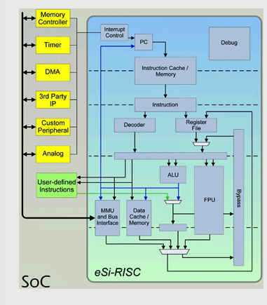
Computer Block Diagram
Instruction 1
Instruction 2
Instruction 3
Instruction 4
int Foo(int)
:::::::::::::
:::::::::::::
Foo( int Z){
Instruction
:::::::::::::
:::::::::::::
return}
-----------------
int Z
-----------------
Stack
Automatic Variables
-----------------
Function parameters
Program execution is sequential decoding of instructions
Program Counter

Slide 5
Function Prototypes
The portion of a function prototype that includes the name of the function and the types of its arguments is called the function signature or simply the signature.
Signature does not specify the function’s return type.
Functions in the same scope must have unique signatures.
Overloaded functions
The scope of a function is the region of a program in which the function is known and accessible.

Slide 6
Function Definitions with Multiple Parameters
Functions often require more than one piece of information to perform their tasks.
Such functions have multiple parameters.
There must be one argument in the function call for each parameter (also called a formal parameter) in the function definition.
Multiple parameters are specified in both the function prototype and the function definition as a comma-separated list.

Slide 7
Parameters
Recall that parameters can be passed to a function by two methods:
Call-by-value
”xerox copy" of value is passed
Ensures that the original data is protected from being changed
Call-by-reference
"address of" actual argument is passed
This approach provides for changes to original
data

Slide 8
Call-by-Value Parameters
Copy of actual argument passed (“xerox copy”)
Thus function cannot damage “original” value
Considered "local variable" inside function (stack)
If modified, only "local copy" changes
Function has no access to "actual argument" from caller
call-by-value arguments are local variable just like variables declared within body of function
This is the default method
Used in all examples thus far

Slide 9
Call by Value Example
code
#include <iostream>
using namespace std;
const double RATE = 10.00; //Global variable
// prototype
double fee(int Hours,
int Minutes);
int main( ){
int hours, minutes;
double bill;
hours = 10;
minutes = 15;
bill = fee(hours, minutes); //function call
printf(“ hours = %i min = %i\n bill =%f\n”
hours, minutes, bill);
return 0;
}
Int hours
Int minutes
Double bill
//definition
double fee(int Hours,
int Minutes){
int quarterHours; //declared on stack
Minutes = Hours*60 + Minutes;
quarterHours = Minutes/15;
//return value from Stack
return (quarterHours*RATE);
}
Passed values on Stack
Int
Hours
Minutes
quaterHrs
Arguments

Slide 10

Call-by-Value Pitfall
Common Mistake:
Declaring parameter "again" inside function: double fee(int hours, int minutes){ int quarterHours; // local variable int minutes //  …. NO!
:::::::::::::
return …. ; }
Compiler error results
"Redefinition error…"
Value arguments ARE like "local variables"
But function gets them "automatically"

Slide 11
References
References can also be used as aliases for other variables within a function.
int X=5;
int & X_ref = X; //only way of declaring reference
Reference variables must be initialized in their declarations and cannot be reassigned as aliases to other variables.
Once a reference is declared as an alias for another variable, all operations supposedly performed on the alias are actually performed on the original variable.

Slide 12
Call-By-Reference Parameters
Used to provide access to caller’s actual argument
Pointer-like approach
Caller’s data can be modified by called function!
Typically used for input function
To retrieve data for caller
Data is then "given" to caller
Specified by ampersand, &, after type in formal parameter list
foo(int & arg1); //pass by reference

Slide 13
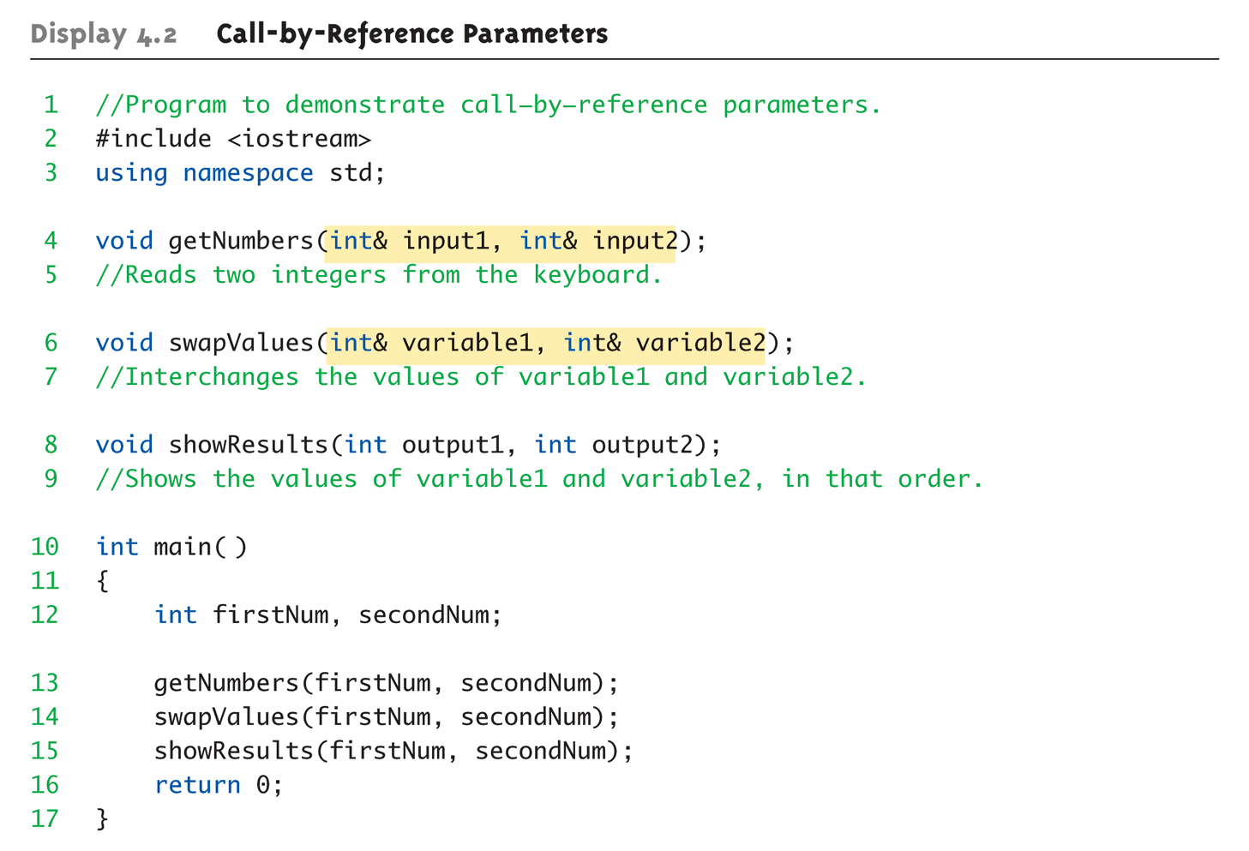
Call-By-Reference
Prototype
Driver program

Slide 14
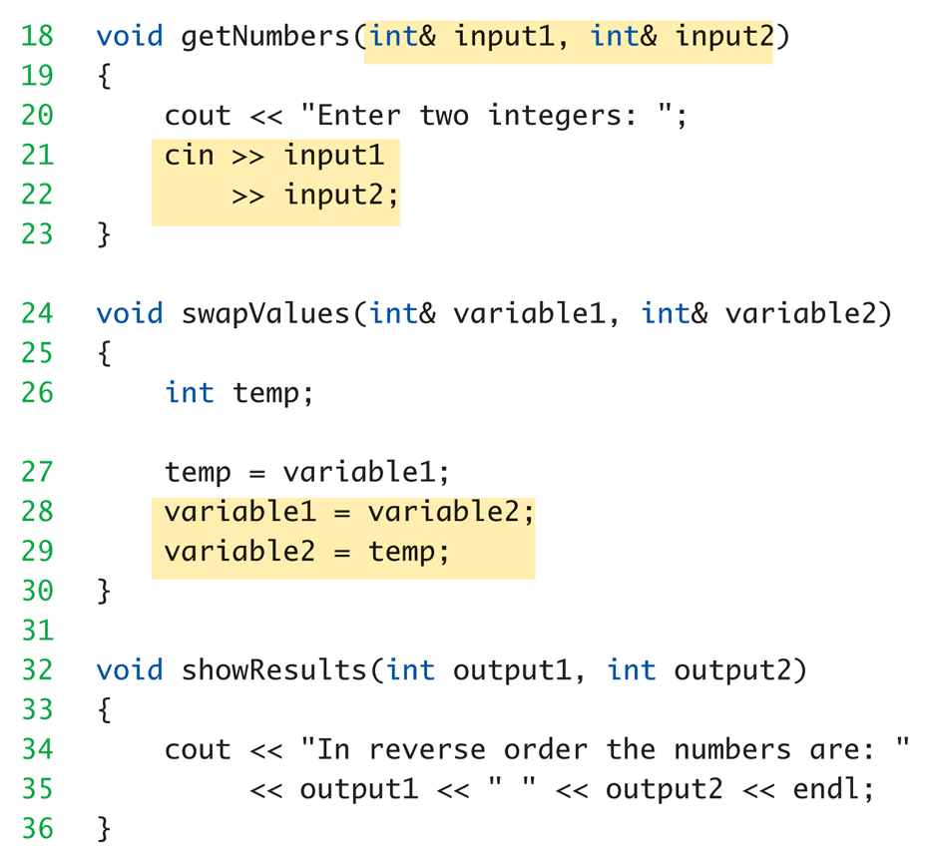
Call-By-Reference
Function Definition

Slide 15
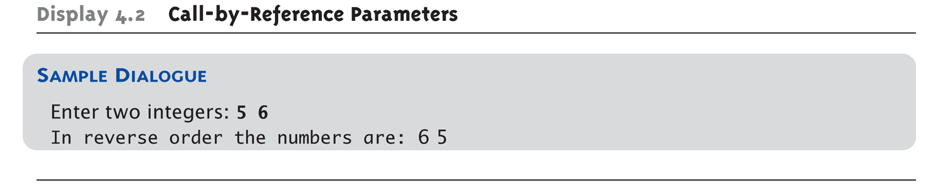
Call-By-Reference

Slide 16
Call-By-Reference Details
What’s really passed in?
A "reference" back to caller’s actual argument!
Refers to memory location of actual argument
Called "address", which is a unique number referring to a distinct place in memory

Slide 17
Constant Reference Parameters
Reference arguments inherently "dangerous"
Caller’s data can be changed/corrupted
Often this is desired, sometimes not
To "protect" data, & still pass by reference:
Use const keyword
void sendConstRef( const int & par1, const int &par2);
Makes arguments "read-only" by function
No changes allowed inside function body
Objects are not const ….!!!!

Slide 18
Call-By-Reference Advantages & Disadvantages
One disadvantage of pass-by-value is that, if a large data item is being passed(i.e. structure) , copying that data can take a considerable amount of execution time and memory space.
With pass-by-reference, the caller gives the called function the ability to access the caller’s data directly, and to modify that data.
A reference parameter is an alias for its corresponding argument in a function call.
To indicate that a function parameter is passed by reference, simply follow the parameter’s type in the function prototype by an ampersand (&); use the same convention when listing the parameter’s type in the function header.
Pass-by-reference eliminates the large overhead of pass-by-value but can weaken security since it can corrupt original data

Slide 19
Parameters and Arguments
Confusing terms, often used interchangeably
True meanings:
Formal parameters
In function declaration and function definition
How many bytes are to be used on stack & order of passed data
Arguments
Used to "fill-in" a formal parameter
In function call (argument list)
Call-by-value & Call-by-reference
Simply the "mechanism" used in plug-in process

Slide 20
Mixed Parameter Lists
Can combine passing mechanisms
Parameter lists can include pass-by-value and pass-by-reference parameters
Order of arguments in list is critical: void mixedCall(int & par1, int par2, double & par3);
Function call: mixedCall(arg1, arg2, arg3);
arg1 must be integer type, is passed by reference
arg2 must be integer type, is passed by value
arg3 must be double type, is passed by reference

Slide 21
Choosing Formal Parameter Names
Choose Parameter Name
Same rule as naming any identifier:
Meaningful names!
Functions as "self-contained modules"
Designed separately from rest of program
Assigned to teams of programmers
All must "understand" proper function use
OK if formal parameter names are same as argument names
Choose function names with same rules
Meaningful names!

Slide 22
Compiler Role
The compiler refers to the function prototype to check that calls to foo(…. ) contain the correct number and types of arguments and that the types of the arguments are in the correct order.
In addition, the compiler uses the prototype to ensure that the value returned by the function can be used correctly in the expression that called the function (e.g., a function call that returns void cannot be used as the right side of an assignment statement).
Each argument must be consistent with the type of the corresponding parameter.
If the arguments passed to a function do not match the types specified in the function’s prototype, the compiler attempts to convert the arguments to those types.

Slide 23

Compiler Role
There are three ways to return control to the point at which a function was invoked.
If the function does not return a result (i.e., it has a void return type), control returns when the program reaches the function-ending right brace, or by execution of the statement
return;
If the function does return a result, the statement
return expression;
evaluates expression and returns the value of expression to the caller.

Slide 24
Function Prototypes and Argument Coercion
An important feature of function prototypes is argument coercion
forcing arguments to the appropriate types specified by the parameter declarations.
These conversions occur as specified by C++’s promotion rules.
The promotion rules indicate how to convert between types without losing data.
The promotion rules apply to expressions containing values of two or more data types
Expression → float*int
also referred to as mixed-type expressions.
The type of each value in a mixed-type expression is promoted to the “highest” type in the expression.

Slide 25
Function Prototypes and Argument Coercion
Promotion also occurs when the type of a function argument does not match the parameter type specified in the function definition or prototype.
Figure below lists the fundamental data types in order from “highest type” to “lowest type.”
Converting values to lower fundamental types can result in incorrect values.
Therefore, a value can be converted to a lower fundamental type only by explicitly assigning the value to a variable of lower type or by using a cast operator.

Slide 26
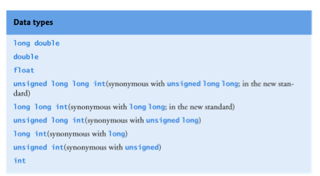


Function Prototypes and Argument Coercion
Promotion Hierarchy

Slide 27
Functions with Empty Parameter Lists
In C++, an empty parameter list is specified by writing either void or nothing at all in parentheses.
int foo(void); //prototye
float goo( );
int main( ) // int main(void)
{
int temp = foo( );
float Temp = goo(void);
}

Slide 28
Predefined void Functions
No returned value
Performs an action, but sends no "answer"
When called, it’s a statement itself
exit(1); // No return value, so not assigned
This call terminates program
void functions can still have arguments
All aspects same as functions that "return a value"
They just don’t return a value!

Slide 29
Overloading
Same function name
Different parameter lists
“Two” separate function definitions
Function "signature"
Function name & parameter list
Must be "unique" for each function definition
Allows same task performed on different data
Overloaded functions must return same value type
Overloaded functions are a special feature of C++

Slide 30
Overloading Example: Average
Function computes average of 2 numbers: double average(double n1, double n2) { return ((n1 + n2) / 2.0); }
Now compute average of 3 numbers: double average(double n1, double n2, double n3) { return ((n1 + n2 + n3) / 3.0); }
Same name, two functions

Slide 31
Overloaded Average() Cont’d
Which function gets called?
Depends on function call itself:
avg = average(5.2, 6.7);
Calls "two-parameter average()"
avg = average(6.5, 8.5, 4.2);
Calls "three-parameter average()"
Compiler resolves invocation based on signature of function call
"Matches" call with appropriate function
Each considered separate function

Slide 32
Overloading Example: distance
Function computes average of 2 numbers: float distance(int x1,int y1, int x2, int y2) //cartesian { float length = (x1-x2)*(x1-x2) + (y1-y2)*(y1-y2);
length = sqrt(length) }
float distance(float R, float Φ1, float Φ2 ); //circle { float length = R*(Φ2-Φ1); }
Same name, two functions
float d1 = distance(U!, U2, V1, V2);
float d2 = distance(R, Φ2, Φ1 )
* (x2,y2)
* (x1,y1)
Φ1
Φ2

Slide 33
Overloading Resolution
1st: Exact Match
Looks for exact signature
Where no argument conversion required
2nd: Compatible Match
Looks for "compatible" signature where automatic type conversion is possible:
1st with promotion (e.g., int→double)
No loss of data
2nd with demotion (e.g., double→int)
Possible loss of data

Slide 34
Overloading Resolution Example
Given following functions:
1. void f(int n, double m); 2. void f(double n, int m); 3. void f(int n, int m);
These calls: f(98, 99); → Calls #3 // int-int f(5.3, 4); → Calls #2 //float-int f(4.3, 5.2); → Calls ???
Avoid such confusing overloading

Slide 35
Automatic Type Conversion and Overloading
Allows for "any" numeric type
Any "subordinate" data automatically promoted
short → int
int → double
float → double
char → double *More on this later!
cmath library – all trig functions defined with double signatures
e.g. sin(theta) – theta is double
Avoids overloading for different numeric types
If two matches are found there is ambiguity ➔ error

Slide 36
Automatic Type Conversion and Overloading Example
double mpg(double miles, double gallons) { return (miles/gallons); }
Example function calls:
mpgComputed = mpg(5, 20); // int, int
Converts 5 & 20 to doubles, then passes
mpgComputed = mpg(5.8, 20.2); //double, double
No conversion necessary
mpgComputed = mpg(5, 2.4); //int, double
Converts 5 to 5.0, then passes values to function

Slide 37
Overloading Pitfall
Only overload "same-task" functions
A mpg() function should always perform same task, in all overloads
Otherwise, unpredictable results
C++ function call resolution:
1st: looks for exact signature
2nd: looks for "compatible" signature

Slide 38
Default Arguments
It is not uncommon for a program to invoke a function repeatedly with the same argument value for a particular parameter.
Can specify that such a parameter has a default argument, i.e., a default value to be passed to that parameter.
When a program omits an argument for a parameter with a default argument in a function call, the compiler rewrites the function call and inserts the default value of that argument.
Default arguments must be the rightmost (trailing) arguments in a function’s parameter list.

Slide 39
Default Arguments
Allows omitting some arguments
Specified in function declaration/prototype
void showVolume( int length, int width = 1, int height = 1); //”right-to-left rule”
Last 2 arguments are defaulted
Possible calls:
showVolume(2, 4, 6); //All arguments supplied
showVolume(3, 5); //height defaulted to 1
showVolume(7); //width & height defaulted to 1

Slide 40
Default Arguments - Example
Default values
#include <iostream>
using namespace std;
void showVolume(int length, int width = 1, int height = 1);
//Returns the volume of a box.
//If no height is given, the height is assumed to be 1.
//If neither height nor width are given, both are assumed to be 1.
int main( )
{
showVolume(4, 6, 2);
showVolume(4, 6);
showVolume(4);
return 0;
}
void showVolume(int length, int width, int height){
cout << "Volume of a box with \n”
<< "Length = " << length << ", Width = " << width << endl
<< "and Height = " << height
<< " is " << length*width*height << endl;
}

Slide 41
Inline functions
C++ provides inline functions to help reduce function call overhead—especially for small functions.
Placing the qualifier inline before a function’s return type in the function definition “advises” the compiler to generate a copy of the function’s code in place (when appropriate) to avoid a function call.
inline int foo(char c){ ::::: } //definition
Trade-off
Multiple copies of the function code are inserted in the program (often making the program larger) rather than there being a single copy of the function to which control is passed each time the function is called.
The complete function definition must appear before the code is inlined so that the compiler knows how to expand a function call into its inlined code.

Slide 42
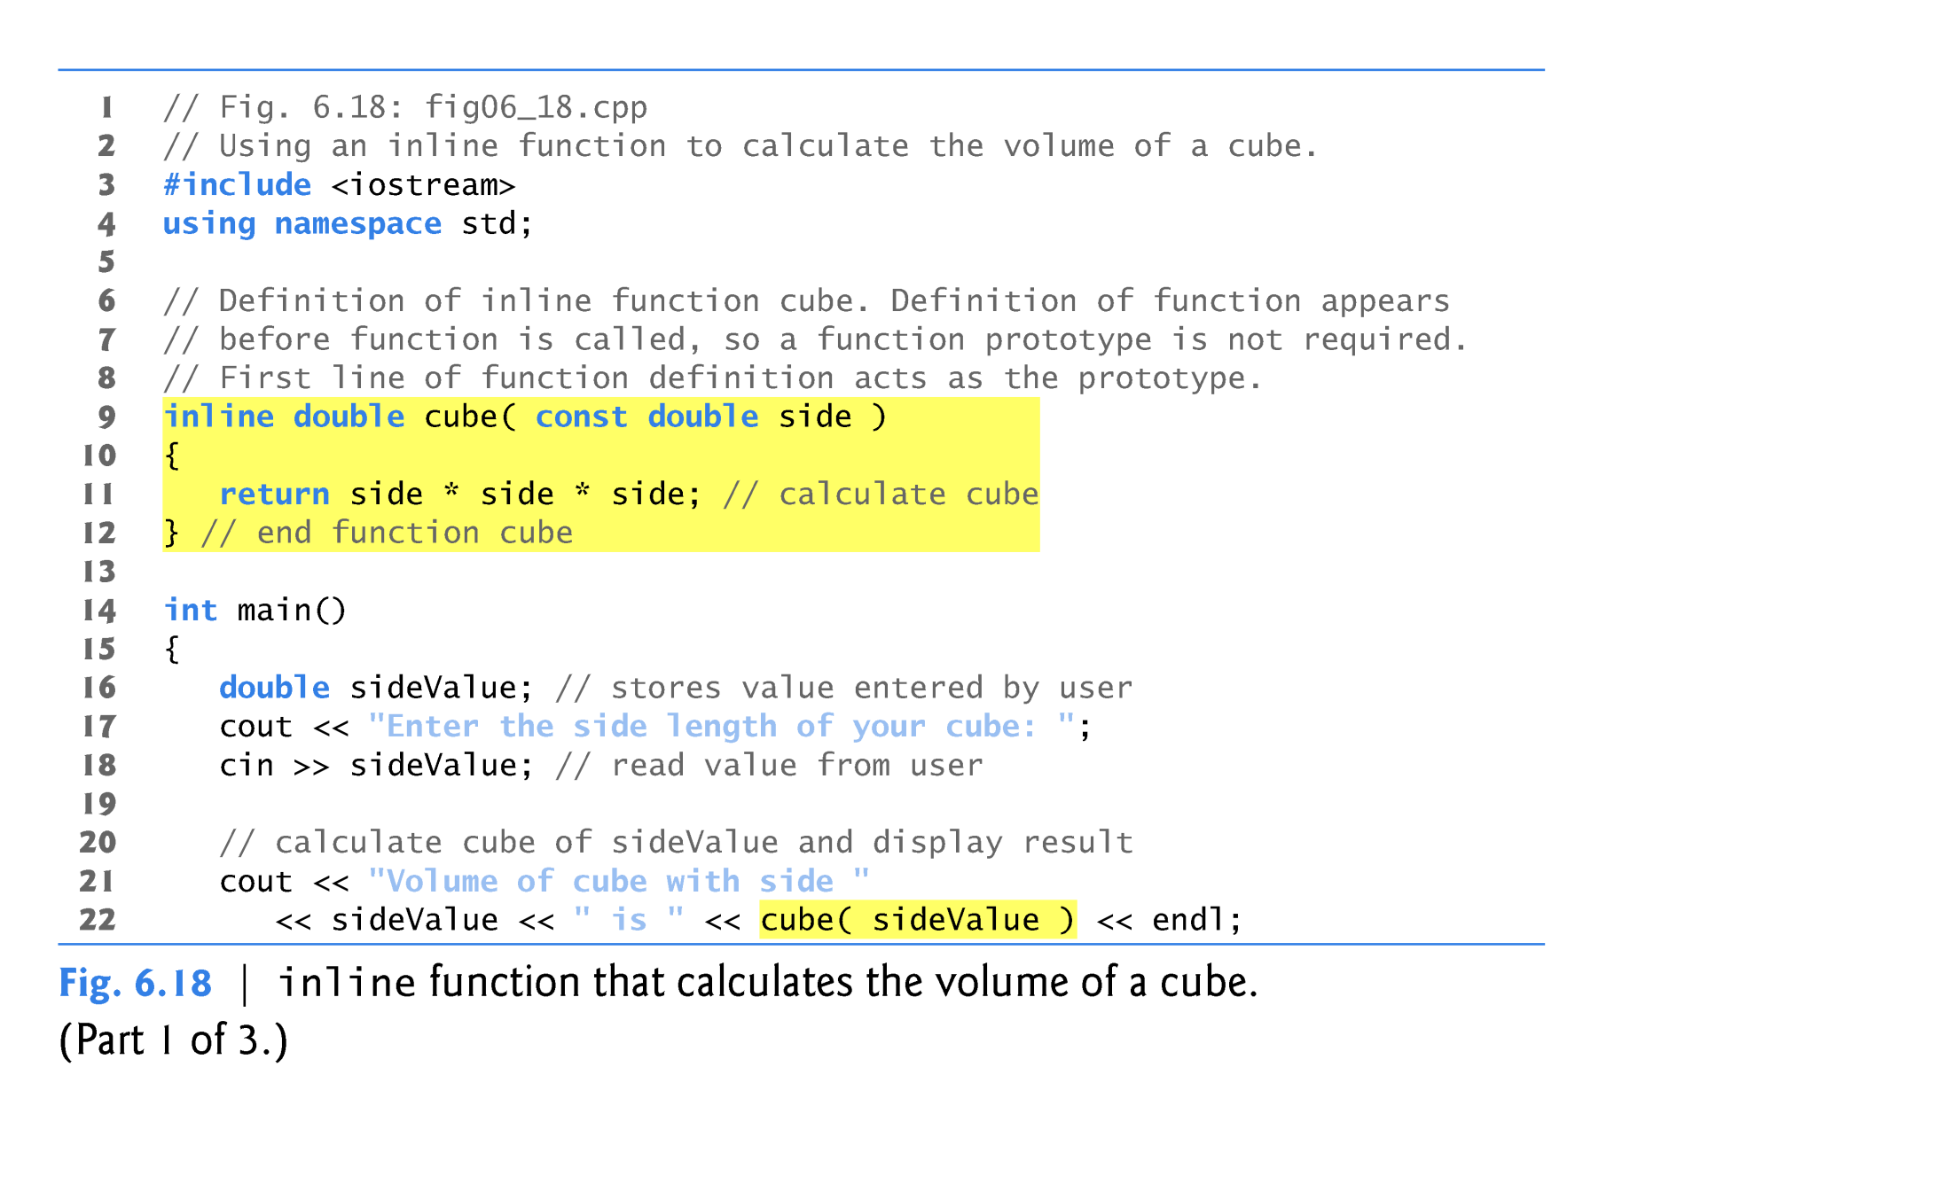
Inline functions

Slide 43
External Linkage
// Function1.cpp
#include <stdio.h>
void foo(int x); //prototype
void goo();
int main(){
int X = 10;
foo(X);
goo( );
return 0;
}
void foo(int x){ // function definition
printf("Function1: x = %d\n", x);
return;
}
//Fucntion2.cpp
#include <stdio.h>
extern void foo(int );
void goo( )
{
static int x = 10;
printf("goo() \n");
foo(x);
return;
}
/**************************/
g++ Function1.cpp Function2.cpp -o Function
./Function
Function1: x = 10
goo()
Function1: x = 10

Slide 44
Predefined Functions
Math Library
Found in library <cmath>
Most return a value (the "answer”)
Example: double sqrt(double x);
String Library
Found in library <cstring>
String manipulation fucntions
Example: int strlen(char * )
Limits Library
Found in library <climits>
Example: INT_MAX
Maximum value for an object of type int32767 (2¹⁵-1) or greater*

Slide 45
The Function Call
Back to this assignment: theRoot = sqrt(9.0);
The expression "sqrt(9.0)" is known as a function call, or function invocation
The argument in a function call (9.0) can be a literal, a variable, or an expression that evaluates to double
The call itself can be part of an expression:
bonus = sqrt(sales)/10;
A function call is allowed wherever it’s legal to use an expression of the function’s return type

Slide 46
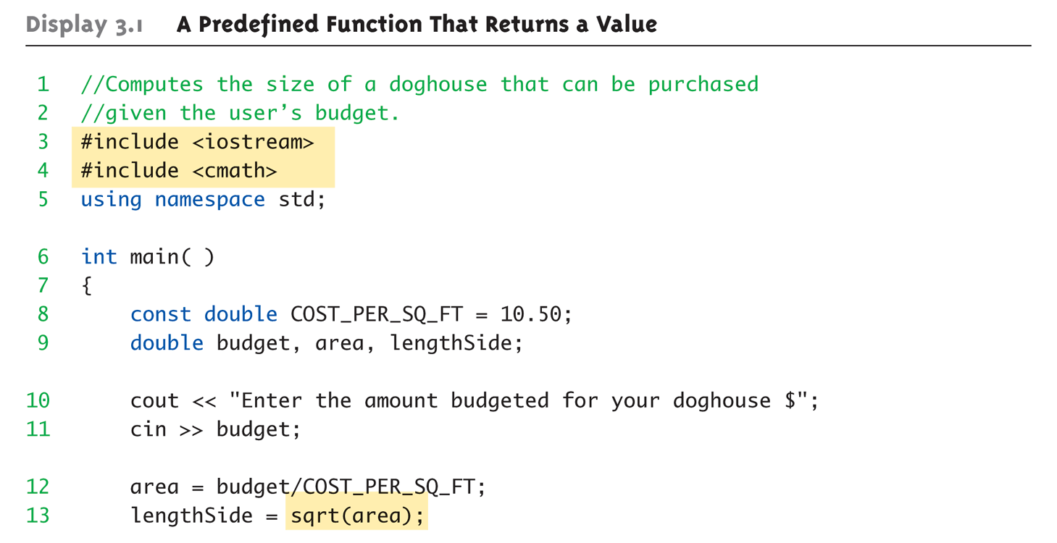
A Larger Example: A Predefined Function That Returns a Value

Slide 47
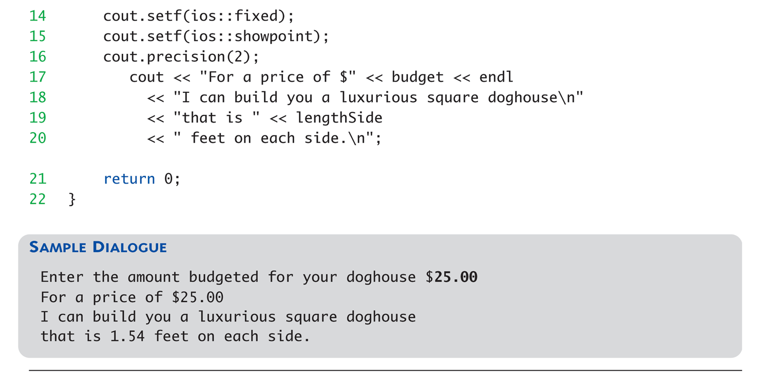
A Larger Example: A Predefined Function That Returns a Value

Slide 48
More Predefined Functions
#include <cstdlib>
Library contains functions like:
abs() // Returns absolute value of an int
labs() // Returns absolute value of a long int
pow(x, y)
Returns x to the power y double result, x = 3.0, y = 2.0; result = pow(x, y); cout << result;
Here 9.0 is displayed since 3.0^{2.0} = 9.0

Slide 49
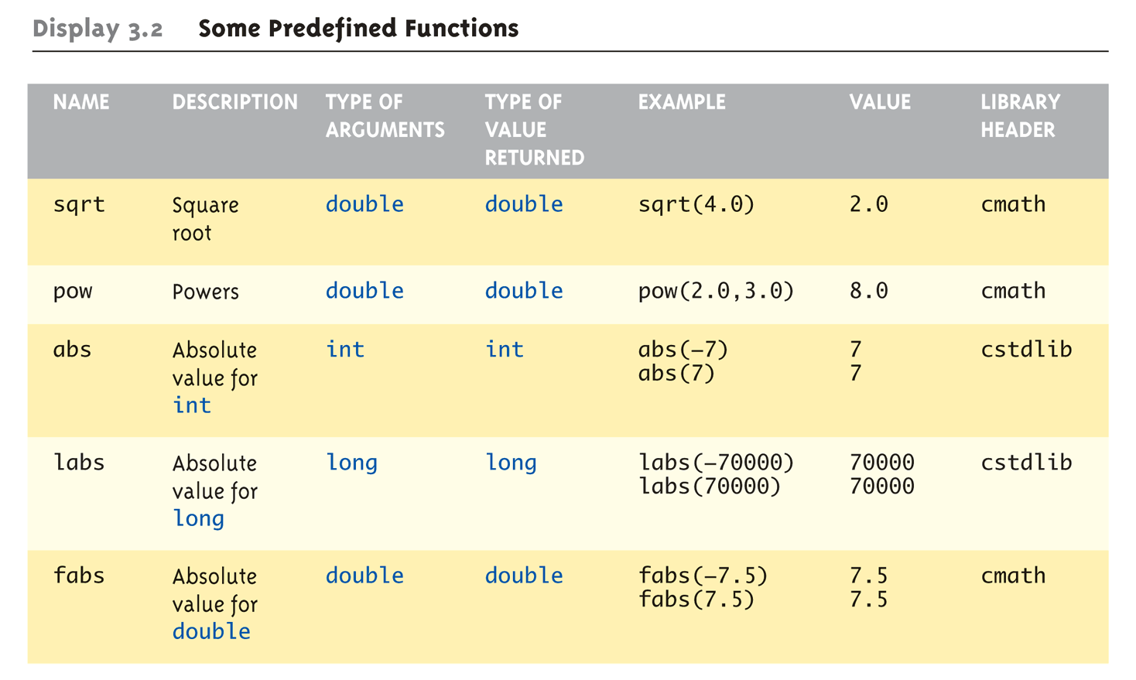
Even More Math Functions

Slide 50
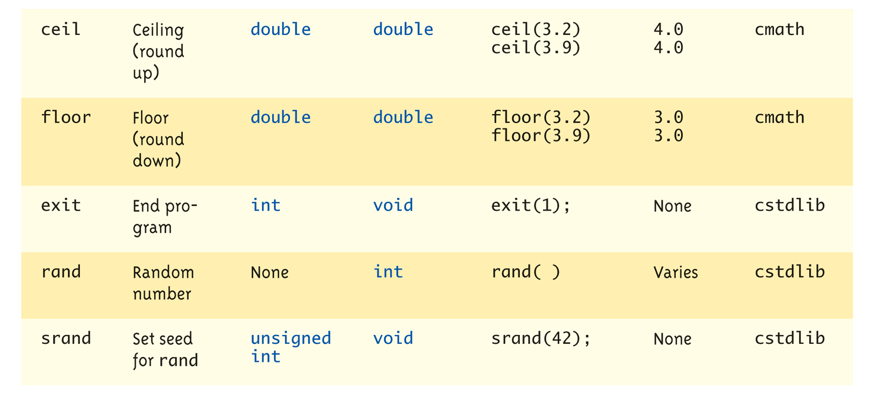
More Math Functions

Slide 51
Random Number Generator
Return "randomly chosen" number
Used for simulations, games
rand()
Takes no arguments
Returns value between 0 & RAND_MAX
Scaling
Squeezes random number into smaller range rand() % 6
Returns random value between 0 & 5
Shifting rand() % 6 + 1
Shifts range between 1 & 6 (e.g., die roll)

Slide 52
Random Number Generator
Return "randomly chosen" number
Used for simulations, games
rand()
Takes no arguments
Returns value between 0 & RAND_MAX
Scaling
Squeezes random number into smaller range rand() % 6
Returns random value between 0 & 5
Shifting rand() % 6 + 1
Shifts range between 1 & 6 (e.g., die roll)

Slide 53
Random Number Seed
Pseudorandom numbers
Calls to rand() produce given "sequence" of random numbers
Use "seed" to alter sequence srand(seed_value);
void function
Receives one argument, the "seed"
Can use any seed value, including system time: srand(time(0));
time() returns system time as numeric value
Library <time> contains time() functions

Slide 54
Random Examples
Random double between 0.0 & 1.0: (RAND_MAX – rand())/static_cast<double>(RAND_MAX)
Type cast used to force double-precision division
Random int between 1 & 6: rand() % 6 + 1
"%" is modulus operator (remainder)
Random int between 10 & 20: rand() % 10 + 10

Slide 55
Scope Rules
Local variables
Declared inside body of given function
Available only within that function
Can have variables with same names declared in different functions
Scope is local: "that function is it’s scope"
Local variables preferred
Maintain individual control over data
Need to know basis
Functions should declare whatever local data needed to "do their job"

Slide 56
Unary Scope Resolution Operator
It’s possible to declare local and global variables of the same name.
C++ provides the unary scope resolution operator (::) to access a global variable when a local variable of the same name is in scope.
Using the unary scope resolution operator (::) with a given variable name is optional when the only variable with that name is a global variable.

Slide 57



Unary Scope Resolution Operator

Slide 58
Global Constants and Global Variables
Declared "outside" function body
Global to all functions in that file
Declared "inside" function body
Local to that function
Global declarations typical for constants:
const double TAXRATE = 0.05;
Declare globally so all functions have scope
Global variables?
Possible, but SELDOM-USED
Dangerous: no control over usage!

Slide 59
Blocks
Declare data inside compound statement
Called a "block"
Has "block-scope"
Note: all function definitions are blocks!
This provides local "function-scope"
Loop blocks: for (int ctr=0;ctr<10;ctr++) { sum+=ctr; }
Variable ctr has scope in loop body block only

Slide 60
Nested Scope
Same name variables declared in multiple blocks
Very legal; scope is "block-scope"
No ambiguity
Each name is distinct within its scope

Slide 61
Testing and Debugging Functions
Many methods:
Lots of printf statements
In calls and definitions
Used to "trace" execution
Compiler Debugger
Environment-dependent
assert Macro
Early termination as needed
Stubs and drivers
Incremental development

Slide 62
The assert Macro
Assertion: a true or false statement
Used to document and check correctness
Preconditions & Postconditions
Typical assert use: confirm their validity
Syntax: assert(<assert_condition>);
No return value
Evaluates assert_condition
Terminates if false, continues if true
Predefined in library <cassert>
Macros used similarly as functions

Slide 63
An assert Macro Example
Given Function Declaration: void computeCoin( int coinValue, int& number, int& amountLeft); //Precondition: 0 < coinValue < 100 0 <= amountLeft <100 //Postcondition: number set to max. number of coins
Check precondition:
assert ((0 < currentCoin) && (currentCoin < 100) && (0 <= currentAmountLeft) && (currentAmountLeft < 100));
If precondition not satisfied → condition is false → program execution terminates and prints source line #!

Slide 64
An assert Macro Example Cont’d
Useful in debugging
Stops execution so problem can be investigated
Outputs line number of failure

Slide 65
assert On/Off
Preprocessor provides means
#define NDEBUG #include <cassert>
Add "#define" line before #include line
Turns OFF all assertions throughout program
Remove "#define" line (or comment out)
Turns assertions back on

Slide 66
Stubs and Drivers
Separate compilation units
Each function designed, coded, tested separately
Ensures validity of each unit
Divide & Conquer
Transforms one big task → smaller, manageable tasks
But how to test independently?
Driver programs

Slide 67
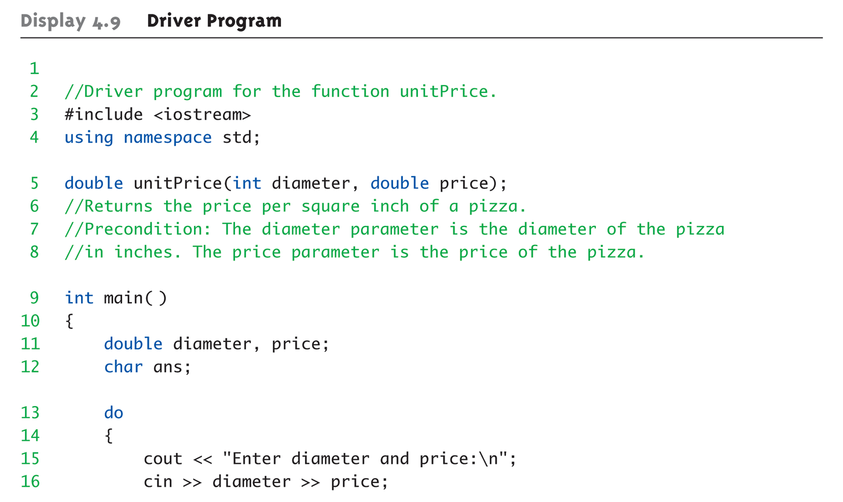
Driver Program Example:

Slide 68
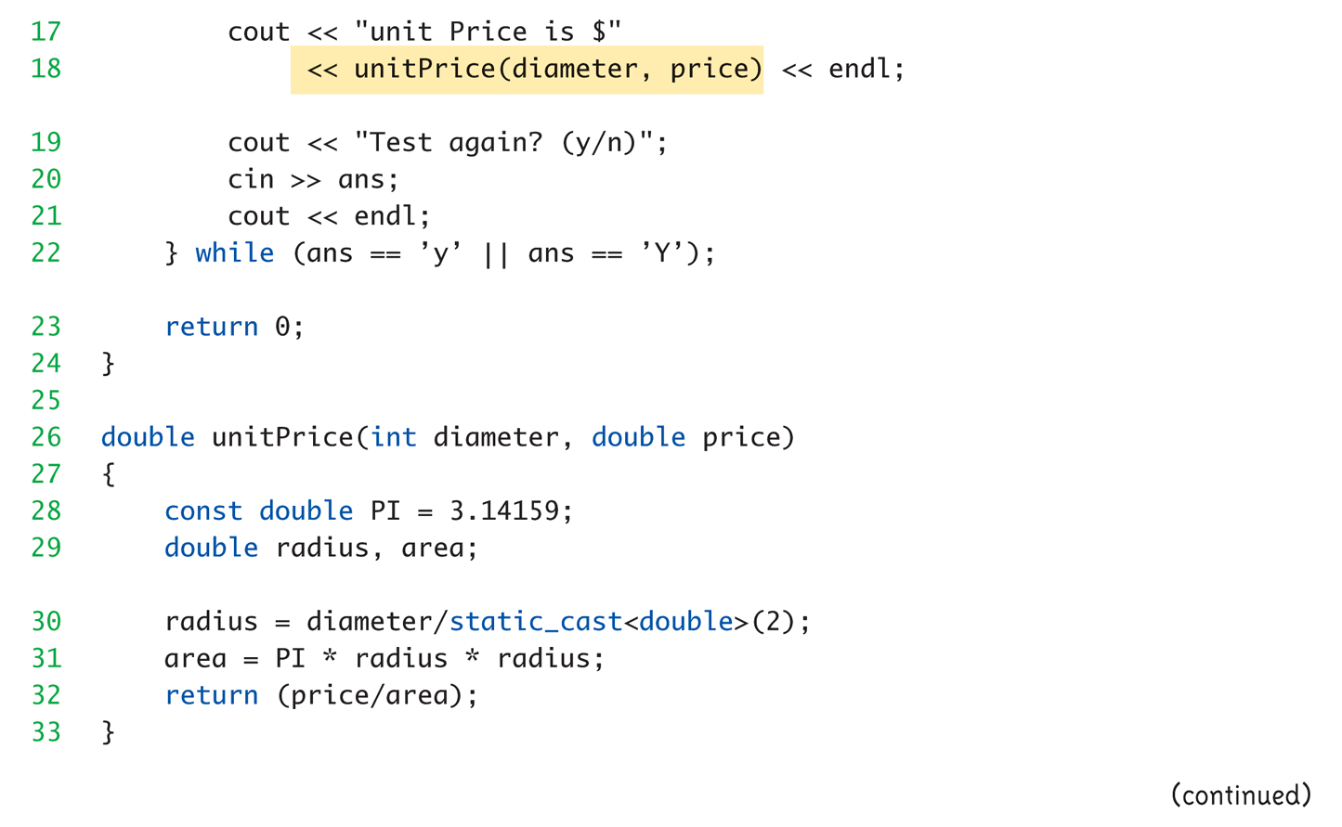
Driver Program

Slide 69
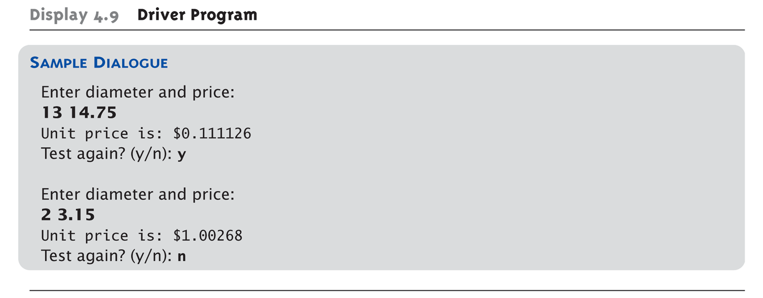
Driver Program

Slide 70
Stubs
Develop incrementally
Write "big-picture" functions first
Low-level functions last
"Stub-out" functions until implementation
Example: double unitPrice(int diameter, double price) { return (9.99); // not valid, but noticeably // a "temporary" value }
Calls to function will still "work"

Slide 71
Fundamental Testing Rule
To write "correct" programs
Minimize errors, "bugs"
Ensure validity of data
Test every function in a program where every other function has already been fully tested and debugged
Avoids "error-cascading" & conflicting results

Slide 72
Quiz#1 Problem
Demonstrate program that utilizes functions
Calculate the surface area, perimeter, volume of a cylinder using the following functions
float Area_Circle(float radius, float height)
float Area_Circle(double diameter, height = 10)
float Perimeter_Cylender(float radius, float height)
float Perimeter_Cylender(double diameter, float height)
float Volume_Cylender(float radius, float height)
float Volume_Cylender(double diameter, float height)
Recall:
Area of Circle = πR²
Perimeter of Circle = 2πR
Diameter = 2*Radius

Slide 73
Summary
Formal parameter is placeholder, filled in with actual argument in function call
Call-by-value parameters are "local copies" in receiving function body
Actual argument cannot be modified
Call-by-reference passes memory address of actual argument
Actual argument can be modified
Argument MUST be variable, not constant

Slide 74
Summary
Multiple definitions of same function name possible: called overloading
Default arguments allow function call to "omit" some or all arguments in list
If not provided → default values assigned
assert macro initiates program termination if assertions fail
Functions should be tested independently
As separate compilation units, with drivers

