Slide 1
C++ Part I (INFO1-CE9264) New York University School of Professional and Continuous Studies Fall 2014
Yedidiah Solowiejczyk
Class Notes # 1

Slide 2
Synopsis
Introduction
Computers: Hardware and Software
Data Hierarchy
Computer Organization
PC Architecture
Operating Systems (OS)
Programming Languages
Introduction to Object Technology
Anatomy of C/C++
Merits of C++
Typical C++ Development Environment
C++ Program Development Steps
Editors
Preprocessor Conditional Compilation
C++ Application on LINUX
C++ Program Demo
C++ Identifiers/Variables
Keywords
Fundamental Data Types
Declarations vs. Definitions
Literals
Escape Sequences
Constants
Naming Conventions
Assigning Data & Shorthand Notations
Data Types
Integer Data Representation
Negative Integers
Floating Point
Arithmetic Precision
Floating Point Accuracy
Characters
ASCII Table
Operators
Arithmetic Operators
Operator Precedence
Precedence Rules
Relational Operators
Flow Control & Relational Operators
Debugging Programs with gdb

Slide 3
Computers: Hardware and Software
Computers
A device (Idiot Savant) that can perform computations (e.g. arithmetic) and make logical (if-then) decisions at phenomenal rate ( > 10⁹ Hz )
Supercomputers are already performing thousands of trillions (quadrillions) of instructions per second….!!!!
Computers process data under the control of sets of instructions called computer programs (software).
These programs guide the computer through orderly sets of actions specified by programs written by programmers

Slide 4
Computers: Hardware and Software
A computer consists of various devices referred to as hardware
(e.g., the keyboard, screen, mouse, hard disks, memory, DVDs and processing units).
Computing costs are dropping dramatically, owing to rapid developments in hardware and software technologies.
Computer chips (microprocessors) control countless devices (i.e. elevators, rockets, air control…., etc)
Embedded systems include anti-lock brakes in cars, navigation systems, smart-phones, home security systems, cell phones, robots, collision avoidance systems, video game controllers and more.

Slide 5
Computers: Hardware and Software
Moore’s Law
Moore's law describes a long-term trend in the history of computing hardware:
the number of transistors that can be placed inexpensively on an integrated circuit doubles approximately every two years.
The capabilities of many digital electronic devices are strongly linked to Moore's law:
processing speed,
memory capacity,
the number and size of pixels in digital cameras
etc
Information Revolution

Slide 6
Data Hierarchy
Data items processed by computers form a data hierarchy that becomes larger and more complex in structure as follows:
Bits: smallest data item (0/1)
Bytes - group of bits (8)
Words – 8/16 bit 32/64 bits
int, long, float, double, etc (4 bytes, 8 bytes, etc)
Records: combination of different fields
Files: group of related records

Slide 7
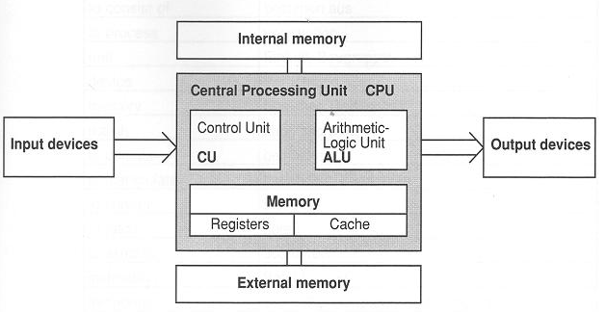
PC Block Diagram
Instructions
&
Data

Slide 8
Computer Organization
Input unit – This is the “receiving” section of the computer. It obtains information (data and computer programs) from input devices and places this information at the disposal of the other units for processing( e.g. keyboards, mouse devices, touch screens, USB devices, etc)
Output unit - This is the “shipping” section of the computer. It takes information that the computer has processed and places it on various output devices to make the information available for use outside the computer.
Most information output from computers today is displayed on screens, printed on paper or used to control other devices.
Computers also can output their information to networks, such as the Internet.

Slide 9
Computer Organization
Memory unit - This is the rapid-access, relatively low-capacity “warehouse” section of the computer.
It stores computer programs while they are being executed.
It retains information that has been entered through the input unit, so that it will be immediately available for processing when needed.
The memory unit also retains processed information until it can be placed on output devices by the output unit.
Information in the memory unit is typically lost when the computer’s power is turned off.

Slide 10
Computer Organization
Arithmetic and logic unit (ALU) – This is the “calculating” section of the computer.
It is responsible for performing integer calculations, such as addition, subtraction, multiplication.
It contains the decision mechanisms that allow the computer, for example, to compare two items from the memory unit to determine whether they are equal, not equal, greater…..
Floating Point Unit (FPU) – This is the “calculating” section of the computer.
It is responsible for performing floating-point calculations, such as addition, subtraction, multiplication, division

Slide 11
Computer Organization
Central processing unit (CPU) - This is the computer’s “administrative” section.
It coordinates and supervises the other sections’ operations.
The CPU tells the input unit when information should be read into the memory unit, tell the ALU when information from the memory unit should be used in calculations and tells the output unit when to send information form the memory unit to certain output devices.
Many of today’s computers have multiple CPUs and, hence, can perform many operations simultaneously—such computers are called multiprocessors.

Slide 12
Computer Organization
Secondary storage unit - This is the computer’s long-term, high-capacity “warehousing” section.
Programs or data not actively being used by the other units normally are placed on secondary storage devices, such as your hard drive, until they are needed, possibly hours, days, months or even years later.
Information in secondary storage takes much longer to access than information in primary memory, but the cost per unit of secondary storage is much less than that of primary memory.
Other secondary storage devices include CDs and DVDs, which can hold hundreds of millions and billions of characters, respectively.

Slide 13
Simplified Block Diagram of Microprocessor
32 bit data bus
DRAM
Register File
Register File
Register File
Register File
X
Y
Instruction
Register File
ALU
+,-,*
AND, OR, XOR
FPU
+,-,*,/
Decoder
Z
Register File
Register File
32 bit data bus
Z = X + Y

Slide 14
PC Architecture
At the heart of the computer is the microprocessor.
This contains several REGISTERS to store data and an ARITHMETIC LOGIC UNIT (ALU) which manipulates data.
It acts as the central processing unit (CPU) of the computer, carrying out a sequence of instructions, called a program.
The program may be stored in memory, as software, or written into the memory from tape or disk.
There are two types of memory.
Read Only Memory (ROM) which stores software permanently.
The software is not lost when the computer is switched off but the stored data cannot be changed.
Store initialization instructions to boot computer up
Random Access Memory (RAM) which can be written to and read from.
The stored data is volatile.
It is lost when the computer is switched off.

Slide 15
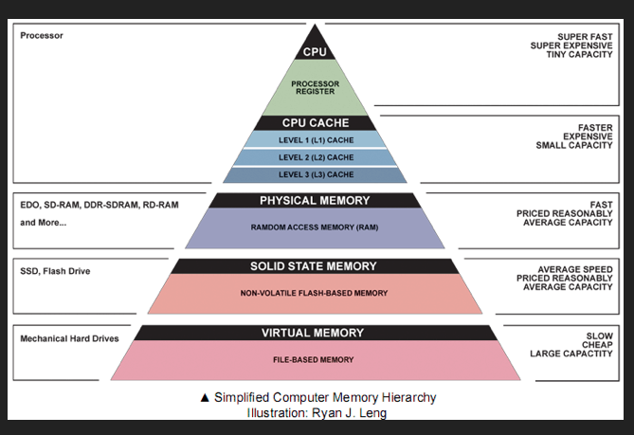
Memory Hierarchy

Slide 16
Operating Systems (OS)
Operating Systems
Software program that make using computers more convenient for users, application developers and system administrators.
Provide services that allow each application to execute safely, efficiently and concurrently (i.e., in parallel) with other applications.
The software that contains the core components of the operating system is called the kernel.
Popular desktop operating systems include Linux, Windows 7 and Mac OS X.
Popular mobile operating systems used in smartphones and tablets include Google’s Android, BlackBerry OS and Apple’s iOS (for its iPhone, iPad and iPod Touch devices).

Slide 17
Common Operating Systems
Windows - A Proprietary Operating System
Microsoft developed the Windows operating system, consisting of a graphical user interface built on top of DOS borrowed from early Apple Macintosh OS(originally developed by Xerox PARC).
Linux—An Open-Source Operating System
1991: Linus Torvalds began developing the Linux kernel
Individuals and companies (i.e. Mozilla, Eclipse, SourceForge, Facebook, etc) contribute their efforts in developing, maintaining and evolving software in exchange for the right to use that software for their own purposes, typically at no charge.

Slide 18
Common Operating Systems
Android – Open Source/Free
Fastest growing mobile and smartphone OS
Based on the Linux kernel and Java.
As of December 2010, more than 300,000 Android smartphones were being activated each day.
UNIX
UNIX was the creation of a group of researchers at Bell Laboratories during the years 1969-1970 (Richie, Thompson, etc)
The desire was to produce a multiuser, multiprocessing OS which would support research in computer science, but which had modest hardware requirements.
The kernel was rewritten in C in 1973.
By 1974 Bell Laboratories Version 5 of the UNIX system was available for a nominal charge with full source code (but, of course, officially unsupported).
Within academic computer science programs it quickly became a popular choice.
The first commercial version was released as System V in 1983 and, in some sense, became the first mature standardized version of UNIX.

Slide 19
Introduction to C/C++
C++ is a powerful high level computer programming language with many features of low-level language that’s appropriate for:
contains a rich instruction set that commands the computer to perform a wide variety of tasks which control the hardware, file I/O, memory management, arithmetic execution, bit fields, etc.
Provides object-oriented programming—today’s key programming methodology for working with objects.
C++ is the object-oriented version of C
Standardized by ANSI (American Nat’l Standards Institute) and ISO (Int’l Organization for Standardization)
Used in more than billion computers, smart phones, handheld devices, etc

Slide 20
Anatomy of C++
C++ is derived from C programming language
Origins – Bell Labs (B. Stroustup – 1980s)
C++ is upward compatible with C and provides
the “high level” & “low level” capabilities of the C programming language
Can maintain close contact with the hardware while capable of performing high level tasks via use of well designed programming constructs
for loops, switch statements, if-else-else if
can manipulate down to the bit level (bitfields)
C++ facilitates data abstraction and encapsulation that hides representations behind abstract interfaces (e.g., the class mechanism and parameterized types)

Slide 21
Anatomy of C++
C++ enforces type checking via function prototypes
Function parameters (arguments) must be specified !!!
Provides type-safe linkage
Decoration of multiple function definitions with different variable signatures so it detects mismatches between function prototypes, definitions and usage
Provides inline function expansion
Built-in dynamic memory management via new and delete operators
Provides default values for function parameters
Operator and function overloading
Arithmetic operators can be applied to objects
Powerful Exception Handling capability

Slide 22
Anatomy of C++
References provide “call-by-reference" parameter passing
Simplifies the interface of functions
Declare constants with the const type qualifier
New bool boolean type
New type-secure extensible I/O interface
Called streams and iostreams
C++ provides a namespace control mechanism for restricting the scope of classes, functions, and global objects
C++ provides enhanced error handling capabilities (e.g., exception handling)

Slide 23
Merits of C++
Availability
Compilers available across wide spectrum of architectures
Portability
Governed by ISO Standards
Efficiency
Language compiles into efficient code because it was designed to work readily with hardware
Rich in operators , pointers, efficient memory management, etc
Correctness
Language catches early as many errors during compilation/linkage
Generality
Language that can be general-purpose so new applications can readily be integrated
Libraries
Interface readily with OS, Graphics & Numerical Packages, Custom Hardware, etc.
Templates
Generic data structures, used on any data type, that are provided with efficient data manipulation functions.

Slide 24
Programming Languages
Computer instructions can be written in various programming languages, namely;
Machine languages
Generally consist of strings of numbers (ultimately reduced to 1s and 0s) that instruct computers to perform their most elementary operations one at a time.
Machine dependent—a particular machine language can be used on only one type of computer.
Assembly languages
English-like abbreviations to represent elementary operations (e.g. fetch, write, move, etc)
Translator programs called assemblers were developed to convert early assembly-language programs to machine language.
High-level languages
Single statements could be written to accomplish substantial # tasks.
Compilers convert high-level language programs into machine language.
grossPay = basePay + overTimePay

Slide 25
Introduction to Object Technology
Objects are essentially reusable software components.
date objects, time objects, shape objects, etc.
Almost any noun can be reasonably represented as a software object in terms of attributes (e.g., name, color and size) and behaviors (e.g., calculating, moving and communicating).
Related to struct declarations
Modular, object-oriented design and implementation approach can make software-development groups much more productive than was possible with earlier popular techniques like “structured programming”

Slide 26
Introduction to Object Technology
Objects are derived from classes and are instantiated when they are declared
Date X;
Person Y;
Objects contain
data (attributes)
member functions (behavior)
Main Characteristics
Encapsulation
Information hiding
Inheritance
Reusability of existing code
Polymorphism
Run-time behavior

Slide 27
C++ Program Development Steps
C++ systems generally consist of three parts:
A program development environment
The C++ language
The C++ Standard Library
Six phases of a C++ Program development
Edit,
Preprocess,
Compile,
Link,
Load,
Execute

Slide 28

C++ Development Steps
Phase 1 – Creating a Program
consists of editing a file with an editor program, normally known simply as an editor.
Type a C++ program (source code) using the editor.
Make any necessary corrections.
Save the program on disk as
XXX.cpp
XXX.cxx
XXX.cc or
XXX.C extensions (note that C is in uppercase) which indicate that a file contains C++ source code.

Slide 29
Editors
Linux editors: vi and emacs (text editors)
Microsoft Windows such as Microsoft Visual C++ (microsoft.com/express) have editors integrated into the programming environment.
Plain text editor, such as Notepad in Windows, to write your C++ code.
Integrated development environments (IDEs)
Provide GUI tools that support the software-development process, including editors for writing and editing programs and debuggers for locating logic errors—errors that cause programs to execute incorrectly.
Microsoft® Visual Studio 2010 Express Edition
Dev C++
NetBeans
Eclipse
CodeLite

Slide 30
C++ Development Steps
Phase 2 – Compiling
Give the command to compile(translate) the program into machine language:
UNIX – command line window
g++ Hello.cpp –o Hello
./Hello
Microsoft command line window
cl Hello.cpp
Hello

Slide 31
C++ Development Steps
Phase 3 – Preprocessor
A preprocessor program executes automatically before the compiler’s translation phase begins
Preprocessor Directives
The C++ preprocessor obeys commands called preprocessor directives, which indicate that certain manipulations are to be performed on the program before compilation.
Advantages of preprocessor directives
Easier to maintain program
Can produce faster running programs
Easier to debug programs
Types of directives
Macro definitions
File Inclusions
Parameterized Macros
Conditional Compilation

Slide 32
C++ Development Steps
Phase 3 – Preprocessor (cont)
MACRO Definitions
#define PI 3.14159 // no semicolons
#define KELVIN 273 // no assignment operators
// #define FREEZE = 32; // wrong !!!!
#include <stdio.h>
int main()
{
float area, Temperature = 100, Radius = 10.;
area = PI*(Radius*Radius);
// same as 3.114159*(Radius*Radius);
Temperature += KELVIN;
return 0;
}
// Constants of the problem should be declared as macro definitions
// Temperature = (farenheight – FREEZE)*(5.0/9.0) 
Being phased out by C++ const definitions

Slide 33
C++ Development Steps
Phase 3 – Preprocessor (cont)
// Predefined Macros
__TIME__
__DATE__
__FILE__
Example:& Macro.cpp.docx
#define N 128 // change in value in the Macro definition acts globally
int main( )
{
int Area;
printf(“Prog name %s Date = %s\n”, __FILE__, __DATE__);
:::::::::::::::::::::::::::::
for(int I = 0; I < N; i++){
::::::::::::
}
for(j = 0; j < N-10; j++) {
::::::::::::
}
}

Slide 34
C++ Development Steps
Phase 3 – Preprocessor (cont)
File Inclusions
Copies header files into program prior to compilation
Reduces amount of code that user needs to include in the development programs
Utilizes existing code provided by the C Programming language
#include <stido.h> // I/O header file
#include <math.h> // math libraries
#include <limits.h> // size of integers
int main(){
float S = 100.0;
double Angle = 1.534;
for (I = 0; I < INT_MAX/16; ++I)
S = S + (float)sqrt(Angle); //formula…????
}

Slide 35
C++ Development Steps
Phase 3 – Preprocessor (cont)
Parameterized Macros - act like functions
#define SQUARE(x) x * x // ➔ (x)*(x) correct
#define MAX(x,y) ( (x)>(y) ? (x): (y) )
#define PI 3.14159
int main()
{
float Area1, Arear2, LargestArea;
int z = 2;
Area1 = PI*SQUARE(z); // same as Area = 3.14159*(z)*(z);
z = z + 10;
Area2 = PI*SQUARE(z+2); // same as Area = 3.14159*(z+2)*(z+2);
LargestArea = MAX(Area1,Area2);
return 0;
}
int main()
{
z = SQUARE(x+2); ➔
z = x+2*x+2 /*! ok */
}

Slide 36
C++ Development Steps
Phase 3 – Preprocessor (cont)
Conditional compilation
instructs compiler whether to include certain blocks of code or not
Easy to manipulate code by only changing inclusion of #define
// #define DEBUG
#define MODEL_X
// program: myProgram.cpp
int main()
{
::::::::
#ifdef DEBUG
printf(….. ); // turns on debug print statements
printf(…..);
#endif
::::::::::
#ifdef MODEL_X
//do calculations according to MODEL_X
#else
// do calculations according to standard model
#endif
}
g++ -D DEBUG myProgram.cpp –o myProgram // include DEBUG into preprocessor

Slide 37
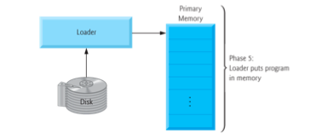
C++ Development Steps
Phase 4 - Linking
The object code produced by the C++ compiler typically contains “holes” due to these missing parts.
A linker links the object code with the code for the missing functions to produce an executable program.
If the program compiles and links correctly, an executable image is produced.
Phase 5 – Loading
Before a program can be executed, it must first be placed in memory. This is done by the loader, which takes the executable image from disk and transfers it to memory.
Additional components
from shared libraries that
support the program are also
loaded.

Slide 38
Preprocessor Conditional Compilation
Conditional compilation is useful when debugging programs.
The C preprocessor can be used to insert debugging code into your program. By appropriate use of
#ifdef - #endif statements,
the debugging code can be enabled or disabled at your discretion (insert
remove
#define DEBUG).
int main (void){
int i, j, k, nread;
nread = scanf ("%d %d %d", &i, &j, &k);
#ifdef DEBUG
fprintf (stderr, "Number of integers read = %i\n",
nread);
fprintf (stderr, "i = %i, j = %i, k = %i\n", i, j, k);
#endif
printf ("%i\n", process (i, j, k));
return 0;
}
#include <stdio.h>
#define DEBUG
int process (int i, int j, int k)
{
return i + j + k;
}
gcc –D DEBUG debug.c (automatically includes DEBUG)

Slide 39
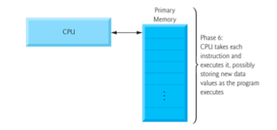
C++ Development Steps
Phase 6 - Execution
Finally, the computer, under the control of its CPU, executes the program one (wide) instruction at a time.
Some modern computer architectures can execute several instructions in parallel.

Slide 40
C++ Development Steps
Phase 7 – Testing & Debugging
Programs execution might not work on the first try.
Runtime Errors – Abort
Zero Divide
Open File Errors
Dynamic Memory Allocation Errors
etc
Erroneous results – Debug
Arithmetic Results do not match manual calculations
Wrong data input/output formats
Print result as char instead of int
Print result as unsigned int instead of signed int
etc
Debugging Tools
Preprocessor Conditional Compilation
Assertions
dbg debugger – Linux/UNIX

Slide 41
C/C++ Application on LINUX
Command Line Window
yedidiah-solowiejczyks-macbook:~ yedidiahsolowiejczyk$ ssh -l ys44 i5.nyu.edu
~~~~~~~~~~~~~~~~~~~~~~~~~~~~~~~~~~~~~~~~~~~~~~~~~~~~~~~~~~~~~~~~~~~~~~~~~~~~~~
WARNING: UNAUTHORIZED PERSONS ........ DO NOT PROCEED
~~~~~~~ ~~~~~~~~~~~~~~~~~~~~ ~~~~~~~~~~~~~~
This computer system is operated by New York University (NYU) and may be
accessed only by authorized users. Authorized users are granted specific,
limited privileges in their use of the system. The data and programs
in this system may not be accessed, copied, modified, or disclosed without
::::::::::::::::::::::::::::::::::::::::::::::::::
monitored and recorded, and anyone accessing this system consents to such
monitoring and recording. Questions regarding this access policy should be
directed (by e-mail) to AskITS@nyu.edu or (by phone) to 212-998-3333.
Questions on other topics should be directed to COMMENT (by email) or to
212-998-3333 by phone.
~~~~~~~~~~~~~~~~~~~~~~~~~~~~~~~~~~~~~~~~~~~~~~~~~~~~~~~~~~~~~~~~~~~~~~~~~~~~~~
Password: XXXXXXX
Last login: Sat Dec 17 13:03:57 2011 from cpe-69-204-232-
******* Access to NYU computers is restricted to authorized users and
approved educational and research purposes only.
------------- Message last updated: 8 January 2008 -------------
Welcome to i5.nyu.edu
Please report problems to "comment@i5.nyu.edu"
Notes:
Please see http://i5.nyu.edu/ for solutions to other common
problems.
------------------------------------------------------------------
You have mail.
ys44@i5$ TERM=ansi
ys44@i5$ export $TERM
ys44@i5$ /usr/bin/csh
ys44@i5$ set history=25
/* assert example */
#include <stdio.h>
#include <assert.h>
void print_number(int* myInt) {
assert (myInt!=NULL);
printf ("%d\n",*myInt);
}
int main () {
int a=10;
int * b = NULL;
int * c = NULL;
b=&a;
print_number (b);
print_number (c); //terminate
return 0;
}

Slide 42
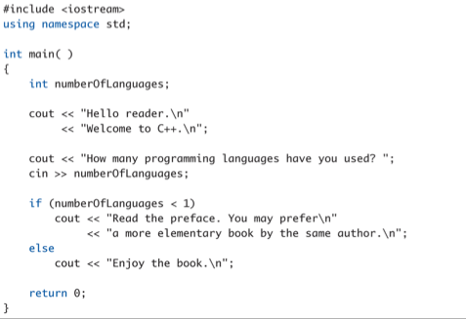
C++ Application on LINUX
Libraries for I/O
/ /Variable declaration
Location of cin/cout
//program ran OK
Input/output functions

Slide 43
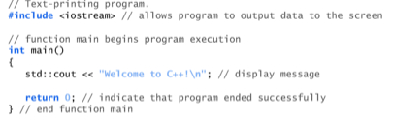
C++ Program Demo
// Single line comment
Printing a Line of Text
// Comments ignored by compiler – no object code generated.
#include <iostream> notifies preprocessor to include the contents of the input/output stream header file <iostream> - otherwise compile errors
Every program contains a int main( ) – function to the OS
Every program returns an int to OS ( 0 – OK; otherwise error #)
int is a reserve word – cannot be used as a variable name
{ :::: } ➔ encloses the code of the program
std::cout - standard output stream object
<< operator – insertion stream operator
; - terminates a statement (instruction)
\n – “newline” escape character
Preprocessor directive
// Indent for clarity

Slide 44
C++ Identifiers/Variables
C++ Identifiers
Name of a variable (or other item defined in program)
A valid identifier is a sequence of one or more letters, digits or underscore characters (e.g. x, x1, x2, ABCD1234, RATE, bigBonus, _hours).
Neither spaces nor punctuation marks or symbols can be part of an identifier (e.g. data-1, X.Y, 3X, 12)  … taboo taboo!
Only letters, digits and single underscore characters are valid.
They can also begin with an underline character (_ )
Keywords/reserved words vs. Identifiers
Case-sensitivity and validity of identifiers (rate != Rate != RATE)
Meaningful names!
C++ Variables
A memory location to store data declared in a program
Variable identifiers usually have to begin with a letter.
In no case can they begin with a digit. 
Must declare all data before use in program
Cannot match any keyword of the C++ language nor your compiler's specific ones, which are reserved keywords.
Logical | Address
bigBone | 0X1200
windRate | 0X1204

Slide 45


Keywords
There are 32 words defined as keywords in C.
These have predefined uses and cannot be used for any other purpose in a C program
They are used by the compiler as an aid to compiling the program.
They are always written in lower case (case sensitive).
Additional C++ Programming Language Keywords (30)
CourseFocus

Slide 46
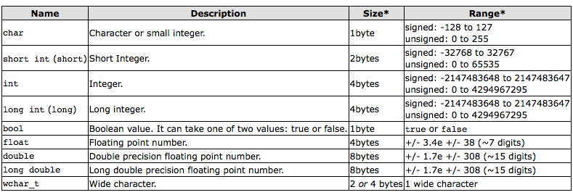
Fundamental Data Types
When programming, we store the variables in our computer's memory, but the computer has to know what kind of data we want to store in them, since it is not going to occupy the same amount of memory to store a simple number than to store a single letter or a large number, and they are not going to be interpreted the same way.
The data type modifiers alters the meaning of base type, namely :
signed, unsigned, long, short

Slide 47
Declarations vs. Definitions
Declaring variables
Ask the computer to allocate memory for a specific data type
int age; // garbage data
int x, y;
float z;
char c;
bool/_Bool flag; (<stdbool.h>
Defining Variables
int Age = 5; // allocate memory & initialize
char c = 65; // ‘A’ - OK
bool flag = 0; // 0/1 (true/false)
Int Rate(5); // C++ init method
float X(1.523456); // C++ init method
int Z = Rate*5; // Expression – ok
int U = 2.345; // possible compile error
Name| Mem Addr | #byes
int x | 0X100100 | 4
int y | 0X100104 | 4
float z | 0X100108 | 4
::::::::::::::::::::
char c | 0X100200 | 1

Slide 48
Literals
Literals
refer to fixed, human-readable values that cannot be altered by the program
Examples:
2 // Literal constant int
5.75 // Literal constant by default double
123.32F // Literal float
35000L // long int
1000U // unsigned int
123223UL // unsigned long int
123.23L // long double
"Z" // Literal constant char
"Hello World" // Literal constant string
Cannot change values during execution

Slide 49
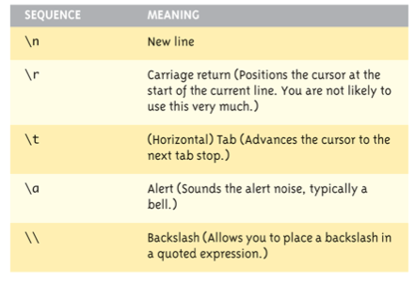
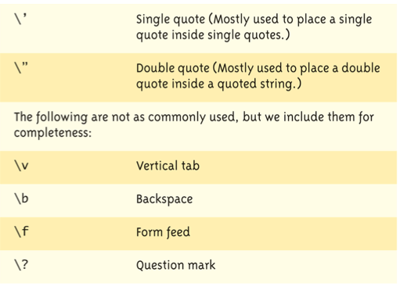
Escape Sequences
"Extend" character set
Backslash ( \ ) preceding a character
Instructs compiler: a special "escape character" is coming
Following character treated as "escape sequence char"

Slide 50
Constants
Naming your constants
Literal constants are "OK", but provide little meaning
e.g., seeing 24 in a program, tells nothing about what it represents
Use named constants instead
Meaningful name to represent data const int NUMBER_OF_STUDENTS = 24;
Called a "declared constant" or "named constant"
Now use it’s name wherever needed in program
Added benefit: changes to value result in one fix

Slide 51
Assigning Data
Initializing data in declaration statement
Otherwise results in "undefined" if you don’t!
int myValue ; // undefined (garbage) value
int hisValue = 10; // defined values
char C = ‘A’; // single quote
float X = 1.23F; //assign to literal float
Assigning data during execution
Lvalues (left-side) & Rvalues (right-side)
Lvalues must be variables
Rvalues can be any expression
Example: distance = rate * time; Lvalue: "distance" Rvalue: "rate * time"

Slide 52
Data Assignment Rules
Compatibility of Data Assignments
Type mismatches
General Rule: Cannot place value of one type into variable of another type
int Var = 2.99; // 2 is assigned to Var!
Only integer part "fits", so that’s all that goes
Called "implicit" or "automatic type conversion"
Promotion Conventions:
Mixed Arithmetic requires:
char ➔ int ➔ long ➔
int ➔ float ➔ double ➔ long double
Microprocessor
FPU
ALU

Slide 53
Naming Conventions
Variables:
Meaningful Name:
int day_of_week; /* Day_of_Week */
float salary; /* Salary – to the penny */
int employeeSalary; // employee salary
ANSI C Standard allows variable names up to 31 characters!
Valid Names Invalid Names
wiggles $Toast
fun1 1fun
Hot_Tub Hot-Tub
_kcal k-cal

Slide 54
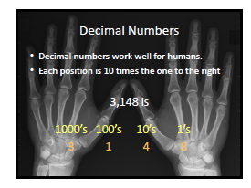
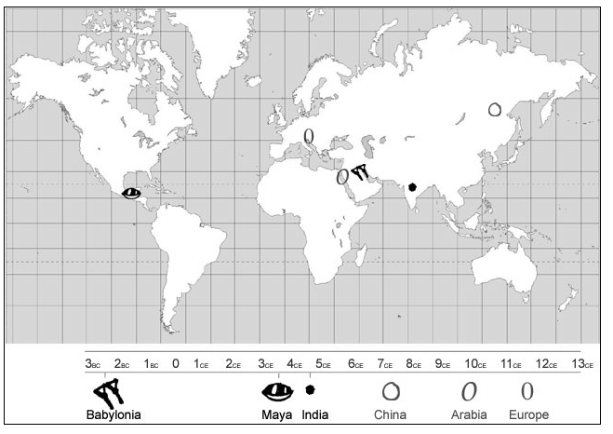
Decimal Based Number System
0, 1, 2, 3, 4, 5, 6, 7, 8, 9
10, 11, 12, 13, 14, 15, 16, 17, 18, 19,
20, …………………………………………., 99
Where does it come from ….. ??????
The first recorded zero is attributed to the
Babylonians in the 3rd century BC.

Slide 55
Integers
Computers are based on binary-base system
Based on the fact that electronic logic can only be ON(1)/OFF(0)
Representing Short Integers (16 bits)
* * 2⁸
2¹⁵
2⁷ 2⁶ 2⁵ 2⁴ 2³ 2² 2¹ 2⁰
2 Bytes (16 bits)
0 0 0 0 0 0 0 0
1 0 1 1 0 1 0 1
1*2⁷ + 0*2⁶ + 1*2⁵ + 1*2⁴ + 0*2³ + 1*2² + 0*2¹ + 1*2⁰
128 + 0 + 32 + 16 + 0 + 4 + 0 + 1 ➔ 181

Slide 56
Integer Data Representation ^{β}
Binary
00101111 ➔ 47 (32 + 8 + 4 + 2 + 1) decimal
Octal (0 – 7)
group 3 bits at a time – 8 based system
00101111 - binary
057 octal (leading zero conveys Octal nature)
Hex (0-9,A,B,C,D,E,F)
group 4 bits at time – 16 based system
00101111 - binary
0X2F (leading 0X conveys Hex nature)
Β – Appendix D - Deitel

Slide 57
Negative Integers
Positive Integers
Example:
7 = 0000 0111(unsigned)
Negative numbers representation
Need to encode negative numbers
-1 = 1111 1111 ????
Numbers are made negative by
taking 1's complement
adding 1
Example:
0000 0001
1111 1110 /* one’s complement */
+ 1
--------------
1111 1111
Negative Integers

Slide 58
Floating Point
Floating point numbers ➔ Real Numbers
What is a Real number (fractional number )
15.3
333.333
0.33333
18.0
Real numbers are expressed as fractions of number 2^{N}
12.0 = (3/4) * 16.
= (3/4) * 2⁴ ⁼ (1/2 + 1/4) * 2⁴
Figuring out how to express a number as a floating point number is not easy!
Usually hardware converts numbers to Floating Point
s | exponent | mantissa (fraction)
0/1| 8 bits | 23 bits
s | 2^{N} | ½ | ¼ | 1/8 | 1/16 | ************** ½⁻²³

Slide 59

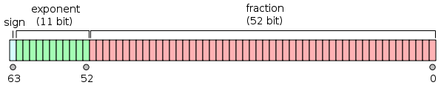
Floating Point
Single Precision
½⁻²³ = 10⁻⁷ (best precision)
Double Precision
½⁻⁵² = 10⁻¹⁶ (best precision)
½ | ¼ | **************************** ½⁻²³
½ | ¼ | ***************************************** ½⁻⁵²

Slide 60
Floating Point
include <iostream>
#include <stdio.h>
using namespace std;
union Float{
float X;
char C[4];
};
int main( ){
union Float FP;
cout << "Enter a floating point number: ";
cin >> FP.X;
printf("FP.X = %8.6f\n", FP.X);
printf("FP.C = %6#X %6#X %6#X %6#X\n", FP.C[0], FP.C[1], FP.C[2], FP.C[3]);
return 0;
}
Enter a floating point number: 0.875
FP1.X = 0.875000
FP1.C = 0X3F 0X60 0 0
0011 1111 0110 0000 0000 0000
s← exp →← mantissa -----→
126 ½ ¼ ⅛ 00 ……………...0
0.875 = (0.5 + 0.25 + 0.125) x 2⁰
½ IEEE
implied
Enter a floating point number: .375
FP2.X = 0.75000
FP2.C = 0X3F 0X40 0 0
0011 1111 0100 0000 0000 0000
FP3.X = FP1.X * FP2.X;
FP3.X = 0.656250
FP3.C = 0X3F 0X28 0 0
0011 1111 0010 1000 0000 000

Slide 61
Arithmetic Precision
Precision of Calculations
VERY important consideration!
Expressions in C++ might not evaluate as you’d "expect"!
"Highest-order operand" determines type of arithmetic "precision" performed
Common pitfall!
For large matrix applications (N >100) , M[N][N]
Use double precision floating point
Otherwise unstable solutions…….
Precision control belongs to the “Numerical Analysis” discipline

Slide 62
Arithmetic Precision Examples
Examples:
int X = 19 / 5 evaluates to 3 in C++!
Both operands are integers
Integer division is performed!
double y = 19.0 / 5 equals 3.8 in C++!
Highest-order operand is "double type"
Double "precision" division is performed!
19.0/5.0 = 3.8
int intVar1 = 1;
int intVar2 = 2;
intVar1 / intVar2;
Performs integer division!
Result: 0!

Slide 63
Floating Point Accuracy
Accuracy and Floating Point Operations
In a computer, real numbers are represented with finite precision.
While in most cases it is safe to assume that the result of an arithmetical operation done on your computer is correct, it is important to remember that this finite-precision representation leads to unavoidable errors, especially when floating-point numbers, which are digital approximations to real numbers, are involved.
Banks do calculations separate on $ and ¢ !!!!
Floating-point numbers must be made to fit in a space (a string of binary digits in a computer's memory register) that can only hold an integer and a scaling factor.
Floating-point numbers are represented by strings of a limited number of bits, but represent numbers much larger or smaller than that number of digits can be made to express.
In other words, floating-point values are finite-precision approximations of infinitely precise numbers.
Generally speaking, every floating-point arithmetic operation introduces an error at least equal to the machine accuracy into the result. This error is known as round off error.
Example 1.0/3.0 ➔ 0.333333…..3333 (doubles - only 16 bits precision)

Slide 64
Characters
Characters
necessary in a programming language in order to express character variables, phrases (strings), etc
characters are encoded as 1 byte(8 bits) - binary patterns
1 byte provides for 256 possible combinations of 1’s and 0’s
arbitrary encoding of alphabet is available in the ASCII (American Std Code for Info Interchange)
ASCII character Set really contains only 128 different symbols
lower case a - z (97 - 122) upper case A - Z(65 - 90)
digits 0 - 9 (48 - 57) blank space (32)
Escape sequence punctuation marks
new line \n (10) - ! (33)
tab \t (9)
arithmetic symbols
* (42)
Character arithmetic is possible: C = B-A; //one
char A = ‘A’ {65}
char B = ‘B’ {66}

Slide 65
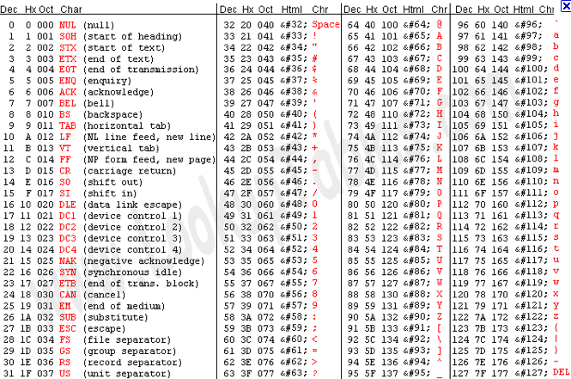
ASCII Table&
& Appendix B - Deitel

Slide 66
Arithmetic Operators
An operator is a symbol that tells the compiler to perform a specific mathematical or logical manipulation
Arithmetic Operators
*, +, -, /, %, ++, --, type casting
Assignment operators
=, +=, -=, *=, /=, %
Microprocessor
+, -, *, /
FPU
ALU

Slide 67
Arithmetic Operations
Addition
Subtraction
Example:
7 + 13 = ????
7 = 00000111
+
13 = 00001101
----------------------
20 = 00010100
= 16 + 4
Example:
25 - 7 = 25 + ( - 7) = ???
25 = 1 1 0 0 1
7 = 0 0 1 1 1
1 1 0 0 0 ==> 1’s complement
+ 1
1 1 0 0 1 ==> - 7
18 = 1 0 0 1 0 (throw out carry bit)
= 16 + 2

Slide 68
Arithmetic Operators
Arithmetic Operators
Unary (one operand)
+X ➔ 0 + X
-X ➔ 0 - X
Binary (two operands)
Addition
X + Y
Subtraction
X – Y
Multiplication
X * Y
Division
X / Y
Mod (remainder)
X % Y

Slide 69
Arithmetic Operators
Assignment Operators
Assignment Operator
X = Y
Copy Y value to X value
Arithmetic/Assignment (Short Hand Notation)
X += 2;
X = X + 2;
X -= 2;
X = X – 2
X *= 2;
X = X * 2;
X /= 2;
X = X / 2;
X %= 2;
X = X % 2;

Slide 70
Arithmetic Operators
Short Hand Notation
C++ (post-increment)
C = C + 1;
C-- (post-decrement)
C = C - 1;
++C (pre-increment)
C = C + 1;
--C (pre-decrement)
C = C - 1;
Example
int y, x = 10; //declare variables
y = x++; //post-increment
y ➔ 10 & x ➔ 11;
x = 10; // re-init x to be 10
y = ++x; // pre-increment
y ➔ 11 & x ➔11

Slide 71
Arithmetic Operations
Addition with Decimal-based system
The hardware logic within a processor can readily implement summation
Subtraction with Decimal-based system
Would be nice if we could implement subtraction using the adding properties of hardware …….
Recall that
x -y ==> x + (-y)
Need to change the y quantity from its value to its negative value and them we can proceed to do addition
How do we do it….?
Recipe
1’s complement of subtrahend
add 1
proceed to a normal addition

Slide 72
Arithmetic Operations
Arithmetic in Binary Based-System
same mechanics as in decimal-based system
Addition
Decimal-based system
1 1 1 1 ==> carry bits
294087
+134998
429085
Binary-based system
1 1 1 1 1 1 - carry
175 ==> 1 0 1 0 1 1 1 1
57 ==> 0 0 1 1 1 0 0 1
232 ==> 1 1 1 0 1 0 0 0

Slide 73
Arithmetic Operations
Multiplication with binary numbers
Hardware can do a fast multiply because we are multiplying by 1 or 0
Example
7 = 0 1 1 1
5 = 0 1 0 1
--------------------
0 1 1 1
0 1 1 1 0
1 0 0 0 1 1 ➔ 32 + 3 = 35
Multiplication with floating point numbers
Number1 = s.2^{N} x fraction1
Number2 = s.2^{M} x fraction2
Result = Number1 x Number 2 = s. 2^{N+M} x (fraction1 x fraction2)
Result = s. 2^{N+M} x fraction3 (truncated to 23 bits)
Still accurate to 10⁻⁷

Slide 74
Arithmetic Operations
Addition with floating point numbers
Number1 = s.2^{N} x fraction1
Number2 = s.2^{M} x fraction2 // assume N > M
Result = Number1 + Number 2
= s. 2^{M} x (2^{N-M} x fraction1 + fraction2)
Result = s. 2^{M} x fraction3 (truncated to 23 bits)
Division with floating point numbers ~ more complex
Newton-Raphson Algorithm
can calculate the reciprocal of a number
use of multiplication and subtraction
needs a seed table as first guess
iterative solution (repeat)
If seed table has mistake
divisions comes out wrong
10 years ago Intel had such a fiasco
$400 million loss
A bit more inaccurate
Int division ➔ no rounding
20/6 ➔ 3

Slide 75
Type Casting
Casting Variables
Changing the format representation of a data type to different data type
int X = (int)5.83;
float w = (float)3;
int Z = static_cast<int>(Rate*Time);
int KELVIN = const_cast <int>273; //cannot be changed
int U = dynamic_cast<int>100.3;
int W = 5.99999; //automatic casting to 5

Slide 76
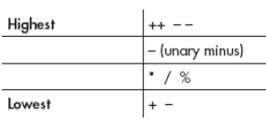
Operator Precedence
Arithmetic Expressions
Z = X + Y*W; //multiple arithmetic operations
Operators on the same precedence level are evaluated by the compiler from left to right
Operator Precedence
When expression contains several operators, how does compiler compute the expression
Z = X + Y*W; // Y*X first calculated – higher precedence
Z = X + (Y*W); // (Y*W) first calculated
Z = -X * Y –W; // (X ➔ -X) ; (-X*Y)
Z = (-X) * Y – (W);
Assignment
X = Y * Z + W
Precedence Table (Fig. 2.14 of Textbook)
Associative Table (left to right or right to left)

Slide 77
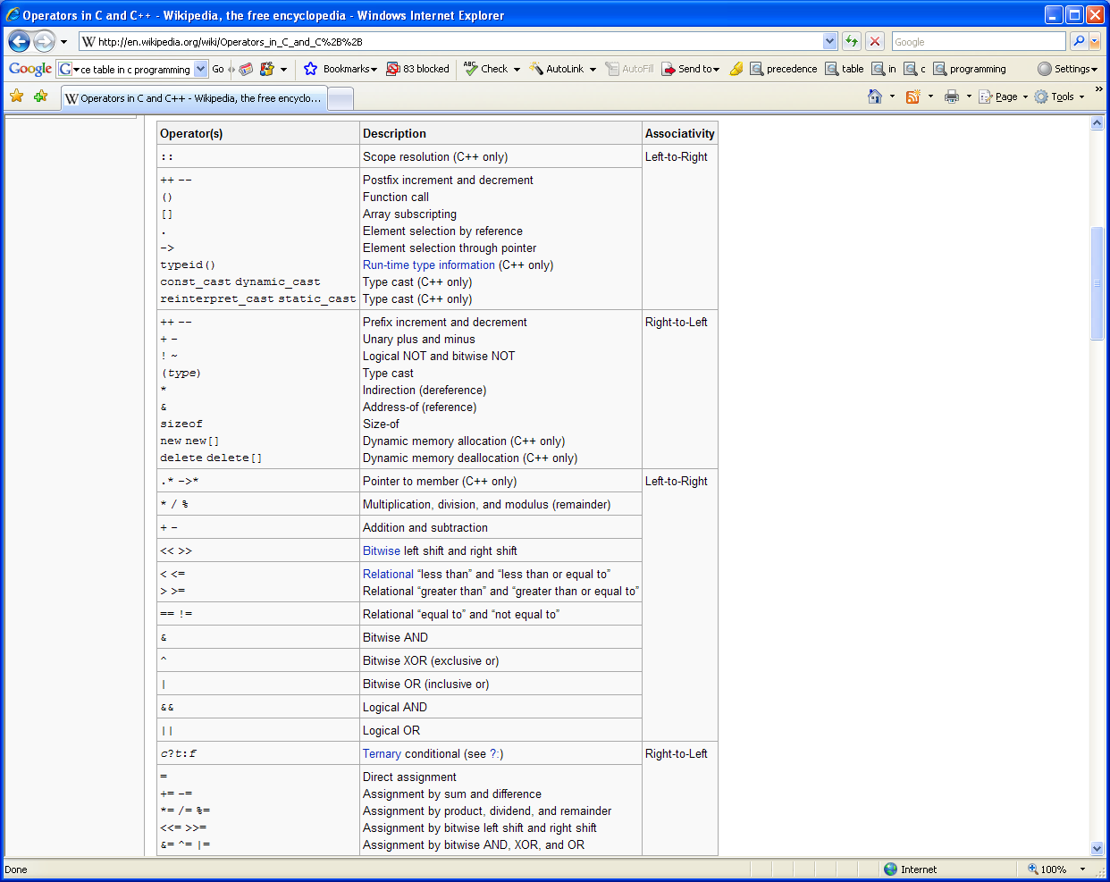
Precedence Table
rules of operator precedence are generally the same as those followed in algebra.

Slide 78
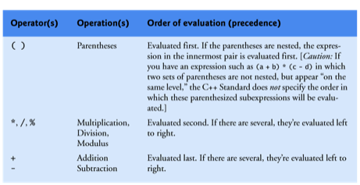
Precedence Rules
As in algebra, it’s acceptable to place unnecessary parentheses in an expression to make the expression clearer.

Slide 79
Precedence Rules
Example:
Computing a 2nd order polynomial
f(X) = 2*X² + 3*X + 7
f(X=5) = (2*5)*5 + 3*5 + 7
Temp1 = (5*5) = 10
Temp1 = Temp1*5 = 50
Temp2 = 3*5 = 15
Temp3 = Temp1 + Temp2 = 65
Temp3 = Temp3 + 7 = 72

Slide 80
Relational Operators
Equality Operators
== equal to
!= not equal to
Example:
X == Y ➔ Outcome Equality expression (T/F)
The outcome of any logical expression is (T/F)
RELATIONAL OPERATORS:
< less than
> greater than
>= greater or equal to
<= less or equal to
Example:
X < Y ➔ Outcome Relational expression (T/F)

Slide 81
Relational Operators
Examples:
Temp = (5 < 7);
Temp ==> 1 (True)
int x = 5;
float y = 4.5;
Temp = ( y > x );
Temp ==> 0 (True - mixed arithmetic allowed )
int x = 5;
int y = 6;
Temp = ( x != y);
Temp ➔ True
Avoid common error !!!!
Temp = ( i = 5) ==> always true (5)
Temp = ( i = 0) ==> always false (0)

Slide 82
Relational Operators
Precedence
Temp = i + j < k -1
Temp = ( i + j ) < ( k -1 ) ➔ precedence of < is lower than + or -
* , / , %
+ , -
< >, <= ,>=
==, !=
Relational operators associate from left to right
Temp = x != y == z
= ( x != y ) == z
left right
Temp = j < k < m;
= ( j < k ) < m
left right
Temp = j == k != m
= (j == k) != m
left right
} Precedence

Slide 83
Flow Control & Relational Operators
The if statement allows a program to take alternative action based on whether a condition is true or false.
If the condition is true, the statement in the body of the if statement is executed.
If the condition is false, the body statement is not executed.
Conditions in if statements can be formed by using the equality operators and relational operators
Examples:
if(number1 == number2) //if true
cout << “Numbers are equal “ << endl;
if(number1 != number2)
cout << “Numbers are not equal “ << endl;
if(number1 > number2)
cout << “number1 is greater than number2 “ << endl;

Slide 84

C++ Program: Infinite Series
D
// To demonstrate Gregory’s Series
#include <iostream>
#define PI_Quarter (3.14159/4.0)
Int main( )
{
int N;
int sign = 1;
for(int I = 0; I < N; i +=2){
sign = sign*(-1)
Sum = Sum + (1.0 /(float)I )*sign
cout << Sum << “ “ << PI_Quater << endl;
}
return 0;
}

Slide 85
Debugging Programs with gdb#
gdb is a powerful interactive debugger that is frequently used to debug programs compiled with GNU’s gcc/g++ compiler.
It allows you to run your program, stop at a predetermined location, display and/or set variables, and continue execution.
It allows you to trace your program’s execution and even execute it one line at a time.
gdb also has a facility for determining where core dumps occur.
A core dump occurs due to some abnormal event, possibly division by zero or attempts to access past the end of an array.
This results in the creation of a file named core that contains a snapshot of the contents of the process’s memory at the time it terminated.
# see Chapter 18 of C Programming – Stephen Kochan

Slide 86
Debugging Programs with gdb
//program GDB.cpp
#include <stdio.h>
#include <iostream>
using namespace std;
int main (void)
{
const int data[5] = {1, 2, 3, 4, 5};
int i, sum;
for (i = 0; i >= 0; ++i)
sum += data[i];
printf ("sum = %i\n", sum);
return 0;
}
i5% g++ -g GDB.cpp -o GDB
i5% ./GDB
Segmentation Fault (core dumped)
A segmentation fault (often shortened to segfault),
bus error or access violation is generally an
attempt to access memory that the CPU cannot
physically address.
It occurs when the hardware notifies an operating
system about a memory access violation.
The OS kernel then sends a signal to the process
which caused the exception.
By default, the process receiving the signal
dumps core and terminates.

Slide 87
Debugging Programs with gdb
i5% gdb GDB
GNU gdb 6.6
Copyright (C) 2006 Free Software Foundation, Inc.
GDB is free software, covered by the GNU General Public License, and you are
welcome to change it and/or distribute copies of it under certain conditions.
Type "show copying" to see the conditions.
There is absolutely no warranty for GDB. Type "show warranty" for details.
This GDB was configured as "sparc-sun-solaris2.10"...
(gdb) run
Starting program: /home1/y/ys44/GDB
warning: Temporarily disabling breakpoints for unloaded shared library "/usr/lib/ld.so.1”
Program received signal SIGSEGV, Segmentation fault.
0x00010bec in main () at GDB.cpp:11
11 sum += data[i];
As you can see from the previous display, the program tried to perform an invalid
memory access at line 11 in your program

Slide 88
Debugging Programs with gdb
(gdb) list 11
6 int main (void)
7 {
8 const int data[5] = {1, 2, 3, 4, 5};
9 int i, sum;
10 for (i = 0; i >= 0; ++i)
11 sum += data[i];
12 printf ("sum = %i\n", sum);
13 return 0;
}
(gdb) print sum
$1 = 541450035 // This value for sum is obviously out of whack
(gdb) print i
$2 = 232 // You have only five elements in the array and you tried to access
// the 233rd element when the error occurred.

Slide 89
Debugging Programs with gdb
(gdb) print data //Show the contents of the data array
$3 = {1, 2, 3, 4, 5}
(gdb) print data[0] //Show the value of the first element
$4 = 1
(gdb) quit
The program is running. Exit anyway? (y or n) y
Y
(gdb) list 10,15 //List lines 10 through 15
10 for (i = 0; i >= 0; ++i)
11 sum += data[i];
12 printf ("sum = %i\n", sum);
13 return 0;
}
(gdb) list foo //Display lines for function foo

Slide 90
Debugging Programs with gdb
Inserting Breakpoints
A breakpoint can be set at any line in your program by simply specifying the line
number to the command.
If you specify a line number but no function or filename, the breakpoint is set on that line in the current file;
if you specify a function, the breakpoint is set on the first executable line in that function.
(gdb) break 12 Set breakpoint on line 12
Breakpoint 1 at 0x1da4: file mod1.c, line 12.
(gdb) break main Set breakpoint at start of main
Breakpoint 2 at 0x1d6c: file mod1.c, line 3.
(gdb) break mod2.c:foo Breakpoint in function foo in file mod2.c
Breakpoint 3 at 0x1dd8: file mod2.c, line 4.

Slide 91
Debugging Programs with gdb
Single Stepping
Another useful command for controlling program execution is the step command, which can be abbreviated as s.
This command single steps your program, meaning that one line of C code in your program is executed for each step command you enter.
If you follow the step command with a number, then that many lines are executed.
Note that a line might contain several C statements; however, gdb is line oriented, and executes all statements on a line as a single step.
If a statement spans several lines, single stepping the first line of the statement causes all the lines of the statement to be executed.

Slide 92
Debugging Programs with gdb
Getting Help with gdb Commands
You can use the built-in help command to get information about various commands or types of commands (called classes by gdb).
The command help, without any arguments, lists all the available classes:
(gdb) help
List of classes of commands:
aliases -- Aliases of other commands
breakpoints -- Making program stop at certain points
data -- Examining data
files -- Specifying and examining files
internals -- Maintenance commands
obscure -- Obscure features
running -- Running the program
stack -- Examining the stack
status -- Status inquiries
support -- Support facilities
tracepoints -- Tracing of program execution without stopping the program
user-defined -- User-defined commands

Slide 93
Debugging Programs with gdb
(gdb) help break
Set breakpoint at specified line or function.
break [LOCATION] [thread THREADNUM] [if CONDITION]
LOCATION may be a line number, function name, or "*" and an address.
If a line number is specified, break at start of code for that line.
If a function is specified, break at start of code for that function.
If an address is specified, break at that exact address.
With no LOCATION, uses current execution address of selected stack frame.
This is useful for breaking on return to a stack frame.
THREADNUM is the number from "info threads".
CONDITION is a boolean expression.
Multiple breakpoints at one place are permitted, and useful if conditional.
Do "help breakpoints" for info on other commands dealing with breakpoints.

Slide 94
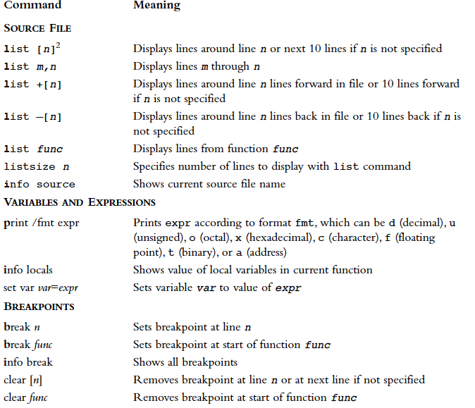
gdb commands

Slide 95
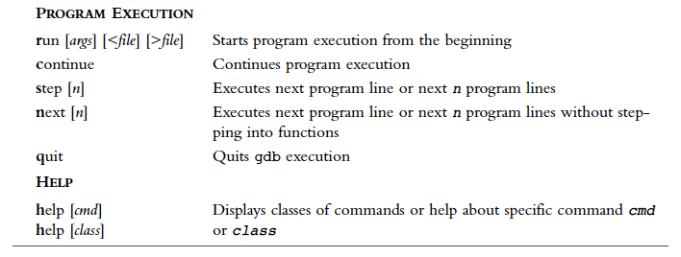
gdb commands

