Slide 1
C++ Part I (INFO1-CE9264) New York University School of Continuous Studies Fall 2014
Yedidiah Solowiejczyk
Class Notes # 6

Slide 2
Synopsis
Review of Classes
Defining Classes
Member Functions
Encapsulation
Public and Private Members
Accessor and Mutator Functions
Structures vs. Classes
Constructors
Constructor Definitions
Constructors with No Arguments
Explicit Constructor Calls
Default Constructor
Initializater section
Class Type Member Variables
Destructors
Destructor Definition
Destructor with No Arguments
Copy constructors
Copy Constructor Definition
More Tools
The const Parameter Modifier
Pitfall: Inconsistent Use of const
Inline Functions
Static Members
Nested and Local Class Definitions
Vectors
A Preview of the STL
Vector Basics
Pitfall: Using Square Brackets beyond the Vector Size
Tip: Vector Assignment Is Well Behaved
Efficiency Issues
Summary
2

Slide 3
Classes in C++
A class is a template(“cookie cutter”) that defines the form of an object (data type).
A class specifies both code and data.
C++ uses a class specification to construct objects.
Objects are instances of a class.
Thus, a class is essentially a set of plans that specify how to build an object.
It is important to be clear on one issue:
a class is a logical abstraction.
It is not an object until an object of that class has been created that a physical representation of that class exists in memory.

Slide 4
Classes in C++
template
Classes in C++
Collection of variables under a single name (name tag)
Variables have different names and can be of different types
Convenient way of grouping several pieces (members) of related information together
Functions that manipulate data members are declared internally in the structure
Member functions are defined via scoping (::) operator
All member functions and data are private by default – public by choice (access control)
Access data members and member functions via dot (.) operator
Access to data implicitly uses this-> pointer
Need not use typedefs to declare new type variables
Interface Unit Test Driver Implementation
Access member function via dot operator
class student {
char name[32];
int id;
int grade:
public:
//member functions
void setData(char *, int, int)
int getGrade ( );
:::::::::::::::::
etc
};
int main( )
{
student X;
X.setData(“Joe Doe” , 12345, 98);
::::::::::::::::::::::::::::
return 0;
}
student::setData(
char*Name,
int Id,
int Grade)
{ strcpy(name,Name);
id = Id
grade = Grade;
}

Slide 5
Class Properties
Class is full-fledged type!
Just like data types int, double, char, etc.
Class can contain variables of various types
int, float, char, double, ….. , object
Parameters of a class type are passed
Pass-by-value
Pass-by-reference
Pass-by-pointer
Can use class type like any other type!

Slide 6
Principles of OOP
Information Hiding
Details of how operations work not known to "user" of class
Data Abstraction
Details of how data is manipulated within ADT/class not known to user
Encapsulation
In OOP it is used to refer to one of two related but distinct notions:
A language mechanism for restricting access to some of the object's components.
A language construct that facilitates the bundling of data with the methods (or other functions) operating on that data.

Slide 7
C++ Access Control
Access Specifiers
public:
Means all member declarations that follow are available to everyone
For structures – default property
For classes – choice property
private:
Means that no one can access that member except the member functions of the object itself
For structures – choice property
For classes – default property
protected:
Acts just like private and is used with inheritance

Slide 8
Access Specifiers
struct student{
//public: //optional
//member functions
void setData(char *,
int id,
int grade);
int getGrade( );
etc
private: //mandatory
char name[32];
int id;
int grade;
};
class student{
//private: //optional
//protected:
char name[32];
int id;
int grade;
public: //mandatory
//member functions
void setData(char *,
int id,
int grade);
int getGrade( );
etc
};

Slide 9
Access Specifiers
Example
class student{
private: //default - optional access specifier
char
int id;
int grade;
public: //mandatory access specifier
void setData(char *, int, int);
int getGrade( ){return grade;}
int getId( ){return Id;}
char * getName( )
};

Slide 10
Public vs. Private Members
Data is almost always designated private in definition!
Upholds principles of OOP (“information hiding”)
Hides data from user
Allow manipulation only via operations
Which are member functions
Public items (usually member functions) are "user-accessible"

Slide 11
Private Member Functions???
Why would a class have a private member function?
Clearly it is not accessible to the outside world…!
Example:
class FinInst {
char name[32];
int id;
float principal;
int rate;
int day, month, year;
int fday, fmonth, fyear;
int NumDays(int fDay,
int fMonth, fYear);
public: //member functions
void setData ( …..)
float getROI(int fDay,
int fMonth,
int fYear);
::::::::::::::::
};
int FinInst::NumDays( int Day,
int Month, int Year)
{
/*calculate #days between day of purchase and day of sale – skip leap days */
}
float FinInst::ROI(int fDay, int fMonth, int fYear)
{
:::::::::::::::::::::::::
int totDays=NumDays( fDay, fMonth, fYear)
:::::
}
Ancillary function & other member functions

Slide 12
Struct & Class Scope Rules
Member variables and functions have unique scope properties in structs and classes
class student{
char name[32];
int id;
int grade;
public:
void setId(int Id);
etc
};
void student::setId(int Id)
{
id = Id;
}
class intern {
char name[32];
int id;
int grade;
public:
void setId(int Id);
etc
};
void intern::setId(int Id)
{
id = Id+1000;
}
int main( )
{
int Id = 10;
student X;
intern Y;
//No Name Conflict
X.setId(Id);
Y.setId(Id);
}
setId(Id) function calls are decoupled

Slide 13
Dot & Scope Resolution Operator
Used to specify "of what thing" they are members
Dot (.) operator:
Specifies member of particular (X) object
X.getGrade( ); // object specific
Scope resolution (::) operator:
Instructs compiler "what class" member is from
Student::getGrade( ){return grade;} //class specific

Slide 14
Accessor and Mutator Functions
Accessor member functions
"get member functions”
Allow object to read data
Simple retrieval of member data
Mutator member functions
“set member functions”
Allow object to change data based application
class student{
public: //member function
void setData(char *,
int id, int grade);
int getGrade( );
int getId( ){return id;} //inline
char * getName( );
private:
char name[32];
int id;
int grade;
};

Slide 15
this -> pointer
this -> pointer
const Pointer that points to the current object.
this -> is an implicit, hidden, first argument to all non-static member functions.
this -> is always of the type “pointer to the current class”
this -> stores the memory address of an object
Two ways for member functions to access: student::getGrade{return grade;}
student::getGrade{return this->grade;}
Useful when using operator overload member functions
int getGrade(struct student* ptr){ // c rendition
return(ptr->grade);
}

Slide 16
Constructors & Destructors
C++ provides classes with the following default member functions
Constructors
Responsible for the creation and initialization of objects when they are instantiated.
Allocating memory on the heap
Destructors
Responsible for destroying objects when they go out of scope.
De-allocating memory on the heap
Copy Constructors
Create a new object as a copy of an existing object.
Good practice to init declared variables & objects

Slide 17
Constructors
Constructors - member functions responsible for
Initialization of objects when they are declared
Initialize some or all member variables
Other actions possible as well (i.e. create data on the heap).
Open TCP/IP ports
A special kind of member function
Automatically called when object is declared
student X; // default constructor invoked
Can override default constructor with own “parameterized” definition
student X(“Joe Blow”, Id, 98);

Slide 18
Constructor Definitions
Constructors defined like any member function
Except:
Must have same name as class
Cannot return a value; not even void!
Can be overloaded with or without arguments
class student {
char name[32];
int id;
int grade:
int getGrade ( );
// constructors
student(char*, int Id,
int Grade);
student( ); //default
//member functions
void setData(char *, int, int)
:::::::::::::::::
etc
};
student::student(char Name, int Id, int Grade)
{ strcpy(name,Name);
id = Id;
grade = Grade;
}

Slide 19
Key Features - Constructors
Constructor name same as class itself!
class student{
private: ::::::::::::::::::::: //member data
public:
student( ); //default constructor
student (char *Name, int Id, int Grade); //overloaded constructor
int getGrade( );
};
Constructor declaration has no return-type
Not even void!
Constructor is usually in public section
It’s automatically called when objects are declared
student X or student Y(“joe blow”, 1234, 88);
If private, could never declare objects..!!! (????)
Not allowed
X.X(“joe” , , ,)

Slide 20
Constructor Code Example
class student{
private: //member data
char *name; //pointer to char
int id;
int grade;
public:
student( ); //default constructor
student (char *Name, int Id,
int Grade);
//accessors & mutators
int getGrade( );
int getId( );
char * getName( );
etc
};
student::student( ) //default construct
{
name = NULL; //safe pointer
int id = 0;
int grade = 0;
}
//overloaded constructor
student::student (char *Name, int Id,
int Grade)
{
int len = strlen(Name);
name = new char[len + 1];
strcpy(name, Name);
id = Id;
grade = Grade;
}

Slide 21
Constructor Initializer List
class student{
private: //member data
char *name; //pointer to char
int id;
int grade;
const double PI;
public:
student( ); //default constructor
student (char *Name, int Id,
int Grade);
etc
};
//default constructor
student::student( ): name(NULL), id(0), grade(0), PI( 3.14159 )
{
}
//overloaded constructor
//initialization Section
student::student (char *Name, int Id,
int Grade): id(Id), grade(Grade), PI( 3.14159 ){
name = new char[strlen(Name));
strcpy(name, Name);
}
Initialization section occurs before constructor is executed
Initialization section needs to be used when initializing constants data members and reference
Code will run faster with initialization section
initialization lists required when doing composition and inheritance

Slide 22
Constructor Initializer List - Composition
class Date{ //simple class
int month;
int day;
public:
Date(int Month, int Day): month(Month), day(Day){ }
Date( ):month(1),day(1){ }
};
class student{
private:
char *name; //pointer to char
int id, grade;
Date date;
public:
student( ); //default constructor
student (char *Name, int Id,
int Grade);
};
//default constructor
student::student( ): name(NULL), id(0), grade(0), date(1,1)
{
}
//overloaded constructor
//initialization Section
student::student (char *Name, int Id,
int Grade, int month, int day): id(Id), grade(Grade), date(month, day)
{
strcpy(name, Name);
}

Slide 23
Overloaded Constructors
class student{
private: //member data
char *name; //pointer to char
int id;
int grade;
public:
//overloaded constructors
student( ); //default constructor
student(char *Name);
student(char *Name, int Id);
student (char *Name, int Id,
int Grade);
//….. etc
//accessors & mutators
:::::::::::::::::::::::::
};
Constructors can overload just like other functions
Recall: function signature consists of:
Name of function
Parameter list
Provide constructors for all possible argument-lists
Particularly "how many”
Examples:
student X; //default constr
student Y( “Joe”);
student Z( “Joe”, 01234);
student W( “Joe”, 01234, 95);
//create 10 default students on heap
student* p = new student[10];

Slide 24
Suppressing Default Constructors
class student{
private: //member data
char *name; //pointer to char
int id;
int grade;
student( ); //default constructor
public:
student( ); //default constructor
student(char *Name);
student(char *Name, int Id);
student (char *Name, int Id,
int Grade);
etc
//accessors & mutators
:::::::::::::::::::::::::
};
Examples:
//compile error
student X; // !!!!!.....NO
student* p = new student; //!!...NO
student Y( “Joe”);
student Z( “Joe”, 01234);
student W( “Joe”, 01234, 95);
Prevent instantiation of default object by:
- Not including default constructor
- Private default constructor
* clear & preferred method

Slide 25
Overloaded Constructors – Default Parameters
class student{
private: //member data
char *name; //pointer to char
int id;
int grade;
public:
student( ); //default constructor
student(char *Name);
student(char *Name, int Id);
student (char *Name = NULL,
int Id = 0,
int Grade = 0);
etc
//accessors & mutators
:::::::::::::::::::::::::
};
Constructors can overload just like other functions
Recall: function signature consists of:
Name of function
Parameter list
Provide constructors for all possible argument-lists
Particularly "how many”
Examples:
student X; //default constr
student Y( “Joe”);
student Z( “Joe”, 1234);
student W( “Joe”, 1234, 95);
etc

Slide 26
Default Constructor
Defined as a constructor with no arguments
student::student( )
One should always be defined
Auto-Generated?
Yes & No
If no constructors AT ALL are defined → Yes
If any constructors are defined → No
If no default constructor is available:
Cannot declare: Student X; ✖
If default constructor in private sector
Student X; ✖ // compile error

Slide 27
Constructor with No Arguments
Standard functions with no arguments:
Called with syntax: callMyFunction( );
Including empty parentheses
Object declarations with no "initializers":
Student X; // This way!
Student X(); // NO! – function that returns Student
What is this really?
Compiler sees a function declaration/prototype!
Prototype for a function named X( ) that takes no arguments and returns a student object
Anonymous Object
X = Student(“joe”, …,…);

Slide 28
Constructor Curiosities
class Fred { public: Fred(); //default constructor ... };
int main()
{
//call default constructor 10 times
Fred a[10];
Fred* p = new Fred[10]; …
}
class Fred { public:
// Assume no default constructor
Fred(int i, int j); //parametrized const ...
};
int main( )
{
/Fred doesn't have a default constructor
Fred a[10]; // ERROR
Fred* p = new Fred[10]; //ERROR …
}

Slide 29
Constructors – FAQ
Q1: Is there any difference between List x; and List x();?
void f() { List x; // Local object named x (of class List) …}
void g() { List x(); // Function named x (that returns a List) … }
Q2: Is the default constructor for Fred always Fred::Fred()?
class Fred { public: Fred(); // Default constructor: can be called with no args …};
class Fred { public: Fred(int i=3, int j=5); // Default constructor: can be called with no args …};

Slide 30
Destructors
Dynamically-allocated variables in objects
Do not go away until "deleted ”
Example:
class student{
char *name;
int id;
etc
public:
student(char *Name){ //constructor
name = new char[(strlen(Name)+1];
strcpy(name, Name);
};
etc
};
If pointers are only private member data
They dynamically allocate "real" data
There must have means to "deallocate" when object is destroyed (out of scope)

Slide 31
Destructor
Opposite of constructor
Automatically called when object goes out-of-scope
Default destructor provided by compiler only removes ordinary variables from stack, not dynamic variables stored on the heap
If you do not create your own destructor, compiler will provide default destructor that does not delete allocated heap memory ➔ memory leak
Defined like constructor, just add ~
student::~student( ) { //Perform delete clean-up duties
delete [ ] name; //delete character pointer
//name = NULL; // make pointer safe }
only one definition of destructor!

Slide 32
Order of Destructors
int main( )
{
Student X; //default constructor #1
Student Y("Joe Doe", 1234, 95); // constructor #2
Student* Z_ptr = new Student; //default constructor #3
Student* R_ptr = new Student[3]; //default constructor #4, #5, #6
delete Z_ptr; //invokes destructor #3
Z_ptr = NULL; //set to safe pointer
delete [ ]R_ptr; //invokes destructor #4, #5, #6
R_ptr = NULL; //invokes destructor #2 on Y
//invokes destructor #1 on X
}
Destructors destruct in reverse order of constructors

Slide 33
Destructors - FAQ
Q1: Can I overload the destructor for my class?
No, You can have only one destructor for a class Fred. It's always called Fred::~Fred().
It never takes any parameters, and it never returns anything.
You can't pass parameters to the destructor anyway, since you never explicitly call a destructor
Q2:What's the order that objects in an array are destructed?
void userCode(){ Fred a[10]; …}
the order for destructors will be a[9], a[8], ..., a[1], a[0]:

Slide 34
Destructors - Summary
Destructors automatically responsible for destroying object when they go out of scope
Destructors cannot be overloaded
No arguments can be passed to destructor
Destructors should deallocate memory on heap, close file descriptors, close ports, etc)
If you do not declare and define your own destructor – compiler will create a default destructor
Never place destructor in private section of class

Slide 35
Copy Constructor
Copy Constructor is automatically called when:
1. When an object is passed by value as a parameter to a function
void foo( Student X);
2. When an object is returned-by-value from a function
Student goo( );
3. When an object is created from another object of the same type
Student X(“Joe Doe”, 123456, 96); //constructor invoked
// copy constructor invoked
Student Y(X); //create object from existing object
Student Z = X; ; //create object from existing object
Necessary to create "temporary copy" of object on the stack during function calls/returns
Copy constructor creates it

Slide 36
Copy Constructor - Summary
Copy constructor is invoked
When an object is passed by value as a parameter to a function
When an object is returned-by-value from a function
When an object is created from another object of the same type
Copy constructor cannot be overloaded
Constant reference argument passed to copy constructor
If you do not declare and define your own copy constructor – compiler will create a default copy constructor (“shallow”)
Place copy constructor in private section of class if you want to prevent steps 1, 2 and 3

Slide 37
Copy Constructor
Copy constructor definition
student( const student & rhs);
Compiler provides a default copy constructor with each class declaration
Performs “shallow copy ” (bitwise copy of data members including pointers to heap)
User defined copy constructor
Performs “deep copy ” (bitwise copy of data members including reassignment of pointers to new heap location)

Slide 38
Shallow Copy Constructor
class student{
private: //member data
char *name; //pointer to char
int id;
int grade;
public:
// constructor
student( );
student (char *Name, int Id,
int Grade);
~student( ); //destructor
//copy constructor – “shalllow”
student(const student &);
// other member functions
}
student::student():name(NULL),
id(0), grade(0){ ; }
student::student (char *Name,
int Id, int Grade):id(Id),
grade(Grade)
{
name =
new char[strlen(Name)+1);
strcpy(name, Name);
}
student:: ~student( )
{delete [ ] name;}
//copy constructor student(const student &rhs)
{
name = rhs.name; //shalow!!!
id = rhs.id
grade = rhs.grade;
}
Danger…!!

Slide 39
Deep Copy Constructor
class student{
private: //member data
char *name; //pointer to char
int id;
int grade;
public:
// constructor
student( );
student (char *Name, int Id,
int Grade);
~student( ); //destructor
//copy constructor – “deep”
student(const student &);
// other member functions
}
student::student():name(NULL),
id(0), grade(0){ ; }
student::student (char *Name,
int Id, int Grade):id(Id),
grade(Grade)
{
name =
new char[strlen(Name)+1);
strcpy(name, Name);
}
student:: ~student( )
{delete [ ] name; name = NULL}
//copy constructor student(const student &rhs)
{ //delete [ ] name;
name =
new char[strlen(rhs.name)+1];
strcpy(name, rhs.name);
id = rhs.id
grade = rhs.grade;
}

Slide 40
Copy Constructor - Summary
Copy constructor is invoked
When an object is passed by value as a parameter to a function
When an object is returned-by-value from a function
When an object is created from another object of the same type
Copy constructor cannot be overloaded
Constant reference argument passed to copy constructor
If you do not declare and define your own copy constructor – compiler will create a default copy constructor (“shallow”)
Place copy constructor in private section of class if you want to prevent steps 1, 2 and 3

Slide 41
Static Members in Classes
Example:
class X{
int I;
static int cnt;
public:
X( ):i(0){cnt++;}
X(int I):i(I){cnt++;}
~X( ){cnt--;}
static int getCnt() const
{ return cnt;}
etc;
};
int X::cnt = 0; //init
int main()
{
X x[10]; // create 10 x
cout << X::getCnt();
}
cnt = 10

Slide 42
Anonymous Objects
An anonymous object is an object in every sense except that it has no name
they can be declared without an identifier
Anonymous objects can be assigned to named objects
Date holiday(4,7);
holiday = Date(12,12);
Anonymous objects useful when returning objects by value
Anonymous object

Slide 43
Constructors – Summary
Constructors automatically responsible for instantiating object
Constructors can be overloaded
Constructors should allocate memory on heap, open file descriptors, open ports, etc) - “deep copy”
If you do not declare and define your own constructors – compiler will create a default constructor
If you declare and define only standard parameterized constructor then default constructor will not be available
Student X; //will not compile
If you want to prevent default (uninitialized) objects from being created then declare default constructor as private

Slide 44
Singleton%
Q: What is a singleton class? A: A class whose number of instances that can be instantiated is limited to one is called a singleton class. Thus, at any given time only one instance can exist, no more. Q: Can you give me an example, where it is used? A: The singleton design pattern is used whenever the design requires only one instance of a class.
Some examples: Application classes.
There should only be one application class.
Logger classes.
For logging purposes of an application there is usually one logger instance required.
% - see SingletonPattern.doc

Slide 45
Singleton
class Singleton
{
private:
static bool instanceFlag;
static Singleton *single_ptr;
Singleton() //default constructor
{
//private constructor
cout << "Private Singleton Constructor " << endl;
cout << "Open Port etc... " << endl;
}
public:
static Singleton* getInstance();
void method(){cout << “Method” <<> endl;
~Singleton(){
cout << "\nSingleton Destructor " << endl;
cout << "instanceFlag = " << instanceFlag << endl;
if(instanceFlag == true){
instanceFlag = false;
cout << "Close ports, etc .... " << endl;
}
else
{
instanceFlag = false; //redundant
cout << "Nothing Happening" << endl;
}
}
};
Singleton* Singleton:getInstance()
{
if(! instanceFlag){ //false case – no singletons around
cout << "\ngetInstance: instanceFlag = " << instanceFlag << endl;
single_ptr = new Singleton(); //create a Singleton
instanceFlag = true;
cout << "new Singleton executed" << endl;
printf("single_ptr = %p\n", single_ptr);
return single_ptr;
}
else
{
cout << "\ngetInstance: instanceFlag = " << instanceFlag << endl;
printf("single_ptr = %p\n", single_ptr);
return single_ptr;
}
}
int main()
{
Singleton *sc1,*sc2; //declare two singleton pointers
sc1 = Singleton::getInstance();
sc1->method();
sc2 = Singleton::getInstance();
sc2->method();
delete sc1;
delete sc2;
return 0;
}

Slide 46
The const Parameter Modifier
Large data types (e.g. classes)
Call by reference is more efficient than call-by-value
Even if function will not make modifications
Protect argument
Use constant parameter
Also called constant call-by-reference parameter
Place keyword const before type
Makes parameter "read-only"
Attempts to modify results in compiler error
Automatic Error Checking
bool islarger(const Date& d1, const Date& d2)
{ }

Slide 47
Const Member Functions
If you declare a class member function to be const, you are promising that the method will not change the value of any of the members of the class
Examples
void SomeFoo( ) const;
Int getData( ) const;
Constant objects can only invoke const fucntions

Slide 48
Inline Functions
Inline functions
Eliminates overhead of jumping execution to the function block of code
More efficient, but only when short pieces of code are involved!
Tradeoff on how many times the function is invoked vs. the cost of adding more code to the entire program
When a function is declared inline for non-member functions, the function is expanded at the calling block.
The function is not treated as a separate unit like other normal functions.
Compiler is free to decide, if a function qualifies to be an inline function.
Inline functions are safer than parametrized macro

Slide 49
Inline Functions
Non-member function inline code
#include <iostream.h>
inline int Double(int );
int main( )
{
int target = 10;
target = Double(target);
target = 2*target; //compiler will substitute this code here
} // at execution, instructions already in place
int Double(int x) // saves a jump in the execution of the code
{
return 2*x;
}

Slide 50
Inline Functions vs. Macro Definition
Example: Unsafe absolute macro
#define unsafe_abs(i) ( (i) >=0 ? (i): (-i) )
inline int safe_abs( int i ){ return ( i >= 0 ? i : -i ); }
void userCode(int x)
{
int ans;
ans = unsafe_abs(x++); //Error – x is incremented twice
ans = safe_abs(x++); //Correct – x is incremented once
} // before passed as argument

Slide 51
Inline Functions
Member function inline code
Any function you define inside a class definition is automatically an inline
Example
class student
char name[32];
int id;
int grade;
public:
int getId( ){return (id );} //inline #1
int getGrade( );
etc
};
inline int getGrade( ){return grade;} //inline #2
int main( )
{
student X(“joe”,123,87);
int Grade, Id;
::::::::::::::::::::::
Grade = X.getGrade( );
//Grade = grade;
Id = X.getId( );
// Id = id;
::::::::::::::::::::
}

Slide 52
Separating Interface from Implementation
Interfaces define and standardize the ways in which things such as people and systems interact with one another.
The interface of a class describes what services a class’s clients can use and how to request those services, but not how the class carries out the services.
A class’s public interface consists of the class’s public member functions (also known as the class’s public services).

Slide 53
Separating Interface from Implementation
In our prior examples, each class definition contained the complete definitions of the class’s public member functions and the declarations of its private data members.
It’s better software engineering to define member functions outside the class definition, so that their implementation details can be hidden from the client code.
Ensures that you do not write client code that depends on the class’s implementation details.
By convention, member-function definitions are placed in a source-code file of the same base name (e.g., XXX.cpp) as the class’s extension.

Slide 54
Separating Interface from Implementation
By convention, member-function definitions are placed in a source-code file of the same base name (e.g., XXX.cpp) as the class’s extension.
Header file XXX.h (Fig. 3.11) is similar but the function definitions replaces with function prototypes that describe the class’s public interface without revealing the class’s member-function implementations.
A function prototype is a declaration of a function that tells the compiler the function’s name, its return type and the types of its parameters.

Slide 55
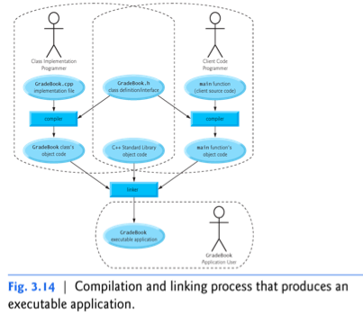
Separating Interface from Implementation

Slide 56
Vectors
Vector Introduction
Recall: arrays are fixed size
Student X[100];
Vectors: "arrays that grow and shrink"
During program execution
Formed from Standard Template Library (STL)
Using template class

Slide 57
Vector Basics
Similar to array:
Has base type
Stores collection of base type values
Declared differently:
Syntax: vector<Base_Type>
Indicates template class
Any type can be "plugged in" to Base_Type
Produces "new" class for vectors with that type
Example declarations: vector<int> v; //integer numbers
vector<double> X; //floating point numbers
vector<complex> Z; // complex numbers

Slide 58
Vector Use
vector<int> v;
"v is vector of type int"
Calls class default constructor
Empty vector object created
Indexed like arrays for access
But to add elements:
Must call member function push_back( )
v.push_back(value);
Member function size( )
Returns current number of elements
N = v.size( );

Slide 59
Vector Example
#include <iostream>
#include <vector>
using namespace std;
int main( )
{
vector<int> v; //create a zero length vector
cout << "Enter a list of positive numbers.\n"
<< "Place a negative number at the end.\n”;
int next;
cin >> next;
while (next > 0){
v.push_back(next);
cout << next << " added. ”;
cout << "v.size( ) = " << v.size( ) << endl;
cin >> next;
}
cout << "You entered:\n”;
cout << "You entered:\n”;
for (unsigned int i = 0; i < v.size( ); i++)
cout << v[i] << " ”;
cout << endl;
return 0;
}

Slide 60
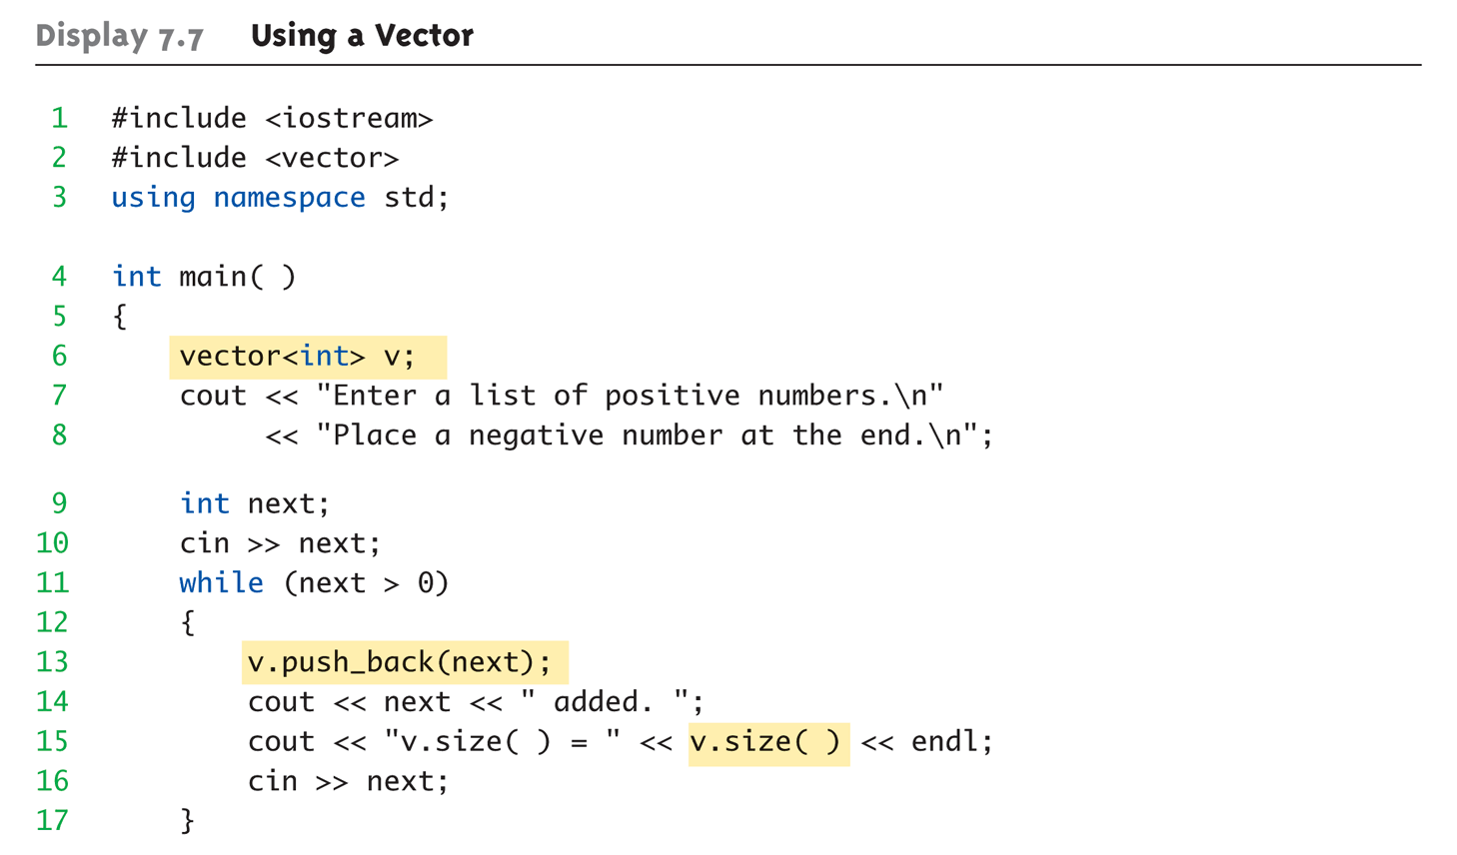
Vector Example: Display 7.7 Using a Vector (1 of 2)

Slide 61
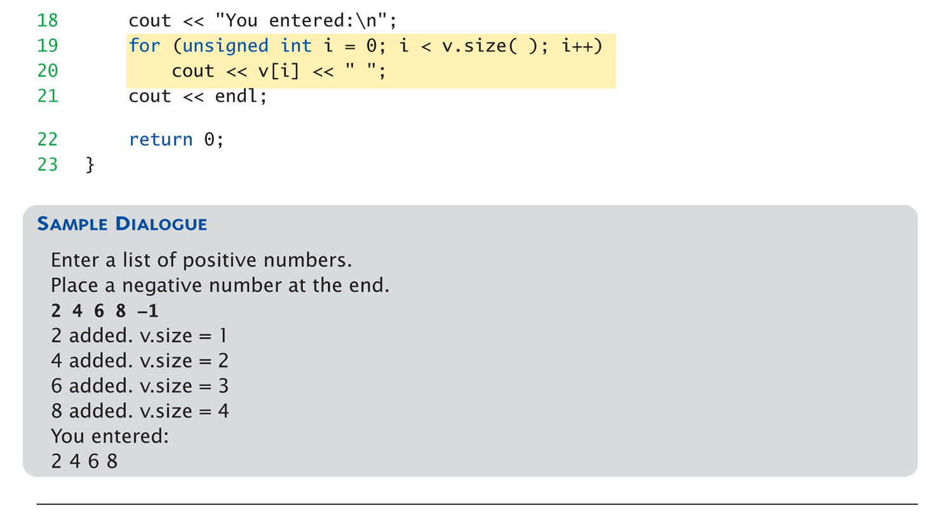
Vector Example: Display 7.7 Using a Vector (2 of 2)

Slide 62
Vector Efficiency
Member function capacity()
Returns memory currently allocated
Not same as size()
Capacity typically > size
Automatically increased as needed
If efficiency critical:
Can set behaviors manually
v.reserve(32); //sets capacity to 32
v.reserve(v.size()+10); //sets capacity to 10 more than size

Slide 63
Summary
Constructors: automatic initialization of class data
Called when objects are declared
Constructor has same name as class
All constructors return nothing
Constructors should allocate memory on heap
Default constructor has no parameters
Should always be defined
Destructor:
called automatically when object goes out of scope
Destructors has no parameters
Destructors return nothing
Destructors responsible for deallocating heap memory

Slide 64
Summary
Copy Constructors
Necessary whenever you pass or return an object by value
Create an object from an existing object
“Shallow” vs. “Deep” versions

