Slide 1
C++ Part II INFO_CE9265-01 Yedidiah Solowiejczyk Week#4
New York University
School
of
Professional Studies
1

Slide 2
Synopsis
Exception and Error Handling
Bugs, Exceptions and Code Rot
Exceptions
try and catch blocks
Defining exception classes
Multiple throws and catches
Exception specifications
Multiple exceptions
Exceptions in Constructors/Destructors
bad_alloc Class
assert macros

Slide 3
Introduction
Typical program development:
Get "core" working
Then take care of "exceptional" cases
Test program “integrity”
C++ exception-handling facilities
Handle "exceptional" situations
Exceptions are errors that occur at run time.
Heap exhaustion during allocation of arrays
Out-of-bounds index array
Mechanism "signals" unusual happening
Another place in code "deals" with exception
Testing “integrity” of program
Create suite of tests to test program (spec-based)
Have an independent testing group

Slide 4

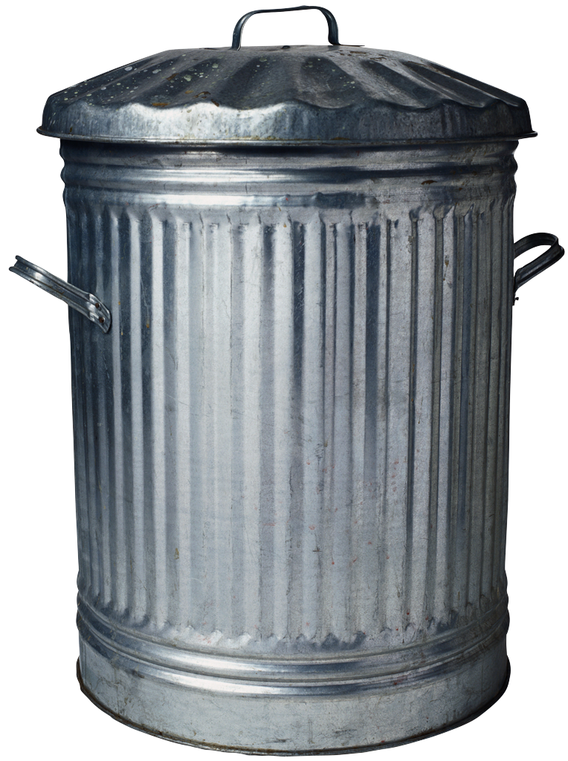
Ariane Rocket Incident
Ariane 5 Launch from French Guiana – June 1996
40 seconds after liftoff the rocket went into “self destroy” mode as a result that it veered by 20 degrees
Ultimate cause of failure was an “unhandled exception”
Overflow of floating point variable….!!!
Leading to triggering an exception which did not have a corresponding handler, thus the device shut itself off
A rocket without reliable position information triggered the rocket to go into “self destruct” mode
The “exception” code should have come up instead with a repositioning strategy to recompute the flight data
Clearly, ignoring an exception was not a reasonable option in this context as well as a costly endeavor gone to waste….

Slide 5
Bugs, Exceptions and Code Rot
The larger the program the greater the potential for bugs
Bugs
All programs have the potential for bugs§
Run-time:
Crash program every time (easier to cure)
Crash intermittently (harder to cure)
Wrong answers
All of the times – easier to fix
Some of the times – harder to fix
Types of bugs:
Poor logic
Program does what asked to do
Syntactic
Use of wrong idiom
Fragility
Run out memory, wrong input type, etc.
Integration, testing and fixing programs represent the the biggest expense in the life cycle of a program

Slide 6
Bugs, Exceptions and Code Rot
Exceptions
One cannot eliminate exceptional circumstances, one can only prepare for them (i.e. life insurance)
An exception is an indication of a problem that occurs during a program’s execution.
Example:
Program that runs out of memory sometimes
What do you do?
Allow program to crash
Inform the user and exit gracefully
Inform the user and allow user to recover
Take corrective action and continue running
In C++, an exception is an object that is passed from the area where problem occurs to the part of the code where the problem is handled

Slide 7
Reliability of Exception Handling
Exception Handling
It’s as if exception handling is a different, parallel path of execution that can be taken when things go wrong.
doesn’t need to interfere with your normally-executing code.
An exception cannot be ignored so it’s guaranteed to be dealt with at some point.
exceptions provide a way to recover reliably from a bad situation

Slide 8

Bugs, Exceptions and Code Rot
Code Rot is a well-known (???) phenomenon in which software deteriorates due to being neglected.
Code Rot is programmers' joke related to the fact that program can be enormously complex in which bugs, mistakes, and errors can hide for a long time before turning up.
Solution to this problem is achieved by writing well-structured and well-documented programs.
A fully-debugged poorly written program can readily degenerate upon addition on new code.
§ Critical bug discovered in the ubiquitous Bash shell has become a major security risk
to various Unix, Linux, and BSD systems -- spanning web servers, desktop installations
of Linux, Mac OS X, and integrated devices such as routers, among others.

Slide 9
Simple Exception Example
int main( )
{
int X, Y, Z; cout << “X value\n"; cin >> X; cout << ”Y value"; cin >> Y; Z = X/Y; //assumes that denominator ≠ 0 cout <<“ Z = “<< Z << endl;
}
Basic code assumes that Y can ever be zero
How do we fix this possible serious run-time error?

Slide 10
Simple Error Detection Example
int main( )
{
int X, Y, Z; cout << “X value\n"; cin >> X; cout << ”Y value"; cin >> Y;
if( Y == 0){ //if-else handler
cout << “ Zero Divide”;
exit(EXIT_FAILURE);
} else Z = X/Y; cout <<“ Z = “<< Z << endl;
}
In C++, division by zero using integer arithmetic typically causes a program to terminate prematurely.
In floating-point arithmetic, some C++ implementations allow division by zero, in which case positive or negative infinity is displayed as INF or -INF, respectively.

Slide 11
The Concept of Exception Handling
The global concept of exception handling is simple.
The idea is to raise some error flag every time something goes wrong.
Next, there is a system that is always on the lookout for this error flag.
Third, the system calls the error handling code if the error flag has been spotted.
Program Flow
The raising of the imaginary error flag is simply called raising or throwing an error.
When an error is thrown the overall system responds by catching the error.
Surrounding a block of error-sensitive code with exception handling is called “trying” to execute a block.
One of the most powerful features of exception handling is that an error can be thrown over function boundaries - propagating up to upper functions if there is a trying-block of code there.
This allows programmers to put the error handling code in one place, such as the main-function of your program.
Incorporate exception handling

Slide 12
C++ Exception Handling§
C++ exception handling is built upon three keywords:
try, catch, and throw
In the most general terms, program statements that you want to monitor for exceptions are contained in a try block.
If an exception (that is, an error) occurs within the try block, it is thrown (using throw).
The exception is caught, using catch, and processed.
Basic Structure
try {
___...
If(condition == TRUE)
throw data type e
___...
}
catch( data type e ){
___...
}
§ - see Exception.cpp
The try block must contain the portion of your program that you want to monitor for errors
Exception is caught by its corresponding catch statement, which then processes the exception.
There can be more than one catch statement associated with a try.

Slide 13
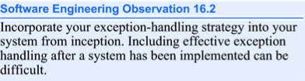
Zero Divide Exception Handling
int X, Y, Z; cout << “X value\n"; cin >> X; cout << ”Y value"; cin >> Y;
try
{
if( Y == 0) //monitor possible anomalies
throw Y; Z = X/Y; cout <<”Z = \n” << Z << endl;
}
catch ( int e ){
cout << “Input Positive Y\n”;
exit(EXIT_FAILURE);
}
It’s a syntax error to place code
between try block and corresponding
catch handlers or between catch
handlers

Slide 14
Zero Divide Example Discussion
Code between keywords try and catch
Same code from ordinary version, except if (Y === 0) throw Z;
Much cleaner code
If ” Y == 0” ➔ do something exceptional
The "something exceptional" is provided after keyword catch

Slide 15
Zero Divide Example try-catch
try block
Handles "normal" situation
catch block
Handles "exceptional" situations
Provides separation of normal from exceptional(“abnormal”)
Not big deal for this simple example, but important concept

Slide 16
catch-block
When thrown is executed flow control needs to go somewhere (sort of “goto” statement)
In C++, flow of control goes from try-block to catch-block
try-block is "exited" and control passes to catch-block
Executing catch block called "catching the exception"
Exceptions must be "handled" in some catch block
catch (int e ){ :::::::::::::::: }//catch handler can have only single parameter
catch (float f){
:::::::
}
looks like function definition with int parameter!
Not a function, but works similarly
throw looks like a "function call"

Slide 17
Mechanics of try-catch
If an exception occurs as the result of a statement in a try block, the try block expires (i.e., terminates immediately).
Next, the program searches for the first catch handler that can process the type of exception that occurred.
The program locates the matching catch by comparing the thrown exception’s type to each catch’s exception-parameter type until the program finds a match.
A match occurs if the types are identical.
When a match occurs, the code contained in the matching catch handler executes & does not return to throw point

Slide 18
Mechanics of try-catch
If the try block completes its execution successfully (i.e., no exceptions occur in the try block), then the program ignores the catch handlers and program control continues with the first statement after the last catch following that try block.
If an exception that occurs in a try block has no matching catch handler, or if an exception occurs in a statement that is not in a try block, the function that contains the statement terminates immediately, and the program attempts to locate an enclosing try block in the calling function.
This process is called stack unwinding.
Note that when no exceptions occur, performance penalty is small.

Slide 19
catch-block Parameter
Recall: catch(int e)
"e" called catch-block parameter
Each catch block can have at most ONE catch-block parameter
Does two things:
type name specifies what kind of thrown value the catch-block can catch
Provides name for thrown value caught; can "do things" with value
A catch handler typically reports the error to the user, logs it to a file, terminates the program gracefully or tries an alternate strategy to accomplish the failed task

Slide 20
// exceptions: multiple catch blocks
#include <iostream.h>
int main () {
try
{ //--------------------------------
char * mystring;
mystring = new char [10];
if (mystring == NULL)
throw "Allocation failure";
for (int n=0; n<=100; n++){
if (n>9)
throw n;
ystring[n]='z'; }
} // ----------------------------------
catch (int i){
cout << "Exception: ";
cout << "index " << i << " is out of range" << endl; }
}
catch (char * str){
cout << "Exception: " << str << endl;
}
return 0;
}

Slide 21
Catching All Exceptions
In some circumstances, you will want an exception handler to catch all exceptions instead of just a certain type. To do this, use this form of catch:
catch(...) { // process all exceptions }
#include <iostream>
using namespace std;
int main(){
int X;
char flag = 'T';
try{ //------------------------
while(1){
cout << "Enter Value" << endl;
cin >> X;
if(X > 100)throw 1;
else
if(X < 0) throw flag;
else
throw 3.0;
}
} //----------------------------------
catch(int a){
cout << "The input is " << a << endl;
}
catch(float b){
cout << "The input is " << b << endl;
}
catch(char c){
cout << "The input is " << c << endl;
}
catch(...){
cout << "Unknown input " << endl;
} //----------------------------------
// Jump to here
return 0;
}
.

Slide 22
Catching All Exceptions
int main(){
int X;
char flag = 'T';
try{
while(1){
cout << "Enter Value" << endl;
cin >> X;
if(X > 100)throw 1;
else
if(X < 0) throw flag;
else
throw 3.0;
} // end of while loop
}
catch(int a){
cout << "The input is " << a << endl;
}
catch(char c){
cout << "The input is " << c << endl;
}
catch(...){
cout << "Unknown input " << endl;
}
return 0;
}
./Exception12
Enter Value
121
The input is 1
i5% !!
./Exception12
Enter Value
-10
The input is T
i5% !!
./Exception12
Enter Value
3
Unknown input

Slide 23

Multiple Throws and Catches
try-block typically can throw any number of exception values, of differing types
Of course only one exception is thrown
Since throw statement ends try-block
But different types can be thrown
Each catch block only catches "one type”
catch (int X);
catch(char Y);
catch(…); // catches any object thrown
Typical to place many catch-blocks after each try-block
To catch "all-possible" exceptions to be thrown

Slide 24
Default Exceptions§
int main(){
int X;
char flag = 'T’;
try {
while(1){
cout << "Enter Value(1 - 100)" << endl;
cin >> X;
if(X > 100)throw X;
else
if(X < 1) throw flag;
else
throw 3.0;
}
} //end of try block
catch(int a){
cout << "The input is too big: " << a << endl;
}
catch(char c){
cout << "The input is negative: " << c << endl;
}
catch(...){ //default catch
cout << "Valid input " << endl;
}
return 0;
}
Results
./Exception12
Enter Value(1 - 100)
101
The input is too big: 101
i5% !!
./Exception12
Enter Value(1 - 100)
-1
The input is negative: T
i5% !!
./Exception12
Enter Value(1 - 100)
55
Valid input
§ See Exception12.cpp

Slide 25

Catching
Order catch blocks in order of importance
Catch-blocks tried "in order" after try-block
First match handles it!
Rest are skipped
Consider: catch (…) { }
Called "catch-all", "default" exception handler
Catches any exception
Ensure “catch-all” placed AFTER more specific exceptions!
Or others will never be caught!

Slide 26
Defining Exception Classes§
throw statement can throw value of any type (e.g. objects)
Exception class
Contains objects with information to be thrown
Can have different types identifying each possible exceptional situation
Still just a class
An "exception class" due to how it’s used
§ - See Exception1.cpp

Slide 27
Trivial Exception Classes
Consider: class Zero { };
Class has no member variables
Class has no member functions (except default constructor)
Nothing but it’s name, which is useful enough
Might be "nothing to do" with exception value
Used simply to "get to" catch block
Print Error message
Can omit catch block parameter

Slide 28
Throwing Objects§
class TooBig{
int x;
public:
TooBig(int X):x(X){ }
int getVal( ) const{return x;}
};
class TooSmall{
int x;
public:
TooSmall(int X):x(X){ }
int getVal( ) const{return x;}
};
class Zero
{ }; //does nothing
//-----------------------------------
#include <iostream>
using namespace std;
int main( )
{
int Z;
§ see Exception2.cpp
try
{
cout << "Input Number" << endl;
cin >> Z;
if(Z < 0)
throw TooSmall(Z); //object
if(Z > 15)
throw TooBig(Z);
if(Z == 0)
throw Zero( );
if(Z < 10)
throw 9;
}
catch( TooSmall Z ){
cout << " TooSmall: " << Z.getVal( ) << endl;
}
catch( TooBig Z){
cout << " TooiBig: " << Z.getVal( ) << endl;
}
catch( Zero){
cout << "Zero" << endl;
}
catch(...){
cout << "Anything Goes" << endl;
}
return 0;
}
Data type
object
Make sure it goes last

Slide 29

Throwing Exception in Functions
Functions might throw exception
Callers might have different "reactions"
Some might desire to "end program"
Some might continue, or do something else
You may not want to catch the exception in that function
Makes sense to "catch" exception in calling function’s try-catch-block
Place call inside try-block
Handle in catch-block after try-block

Slide 30
Throwing Exception in Function
class DivZero{};
double safeDivide(int N, int D);
int main()
{
int num, den;
double Q;
cout << “Enter num,den” << endl;
cin >> num >> den;
try{
Q = safeDivide(num, den);
}
catch(DivByZero){
cout << “Divide Error” << endl;
exit(1);
} //end of catch block
cout << “Q = “ << Q << endl;
return 0;
}
double safeDivide(int N, int D){
if(D == 0)
throw DivByZero();
return (N/(double)D);
}
./DivZero
Enter num,den
10 2
Q = 5
i5% !!
./DivZero
Enter num,den
10 0
Divide Error

Slide 31
When to throw exception
Exception handling is designed to process synchronous errors, which occur when a statement executes, such as out-of-range array subscripts, arithmetic overflow (i.e., a value outside the representable range of values), division by zero, invalid function parameters and unsuccessful memory allocation (due to lack of memory).
Exception handling is not designed to process errors associated with asynchronous events (e.g., disk I/O completions, network message arrivals, mouse clicks and keystrokes), which occur in parallel with, and independent of, the program’s flow of control.
Exception-handling also is useful when a program interacts with constructors and destructors .

Slide 32
Exceptions and constructors
What happens when an error is detected in a constructor?
For example, how should an object’s constructor respond when new fails because it was unable to allocate required memory for storing that object’s internal representation?
Because the constructor cannot return a value to indicate an error, we must choose an alternative means of indicating that the object has not been constructed properly.
When throwing an exception in a constructor, clean up whatever objects and memory allocations you have made prior to throwing the exception
When throwing an exception in a constructor, the memory for the object itself has already been allocated by the time the constructor is called. So, the compiler will automatically deallocate the memory occupied by the object after the exception is thrown.
Another scheme is to set some variable outside the constructor.

Slide 33
Exceptions and constructors
The preferred alternative is to require the constructor to throw an exception that contains the error information, thus offering an opportunity for the program to handle the failure.
Before an exception is thrown by a constructor, destructors are called for any member subobjects built as part of the object being constructed.
Destructors are called for every automatic object constructed in a try block before an exception is thrown.
Stack unwinding is guaranteed to have been completed at the point that an exception handler begins executing.

Slide 34
Exceptions and constructors
If an object has member objects, and if an exception is thrown before the outer object is fully constructed, then destructors will be executed for the member objects that have been constructed prior to the occurrence of the exception.
If an array of objects has been partially constructed when an exception occurs, only the destructors for the constructed objects in the array will be called.
An exception could preclude the operation of code that would normally release a resource (such as memory or a file), thus causing a resource leak…!!
One technique to resolve this problem is to initialize a local object to acquire the resource.
When an exception occurs, the destructor for that object will be invoked and can free the resource.

Slide 35
Exception in Constructors§
class Array
{
public:
// constructors
Array(int itsSize = 10);
Array(const Array &rhs);
~Array() { delete [] pType;}
// friend function
friend std::ostream& operator<< (std::ostream&, const Array&);
private:
int *pType;
int itsSize;
};
class xZero{
public:
xZero(int size){
std::cout << "Zero!!. Received: ";
std::cout << size << std::endl;
}
};
class xNegative {
public:
xNegative(int size) {
std::cout << "Negative! Received: ";
std::cout << size << std::endl;
}
};
int main()
{
int choice;
std::cout << "Enter the array size: ";
std::cin >> size
try{ //---------------------------
Array intArray(size); //instantiate array
} //end of try
catch(xZero temp){
std::cout << "Zero case\n";}
catch(xNegative temp){
std::cout << "Negative case\n";}
catch(...){};
std::cout << "Done.\n";
return 0;
} //----------------------------------
Array::Array(int size):itsSize(size {
if (size == 0)
throw xZero(size);
if (size < 0)
throw xNegative(size);
pType = new int[size];
for (int i = 0; i<size; i++)
pType[i] = 0;
}
§See ArrayExcept.cpp

Slide 36
Exceptions and destructors§
The most plausible way to report a failure during object construction is by throwing an exception. However, this is not recommended for destructors.
The problem is that a destructor may be invoked automatically when an uncaught exception is thrown in its scope.
If the called destructor invoked due to an exception also throws an exception, the result is an infinite recursion.
Why do they say it's bad?
1. If a destructor, called by the language runtime during stack unwinding, terminates with an exception the whole program is terminated.
2. It becomes difficult (some people say impossible) to design predictable (correct)
containers in the face of throwing destructors.
3. Unspecified (and thus undefined) behavior of some parts of C++ language in the face of throwing destructors.
4. It is unpleasant to think about the fate of an object that happened to throw
from its destructor. In other words, what happens to the object for which the
destruction process has failed?
§ - see Exception8.cpp

Slide 37
Exception Specification
An optional exception specification (also called a throw list) enumerates a list of exceptions that a function can throw.
For example, consider the function declaration
int someFunction( double value ) throw ( ExceptionA, ExceptionB, ExceptionC { // function body }
Indicates that function someFunction can throw exceptions of types ExceptionA, ExceptionB and ExceptionC.
C++ provides a syntax to allow you to politely tell the user what exceptions this function throws, so the user may handle them.
This is the exception specification and it’s part of the function declaration, appearing after the argument list.

Slide 38
Exception Specification
A function can throw only exceptions of the types indicated by the specification or exceptions of any type derived from these types.
If the function throws an exception that does not belong to a specified type, the exception-handling mechanism calls function unexpected, which terminates the program.
A function that does not provide an exception specification(throw list) can throw any exception.
Placing throw()—an empty throw list—after a function’s parameter list states that the function does not allow throw exceptions.
If the function attempts to throw an exception, function unexpected( ) is invoked.
[Note: Some compilers ignore exception specifications.]

Slide 39
Exception Specification in Functions§
//An exception specification describes which exceptions a function is allowed to throw.
Example
#include <iostream>
using namespace std;
void
XHandler(int test) throw(int, char, double)
{
if(test == 0) throw test; //throw int
if(test == 1) throw 'a'; //throw char
if(test == 2) throw 123.3; // double
}
int main( ){
int flag;
cout << "Enter number(0-3)" << endl;
cin >> flag;
// § - see Exception3.cpp
try {
XHandler(flag);
}
catch(int i){
cout << "Caught int\n";
}
catch(char c){
cout << "Caught char\n";
}
catch( double d){
cout << "Caught double\n";
}
cout << "end" << endl;
return 0;
}
//Exception specifications are enforced at runtime.
//When a function violates its exception specification, unexpected() is called which in turn calls terminate( )

Slide 40
Throw List Summary
void someFunction() throw(DividebyZero, OtherException); //Exception types DividebyZero or OtherException //treated normally. All others invoke unexpected()
void someFunction() throw (); //Empty exception list, all exceptions invoke unexpected()
void someFunction(); //All exceptions of all types treated normally
Warning: some compilers treat exception specification as a comment

Slide 41
Uncaught Exceptions
Every Exception thrown should be caught
If not ➔ program terminates
terminate() is called
Recall for functions
If exception is not in throw list:
unexpected() is called
In turn calls terminate( )
So same result
terminate( ) is also invoked when
During stack unwinding, a destructor throws an exception and that exception is not handled.
The expression that is thrown also throws an exception, and that exception is not handled.
The constructor or destructor of a nonlocal static object throws an exception, and the exception is not handled.

Slide 42
Processing Unexpected Exceptions
Function unexpected calls the function registered with function set_unexpected (defined in header file <exception>).
If no function has been registered in this manner, function terminate is called by default.
Cases in which function terminate is called include:
the exception mechanism cannot find a matching catch for a thrown exception
a destructor attempts to throw an exception during stack unwinding
an attempt is made to rethrow an exception when there is no exception currently being handled
a call to function unexpected defaults to calling function terminate

Slide 43
unexpected()§
unexpected( )- function automatically called when a function throws an exception that is not listed in its exception-specification
Use set_unexpected
Consult compiler manual or advanced text for details
unexpected_handler set_unexpected (unexpected_handler f) throw();
Sets f as the unexpected handler function.
The unexpected handler by default simply calls terminate( )
Function set_terminate can specify the function to invoke when terminate is called.
terminate() calls abort, which terminates the program without calling the destructors of any remaining objects of automatic or static storage class.
This could lead to resource leaks when a program terminates prematurely.
§ - see Exception5.cpp

Slide 44


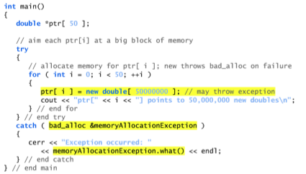
Processing new Failures
The C++ standard specifies: when operator new fails, it throws a bad_alloc exception (defined <new>).
Results
***
***
// bad_alloc() calls abort( )

Slide 45
Processing new Failures
The C++ standard specifies that compilers can use an older version of new that returns 0 upon failure.
For this purpose, header <new> defines object nothrow (of type nothrow_t), which is used as follows:
double *ptr = new( nothrow )double[ 50000000 ];
The preceding statement uses the version of new that does not throw bad_alloc exceptions (i.e., nothrow) to allocate an array of 50,000,000 doubles.
Make programs more robust by using standard new so bad_alloc() is automatically called upon failure

Slide 46
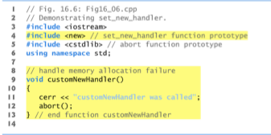
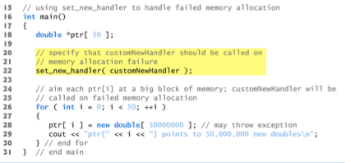

Processing new Failures
***

Slide 47
Derived Classes
Remember:
derived class objects are also objects of base class
If a catch handler catches a pointer or reference to an exception object of a base-class type, it also can catch a pointer or reference to all objects of classes publicly derived from that base class—this allows for polymorphic processing of related errors.
When you redefine or override a function definition in derived class, it should have the same exception specification(throw list) as it had in base class or it should have a subset of those in base class specification
In overridden or redefined functions you cannot add any exception specification

Slide 48
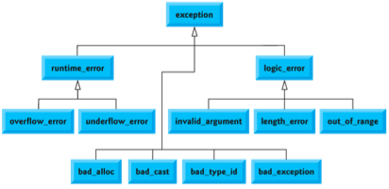
Exception Class Hierarchies
The C++ Standard Library includes a hierarchy of exception classes
This hierarchy is headed by base-class exception( ) (defined in header file <exception>), which contains virtual function what(), which derived classes can override to issue appropriate error messages.

Slide 49
Exception Class Hierarchies
// standard exceptions
#include <iostream>
#include <exception>
using namespace std;
class myexception: public exception {
virtual const char* what() const throw(){
return "My exception happened"; }
} myex;
int main ()
{
try
{
throw myex;
}
catch (exception& e)
{
cout <<“e.what = “ << e.what() << endl;
}
return 0;
}
class exception {
public:
exception () throw();
exception (const exception&) throw();
exception& operator= (const exception&) throw();
virtual ~exception() throw();
virtual const char* what() const throw(); }
e.what = My exception happened.

Slide 50
Stack Unwinding
When an exception is thrown but not caught in a particular scope, the function call stack is “unwound,” and an attempt is made to catch the exception in the next outer try…catch block.
Unwinding the function call stack means that the function in which the exception was not caught terminates, all local variables in that function are destroyed and control returns to the statement that originally invoked that function.
If a try block encloses that statement, an attempt is made to catch the exception.
If a try block does not enclose that statement, stack unwinding occurs again.
If no catch handler ever catches this exception, function terminate is called to terminate the program.

Slide 51
Stack unwinding (C++ only)
When an exception is thrown and control passes from a try block to a handler, the C++ run time calls destructors for all automatic objects constructed since the beginning of the try block.
This process is called stack unwinding.
The automatic objects are destroyed in reverse order of their construction.
If an exception is thrown during construction of an object consisting of subobjects or array elements, destructors are only called for those subobjects or array elements successfully constructed before the exception was thrown.
A destructor for a local static object will only be called if the object was successfully constructed.
If during stack unwinding a destructor throws an exception and that exception is not handled, the terminate() function is called.

Slide 52
Stack unwinding (C++ only)§
#include <iostream>
using namespace std;
struct E {
const char* message;
E(const char* arg) : message(arg) { }
}; //no catch( )
void my_terminate() {
cout << "Call to my_terminate" << endl;
};
struct A {
A() { cout << "In constructor of A" << endl; }
~A() {
cout << "In destructor of A" << endl;
throw E("Exception thrown in ~A()");}
};
struct B {
B() { cout << "In constructor of B" << endl; }
~B() { cout << "In destructor of B" << endl; }
}; //§ - see Exception8.cpp
int main() {
set_terminate(my_terminate);
try {
cout << "In try block" << endl;
A a; B b; //create objects
throw ("Exception thrown in try block of main()");
} //end off try - destroy object a and b
catch (const char* e) {
cout << "Exception: " << e << endl;
}
catch (...) {
cout << "Some exception caught in main()\n”;
}
cout << "Resume execution of main()" << endl;
} /************ Results ************
In try block
In constructor of A
In constructor of B
In destructor of B
In destructor of A
Call to my_terminate
**********************************/

Slide 53
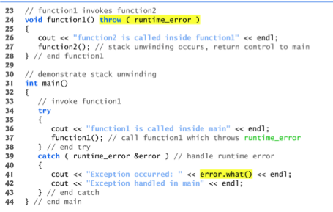
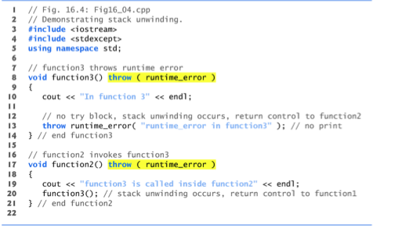

Stack Unwinding (C++ only)

Slide 54

Rethrowing an Exception
It’s possible that an exception handler, upon receiving an exception, might decide either that it cannot process that exception or that it can process the exception only partially.
In such cases, the exception handler can defer the exception handling (or perhaps a portion of it) to another exception handler.
In either case, you achieve this by rethrowing the exception via the statement
throw;
Regardless of whether a handler can process an exception, the handler can rethrow the exception for further processing outside the handler.
The next enclosing try block detects the rethrown exception, which a catch handler listed after that enclosing try block attempts to handle.

Slide 55
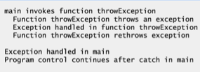
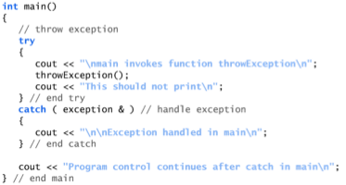
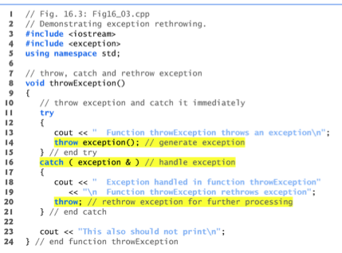
Rethrowing an Exception
###
***
###
***
!!!

Slide 56
bad_alloc( )
Objects of class bad_alloc are thrown when the implementation cannot allocate storage.
The class is derived from exception, and thrown by allocator, new, and others.
class bad_alloc : public exception {
public:
bad_alloc() throw();
bad_alloc(const bad_alloc&) throw();
bad_alloc& operator=(const bad_alloc&) throw();
virtual ~bad_alloc() throw();
virtual const char* what() const throw();
};
new operator throws bad_alloc exception if insufficient memory: try { NodePtr pointer = new Node; } catch (bad_alloc &ba) { cerr << "Ran out of memory!"; // Can do other things here as well…
cerr << ba.what( ); }
In library <new>, std namespace
#include <new>
using std::bad_alloc;

Slide 57
assert( )
If it is not defined, assert() is defined to create no code at all. If DEBUG is defined, the functionality defined
The assert() macro returns TRUE if its parameter evaluates TRUE and takes some kind of action if it evaluates FALSE.
Many compilers will abort the program on an assert() that fails; others will throw an exception
One powerful feature of the assert() macro is that the preprocessor collapses it into no code at all if DEBUG is not defined.
#define DEBUG
#include <iostream.h>
#ifndef DEBUG
#define ASSERT(x)
#else
#define ASSERT(x) \
if (! (x)) \
{ \
cout << "ERROR! Assert " << #x << " failed\n"; \
cout << " on line " << __LINE__ << "\n"; \
cout << " in file " << __FILE__ << "\n"; \
}
#endif
int main()
{
int x = 5;
cout << "First assert: \n";
ASSERT(x==5);
cout << "\nSecond assert: \n";
ASSERT(x != 5);
cout << "\nDone.\n";
return 0;
}
First assert:
Second assert:
ERROR!! Assert x !=5 failed
on line 24 in file test1704.cpp
Done.

Slide 58
When to Throw Exceptions
Typical to separate throws and catches
In separate functions
Throwing function:
Include throw statements in definition
List exceptions in throw list
In both declaration and definition
Catching function:
Different function, perhaps even in different file
void functionA( ) throw(MyException){
::::::::::::::::
throw MyException( argument);
}
void functionB( ){
::::::::::::::::
try {
::::::::::::
functionA( );
}
catch(MyException e)
{ }
}
throw statements should be used within functions and listed in exception specification(throw list) for the functionn

Slide 59
Overuse of Exceptions
Exceptions alter flow of control
Similar to old "goto" construct
"Unrestricted" flow of control
Should be used sparingly
Good rule:
If desire a "throw": consider how to write program without throw
If alternative reasonable ➔ do it

Slide 60
Summary
Exception handling allows separation of "normal" cases and "exceptional" cases
Exceptions thrown in try-block
Or within a function whose call is in try-block
Exceptions caught in catch-block try-blocks typically followed by more than one catch-block
List more specific exceptions first
Best used with separate functions
Especially considering callers might handle differently
Exceptions thrown in but not caught in function, should be listed in throw list
Exceptions thrown but never caught → program terminates
Resist overuse of exceptions
Unrestricted flow of control

