Slide 1
C++ Part I (INFO1-CE9264) New York University School of Professional Studies Fall 2014
Yedidiah Solowiejczyk
Class Notes # 9

Slide 2
Synopsis
Review of Pointers
Pointer declaration, dereferencing, arithmetic,
Pointers and functions, arrays, matrices
new & delete, function pointers
Linked list & binary trees
References
An Array Type for Strings
C-Strings
Character Manipulation Tools
Character I/O
get, put member functions
putback, peek, ignore
Standard Class string
String processing

Slide 3
Review of Pointers
Pointer Declaration
Pointer is a 4 byte variable that contains address
Int X[100]; //declare array
int * x_ptr = & X[0]; //declare ptr & init address
Dereferencing
for(int i = 0; i < 100; ++i){
*x_ptr = i*2 + ; //0,2,4,6…..198 (writing)
Sum = Sum + *x_ptr++; (reading)
}
Pointer arithmetic (±)
x_ptr = &X[0] + 10; // move up ten ints
x_ptr = x_ptr – 10; // back to square one

Slide 4
Review of Pointers
Pointers and functions, arrays, matrices
int X[100];
int *X_ptr = &X[0];
foo(X_ptr, 100); //pass pointer to function
void foo(int *p, int Size){ //function definition
for(int k = 0; k < Size; ++k) {*p++ = 10*k; }
--------------------------------------------------
int Matrix[100][80]; //declare 100 x 80 matrix
int M_ptr = &M[0][0]; // init pointer
for(int k = 0; k <100; ++k)
*(M_ptr + k*80 + 50) = 17; //paint 50th column to 17

Slide 5
Review of Pointers
new & delete
new creates N data types on the heap
Access to this data is via X_ptr handler
int *X_ptr = new int[100]; // x_ptr != NULL
for(int i = 0; i < 100; ++i)
*(X_ptr + i) = I*5; //0, 5, 10, 15, 20, …..
::::::::::::::::
:::::::::::::::::
delete [ ] X_ptr; // remove from heap
// memory manager knows how many
Better indexing method

Slide 6
Command Line Arguments
It is possible to pass some values from the command line to your C programs when they are executed.
These values are called command line arguments and many times they are important for your program specially when you want to control your program from outside instead of hard coding those values inside the code.
The command line arguments are handled using main() function arguments where argc refers to the number of arguments passed, and argv[] is a pointer array which points to each argument passed to the program.
Example:
#include <stdio.h>
int main( int argc, char *argv[ ] ){
int Rows, Cols;
if( argc == 3 ) {
printf("The argument supplied is %s\n", argv[1]); }
else if( argc > 3 ) {
printf("Too many arguments supplied.\n"); }
else { printf(”Usage: Matrix #rows #cols\n"); }
Rows = atoi(argv[1]);
Cols = atoi(argv[2]);
}
Array of pointer to chars
$./Matrix 10 20

Slide 7
Linked Lists
Like an array, a linked list is a data structure for holding numerous pieces of data in some sequence.
The big problem with arrays is that you generally need to know in advance how many pieces of data you want to store in order to define them (define N).
Whilst there are such things as dynamic arrays, which get around this problem, they can become a little difficult to manage.
Linked lists to the rescue!!!!
Unlike predefined static arrays, linked lists are designed to have items added to them in real time while the program is actually running.
If the user inputs more data, more items are added to the linked list to hold them.
7

Slide 8

Linked Lists
Some common applications of linked lists include:
inserting/sorting dynamically records
creating hash tables for collision resolution across communication channels,
structuring binary trees
building stacks and
queues in programming, and managing relational databases
xxxx James 917-5551212 ….
8

Slide 9
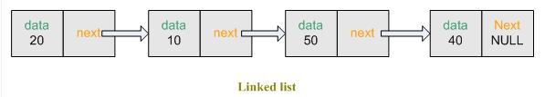
Linked Lists
Basic implementation of a linked list in C, each node contains (integer) data or strings as its piece of data as well as a pointer of type “n
class node{
int data; // or any other data type
struct node * next;
node * linkedlist; //pointer of type node
//member functions (e.g. constructors, inserter, removers, etc)
} ;
9

Slide 10
Linked List Operations
Creating a node
Creating a new node is simple. The memory needed to store the node is allocated(Heap), and the pointers are set up. This function leaves allocation of data to the user.
Inserting a node
In a singly-linked list, there is no efficient way to insert a node before a given node or at the end of the list, but we can insert a node after a given node or at the beginning of the list.
Removing a node
De-allocate node memory from heap
Traversing the list
Print contents of all nodes –terminate at NULL
Searching the list of nodes
Search sequentially for specific value and print
10

Slide 11
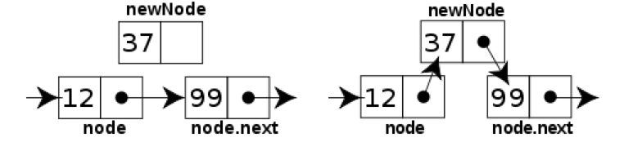
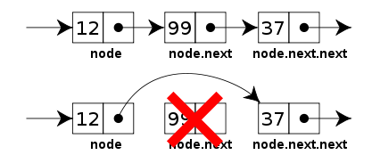
Linked Lists
Inserting a node
Inserting a node before an existing one cannot be done directly; instead, one must keep track of the previous node and insert a node after it.
Removing a node
removing the node after a given node and for removing a node from the beginning of the list. To find and remove a particular node, one must again keep track of the previous element.
Created on the heap
11

Slide 12
Linked List§
struct link{
int data;
link* next;
};
class LinkList{
private:
link *first;
public:
LinkList(){first = NULL;}
void addItem(int d);
void display();
};
int main(){
LinkList li;
for(int i = 0; i < 7; ++i)
li.addItem(i*10);
li.display(); //display entire list
return 0;
}
void LinkList::addItem(int d){
link* newlink = new link;
newlink->data = d;
newlink->next = first; //front insert
first = newlink;
}
void LinkList::display(){
link* current = first;
while( current != NULL){
cout << current->data << endl;
current = current->next;
}
}
////// Results //////
/************** Results **********/
./a.out
60
50
40
30
20
10
0
§See LinkList.cpp

Slide 13
Binary Tree
The binary tree is a useful data structure for rapidly storing sorted data and rapidly retrieving stored data.
A binary tree is made of nodes, where each node contains a "left" pointer, a "right" pointer, and a data element.
The "root" pointer points to the topmost node in the tree.
The left and right pointers recursively point to smaller "subtrees" on either side.
A null pointer represents a binary tree with no elements -- the empty tree.
The formal recursive definition is: a binary tree is either empty (represented by a null pointer), or is made of a single node, where the left and right pointers (recursive definition ahead) each point to a binary tree.
13

Slide 14
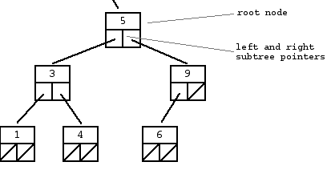
Binary Search Tree
A "binary search tree" (BST) or "ordered binary tree" is a type of binary tree where the nodes are arranged in order:
for each node, all elements in its left subtree are less-or-equal to the node (<=), and all the elements in its right subtree are greater than the node (>).
The tree shown above is a binary search tree -- the "root" node is a 5, and its left subtree nodes (1, 3, 4) are <= 5, and its right subtree nodes (6, 9) are > 5.
struct node { int data; struct node* left; struct node* right; }
14

Slide 15
Binary Search Tree
A "binary search tree" (BST) or "ordered binary tree" is a type of binary tree where the nodes are arranged in order:
for each node, all elements in its left subtree are less-or-equal to the node (<=), and all the elements in its right subtree are greater than the node (>).
The tree shown above is a binary search tree -- the "root" node is a 5, and its left subtree nodes (1, 3, 4) are <= 5, and its right subtree nodes (6, 9) are > 5.
struct node { int data; struct node* left; struct node* right; }
15

Slide 16
Binary Search Tree Structures
Dictionary
Binary tree is a data structure in which each node has at most two children
struct node{
char fruit[32];
char describer[128];
struct node *left;
struct node *right;
};
Searches are quick
~ log₂(N) fast rather than N
lemon
date
pear
berry
grape
orange
quince

Slide 17
References
A reference variable is an alias to another variable
A reference must be initialized at the point that it is declared
References are also “typed”
int X;
char C;
int &r_X = X; // reference declaration and init
char &r_C = C;
& symbol is used for declaring a reference
The address of the reference is the same as the address of target
The value of the reference is the same as the value of target
int X = 10;
int &r_X = X;
cout << “X = “ << X << “r_X = “ << r_X << endl; // ans: 10
cout << “&X = “ << &X << “&r_X = “ <<& r_X << endl; //ans: 0X????
17

Slide 18
References
Any object can be referenced
int, long, float, double, char, … , structs, objects
References cannot be NULL
A program with a NULL reference – invalid
Prone to crash
Rules for using references
References must be initialized when created
An initialized reference cannot be changed to refer to another object
You cannot have NULL references (illegitimate)
18

Slide 19
Passing Parameter Methods
Parameters are passed to functions
Call-by-value
Requires copy be made on the stack → Overhead
Difficult if not impossible to pass arrays to functions
Call by Pointer
Dereferencing within function blurs readability
Call-by-reference
Placeholder for actual argument
Most efficient method & more readable
Negligible difference for simple types
For class types → clear advantage
Call-by-reference desirable
Especially for "large" data, like class types

Slide 20
References and Functions
Most common use of references
Passing Function Arguments by reference and returning values by reference
Same as passing arguments by pointer but easier on notation of receiving function
A reference (&) is like a constant pointer that is automatically dereference
Passing arguments by reference
void swap( int &r_x, int &r_y) | void swap( int * x_ptr, int *y_ptr)
{ | {
int temp; | int temp;
temp = r_x; | temp = *x_ptr;
r_x = r_y; | *x_ptr = *y_ptr;
r_y = temp; | *y_ptr = temp;
} |}
Pass by reference
Pass by ptr
not as clean
20

Slide 21
References and Functions
Returning value by reference
Examples:
int *f(int *x_ptr) { | int &g( int &r_x){
//increment value | //increment value
*x_ptr += 1; | r_x += 1;
return x_ptr; | return r_x;
} |
Safe, return values outside function scope
Returns pointer
Returns reference
21

Slide 22
References and Classes
Default constructor
class Rational{
private:
int N;
int D;
public:
//constructors
Rational( ):N(0), D(1){ } //default
Rational(int n, int d):N(n), D(d) { }
Rational(const & rhs):
N(rhs.N), D(rhs.D) { } //copy
~Rational( ){ } //destructor
const Rational operator*(const
Rational &rhs)const; //member
};
//arithmetic operator
const Rational Rationnal::Rational operator*(const Rational& rhs) const {
Rational Answer; //temp
Answer.N = N*(rhs.N);
Answer.D = D*(rhs.D);
return Answer;
}
int main( ){
Rational X(10,3),Y(5,4), Z;
Z = X*Y;
//Z = X.operator*(Y); //same
(X*Y).input( ); //NO!!!
return 0;
}
Default constructor
Destructor
&
Copy constructor

Slide 23
Introduction to Strings
Two string types:
C-strings
Array with base type char
End of string marked with NULL, "\0"
"Older" method inherited from C
String class
Uses templates
Uses a more modern string handling facilities

Slide 24
C-Strings
Array with base type char
One character per indexed variable
One extra character: "\0"
Called "NULL character"
End marker
char phrase[6] = {‘h’, ‘e’,’l’,’l’,’o’,’\0’};
We’ve used c-strings
Literal "Hello" stored as c-string
Stored in the “pool of strings”

Slide 25
C-String Variable
C-String Variable is an Array of characters: char s[10];
Declares a c-string variable to hold up to 9 characters
+ one NULL character
Typically "partially-filled" array
Declare large enough to hold max-size string
Indicate end with NULL
Only difference from standard array:
Must contain NULL character which acts as sentinel to mark end of C-string

Slide 26
C-String Storage
A standard array: char s[10];
If s contains string "Hi Mom", stored as:
Includes the NULL character (‘\0’)
The thing that differentiates a C-string from ordinary array of chars is that the C-string must contain a NULL

Slide 27
C-String Initialization
Can initialize c-string: char myMessage[20] = "Hi there.";
Need not fill entire array
Initialization places ‘\0’ at end
Can omit array-size: char shortString[ ] = "abc"; // three chars + NULL
Size = 4
Automatically makes size one more than length of quoted string
NOT same as: char shortString[ ] = {‘a’, ‘b’, ‘c’}; //only three chars
Size = 3

Slide 28
C-String Indexes
A c-string IS an array
Can access indexed variables of: char ourString[5] = "Hi";
ourString[0] is "H"
ourString[1] is "i"
ourString[2] is "\0"
ourString[3] is unknown
ourString[4] is unknown

Slide 29
C-String Index Manipulation
Can manipulate indexed variables char happyString[7] = "DoBeDo"; happyString[6] = "Z";
Be careful!
Here, "\0" (NULL) was overwritten by a "Z"!
If NULL overwritten, c-string no longer "acts" like c-string!
Unpredictable results!
printf(“%s”, happyString); // will fail….

Slide 30
C-String Example
const int SIZE = 20;
int index = 0;
char ourString[20] = “HELLO WORLD”;
while( (ourString[index] != ‘\0’){
ourString[index] += 32 ; // convert to lower case
index+++;
}
PS1 – Remember that ‘A’ = 65 & ‘a’ = 97
PS2 – No need to include using statement to declare or initialize C-strings
PS3 – Cannot use = and == with C-strings
strcpy(ourString, “Good Bye”);
strcmp(OurString, “Bye World”);

Slide 31
String Manipulation Functions
#include <cstring> //mandatory
// find length of string
int len = strlen(char * string1);
// compares two strings
int strcmp(char *string1,char * string2);
//copies string 2 over string1
char * strcpy(char * string1, char * string2);
//make sure that size of size1 <= strlen1 + strlen2
// string concatenates – appends s2 to s1
char * strcat(char *string1, char * string2;
// search string for character
char *strchr(char *string1, int c);
//copy the 1st n chars of string2
char * strncat(char *string1,char *string2, int n);

Slide 32
String Manipulation Example
#include <cstring>
class Student{
char * s_prt;
public:
Student(char *String){
int len = strlen(String);
s_ptr = new char[len+1];
strcpy(s_ptr, String);
}
~Student(){ delete [ ]s_ptr;}
//etc
};

Slide 33
Library
Declaring c-strings
Requires no C++ library
Built into standard C++
#include <string.h> if using string manipulation functions
Manipulations
Require library: #include <cstring> //global space
Typically included when using c-strings
Normally want to do "fun" things with them

Slide 34
= and == with C-strings
C-strings are not like other variables
Cannot assign or compare: char aString[10]; aString = "Hello"; // ILLEGAL!
Can ONLY use "=" at declaration of c-string!
Remember that “Hello” lives in the string f pools
char aString[10] = “Hi there”; //Initialization
Must use library function for assignment: strcpy(aString, "Hello World how do we do?");
Built-in function (in <cstring>)
Sets value of aString equal to "Hello ………"
NO checks for size!
Up to programmer, just like other arrays!
For control of # chars copied use:
strcpy(aString, "Hello World how do we do?”, 10)

Slide 35
Comparing C-strings
Also cannot use operator == char aString[10] = "Hello"; char anotherString[10] = "Goodbye";
aString == anotherString; // NOT allowed!
Must use library function again: if (strcmp(aString, anotherString)) cout << "Strings NOT same."; else cout << "Strings are same.";

Slide 36
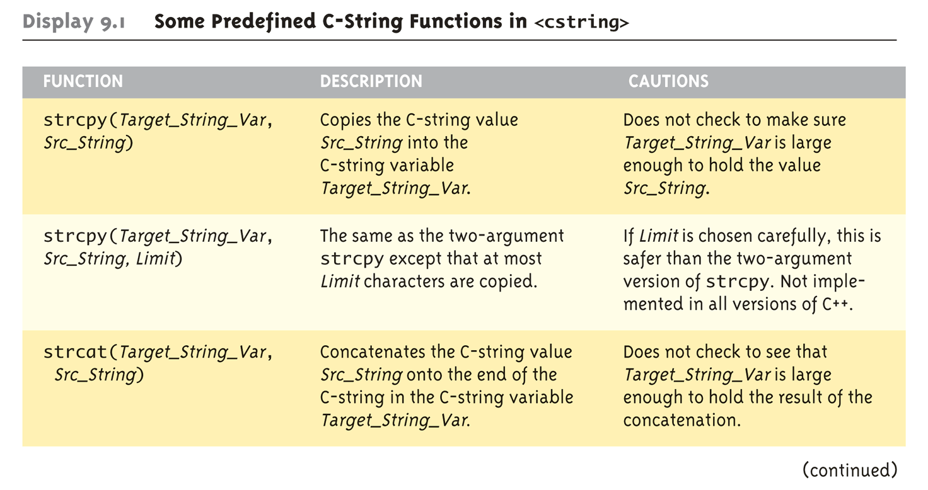
The <cstring> Library: Some Predefined C-String Functions in <cstring>
Full of string manipulation functions

Slide 37
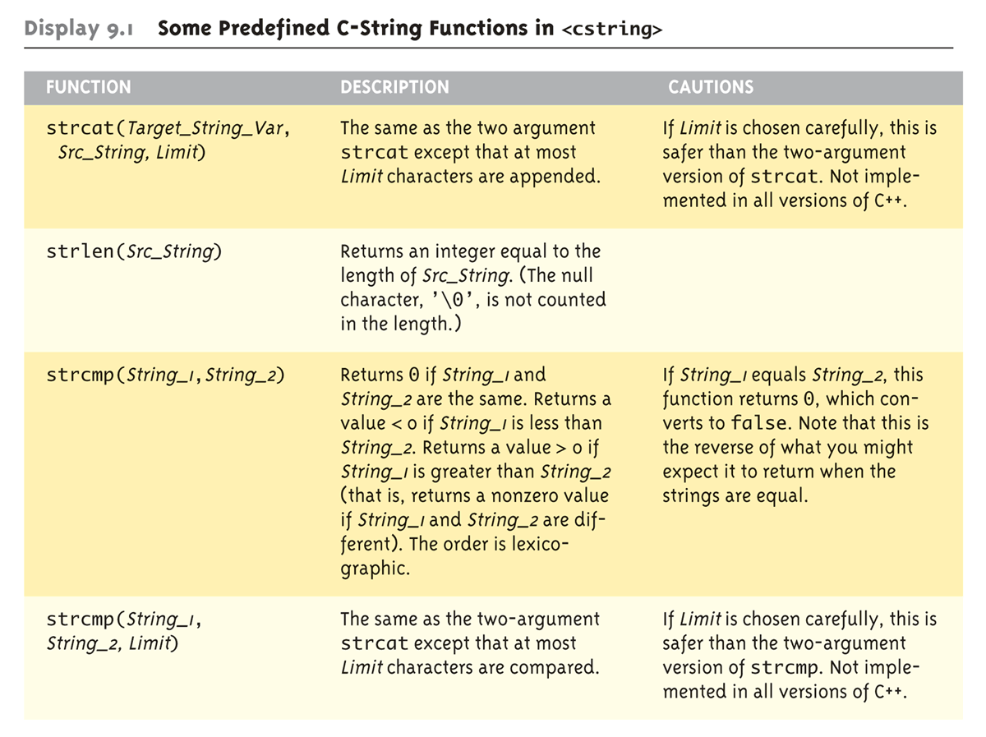
The <cstring> Library: Some Predefined C-String Functions in <cstring>

Slide 38
C-string Functions: strlen()
"String length"
Often useful to know string length: char myString[10] = "dobedo"; cout << strlen(myString);
Returns number of characters
Not including NULL
So you need to include extra char when using malloc
Result here: 6

Slide 39
C-string Functions: strcat()
strcat()
"String concatenate": char stringVar[20] = "The rain"; strcat(stringVar, "in Spain");
Note result: stringVar now contains "The rainin Spain"
Be careful!
Incorporate spaces as needed!
Removes 1st NULL before appending

Slide 40
C-string Arguments and Parameters
Recall:
c-string is array
So c-string parameter is array parameter
C-strings passed to functions can be changed by receiving function!
void foo(char *, int size);
Like all arrays, typical to send size as well
Function "could" also use "\0" to find end
So size not necessary if function won’t change c-string parameter
Use "const" modifier to protect c-string arguments
void foo(const char *, int size);

Slide 41
Array of char pointers§
int main(){
char *phrase[] = { {"to be or not to be"},
{"that is the question"},
{"tomorrow and tomorrow"},
{"and tomorrow, creeps in"},
{"this petty place"},
{"#"}
};
int i = 0;
while(*phrase[i] != '#'){
cout << phrase[i] << endl;
i++;
}
cout << "------------" << endl;
//switch pointers
char *temp;
temp = phrase[0];
phrase[0] = phrase[1];
phrase[1] = phrase[2];
phrase[2] = phrase[3];
phrase[3] = phrase[4];
phrase[4] = phrase[5];
phrase[5] = temp;
i = 0;
while(*phrase[i] != '#'){
cout << phrase[i] << endl;
i++;
}
return 0;
}
to be or not to be
that is the question
tomorrow and tomorrow
and tomorrow, creeps in
this petty place
------------
that is the question
tomorrow and tomorrow
and tomorrow, creeps in
this petty place
§See StringDemo.cpp

Slide 42
C-String Output
Can output with insertion operator, <<
As we’ve been doing already: cout << news << " Wow.\n";
Where news is a c-string variable
Possible because << operator is overloaded for c-strings!

Slide 43
C-String Input
Can input with extraction operator, >>
Issues exist, however
Whitespace is "delimiter"
Tab, space, line breaks are "skipped"
Input reading "stops" at delimiter
Watch size of c-string
Must be large enough to hold entered string!
C++ gives no warnings of such issues!

Slide 44
C-String Input Example
char a[80], b[80]; cout << "Enter input: "; cin >> a >> b; cout << a << b << "END OF OUTPUT\n";
Dialogue offered: Enter input: Do be do to you!
// watch out for delimeter - DobeEND OF OUTPUT
Note: Underlined portion typed at keyboard
C-string a receives: "do"
C-string b receives: "be”
Skips whitespaces in output

Slide 45
C-String Line Input
Can receive entire line into c-string
Use getline( ), // predefined member function of cin
Extracts characters from the stream as unformatted input and stores them into s as a c-string, until either the extracted character is the delimiting character, or n characters have been written to s (including the terminating null character). char a[80]; cout << "Enter input: "; cin.getline(a, 80);
Or
cin.getline(a, 80, ‘#’) //delimeter overloaded function cout << a << "END OF OUTPUT\n";
Dialogue: Enter input: Do be do to you! Do be do to you!END OF INPUT

Slide 46
getline()
Can explicitly tell length to receive: char shortString[5]; cout << "Enter input: "; cin.getline(shortString, 5); cout << shortString << "END OF OUTPUT\n";
Results: Enter input: dobedowap dobeEND OF OUTPUT
Forces FOUR characters only be read
Recall need for NULL character!

Slide 47
Character I/O
Input and output data
ALL treated as character data
e.g., number 10 outputted as "1" and "0"
Conversion done automatically
Uses low-level utilities
C++ provides some low-level utilities that we can use ourselves as well
get( )
put( )

Slide 48
get() member Function
Reads one char at a time
Member function of cin object: char nextSymbol; cin.get(nextSymbol);
Reads next char & puts in variable nextSymbol
Argument must be char type
Not "string”!
Reads the next character whether it is “whitespace” or not

Slide 49
get() member Function
get( ) - Extracts characters from the stream, as unformatted input:\n
(1) single character
Extracts a single character from the stream. The character is either returned (first signature), or set as the value of its argument (second signature).
(2) c-string
Extracts characters from the stream and stores them in s as a c-string, until either (n-1) characters have been extracted or the delimiting character is encountered: the delimiting character being either the newline character ('\n') or delim (if this argument is specified). The delimiting character is not extracted from the input sequence if found, and remains there as the next character to be extracted from the stream (see getline for an alternative that does discard the delimiting character). A null character ('\0') is automatically appended to the written sequence if n is greater than zero, even if an empty string is extracted.
(3) stream buffer
Extracts characters from the stream and inserts them into the output sequence controlled by the stream buffer object sb, stopping either as soon as such an insertion fails or as soon as the delimiting character is encountered in the input sequence (the delimiting character being either the newline character, '\n', or delim, if this argument is specified). Only the characters successfully inserted into sb are extracted from the stream: Neither the delimiting character, nor eventually the character that failed to be inserted at sb, are extracted from the input sequence and remain there as the next character to be extracted from the stream.

Slide 50
get() Example
// istream::get example
#include <iostream> // std::cin, std::cout
#include <fstream> // std::ifstream
int main () {
char str[256];
std::cout << "Enter the name of an existing text file: ";
std::cin.get (str,256); // get c-string
//or
std::cin.get(str, 256, ’#’);
return 0;
}

Slide 51
get( ) - Discarding ‘\n’
#include <iostream>
using namespace std;
Int main() {
char symbol;
char phrase[32];
Int index = 0;
cout << “enter phrase” << endl;
do{
cin.get(symbol);
phrase[index] = symbol;
index++;
}while (symbol != ‘\n’);
phrase[index] = ‘\0’; //NULL terminate
}

Slide 52
put( ) member function
Outputs one character at a time
Member function of cout object:
Examples: cout.put(‘a’);
Outputs letter "a" to screen
char myString[10] = "Hello"; cout.put(myString[1]);
Outputs letter "e" to screen
cout.put(‘a’); ⬅➔ cout << ‘a’;

Slide 53
More Member Functions
putback()
Once read, might need to "put back"
cin.putback(lastChar);
peek()
Returns next char, but leaves it there
peekChar = cin.peek();
ignore()
Skip input, up to designated character
cin.ignore(1000, "\n");
Skips at most 1000 characters until "\n” (delimiter)

Slide 54
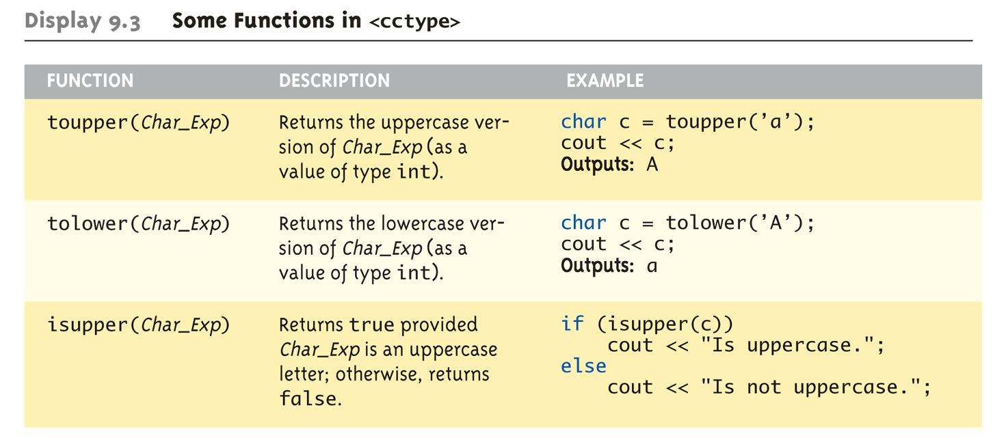
Character-Manipulating Functions: Display 9.3 Some Functions in <cctype> (1 of 3)
Int toupper ( char) – returns integer value of converted char
Int tolower(char) – returns integer value of converted char
cout << toupper(‘A’); // will output 65

Slide 55
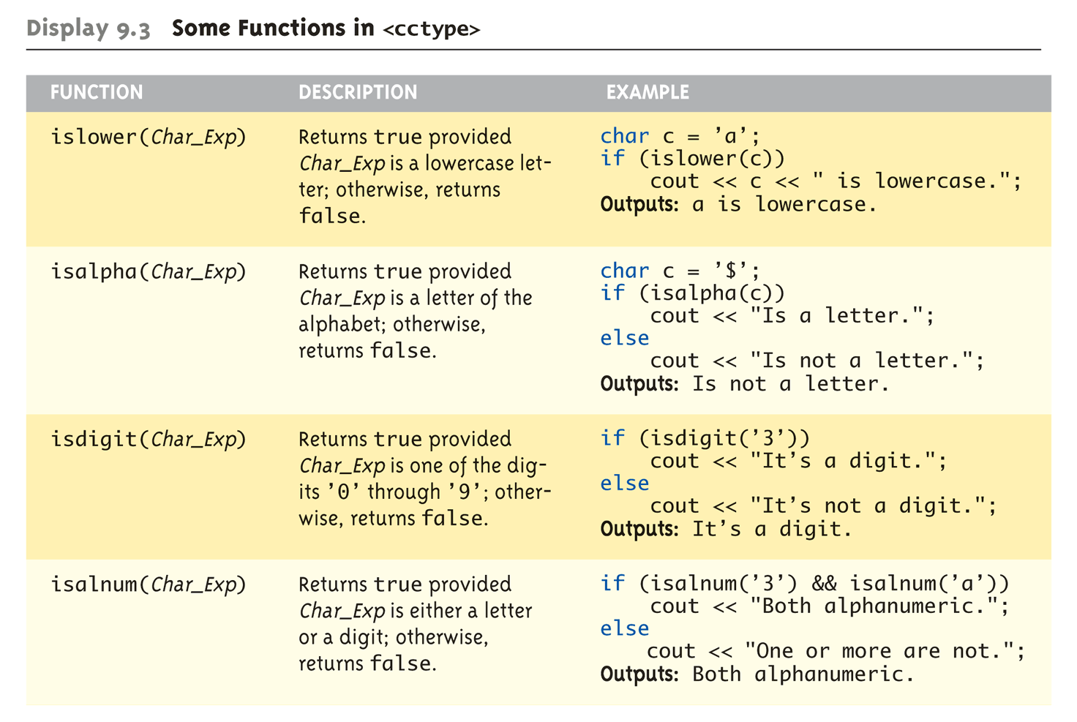
Character-Manipulating Functions: Display 9.3 Some Functions in <cctype> (2 of 3)

Slide 56
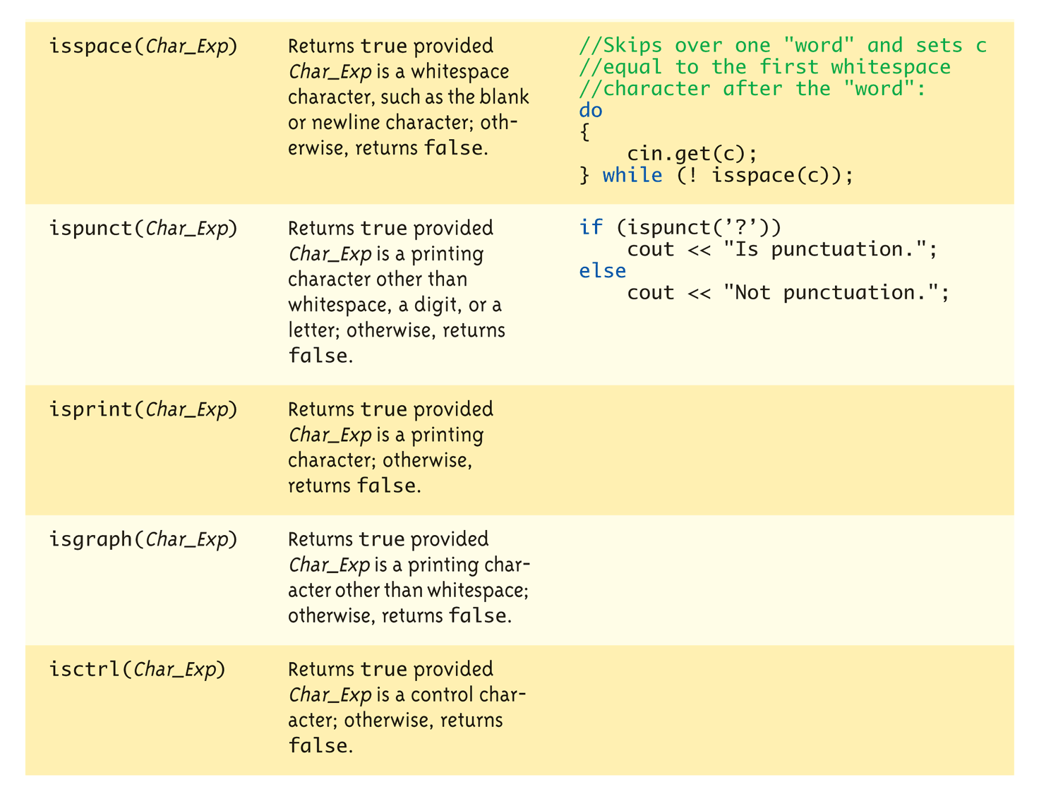
Character-Manipulating Functions: Display 9.3 Some Functions in <cctype> (3 of 3)

Slide 57
cctype functions
/* isdigit example */
#include <stdio.h>
#include <stdlib.h>
#include <cctype>
int main ( )
{
char str[]="1776ad";
int year;
if (isdigit(str[0]){
year = atoi (str);
printf ("The year that followed %d was %d.\n",year,year+1);
}
return 0;
}
The year that followed 1776 was 1777

Slide 58
cctype functions
/ * isalnum example */
#include <stdio.h>
#include <ctype.h>
int main () {
int i;
char str[]="c3po...";
i=0;
while (isalnum(str[i]))
++;
printf ("The first %d characters are alphanumeric.\n",i);
return 0;
}
The first 4 characters are alphanumeric.

Slide 59
Command Line Arguments
Programs invoked from the command line (e.g. a UNIX shell, DOS command prompt) can be sent arguments
Example: COPY C:\FOO.TXT D:\FOO2.TXT
This runs the program named “COPY” and sends in two C-String parameters, “C:\FOO.TXT” and “D:\FOO2.TXT”
It is up to the COPY program to process the inputs presented to it; i.e. actually copy the files
Arguments are passed as an array of C-Strings to the main function

Slide 60
Command Line Arguments
Header for main
int main(int argc, char *argv[])
argc specifies how many arguments are supplied. The name of the program counts, so argc will be at least 1.
argv is an array of C-Strings.
argv[0] holds the name of the program that is invoked
argv[1] holds the name of the first parameter
argv[2] holds the name of the second parameter
etc.

Slide 61
Example: Command Line Arguments
// Echo back the input arguments
int main(int argc, char *argv[])
{
for (int i=0; i<argc; i++)
{
cout << "Argument " << i << " " << argv[i] << endl;
}
return 0;
}
Sample Execution
> Test hello world
Argument 0 Test
Argument 1 hello
Argument 2 world
Sample Execution
> Test
Argument 0 Test
Invoking Test
from command
prompt

Slide 62
Standard Class string
C-strings are simply arrays of characters terminated with NULL
To manipulate these C-strings one need worry about all the details of handling arrays
malloc & free
Resizing the array to accommodate extra chars
The ANSI/ISO standard for C++ specifies that a class string must be available that treats strings as basic data type
No need to worry about implementation details

Slide 63
Standard Class string
Defined in library: #include <string> using namespace std;
Allows for string variables and expressions
Treated much like simple types
Can assign, compare, add string objects: string s1, s2, s3; //default constructor s3 = s1 + s2; //Concatenation & Assignment s3 = "Hello Mom!" //Assignment
Note c-string "Hello Mom!" automatically converted to string type!
Class string has default constructor
Empty string
Class string has parameterized constructor
string noun(“ants”); //”ants” is a c-variable that is automatic converted to non-NULL terminated value
string noun = “ants”;

Slide 64
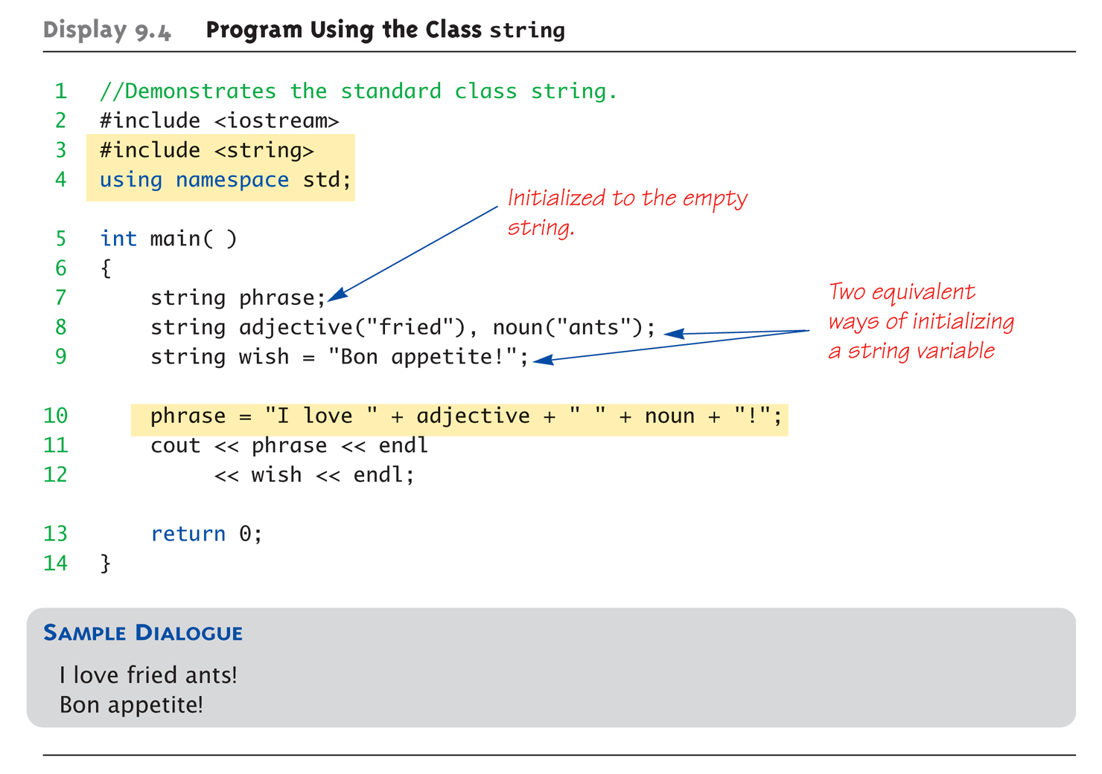
Program Using the Class string
together

Slide 65
I/O with Class string
Just like other types!
string s1, s2; cin >> s1; cin >> s2;
Results: User types in: May the hair on your toes grow long and curly!
Extraction, cin, still ignores initial whitespace & stops a WS: s1 receives value "May" s2 receives value "the"

Slide 66
getline() with Class string
For complete lines: string line; //default constructor cout << "Enter a line of input: "; getline(cin, line); //stand-alone function cout << line << "END OF OUTPUT";
Dialogue produced: Enter a line of input: Do be do to you! Do be do to you!END OF INPUT
Similar to c-string’s usage of getline()

Slide 67
Other getline() Versions
Two versions of getline()
istream & getline(cin, line); line => string
Can specify "delimiter" character: string line; cout << "Enter input: "; istram & getline(cin, line, ‘?’);
Receives input until ‘?’ encountered
getline() actually returns reference to cin
string s1, s2; getline(cin, s1) >> s2;
Results in: (cin) >> s2;
To read one character at a time
cin.get(nextChar);

Slide 68
Pitfall: Mixing Input Methods
Be careful mixing cin >> var and getline()
int n; string line; //empty string cin >> n; getline(cin, line);
If input is: 42 Hello hitchhiker.
Variable n set to 42
line set to empty string
cin >> n skipped leading whitespace, leaving "\n" on stream for getline()! since getline() skips ‘\n’ and white space
cin.ignore(1000, ‘\n’); //discards next 1000 chars & ‘\n’

Slide 69
Class String Processing
Same operations available as c-strings
And more!
Over 100 members of standard string class
Some member functions:
.length()
Returns length of string variable
.at(i)
Returns reference to char at position I
Checks range bounding – throws exception

Slide 70
String Member Functions
Member Function | Description
constructor | Construct string object (public member function )
destructor | String destructor (public member function )
operator=( ) | String assignment (public member function )
Capacity
Member Function | Description
size() | Return length of string (public member function )
length( ) | Return length of string (public member function )
capacity( ) | Return size of allocated storage (public member function )
empty( ) | Test if string is empty (public member function )
resize( ) | Resize string (public member function )

Slide 71
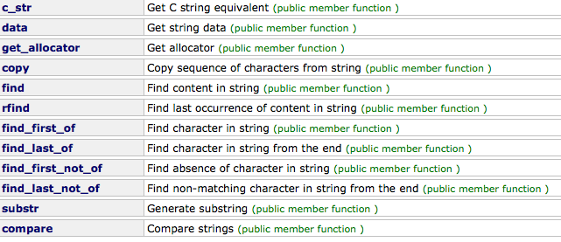

String Member Functions
String operations
Capacity
Iterators

Slide 72
String Member Functions
Member Function | Description
operator += | Append to string (public member function )
append | Append to string (public member function )
push_back( ) | Append character to string (public member function )
Element access
Member Function | Description
operator[] | Get character of string (public member function )
at( ) | Get character in string (public member function )
back( ) | Access last character (public member function )
front( ) | Access first character (public member function )

Slide 73
C-string and String Object Conversions
Automatic type conversions
From c-string to string object: char aCString[] = "My C-string"; //C-string variable string stringVar; // empty string stringVar = aCstring; ✔
Perfectly legal and appropriate!
aCString = stringVar;
ILLEGAL!
Cannot auto-convert to c-string
Must use explicit conversion: strcpy(aCString, stringVar.c_str());
Notice
aCString = stringVariable.c_str(); //illegal
Assignment operator does not work with C-strings
Member function c-str returns C-string corresponding to string object

Slide 74
Summary
C-string variable is "array of characters"
With addition of NULL character, "\0"
C-strings act like arrays
Cannot assign, compare like simple variables
Libraries <cctype> & <string> have useful manipulating functions
cin.get() reads next single character
getline() versions allow full line reading
Class string objects are better-behaved than c-strings

