Slide 1
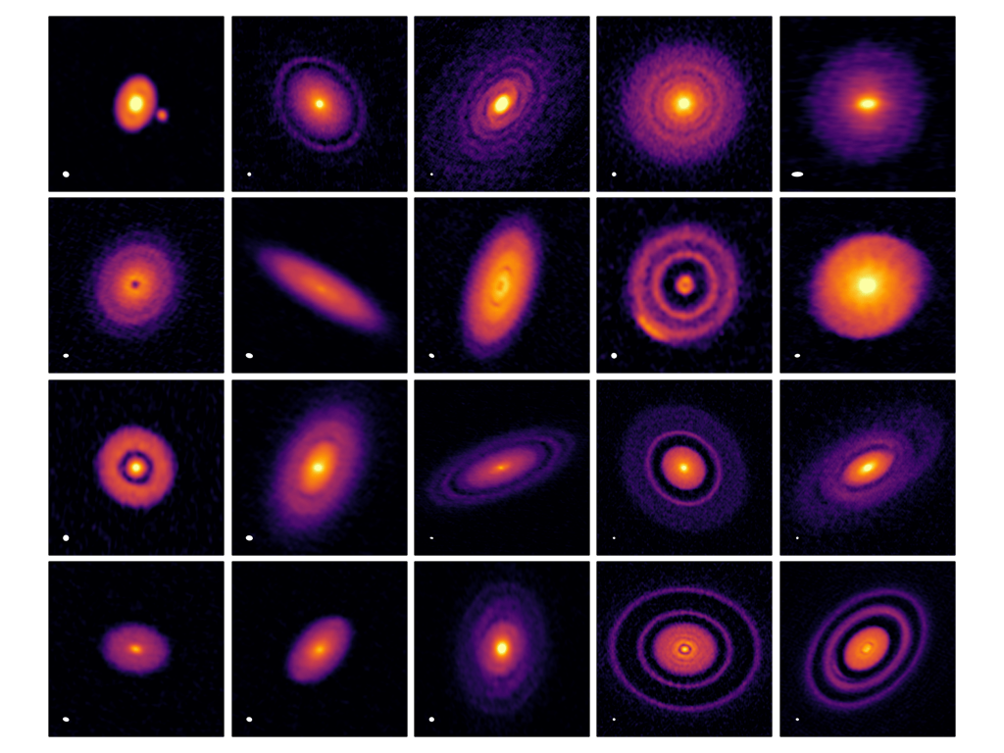
1. Rings and Gaps in Protoplanetary Disks
Content
Introduce annular substructures observed by ALMA.
Compare mechanisms involving planets, snowlines, and MHD processes.
Present PDS 70 as a case study of planet-induced gap formation.
References
Long et al. (2018)
Huang et al. (2018)
https://scixplorer.org/abs/2018ApJ...869...17L/abstract
https://scixplorer.org/abs/2018ApJ...869L..42H/abstract
Keppler et al. (2018)
Andrews (2020)
https://scixplorer.org/abs/2018A&A...617A..44K/abstract
https://scixplorer.org/abs/2020ARA&A..58..483A/abstract
Notes:
Rings and Gaps in Protoplanetary Disks
Introduce annular substructures observed by ALMA.
Compare mechanisms involving planets, snowlines, and MHD processes.
Present PDS 70 as a case study of planet-induced gap formation.
References
Long et al. (2018)
Huang et al. (2018)
Andrews (2020)
Keppler et al. (2018)
Rings and Gaps in Protoplanetary Disks
Introduce annular substructures observed by ALMA.
Compare mechanisms involving planets, snowlines, and MHD processes.
Discuss how observations can distinguish between these mechanisms.
Present PDS 70 as a case study of planet-induced gap formation.
References
Long et al. (2018)
https://scixplorer.org/abs/2018ApJ...869...17L/abstract
Huang et al. (2018)
https://scixplorer.org/abs/2018ApJ...869L..42H/abstract
Andrews (2020)
https://scixplorer.org/abs/2020ARA%26A..58..483A/abstract
Keppler et al. (2018)
https://scixplorer.org/abs/2018A%26A...617A..44K/abstract
Project 1: Rings and Gaps in Protoplanetary Disks
Introduce annular substructures observed by ALMA. Compare mechanisms involving planets, snowlines, and magnetohydrodynamic processes, and discuss how observations can distinguish between them. Present PDS 70 as a case study of a planet embedded within a disk gap.
References
Long, F., et al. (2018). Gaps and Rings in an ALMA Survey of Disks in the Taurus Star-forming Region. ApJ, 869, 17.
https://scixplorer.org/abs/2018ApJ...869...17L/abstract
Huang, J., et al. (2018). The Disk Substructures at High Angular Resolution Project (DSHARP). II. Characteristics of Annular Substructures. ApJL, 869, L42.
https://scixplorer.org/abs/2018ApJ...869L..42H/abstract
Andrews, S. M. (2020). Observations of Protoplanetary Disk Structures. ARA&A, 58, 483–528.
https://scixplorer.org/abs/2020ARA%26A..58..483A/abstract
Keppler, M., et al. (2018). Discovery of a planetary-mass companion within the gap of the transition disk around PDS 70. A&A, 617, A44.
https://scixplorer.org/abs/2018A%26A...617A..44K/abstract
Image source
https://almascience.eso.org/almadata/lp/DSHARP/
ALMA DSHARP disk images
Credit: ALMA (ESO/NAOJ/NRAO), S. Andrews et al.

Slide 2
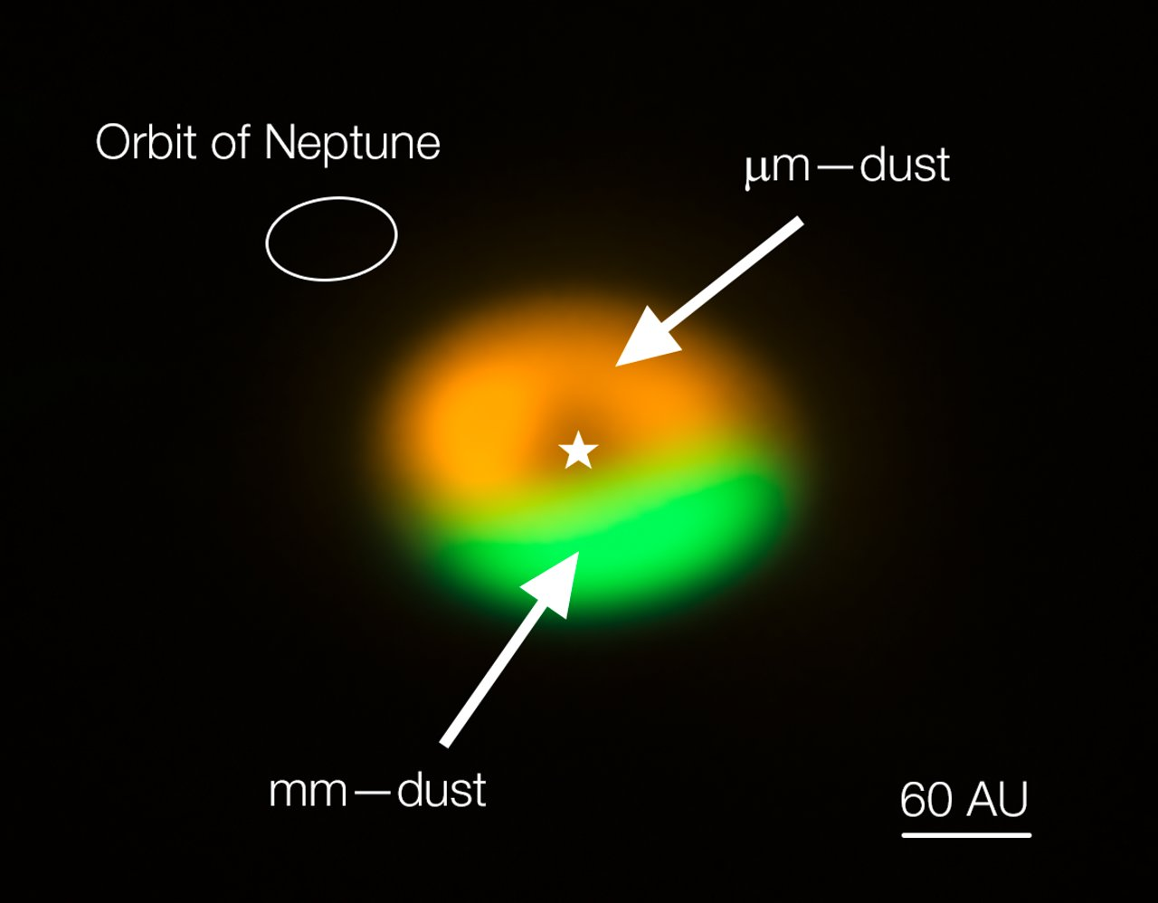
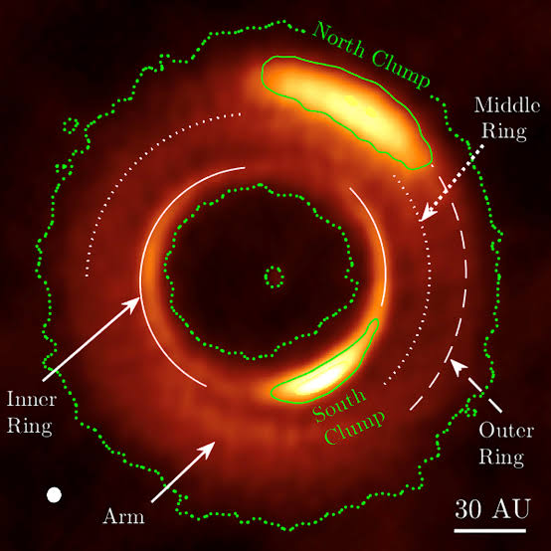
Oph IRS 48 / MWC 758
2. Azimuthal Clumps in Protoplanetary Disks
Content
Introduce ALMA observations of azimuthal dust concentrations.
Explain how vortices trap particles against turbulent diffusion.
Discuss the Rossby wave instability as the origin of asymmetry.
Present Oph IRS 48/MWC 758 as a case study of an asymmetric dust trap.
References
Li et al. (2001)
van der Marel et al. (2013)
https://scixplorer.org/abs/2001ApJ...551..874L/abstract
https://scixplorer.org/abs/2013Sci...340.1199V/abstract
Dong et al. (2018)
Andrews (2020)
https://scixplorer.org/abs/2018ApJ...860..124D/abstract
https://scixplorer.org/abs/2020ARA&A..58..483A/abstract
Notes:
Azimuthal Clumps in Protoplanetary Disks
Introduce crescents and azimuthal dust concentrations observed by ALMA.
Explain how vortices trap particles against turbulent diffusion.
Discuss the Rossby wave instability and alternative origins of asymmetry.
Present Oph IRS 48 as a case study of an asymmetric dust trap.
References
van der Marel et al. (2013)
Lyra & Lin (2013)
Andrews (2020)
Sources: van der Marel et al. (2013), Science 340, 1199; Lyra & Lin (2013), ApJ 775, 17. Image source: ESO eso1325d, ALMA (ESO/NAOJ/NRAO)/Nienke van der Marel.

Slide 3
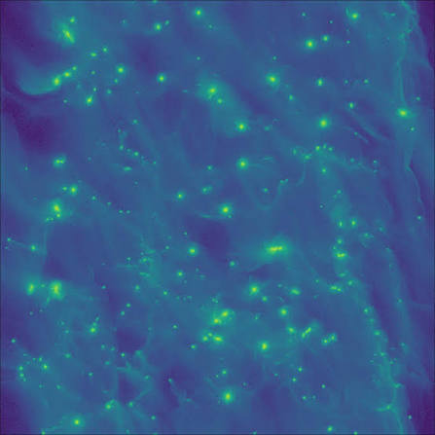
3. From Dust to Planetesimals (Streaming Instability)
Content
Explain radial drift and the drift barrier.
Discuss how pressure bumps concentrate solid particles.
Introduce the streaming instability and its physical mechanism.
Discuss gravitational collapse and the initial planetesimal mass function.
References
Youdin & Goodman (2005)
Johansen et al. (2007)
https://scixplorer.org/abs/2005ApJ...620..459Y/abstract
https://scixplorer.org/abs/2007Natur.448.1022J/abstract
Schäfer, Yang & Johansen (2017)
Drążkowska et al. (2023)
https://scixplorer.org/abs/2017A&A...597A..69S/abstract
https://scixplorer.org/abs/2023ASPC..534..717D/abstract
Notes:
From Dust to Planetesimals (Streaming Instability)
Explain radial drift and the drift barrier.
Discuss how pressure bumps concentrate solid particles.
Introduce the streaming instability and its physical mechanism.
Discuss gravitational collapse and the initial planetesimal mass function.
References
Drążkowska et al. (2023)
Youdin & Goodman (2005)
Schäfer, Yang & Johansen (2017)
From Dust to Planetesimals
Explain dust growth, radial drift, and the drift barrier.
Discuss pressure traps and the conditions for particle concentration.
Introduce the streaming instability and its physical mechanism.
Explain how pebble clouds collapse into planetesimals.
References
Drążkowska et al. (2023)
https://scixplorer.org/abs/2023ASPC..534..717D/abstract
Youdin & Goodman (2005)
https://scixplorer.org/abs/2005ApJ...620..459Y/abstract
Project 2: From Dust to Planetesimals
Explain dust growth and radial drift, pressure traps, the streaming instability, and the gravitational collapse of pebble clouds into planetesimals. Discuss the conditions required for efficient particle concentration and planetesimal formation.
References
Drążkowska, J., et al. (2023). Planet Formation Theory in the Era of ALMA and Kepler: from Pebbles to Exoplanets. Protostars and Planets VII.
https://scixplorer.org/abs/2023ASPC..534..717D/abstract
Youdin, A. N., & Goodman, J. (2005). Streaming Instabilities in Protoplanetary Disks. ApJ, 620, 459–469.
https://scixplorer.org/abs/2005ApJ...620..459Y/abstract
Image source
https://www.gauss-centre.eu/results/astrophysics/planet-formation-through-the-gravitational-collapse-of-solids-and-gas
Dust concentration in a planetesimal formation simulation
Credit: Gauss Centre for Supercomputing, Klahr project

Slide 4
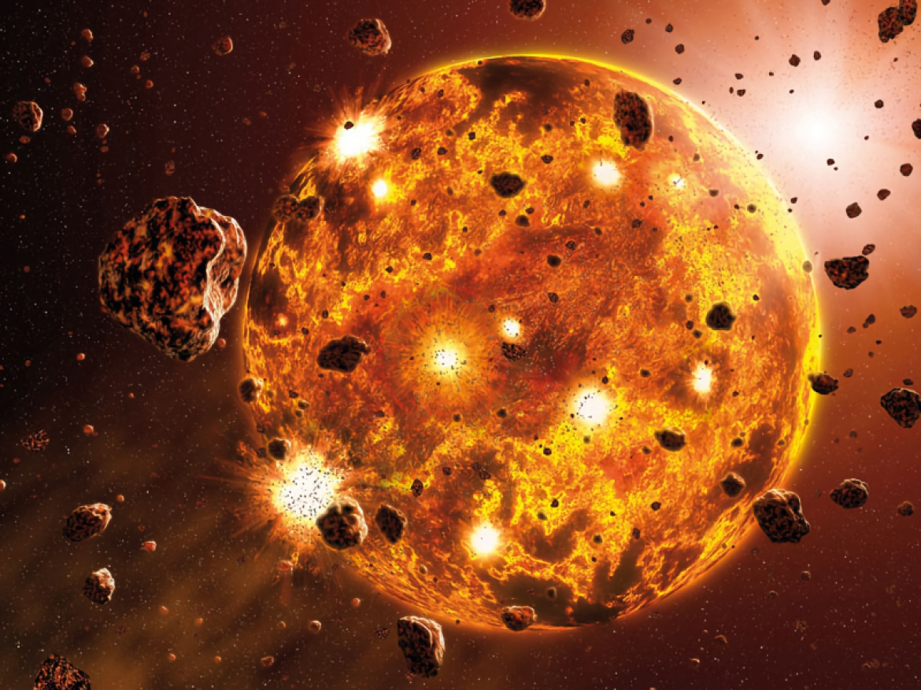
4. Core Accretion: From Planetesimals to Planetary Embryos
Content
Explain how pebble accretion build solid embryos and cores.
Discuss pebble capture, accretion efficiency, and the pebble isolation mass.
Explain how a solid core can later accrete gas.
References
Lambrechts & Johansen (2014)
Johansen & Lambrechts (2017)
https://scixplorer.org/abs/2014A&A...572A.107L/abstract
https://scixplorer.org/abs/2017AREPS..45..359J/abstract
Drążkowska et al. (2023)
https://scixplorer.org/abs/2023ASPC..534..717D/abstract
Notes:
4. Core Accretion: From Planetesimals to Planetary Embryos
Explain how planetesimal and pebble accretion build solid embryos and cores.
Introduce runaway and oligarchic growth and compare their timescales.
Discuss pebble capture, accretion efficiency, and the pebble isolation mass.
Explain how a solid core can later accrete gas to form a giant planet.
References
Johansen & Lambrechts (2017)
https://scixplorer.org/abs/2017AREPS..45..359J/abstract
Liu & Ji (2020)
https://scixplorer.org/abs/2020RAA....20..164L/abstract
Drążkowska et al. (2023)
https://scixplorer.org/abs/2023ASPC..534..717D/abstract
Kambara & Kokubo (2025)
https://scixplorer.org/abs/2025ApJ...985...71K/abstract
The image is an AI-generated educational concept, not a simulation or observation. Core accretion builds solids before substantial gas capture. Gas disk fragmentation can form gas-rich bound clumps without a pre-existing solid core. GI alone does not imply fragmentation, and fragments need not survive.

Slide 5
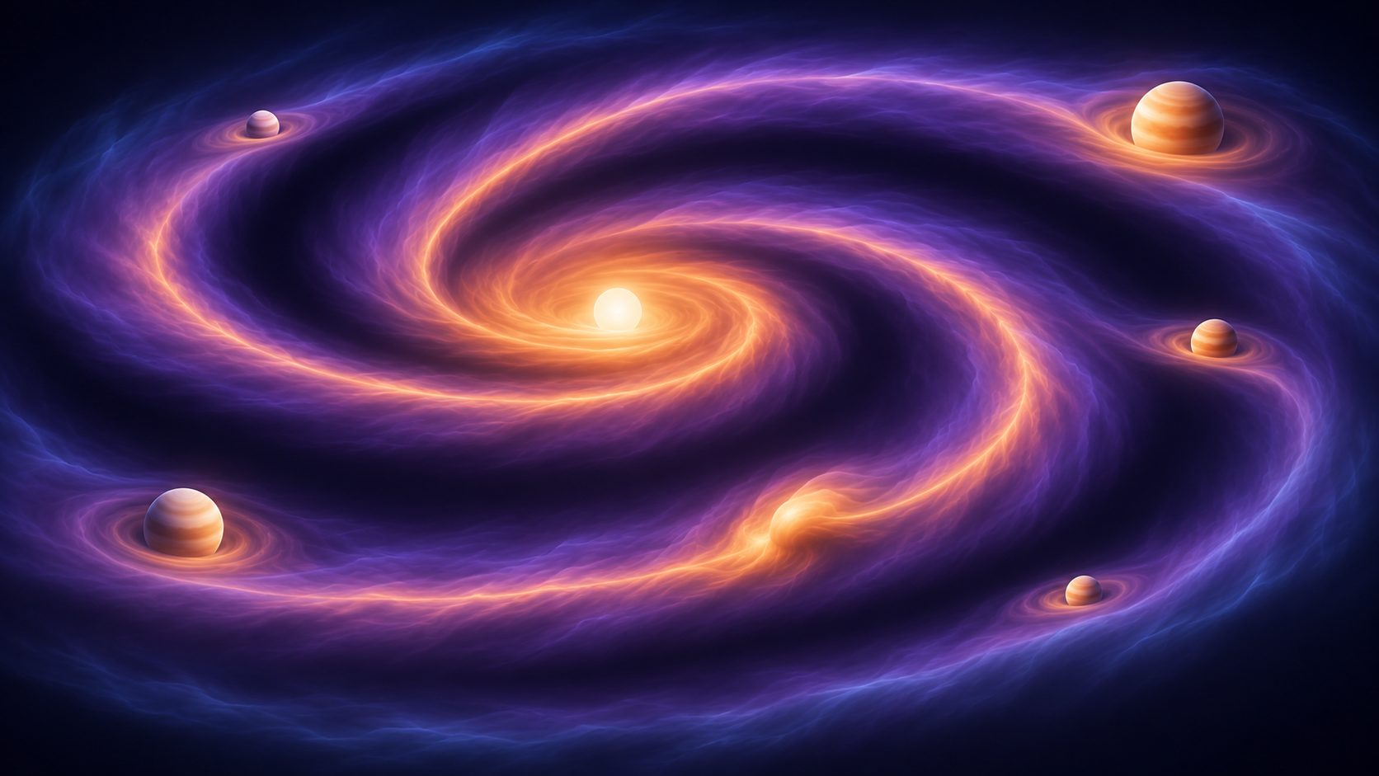
5. Gravitational Instability: Giant Planets
Content
Introduce the Toomre parameter and the onset of gravitational instability in gas disks.
Explain how spiral heating and cooling determine whether the disk remains self-regulated or fragments.
Describe how gravitationally bound gas clumps contract and evolve into giant planets
Compare planets formed by disk fragmentation with those formed by core accretion
References
Gammie (2001)
Zhu et al. (2012)
https://scixplorer.org/abs/2001ApJ...553..174G/abstract
https://scixplorer.org/abs/2012ApJ...746..110Z/abstract
Kratter & Lodato (2016)
Deng et al. (2021)
https://scixplorer.org/abs/2016ARA&A..54..271K/abstract
https://scixplorer.org/abs/2021NatAs...5..440D/abstract
Notes:
5. Gravitational Instability: Gas Disk Fragmentation
Introduce the Toomre parameter and the onset of gas disk self-gravity.
Explain spiral heating, cooling, and the conditions for disk fragmentation.
Describe gas-rich clump formation without a pre-existing solid core.
Distinguish GI from fragmentation and discuss fragment survival and migration.
References
Gammie (2001)
https://scixplorer.org/abs/2001ApJ...553..174G/abstract
Kratter & Lodato (2016)
https://scixplorer.org/abs/2016ARA&A..54..271K/abstract
The image is an AI-generated educational concept, not a simulation or observation. Core accretion builds solids before substantial gas capture. Gas disk fragmentation can form gas-rich bound clumps without a pre-existing solid core. GI alone does not imply fragmentation, and fragments need not survive.

Slide 6
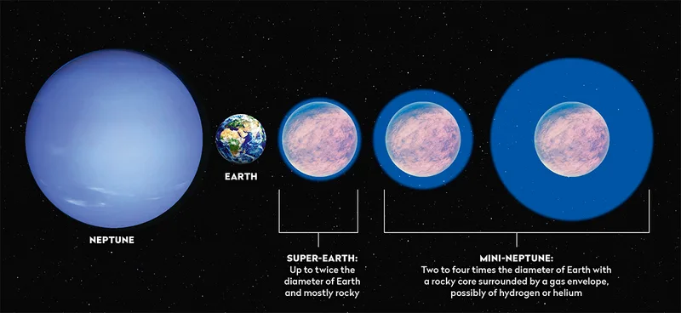
6. Super-Earths and Mini-Neptunes
Content
Introduce the observed sizes and architectures of close-in planets.
Compare in situ growth with formation farther out followed by migration.
Explain “peas in a pod” structure.
Discuss radius valley.
References
Izidoro et al. (2017)
Fulton et al. (2017)
https://scixplorer.org/abs/2017MNRAS.470.1750I/abstract
https://scixplorer.org/abs/2017AJ....154..109F/abstract
Zhu & Dong (2021)
Drążkowska et al. (2023)
https://scixplorer.org/abs/2021ARA&A..59..291Z/abstract
https://scixplorer.org/abs/2023ASPC..534..717D/abstract
Notes:
Super-Earths and Mini-Neptunes
Introduce the observed sizes and architectures of close-in planets.
Compare in situ growth with formation farther out followed by migration.
Explain rocky cores, gaseous envelopes, and the evolution of resonant chains.
Discuss atmospheric escape and the radius valley.
References
Zhu & Dong (2021)
Izidoro et al. (2017)
Fulton et al. (2017)
Drążkowska et al. (2023)
Planet Migration, Super-Earths and Mini-Neptunes
Explain disk torques, gap opening, and migration traps.
Compare in situ formation with formation farther out followed by migration.
Discuss resonant chains, their disruption, and compact planetary systems.
Connect core and envelope evolution with atmospheric escape and the radius valley.
References
Kley & Nelson (2012)
https://scixplorer.org/abs/2012ARA%26A..50..211K/abstract
Drążkowska et al. (2023)
https://scixplorer.org/abs/2023ASPC..534..717D/abstract
Zhu & Dong (2021)
https://scixplorer.org/abs/2021ARA%26A..59..291Z/abstract
Izidoro et al. (2017)
https://scixplorer.org/abs/2017MNRAS.470.1750I/abstract
Fulton et al. (2017)
https://scixplorer.org/abs/2017AJ....154..109F/abstract
Project 5: Planet Migration and Migration Traps
Explain angular momentum exchange between planets and disks, Lindblad and corotation torques, and Type I migration. Discuss how gap opening changes migration and how disk structure can create migration traps. Introduce resonant capture as a consequence of convergent migration.
References
Kley, W., & Nelson, R. P. (2012). Planet–Disk Interaction and Orbital Evolution. ARA&A, 50, 211–249.
https://scixplorer.org/abs/2012ARA%26A..50..211K/abstract
Drążkowska, J., et al. (2023). Planet Formation Theory in the Era of ALMA and Kepler: from Pebbles to Exoplanets. Protostars and Planets VII.
https://scixplorer.org/abs/2023ASPC..534..717D/abstract
Image source
https://planetplanet.net/2022/06/27/orbital-migration/
Spiral density waves launched by an embedded planet
Credit: Sean Raymond, planetplanet.net

Slide 7
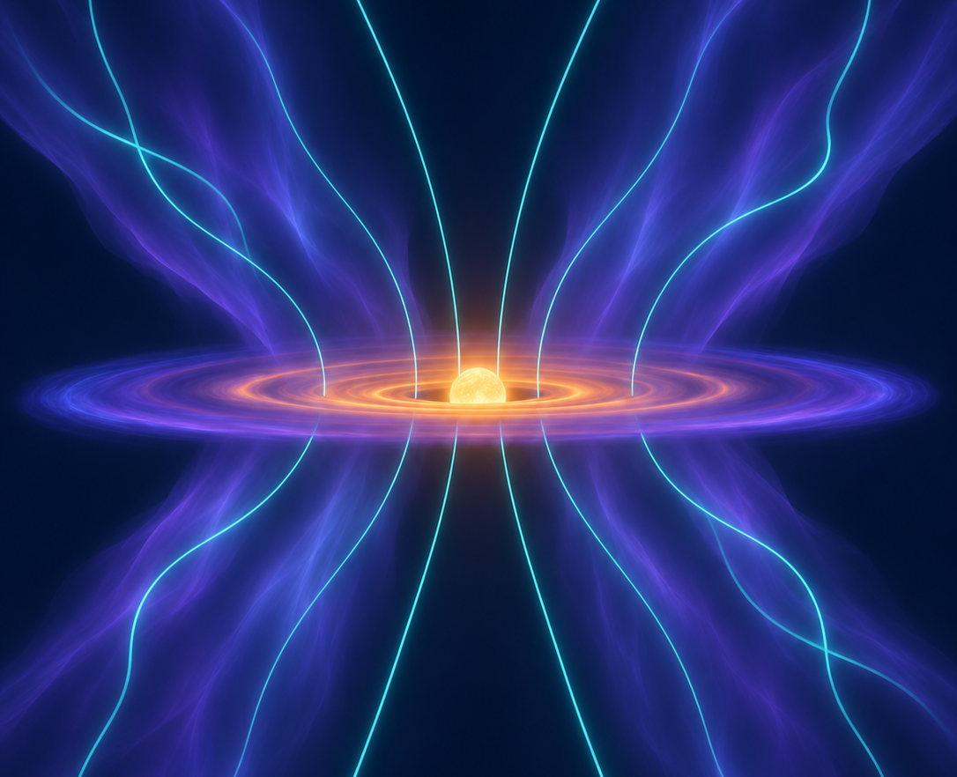
7. MHD in Protoplanetary Disks
Content
Explain how magnetic tension transfers angular momentum in the MRI.
Introduce Ohmic diffusion, the Hall effect, and ambipolar diffusion.
Compare MRI turbulence with accretion driven by magnetized disk winds.
Discuss implications for disk evolution, dust transport, and planet formation.
References
Balbus & Hawley (1991)
Bai & Stone (2013)
https://scixplorer.org/abs/1991ApJ...376..214B/abstract
https://scixplorer.org/abs/2013ApJ...769...76B/abstract
Lesur et al. (2023)
Bai (2026)
https://scixplorer.org/abs/2023ASPC..534..465L/abstract
https://scixplorer.org/abs/arXiv:2606.17150/abstract
Notes:
MHD in Protoplanetary Disks
Explain how magnetic tension transfers angular momentum in the MRI.
Introduce Ohmic diffusion, the Hall effect, and ambipolar diffusion.
Compare MRI turbulence with accretion driven by magnetized disk winds.
Discuss implications for disk evolution, dust transport, and planet formation.
References
Balbus & Hawley (1991)
Bai & Stone (2013)
Lesur et al. (2023)
MHD in Protoplanetary Disks
Explain how magnetic tension transfers angular momentum in the MRI.
Introduce Ohmic diffusion, the Hall effect, and ambipolar diffusion.
Compare MRI turbulence with accretion driven by magnetized disk winds.
Discuss implications for disk evolution, dust transport, and planet formation.
References
Balbus & Hawley (1991)
https://scixplorer.org/abs/1991ApJ...376..214B/abstract
Bai & Stone (2013)
https://scixplorer.org/abs/2013ApJ...769...76B/abstract
Lesur et al. (2023)
https://scixplorer.org/abs/2023ASPC..534..465L/abstract
Image: https://i.astro.tsinghua.edu.cn/~xbai/research.html
Schematic model, not a unique universal disk structure.

