Slide 1
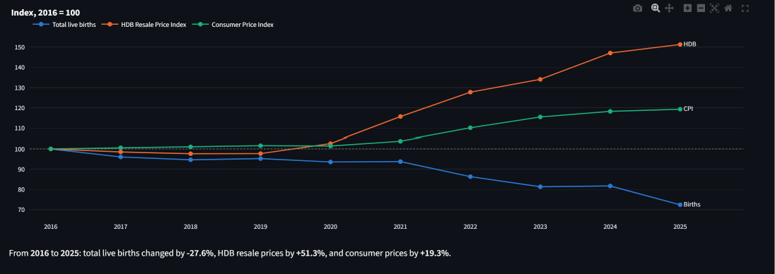



Births vs. Prices, 2016–2025
1
Live births fell 27.6% while HDB resale prices rose 51.3%
2
The gap opens after 2020
Live births
−27.6% (41,251 → 29,864)
HDB resale
+51.3% (index 100 → 151.3)
Consumer prices
+19.3% (index 100 → 119.3)
2016–2020: all three stay within 7% of their 2016 level
Live births and the HDB index move in opposite directions: r = −0.94 across the 10 years
From 2021 HDB prices rise every year; births drop most in 2022 (−7.9%) and 2025 (−11.4%)
Notes:
Picture 1. All three series are rebased to 2016 = 100. Live births fell 27.6% (41,251 to 29,864) while HDB resale prices rose 51.3% and consumer prices 19.3%. Until 2020 the three lines stay close together; from 2021 HDB prices climb every year and births fall, most sharply in 2022 (−7.9%) and 2025 (−11.4%). Level correlation of births with the HDB index is −0.94. Same-year changes are unrelated (r = +0.06), but price growth one year earlier is (r = −0.75, p = 0.03, n = 8), which fits a delayed response.

Slide 2
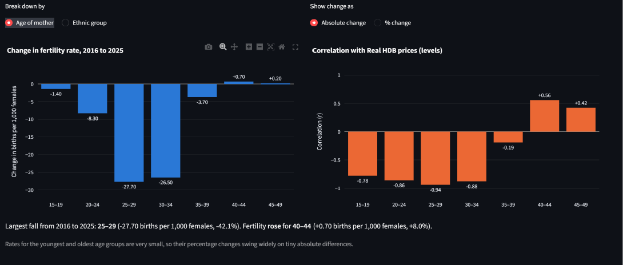



Fertility by Age of Mother
1
The fall is concentrated in mothers aged 25–34
2
The same ages track housing prices most closely
Age 25–29
−27.7 per 1,000 (−42%), r = −0.94
Age 30–34
−26.5 per 1,000 (−28%), r = −0.88
Age 40–44
+0.7 per 1,000 (+8%), r = +0.56
The ages when couples usually marry and buy a first flat fell the most
Ages 25–34 account for about 80% of the total fall in age-specific fertility
Gains at 40+ (+0.9 per 1,000) are far too small to offset the falls (−67.6)
Notes:
Picture 2. Fertility fell most for mothers aged 25–29 (−27.7 births per 1,000 females, −42.1%) and 30–34 (−26.5, −27.5%). Together these two groups make up about 80% of the total decline across age groups. Rates at 40–44 and 45–49 rose slightly, which suggests some postponement, but the gain (+0.9) is far too small to offset the falls (−67.6). The correlation with real HDB prices (HDB index divided by CPI) is strongest for 25–29 (−0.94), 30–34 (−0.88) and 20–24 (−0.86), weak for 35–39 (−0.19) and positive but not significant for 40+.

Slide 3
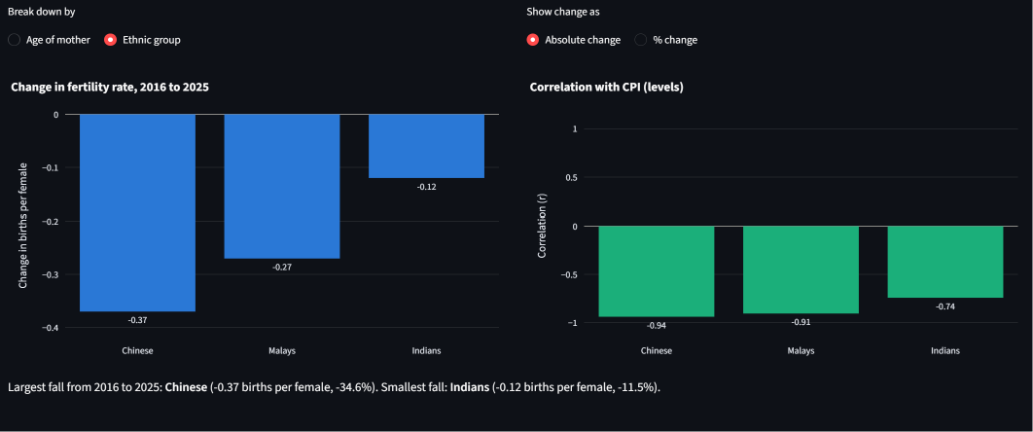


Fertility by Ethnic Group
1
Fertility fell in every ethnic group, most for Chinese
2
All three groups move against consumer prices
Chinese
1.07 → 0.70 (−34.6%), r = −0.94
Malays
1.80 → 1.53 (−15.0%), r = −0.91
Indians
1.04 → 0.92 (−11.5%), r = −0.74
Malay fertility held near 1.8 until 2022, then fell after inflation picked up
Every group stays below the replacement level of 2.1 births per female
Caution: 10 yearly points with shared trends show association, not cause
Notes:
Picture 3. Fertility fell in all three groups: Chinese 1.07 to 0.70 (−34.6%), Malays 1.80 to 1.53 (−15.0%), Indians 1.04 to 0.92 (−11.5%). All remain below the replacement level of 2.1. Level correlations with CPI are −0.94, −0.91 and −0.74. Timing differs: Chinese fertility declined steadily, while Malay fertility held near 1.8 until 2022 and then fell after CPI inflation picked up in 2022–2023. Caveat: only 10 annual observations and both series trend, so this is association, not proof of cause.

