Slide 1
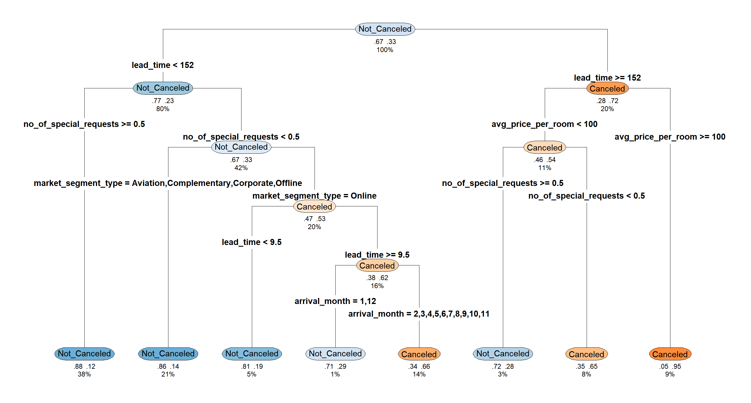
Three red-flag rules catch 69% of cancellations
A decision tree asks yes/no questions about each booking. Pruned to eight groups, it reads like a flowchart.
Share of bookings cancelled in each group
96%
Booked 152+ days ahead at €100 or more
8.5% of bookings
64%
Booked 152+ days ahead under €100, no special request
7.6% of bookings
63%
Booked online 10 to 151 days ahead, no special request, February to November stay
15.0% of bookings
12%
Booked under 152 days ahead with a special request
38.2% of bookings (safest group)
The three red-flag rules cover 31% of bookings. The rules held on unseen bookings: every group was within 4 points of its training rate.
CART in R (rpart), pruned with 10-fold cross-validation. Rates measured on 10,882 test bookings that were not used to build the tree.
Notes:
CART splits the bookings with yes/no questions. The full pruned tree has 181 end groups, too large to show, so this is a simplified management tree with eight groups. Three groups are red flags: long lead time at 100 euros or more (96% cancel), long lead time at a lower price with no special request (64%), and online bookings made 10 to 151 days ahead with no special request outside December and January (63%). Together they are 31% of bookings and 69% of all cancellations. The safest group is bookings with at least one special request: only 12% cancel.

Slide 2
Random forest gets 9 in 10 bookings right
500 decision trees vote on each booking. Less readable than a single tree, but more accurate and more stable.
90%
81%
88%
Actual cancellation rate by risk band
of unseen bookings classified correctly
of all cancellations caught
of alerts are real cancellations
Model | Accuracy | Cancellations caught | AUC
No model | 67% | 0% | 0.50
Management tree | 81% | 69% | 0.82
Optimal CART | 87% | 77% | 0.92
Random forest | 90% | 81% | 0.95
AUC measures how well the model ranks risky bookings: 0.5 is chance, 1 is perfect.
The very-high band is 1 booking in 5 and holds 61% of all cancellations.
Random forest in R (randomForest), 500 trees. All figures measured on 10,882 test bookings. No model = assume no booking cancels.
Notes:
A single tree is easy to read but can change when the data changes. A random forest builds 500 trees on different random samples and lets them vote. On the 10,882 bookings the model never saw, it is right 90% of the time, against 67% if we simply assume nobody cancels. It catches 81% of cancellations, and 88% of the bookings it flags really are cancelled. More useful than a yes or no answer is the risk score: only 4% of low-risk bookings cancel, 96% of very-high-risk bookings do. That top band is one booking in five and contains 61% of all cancellations. The alert threshold is a business choice: lowering it from 50% to 30% catches 88% of cancellations, with more false alarms.

Slide 3




Lead time and special requests drive cancellation
The forest ranks each factor by how much accuracy is lost when that factor is scrambled.
Importance of each factor (top 8 of 17)
How the top four work
Lead time
Booked 152+ days ahead: 72% cancel, against 23% for shorter lead times.
Special requests
With a request (under 152 days ahead), only 12% cancel.
Room price
Long-lead bookings at €100 or more: 96% cancel.
Booking channel
With no request, online bookings cancel 52% of the time; other channels 15%.
Importance = mean decrease in accuracy (randomForest, R). Cancellation rates are for decision-tree groups on the 10,882 test bookings.
Notes:
Which factors matter most? The forest ranks them by how much its accuracy falls when each factor is scrambled. Lead time is clearly first, then special requests, room price, booking channel and arrival month. These are the same factors the decision tree chose for its splits, so two different methods agree. The further ahead a room is booked, the more likely it is cancelled: 72% beyond 151 days against 23% otherwise. A special request signals commitment. Online bookings without any request cancel far more often than offline or corporate ones. Guest history ranks last only because 97% of bookings are from first-time guests.

Slide 4
Four booking segments call for different handling
Clustering groups similar bookings without knowing which were cancelled. One segment produces 41% of all cancellations.
Cancellation rate by segment (hotel average 33%)
A Long-lead planners
20% of bookings, 41% of cancellations
Booked about 7 months ahead, few special requests.
Deposit or non-refundable rate; reconfirm before arrival.
B Premium groups and families
12% of bookings, 14% of cancellations
Highest price (€158), 3 guests, booked online.
Pre-arrival contact; review free-cancellation terms.
C Short-notice, short stay
42% of bookings, 32% of cancellations
Booked about 6 weeks ahead for 2 nights.
Standard policy with an automated reminder.
D Engaged guests
26% of bookings, 13% of cancellations
Most special requests, longest stays (4 nights).
Keep terms flexible; prioritise service.
Segment A is 1 booking in 5 but 2 cancellations in 5: deposits and reconfirmation pay off most here.
K-means in R on lead time, room price, special requests, nights and guests (all 36,275 bookings). Segments overlap: use them for policy, the forest score for single bookings.
Notes:
The first two models predict. Clustering describes. K-means grouped the 36,275 bookings into four segments using lead time, price, special requests, length of stay and party size, without being told which were cancelled. Segment A, long-lead planners, is one booking in five but two in five cancellations: this is where deposits, non-refundable rates and reconfirmation matter most. Segment D, engaged guests with special requests, cancel only 16% of the time and should be protected with flexible terms. The segments overlap at the edges, so we use them to design policy for groups, and the random forest score to judge individual bookings.

