Slide 1
More Accurate Spectral Analysis
Hope-Simpson 2.7

Slide 2
Models
FFT
Convolve
Savitzky–Golay filter
Interp spline

Slide 3
Fast Fourier Transformation (FFT)
Assume we have N-point sequence, and now is decomposed into a series of short sequences. FFT makes full use of the symmetric and periodic properties of the exponential factor in the DFT, and then obtain the corresponding short sequences in DFT and make appropriate combinations to achieve the purpose of eliminating repeated calculations, reducing multiplication operations and simplifying the structure.

Slide 4
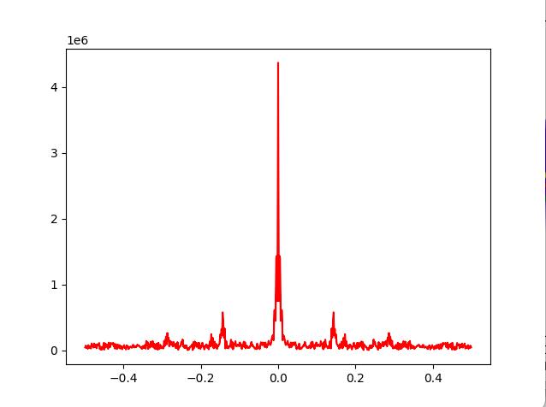
Fast Fourier Transformation (FFT)
Use Fourier Transformation to process the daily new data of the Covid-19 in Texas and the entire United States, eliminate noise points, so that the peak point of the original data will become flat and smooth, so as to achieve more accurate predictions of future data.

Slide 5
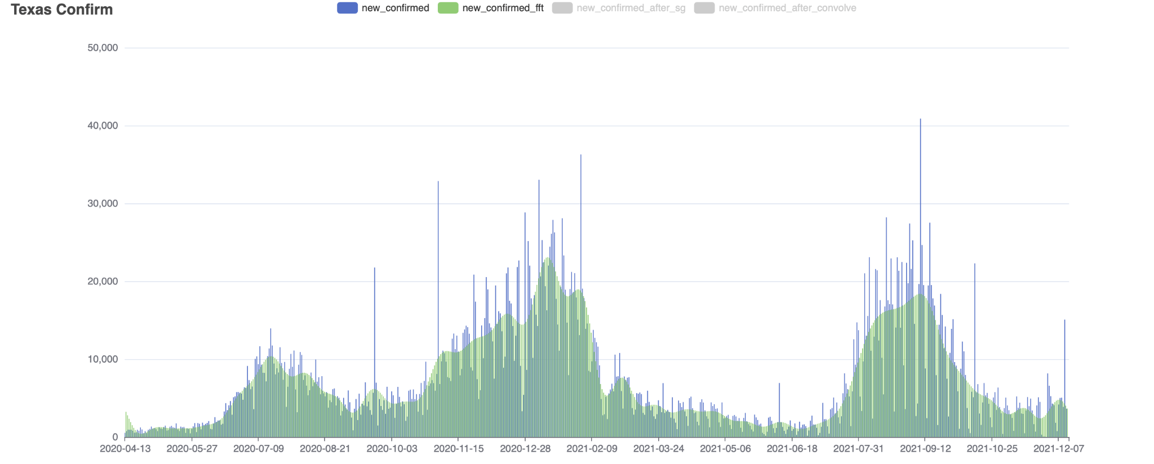
Fast Fourier Transformation (FFT)

Slide 6
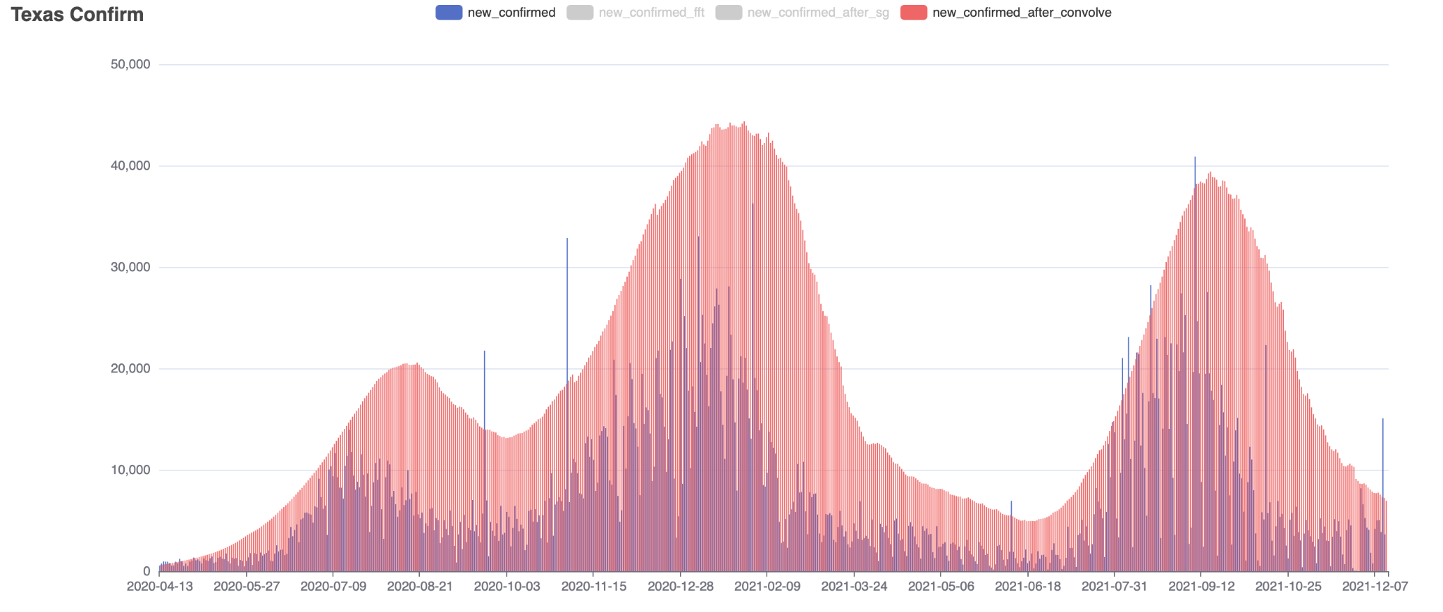
Convolve
We try to convolute the Covid-19 data, but the data after convolution is too large. We divide it by 10000 for display. On the trend, this processing result can show the changes of cases, but the data is not very relevant.

Slide 7
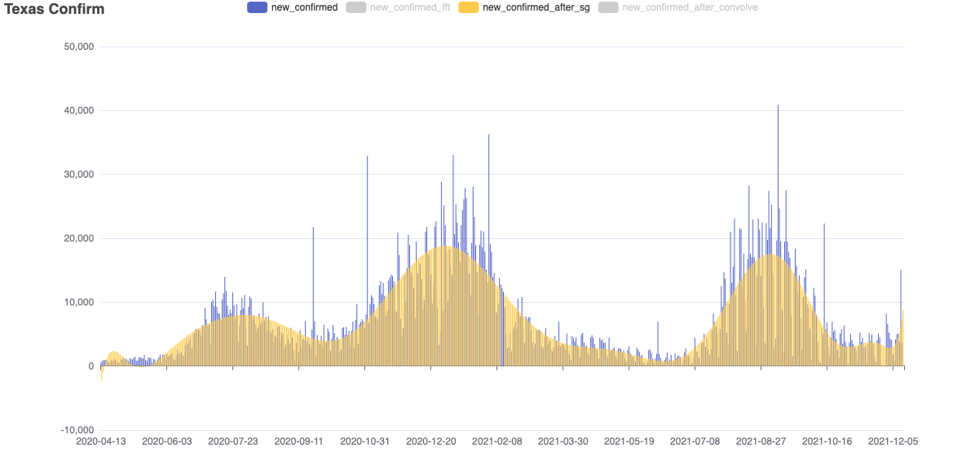
Savitzky–Golay filter
A Savitzky–Golay filter is a digital filter that can be applied to a set of digital data points for the purpose of smoothing the data, that is, to increase the precision of the data without distorting the signal tendency.

Slide 8
Interp Spline
In the mathematical field of numerical analysis, spline interpolation is a form of interpolation where the interpolant is a special type of piecewise polynomial called a spline.
We used Interp Spline in processing the data of the increment and death in Covid-19. As you can see from the chart, we firstly collected data on April 13, 2020, then continued collecting data after every six days, while ignoring data on other days.

Slide 9
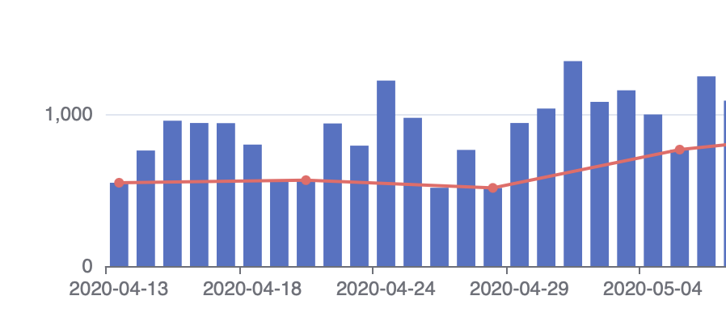
Interp Spline

Slide 10
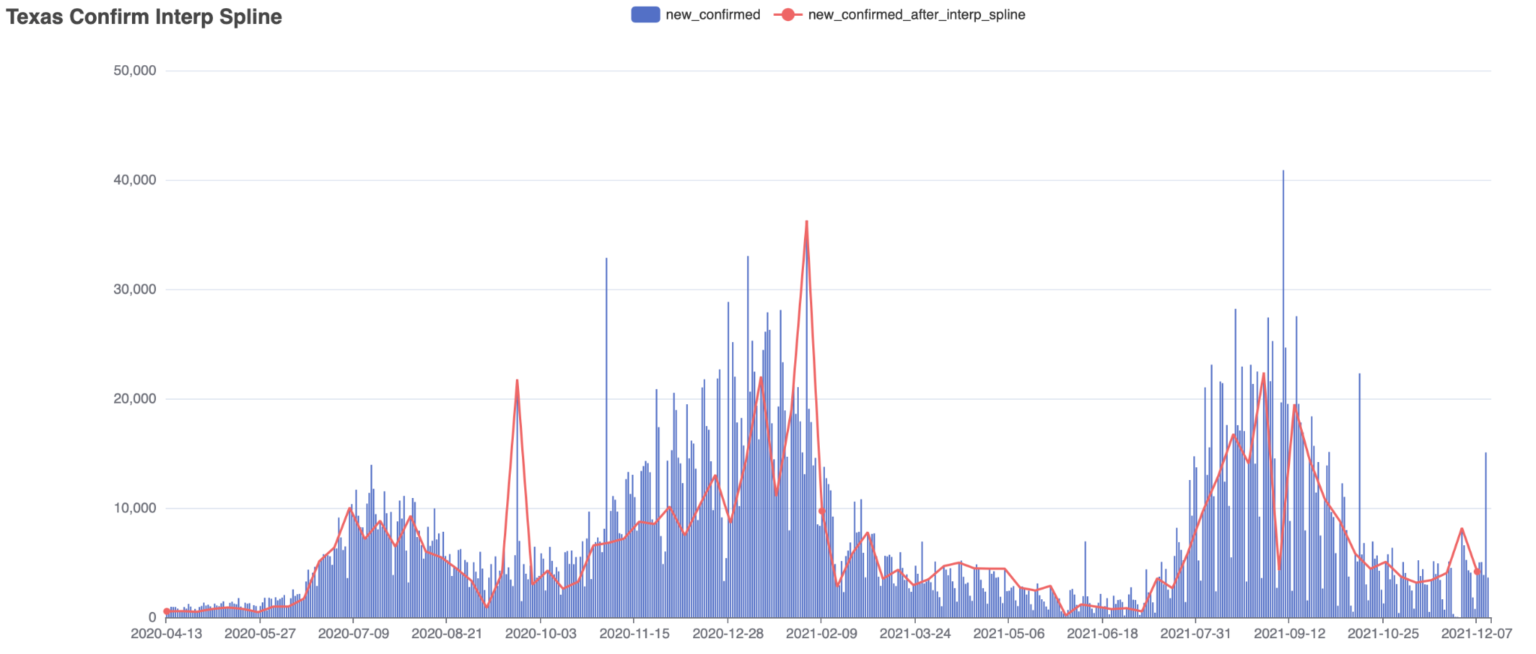
Interp Spline

Slide 11
Conclusion
After trying and comparing these four methods, we think FFT and Savitzky–Golay filter are better solutions, because the data trends they show are closest to the original data trends as well as having a good effect on predicting future trends.

