Slide 1
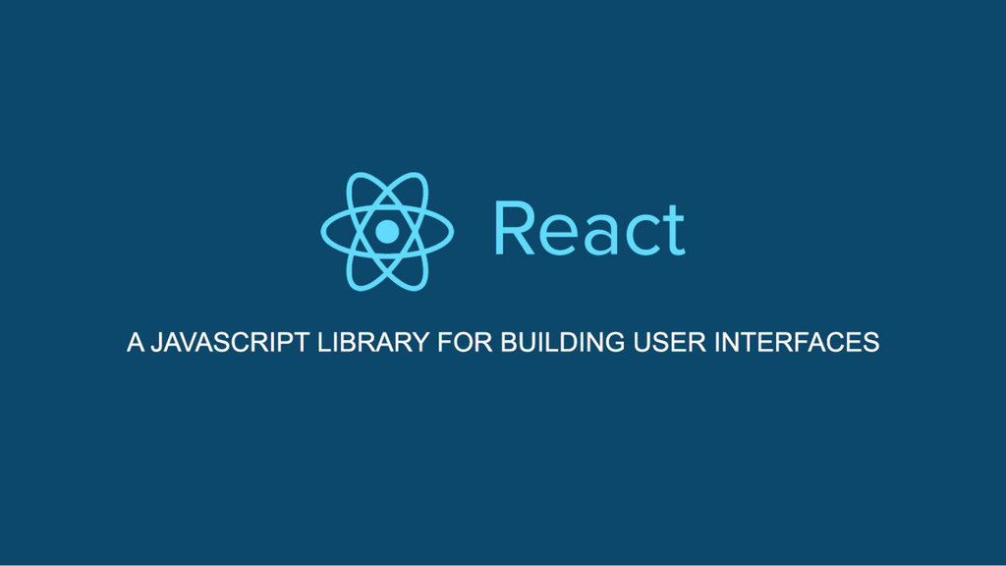

Slide 2
Table of content
Why React?
Core features of React.
What is DOM/Virtual DOM?
What is
Package manager – npm/yarn.
Bundler – Webpack/Browserify.
Compiler – Babel.
What is JSX?
Embedding Expressions in JSX.
Rendering Elements.
Functional and Class Components.
What is Props?
What is State?
Set State() examples.
Class component features.
Lifecycle methods.
How to use State correctly?
Handling Events.
Passing arguments to Event Handlers.
Conditional Rendering.
Lists and Keys.
Forms - Controlled Components.

Slide 3








Applications using React

Slide 4
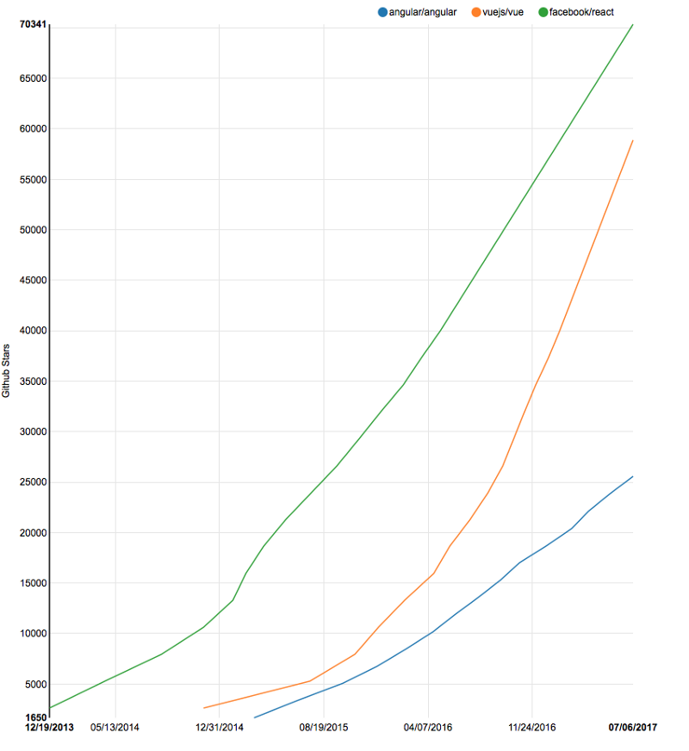
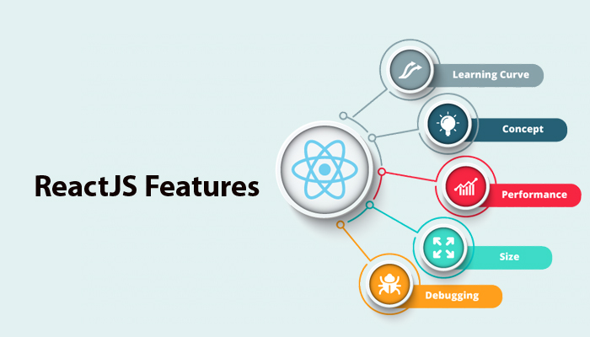
Why React?

Slide 5
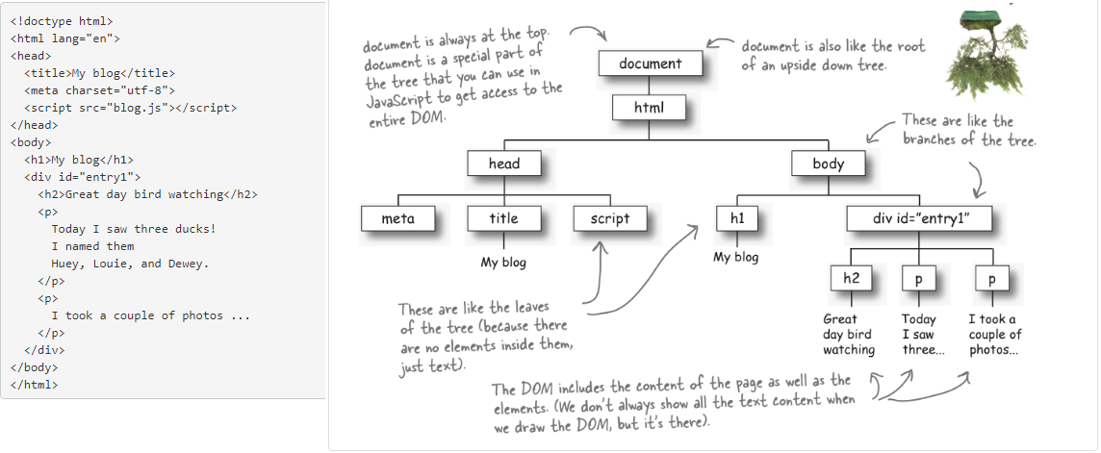
What is DOM/Virtual DOM?

Slide 6
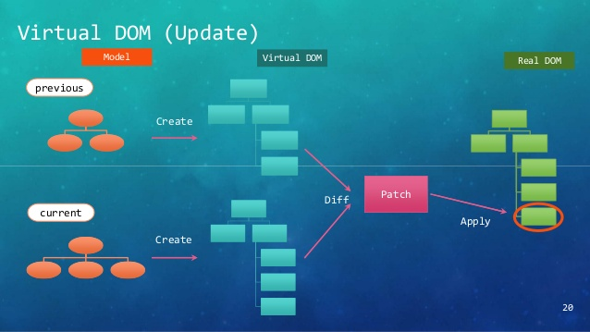

Slide 7
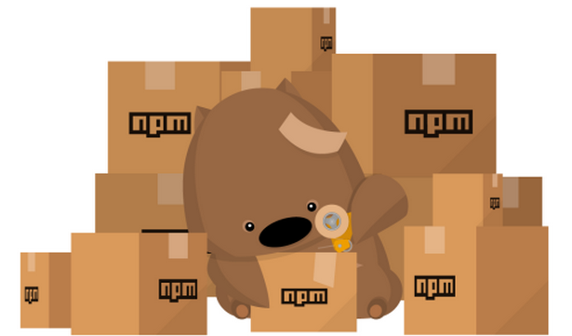
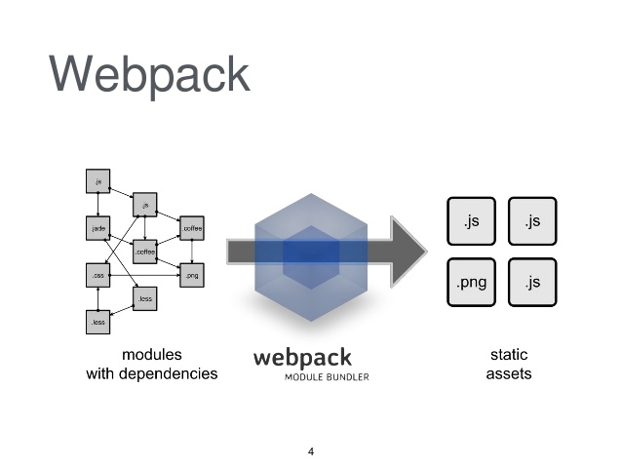
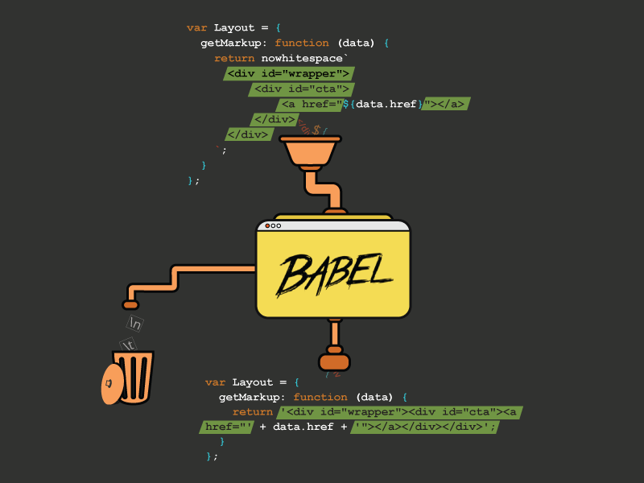
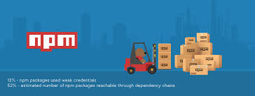
What is npm/yarn, Webpack and Babel?

Slide 8
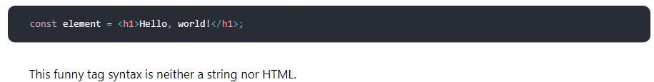
What is JSX?
It is called JSX, and it is a syntax extension to JavaScript.
Facebook recommend using it with React to describe what the UI should look like.
Though JSX may remind us of a template language, it comes with the full power of JavaScript.
JSX produces React “elements”.

Slide 9
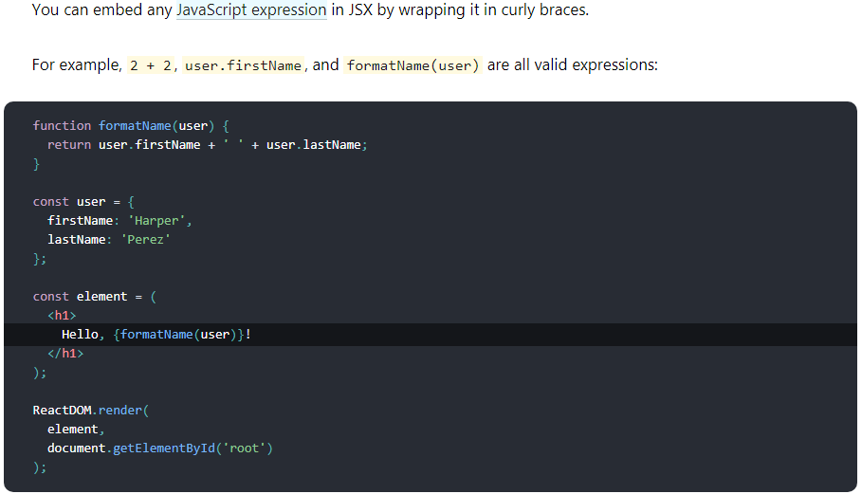
Embedding Expressions in JSX

Slide 10
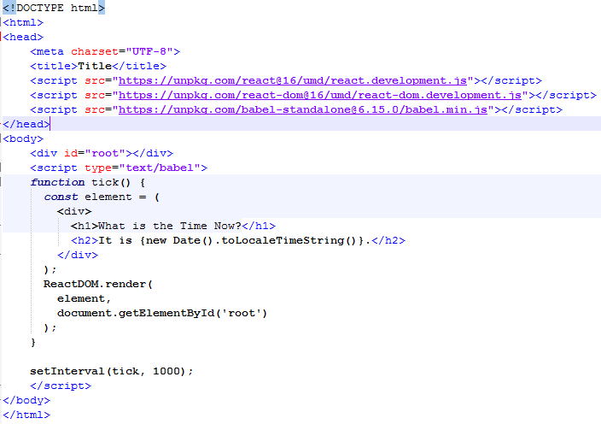
Rendering Elements

Slide 11

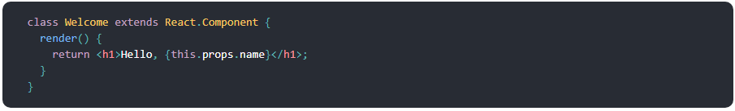
Functional and Class Components

Slide 12
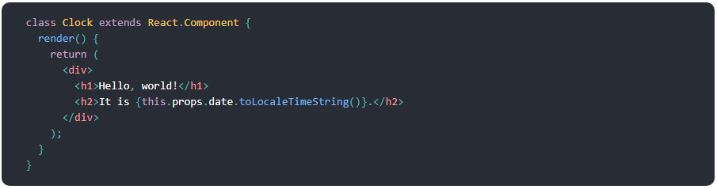
What is Props?

Slide 13
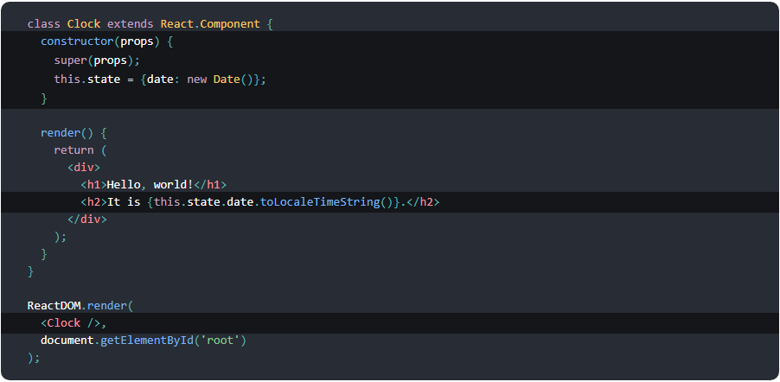
What is State?

Slide 14
References
https://reactjs.org/docs/hello-world.html
https://medium.com/unicorn-supplies/angular-vs-react-vs-vue-a-2017-comparison-c5c52d620176
https://medium.com/@hidace/understanding-reacts-virtual-dom-vs-the-real-dom-68ae29039951

Slide 15


