Slide 1
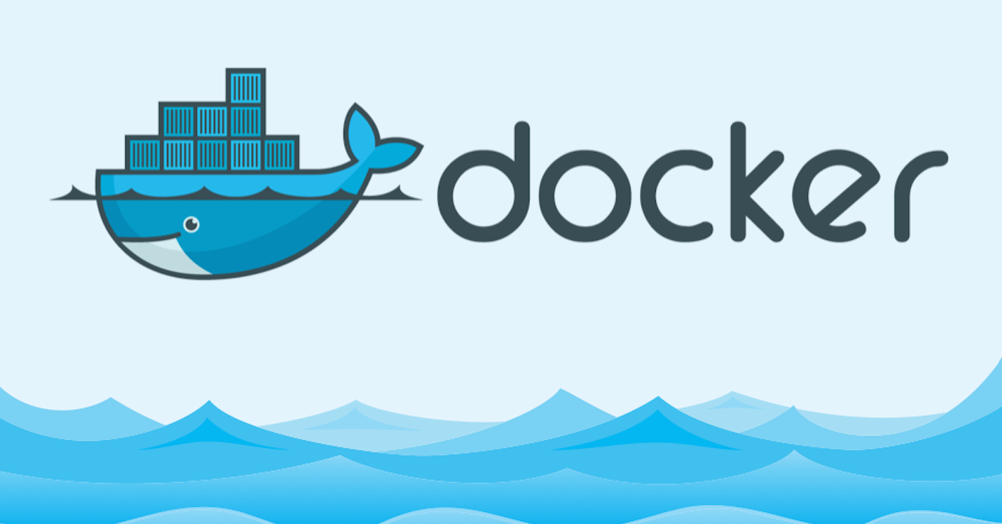

Slide 2
What is Docker?
The world’s leading software containerization platform.
An open-source project that automates the deployment of software applications inside portable lightweight containers.
Containers wrap a piece of software in a complete file system that contains everything needed to run: code, system tools, and system libraries – anything that can be installed on a server.
This guarantees that the software application can run on any machine with Docker installed, regardless of the underlying OS.

Slide 3
What Docker can do?
Here are some of the things that Docker can deal with:
Isolating an application dependencies
Creating an application image and replicating it
Creating ready to start applications that are easily distributable
Testing out applications and disposing them afterwards

Slide 4
Important entities in Docker
Images
Images on Docker are like the snapshot of a virtual machine, but way more lightweight.
There are several ways to create an image on Docker, most of them rely on creating a new image based on an already existing image.
If we feel the need to build and image from scratch, there are ways.
To create an image you take one image and modify it to create a child image.

Slide 5
Important entities in Docker
Containers
From images you can create containers, this is the equivalent of creating a VM from a snapshot, but way more lightweight.
Containers have one big difference that separate them from VMs, they are designed to run a single process.
Containers are designed to run an application, not a machine

Slide 6
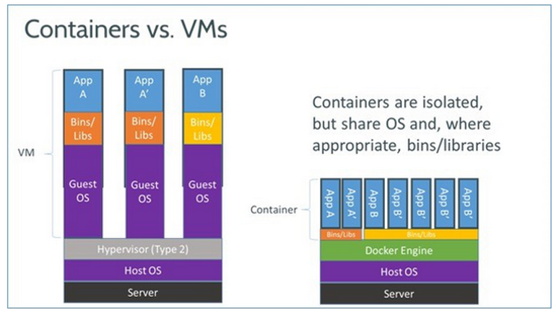

Slide 7
System Requirements
64bit Windows 10 Pro, Enterprise and Education. Hyper-V package must be enabled.
If you have an earlier Windows system that doesn’t meet the Docker for Windows prerequisites, get Docker Toolbox.
Docker for AWS
Docker for AWS is a native AWS application optimized to take optimal advantage of the underlying AWS IaaS services while giving you a modern Docker platform that you can use to deploy portable apps.
Docker for AWS does not require any software installed. You just need a browser and an AWS account, and can provision Docker in a few clicks.
Docker for AWS installs a Swarm of Docker Engines secured end to end with TLS by default, and is integrated with AWS Auto scaling, Elastic Load balancer and Elastic Block Store.

Slide 8
Advantages of using Docker
Skip the setup and maintenance of development environments and language-specific tooling.
Stop wasting hours setting up developer environments, spinning up new instances, and making copies of production code to run locally.
With Docker, you simply take copies of your live environment and run them on any new endpoint running a Docker engine.
Packaging an application in a container with its configurations and dependencies guarantees that the application will always work as designed in any environment: locally, on another machine, in test or production.
No more worries about having to install the same configurations into different environments.

Slide 9
References
https://en.wikipedia.org/wiki/Docker_(software)
https://opensource.com/resources/what-docker
https://docs.docker.com/engine/tutorials/dockerimages/
For more details - https://www.docker.com/

Slide 10


