Slide 1
A – APL valve
Patient
B – Bag
C – CO2 absorber
F – Fresh gas flow

Slide 2
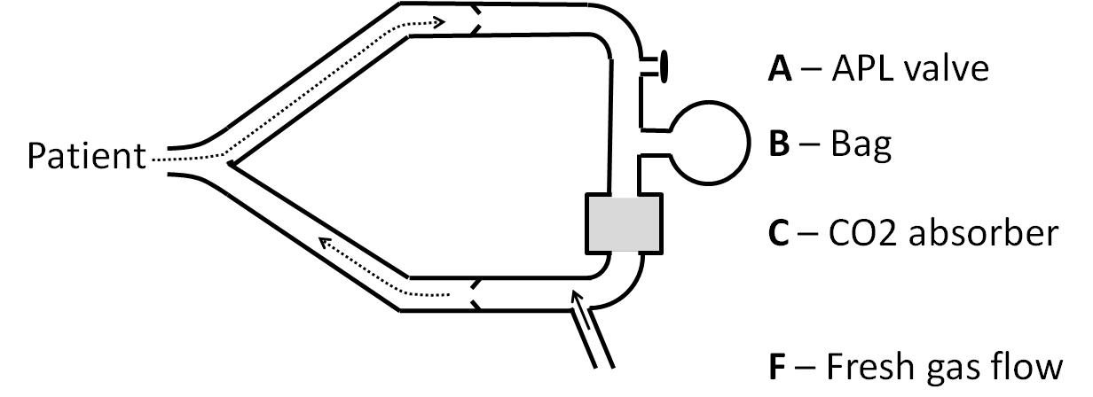

Slide 3
Patient

