Slide 1
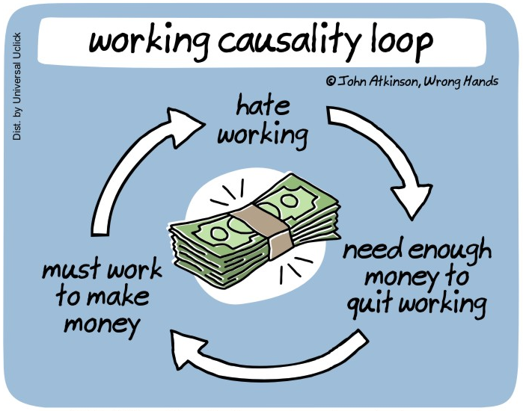
Causal Inference – Chapter 2
Graphical Models
Prof. Marco Zaffalon

Slide 2
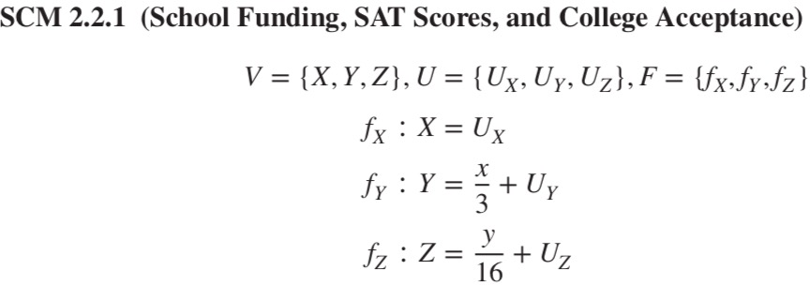
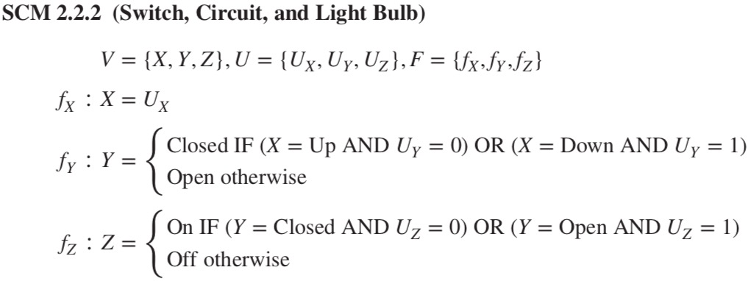
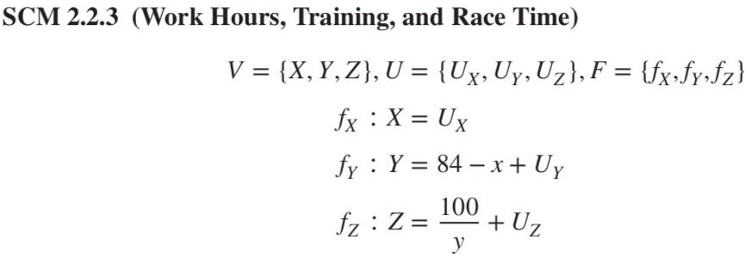
Example
Consider the following three hypothetical structural causal models (SCMs)
Continuous variables
Linear relations
Positive correlations
And
no
functions
in
common
Categorical variables
Logical relations
Continuous variables
Non-linear relations
Negative correlations

Slide 3
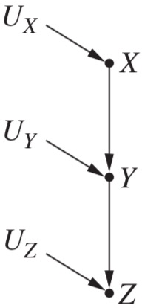
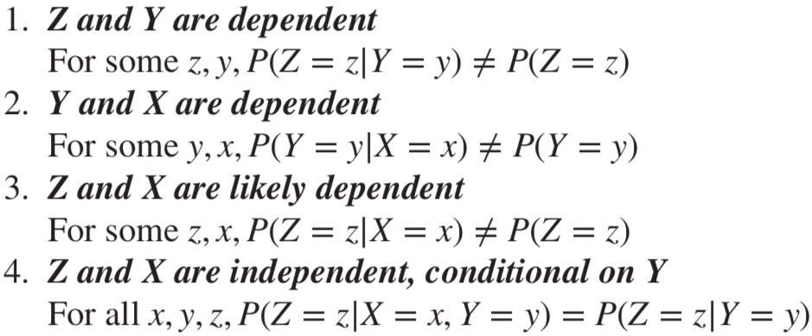
Example - ctd
In spite of that, they share the same graphical structure
And because of that, all three SCMs must share some independencies
Which we would find in datasets generated by these SCMs
And we can predict them just by looking at the graphical model alone
The independencies are these:
Why?

Slide 4
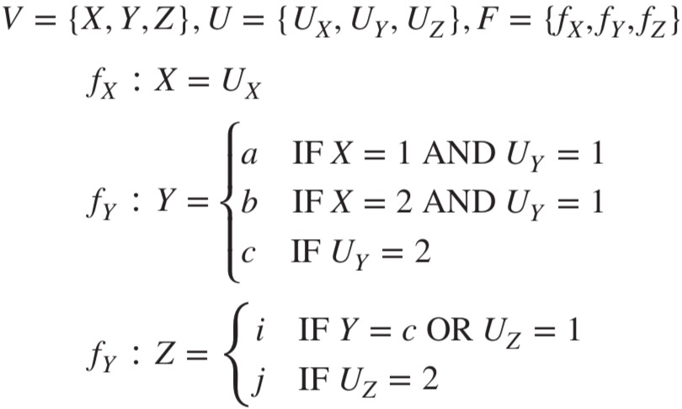
Example - ctd
Two variables connected by an edge are dependent
Take X -> Y
This means that X is in the function for Y
Which means that Y depends on X for its value
And we would see this dependence in a dataset
So X,Y are dependent and so are Y,Z
X,Z instead are potentially dependent
There are pathological cases where they are not dependent
X affects Y only when it equals a or b
Y affects Z only when it equals c

Slide 5
Chains
We said that X and Z are likely dependent
X and Z independent conditional on Y ?
Conditioning on Y means studying separately the cases on which Y takes different values
Like splitting a dataset into multiple datasets depending on the value Y takes
Say that we consider Y=a
We examine the cases with different values of X
U_{Y} changes in order to have Y=a all the times
But Z depends on Y only, not U_{Y} , so Z stays unaltered
X does not affect Z when Y=a
Same with different values of Y
So X and Z are independent conditional on Y
This holds since they are in a chain: X -> Y -> Z
It can be generalized as follows (U-variables must be independent of each other)

Slide 6
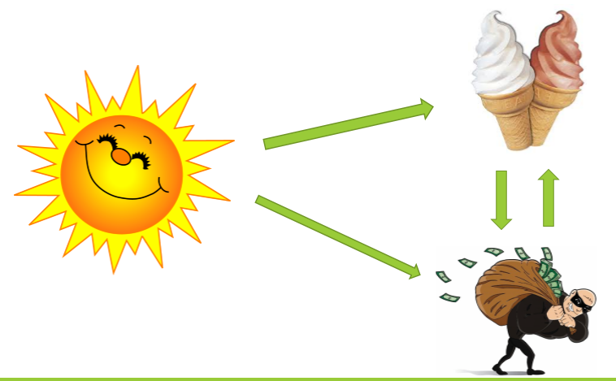
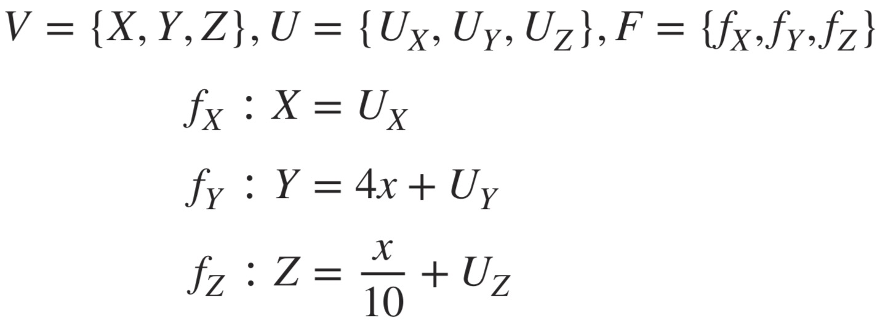
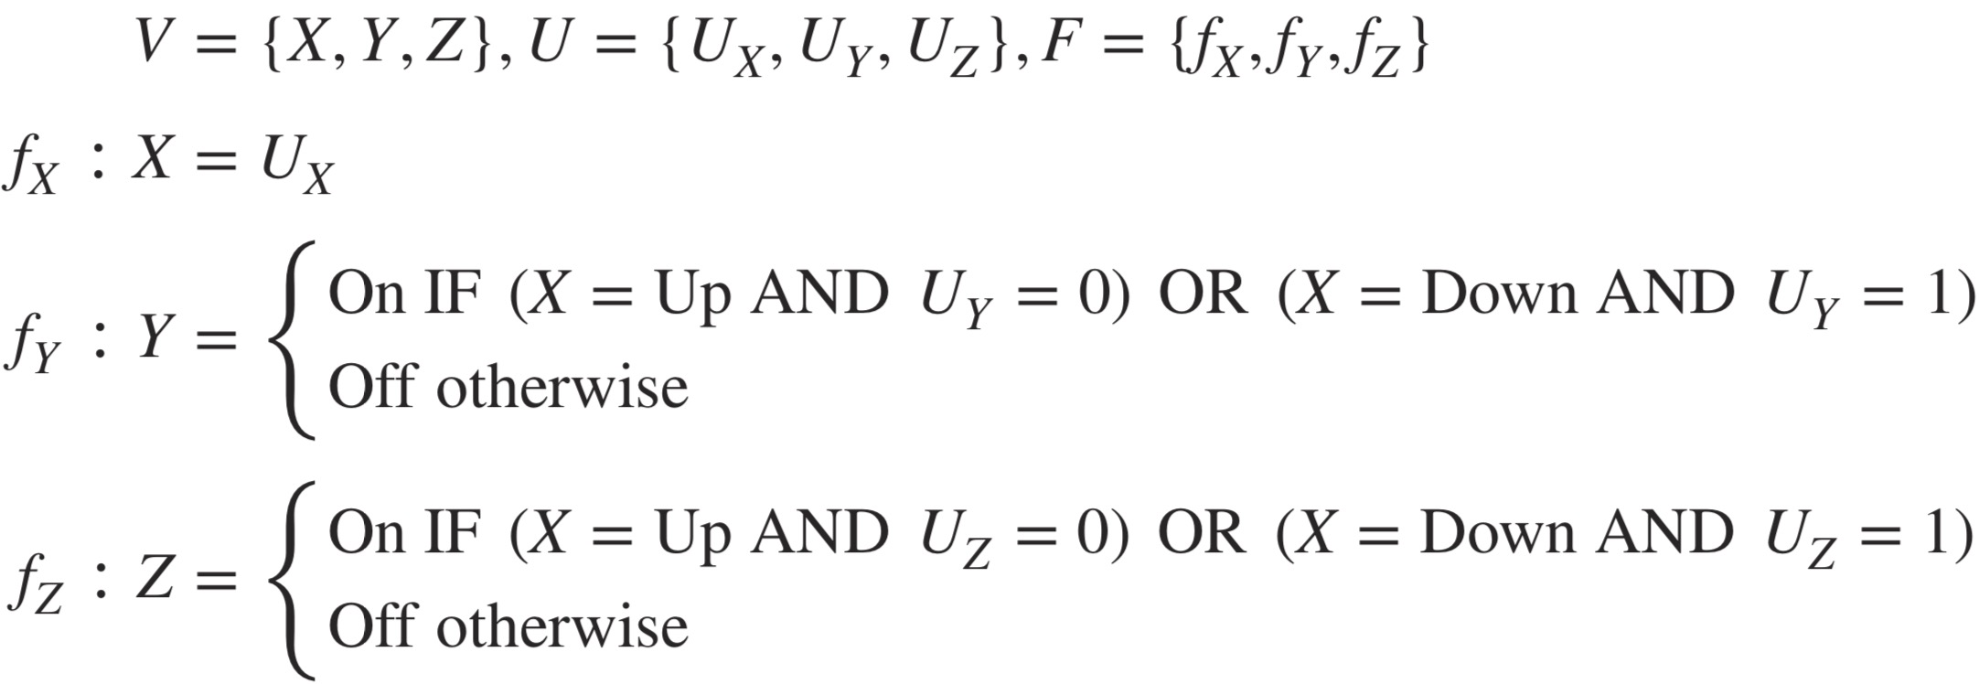
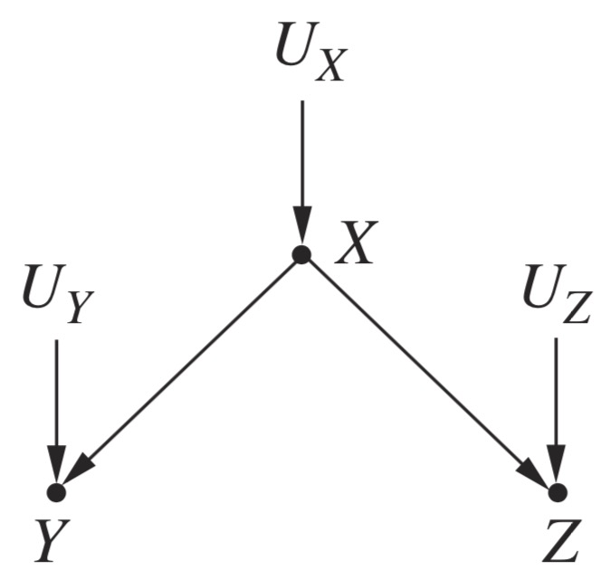
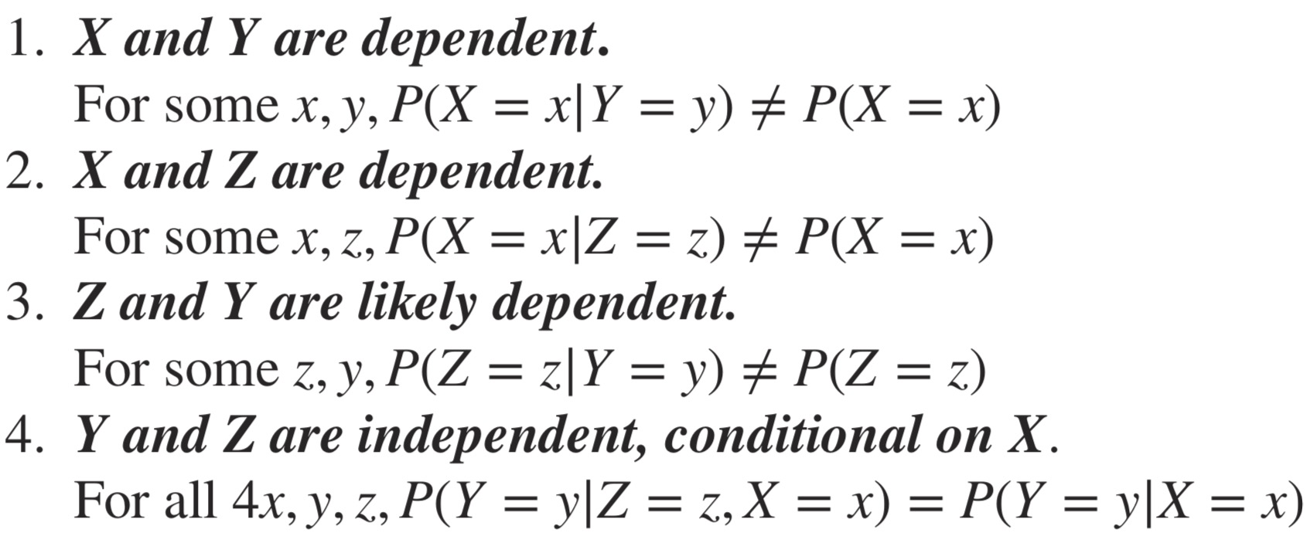
Another example

Slide 7
Forks
Y and Z are likely dependent
When X changes both Y and Z change
Then Y and Z are likely to change together
Yet, it does not need to be the case
Y and Z are independent conditional on X
We split a dataset according to the values of X and we treat the subsets separately
X is constant on each of them
Then Y and Z will vary but only as a consequence of U_{Y} and U_{Z}
And they are independent, so Y and Z will be as well
Y <- X -> Z makes up a fork

Slide 8
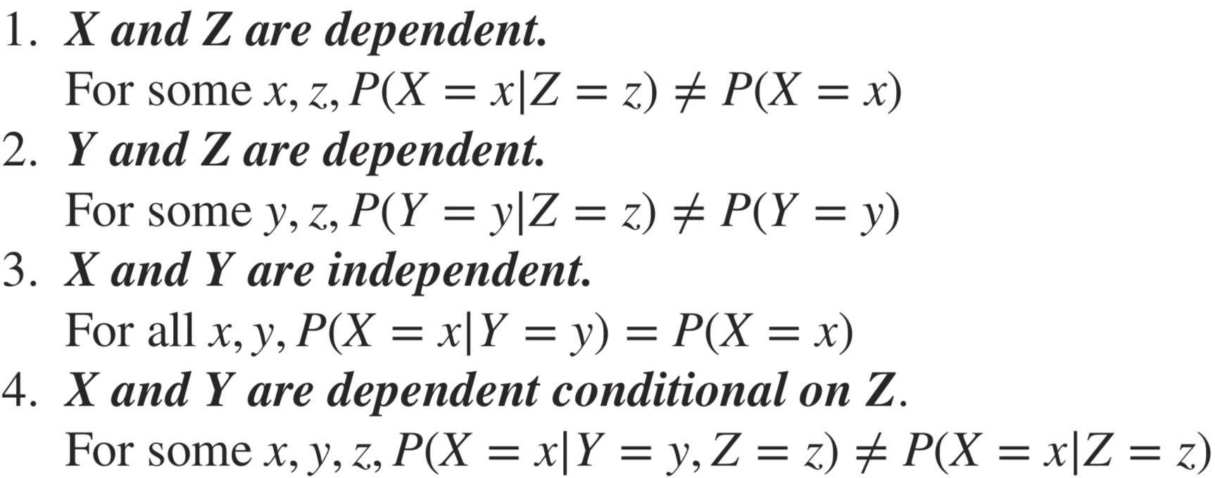
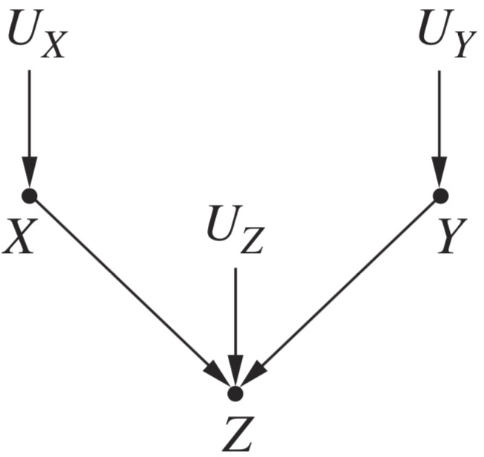
Colliders
The configuration in the figure is called collider
Point 3 is self-evident
There is no causal mechanism involving X and Y together
They respond only to U_{X} and U_{Y} that are assumed independent
Events independent in the present do not become dependent because of a common future effect
Why then point 4??
Two variables that become dependent by conditioning on a common effect
Conditioning on Z means to consider cases where its value is constant
But then any change in X must be compensated by a change in Y
Consider Z = X+Y
If I tell you X=3, you know nothing about Y
But if I tell you that Z=10 and then that X=3, you know all there is to know about Y

Slide 9
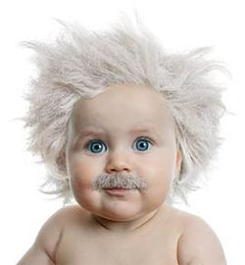

Example
Example: a college gives scholarships (Z) to students
Either with unusual musical talent (X) or with extraordinary grade point average (Y)
Ordinarily X and Y are independent (in the general population)
However, if we discover that a student is on scholarship, knowing that (s)he lacks musical talent tells us immediately that (s)he must have high grade point average

Slide 10



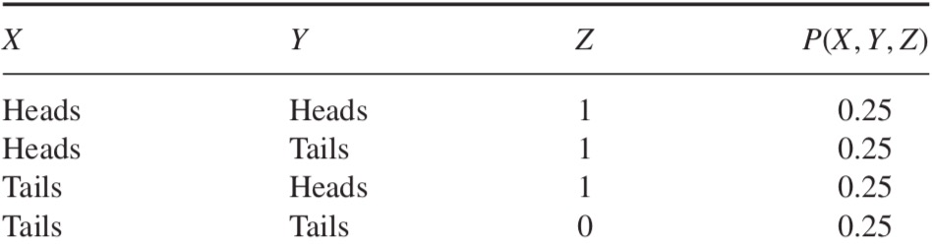
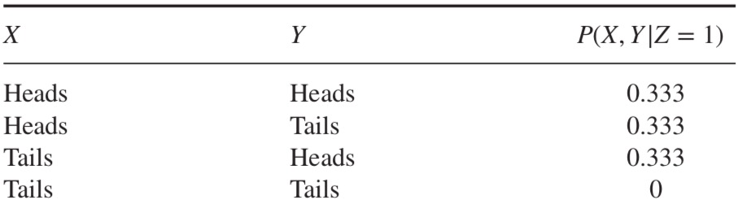
A numerical example
Toss of two independent coins
Simultaneous, independent tosses
A bell rings whenever at least one heads
Variables
X,Y the two coins, Z the bell rings
X tells us nothing about Y
But say that Z=1 and X=Tails, then Y must be heads
Now assume that Z=1 and let us show:
P(X=Heads|Z=1)≠P(X=Heads|Y=Heads,Z=1)
We get P(X=Heads|Z=1) = 2/3
If we filter the second table on Y=heads: we get P(X=Heads|Y=Heads,Z=1) = 1/2
Even more strongly when Z=0
In this case it can only be double tails
Conditioning on Z=1

Slide 11
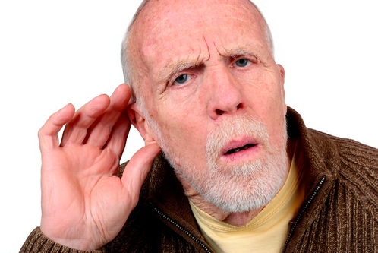
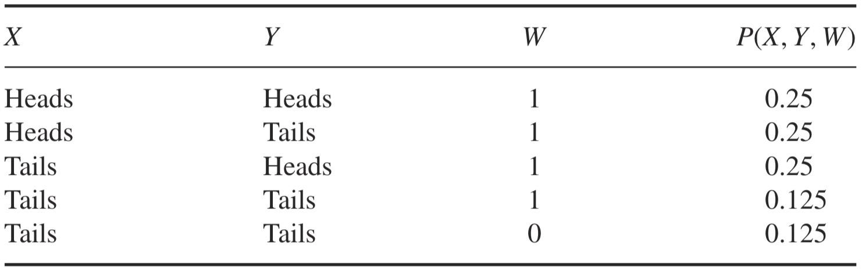
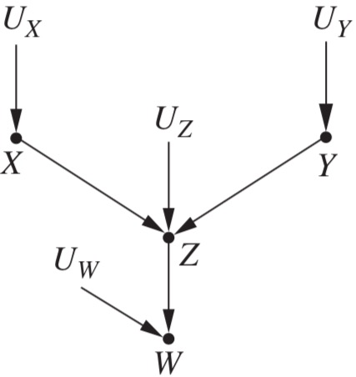
A numerical example - ctd
Suppose we do not hear the bell directly
We rely on an unreliable witness
X,Y the two coins, Z the bell rings, W the witness
Whenever the bell does not ring, there is 50% chance that our witness will falsely report that it did
Joint probabilities
From the table:
So X and Y are dependent given W

Slide 12
General rule in colliders
This rule is particular important for causality
To discover causal models from data
To test a model
To fully solve Simpson-like paradoxes (such as Monty Hall)
It gives rise to unintuitive patterns of dependence
We often (wrongly) take for granted that “there is no correlation without causation”
I.e., one variable causes the other or a third variable causes both
Rule 3 shows that this is not (always) true

Slide 13
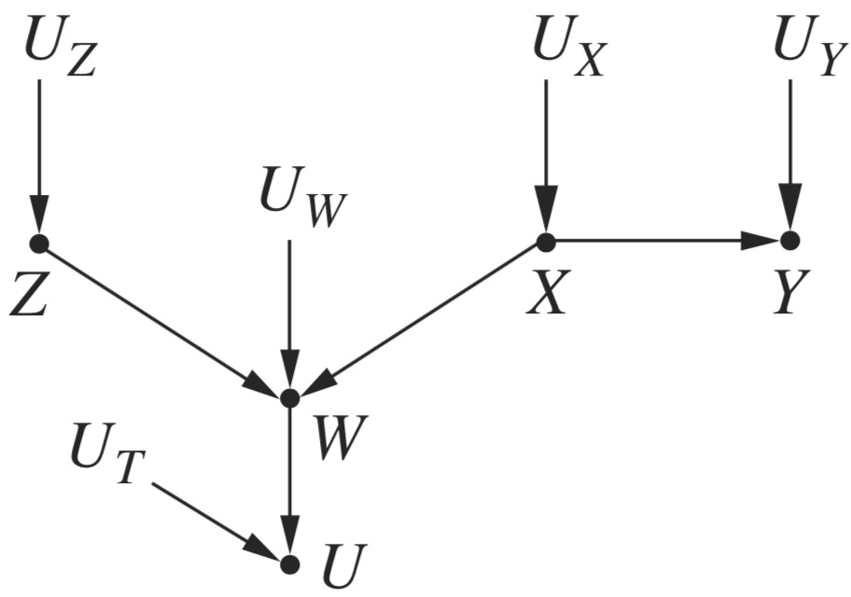
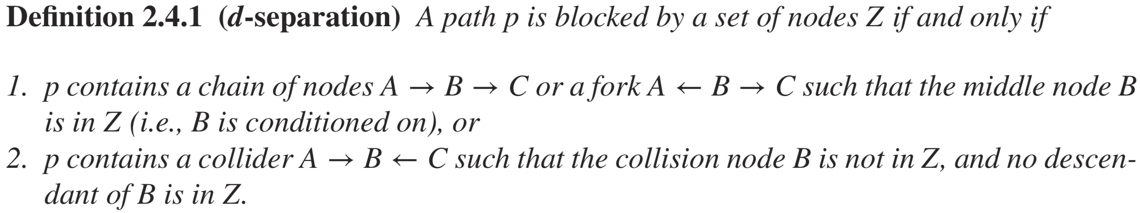
D-separation
Graphical models can be large and complicated
Long paths with different rules applicable
Multiple paths between variables
We need a criterion that works on any graph to find dependences and independencies
This criterion is called d-separation
D-separation tells when two variables are d-separated along a path (blocked): i.e., independent and when they are d-connected along a path (unblocked): i.e., likely dependent
They are actually independent if they are d-separated along all possible paths
They are likely dependent if there is at least one unblocked path connecting them
E.g., Z and Y in the figure
They are d-separated (unconditionally independent)
They are d-connected if we condition on W; again d-separated if we condition on {X,W}

Slide 14
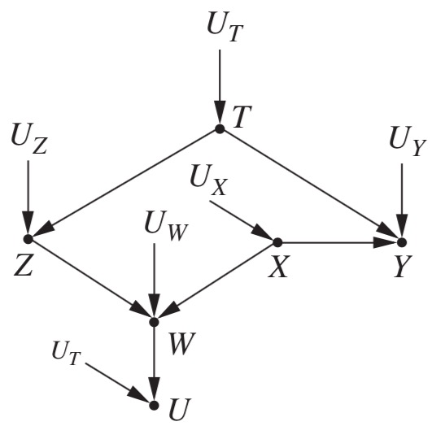
Slightly more complicated example
We add a new path to the graph (Z<-T->Y)
Now Z and Y are unconditionally dependent
T is open in Z<-T->Y
If we condition on T?
They are independent
Conditional on {T,W}?
They are dependent
Conditional on {T,W,X}?
They are independent again
In particular, they are d-connected conditional on:
W,U,{W,U},{W,T},{U,T},{W,U,T},{W,X},{U,X}, and {W,U,X}
And they are d-separated conditional on:
T, {X,T},{W, X,T},{U,X,T}, and {W,U,X,T}

Slide 15
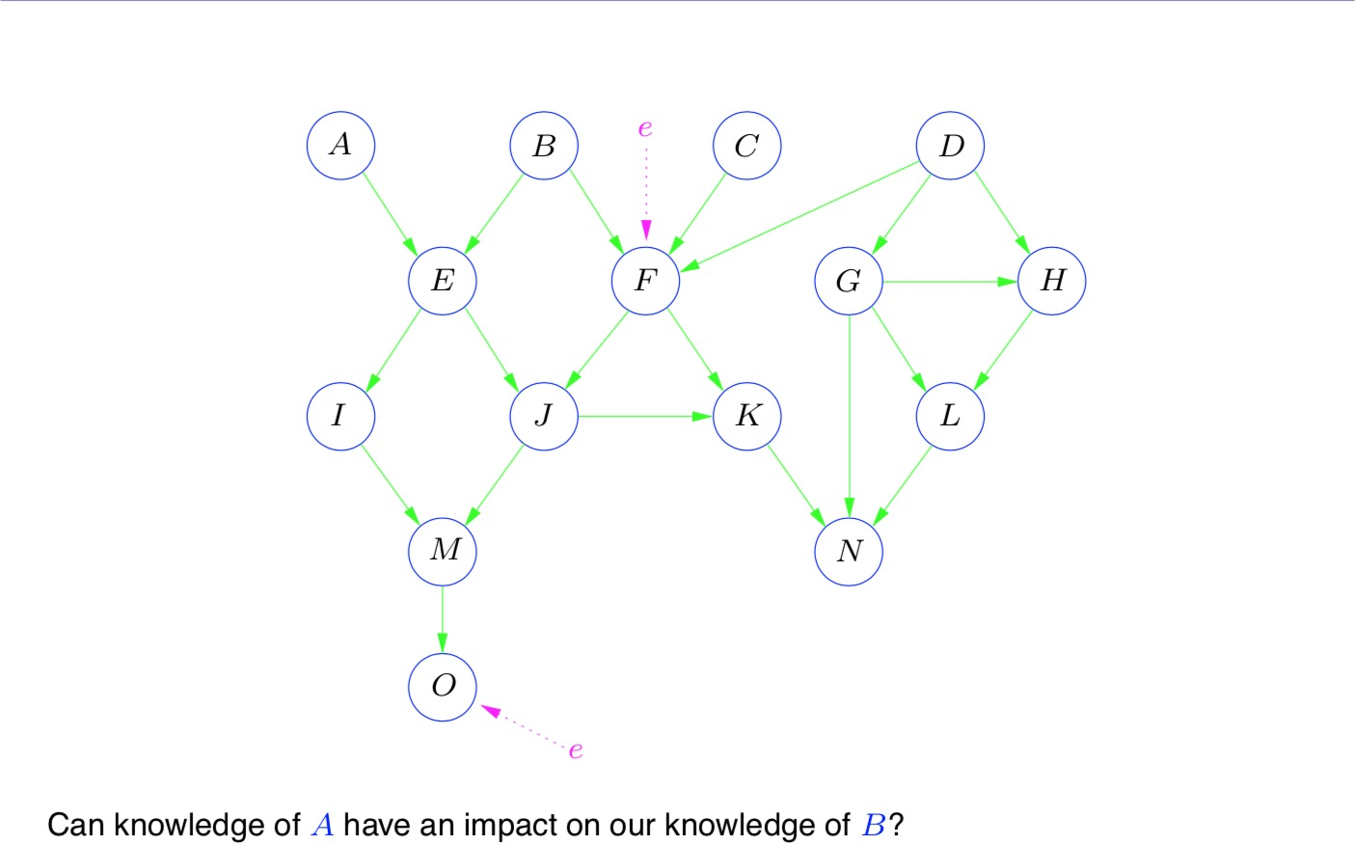
Exercises

Slide 16
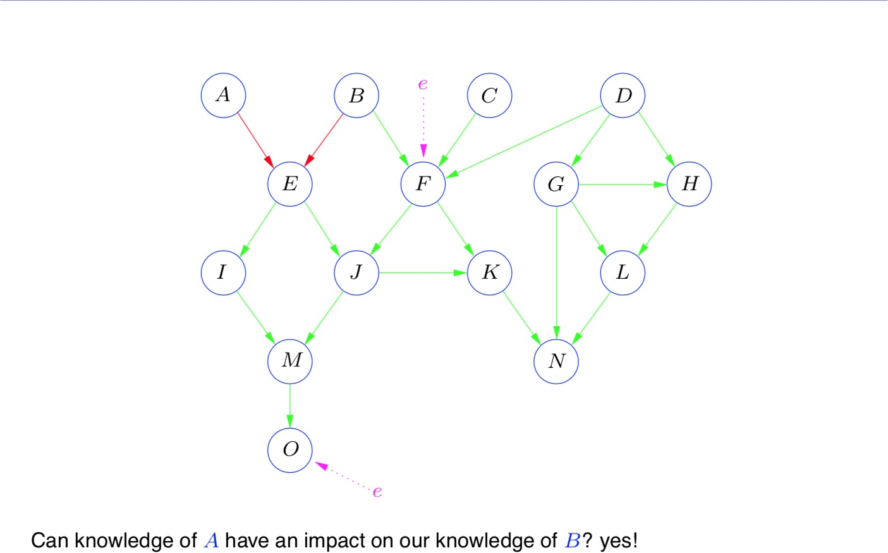
Exercises

Slide 17
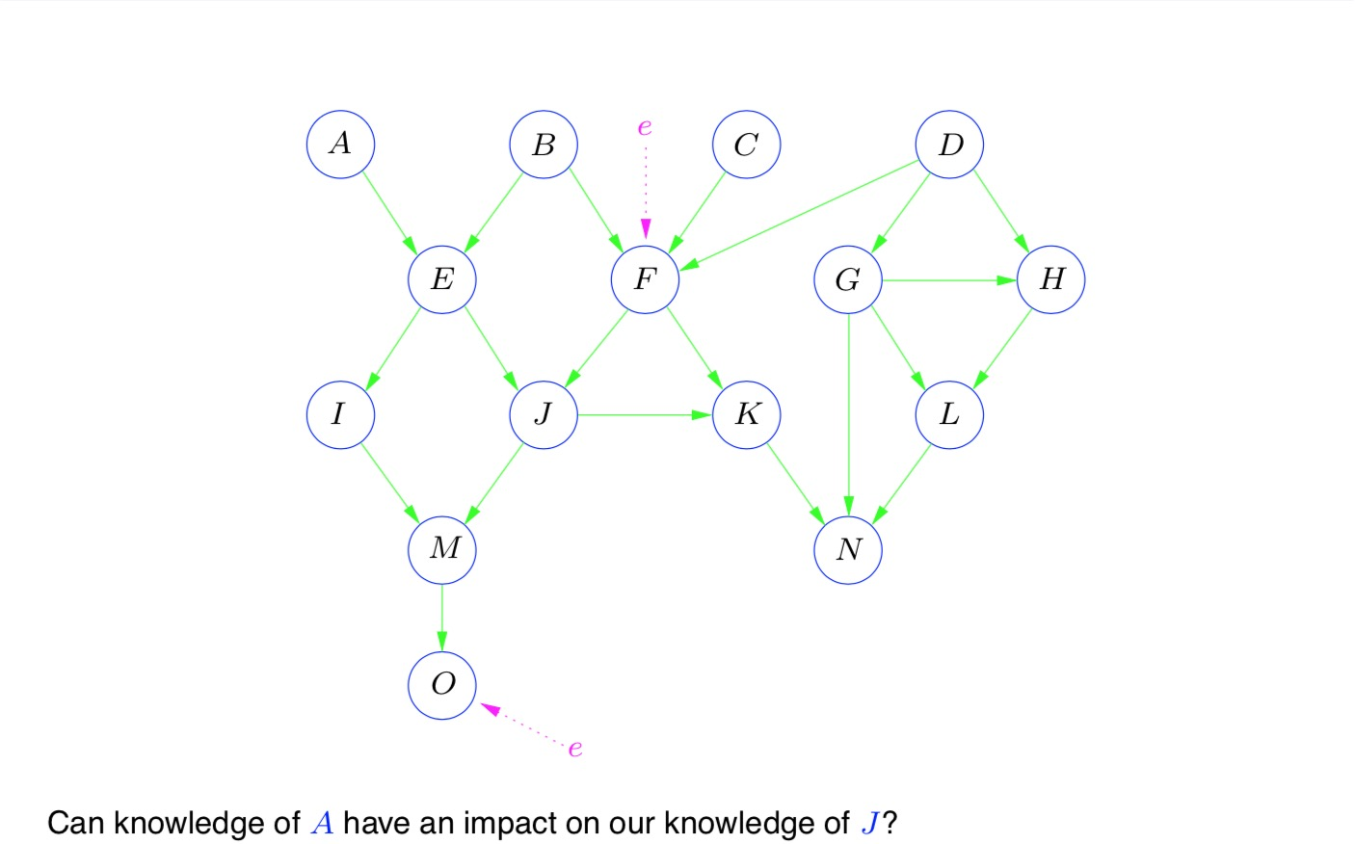
Exercises

Slide 18
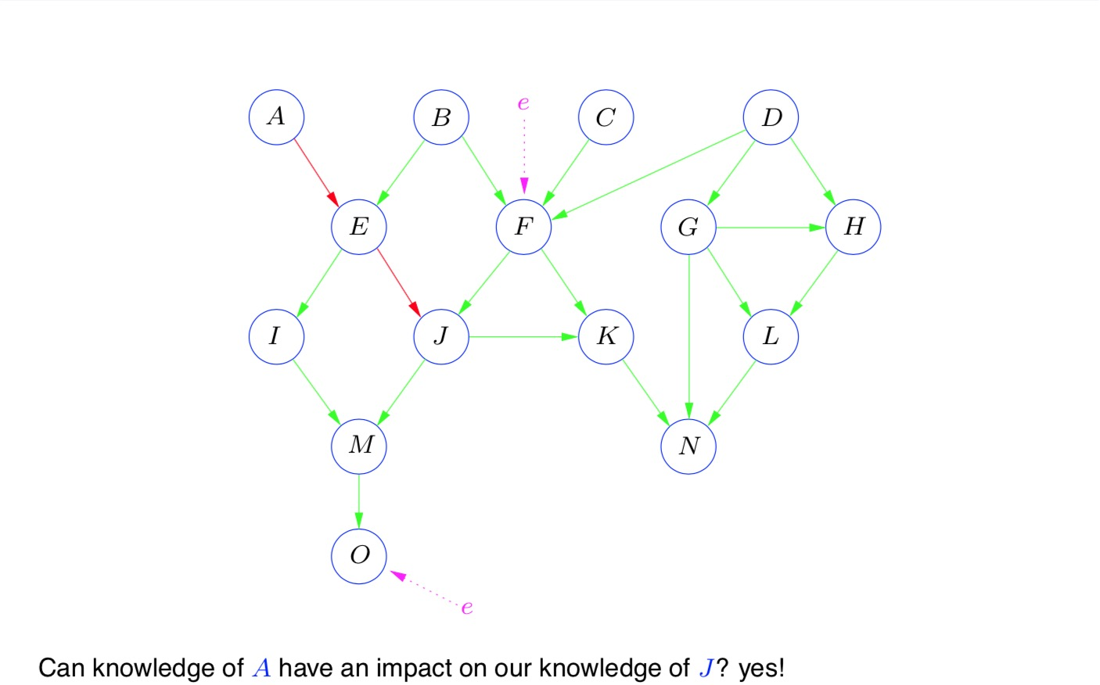
Exercises

Slide 19
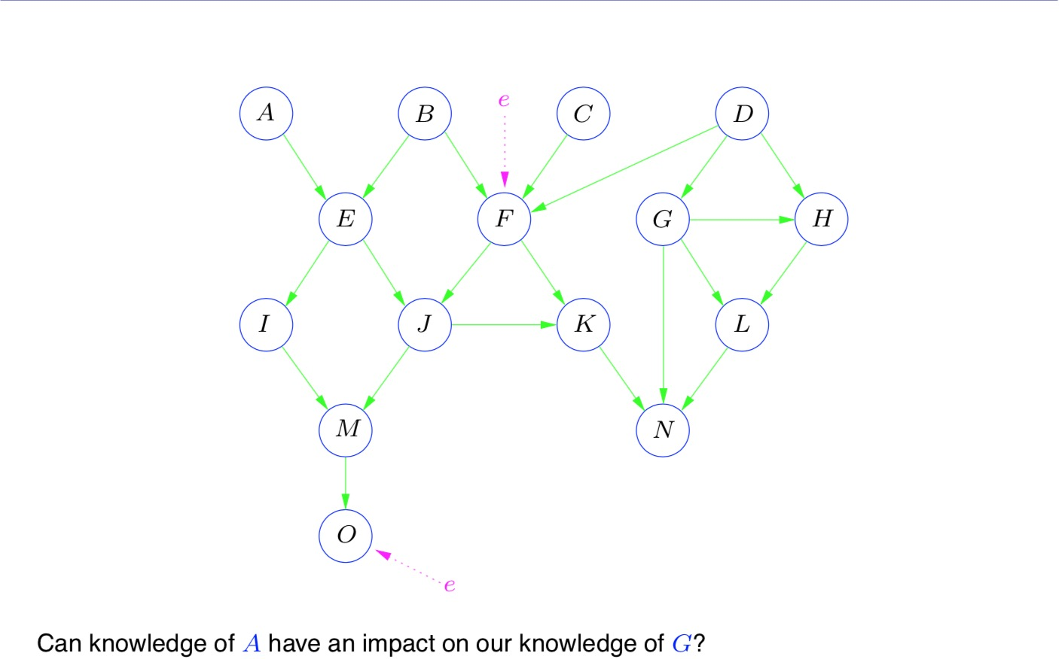
Exercises

Slide 20
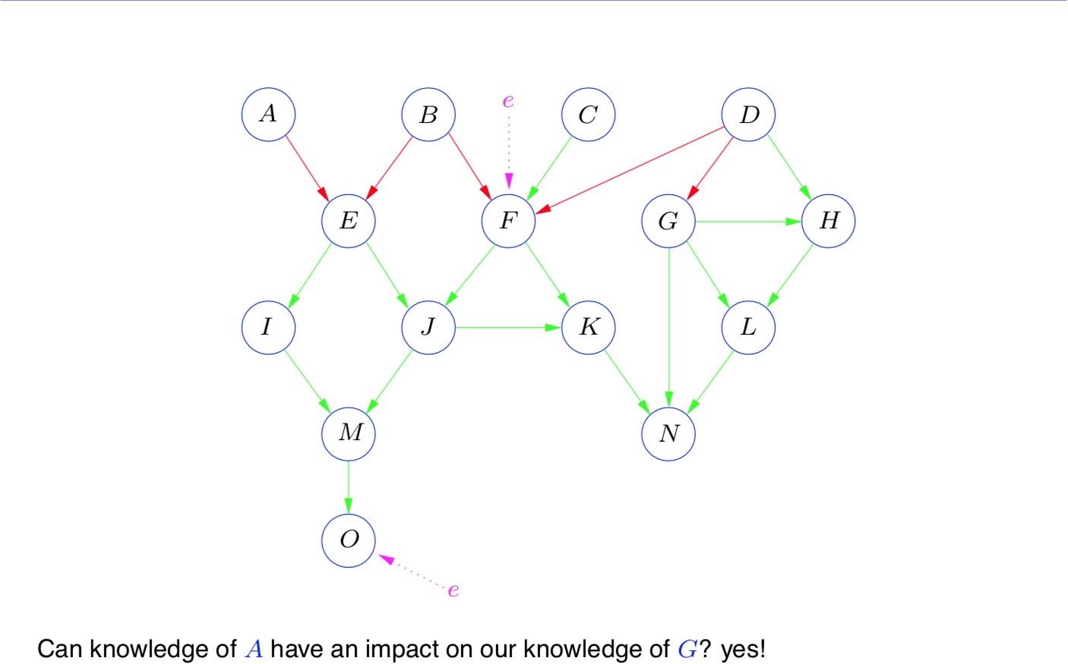
Exercises

Slide 21
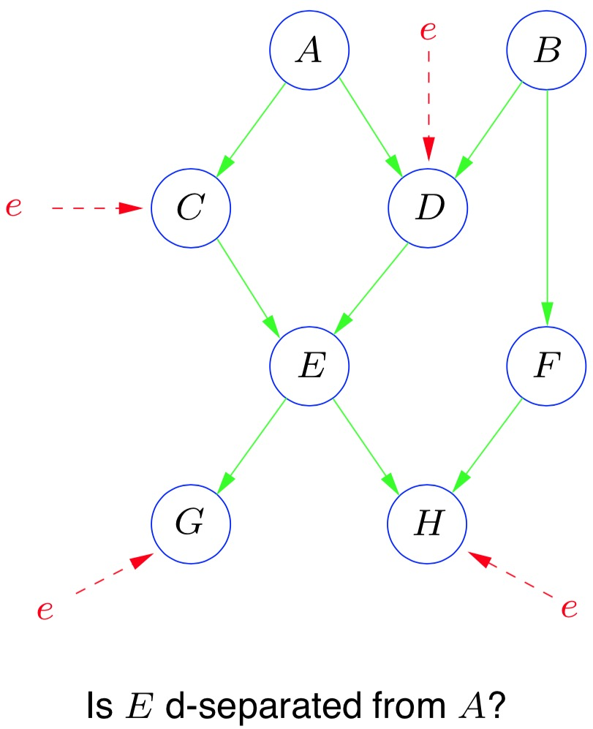
Exercises

Slide 22
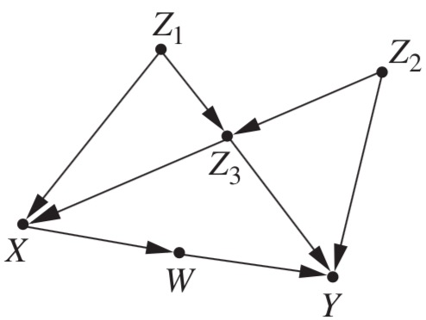
Model testing
Causal models have testable implications in the data sets they generate
Say we have a graph G that we believe represents the causal mechanism generating our data S
The graph tells us that A and B are d-separated given C
We examine S and find out that A and B are dependent given C
Then we have to reject G as the model generating the data
Consider the graph in the figure
It states that W and Z₁ are independent given X
Suppose we regress W on X and Z₁
We find the line w = r_{X}x + r₁z₁
If r₁≠0, then W and Z₁ are dependent given X (cond. independence implies zero cond. correlation)
Then our model is wrong
But we know also where it is wrong
The true model must have a path between W and Z₁ that is not d-separated by X
Theoretical result that holds for all acyclic models with independent errors:
If every d-separation is an independence in the data, then no further test can refute the model
I.e., one can always find functions F and probabilities for the U terms that yield the data precisely

Slide 23
Causal search
Advantages of d-separation
It is non-parametric, only the graph matters
It tests models locally, so we can repair our models
It means that we can still get information about the rest of the model
We can use it to infer causal structures from data
In a reverse-engineering way
We can in principle test and reject many models eventually keeping only those that pass the test
These would be the causal models consistent with the data
It will be a set of models because many models can produce the very same data
We say that these models are indistinguishable
Indistinguishable models make up an equivalence class
Theoretical result: two graphs G₁ and G₂ are in the same equivalence class iff
They share a common skeleton (the graph obtained by dropping orientations)
They share common v-structures (like Z₁ -> Z₃ <- Z₂)
Any two graphs satisfying 1 and 2 have exactly the same d-separations
Whence, the same testable implications

