Slide 1
Congressional Stock Trading Trends in the House of Representatives
Connor Cabrey

Slide 2
Introduction
“Speaker of the House Nancy Pelosi and venture capitalist husband Paul Pelosi beat the stock market by 5 percent in 2019 and by 14% in 2020. Based on the stocks purchased and disclosed from 2019 through Q4 2021, her portfolio grew 96% over that time, gaining $62 million in value. And that’s not including the $2.8 million made from options trading.”
-Emilee Klein & Tiffany Zheng (07JAN22, fineprintdata.com)

Slide 3
“Senate Intelligence Committee Chairman Richard Burr (R-N.C.), for example, co-authored an op-ed on February 7, 2020 in which he publicly reassured the American people that “the United States today is better prepared than ever before to face emerging public health threats, like the coronavirus.” At a private luncheon around that same time, however, Senator Burr warned attendees that the coronavirus “is much more aggressive in transmission than anything that we have seen in recent history . . . . It is probably more akin to the 1918 pandemic.” Acting on the beliefs expressed privately, the Senator picked up between $628,000 and $1.72 million in cash by dumping a large share of his personal holdings on February 13, the week before financial markets began to tank in response to worsening news about the spread of COVID-19.”
-Jacob Winton, (Wake Forest Law Review 21APR21)

Slide 4
Agenda
Research Question
Data / Methods
Plots
Analysis / Path Forward
Challenges
Conclusion

Slide 5
Research Question
What is the relationship between stock trading / portfolio performance in the House of Representatives leading up to Bill Passage Votes?

Slide 6
Data / Methods
Stock Data
Congressional Representatives are required by law to register their stock trades, both owned individually and jointly
This data is tracked and can be found here.
15929 x 12 cleaned to 14588 x 7
Voting Data
All voting data for the house of Representatives can be found here
Interested in “On Passage” votes only
Voting records go back to 1789
57879 x 18 cleaned to 275 x 5

Slide 7
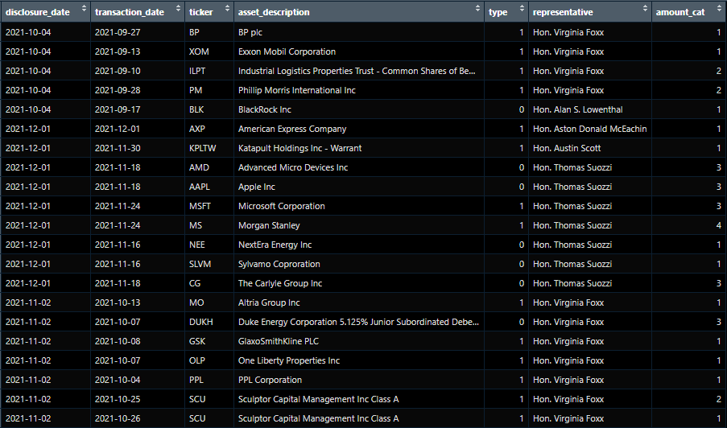
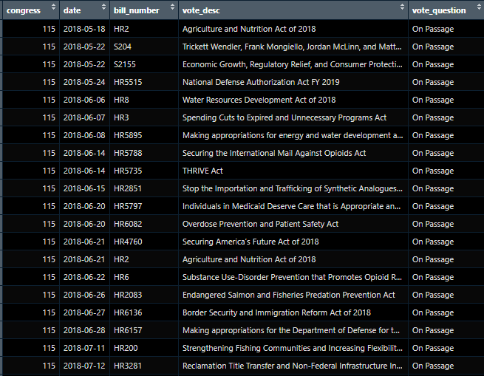
Data / Methods

Slide 8
Data / Methods
ID Trading Volume by Day Statistics
Mean = 15.89
Median = 11
ID Days where trading volume is above average

Slide 9
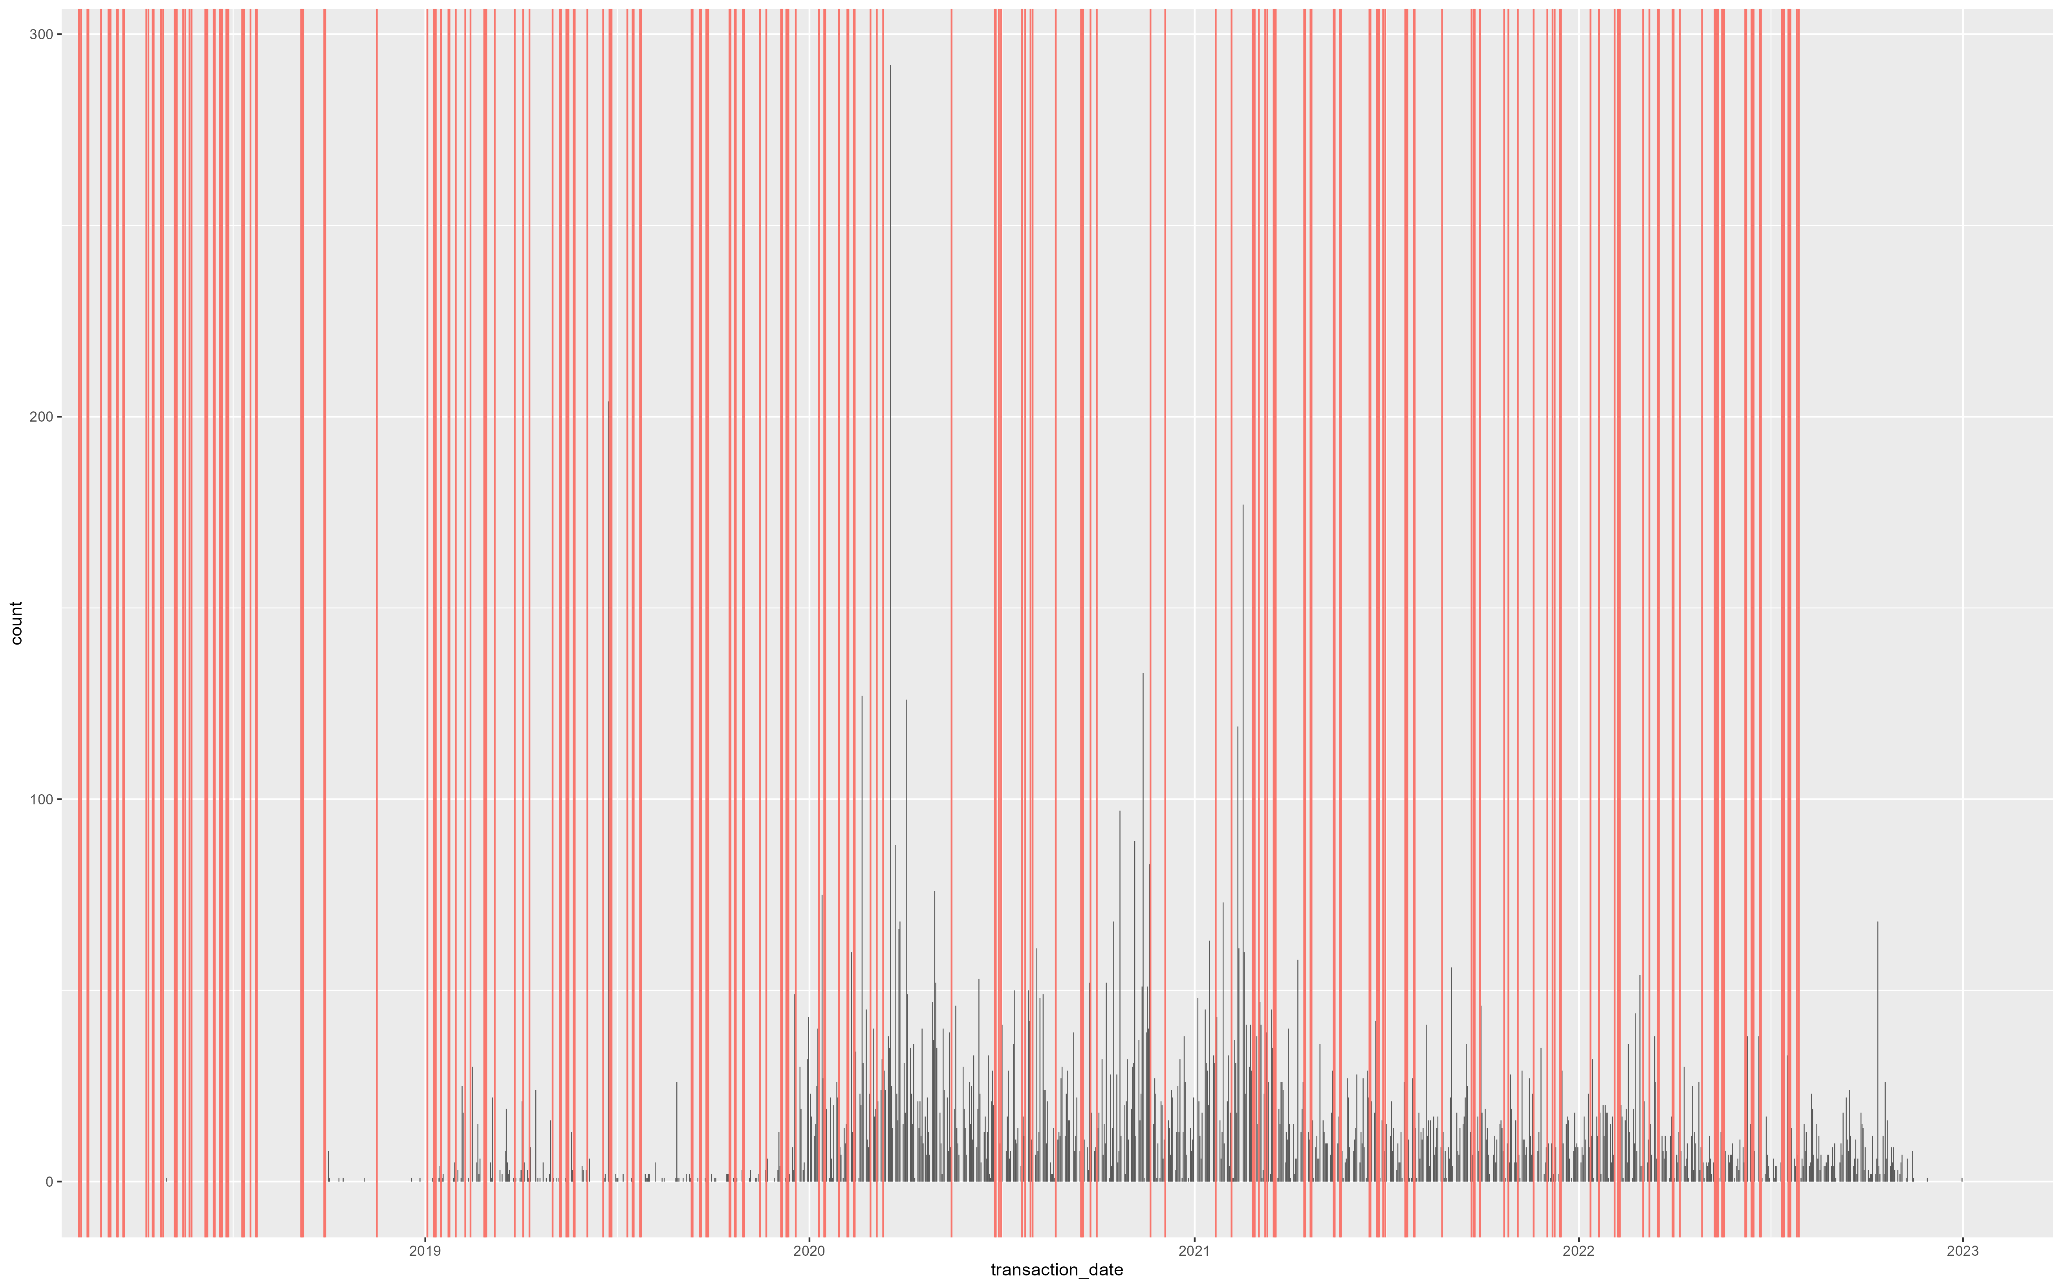
Plots

Slide 10
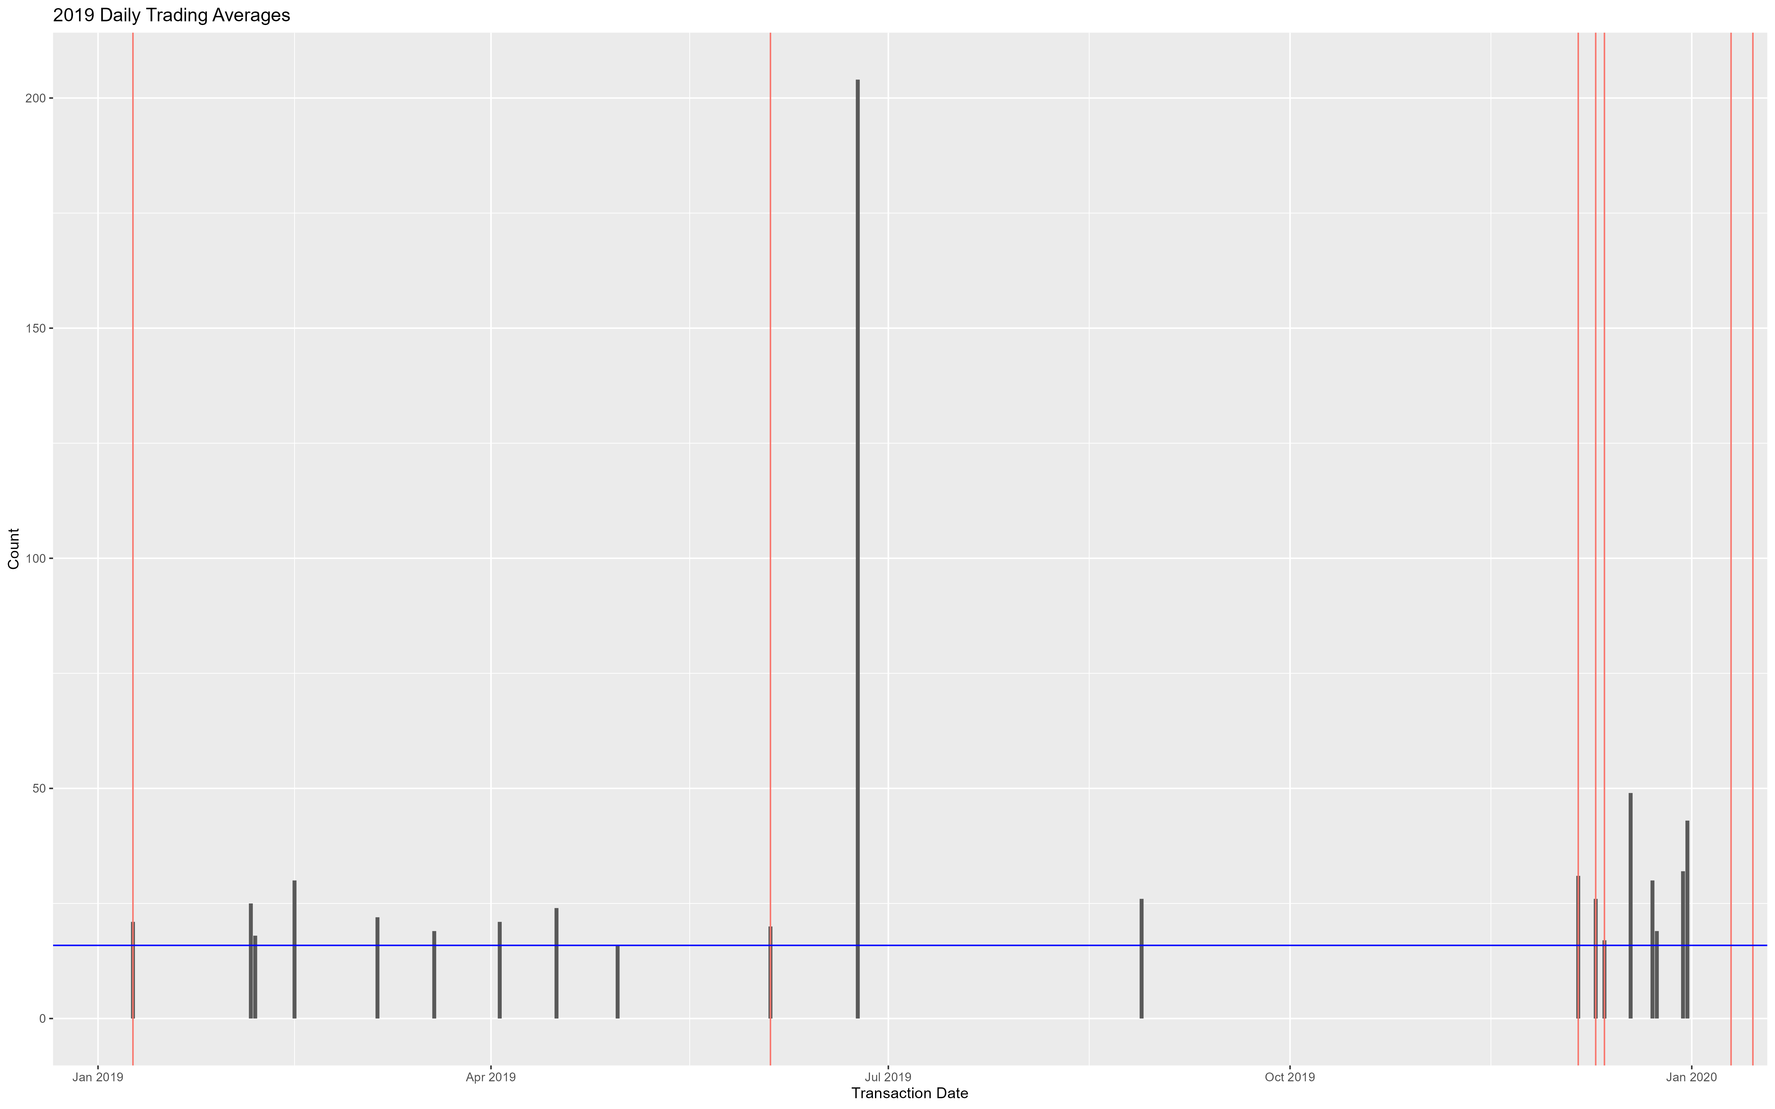
Plots - 2019

Slide 11
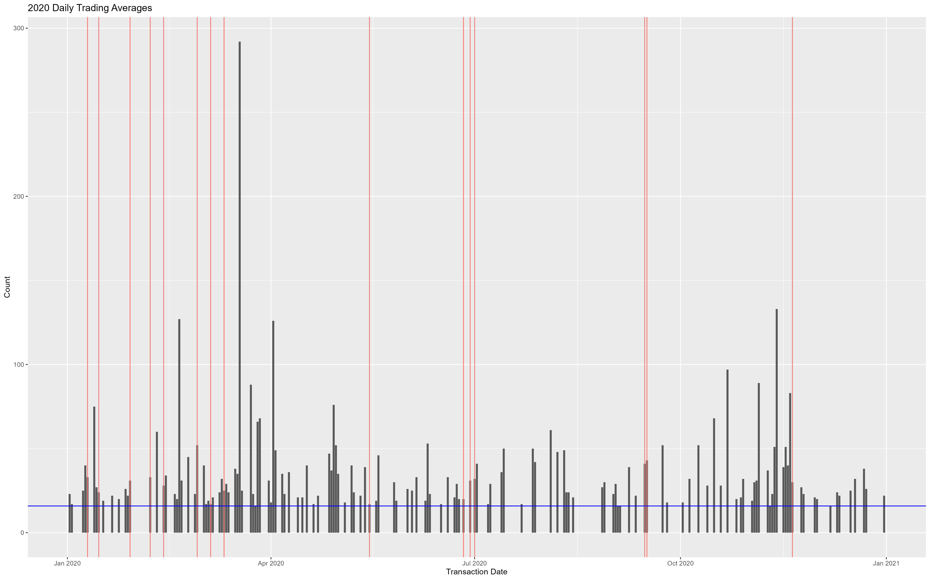
Plots - 2020

Slide 12
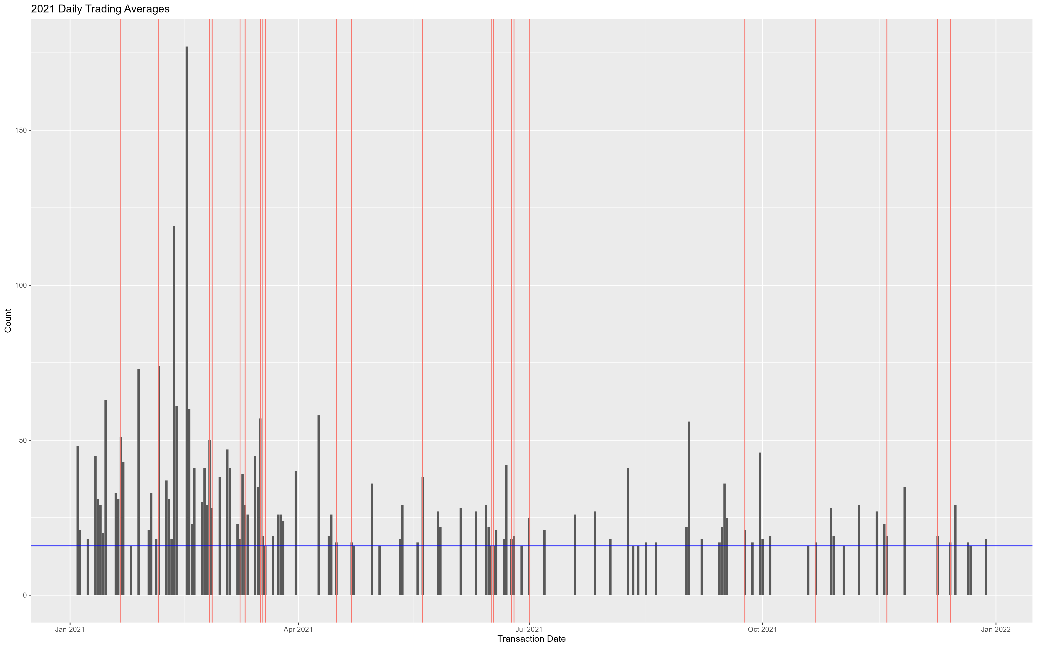
Plots - 2021

Slide 13
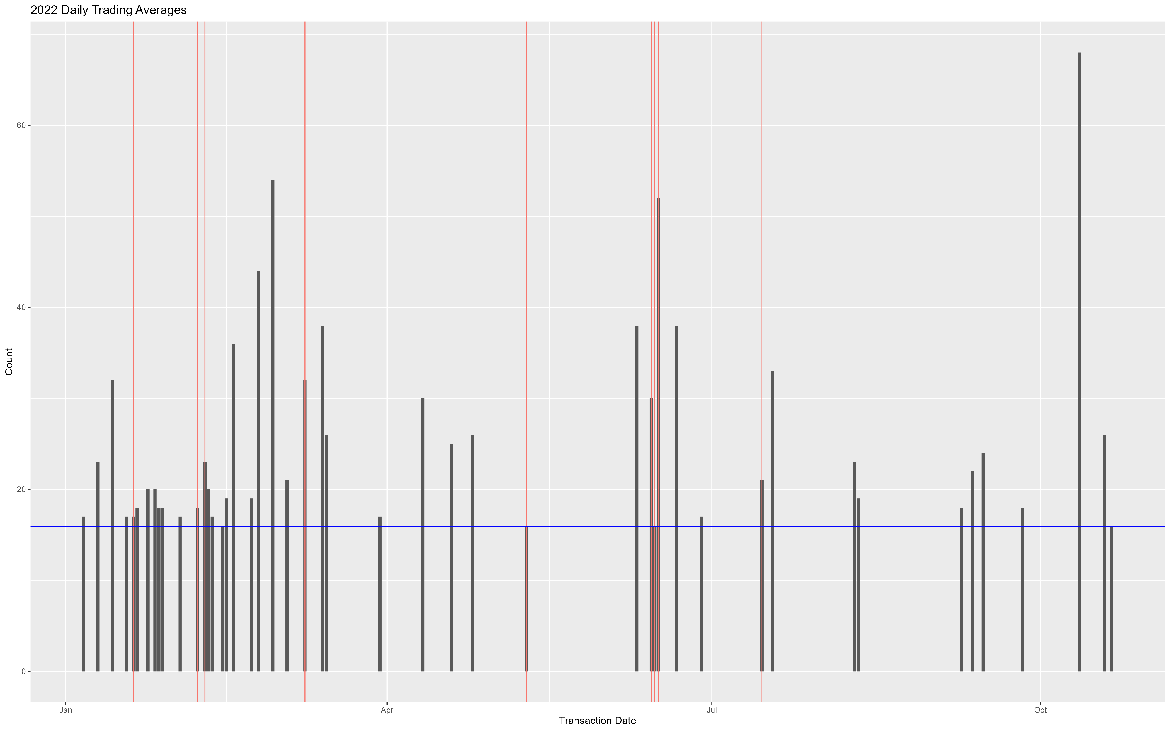
Plots - 2022

Slide 14
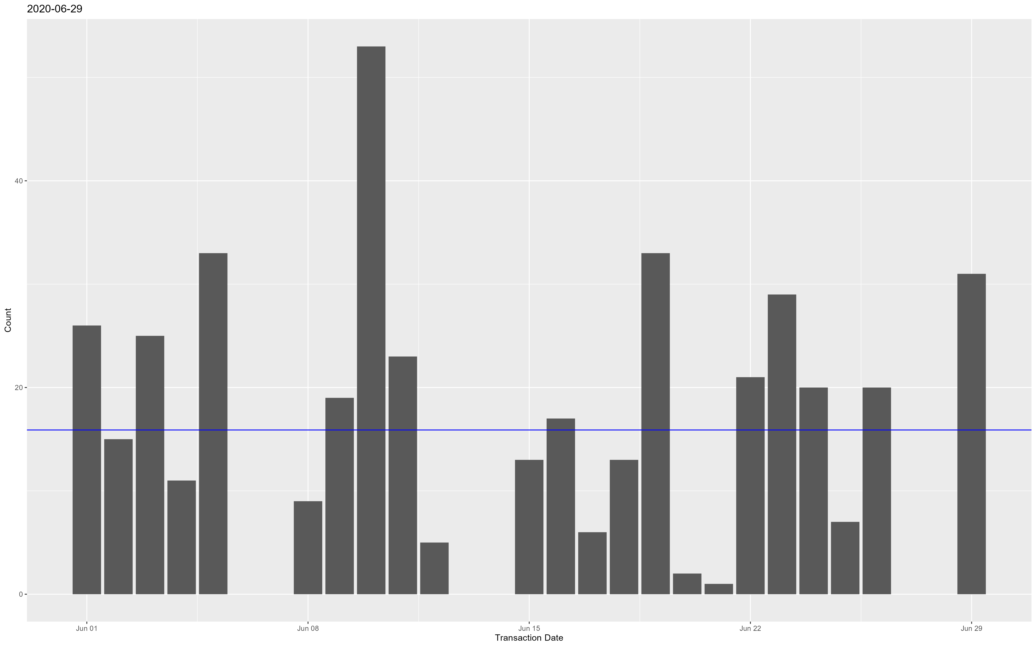
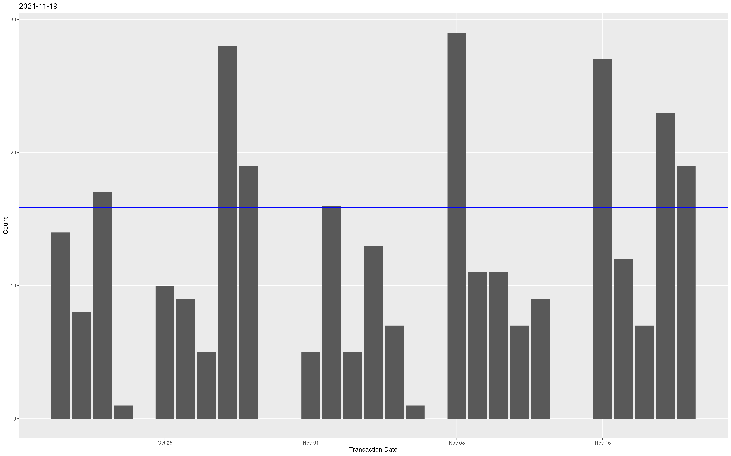
Plots – 30 Days to Bill Passage
Emergency Housing Protections and Relief Act
Build Back Better Act

Slide 15
Analysis / Path Forward
Breakdown by amount category
<= $15,000 Cat 1
> $15,000 <= $50,000 Cat 2
> %50,000 <= $100,000 Cat 3
> $100,000 Cat 4
Look at individual tickers
Categories – build “funds”
See if trends in funds match up with categories / description of what is in the bills that pass the house
Functions

Slide 16
Challenges
Overlap of Bill Passage
Incorporation of “Suspend the Rules and Pass” and other vote questions
Total Value of trades are unknown

Slide 17
Conclusion

Slide 18
Bibliography
C. Eggers, Andrew, and Jens Hainmueller. “Capitol Losses: The Mediocre Performance of Congressional Stock Portfolios.” The Journal of Politics 75, no. 2 (April 2013): 535–51. https://doi.org/10.1017/S0022381613000194.
FinePrint. “Deep Dive: Pelosi’s Stocks and Options 2019-2021.” FinePrint, October 6, 2021. https://www.fineprintdata.com/post/pelosistocks.
Karadas, Serkan, Minh Tam Tammy Schlosky, and Joshua C. Hall. “Aggregate Congressional Trading and Stock Market Returns.” Journal of Financial Economic Policy 14, no. 2 (January 1, 2021): 172–86. https://doi.org/10.1108/JFEP-02-2021-0035.
“Office of the Clerk, U.S. House of Representatives - Public Disclosure.” Accessed October 18, 2022. https://disclosures-clerk.house.gov/.
Schieberl, Jeffrey, and Marshall Nickles. “Congressional Insider Trading: Is It Legal?” Journal of Business Case Studies (JBCS) 9, no. 3 (April 26, 2013): 221–26. https://doi.org/10.19030/jbcs.v9i3.7798.
Schulp, Jennifer J., and Caleb O. Brown. “Will Banning Congressional Stock Trading Achieve Anything?,” September 27, 2022. https://policycommons.net/artifacts/2680360/will-banning-congressional-stock-trading-achieve-anything/3703736/.
“Voteview | Data.” Accessed December 7, 2022. https://voteview.com/data.

