Slide 1
MERGE
Don’t just listen to music; listen to people

Slide 2
OVERVIEW
Review the tasks
Show revised UI
Demo
Discuss prototyping tools

Slide 3
TASKS

Slide 4
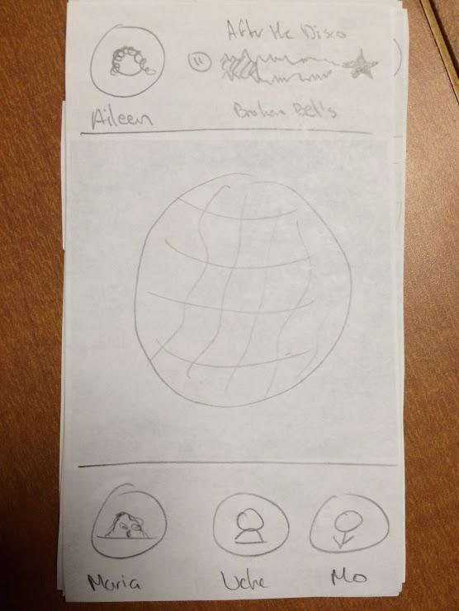
SHARE MUSIC
KEY CHANGES:
Make it easier to search

Slide 5
DISCOVER NEW MUSIC
KEY CHANGES:
Create an inbox
Show recommendations on app open

Slide 6
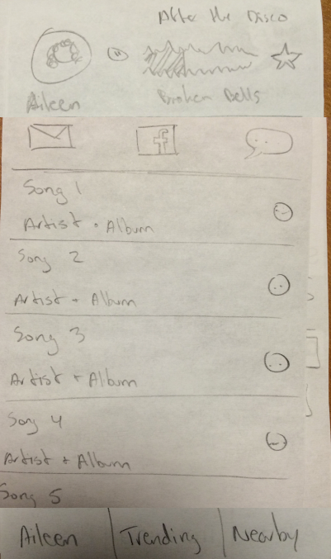
FORM NEW RELATIONSHIPS
KEY CHANGES:
Create an inbox
Make the UI more clear

Slide 7
REVISED UI

Slide 8
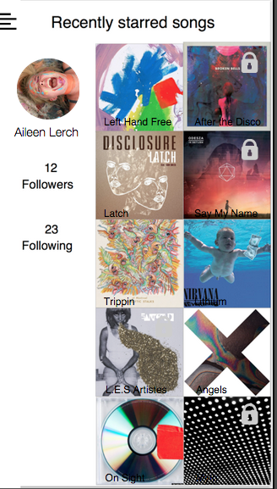
USER PROFILE
Simplified the interface to reflect simplified app usage
Gives users more control

Slide 9
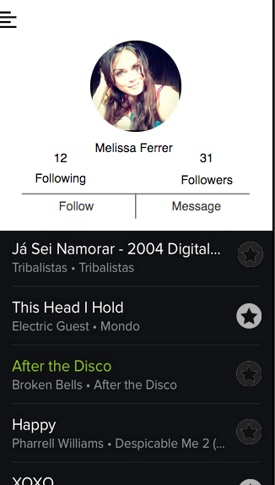
FRIENDS PROFILE

Slide 10
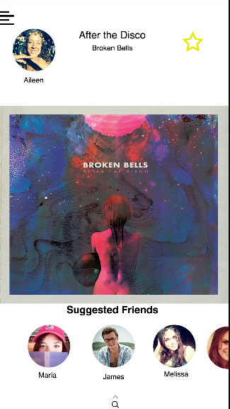
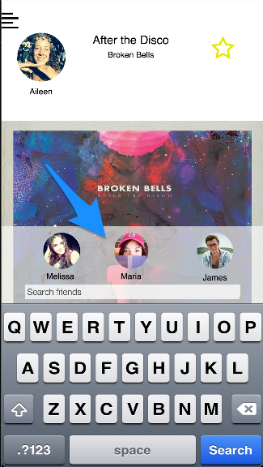
SEARCH

Slide 11
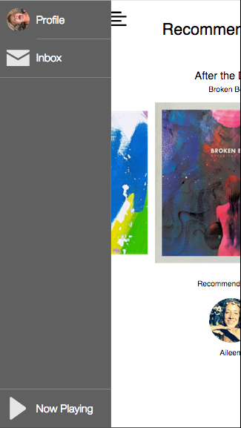
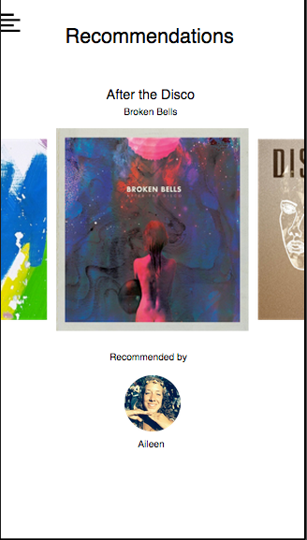
INBOX
Shown at start
Accessible through menu

Slide 12
DEMO

Slide 13
TOOLS USED
Proto.io
What worked:
Has a lot of features: animations, text fields, etc
What didn’t work:
Wasn’t great for collaboration
Also, we can only use it for 10 more days

Slide 14
CONCLUSION
We incorporated the results from testing
Merge is now a much more focused app
Improvements can still be made to the UI

