Slide 1
Merge
Don’t just listen to music; listen to people

Slide 2
Problem
Current music discovery tools do not address two significant aspects of the music discovery process:
Music is a incredibly social form of art that connects users
Users often associate certain music depending on places, activities, or friends.
The social element of music discovery is so strong that some users only listen to new songs or artists on the suggestion of a trusted friend. Currently, the only tools that users have to facilitate this social music discovery require users to actively participate in this process.

Slide 3
Solution
Automate the process of music discovery and selection based on music preferences of peers
Allow users to easily share their music with others who are likely to enjoy it

Slide 4
Overview
Heuristic Evaluation Results
Revised Design
Prototype Implementation Details
Demo

Slide 5
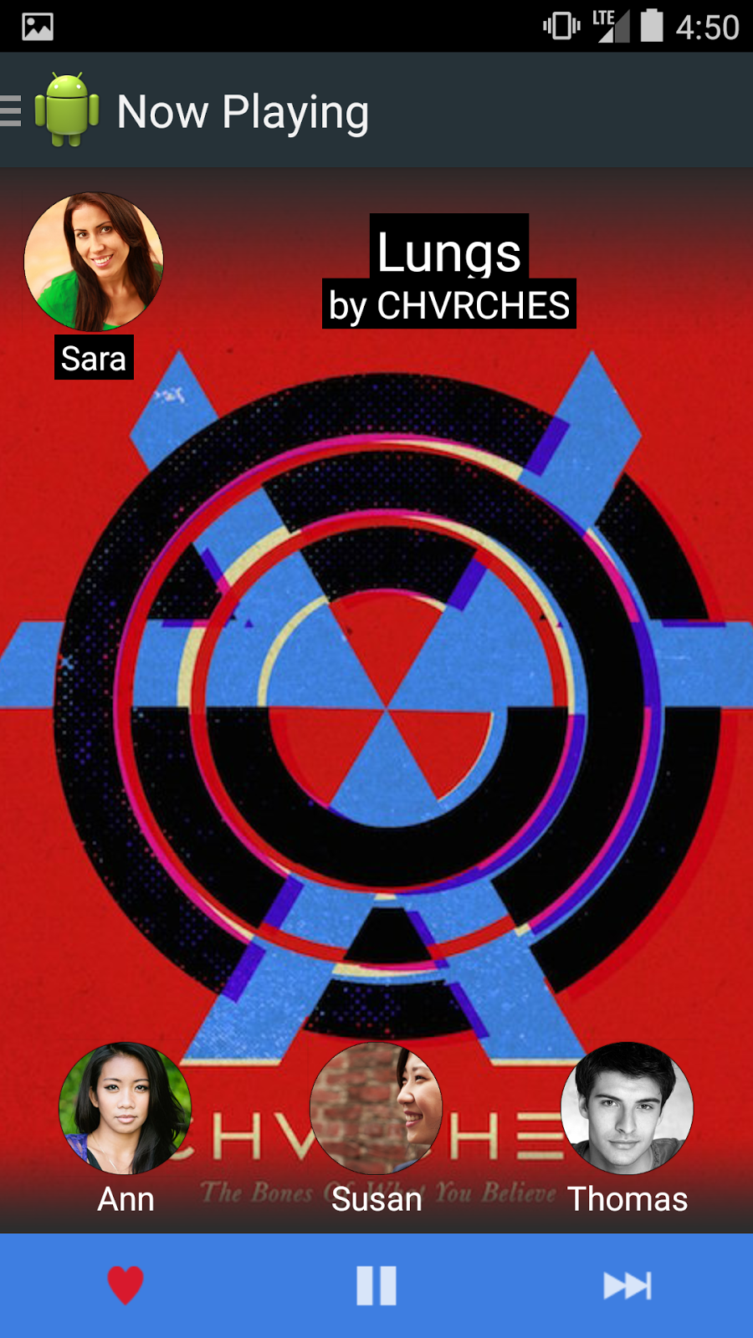
Heuristic Evaluation Results
- Limited functionality in the playback bar
-Difficult to get to the next song (need a next button or swipe method)

Slide 6
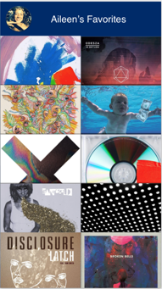
Heuristic Evaluation Results
-Side bar seems empty for number of options we had
-User profile lacking in functionality

Slide 7
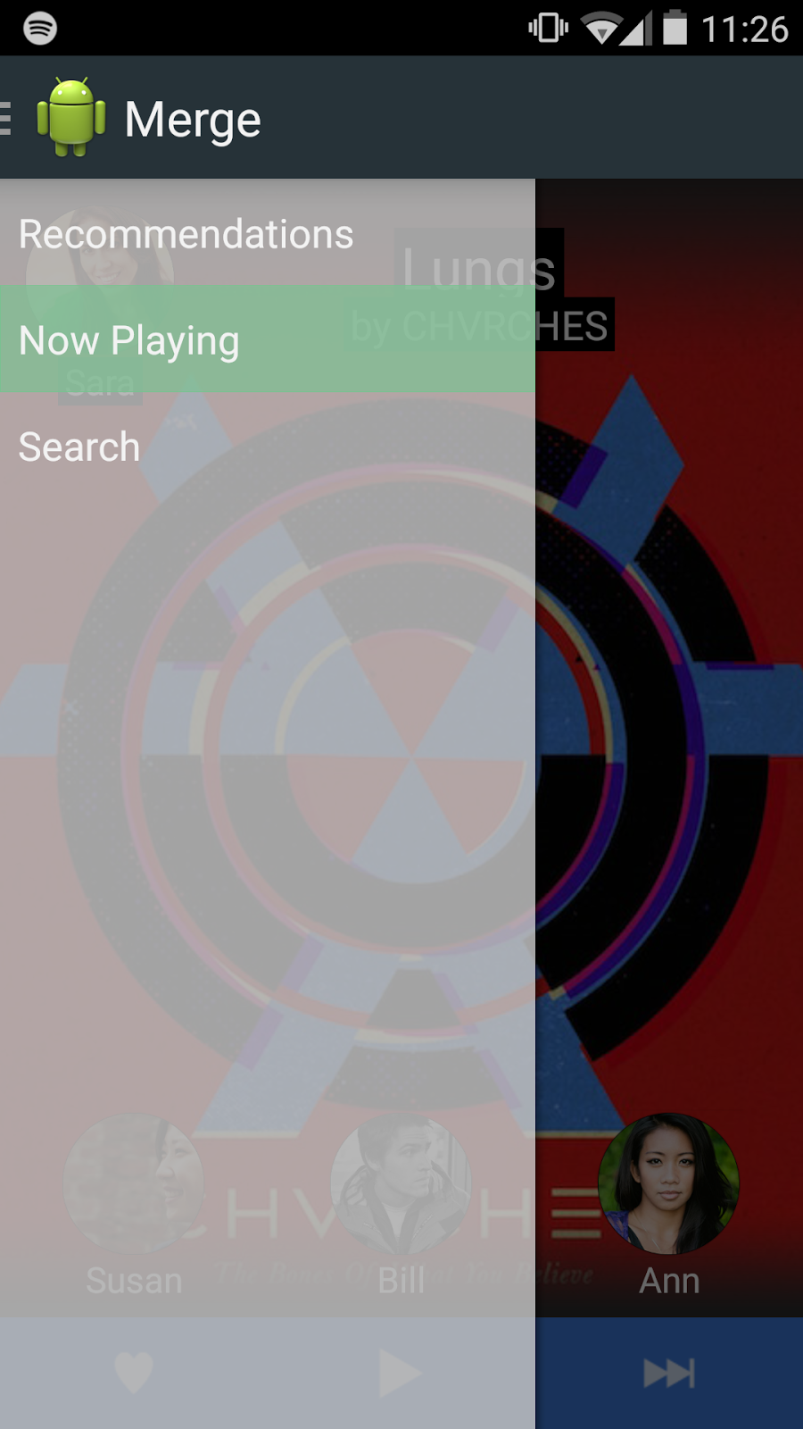
Heuristic Evaluation Results
-Wanted a friend selection page for sharing
-Too many gesture operations on friends under the song

Slide 8
Tools Used
Android Studio
Based on IntelliJ
Easy testing
Can view on both computer and phone
Extensive API documentation available

Slide 9
Implemented Features
Sharing Task:
Recommendations playing/swiping through
Now playing view
Drag faces to share music

Slide 10
Unimplemented Features/Plans
User Profile full interaction and messaging
“Message User” screen
Using the search bar to find other friends to share with
The menu buttons don’t move to the correct screens
Full pause screen

Slide 11
Hard-Coded Data
Faces of the people you can share with
Recommendations
Songs to choose and play

Slide 12
Issues/Questions
None!

Slide 13
Demo

