Slide 1
Predicting Air Quality Index in Cleveland, OH
Anna Funsten
Ben Jackany
Chris Caldarella
2021-05-21

Slide 2
Outline
Air Quality and Asthma
Data Source and Data Cleaning
Regression Models
Streamlit Application
Summary
Sources

Slide 3
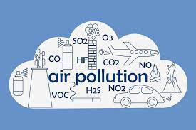
Air Quality Measures
Carbon Monoxide
Nitrogen Dioxide
Ozone
10um Particulate Matter
2.5um Particulate Matter
Sulfur Dioxide

Slide 4
Air Quality Measures
Daily Air Quality Index = pollutant with highest individual air quality index for that day
Carbon Monoxide | 0.5 ppm | 6 AQI
Nitrogen Dioxide | 36 ppb | 34 AQI
Ozone | 0.026 ppm | 24 AQI
10um Particulate Matter | 21 ug/m3 SC | 19 AQI
2.5um Particulate Matter | 9.6 ig/m3 LC | 40 AQI
Sulfur Dioxide | 5 ppb | 7 AQI
Cumulative AQI |  | 40 AQI

Slide 5
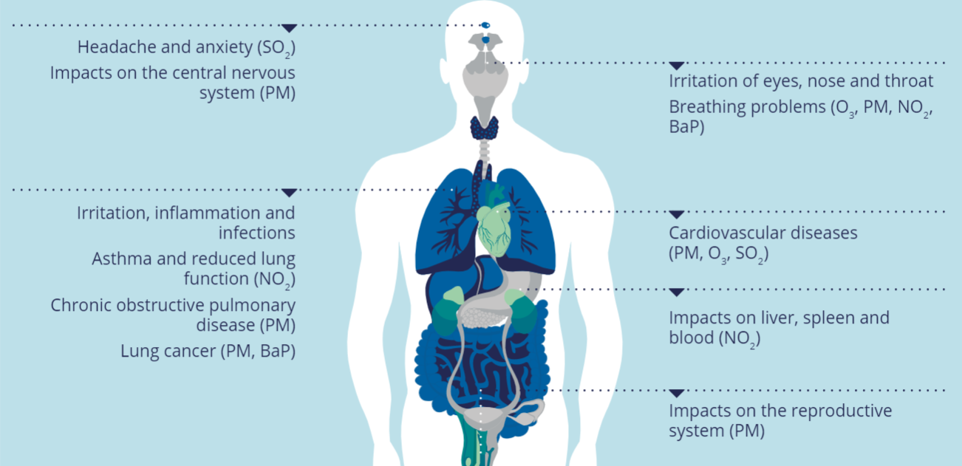
Air Pollution and Lungs

Slide 6
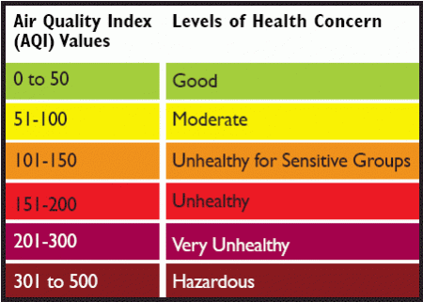

Slide 7
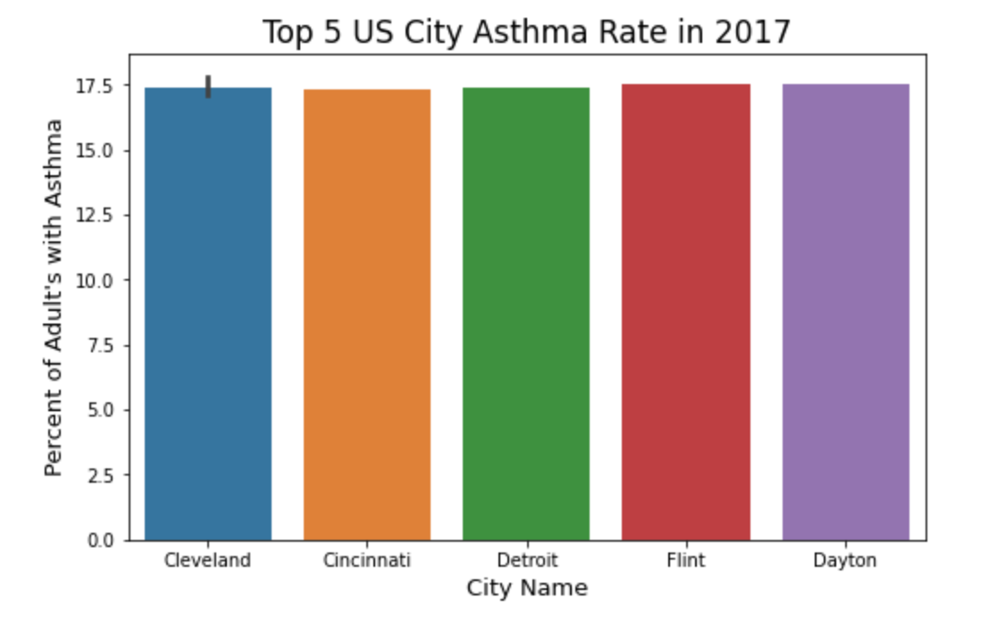
Asthma Rate in Cleveland, OH
Notes:
Cleveland with the highest US asthma rate for adults older than 18 years old based on CDC data from 2017. 17.5% of all adults in Cleveland have Asthma. Seeing that Cleveland had a high asthma rate narrowed allowed us to narrow in on one city to look at air quality

Slide 8
What is the relationship between daily pollutants and Air Quality Index (AQI)?
Can we create a model that accurately predicts Air Quality Index (AQI)?
Notes:
Can we create a model that accurately predicts AQI based on daily 2017-2019 pollutant and temperature data from Cleveland, Ohio?tant and temperature data from Cleveland, OH.

Slide 9
Data Source and Data Cleaning
-2017-2019 daily pollutant data from EPA
-Daily high and low temperature from Cleveland.com
-Calculated daily cumulative AQI
-Calculated average daily temperature

Slide 10
Model | RSME | R2 Score
Baseline (mean AQI) | 15.441 | .0000225
Linear Regression | 8.236 | 0.762
Elastic Net | 8.290 | 0.759
Lasso | 8.290 | 0.759
Ridge | 8.238 | 0.762
KNN Regressor | 8.528 | 0.745
Neural Networks | 5.783 | 0.883
Decision Tree Regressor | 7.223 | 0.817

Slide 11
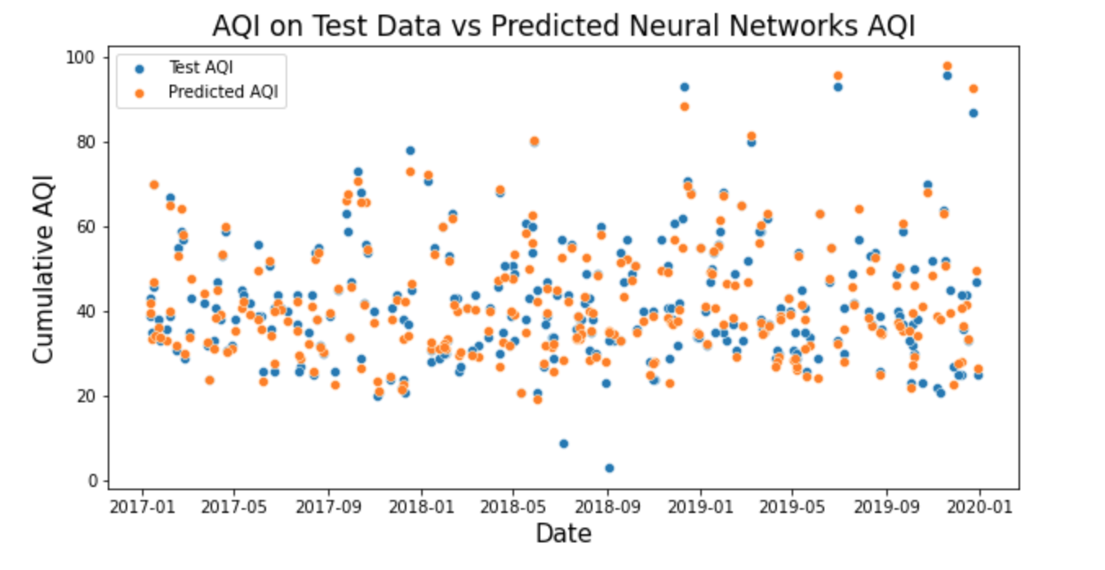
Best Model: Neural Networks
-5 Dense Layers:
50, 200, 50, 50, 1
-Early Stopping: 5
-Batch Size: 100
-Epochs: 100
Notes:
Batch size number of samples processed before updating
Early stopping to prevent overfitting

Slide 12
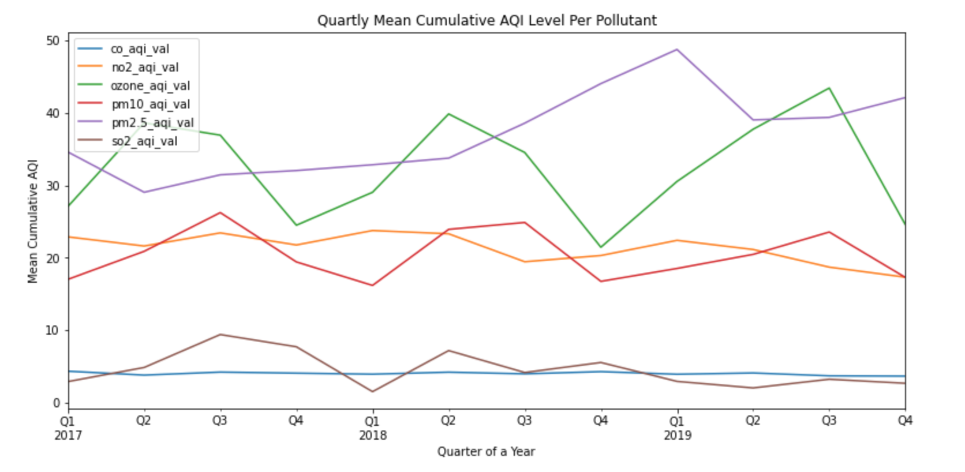
Important Features Identified Decision Tree Regressor Model
PM 2.5 values
Ozone values
Notes:
Pm 2.5 0.800
Ozone 0.146
Feature importance for decision tree

Slide 13
Streamlit

Slide 14
Summary
Best Model: Neural Networks
RSME: 5.783
R2: .883
Recommendation:
Pay attention to Ozone and PM 2.5 values regarding overall air quality
Limitations
Data specific to Cleveland, OH
Further Research

Slide 15
Sources
https://www.eea.europa.eu/themes/air/health-impacts-of-air-pollution
https://www.cnet.com/health/air-quality-index-how-to-tell-if-the-air-quality-is-bad-in-your-area/
https://ecolink.com/info/six-common-air-pollutants/
https://www.epa.gov/outdoor-air-quality-data/download-daily-data
https://www.cleveland.com/datacentral/2008/09/cleveland_weather_history_find.html
https://www.airnow.gov/sites/default/files/2020-05/aqi-technical-assistance-document-sept2018.pdf
https://www.epa.state.oh.us/portals/27/ams/plans/NCORE-GTCraig.pdf
https://www.breeze-technologies.de/blog/what-is-an-air-quality-index-how-is-it-calculated/

