Slide 1

Electricity Consumption in North Carolina
CHRISTOPHER CALDARELLA
DATA SCIENTIST
2021-05-24

Slide 2
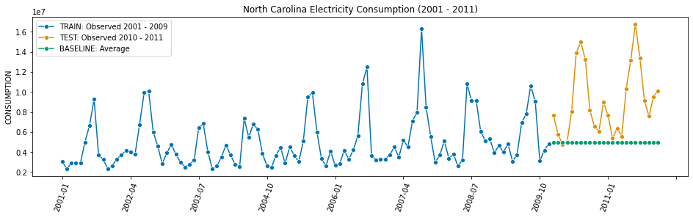
Null Model

Slide 3
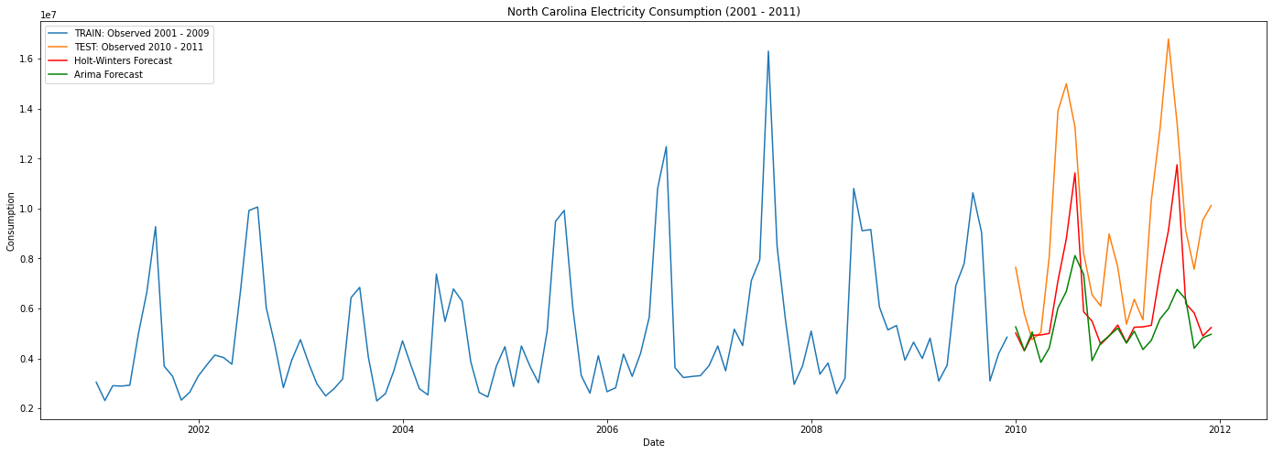
Holt-Winters and SARIMAX

Slide 4
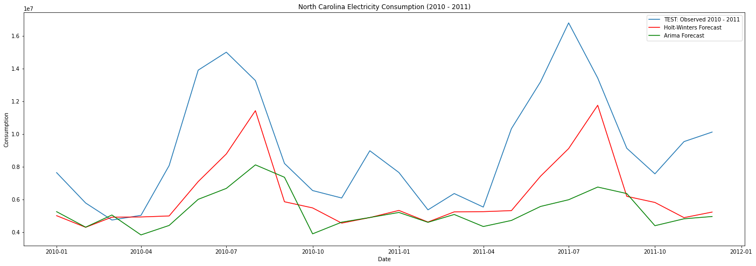
Holt-Winters and SARIMAX

Slide 5
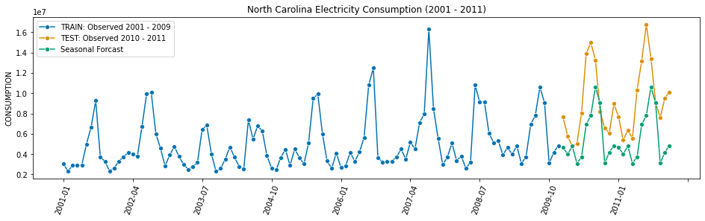
Seasonal Model

Slide 6
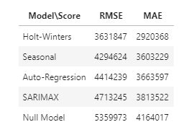
Best Models
Holt Winters out-performed all models
Some Surprises:
Seasonal actually out-performed SARIMAX and Auto-Regression
Although a simple model, Auto-Regression did ok.
SARIMAX did not do so well.

Slide 7

Questions?

