Slide 1

Electricity Consumption in North Carolina
CHRISTOPHER CALDARELLA
DATA SCIENTIST
2021-05-24

Slide 2
Problem Statement
Using data from EIA (US Energy Information Administration) are there any patterns in electricity usage in North Carolina from 2001 through 2011, and can we use this data to make a predictive Time-Series Model?

Slide 3
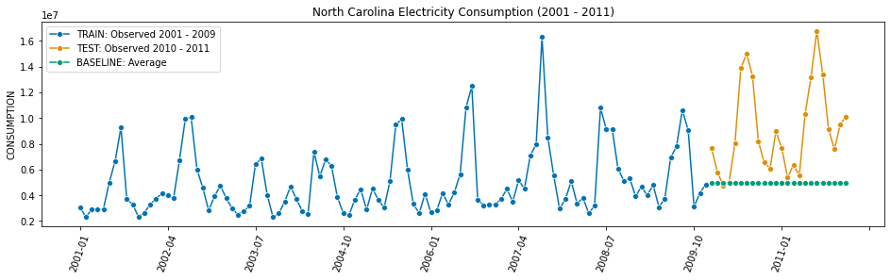
Null Model

Slide 4
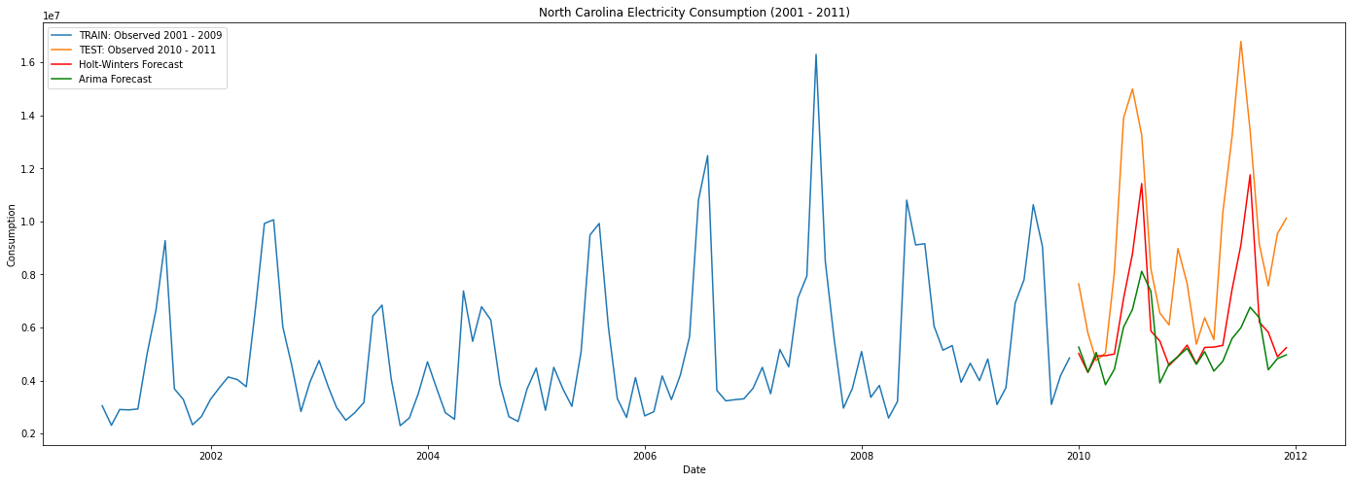
Holt-Winters and SARIMAX

Slide 5
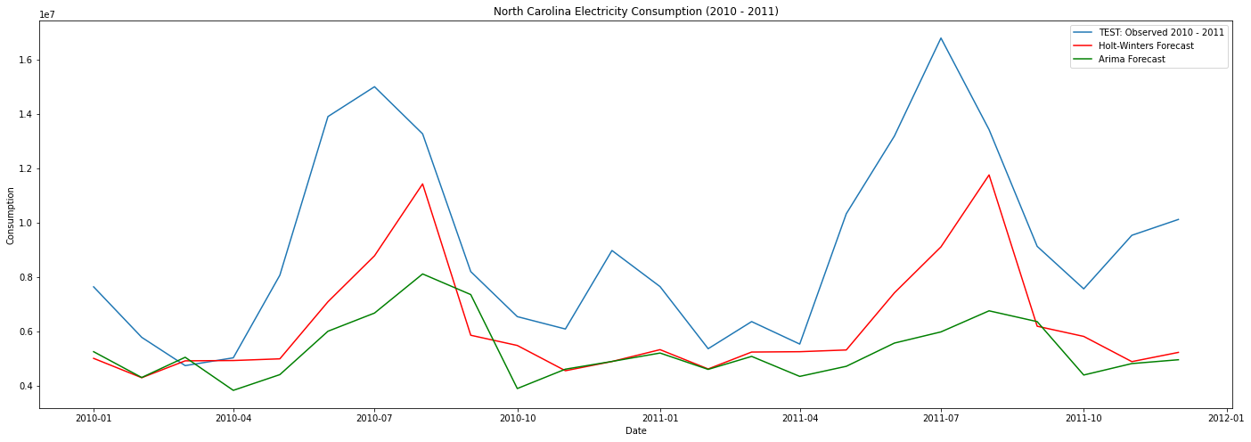
Holt-Winters and SARIMAX

Slide 6
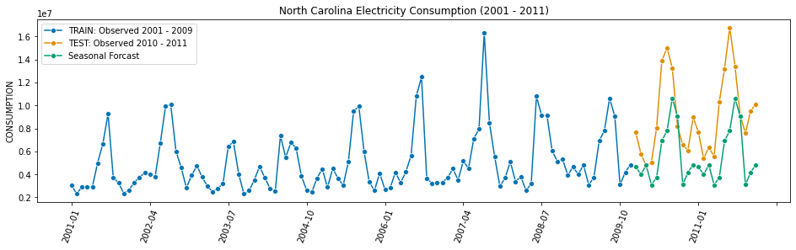
Seasonal Model

Slide 7
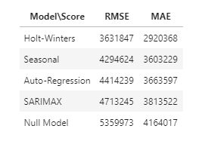
Best Models
Holt Winters out-performed all models
Some Surprises:
Seasonal actually out-performed SARIMAX and Auto-Regression
Although a simple model, Auto-Regression did ok.
SARIMAX did not do so well.

Slide 8

Questions?

