Slide 1
Comparing Text with Supervised Machine Learning
Christopher Caldarella, Data Scientist
2021-05-04
Notes:
Hello, today we will be
Comparing Text using Supervised Machine Learning
I am your host,
Christopher Caldarella, Data Scientist

Slide 2
Can Machine Learning tell where text is from?
I pulled data from the popular(?) “social news aggregation” website (per Wikipedia) “Reddit.com”
Data is exclusively comments pulled from 2 similar “subreddits”
I want to know if a trained Model can predict which “subreddit” each comment came from
Subreddits include: “AMA”, and “AskReddit”
These are 2 popular subreddits within the community where people post answers to questions asked.
Subreddit names were removed as part of EDA/Cleaning
Notes:
Problem Statement:
Can Supervised Machine Learning tell us where a subreddit comment comes from?
I pulled data from “Reddit.com”
Data is exclusively comments pulled from 2 similar subreddits: “AMA”, and “AskReddit”
For those unfamiliar, AMA is shorthand for “Ask Me Anything”
e.g. Hey Reddit, I just joined a Data Science Bootcamp – Ask Me Anything!
And Ask Reddit is where people just ask any question, shallow or insightful or anywhere inbetween.
These are 2 somewhat popular subreddits within the community where people can post answers or ask more questions.
So, I want to know if a trained Model can predict which “subreddit” each comment came from
One Bayesian model, and another model - in this case Logistic Regression.
Subreddit names were removed as part of Exploratory Data Analysis/Cleaning
(meaning I removed “AMA” and “AskReddit” from the body of any comments)
I guess another thing to ponder is how a Naïve Bayes model does against other models, or vice-versa.

Slide 3
(Pulling Data,) EDA and Cleaning
Webscraping: created a Scraper using Python’s “requests” library.
Pulled about 12,000 comments total; 10,000 for TTS
Analysis and Cleaning
I added a column ‘post_length’, a character count
I dropped a lot of columns; close to 30 (out of 37)
There just was not a lot of data in those columns
A lot of it was ‘[]’ or NaNs, or easily identifiable features
From the 10,000 entries, over 9,700 were usable, which is fine
Removed ‘[deleted]’, and some lengthy ‘outlier’ comments
Notes:
Webscraping:
I had some fun with this. I made a basic scraper, and then started adding things to it.. Probably too many things.
Using the “requests” library I was able to pull things from reddit using the Pushshift.io API like we did in class.
I added some bells and whistles, like a for loop to get comments from each subreddit (so I did not have to run it twice).
Then I added a function around that part
So it would loop through the request part since the API only pulls 100 comments at a time.
I also had a very bad internet connection at the time (which has since been corrected),
so I had to throw in a try/except statements to handle the
Poor internet connection, and retry a few times if it bombed out.
Because of this I added a part that wrote to a csv-file the last “before” value. The scraper would just pull the most recent data if that file was not there, otherwise it would pull the value from the csv-file and pick up from
Where it left off (since the connection would sometimes cause the function to error out).
And if it I was leaving it to run overnight, I wanted to know where it left off, so I added some logging functionality and output to the screen as it was running (and I added date/time to the log so I could tell when/where it failed).
But all in all, I don’t think it ran more than 30 minutes once everything was working correctly. But it was 30 minutes I could be doing something else.
…After my internet was fixed I added a ‘sleep’ timer
So the function not do anything
for ten seconds between each request.

Slide 4
(Pulling Data,) EDA and Cleaning
Webscraping: created a Scraper using Python’s “requests” library.
Pulled about 12,000 comments total; 10,000 for TTS
Analysis and Cleaning
I added a column ‘post_length’, a character count
I dropped a lot of columns; close to 30 (out of 37)
There just was not a lot of data in those columns
A lot of it was ‘[]’ or NaNs, or easily identifiable features
From the 10,000 entries, over 9,700 were usable, which is fine
Removed ‘[deleted]’, and some lengthy ‘outlier’ comments
Notes:
Analysis and Cleaning:
I had to drop a LOT of data…
But I also added a column named post_length that counted the number of characters in the comment.
Which later helped me identify some possible outliers.
At least I think it helped.
Out of ten thousand observations, I was left with over 9700 observations to train my data with.
But in the end I think I ended up with less than 10 columns.
But the columns I dropped did not have much in the way of content
Here let me show you…

Slide 5
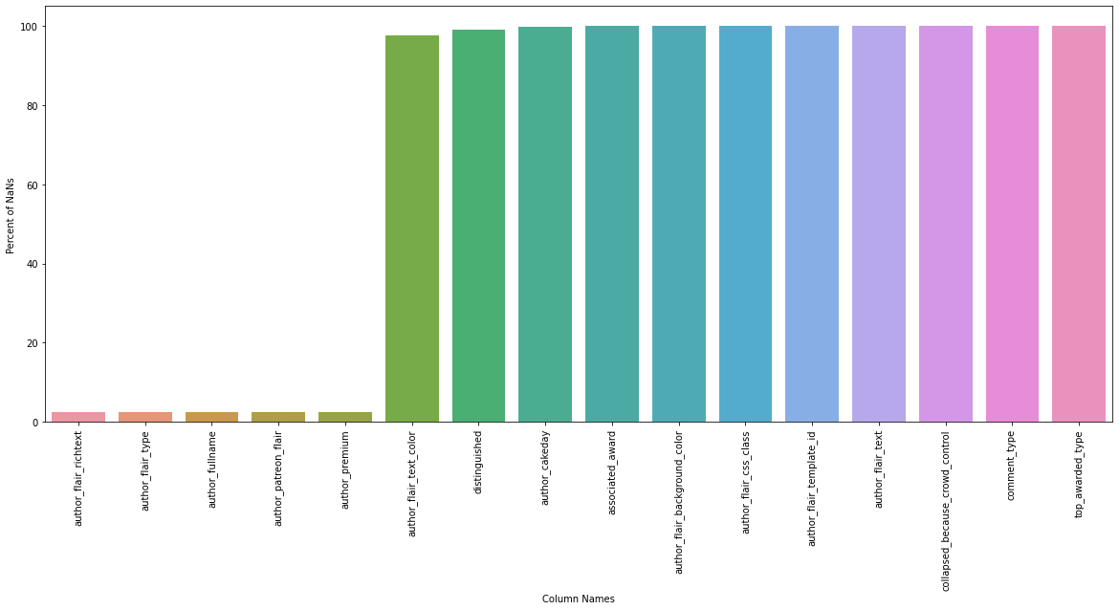
(Pulling Data,) EDA and Cleaning (cont.)
Dropped Columns
(11 here)
Notes:
Analysis and Cleaning:
Here are 11 rows that are generally all null/NaNs
I know, I know – you can’t see what they are but that is not what is important – so please bear with me….
Anyway, Off the bat we are not looking at much.
I went looking through each column, looking for unique values and value counts
I found a lot of columns with empty square-brackets.
So I converted them to NaNs (basically, so I could drop them later)

Slide 6
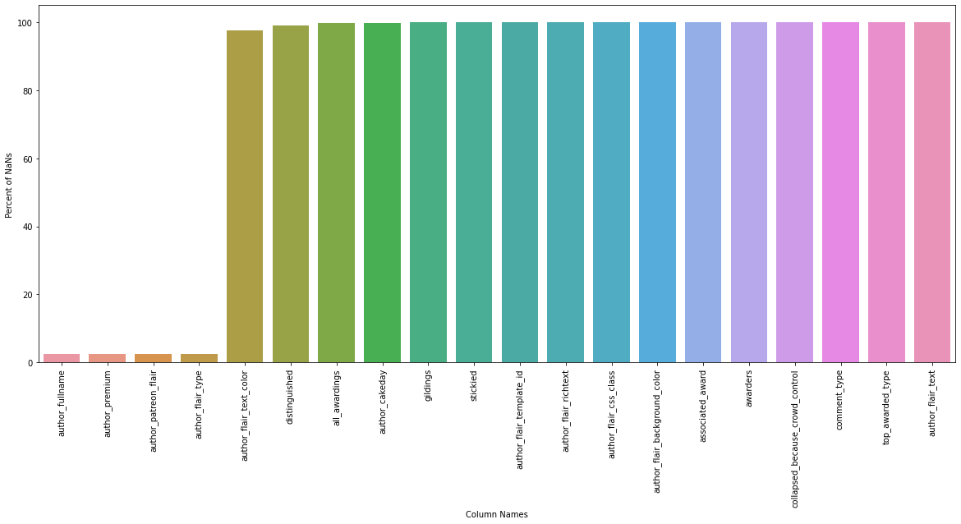
(Pulling Data,) EDA and Cleaning (cont.)
Dropped Columns
(16 here)
After changing empty brackets to NaNs
(Almost half)
Notes:
Analysis and Cleaning:
And here is what I want to point out;
16 COLUMNS (out of 37 – or 36 if you do not count or ‘subreddit’ column) has no data
So that is close to half of our data, but that is ok since all I really need is the comment or “body” column.
Anyway, I just wanted to point it out.

Slide 7

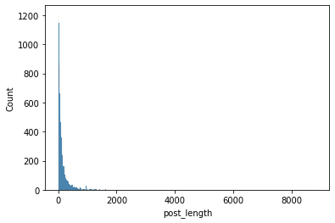
(Pulling Data,) EDA and Cleaning (cont.)
Added "Post Length feature
Dropped Rows
Comments with letters greater than…
6000: 4
4000: 11
2000: 32
1000: 149
(More from “AMA”)
Notes:
Analysis and Cleaning:
I added a post_length feature that had the number of characters per comment
Comments with character-count of 2000 or more were skewed such that they were more commonly “AMA” comments.
I tested both with removing none of the outliers,
and typically I used the data that removed rows with over 2000 characters in the comment
But, in the end, I settled on removing posts with 4000 characters or more.

Slide 8
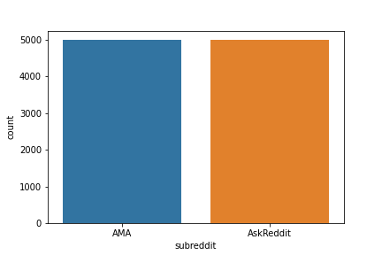
Null Model
Base model was pretty simple: 50/50
Notes:
After cleaning up, I took a look at my null model – it is very simple.
Even after getting rid of some rows, my null model was still balanced at about 50/50
And both subreddits are pretty text-heavy subreddits (Not a lot of pictures/video media).
So the ratio was only altered after EDA/Cleaning, but generally remained pretty balanced.
I think that starting with 10,000 (5000 from each subreddit) helped with that.
To ensure a more difficult model, I made sure to focus on the comments instead of the posts.
What I mean is that the Posts for each of these subreddits have a certain style in the writing
Like “Hey reddit, I did X, Y or Z – Ask Me Anything (AMA)
Or, Why is it that something is like something.
To keep this challenging, I dropped all columns that had any subreddit identifiers, and deleted the subreddit name from the body of the post (if applicable).
When I first started on this, my first results were such that I was better off guessing.
Maybe I was better inverting my predictions – Just kidding… but I do not think even that would have helped.

Slide 9
General Observations
What are we looking for?
A model that performs as well or better than a Naïve Bayes model.
All models used a Vectorizer of some sort:
Count Vectorizer
TF-IDF Vectorizer (Term-Frequency-Inverse Document Frequency)
Most Models I tested seemed to do better with TFIDF
(One of few that performed better with Count Vectorization was Ada Boost)
Most models preferred no Stop-Words
Notes:
Since we are testing the Naïve Bayes Model,
I kind of gravitated towards the Logistic Regression model from the start.
As I mentioned, I got less-than-impressive results, but I had only assembled some basic models without making any adjustments
I used Count Vectorizer and
Term Frequency-Inverted Document Frequency,
Or TF-IDF,
on pretty much every combination I iterated.
.…
As we know Count Vectorizer turns the words into columns and counts how many times they occur
And the TF-IDF Vectorizer takes that same approach, but multiplies that “term-frequency” by the inverse of how many “documents” contain that term (or in this case, reddit comments)
….
Generally-speaking, I found that TF-IDF seemed to perform slightly better.
The only notable model were Count Vectorizer seemed to do well was
With an Ada Boosting model and a KNN model;
the Ada model was a bit overfit but did pretty well otherwise.
Most models seemed to prefer to not use stop words

Slide 10
Scoring
Looked mostly at F1 Score since it is balanced
Kept Accuracy and Recall in mind as well
Also looked at TP, FN, FP, and TN and Confusion Matrices
Notes:
=== HALF WAY POINT ===
I Looked mostly at F1 Score since it is balanced
Kept Accuracy and Recall in mind as well
I Also looked at TP, FN, FP, and TN
and I used Confusion Matrices to compare those

Slide 11
Techniques
Pipeline and GridSearchCV, TF-IDF
Most results: Max_features: 5000, stop words: None
Later created Functions/Classes to handle and organize my data.
Stored scores in DataFrames
Ccreated Markup Headers as Labels
Comparisons were mainly made with tables and some confusion Matrices

Slide 12
Models without ‘body’, and Voting
What are Models without ‘body’
Removed ‘body’ feature and used the other features.
Most other features I was left with were numerical or Boolean
I was not able to figure out how to combine them
ElasticNet (Ridge) and Linear Regression Models
With the features that had numerical data – manipulated results by rounding
Used OHE, KNNImputer, and Standard Scaler which helped a little
Random Forest and Logistic Regression had high Recall scores (95%) but were severely biased towards ‘AskReddit’
Tried Voting (w/ body) with Boosting and Logistic Regression
I thought the Boosting overfitting would help, but just brought the scores down
Notes:
I removed body from the feature list.
I could not figure out how to keep ‘body’ with the other components,
Or how to process it together, with sparse matrices and data frames, not mixing
Best I can figure is taking probabilities of each set but I did not have
the time to work that out
…and there is probably something exists that I am totally missing
Linear Regression performed miserably. Which makes sense.
The bulk of this data was purely categorical
Using Classification with the other features (besides body) did not give me much without huge Bias
so, I looked to voting.
Needless to say, with voting I focused back onto Classfication
I used Gradient Boosting and Ada Boosting with ok results and some overfitting,
so I paired them up with Logistic Regression (my best performer)

Slide 13
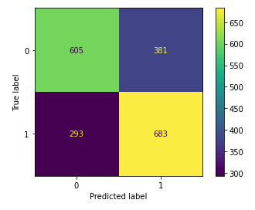
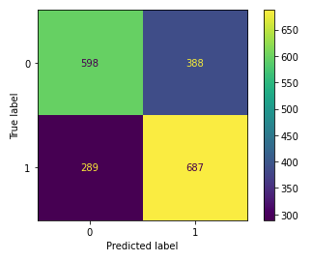
Voting (cont.)
Maximized values by setting Logistic Regression to 0.6 minimum
Ada, Gradient, Logistic Regression Random Forest, Logistic Regression
Notes:
TF-IDF performed slightly ‘better’, except with Ada boosting
As I had mentioned
I took my grid search Models objects for Ada Boosting, Gradient, Boosting, and Logistic Regression,
Results were maximized (evenly) after setting the weight for Logistic Regression to at LEAST 0.6
The ratios of the others did not matter.
And that took a loooong time to run.
I also tried Decision Tree with Logistic Regression with much of the same results,
But slightly more biased towards ‘AskReddit’
I also tried using the TF-IDF and Count vectorizers fitted to X directly, and using
Each of the Classifiers with the Voting Classifier directly
(like you are supposed to) and I got more biased results, again, towards ‘AskReddit’
A handful of predictions (at best) moved from False to True – maybe one or two
And/or improved either True Positive or True Negative at the detriment of the other.
After many combinations, I decided to abandon this process
Worth noting that these are my 2nd round of tests, with my first set of data
(which is why it is only 2,000-ish entries)

Slide 14

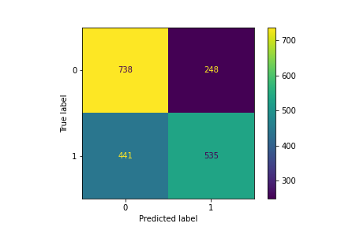
Lemmatized Bayes
Like most other Models, Bayes with Lemmatization was Biased
F1 Score: 0.6083
(Compared to 0.6398 w/o Lemma)
It looks like the Bias skews towards ‘AMA’ (0)

Slide 15
Models (F1 Scores on Test Data)
Logistic Regression - 0.7047 *
Naïve Bayes - 0.6398 *
K Neighbors - 0.6800 ‡
Random Forrest - 0.6642
Decision Tree - 0.6359
Bagging - 0.6146
Ada Boosting - 0.6679 ‡
Gradient Boosting - 0.6720
‡ CountVectorizer
* From new data

Slide 16
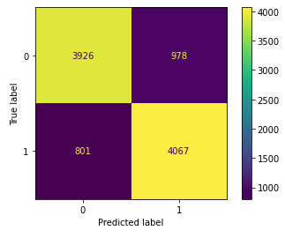
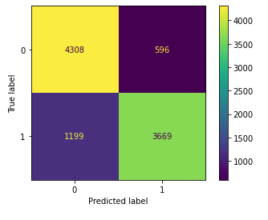
Logistic Regression vs Naïve Bayes
Logistic Regression Naïve Bayes

Slide 17
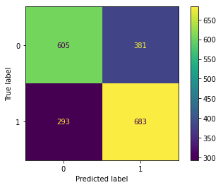
Logistic Regression vs Naïve Bayes
Why not both?
It can work! …
But, F1 Score of 0.6696
Logistic Regression on its own still might be better

Slide 18
Conclusion: What is better?
It Depends
When trying to figure out what category something falls in, we need to find what has the least detriment if any at all.
In this case, we want balance: And Logistic Regression delivers
Notes:
In this case, trying to predict how to classify text into subreddits
No one’s health or life is on the line
And it is not something where we need to determine any sort of risk,
Like lending out money for a loan.
So I think we want a model that predicts very well, but that is pretty evenly balanced.
Which we knew, but I would go with Logistic Regression if I had to pick.
The Bayes model did ok too, but Logistic Regression seemed the least biased out of everything I tried.

Slide 19
Questions?

