Slide 1
Introduction to Cloud Computing
50466 Windows® Azure™ Solutions with Microsoft® Visual Studio® 2010

Slide 2
What is Cloud Computing and why is it important?
Wikipedia defines cloud computing as:
“Internet-based computing, whereby shared resources, software and information are provided to computers and other devices on-demand, like the electricity grid.”
The idea behind cloud computing is to access software applications and/or data from resources available through the Internet with a simple browser.
In cloud computing, you pay for the resources (applications and data) you use, as you go.
Key reasons for shifting to cloud computing include cost savings, improved scalability and reliability, and availability of applications/data anywhere.

Slide 3
What is Cloud Computing and why is it important? Cont.
How does the cloud save costs?
Expensive hardware, networks, and other equipment found in a data center that host applications and data are expensive.
In the cloud, cloud providers own and operate these resources rather than you and your organization.
As a user or customer of “the cloud,” you merely pay for access to the applications in the cloud and/or rent space for your data and applications.
Just as you pay for the electricity and water you use at home or locker space for your clothes at the gym, you now pay for application use and data storage.
Computing resources in the cloud now become utilities you purchase. The more you use, the more you pay.

Slide 4
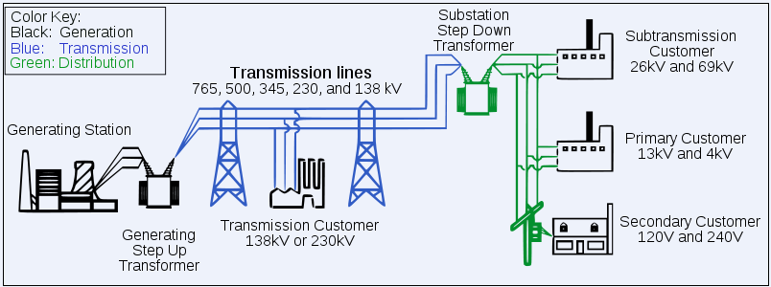
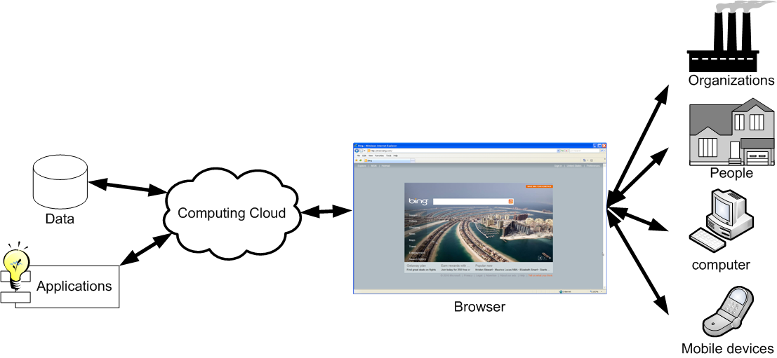
What is Cloud Computing and why is it important? Cont.
Because of analogies to electrical and other utility services, cloud computing is often called utility computing.

Slide 5
What is Cloud Computing and why is it important? Cont.
How does the cloud make applications and data more accessible?
Because cloud assets are accessible over the Internet via a simple browser, it makes the applications and data more accessible.
Users of the cloud don’t need to install anything on their machines. In fact, they don’t even need “their machines.”
In the cloud, word processing, for example, is an application you access from the cloud via browser and you save your document to cloud storage.
Start to create the document from a browser on a laptop in the local café and complete the document at home from the browser on your desktop.
In fact, the machine you use to access apps and data (like the word processor and document) might even be your Windows Mobile phone or other mobile device.
Cloud computing provides real ubiquitous computing.

Slide 6
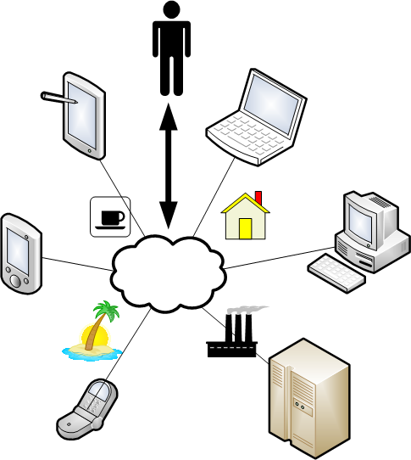
What is Cloud Computing and why is it important? Cont.

Slide 7
What is Cloud Computing and why is it important? Cont.
While an increasing number of applications today can run via a browser, cloud computing does not prohibit more thick or rich clients.
The cloud provides an environment for highly scalable, pay-as-you-go applications.
Rich clients or “fat” client applications can leverage this environment just as well.

Slide 8
What is Cloud Computing and why is it important? Cont.
Accountants like to talk about the savings of OpEx versus CapEx when discussing the cloud.
In effect, organizations now have more operational expenses (OpEx) – that is the utility costs associated with the application and data they use/store in the cloud.
However, OpEx is more flexible. As demands for the applications or data increase, more computing capacity can be purchased from cloud providers.
As the demand for the application or data wanes, an organization can reduce their computing capacity from the cloud provider saving the organization money.
You pay for exactly what you use in the cloud, not for what you might use. “Scale on demand” is how cloud computing believers like to refer to it.
When building a data center, your organization builds it to handle the peak predicted utilization. This generally leads to a lot of wasted capacity.

Slide 9
What is Cloud Computing and why is it important? Cont.
Companies incur a capital expenditure when spending money on a fixed asset like a data center or hardware.
Cloud computing also helps to lower the more expensive and harder to manage capital expenditures (CapEx) of data centers and hardware and software therein.
Data centers are large capital expenditures rarely used at an optimal level.
Data centers are often crowded and over utilized (creating hardship and performance problems for users), or underutilized (thereby creating waste).

Slide 10
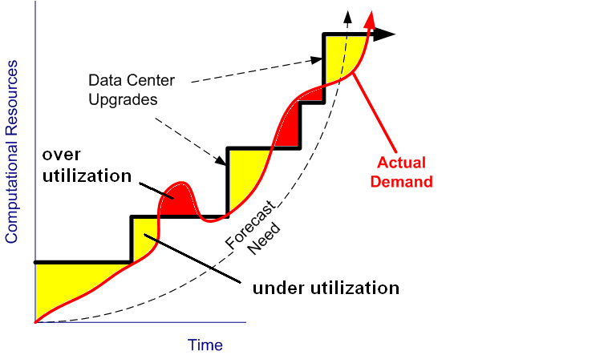
What is Cloud Computing and why is it important? Cont.
There are other reasons for exploring cloud computing.

Slide 11
What is Cloud Computing and why is it important? Cont.
In addition to purchase costs of hardware and software found in most data centers, there are costs associated with maintenance and upgrades.
Upgrades, patches, and fixes in both hardware and software are additional hits to IT budgets.
Hidden costs in the time it takes IT personnel to deal with maintenance issues and push out upgrades can be significant.
Cloud computing helps to alleviate, if not eliminate, maintenance/upgrade costs.
Cloud providers spread the maintenance costs across the many cloud platform users, building the costs into their utility fees.

Slide 12
What is Cloud Computing and why is it important? Cont.
System availability is always of concern of IT personnel.
Subscribers to cloud computing resources often sign an agreement that includes a service level agreement that guarantees certain “up time” and reaction to outages.
This agreement often encourages better reliability than found in most organizational data centers.
This is especially the case when the cloud provider has the capability to bring up the applications/data in multiple cloud data centers quickly during an outage.
In fact, most cloud providers offer data centers – cloud computing resource centers – in multiple geographical locations.
This allows cloud users to geographically distributed apps and data that provide less network latency and help address geopolitical concerns and legal regulations.

Slide 13
What is Cloud Computing and why is it important? Cont.
Cloud computing offers more agility to IT organizations by providing application platforms and data storage at a minutes’ notice.
This enables organizations to develop and prototype services that might otherwise take weeks or months just to provision the new environment.
In general, this agility can and often does lead to faster time-to-market.
Cloud providers meter the use of cloud assets so they can charge subscribers accordingly.
Because the cloud computing providers must meter the use of applications/data to the users, you can in turn use that same metered data to charge your customers
The pay-as-you-go model and metering associated with it lends itself well to all spectrum of computing service use.

Slide 14
What is Cloud Computing and why is it important? Cont.
Cloud computing lends itself to device/platform independence.
Users of the cloud often access applications and data via a browser.
Since all it takes to access cloud applications and data is a browser, there is less concern over hardware, OS, and other platform questions on the part of users.

Slide 15
Types of Cloud Computing Services
While the goal of cloud computing is to provide applications and/or data over the Internet, what do cloud providers do to give us cloud computing?
The answer depends, and this creates a great deal of confusion about what cloud computing is (or is not).
Organizations that support cloud computing may offer the actual applications and data you use as a consumer of cloud services.
Some cloud providers provide the tools and environment for building and hosting applications or data without actually providing the applications or data.
Still others just provide a host environment.

Slide 16
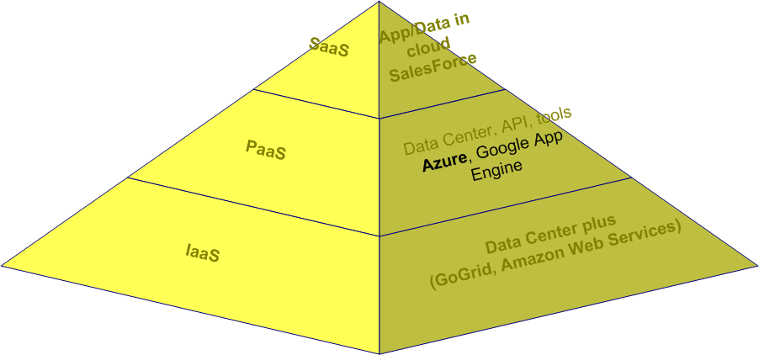
Types of Cloud Computing Services Cont.
To help qualify and quantify provider participation in cloud computing, the industry has devised several categories of cloud computing services.
These categories help describe the capabilities and services offered by cloud computing organizations.
This classification is often referred to as a cloud computing ontology.
While you can find a more fine-grained ontology, generally speaking the three categories of cloud computing services offered today are IaaS, PaaS, and SaaS.

Slide 17
Types of Cloud Computing Services Cont.
Infrastructure as a Service (IaaS) can be thought of as a traditional "data center" service.
IaaS providers are about “renting” (in a pay-for-capacity style) computing time and space on raw hardware.
In other words, as a customer of IaaS, you are effectively using a part of someone else’s data center.
IaaS offers servers, load balancers, basic software, data storage, network equipment as virtualized computing power to host your applications and data.
The “virtualized computing power” allows raw hardware to be more easily shared.
Each server is typically divided into multiple virtual servers each with their own operating system.
You provide the software/data and the IaaS provider gives you the environment to run it on so that you never touch hardware.

Slide 18
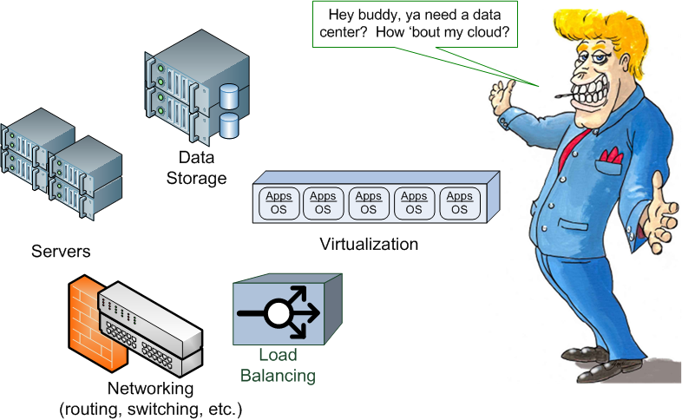
Types of Cloud Computing Services Cont.
Amazon Web Services, Flexiscale, and GoGrid are often-referenced IaaS providers.

Slide 19
Types of Cloud Computing Services Cont.
Platform as a Service (PaaS) is a step up from IaaS. In fact, you can think of PaaS as IaaS-plus.
PaaS offers the hardware and virtualized computing like IaaS.
However, PaaS provides more. PaaS provides a “platform” on which to write applications/data.
The platform is a set of tools and API in support of cloud application development.
The platform often comes with email, cache, security, monitoring, and other services that the applications can utilize.
The platform helps developers address issues of enterprise functionality and scale with minimal work.
PaaS is often described as "cloudware" or an operating system for cloud computing.
As an OS does, the PaaS environment abstracts away any hardware and manages all the details of the application beyond the actual business code.

Slide 20
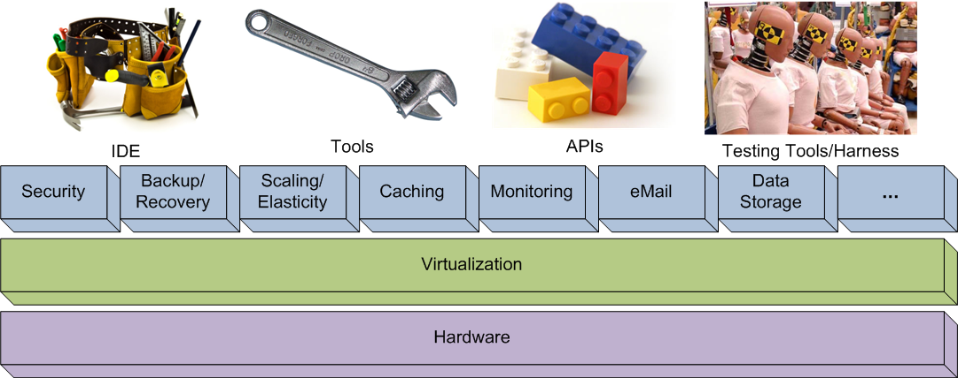
Types of Cloud Computing Services Cont.
Microsoft Windows Azure, Amazon EC2, Google’s App Engine, and Force.com are often cited examples of PaaS.

Slide 21
Types of Cloud Computing Services Cont.
Software as a Service (SaaS) is about making packaged commercial software available over the Internet under a subscription or pay-for-usage service.
This is cloud computing in its ultimate form.
Consumers of this service just use already created applications (and possibly data) over the Internet.
SaaS users are not writing any applications and are not looking for an environment to host applications.
SaaS users have a business to run and have essentially outsourced all their computing needs for a particular application to cloud provider.
SaaS users have decided to rely on the cloud provider to give them everything – from the hardware all the way up to the applications they use.
Microsoft’s Online Service, Salesforce.com, and LotusLive, and are often identified as SaaS solutions.
See www.saas-showplace.com for more examples.

Slide 22

Types of Cloud Computing Services Cont.
A house analogy can help clarify the differences between IaaS, PaaS, and SaaS.
Assume you and your significant-other need a place to live.
Under the IaaS model, you would rent the property from some owner.
However, you must still build the house and make sure all your service needs are taken care of (electric, water, cable, etc. hook ups).

Slide 23
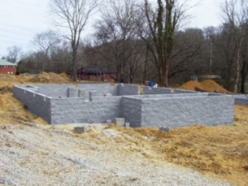
Types of Cloud Computing Services Cont.
Under the PaaS model, you rent a lot that already has a foundation on it and it likely already has the electric, water, cable, etc. hook ups installed.
In fact, the owner even left a shed full of tools on the property to assist you in building your house on the foundation.
You still need to build the house on the foundation, but a lot of hard work has already been done and there are tools to get you the rest of the way.

Slide 24

Types of Cloud Computing Services Cont.
To complete the analogy, if you were an SaaS-styled home purchaser, you would only be looking at properties where the home is already built.
In fact, you probably want all the service hook ups already on and the home complete furnished.
As a SaaS-buyer, you have a life to live and you don’t have time or the energy to do any of this yourself. You just want to move in and start living.

Slide 25
Types of Cloud Computing Services Cont.
It should be mentioned that IaaS, PaaS, and SaaS classification are not official.
In fact, there are several organizations vying for the “standard” cloud computing service ontology or taxonomy.
Many of the proposed ontology share the same classifications. Again, most also go much farther to provide classifications that are more detailed.
For example, some ontology define File storage as a service (FaaS), Monitoring as a Service (MaaS), and many other “as-a-service” categories.
Providers are sometimes associated as service providers under multiple categories in the alternate ontology.
Lack of common terminology and definition confuses and frustrates the IT community and has led to feelings of “market hype” in cloud computing.
The three categories above are a bit broad, but help to qualify those participating in cloud computing today.

Slide 26
Where is the cloud?
Are you already in the cloud?
The organization you belong to might have a data center today.
Your organization might make applications and data available over the Internet.
Resources in that data center may be “leased” to teams or sub-organizations within your company.
Is your organization a cloud computing provider? Are you participating in cloud computing without even knowing it?

Slide 27
Where is the cloud? Cont.
In other words, your organization might already have its own private cloud.
A private cloud is cloud computing on internal networks – Intranet based applications/data.
Organization like IBM, Oracle and many others will sell you the equipment, virtualization operating systems, software, etc. to help you build your own cloud.
Proponents of private clouds suggest private clouds allow organizations to spread costs of expensive hardware/software through flexible virtualized environments.
Private clouds also maintain data security, corporate governance, and reliability; all specific reasons why some organizations cannot move to the public cloud.
Public clouds are defined as those environments provided by companies like Microsoft and Force.com that offer computing resources to the public.
Detractors of private clouds say that because organizations must still outlay the capital expenditure for all the resources, they miss the real benefits of the cloud.

Slide 28
Where is the cloud? Cont.
Most people associated with cloud computing today believe that most applications and data will eventually reside in hybrid clouds.
That is, applications (and associated data) will reside partially in on-premise environments (and private clouds) and partially in public clouds (off-premise).
Security issues, origins of data, etc. will require portions of an organization’s application and data storage to remain under private control.
However, cost and availability will push much of an organization’s portfolio of applications and data to the virtualized world of public cloud computing.

Slide 29
Concerns About Cloud Computing
Cloud computing has been touted by industry experts as “the next big thing.”
Therefore, almost every vendor claims to be participating in cloud computing.
As such, cloud computing has suffered from a lack of clarity as to what it is and how it might help companies.
Richard Stallman (Free Software Foundation/GNU founder) uses the term “stupidity” when discussing cloud computing.
Larry Ellison (Oracle CEO) claims, “We’ve redefined cloud computing to include everything that we already do” and has called it “gibberish” and “idiocy.”
Is cloud computing “the next big thing” or ‘stupidity” and “idiocy?”

Slide 30
Concerns About Cloud Computing Cont.
Even comparing cloud computing to the formation of the electric grid in the early 20th century might be inappropriate.
In the ACM article “Cloud Computing and Electricity: Beyond the Utility Model,” authors suggest:
Issues such as interoperability (vendor lock-in) and security are issues that the electric grid providers did not have to address.
Pace of innovation, limits of scale, and latency (speed of light limits with regard to network traffic) are obstacles even cloud computing cannot immediately resolve.
“An overly simplistic reliance on the utility model risks blinding us to the real opportunities and challenges of cloud computing.”

Slide 31
Concerns About Cloud Computing Cont.
Marketing hype has lead organizations to ignore or misunderstand cloud computing technologies and the benefits that come from them.
Like many proceeding “hyped” technologies, cloud computing is not a silver bullet that will kill all IT-ills.
In order for cloud computing to succeed, real products must help save or create money, increase availability of applications/data, and solve real IT challenges.

Slide 32
Concerns About Cloud Computing Cont.
What are some of the chief concerns about cloud computing?
Privacy: privacy groups are concerned that cloud organizations can monitor the use of cloud based applications and data.
Security: physical control and protection of data in the cloud becomes a joint effort between application/data providers and cloud providers.
Are the security efforts of the cloud providers as good, or better, than organizations that have already been trusted with that data?
Compliance/Governance: there are many laws and policies (HIPAA, SOX, taxing, etc.) regarding the management of applications and data.
Do cloud-providing organizations adhere to the same compliance/governance requirements? If so, how well?
How does the cloud affect businesses that use the cloud?
For example, your organization may operate in a state without sales tax on Internet goods.

Slide 33
Concerns About Cloud Computing Cont.
The cloud data center may operate in a state that taxes for sales over the Internet. Do the tax laws apply? Should they apply?
How are businesses liable for applications and data in a cloud data center in the middle of unrest (war, political unrest, natural disaster, man-made disaster)?
Interoperability: can an application or its data be moved back on-premise? Can a cloud application be moved to another cloud platform without issue?
There are a number of cloud computing open standards under development (OGF's Open Cloud Computing Interface, The Open Cloud Consortium).
These efforts are in their infancy and adherence by cloud computing organizations is haphazard.
Stability: How do I do business if the cloud is down?

Slide 34
Concerns About Cloud Computing Cont.
Most acknowledge that some things won’t ever be in the cloud (at least not in the foreseeable future). Some of these include:
Sensitive financial data
Personal information (especially when regulations prohibit it – ex: European customer data cannot be stored outside Europe)
Critical intellectual property
Situations where auditing of apps/data is a requirement.

Slide 35
What is Microsoft Windows Azure?
Windows Azure is Microsoft’s cloud computing platform, or as mentioned, is a Platform as a Service (PaaS).
Microsoft provides the hardware/software to host your applications, more formerly known as services, and data.
The services may be a Web site or a computational service to “crunch data” or provide some other useful computational capability.
Along with services, data can be stored in a variety of forms. You can access the data via an HTTP API from inside or outside the data centers.
The data is replicated no less than three times to protect it (and applications that use it) from system failures.
You pay for the computational processing and storage in Windows Azure on a consumption model – that is in a pay as you go and for what you use manner.

Slide 36
What is Microsoft Windows Azure? Cont.
A growing number of Microsoft cloud data centers (more than a dozen at this time) provide the hosting hardware, networks and general infrastructure.
Each data center teems with thousands of servers.
Your applications and data are not likely to run stand-alone on any given server in the cloud.
Users of the Windows Azure cloud data centers share resources.
Therefore, each machine is also running a hypervisor called Hyper-V (modified for Windows Azure).
The hypervisor provides virtualization of the server.
That is, the hypervisor provides the capability to run several operating systems simultaneously on one server.
The hypervisor allocates the resources of the actual hardware to several virtual machines.

Slide 37
What is Microsoft Windows Azure? Cont.
Windows Azure grants your services and data their own virtual machine, but not necessarily an entire server.
Today, virtual machines in the Microsoft Data Centers run a modified version of Windows Server 2008.
You hear more about the data centers and virtual machines later.

Slide 38
What is Microsoft Windows Azure? Cont.
The Windows Azure platform also provides a software development kit (SDK) for creating services and data stores that reside in or use the cloud.
The Windows Azure SDK along with Windows Azure Tools for Visual Studio provides Visual Studio templates for easier application creation.
The SDK comes with an API to access data and environmental services in the Windows Azure cloud.
The SDK also provides a simulation environment for approximating applications running in the Windows Azure cloud on your development machine.
Deployment tools in the SDK provide a means for getting services and data to the cloud.
Many developers use the Microsoft Windows Azure Developer Portal Web site for deployment assistance.
Of course, as with any SDK, it ships with samples and documentation to assist developers.

Slide 39
What is Microsoft Windows Azure? Cont.
There will be much more on the SDK and Windows Azure Tools for VS later in class as well.
In fact, this class is largely dedicated to exploring what the SDK has to offer and how to take advantage of it.

Slide 40
Why Windows Azure?
Why should you use Windows Azure versus a different cloud environment?
Windows Azure allows you to leverage existing Microsoft, Windows, and.NET code and knowledge.
Windows Azure allows you to work in a familiar development environment.
Microsoft’s capability rivals or is better than other PaaS environments.
Microsoft’s cloud service level agreement (SLA) for cloud services and data rivals or is better than cloud competitor SLAs.
Windows Azure’s price point is attractive.

Slide 41
Why Windows Azure? Cont.
Microsoft’s investment in the cloud is huge.
Microsoft has invested over a billion dollars on the data centers alone.
75% of Microsoft's software developers are now working on cloud-based or cloud-inspired software.
This figure is expected to near 90% in the not-too-distant future.
Microsoft’s huge investment is your gain allowing you to focus on application development and not infrastructure.
Welcome to the Windows Azure community!

Slide 42
Optional Lab Exercise: Account Setup Lab (Optional)

Slide 43
Chapter Summary
Cloud computing is Internet-based computing, whereby shared resources are provided to computers and other devices on-demand.
Cloud computing delivers access to software applications and/or data from resources available through the Internet with a simple browser.
Key reasons for shifting to cloud computing include cost savings, scalability, reliability, and availability of applications/data anywhere.
Computing resources in the cloud are utilities you purchase. The more you use, the more you pay.
Because of analogies to electrical and other utility services, cloud computing is often called utility computing.
Because cloud assets are accessible over the Internet via a simple browser, it makes the applications and data more accessible.
Cloud computing provides real ubiquitous computing.

Slide 44
Chapter Summary Cont.
The industry has devised several categories of cloud computing services.
These categories help describe the capabilities and services offered by cloud computing organizations.
Generally speaking the three categories of cloud computing services offered today are IaaS, PaaS, and SaaS.
Infrastructure as a Service (IaaS) can be thought of as a traditional "data center" service.
PaaS provides more. PaaS provide a “platform” that users write applications/data for that runs on the virtualized computing environment.
The platform is a set of tools and API in support of cloud application development.
PaaS is often described as "cloudware" or an operating system for cloud computing.

Slide 45
Chapter Summary Cont.
Software as a Service (SaaS) is about making packaged commercial software available over the Internet under a subscription or pay-for-usage service.
Windows Azure is Microsoft’s Platform as a Service (PaaS) offering.

