Slide 1
Windows Azure Architecture
50466 Windows® Azure™ Solutions with Microsoft® Visual Studio® 2010

Slide 2
Hello Azure
OK, so you are probably itching to get started.
To begin this chapter, how about putting Hello World in the cloud?
Hello World allows you to get a better sense of what Windows Azure is so that you can explore the architecture (pieces and parts) of Windows Azure in this chapter.
It also gives you a chance to see that building applications for Windows Azure is generally no different from building applications for your own host environments.
You explore details of each of the pieces of Windows Azure as well as how to build more sophisticated apps in later chapters.
Instructors – feel free to skip this portion of the text and replace it with a demonstration, as you deem appropriate.

Slide 3
Hello Azure Cont.
To begin, you start Visual Studio (VS 2010).
You can use other IDEs or even operate without an IDE (for hardcore developers), but Visual Studio (VS) is the tool of choice for most Windows Azure developers.
Windows Azure Tools (WAT) for VS (covered in a bit) must also be installed.
WAT includes the Windows Azure SDK (also covered in a bit).
You need to run VS as administrator. Administrative rights are required to start the Compute Emulator and Storage Emulator(yep – also covered in a bit).

Slide 4
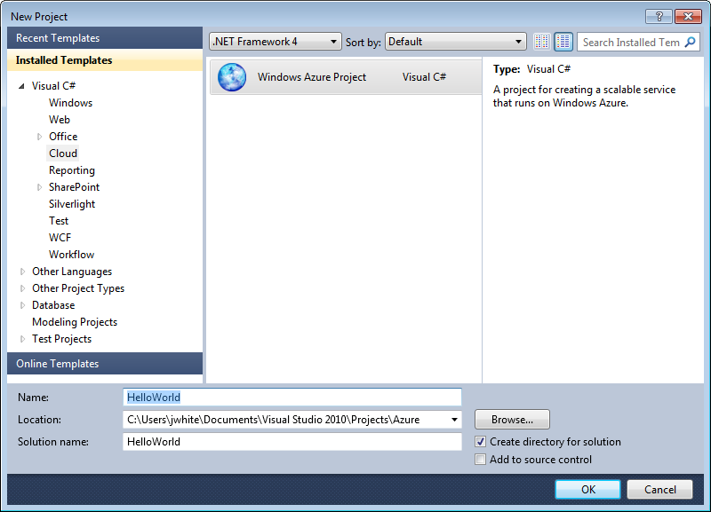
Hello Azure Cont.
Using VS, you begin by creating a new Windows Azure project. WAT provides new templates for creating cloud applications.
Note, both .NET Framework 3.5 and .NET Framework 4 projects are supported.
When creating a new project, you also request the number and types of Windows Azure roles you want in your solution (see picture below).

Slide 5
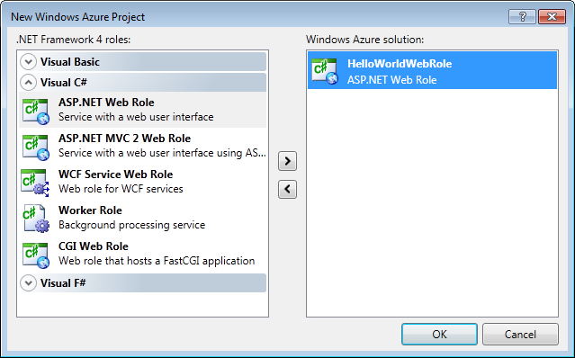
Hello Azure Cont.
You learn a little about roles in this chapter, but you learn details in later chapters.
For now, the Hello World cloud project shown here contains a single ASP.NET Web Role. An ASP.NET Web Role looks and feels like a normal ASP.NET project.

Slide 6
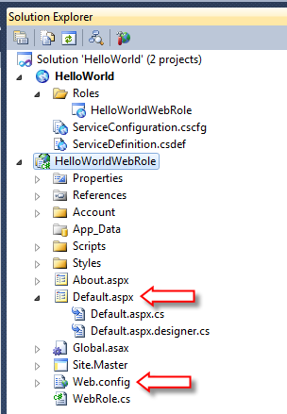
Hello Azure Cont.
In fact, exploring the HelloWorldWebRole project reveals some very familiar files (so long as you are familiar with ASP.NET development).
Note the Default.aspx page (complete with code behind).
Note the standard Web.config file.

Slide 7
Hello Azure Cont.
To “code” Hello World for the cloud, simply open the Default.aspx page and add or modify the HTML provided by VS.
<%@ Page Title="Hello World" Language="C#" MasterPageFile="~/Site.master" AutoEventWireup="true"
CodeBehind="Default.aspx.cs" Inherits="HelloWorldWebRole._Default" %>
<asp:Content ID="HeaderContent" runat="server"
ContentPlaceHolderID="HeadContent">
</asp:Content>
<asp:Content ID="BodyContent" runat="server"
ContentPlaceHolderID="MainContent">
<h2>
Welcome to the cloud
</h2>
<p>
Hello World
</p>
</asp:Content>

Slide 8
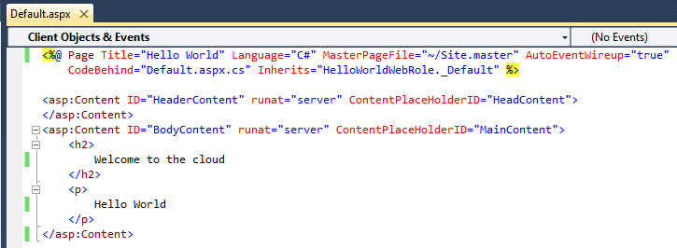
Hello Azure Cont.
As you can see, building Windows Azure applications does not necessarily require knowledge of lots of new APIs.
As this demonstration shows and as you will learn throughout class, you can rely heavily on your existing ASP.NET (and general .NET) experience.
However, in order to build more sophisticated applications or take advantage of special Windows Azure features, more Windows Azure-specific skills are required.
Building Windows Azure applications (or porting applications to the cloud) is not entirely without challenges, but you can leverage existing .NET foundations.

Slide 9
Hello Azure Cont.
Now you are ready to test the Windows Azure form of Hello World.
Normally, this would mean debugging (F5) the application under a local copy of IIS.
As this application is destined for the cloud (i.e. a set of virtual servers running in a Microsoft data center), how do you test it locally on your development box?
The answer is through a simulation capability called the Windows Azure Windows Azure SDK Compute Emulator.
In previous versions of Azure, the simulation capability was known as the Development Fabric.
Some Azure documentation will still refer to the simulation capability as the Development Fabric.

Slide 10
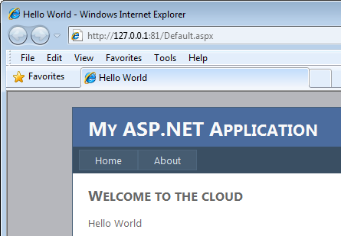
Hello Azure Cont.
The Compute Emulator is provided by the Windows Azure SDK (and thereby included in the WAT for VS).
You hear more about the compute emulator below and in future chapters.
To run Hello World in the Compute Emulator just start debugging the solution in VS (press F5).
This causes VS to start the Compute Emulator and launch a browser to display Hello World.

Slide 11
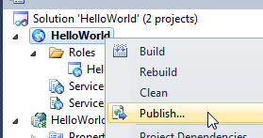
Hello Azure Cont.
Ok, now you know how to create a simple Windows Azure application. How do you get it into the cloud?
The process of moving an application into the Windows Azure runtime environment (the Microsoft data centers running Azure) is called publishing.
You may also find some documentation refer to the process as deploying.
In fact even the window prompt that appears when you ask to publish is labeled “Deploy Windows Azure project.”
To publish (or deploy) Hello World, right click on the HelloWorld project in the Solution Explorer and select Publish….

Slide 12
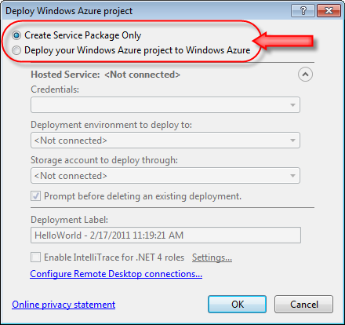
Hello Azure Cont.
Visual Studio displays the Deploy Windows Azure project window when you request to publish (as shown below).
VS can publish directly to the cloud, or it can create the files necessary (the service package) for you to manually deploy them in the cloud at a later time.
The radio buttons at the top of the Deploy Windows Azure project window allow you to pick from these two options.

Slide 13
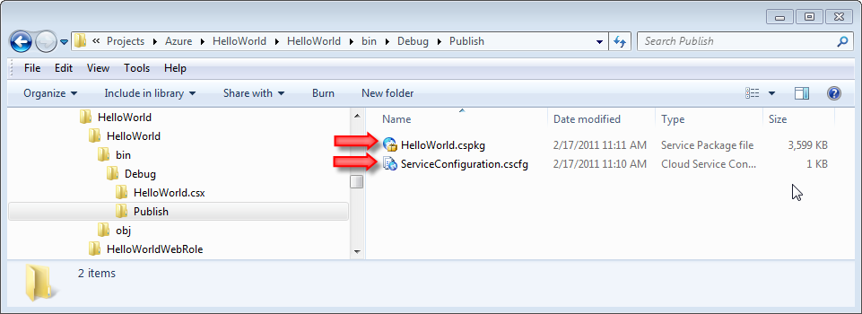
Hello Azure Cont.
Regardless of how you deploy, VS creates two files when you publish: a .cspkg file and .cscfg file.
These files make up the service package. You can find them in the .\bin\Debug\Publish folder of your project after you publish.
These files contain the HelloWorld code and configuration respectively. More details on these files are forthcoming.
By the way, “cs” in both cspkg and cscfg does not stand for CSharp (C#) but rather cloud service.
Take heart Visual Basic developers, you have friends in the cloud! In fact, the HelloWorld cloud could have been a VB project with no impact on the results.

Slide 14
Hello Azure Cont.
In order to deploy directly to the cloud through VS, you must have a Windows Azure account with a hosted service and storage account already configured.
You learn more about hosted services, storage accounts and how to configure them later in class.
So for now, let’s look at manually deploying the service package to the cloud.
You will get a chance to experience both manual deployment and direct deployment in your lab.
By the way, you will also learn that there are other ways to deploy applications to the cloud outside of VS.
With the cloud service package and cloud service configuration created via publishing, you can go to the Developer Portal to deploy the application.

Slide 15
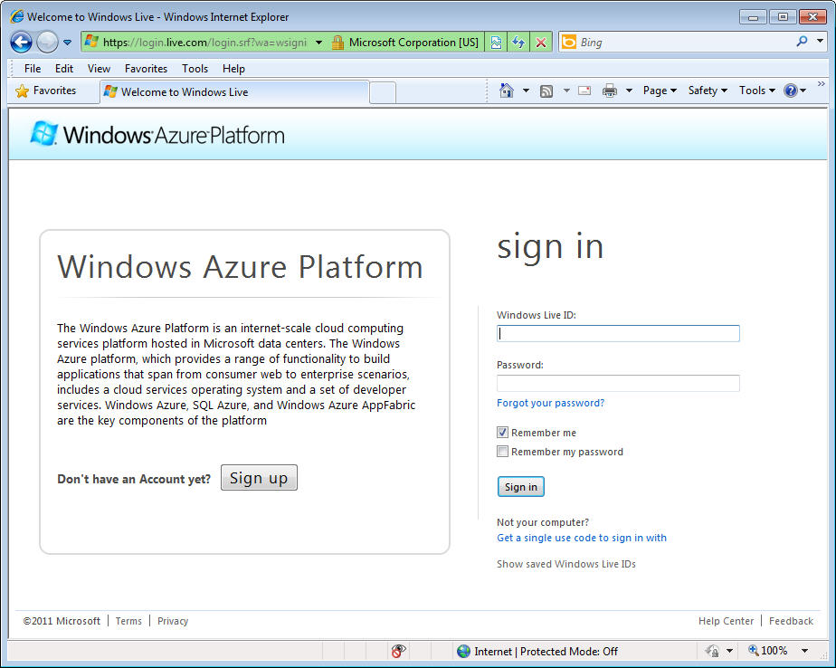
Hello Azure Cont.
To use the Developer Portal, you need to sign into the Portal using your Windows Live ID.

Slide 16
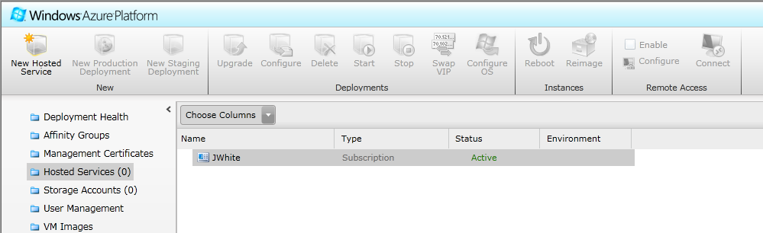
Hello Azure Cont.
Later, class provides details about Windows Azure accounts and costs for Windows Azure.
Assuming you have a Windows Azure account (also known as a subscription), what’s next?

Slide 17
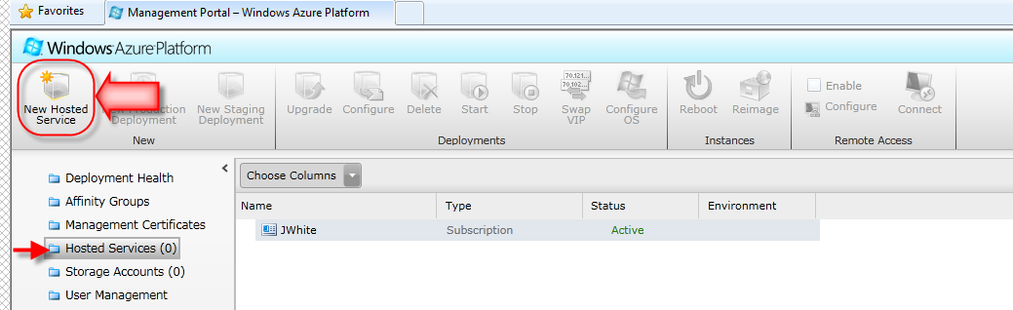
Hello Azure Cont.
First, create a new hosted service.
Applications (more specifically a collection of roles part of a solution) running in Windows Azure are called hosted services.
When you request to create a new hosted service, you must provide some details to Azure via the Create a new Hosted Service window.

Slide 18
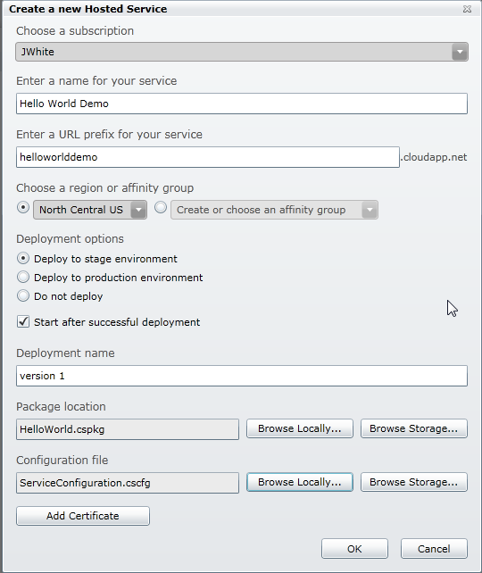
Hello Azure Cont.

Slide 19
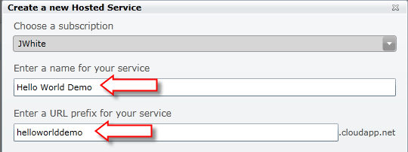
Hello Azure Cont.
To start, you must give each service a name.
Following that, you provide a production URL for your service – more precisely a URL prefix that is added to .cloudapp.net.
The URL must be unique (across all of Azure) and Azure will check that it is available and tell you if it is not).
To have your own domain name (something like www.mycompany.com) point to your service, establish a DNS CNAME that redirects to this service URL.
CNAMEs are a standard domain name feature available through most domain registrars.

Slide 20
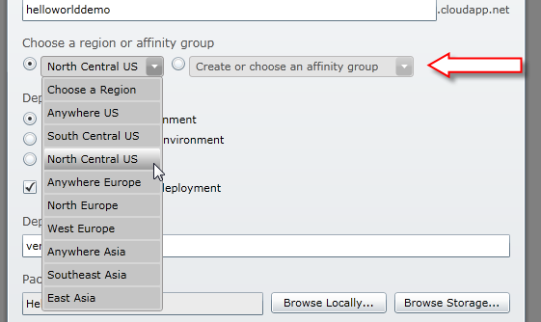
Hello Azure Cont.
You must also select the region where the service should run.
Your choice in region dictates the data center(s) that host your service.

Slide 21
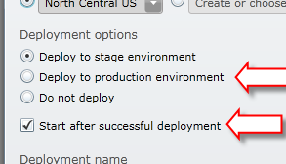
Hello Azure Cont.
Next, pick whether you want to deploy to either stage or production and whether you want the hosted service to start after deployment.
When in the staging area, the URLs are just GUIDs. Which means the application will not be easily accessible from the outside world.
As its name implies, the staging area allows applications to be deployed to the cloud and tested before final release.
Typically, after the application tests out in staging, you move it to production for use by the world – under the production URL you have chosen for the service.
However, you can deploy directly to production if you desire.
Importantly, you pay the same price no matter where the application is deployed.

Slide 22
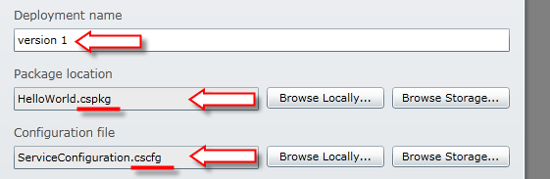
Hello Azure Cont.
In fact, you pay as soon as you deploy your application, regardless of whether it is running or not!
Lastly, provide the Portal with your application files.
Each deployment must have a name. Most people provide some type of version number to express the version of the application deployed.
Using the browse buttons, point the Portal to your service package (file with the .cspkg extension) and configuration file (with the .cscfg file extension).

Slide 23
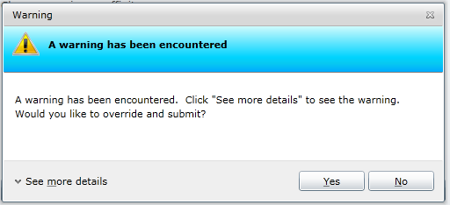
Hello Azure Cont.
The Azure Portal attempts to assist you in deploying healthy services that live up to certain conventions and standards.
Therefore, it is common to see a warning message indicating something in the new service gives Azure pause.
Make sure you read any warnings and acknowledge the issues before continuing your deployment.

Slide 24
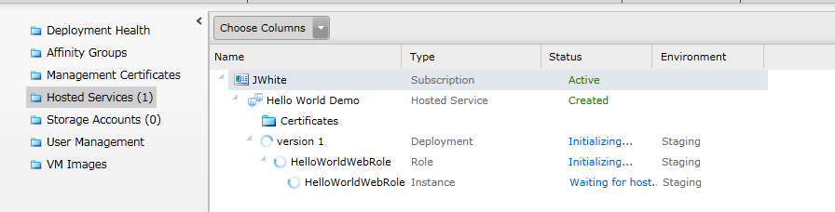
Hello Azure Cont.
It takes several minutes (between 5-20 for an application of this size/complexity) to move the code into the cloud and start the application.
The Portal constantly self-refreshes to provide you an indication of where it is in the process of deployment and startup.
Once ready to run, the status of your deployment turns to “Ready”.
You will also see a set of enabled buttons for your deployment that allow you to upgrade, configure, stop, etc. your newly deployed service.

Slide 25
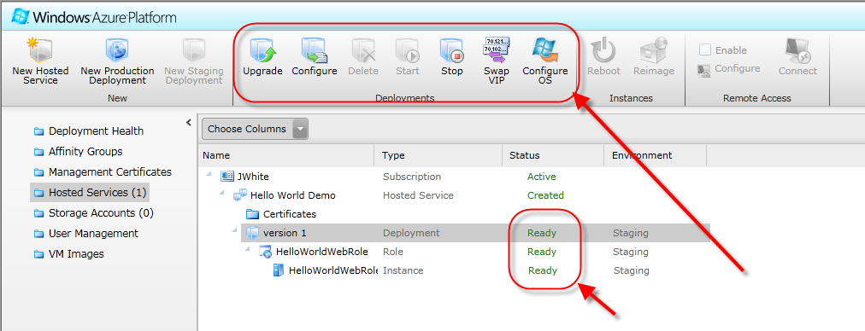
Hello Azure Cont.

Slide 26
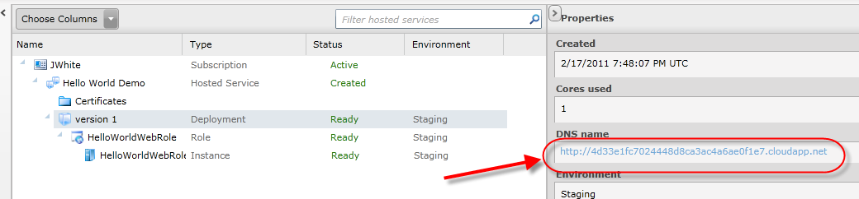
Hello Azure Cont.
Importantly, remember you are incurring charges (or at least using some of your “free” Azure hours).
Even if a service is stopped and not accessible to anyone, you are still incurring charges!
Once fully deployed and running, you can test your application in Stage or Production.
Click on the DNS name listed in the Properties area of the Portal to test Hello World.
A browser opens at the URL specified and the Hello World page should display.

Slide 27
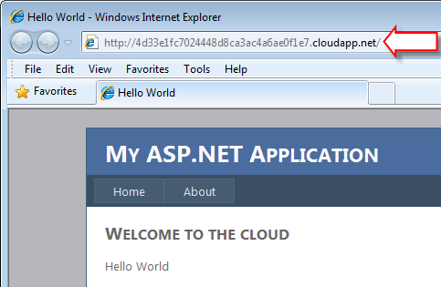
Hello Azure Cont.
When testing the deployment in stage, notice the URL is a GUID and not the production URL you specified for your application.

Slide 28
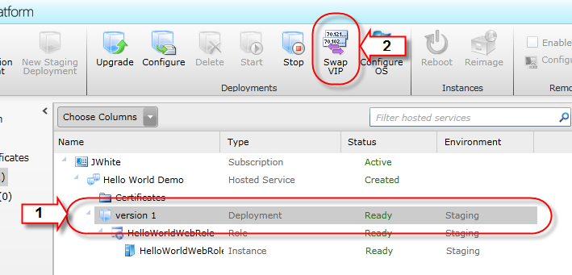
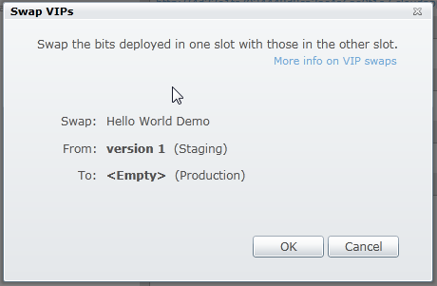
Hello Azure Cont.
To use the URLs you specified for the application, move the application from Staging to Production.
Moving the application to production is quite easy.
Simply return to the Portal and select the deployment under the hosted service listing.
With the deployment selected in the list, push the Swap VIP icon at the top of the page.
You will be asked to confirm the swap.

Slide 29
Hello Azure Cont.
The process of moving the application to production occurs more quickly (typically within a few seconds) compared to the initial deployment.
In fact, Windows Azure does not actually “move” anything when the application is put into production.
It simply swaps out the URLs in DNS and load balancers within the cloud (thus the name for the icon).
Later in class and through your labs, you learn more about the staging and production environments and more about the configuration of these environments.

Slide 30
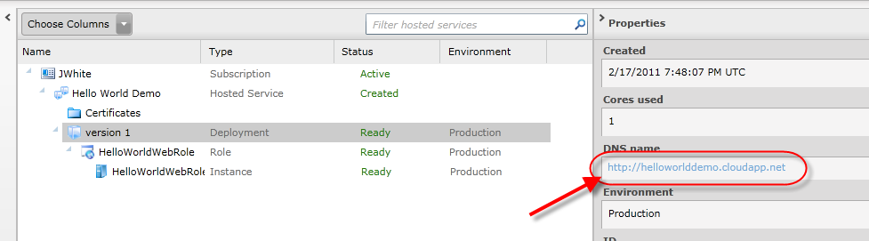
Hello Azure Cont.
Again, to see the application running in production, click on the DNS Name listed in the Properties area of the Portal to test Hello World.
Hello World now launches in a browser with the production URL you specified during your deployment.

Slide 31
Microsoft Data Centers
Now that you have seen Hello World built and running in the cloud, you probably have some questions.
Where exactly is Hello World running?
What does that environment (hardware, software, configuration, etc.) look like?
Microsoft has a growing number of data centers located across the world.
At the time of this writing, there are more than twenty data centers.
Windows Azure runs in most of these data centers.
Some data centers support Microsoft’s own cloud-based applications like Bing Search, Windows Live, Xbox Live, Exchange Online, SharePoint Online, and more.

Slide 32
Microsoft Data Centers Cont.
Microsoft rarely shares the exact number and location of the data centers.
In fact, they number and location are subject to change.
However, when you deploy your application or request data storage, the Developer Portal provides you a hint as to Azure-supporting data centers.
When you create and deploy a hosted service, the Developer Portal has you pick from a list of Azure-supporting data center geographical locations.

Slide 33
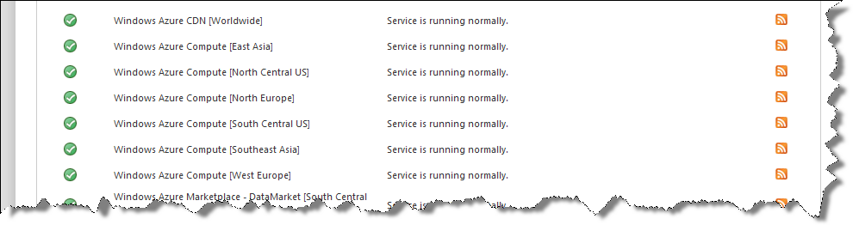
Microsoft Data Centers Cont.
Microsoft also has an on-line dashboard indicating the status of the Windows Azure platform.
You can find the dashboard here: www.microsoft.com/windowsazure/support/status/servicedashboard.aspx.
The dashboard also lists the geographical regions running Windows Azure.

Slide 34
Microsoft Data Centers Cont.
The data centers are not all the same.
In fact, Microsoft classifies four generation of data centers.
Over time, Microsoft’s understanding of the cloud and data centers has improved.
The data centers have evolved to be more ecologically friendly as well as more cost efficient.
The first-generation of data center is typical of what you might find or expect in most organizations.
In general, first generation data centers consist of racks of computers, raised flooring, UPS, and backup generators in a very cool room.
The focus of first generation data centers, as described by Hay and Prince in Azure in Action was:
“making sure the servers are running, and absolutely no thought or concern for the operating costs of the data center.”

Slide 35
Microsoft Data Centers Cont.
The second-generation data center focused on operational efficiency and impact on local resources.
In Hay and Prince’s words, the 2nd generation data centers “apply a healthy dose of thinking about what happens on the second day of operation.”
In Quincy Washington, the data center ran on clean hydroelectric power. In San Antonio Texas, recycled civic gray-water cools the data center.

Slide 36
Microsoft Data Centers Cont.
Chicago hosts the first third-generation data center, and it opened in June 2009. Microsoft calls it a “mega data center.”
Dublin Ireland hosts another of these 3rd generation data centers.
Microsoft realized they needed to have more dense and cost effective data centers.
Instead of typical racks of computers found in typical data centers, the 3rd generation data centers contain “Cblox.”
Cblox are shipping containers that house 1800 to 2500 servers each.
The typical ratio of person to server can be anywhere from 1:10 to 1:100 in most organizational data centers.
Microsoft, through 3rd generation data centers, aims to reduce that to 1:30,000 or higher.
The Chicago data center contains several Cblox totaling ~360,000 servers.
The data center is the only primary consumer of a dedicated nuclear power plant core from Chicago Power & Light.

Slide 37
Microsoft Data Centers Cont.
You can peak into the Chicago data center via a video available here: www.microsoft.com/showcase/en/us/details/bafe5c0f-8651-4609-8c71-24c733ce628b.
Microsoft is designing and planning the fourth-generation data centers.
You can see an animation video on the proposed 4th generation data centers here: www.youtube.com/watch?v=PPnoKb9fTkA.
Microsoft plans to use this design “foundation of our cloud data center infrastructure in the next five years.”
4th generation data centers may revolutionize how we think about “computer rooms.”
In fact, the whole 4th generation data center will be outside. Cblox will be parked in a grassy field!
This allows 4th generation data center to be put up anywhere quickly and cheaply.

Slide 38
Virtualization
So, Microsoft data centers have lots of servers. How are those servers outfitted?
Generally speaking, each server operates on a 1.5 to 1.7GHz CPU.
Per MSDN site, an extra large virtual machine (which occupies an entire server) has 8 CPU cores and 14 GB of RAM.
The network speed of the servers is listed as 100Mbs.
Microsoft’s hypervisor, called Hyper-V, runs on top of the bare metal.
To be precise, the hypervisor running in the data centers is a modified version of Hyper-V (called Windows Azure hypervisor).
Microsoft optimized Hyper-V for the hardware running in the data centers.

Slide 39
Virtualization Cont.
The hypervisor allows machine resources in the data center to be shared, and allows applications and data to be moved around quickly and easily.
The hypervisor runs on each server. It manages and controls the virtual servers running on the physical server.
Virtual machine and partition are other names for virtual server.
One of the virtual servers on each physical server is selected as the host or root partition. The other virtual servers are guest partitions.

Slide 40
Virtualization Cont.
The host partition is a virtual server too, but it has additional responsibilities. The host partition manages the hypervisor and the underlying hardware.
The host partition has full access to I/O ports, memory, and all the raw hardware.
The host partition uses good ‘ol fashion device drivers to communicate with the underlying hardware.
Cloud servers boot from the host partition.

Slide 41
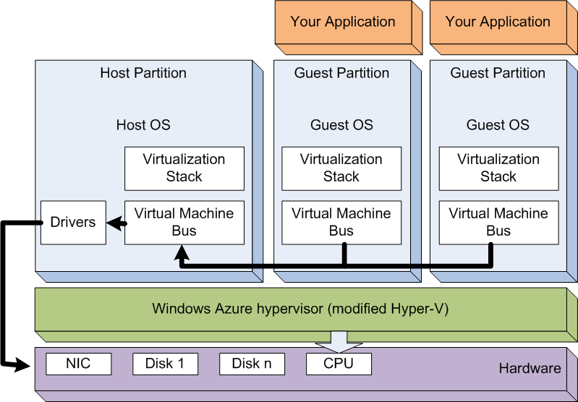
Virtualization Cont.
Guest partitions each run a guest operating system and don’t have direct access to the hardware.
In particular, guest partitions (and their OS) do not have access to the physical CPU. Requests from processing go through the hypervisor.
Guest partitions have a virtual machine bus and virtualization stack that route all hardware requests from the guest partition’s OS to the host partition.

Slide 42
Virtualization Cont.
Each virtual partition in the Microsoft cloud runs a modified version of Windows Server 2008 R2 Enterprise Edition.
The OS required some low level changes to better support the hypervisor.
Microsoft calls these “enlightened operating systems” in that they have knowledge of the hypervisor and are tightly coupled/optimized to that hypervisor.
It is unlikely that your applications notice any difference from a normal Windows Server 2008 OS.
A lot of other hardware exists in the data centers beyond the servers and virtual machines.
Load balancers, switches, routers are just some of the other components that exist in the Windows Azure data centers.
Collectively the physical and virtual servers and all the supporting hardware and software is known as the Windows Azure Fabric.

Slide 43
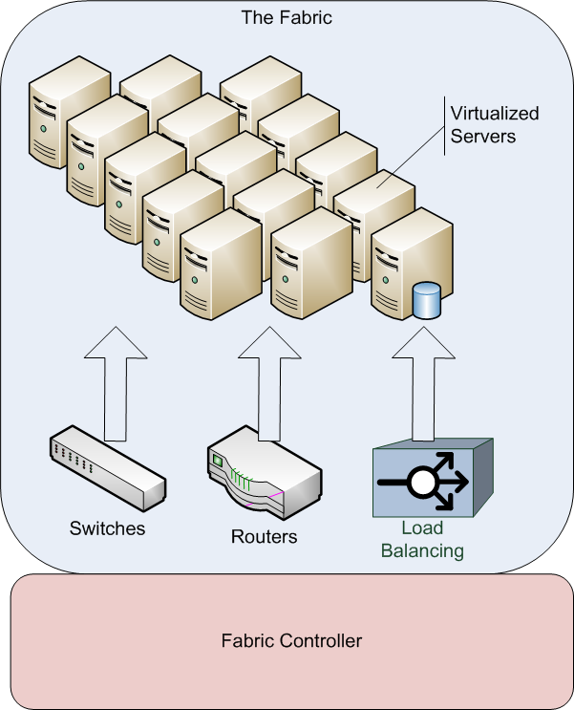
Virtualization Cont.

Slide 44
Virtualization Cont.
In a way, the Fabric is another name for a Microsoft data center.

Slide 45
The Fabric Controller
The Fabric Controller is often called the “brains” of Windows Azure.
As its name implies, the Fabric Controller (FC) controls the hardware, software and just about everything in the Microsoft cloud.
The Fabric Controller manages all the hardware and virtualization described hereto in this chapter.
The Fabric Controller manages the physical deployment of your hosted services and data into the virtualized environment.
The Fabric Controller handles upgrades and configuration changes to your services and data stores.
The Fabric Controller monitors the hardware, software and your services and takes corrective action when any fail.

Slide 46
The Fabric Controller Cont.
The FC is itself software. It is largely managed code.
The FC software actually runs on a set of five to seven machines (each with a replica) at each data center.
One of the machines is designated as the primary machine. The primary machine is responsible for executing all tasks.
If the primary goes down, a backup takes its place.
Even if all the FC machines where to go down, the Fabric would still operate, albeit without modifications, until the FC server is back up and running.

Slide 47
The Fabric Controller Cont.
The FC operates under a driver model.
Your Windows operating system really doesn’t know how to work with a disk or pointing device directly. Instead, it works through a driver.
Likewise, the FC works with a set of drivers for each component (server, router, switch, load balancer, etc.) in the Fabric.
This allows the FC to operate with a heterogeneous set of equipment over time.

Slide 48
The Fabric Controller Cont.
As one of its important roles, the FC serves as deployment manager for your services and data stores.
When you request to deploy a hosted service (like Hello World above) to the cloud, the FC first must find a home for the service.
It uses a resource allocation algorithm to find a collection of machine nodes to host your application.
The algorithm uses service configuration data (like the number of role instances, disk and machine size requirements, etc.) to determine appropriate servers.
You learn more details about service configuration options later.
Once found, the FC reserves capacity on each of the identified servers.

Slide 49
The Fabric Controller Cont.
Next, the FC must prepare an appropriate image on the identified host servers.
One of the key components of the Windows Azure hypervisor is the management of virtual images (a.k.a. operating system images or virtual hard disk).
No install of operating systems and software occur in Windows Azure.
Instead, virtual images (or virtual hard disks –VHD) are centrally created and stored in a central repository.
There are many different images to address the variety of needs by cloud users.
Images are created so that the smallest footprint possible is used for each need.
For example, if a service does not need IIS, then an image without IIS in it is loaded.
Smaller images also limit security loopholes and the need for future upgrade patches.

Slide 50
The Fabric Controller Cont.
The FC deploys a virtual image from that library to each of the servers identified to host your service.
This is accomplished quickly and simply via xcopy.
The FC accomplishes maintenance updates/patches by the same means to keep management and deployment to the Fabric as simple and fast as possible.
Once the image is loaded and the guest virtual machine is up and running, the FC copies your service to the machine.
Different deployment actions occur depending on the type of service, its configuration, etc.
In cases where the service needs load balancing, the FC programs the load balancer and other network hardware for traffic routing.
Load balancers in Windows Azure perform simple round-robin algorithms to route traffic to resources running in the cloud.

Slide 51
The Fabric Controller Cont.
The FC manages and monitors all the hardware, software and even your services (and data stores).
For each component or resource it manages, it creates a goal state.
Think of the goal state as the acceptable operating parameters of any component in the Fabric – including your services and even the servers themselves.
The FC wants everything to be running within its goal state.
When the FC determines something is failing, it tries to recover that resource and get it back to its goal state.
Recovery means different things for different components and resources. It might mean restarting the resource.
When a server cannot be returned to its goal state, the FC moves the services (and virtual machines) running on that server to a new server automatically.

Slide 52
Windows Azure Platform Architecture
You applications run on top of the virtual environment just described.
However, the Windows Azure Platform is much more than the data centers, virtual servers, etc. your application runs on.
In fact, what has been described so far might qualify as an IaaS, but not a PaaS.
The Microsoft Windows Azure “Platform” consists of several pieces to include Windows Azure, SQL Azure, and Windows Azure AppFabric.
Additionally, the platform provides a development environment called the Compute Emulator and Storage Emulator and deployment tools and services.

Slide 53
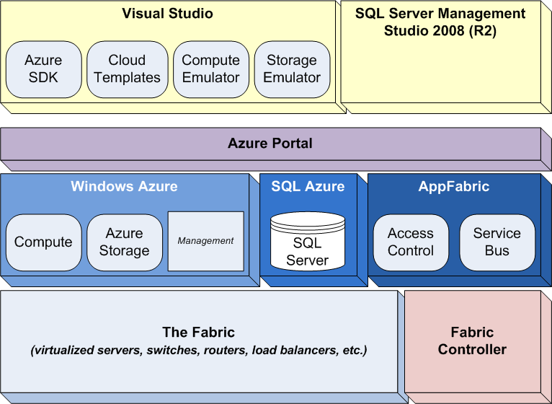
Windows Azure Platform Architecture Cont.

Slide 54
Windows Azure
Windows Azure is the focus of this class.
The name “Windows Azure” gets used in many places in Microsoft cloud computing circles, and one has to be careful of the context in using the term.
In this context, Windows Azure is a specific piece of the overall Microsoft cloud-computing environment.
Unfortunately, Windows Azure (or more precisely the Windows Azure Platform) also generically refers to the entire cloud computing solution.
It’s kind of like saying Coca-Cola. Coca-Cola is an entire brand of soft drink products (regular Coke, Diet Coke, Coke Zero, etc).
However, you can also order a Coca-Cola (or “regular Coke”) as a specific soft drink when you are in a restaurant.

Slide 55
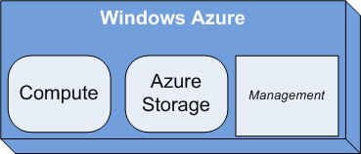
Windows Azure Cont.
Windows Azure is the core of the Windows Azure Platform.
Microsoft calls Windows Azure the operating system for the cloud.
Windows Azure consists of three “services”: Compute, Storage and Management.
It provides the runtime environment for your computational applications/services called Compute.
The runtime includes a Web server (IIS), when needed, for your applications.
In the example that introduced this chapter, Hello World ran as a Web Site (with IIS) under Window Azure’s Compute service.

Slide 56
Windows Azure Cont.
It also provides the hosting environment for Azure-specific data storage called Windows Azure Storage Services (more on Windows Azure Storage in a bit).
Microsoft also describes a management service as part of Windows Azure to provide automated infrastructure and management of cloud services.
The management service is in fact the Fabric Controller along with additional capability to provide services such as custom logging and tracing.

Slide 57
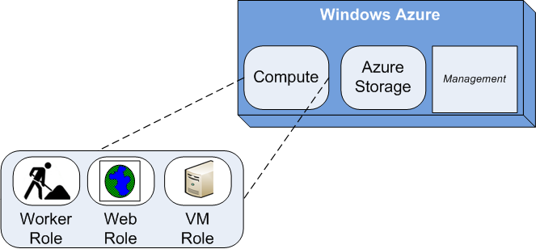
Windows Azure Roles
Applications run in Windows Azure Compute and consist of one or more components or services also known as Hosted Services.
In Windows Azure, there are three types of components in Hosted Services: Web roles, worker roles and VM roles.
Simply put, Web roles are Web applications.
Worker roles are background processes.
VM roles (new to Windows Azure SDK 1.3) are customized and complete virtual machine images.
Hello World, above, consisted of a single Web role.

Slide 58
Windows Azure Roles Cont.
When deployed, the FC assigns each role to its own guest partition (virtual machine).
Through configuration, you can request multiple instances of roles be created. Each role instance gets its own guest partition in the Fabric.
Multiple instances provide extra processing power and failover capability, but at additional cost.

Slide 59
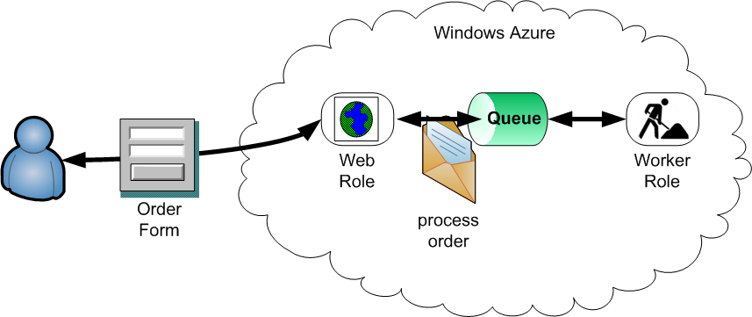
Windows Azure Roles Cont.
Many applications use both Web and work roles.
Generally speaking, users (human) interact with a Web role. Web roles then request worker roles to provide batch processing on the data provided by users.
Roles can communicate directly with each other or can communicate via messages using Azure Storage Queues.

Slide 60
Windows Azure Roles Cont.
It should be noted that worker roles can expose external endpoints. This allows users in the form of other systems, to communicate directly with worker roles.
Web and worker roles are the focus of two chapters in this class (one each for Web and worker roles).
VM roles are designed to give you a platform in the cloud to run whatever you want, however you want.
You build the virtual machine from the ground up – installing and configuring your virtual machine as you see fit (within the operating parameters of Azure).
VM roles make it easier to move existing Windows Server applications to the Windows Azure hosting environment.
Creating VM roles requires Windows Server 2008 (R2 recommended) and Hyper-V Manager.

Slide 61
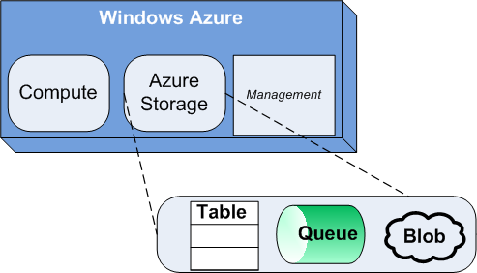
Windows Azure Storage
Windows Azure Storage consists of three types of data storage in the cloud: tables, blobs and queues.
Storage is not relational database storage. SQL Azure, mentioned below, is the relational database in the cloud.
Queue storage provides reliable and durable message stores. Queues allow cross service communications in a loosely coupled fashion.
Table storage offers structured tables similar to what you would find in a relational database, but without custom indexes and relationships to other tables.

Slide 62
Windows Azure Storage Cont.
Data is stored in row-column form, but relationships between rows and columns are limited.
Binary Large Object (BLOB) storage houses large binary data such as images, videos, music, documents, etc. in an organized file system.
The storage offered by tables, queues, and blobs is replicated, scalable and typically cheaper than storing data in relational form in the cloud.
A separate chapter covers each storage mechanism in more detail.

Slide 63
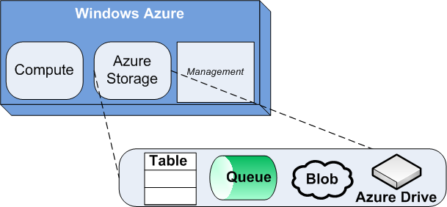
Windows Azure Storage Cont.
Windows Azure Drive (formerly X-Drive) is sited as a fourth type of storage in some Windows Azure literature/documentation.
Windows Azure Drive acts as a local NTFS volume.
This volume is mounted on the server’s file system and is accessible to code running in a role
Windows Azure Drive, which is covered under the local storage chapter, is really a façade on top of blob storage.

Slide 64
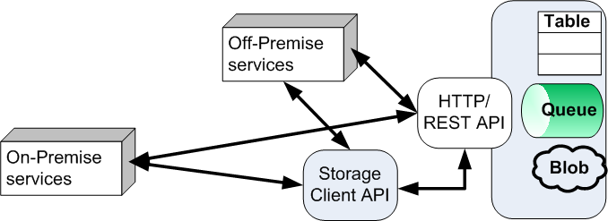
Windows Azure Storage Cont.
You access Windows Azure Storage (any of the three types) through a REST API over HTTP.
Because it is accessible via HTTP and a REST API, you can access the data from applications running in and out of the cloud (off or on-premise).
To simplify access to storage from managed code, the Windows Azure SDK (discussed below) contains a Storage Client API.
The Storage Client API abstracts away the details of the REST API.
Since the Storage Client API still uses the REST API under the covers, it is often also referred to as the Client Wrapper library.

Slide 65
Windows Azure Storage Cont.
Similar SDKs like the Windows Azure SDK for Java provide a access to Azure Storage via other programming languages/environments.
A separate chapter in this class covers each type of Windows Azure Storage (queues, blobs, and tables).

Slide 66
Developing Windows Azure Applications and Data Stores
As with all .NET development, most developers use Visual Studio (VS) to develop Windows Azure applications.
Visual Studio 2010 or Visual Web Developer 2010 support Windows Azure development (for the latest Windows Azure SDK 1.3).
Prior versions of Windows Azure SDK allow the use of VS 2008 or Visual Web Developer Express 2008, but require some service pack upgrades.

Slide 67
Developing Windows Azure Applications and Data Stores Cont.
Additionally, if you use VS, you should have the Windows Azure Tools (WAT) for Microsoft Visual Studio.
This allows VS to create, configure, build, debug, test, package and deploy services in Windows Azure.
As of this writing, the current version of the WAT is 1.3 (also known as the November 2010 release).
Obtain WAT from this here: http://www.microsoft.com/web/gallery/install.aspx?appid=WindowsAzureToolsVS2010.
WAT includes the Windows Azure SDK (discussed below).
With this install, VS provides a number of project templates for creating various Web and worker role services.
You get to use these templates in your labs.

Slide 68
Developing Windows Azure Applications and Data Stores Cont.
WAT for VS includes the Windows Azure SDK.
The SDK is what really provides the APIs, tools, documentation, and samples needed to develop Windows Azure applications.
The SDK contains the Compute Emulator and Storage Emulator (coming up) that allows you to test Windows Azure applications locally.
While most developers do not, you can use the SDK independent of VS.
Download the Windows Azure SDK (without WAT) from here: http://msdn.microsoft.com/en-us/windowsazure/cc974146.aspx.
As of this writing, Windows Azure applications run in .NET 3.5 or .NET 4.0 environments (which is required on the development machine).
Windows 7, Windows Server 2008, Windows Server 2008 R2, and Windows Vista support the SDK (or WAT).
Some of the supported OS may need service pack upgrades or other software.
See the Windows Azure SDK Web site for details.

Slide 69
Developing Windows Azure Applications and Data Stores Cont.
Additionally, your development box must have the following:
IIS 7.0 (with ASP.NET, WCF HTTP Activation, Static Content, and optionally CGI).
Microsoft SQL Server Express 2008, Microsoft SQL Server Express 2005, or Microsoft SQL Server 2008
Additional service packs or Hotfixes may be required depending on your environment. See the WAT or SDK page for more details.

Slide 70
Developing Windows Azure Applications and Data Stores Cont.
As an alternative to .NET and Visual Studio development, you can use other languages and development tools to leverage the Windows Azure Platform.
Currently, there are Windows Azure SDKs in Java and PHP.
There are also tools and additional SDKs to access other parts of the Windows Azure Platform.
Some of these SDKs and tools allow you to build non-.NET applications to run in Azure. Others allow access to Azure resources from outside the Azure cloud.
See http://www.microsoft.com/windowsazure/interop/default.aspx for more details.

Slide 71
Compute and Storage Emulators
As you are going to learn in this class, you write Windows Azure code in a fashion similar to writing other .NET applications.
However, ultimately the code runs on a virtual server in a Microsoft data center.
You probably don’t run a hypervisor and virtualized environment on your development box.
So how can you test and debug your applications during development?
Compute Emulator and Storage Emulator provide a local cloud simulation environment for testing your applications on your development box.
Compute Emulator and Storage Emulator are part of the Windows Azure SDK (and so too part of the Windows Azure Tools for Visual Studio).
Compute Emulator was known as Development Fabric (or Dev Fabric) prior to SDK 1.3.
Storage Emulator was known as Development Storage (or Dev Storage) prior to SDK 1.3. Some documentation still uses these names.

Slide 72
Compute and Storage Emulators Cont.
Compute Emulator uses process to simulate virtual machines that exist in the Windows Azure Fabric.
Compute Emulator is started when you create a Windows Azure project and Debug (press F5) in VS.
Compute Emulator is based on 90% of the real Fabric, thereby offering as close-to-the-real thing as possible on your local development box.
Compute Emulator, however, does not check whether code can run in the cloud.
Furthermore, it does not check for items that don’t exist in the cloud that might exist on your local machine (for example some library or file).
Don’t use the Compute Emulator to get accurate performance of your application running in the cloud.
In most cases, performance will be better in the cloud.
Debug applications running in the cloud can be challenging.
Therefore, Compute Emulator provides the best means of testing and debugging applications locally before deploying them to the cloud.

Slide 73
Compute and Storage Emulators Cont.
Storage Emulator simulates the Windows Azure Storage (Blobs, Queues, Tables) services using your local SQL Server instance
Storage Emulator is the reason you need SQL Server or SQL Server Express on your development box.
Storage Emulator uses the SQL Server or SQL Server Express instance to simulate Windows Azure Storage.
Importantly, because Windows Azure Storage works via REST and HTTP, application code running in Compute Emulator can access real Windows Azure Storage in the cloud.
This reduces the need to operate with “simulated” data stores.

Slide 74
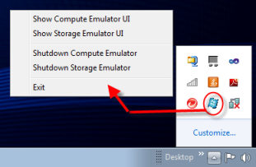
Compute and Storage Emulators Cont.
The Compute Emulator icon appears in the system tray of your system when the Compute Emulator is running.
A right click menu from the icon allows you to show the Compute Emulator and Storage Emulator user interfaces (covered in later chapters).
You can also stop and start the emulators from this menu.

Slide 75
Deploying to the Cloud & Managing the Cloud
Once you have created your Windows Azure application, use VS or the CSPack.exe to package your services for deployment to the cloud.
The SDK provides the CSPack.exe tool. It is a command line tool for packaging services.
Windows Azure Tools provide VS with a packaging capability that uses CSPack.exe under the covers.

Slide 76
Deploying to the Cloud & Managing the Cloud Cont.
During your labs, you will get an opportunity to see how packaging is accomplished.
Packaging produces two files.
One, the .cspkg file (in the form of [Service Name].cspkg), contains all the runtime components and files required by the cloud to run your service.
The .cspkg file is a ZIP archive.
The other, the .cscfg file (in the form of [Service Name].cscfg), contains your service configuration – something you learn more about in the next chapter.
The .cscfg file is an XML file that tells the Fabric Controller how to deploy and manage your application.

Slide 77
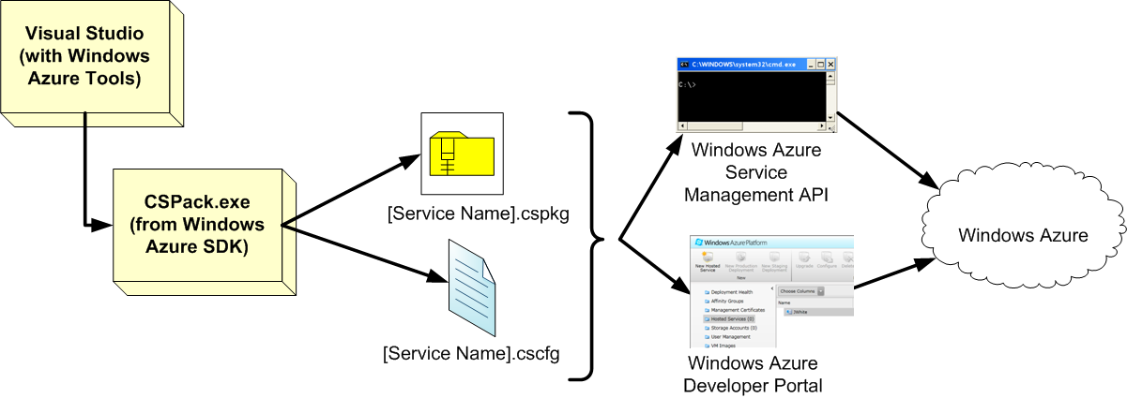
Deploying to the Cloud & Managing the Cloud Cont.

Slide 78
Deploying to the Cloud & Managing the Cloud Cont.
To deploy your applications to Windows Azure, you have three options.
You can deploy through Visual Studio, the Developer Portal, or use the Service Management API.
All require a Windows Live ID account with appropriate subscription account set up for Windows Azure.
Most developers use Visual Studio or the Portal.
Toolmakers are the intended primary users of the Service Management API.

Slide 79
Deploying to the Cloud & Managing the Cloud Cont.
The Windows Azure Developer Portal is a central management tool for all aspects of your applications in the Microsoft Windows Azure cloud.
Find the Windows Azure Developer Portal at windows.azure.com.

Slide 80
Deploying to the Cloud & Managing the Cloud Cont.
Through the Portal, you can create and deploy services, create and manage storage and databases, and set up details of AppFabric (covered later).
Help and resources are available from the Portal.
The Portal also provides a link to Microsoft Online Services for managing the details and billing of your account.
The Portal will be a focus of many parts of this class.

Slide 81
Deploying to the Cloud & Managing the Cloud Cont.
The Service Management API is a RESTful HTTP API.
It offers a subset of functions you can perform through the Windows Azure Developer Portal.
You can use the Service Management API to deploy or upgrade applications or start or stop an existing service.
You cannot use the Service Management API to, for example, create new services or get at billing data.
CSManage.exe is a command line tool provided by the Windows Azure team. It sits on top of the Service Management API.
Find the CSManage utility at code.msdn.microsoft.com/windowsazuresamples.
To use this tool, you create a configuration file (in XML) that provides commands to CSManage for actions you want performed in the Windows Azure cloud.
There is a one-to-one mapping between all the operations that can be configured with CSManage and the underlying Service Management API.
The Service Management API is not covered in this class.

Slide 82
SQL Azure
SQL Azure is the relational database in the Windows Azure platform.
The relational database management system is SQL Server at its core.
SQL Azure is not a full-blown SQL Server 2008. This is SQL Server with a number of limitations.
For example, as of this writing, databases are limited in size to 50GB and does not support distributed queries or transactions.
Some sources have implied SQL Azure is essentially SQL Express.
While not exactly true either, the following quote might help you understand why a comparison to SQL Express can be useful.
Find a detailed list of the limitations online at msdn.microsoft.com/en-us/library/ee336245.aspx.
“If your application works today against SQL Express edition and does not make use of some of the more advanced features of SQL Server, then your application should work in the cloud with little or no modification.”

Slide 83
SQL Azure Cont.
You learn more about SQL Azure in a later chapter. In general, however, you should be aware of a few features of SQL Azure.
Supporting SQL Azure in the data center is a SQL Azure Fabric.
This Fabric provides (not unlike the Windows Azure Fabric) the automatic deployment, replication, failover, and load balancing of database servers.
SQL Azure databases are replicated three times.
When establishing cloud services, you can create affinity groups to make sure services are located in the same data center as SQL Azure databases they use.

Slide 84
SQL Azure Cont.
To manage and administer databases, you may also use familiar tools.
You create a SQL Azure database server through the Windows Azure Developer Portal.
Then, access and manage the database through common SQL Server tools like SQL Server Management Studio (SSMS), SQLCMD.exe, or Visual Studio.
As of this writing, SSMS 2008 R2 or better is required.
Additionally, a number of commercial and free tools are appearing on the market to assist you manage and access SQL Azure data.
You can find a data migration tool (Data Migration Wizard) to help migrate data in and out of the cloud at sqlazuremw.codeplex.com.
As a warning, be aware that even migrating data in/out of the cloud incurs regular transaction and bandwidth charges.

Slide 85
SQL Azure Cont.
Generally, you can access SQL Azure in your application code in the same way you access SQL Server from your applications.
You can use ODBC or ADO.NET (to include use of LINQ, Entity Framework, or WCF Data Services).
Like Windows Azure Storage, SQL Azure is also available to applications running both inside and outside the cloud (off and on-premise).
In fact, you can decide to store your data in the cloud without ever having any code in the cloud.

Slide 86
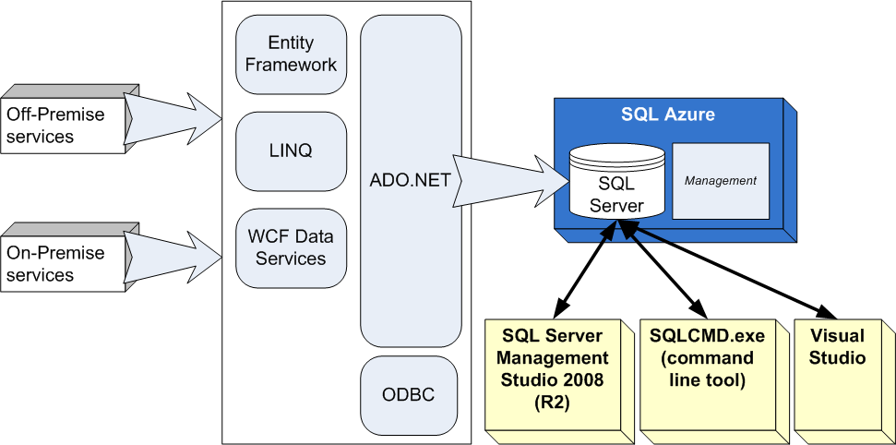
SQL Azure Cont.

Slide 87
AppFabric
AppFabric (formerly .NET Services) provides many enterprise-level services to include access control, caching and distributed messaging via a service bus.
Like SQL Azure, these services can be utilized without having applications or data stored in the cloud.
These independent services can be used by on-premise or cloud applications.
You can communicate with these services using REST over HTTP.
Note: AppFabric (as part of the Windows Azure Platform) should not be confused with Windows Server AppFabric.
Windows Server AppFabric is a set of technologies that make it easier to build, scale and manage Web and composite applications running on IIS.
Windows Server AppFabric v.1 is a combination of AppFabric Hosting (formerly Dublin) and AppFabric Caching (formerly Velocity).
Beyond this chapter, the AppFabric is not covered further in this class.

Slide 88
AppFabric Cont.
The Access Control Service (ACS) of the AppFabric provides claims-based federated authorization to applications.
What does that mean?
Consider applications you write and support today. Do users have to have a way to login, presumably with a username and password?
How does your organization manage the identities (username and passwords)? How does your application handle authentication and authorization?
Applications running on your network (on-premise) probably use some type of identity store like Active Directory to authenticate users.
Once authenticated, Windows OS maps the user to certain roles.
Your application checks the user’s role to authorize use of certain services.
This is the essence of role-based security.

Slide 89
AppFabric Cont.
However, there are many issues with regard to the role-based security model.
For example, when an application moves to the cloud, access to the identity store and Windows OS assigned roles is not available.
Do you really want to build your own cloud-based identity store and role mapping code for applications in the cloud?
The management of identity and roles can be a big burden.
What if your application or service becomes very popular? A new client with 1000 employees is signing up to use it.
How do you manage the new 1000 usernames and passwords (identities)?
Moreover, what happens when an employee leaves the company?
When are you notified and how long does that former employee have access they should not have?

Slide 90
AppFabric Cont.
ACS can help resolve these issues using a different security model.
Under ACS and the claims-based security model, service providers, identity providers and access control providers establish a trust relationship.
Users, for example, would authenticate against their own identity provider and receive a digitally signed token from that system.
This token would contain input claims, which is information about the user (like username, password, organization, etc.).
The user then calls on the ACS to map the token and input claims to a token with application specific output claims.
Output claims include information an application can use to allow (or deny) access to a service.
For example, the output claim might indicate the user as a super user, or read-only access.
Finally, the user uses the new token with output claims to call on the actual service.

Slide 91
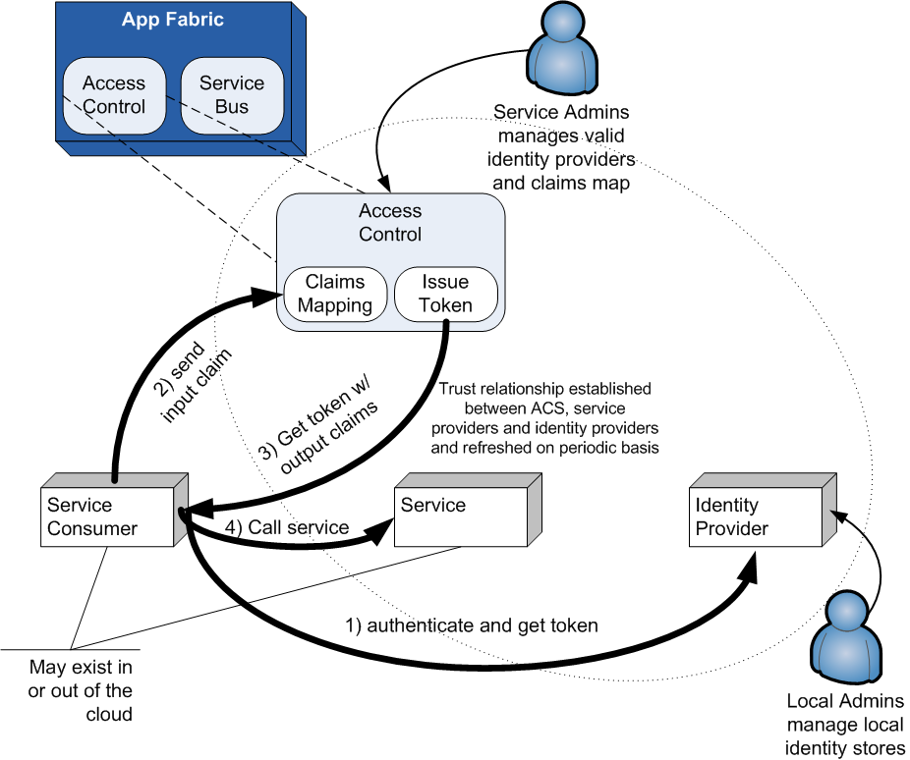
AppFabric Cont.

Slide 92
AppFabric Cont.
Service administrators manage the mapping between input and output claims in ACS.
With ACS, applications (and service administrators) don’t have to deal with individual users or identity stores.
Instead, application code is just looking for specific output claims in the user tokens in order to grant access.
AppFabric Caching provides cache for things such as ASP.NET session state or temporary memory persistence for.NET objects.
Caching can improve application performance, and enable better scalability.
AppFabric Caching was in Microsoft Community Technology Preview status as of this writing.

Slide 93
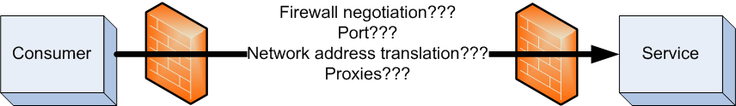
AppFabric Cont.
The AppFabric Service Bus servers as an Enterprise message relay mechanism.
Use the Service Bus to expose Windows Communication Foundation (WCF) endpoints.
Consumers that want to communicate with the WCF endpoint can do so in a transparent and loosely coupled fashion.
The services and consumers may be on-premise or cloud applications.
In a distributed environment, getting consumers and services to communicate with each other can be difficult.
To provide direct communications, consumer and service might need to understand and negotiate each other’s firewalls, ports, network addresses, etc.
This leads to code in both consumer and service that is tightly coupled and non-transparent.

Slide 94
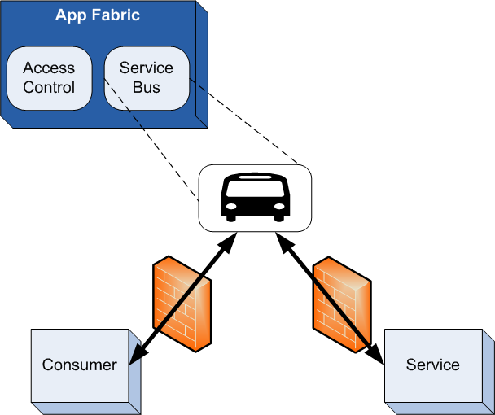
AppFabric Cont.
Using Windows Azure, you build WCF services to listen for messages coming from the Service Bus versus an HTTP or other endpoint.
Consumer applications connect to and send messages through the Service Bus. The Service Bus relays the messages on to the actual service.
Consumers connect to the Service Bus and make calls to the services through the bus.
Using the Service Bus, services and consumers can communicate with each other but only need information about connecting to the Service Bus.

Slide 95
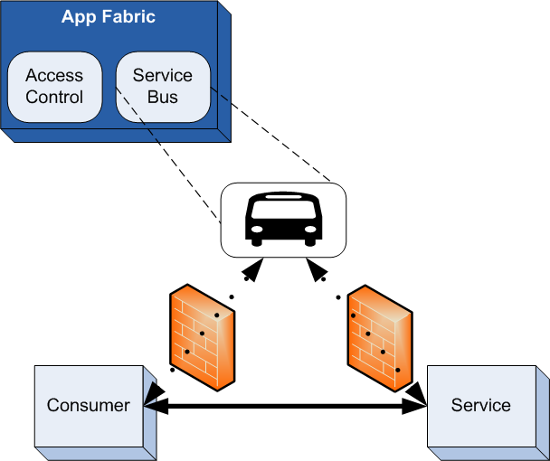
AppFabric Cont.
In fact, if possible, the service bus will directly connect a WCF service and WCF client to optimize the connection when appropriate.

Slide 96
AppFabric Cont.
Microsoft provides an AppFabric SDK to build applications that work with the AppFabric services .
The SDK includes a set of libraries, tools, documentation, and sample applications.
The AppFabric SDK is not part of any Visual Studio tool at this time.
Find the SDK at this location: www.microsoft.com/downloads/details.aspx?displaylang=en&FamilyID=39856a03-1490-4283-908f-c8bf0bfad8a5.
Alternative language AppFabric SDKs are available in Java, Ruby, and PHP.
These SDK allow applications in these other languages to leverage the AppFabric services .
See www.interoperabilitybridges.com/projects for more details on these alternative SDKs.

Slide 97
Lab Exercise: Introduction to Windows Azure Lab

Slide 98
Chapter Summary
Building or porting applications in Windows Azure is not entirely without challenges, but you can leverage existing .NET experience.
Microsoft has a growing number of data centers located across the world.
At the time of this writing, there are more than twenty data centers.
Windows Azure runs on some of these data centers.

Slide 99
Chapter Summary Cont.
The hypervisor allows machine resources in the data center to be shared, and allows applications and data to be moved around quickly and easily.
The hypervisor runs on each server. It manages and controls the virtual servers running on the physical server.
Guest partitions (virtual servers) each run a guest operating system and don’t have direct access to the hardware.
Each virtual partition in the Microsoft cloud runs a modified version of Windows Server 2008 R2 Enterprise Edition.
Collectively the physical and virtual servers and all the supporting hardware and software is known as the Azure Fabric.
The Fabric Controller is often called the “brains” of Windows Azure.
As its name implies, the Fabric Controller (FC) controls the hardware, software and just about everything in the Microsoft cloud.
The Fabric Controller manages the physical deployment of your services and data into the virtualized environment.

Slide 100
Chapter Summary Cont.
The Microsoft Windows Azure Platform consists of several pieces to include Windows Azure, SQL Azure, and AppFabric.
Windows Azure consists of three “services”: Compute, Storage and Management.
It provides the runtime environment for your computational applications/services called Compute.
SQL Azure is the relational database in the Windows Azure platform.
AppFabric provides three enterprise-level services: access control, caching and distributed messaging via a service bus.

