Slide 1
Windows Azure Web Role
50466 Windows® Azure™ Solutions with Microsoft® Visual Studio® 2010

Slide 2
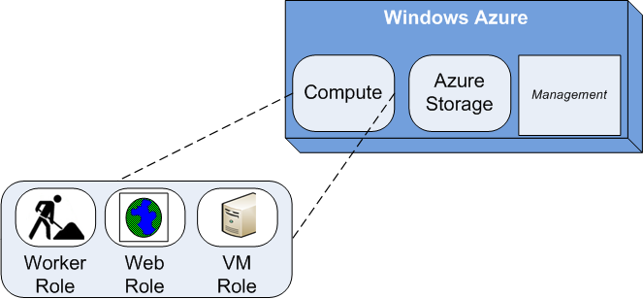
The Web Role
As mentioned in the last chapter, Windows Azure supports three types of roles in hosted services: Web roles, worker roles and VM roles.
Web roles are the focus of this chapter.
Web roles run under Windows Azure Compute service.
A Web role is a Web site, Web application or Web service (Windows Communication Foundation service) supported by IIS 7 and ASP.NET in the cloud.

Slide 3
The Web Role Cont.
Windows Azure Tools (WAT) for VS provides four Web role templates as specified in table below.
Web Role Type | Description
ASP.NET Web Role | General Web application that talks HTTP/HTTPS, runs on IIS 7, and the ASP.NET stack. Essentially the same as an ASP.NET Web Application template, but built to run in the Windows Azure cloud.
ASP.NET MVC 2 Web Role | A Web application that talks HTTP/HTTPS, runs on IIS 7, but is prewired to support the MVC 2 Framework. Essentially the same as an ASP.NET MVC 2 Web Application, but built to run in the Windows Azure cloud.
WCF Service Web Role | A Windows Communication Foundation (WCF) service hosted in IIS with HTTP or HTTPS endpoints. Essentially the same as WCF Service Application template, but built to run in the Windows Azure cloud.
CGI Web Role | Host a FastCGI protocol project. This allows Web sites written in languages such as PHP or Python to run in Windows Azure.

Slide 4
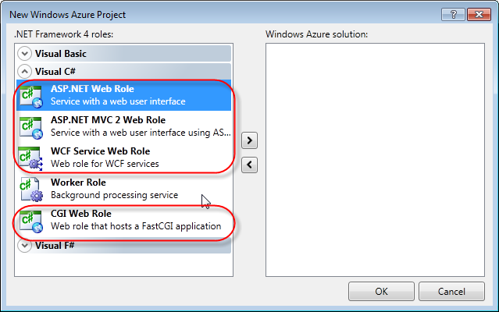
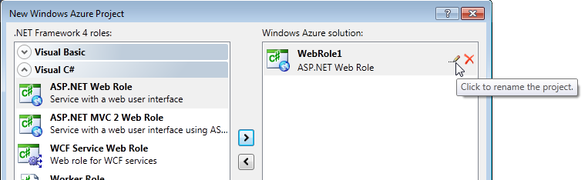
The Web Role Cont.
You can use either Visual C# or Visual Basic to write Web roles (or any Windows Azure service).
When you request a new Windows Azure project in VS, Windows Azure prompts you to add any of these Web roles to your solution.
You may add any number of each role to the Windows Azure project.
You can change the name of the role once selected to be part of the project.

Slide 5
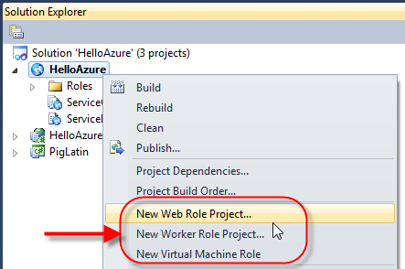
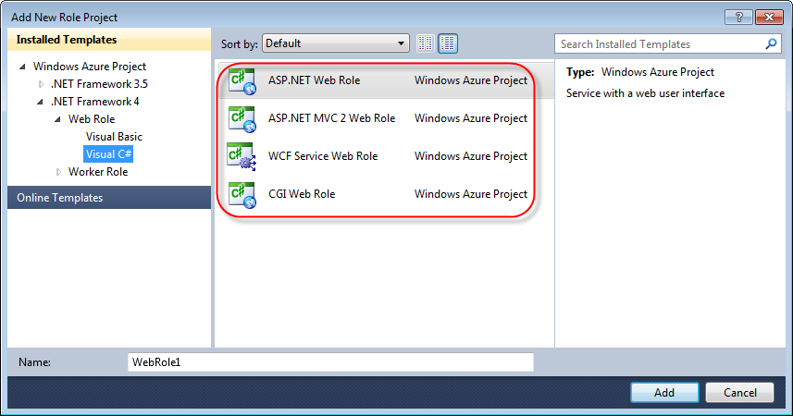
The Web Role Cont.
If you have an existing Windows Azure project, you can add new roles to your project.
Right click on the Windows Azure project and VS displays a menu that allows you to add new Web or worker roles to the project.
When selecting to add a Web Role, VS provides a similar Web role selection-prompt for choosing the Web role type to add.

Slide 6
The Web Role Cont.
Please note (particularly for WCF services), Windows Azure limits inbound traffic to HTTP or HTTPS.
Outbound traffic can use TCP sockets.
Windows Azure does not support UDP at this time.
Web roles run inside or (are hosted in) Internet Information Services (IIS) 7.
As of Windows Azure SDK 1.3, Web roles have full IIS 7 support.
Prior to Windows Azure SDK 1.3, Web roles ran in an IIS Hosted Web Core. The IIS Hosted Web Core had the same pipeline as IIS, but with a few restrictions.
Importantly, this means Azure now supports multiple Web sites in your Web roles.
Azure now also supports activation of WCF services over non-HTTP transports through Windows Activation Services.

Slide 7
The Web Role Cont.
When you request a Web role, the Fabric Controller configures virtual machines with an image containing IIS 7 and deploys your application within IIS 7.
Web roles are heavily dependent on the features built into IIS 7.
Because Windows XP (and other older operating systems) only supports older versions of IIS, the Windows Azure SDK doesn't run on Windows XP.

Slide 8
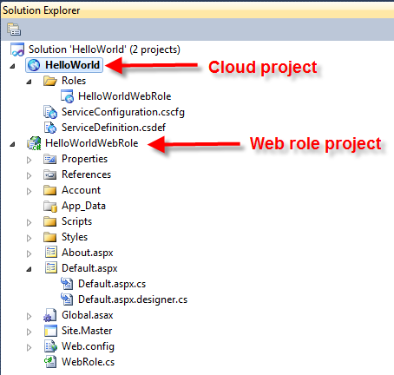
Exploring the Web Role Project
Once you create a new Windows Azure project, VS creates a solution that includes a cloud project along with a project for each role you requested.
For example, in the Hello World project from the last chapter, notice the HelloWorldWebRole project along with the HelloWorld cloud project.
Details on the cloud project are forthcoming. Before looking at the cloud project, let’s explore the Web role project.

Slide 9
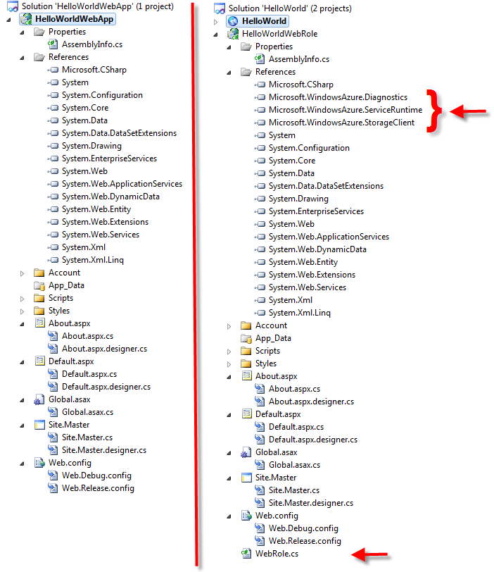
Exploring the Web Role Project Cont.
A Web role project looks nearly identical to non-Azure Web project.
In other words, an ASP.NET Web role project looks almost identical to an ASP.NET Web Application project.
A WCF Service Application looks almost identical to a WCF Service Web role.
For example, below are the default contents of a standard ASP.NET Web Application and ASP.NET Web Role project as produced by VS.

Slide 10
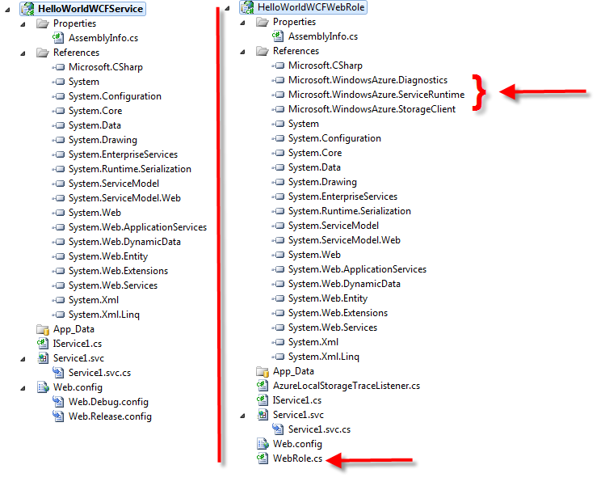
Exploring the Web Role Project Cont.
The “normal” Web application project is shown on the left while a Web role project is shown on the right. Notice much difference?
In fact, the only difference is that the Web role adds 3 Windows Azure references and the WebRole.cs file.
Below is a similar comparison of a normal WCF Service Application project and a WCF Service Web role project. Again, not much difference.

Slide 11
Exploring the Web Role Project Cont.
Web role projects, created by using the cloud templates provided through WAT, include references to three Windows Azure namespaces listed in the table below.
You explore the classes of these namespaces later, starting with the ServiceRuntime package in this chapter.
While quite frequently used, the other two namespaces (Diagnostics and StorageClient) are optional.
That is, diagnostics/logging and the use of Windows Azure Storage are not required by each role.
Namespace | Description
Microsoft.WindowsAzure.Diagnostics | Classes for collecting logs and diagnostic information
Microsoft.WindowsAzure.ServiceRuntime | Classes that allow you to interact with the Windows Azure environment
Microsoft.WindowsAzure.StorageClient | A client library for working with the Windows Azure storage services

Slide 12
Exploring the Web Role Project Cont.
The WebRole.cs class extends the RoleEntryPoint class from the Microsoft.WindowsAzure.ServiceRuntime namespace.
RoleEntryPoint provides callbacks to initialize, run, and stop instances of a role.
In this way, the WebRole.cs file acts like a Global.asax file in a traditional ASP.NET application.
The Windows Azure platform calls the OnStart() method after loading the Web role assembly and starting the role.
public override bool OnStart()
{
// For information on handling configuration changes
// see the MSDN topic at
// http://go.microsoft.com/fwlink/?LinkId=166357.
return base.OnStart();
}

Slide 13
Exploring the Web Role Project Cont.
The method returns true if initialization of the role succeeded.
Of course, you can add your own code to the OnStart() method to further initialize your Web role for your application needs.
In particular, a comment in the role points developers to an MSDN post for how to use the method to establish an event listener for handling configuration changes.
You learn more about the configuration of Windows Azure roles (how and why you change them at runtime) later in this chapter.

Slide 14
Exploring the Web Role Project Cont.
By default, the WebRole.cs does not provide an overridden OnStop() method.
However, you may want to add an override the OnStop() method.
Add an OnStop() method to WebRole.cs when you want to do clean up of resources used by the role when the Web role is stopped.
public override void OnStop()
{
// clean up resources
}

Slide 15
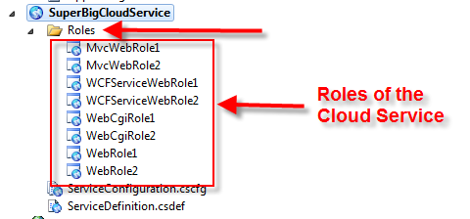
Exploring the Windows Azure Project
The Windows Azure project created during the formation of the solution is a container and the configuration for all the roles in the project.
When you create a Windows Azure project, a Roles subdirectory lists each of the Windows Azure roles that are part of the project.
As shown in the exaggerated example below, this cloud service has two of each type of Web role. Each of the Web roles is listed in the Roles subdirectory.

Slide 16
Exploring the Windows Azure Project Cont.
Each Windows Azure project also has two very important files: the service definition file and service configuration file.
ServiceDefinition.csdef is the default name of service definition file.
ServiceConfiguration.cscfg is the default name of the service configuration file.
These XML files define the configuration for all the roles in the cloud service.
These files define what many call the Service Model of your service.
The Fabric Controller uses the information in these files to determine how to deploy and operate your application in the Fabric.
The service definition and service configuration files are related, but each has a specific and different purpose.

Slide 17
Exploring the Windows Azure Project Cont.
The service definition file defines the roles and overall structure of your service.
In particular, it defines the size of the virtual machine required to support each role, whether a role requires native code execution, and the ports roles listen on.
The service definition file is also used to configure your web role to support multiple web sites and web applications.
The service definition file also defines configuration settings (i.e. configuration parameters or environmental variables) used by the application.
However, the service definition file does not provide the values for the configuration settings.

Slide 18
Exploring the Windows Azure Project Cont.
Importantly, definitions in the service definition file cannot change at runtime!
The service definition file is part of your application’s cloud service package.
You may recall from the last chapter that the cloud service package file ended with a .cspkg extension.
To change the service definition, you must deploy a new cloud service package.
This means you must stop the service, provide a new/updated service definition, and then restart the service.

Slide 19
Exploring the Windows Azure Project Cont.
The service configuration file defines values for configuration that can change at runtime.
The service configuration file defines the values for all configuration parameters defined in the service definition file.
The service configuration file also defines the number of instances (i.e. the number of virtual machines) required for each role.
You might recall from the last chapter, when you publish an application into the cloud, you must provide the Developer Portal with the service configuration file.
The service configuration file ends with a .cscfg file extension.

Slide 20
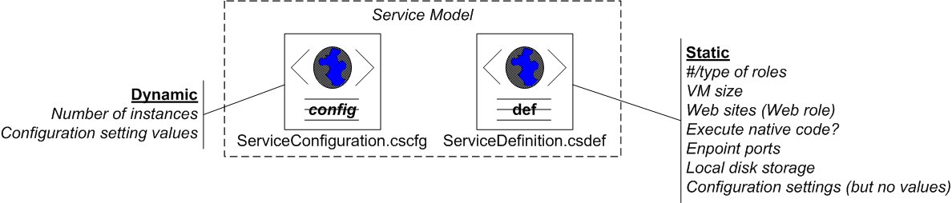
Exploring the Windows Azure Project Cont.
So, the key difference between the service definition and service configuration file is change.
The service definition file is static at runtime; defining the infrastructure and operational behavior of the service.
The service configuration file expands on the definitions of the service definition by specifying current configuration values that can be modified at runtime.
For example, you may need to change the database connection string (which might be different for staging versus production) in the runtime environment.

Slide 21
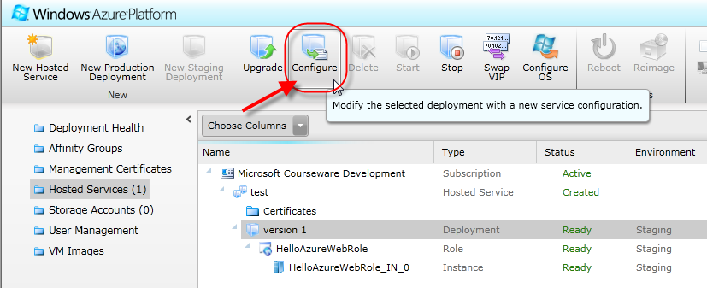
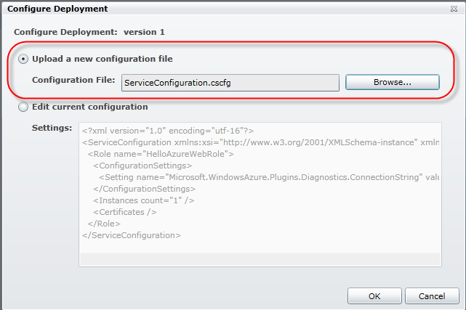
Exploring the Windows Azure Project Cont.
The Windows Azure Developer Portal and Service Management API provide mechanisms for changing the service configuration file for running services.
When you request to change the configuration through the Portal, you can choose to upload a new service configuration file (.cscfg file).

Slide 22
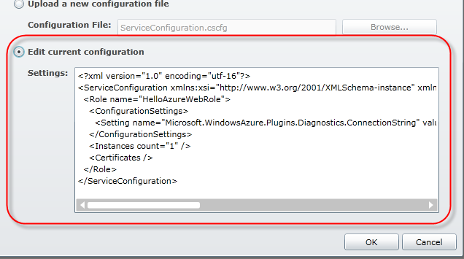
Exploring the Windows Azure Project Cont.
Alternatively, you can request to edit the deployed configuration file with an editor provided by the Portal.
In development, you may manually enter the XML metadata and configuration specified in the service definition and service configuration files.
A schema dictates the structure of information in both files. Therefore, VS provides intellisense for editing.
You can find a complete schema reference for both the service definition and service configuration here: msdn.microsoft.com/en-us/library/dd179398.aspx.
However, manual entry tends to be a messy, labor intensive, and error prone way of defining the structure and configuration values of your service.

Slide 23
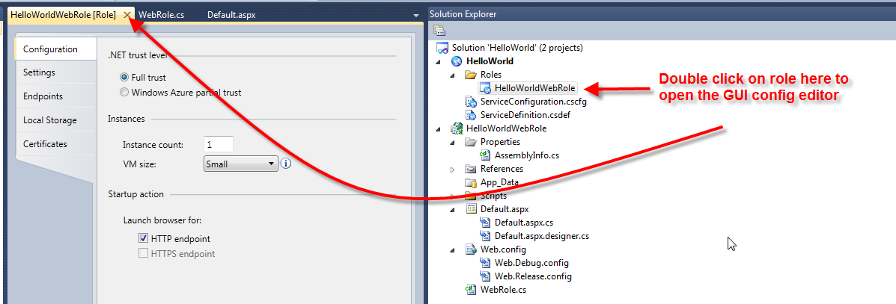
Exploring the Windows Azure Project Cont.
As a preferred option, use a dialog box GUI provided as part of the Windows Azure Tools for VS to enter configuration into the files.
To access the GUI editor for the service definition and configuration files, double click on any of the roles listed in the Roles subdirectory of the Windows Azure project.

Slide 24
Exploring the Windows Azure Project Cont.
Note that the GUI dialog box somewhat obfuscates whether you are entering service definition or service configuration information.
Further, double clicking on each role brings up a separate GUI dialog box that allows you to define configuration for that role.
This almost makes it seem like there are multiple configuration files.
However, when you save the data via the GUI, it all gets turned into XML and stored appropriately in the single service definition and configuration files.

Slide 25
Reacting to Configuration Change
At runtime, when a service configuration setting changes, Windows Azure throws RoleEnvironment.Changing and .Changed events.
The Changing event occurs before the configuration change is applied to an instance of a role.
The Changed event occurs after the configuration change is applied to an instance of a role.
You can find both of these events in Microsoft.WindowsAzure.ServiceRuntime.
These events allow the roles to detect a configuration change and restart themselves with the new option(s).

Slide 26
Reacting to Configuration Change Cont.
Many developers use the WebRole.cs OnStart() method to register a callback method to react to the Changing event.
public override bool OnStart()
{
RoleEnvironment.Changing += RoleEnvironmentChanging;
return base.OnStart();
}
Public Overrides Function OnStart() As Boolean
RoleEnvironment.Changing = (RoleEnvironment.Changing +
RoleEnvironmentChanging)
Return MyBase.OnStart()
End Function

Slide 27
Reacting to Configuration Change Cont.
Here is an implementation of the RoleEnvironmentChanging method (added to WebRole.cs) that would react to a change in the service configuration.

Slide 28
Reacting to Configuration Change Cont.
private void RoleEnvironmentChanging(object sender, RoleEnvironmentChangingEventArgs e)
{
// Add code for handling changes
// If a configuration setting is changing
if (e.Changes.Any(change => change is
RoleEnvironmentConfigurationSettingChange))
{
// Set e.Cancel to true to restart this role instance
e.Cancel = true;
}
}
Private Sub RoleEnvironmentChanging(ByVal sender As Object, ByVal e As RoleEnvironmentChangingEventArgs)
' Add code for handling changes
' If a configuration setting is changing
If e.Changes.Any(change=, Greater, (TypeOf change Is RoleEnvironmentConfigurationSettingChange)) Then
' Set e.Cancel to true to restart this role instance
e.Cancel = true
End If
End Sub

Slide 29
Reacting to Configuration Change Cont.
In this case, the method just checks to see if a configuration setting has been changed, and if so, restarts the role to include the change.
The RoleEnvironmentChangingEventArgs object passed in provides a Changes property.
This property provides you a collection of the configuration changes that are about to be applied to the role instance.
See msdn.microsoft.com/en-us/library/gg433017.aspx for more details on the events and how to use them.

Slide 30
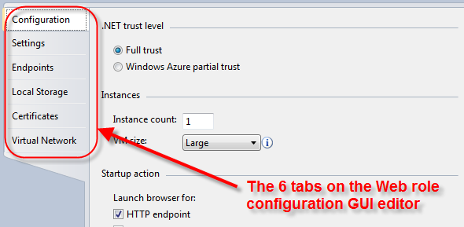
Web Role Configuration
There are many configuration elements and setting options for Web roles.
Most of the configuration elements are the same for worker roles. You examine configuration elements unique to worker roles in the worker role chapter.
The VS GUI editor for configuration provides six tabs (Configuration, Settings, Endpoints, Local Storage, Certificates and Virtual Network) for specifying settings.
These tabs provide a good way to explore role configuration.
The VS GUI editor for configuration can be obtained by selecting Properties on the role reference in the Solution Explorer.

Slide 31
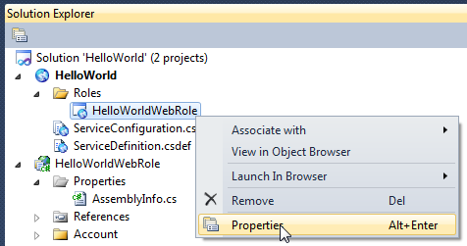
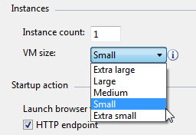
Web Role Configuration Cont.
On the Configuration tab are two of the more important configuration settings for any role: instances count and VM size.
The instance count (defaults to 1) allows you to specify the number of role instances (i.e. virtual machines) you want running in the cloud.
Running in Windows Azure Compute, role instances are often called compute instances.

Slide 32
Web Role Configuration Cont.
The VM size determines the size of the physical hardware used and virtual machine created to host your service.
The Web role and the VM size is defined in the service definition file, while the number of instances is stored in the service configuration file.
What does this tell you about what can change at runtime?

Slide 33
Web Role Configuration Cont.
<?xml version="1.0" encoding="utf-8"?>
<ServiceConfiguration serviceName="HelloWorld" xmlns="http://schemas.microsoft.com/ServiceHosting/2008/10/ServiceConfiguration" osFamily="1" osVersion="*">
<Role name="HelloWorldWebRole">
<Instances count="1" />
<ConfigurationSettings>
<Setting name=
"Microsoft.WindowsAzure.Plugins.Diagnostics.ConnectionString"
value="UseDevelopmentStorage=true" />
</ConfigurationSettings>
</Role>
</ServiceConfiguration>
<ServiceDefinition name="HelloWorld" xmlns="http://schemas.microsoft.com/ServiceHosting/2008/10/ServiceDefinition">
<WebRole name="HelloWorldWebRole" vmsize="Small">
<Sites>
<Site name="Web">
<Bindings>
<Binding name="Endpoint1" endpointName="Endpoint1" />
</Bindings>
</Site>
</Sites>
<Endpoints>
<InputEndpoint name="Endpoint1" protocol="http" port="80" />
</Endpoints>
<Imports>
<Import moduleName="Diagnostics" />
</Imports>
</WebRole>
</ServiceDefinition>

Slide 34
Web Role Configuration Cont.
Once deployed, Windows Azure provides automatic load balancing for Web roles that have two or more instances.
During the deployment process, the FC sees the number of instances specified in your configuration file.
It then allocates and configures load balancing for your service.
How does this work? When deploying your application, the FC requests a DNS entry that maps your service URL to a virtual IP address (VIP).
Internal to the data center, each role instance has an internal-only IP address called the direct IP address (DIP).
The FC also informs load balancers to redirect any request at the VIP to the DIP.
Load balancers work on a simple round-robin algorithm.

Slide 35
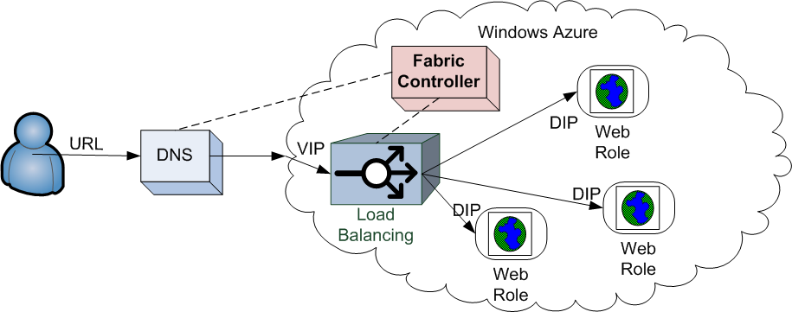
Web Role Configuration Cont.
It is because of the VIP and DIP that the FC is able to quickly move your services from Staging to Production as discussed in the last chapter.
When you “move” your application from Staging to Production, no code really moves.
Instead, the FC just informs DNS and the load balancers that the URL you selected is now the URL for the VIP.

Slide 36
Web Role Configuration Cont.
An important point to be made here is that while automatic failover is provided by Windows Azure, automatic scale out is not!
If an instance dies, the FC tries to recover the instance and automatically reestablishes the failed instances on a new virtual machine if it cannot restart it.
If you need more instances to address a Slashdot effect upon your Web role, for example, you must add them through a configuration update.
Windows Azure does not scale automatically.
Either through manual detection and intervention or via sophisticated service management code, you must handle the scale out (and down) of your instances.

Slide 37
Web Role Configuration Cont.
The VM Size determines how much of a physical server is dedicated to the virtual machine running each of the instances of your role.
The VM Size cannot change at runtime. Therefore, in order to avoid service stops and upgrades, it is important to get the right size VM for your instances.
The virtual machine also affects cost. The larger the virtual machine, the higher the cost.
Virtual machines range in extra small to extra large. Small is the default VM size.
The table below shows the number of CPU cores, amount of memory, and allotted local disk space dedicated to each of the VM sizes.

Slide 38
Web Role Configuration Cont.
VM Size | CPU cores | Available Memory | Allotted Local Disk Space
Extra Small | Shared | 768 MB | 20 GB
Small | 1 | 1.75 GB | 225 GB
Medium | 2 | 3.5 GB | 490 GB
Large | 4 | 7.0 GB | 1,000 GB
Extra Large | 8 | 14 GB | 2,040 GB
Assigning an extra large VM to your instances is essentially requesting the FC to allocate an entire physical server to your role.
At this time, the VM size must be the same for all instances of one role. Different roles can have different size VMs.

Slide 39
Web Role Configuration Cont.
The extra small VM was added to Azure with Windows Azure SDK 1.3.
Therefore, this size VM is not available when using early versions of the Windows Azure SDK.
While the extra small instance may serve the needs of some tiny applications, the real purpose of extra small VMs is to assist developers.
Extra small VMs allows more people to test drive Azure.
The extra small VM should:
"make the process of development, testing and trial easier for enterprise developers. The Extra Small instance will also make Windows Azure more affordable for developers interested in running smaller applications on the platform."

Slide 40
Web Role Configuration Cont.
Additionally, according to Microsoft, you can expect small VMs will have “medium” I/O performance compared to that of other sized VM’s.
This is because larger VMs get a larger allocation of the shared resources in the cloud.
According to Microsoft documentation, “having a larger allocation of the shared resource will also result in more consistent I/O performance.”

Slide 41
Web Role Configuration Cont.
Remember, in the cloud, you pay for what you use! More precisely, you pay for what you allocate.
Picking the number of instances for your role and the size of the virtual machine, really affects how much of the cloud you use.
The table below specifies the cost per compute instance for each of the VM sizes at the time of this writing (Under the Pay-as-you-go plan).
Please note that partial compute instance hours are billed as full compute hours.
VM Size | Cost per instance per hour in Windows Azure Compute
Extra Small | $0.05
Small | $0.12
Medium | $0.24
Large | $0.48
Extra Large | $0.96

Slide 42
Web Role Configuration Cont.
Carefully experiment and plan the number of instances and VM size you need.
Consider and weigh scale and redundancy/failover versus costs.
You might find, for example, a single extra large instance can handle the needs of several smaller instances; thereby reducing the overall cost of your hosted service.
Additional costs (covered later in class) are incurred for data storage, transactions, etc. that you use.
Microsoft offers additional pricing plans for those that have larger volume needs.
For details and the latest costs associated with Windows Azure, always consult the Windows Azure Platform pricing Web site: www.microsoft.com/windowsazure/pricing/.

Slide 43
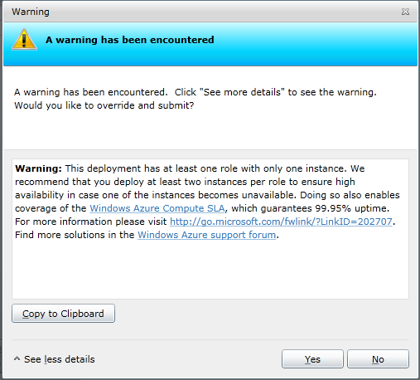
Web Role Configuration Cont.
In order to qualify for the Windows Azure Service Level Agreement (SLA), any role you have deployed to Azure must have at least two instances.
When you deploy your service to Azure, you are warned if your service configuration does not specify at least two instances for every role.
You might recall from your lab associated to the last chapter that the Portal warned you that the HelloWorld service had only one Web role instance.

Slide 44
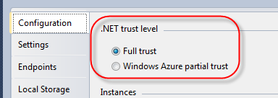
Web Role Configuration Cont.
The trust level specifies privileges the role has to access certain machine resources and execute native code.
Your selection sets the enableNativeCodeExecution attribute of the role in the service definition file.
The default value is Full trust enabled (making the enableNativeCodeExecution attribute not required in the service definition file).
Windows Azure roles run under a user context and never as administrators. Therefore, access to the underlying server (physical or virtual) is limited.
<WebRole name="HelloWorldWebRole" enableNativeCodeExecution="true">
...
</WebRole>

Slide 45
Web Role Configuration Cont.
However, when the trust level is set to Full trust (the default), the role has access to certain machine resources (like system registries) and can execute native code.
Native code might include executing unmanaged C++ code, or calling a Win32 DLL with P/Invoke.
Running other native processes is very important to support additional languages (such as Java) on Windows Azure.

Slide 46
Web Role Configuration Cont.
Under partial trust, the role cannot access machine resources and cannot execute native code.
Under partial trust, code cannot connect to external IP addresses over TCP and can only access files/folders in its local storage.
Partial trust is very similar to ASP.NET's medium trust level.
While partial trust is very restrictive, it also helps to secure your role by default.
Hackers working on a Web site running under partial trust would find accessing anything very difficult.

Slide 47
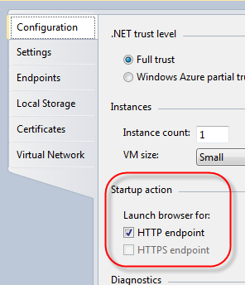
Web Role Configuration Cont.
The startup action is a configuration setting for testing/debugging in VS only and has no applicability to the way the role behaves or runs in the cloud.
This setting only applies to Web roles.
In fact, this one configuration option is not saved in either the service configuration or service definition file.
The two check boxes determine which endpoint (HTTP or HTTPS) is used by the browser(s) that are launched using the Compute Emulator.
The HTTPS option is only available if you enable your role for HTTPS endpoints (covered below).

Slide 48
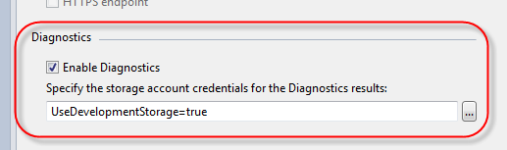
Web Role Configuration Cont.
Lastly, on the Configuration tab you have the ability to enable/disable Diagnostics.
By default, Diagnostics are enabled. This setting tells Windows Azure whether to capture diagnostic/log data and where to store it if captured.
By default, diagnostic/log data is captured locally in the Storage Emulator of your system.
You learn more about diagnostic data and this setting in a later chapter.

Slide 49
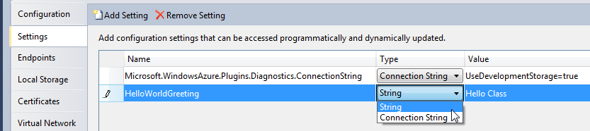
Web Role Configuration Cont.
The Settings tab allows you to define configuration settings that are accessible from the role code.
Configuration settings are key-value pairs that may identify resources, provide indicators for conditionalized code, or otherwise provide a config value to the role.
The same kind of idea is available via appSettings in app.config or web.config in ASP.NET applications.
You can add (and remove) settings in this tab and specify them as simple name-value strings or specify them as connection strings pointing to some resource.

Slide 50
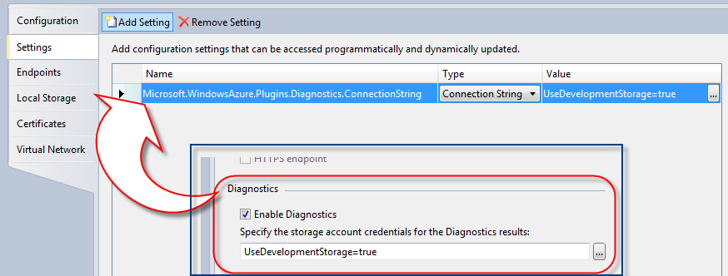
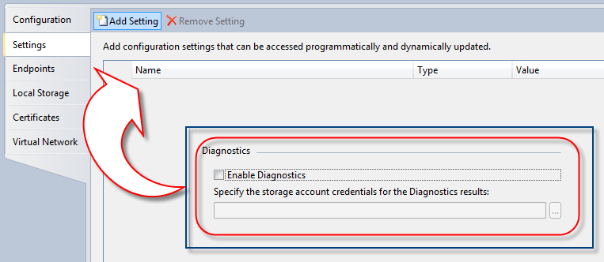
Web Role Configuration Cont.
In fact, under the covers, enabling Diagnostics (mentioned above) is defined by a Microsoft.WindowsAzure.Plugins.Diagnostics.ConnectionString setting.
When you enable Diagnostics, the Microsoft.WindowsAzure.Plugins.Diagnostics.ConnectionString setting is defined.
When you disable Diagnostics, this setting is removed.

Slide 51
Web Role Configuration Cont.
Custom settings you define in the Settings tab show up as elements in both the service definition and service configuration files.
When you create a new custom setting, it shows up as a setting under <ConfigurationSettings> in the service definition file.

Slide 52
Web Role Configuration Cont.
<ServiceDefinition name="HelloWorld" xmlns="http://schemas.microsoft.com/ServiceHosting/2008/10/ServiceDefinition">
<WebRole name="HelloWorldWebRole" vmsize="Small">
<Sites>
<Site name="Web">
<Bindings>
<Binding name="Endpoint1" endpointName="Endpoint1" />
</Bindings>
</Site>
</Sites>
<Endpoints>
<InputEndpoint name="Endpoint1" protocol="http" port="80" />
</Endpoints>
<Imports><Import moduleName="Diagnostics" /></Imports>
<ConfigurationSettings>
<Setting name="HelloWorldGreeting" />
</ConfigurationSettings>
</WebRole>
</ServiceDefinition>

Slide 53
Web Role Configuration Cont.
It is also present in the service configuration file. In the configuration file, the actual value for the custom setting is also specified.
<ServiceConfiguration serviceName="HelloWorld" xmlns="http://schemas.microsoft.com/ServiceHosting/2008/10/ServiceConfiguration" osFamily="1" osVersion="*">
<Role name="HelloWorldWebRole">
<Instances count="1" />
<ConfigurationSettings>
<Setting name=
"Microsoft.WindowsAzure.Plugins.Diagnostics.ConnectionString"
value="UseDevelopmentStorage=true" />
<Setting name="HelloWorldGreeting" value="Hello Class" />
</ConfigurationSettings>
</Role>
</ServiceConfiguration>

Slide 54
Web Role Configuration Cont.
What is the reason for this arrangement? Remember again, the service definition file remains static at runtime while the service configuration settings are dynamic.
So, this arrangement allows you to change the values of custom settings, but you cannot add or remove settings at runtime.

Slide 55
Web Role Configuration Cont.
To access any custom setting, use the RoleEnvironment class in the Microsoft.WindowsAzure.ServiceRuntime namespace.
This class represents the Windows Azure environment to the application code.
Call on the GetConfigurationSettingValue( ) method to access the value for any of the name-value custom setting pairs.
protected void Page_Load(object sender, EventArgs e)
{
WelcomeLabel.Text =
RoleEnvironment.GetConfigurationSettingValue("HelloWorldGreeting");
}
Protected Sub Page_Load(ByVal sender As Object, ByVal e As System.EventArgs) Handles Me.Load
Me.PageTitleLabel.Text =
RoleEnvironment.GetConfigurationSettingValue("GameTitle")
End Sub

Slide 56
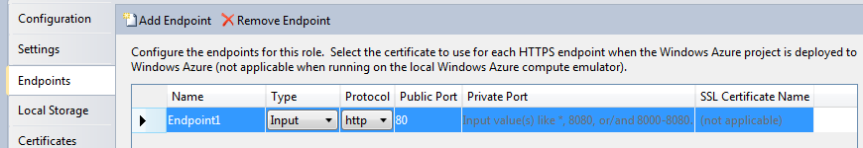
Web Role Configuration Cont.
As you may recall in the last chapter, when you deploy your application to Windows Azure, you select the URL for your service.
The Endpoints tab, however, allows you to specify the protocol and ports of your service endpoints.
By default, your Web role had defined one Input, HTTP endpoint operating at port 80 publicly.
Input endpoints are used to contact the service (from outside of your application).
Internal endpoints are used by roles to communicate with each other (from inside your application).

Slide 57
Web Role Configuration Cont.
Roles (both Web and worker) can have both internal and input endpoints.
When specifying details about an endpoint, you can dictate the protocol (HTTP by default, HTTPS, or TCP) used when communicating with the role.
When using HTTPS, you must also specify the name of the SSL certificate used to secure the communications.
Certificates are specified in the Certificates tab (see below).
Internal endpoints are only accessible to other roles within the cloud service. Therefore, they cannot be secured with certificates.
Typically, public facing ports are set to 80 and 443 for HTTP and HTTPS respectively.
You can also optionally provide an explicit port for internal endpoints which are also known as a local endpoints (again – only to be used internally within Azure).
If you elect not to provide a private port, the Fabric assigns the internal port number at run time.

Slide 58
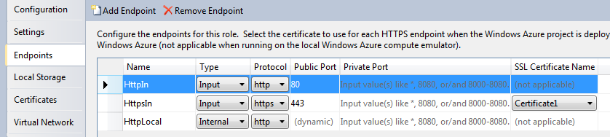
Web Role Configuration Cont.
The non-dynamic service definition file stores all endpoint configurations.

Slide 59
Web Role Configuration Cont.
<ServiceDefinition name="HelloWorld" xmlns="http://schemas.microsoft.com/ServiceHosting/2008/10/ServiceDefinition">
<WebRole name="HelloWorldWebRole">
<Sites>
<Site name="Web">
<Bindings>
<Binding name="Endpoint1" endpointName="HttpIn" />
<Binding name="Endpoint2" endpointName="HttpsIn" />
<Binding name="Endpoint1" endpointName="HttpLocal" />
</Bindings>
</Site>
</Sites>
<Endpoints>
<InputEndpoint name="HttpIn" protocol="http" port="80" />
<InputEndpoint name="HttpsIn" protocol="https" port="443"
certificate="Certificate1" />
<InternalEndpoint name="HttpLocal" protocol="http" />
</Endpoints>
<Imports>
<Import moduleName="Diagnostics" />
</Imports>
<Certificates>
<Certificate name="Certificate1" storeLocation="LocalMachine" storeName="CA" />
</Certificates>
</WebRole>
</ServiceDefinition>

Slide 60
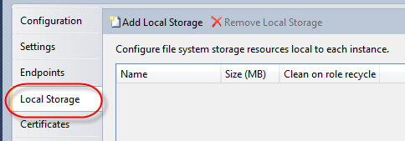
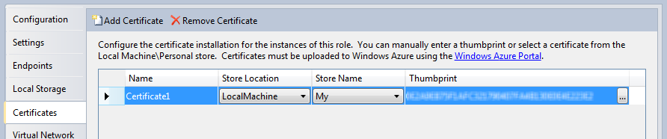
Web Role Configuration Cont.
You learn about Local Storage configuration, as specified in the Local Storage tab, in a later chapter.
The Certificates tab provides a means to manage digital certificates (X.509) used for encrypting HTTPS role endpoints or custom messages.
This tab allows you to name certificates used in both Compute Emulator and the Windows Azure cloud environments.
However, the actual certificates specified in the tab are only used in developing and testing your application (in the Compute Emulator).
Certificates must be uploaded to Windows Azure for use in the cloud.
You upload certificates into the cloud via the Developer Portal or Service Management API.

Slide 61
Web Role Configuration Cont.
Adding a certificate to be used in development and testing requires you specify a name, location, store name, and the actual certificate.
The location is either LocalMachine or CurrentUser.
Select the store name from the list of My, Root, CA, or Trust, TrustedPeople, or Disallowed.
As for the certificate, you can either enter the thumbnail manually or select a certificate from your personal store.

Slide 62
Web Role Configuration Cont.
Certificate configuration is stored in both the service definition and service configuration files.
The service definition file specifies the name and location of a certificate used by the service.
However, the service configuration file details the thumbprint and algorithm of the certificate.
<WebRole name="HelloWorldWebRole" vmsize="Small">
...
<Certificates>
<Certificate name="Certificate1" storeLocation="LocalMachine"
storeName="CA" />
<Certificate name="MessageCert" storeLocation="CurrentUser"
storeName="Root" />
</Certificates>
</WebRole>

Slide 63
Web Role Configuration Cont.
<Role name="HelloWorldWebRole">
...
<Certificates>
<Certificate name="Certificate1"
thumbprint="XXXXXXXXXXXXXXXXXXXXXXXXX791474723365"
thumbprintAlgorithm="sha1" />
<Certificate name="MessageCert" thumbprint=""
thumbprintAlgorithm="sha1" />
</Certificates>
</Role>
This allows the name of the certificate to be referenced in code, while the actual certificate can be dynamically set.

Slide 64
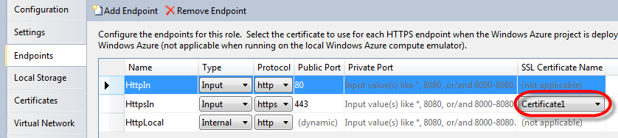
Web Role Configuration Cont.
If using HTTPS for an endpoint on a Web role, don’t forget that the certificate name must be referenced in the endpoint configuration.

Slide 65
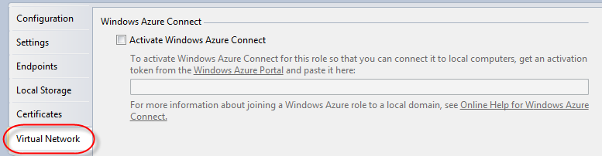
Web Role Configuration Cont.
The last configuration tab (Virtual Networking tab) is for activating and configuring your role for Windows Azure Connect.
Windows Azure Connect was previously known as project Sydney.
Azure Connect allows you to set up secure, IP-level network connectivity between your roles and local (on-premises) resources.
In order to connect your role to other resources, you need to establish an activation token via the Windows Azure Developer Portal.
You use that token on this configuration page to allow your role to connect and communicate with other resources.
Windows Azure Connect is beyond the scope of this class.
For more information on Windows Azure Connect see msdn.microsoft.com/en-us/library/gg432997.aspx.

Slide 66
Web Role with Multiple Web Sites
With Windows Azure SDK 1.3, you can run multiple Web Sites in a single Web role.
Prior to Windows Azure SDK 1.3, each Web role ran a single Web application.
This constraint was largely because Web roles were hosted in IIS Hosted Web Core where a single application was bound to a single HTTP/HTTPS endpoint.
Now, Windows Azure supports full IIS capabilities allowing Web roles to support multiple Web sites and Web applications.
Multiple Web sites and applications are accomplished using Web sites, virtual applications, and virtual directories features in IIS 7.0.
You can find more information about these IIS 7 features here: learn.iis.net/ page.aspx/150/understanding-sites-applications-and-virtual-directories-on-iis-7

Slide 67
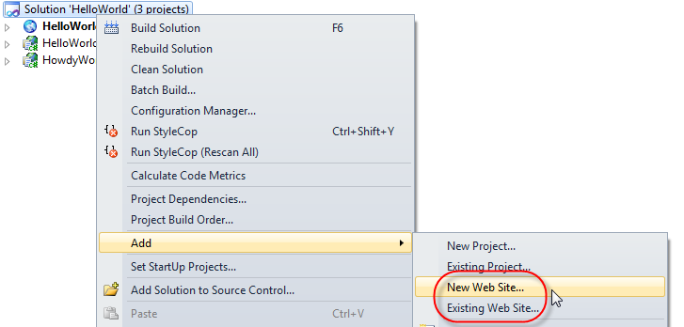
Web Role with Multiple Web Sites Cont.
Once you have a Windows Azure project with an existing Web role, you can create or add existing Web sites to the project.
There is nothing Azure-specific that needs to be done to create or add a Web site to the solution.
Simply use the existing VS means of creating or adding a Web Site to the solution containing your Windows Azure project.

Slide 68
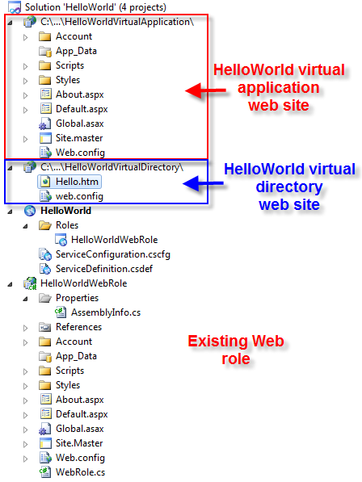
Web Role with Multiple Web Sites Cont.
In this example, a virtual application and virtual directory Web sites were added to the HelloWorld project.
Without any other work, if you were to run this application in the cloud or on the Compute Emulator, only the HelloWorld Web role would be accessible.
Neither of the two new Web sites could be reached.

Slide 69
Web Role with Multiple Web Sites Cont.
In order to incorporate the Web sites into the Windows Azure project, new elements need to be added to the service definition file (.csdef).
Specifically, you need to add a new <VirtualApplication> and <VirtualDirectory> elements for the Web sites added to the solution.
Unfortunately, there are no tools to accomplish this task at this time.
You must open the service definition file and add the XML necessary to define your Web sites.

Slide 70
Web Role with Multiple Web Sites Cont.
When you open the service definition file, you find there is an existing <Site> child element to the <Sites>.
This site is for the existing Web role endpoint – the HelloWorldWebRole in this example.
<WebRole name="HelloWorldWebRole">
<Sites>
<Site name="Web">
<Bindings>
<Binding name="Endpoint1" endpointName="Endpoint1" />
</Bindings>
</Site>
</Sites>
...
</WebRole>

Slide 71
Web Role with Multiple Web Sites Cont.
Add child <VirtualApplication> and <VirtualDirectory> elements to the <Site> in order to add virtual application and virtual directory Web sites.
The example virtual application and virtual directory from above are added here.

Slide 72
Web Role with Multiple Web Sites Cont.
<WebRole name="HelloWorldWebRole">
<Sites>
<Site name="Web">
<VirtualApplication name="HelloWorldVirtApp"
physicalDirectory="../../WebSites/HelloWorldVirtualApplication" />
<VirtualDirectory name="HelloWorldVirtDir"
physicalDirectory="../../WebSites/HelloWorldVirtualDirectory" />
<Bindings>
<Binding name="Endpoint1" endpointName="Endpoint1" />
</Bindings>
</Site>
</Sites>
...
</WebRole>

Slide 73
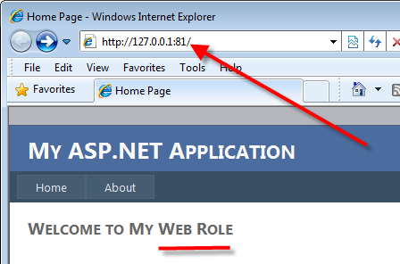
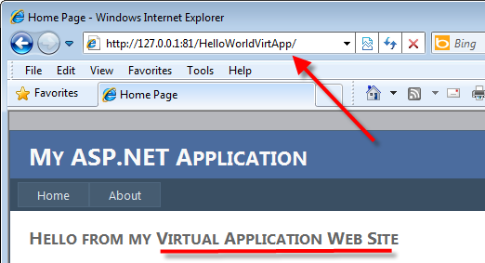
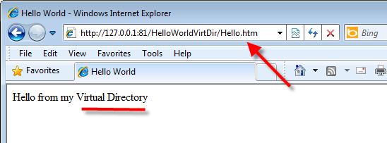
Web Role with Multiple Web Sites Cont.
Now the Web sites (virtual application and virtual directory) can be accessed through Azure or the Compute Emulator.
Simply use the virtual application name with the Web role URL to access the virtual application Web site.
Use the virtual directory name and resource name with the Web role URL to access a resource in the virtual directory.

Slide 74
Web Role with Multiple Web Sites Cont.
You can still run in the old-style Hosted Web Core mode.
This limits the capabilities of your application – such as having multiple Web sites per role.
To run in Hosted Web Core versus full IIS 7, simply remove the <Sites> element from the service definition file.
<WebRole name="HelloWorldWebRole">
<Sites>
<Site name="Web">
<Bindings>
<Binding name="Endpoint1" endpointName="Endpoint1" />
</Bindings>
</Site>
</Sites>
...
</WebRole>

Slide 75
ServiceRuntime API
The Microsoft.WindowsAzure.ServiceRuntime namespace contains a number of classes that you will probably use in your role code.
You have already seen a few of the classes from this namespace. RoleEntryPoint, for example, is in the ServiceRuntime namespace.
Of particular importance is the RoleEnvironment class. This class represents the Windows Azure environment to your service.
While the focus of this chapter has been on Web roles, the API can be and typically is used with either Web or worker roles.
As mentioned previously, Windows Azure projects reference this namespace by default.

Slide 76
ServiceRuntime API Cont.
As you have probably already started to surmise, writing applications for the cloud requires some additional design and code considerations.
You usually don’t just “flop an existing application into the cloud.”
While Windows Azure applications leverage .NET knowledge and APIs, cloud applications are written as highly scalable, distributed, resource sharing systems.
A standard ASP.NET application not designed for Windows Azure, for example, may run just fine in the cloud but it may cost more to execute that it should.
For example, your original ASP.NET application may not have been built considering the cost of storage or transactions.
In a pay-as-you-go environment, this could be economically adverse.
Windows Azure also provides a host of amenities, which standard ASP.NET application typically may not take advantage.

Slide 77
ServiceRuntime API Cont.
Amenities include Fabric management of the code, Windows Azure storage and the App Fabric.
Therefore, when writing applications, you may want to conditionalize code based on whether the application is running in or out of the Azure cloud.
Use the RoleEnvironment class to determine where the service is running.
The IsAvailable property indicates whether the code is running in the Windows Azure environment (or in the local Compute Emulator).
if RoleEnvironment.IsAvailable)
{
//do stuff in Windows Azure
} else
{
//not in Windows Azure – do other stuff
}

Slide 78
ServiceRuntime API Cont.
In addition to some of the capability you have already seen, the RoleEnvironment class also serves several other purposes.
The RequestRecycle() method asks the Windows Azure platform to stop and restart the role instance.
The DeploymentId property returns a string that uniquely identifies the service. You may want to use this identifier when logging.
The CurrentRoleInstance property returns a RoleInstance object (from the ServiceRuntime namespace) that represents the instance of the code executing.
A RoleInstance object provides applications with the access to the endpoints associated with an instance.
The endpoints can then be used to establish direct communications with the instance.
The Roles property returns a set of Role objects, each of which represent a role in the service.
You see more on the use of Role and RoleInstance later in class. The Role and RoleInstance classes are also defined in the ServiceRuntime namespace.

Slide 79
Running in the Compute Emulator
From the last chapter, you learned the Compute Emulator simulates the virtual machine environment of Azure on your local development box.
The Compute Emulator comes with the Windows Azure SDK (remember the SDK, and therefore the emulator, comes with Windows Azure Tools for VS).
It represents about 90% of the same code base as seen in the cloud, but there are some differences and limitations.

Slide 80
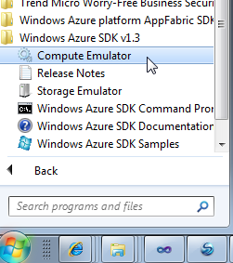
Running in the Compute Emulator Cont.
When you press F5 to debug a project, VS automatically starts the Compute Emulator.
In fact, when you start debugging on a Windows Azure project, VS starts CSRun.exe (found in the bin directory of the SDK).
So, if you are not using VS, you can start the Compute Emulator using this same executable.
CSRun.exe deploys a service to the Compute Emulator, and then manages the running service.
You can also start the Compute Emulator directly from the Windows Azure SDK program Start menu, or by running DFUI.exe from the SDK bin directory.
Csrun /run:<serivice csx folder>;<service .cscfg file> /launchBrowser

Slide 81
Running in the Compute Emulator Cont.
When you debug a Windows Azure project that contains Web or worker roles, the Compute Emulator is started.
When you debug a cloud service that contains Web roles, a browser opens to the URL of each Web role.
The URL of the Web roles in the Compute Emulator will be at localhost (http://127.0.0.1) on an available port on the system.
Because ports may be occupied, the ports used by Compute Emulator for your roles may not always be the same as the port specified in the configuration file.
Closing a browser running the Web role automatically stops debugging.
As an important note, at this time, you cannot access Web roles from other systems while the service is running in the Compute Emulator.

Slide 82
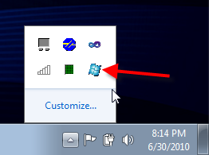
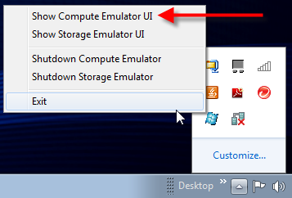
Running in the Compute Emulator Cont.
The Compute Emulator comes with a UI (a process called DFUI.exe ) that shows you what services you have running.
Recall, the Compute Emulator used to be called the Dev Fabric, thus the name DFUI.exe.
While there are a few ways to start the Compute Emulator UI, probably the easiest way is to find the Compute Emulator icon in the system tray when it is running.
Right click on the icon and select Show Compute Emulator UI from the menu.

Slide 83
Running in the Compute Emulator Cont.
You learn about the Storage Emulator UI (the other option shown in the menu) in a later chapter.

Slide 84
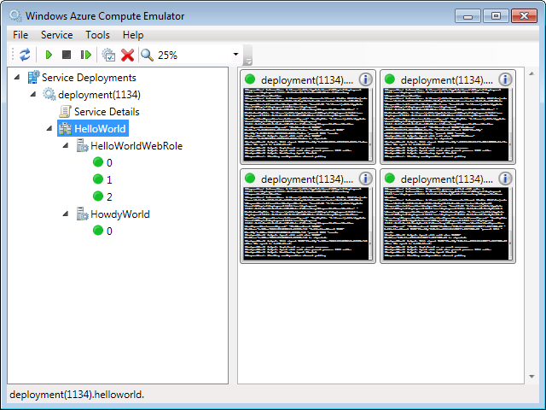
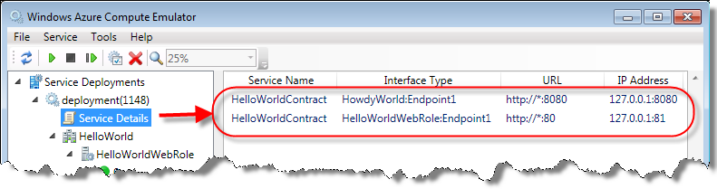
Running in the Compute Emulator Cont.
The Compute Emulator UI also displays the health and status of each role and each role instance.
In the example below, the UI shows two Web roles running for the HelloWorld cloud service.
The HelloWorldWebRole Web role has three instances while the HowdyWorld Web role has just one.
The Service Details in the UI also provides endpoint address information.

Slide 85
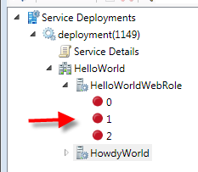
Running in the Compute Emulator Cont.
Notice the colored dot next to the instance numbers. Green indicates a healthy running instance. Red indicates a stopped instance.
The number next to the green dot represents an instance id (per service). Instance ids are zero based (thus the 0, 1, 2 numbers next to green dots above).
Clicking on the instance also allows you to see the trace log of the instance.

Slide 86
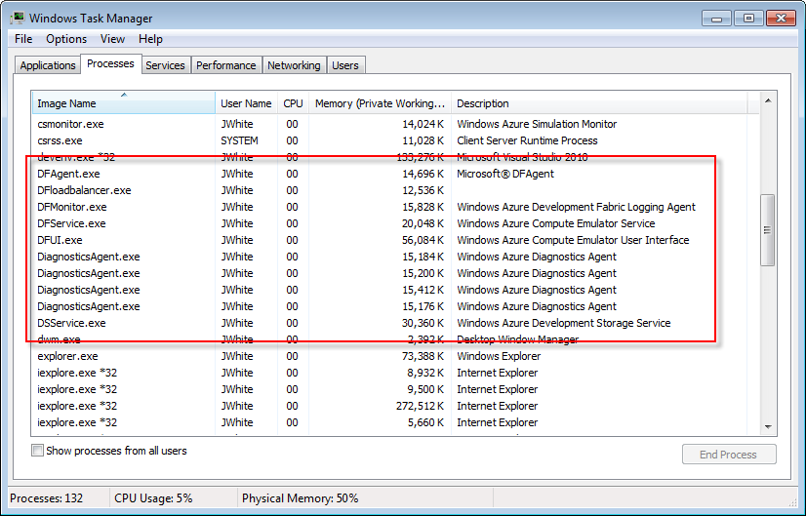
Running in the Compute Emulator Cont.
The Compute Emulator is actually a collection of processes running on your development machine.
Opening the Task Manager while the Compute Emulator is running gives you a picture of the many executables that make up the Compute Emulator.
You should see one DiagnosticsAgent.exe process running for each instance of each role.
In the case shown here, four roles are running.

Slide 87
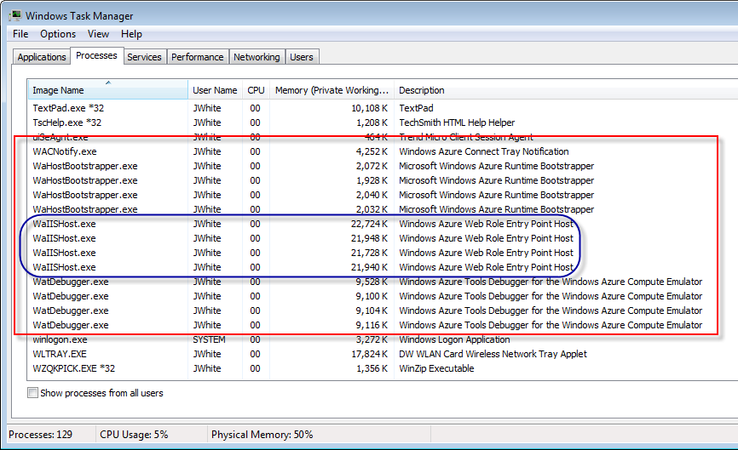
Running in the Compute Emulator Cont.
In addition, several processes provide the IIS Web hosting capability in support of your Azure roles.
Note that there is one WaHostBootstrapper.exe and one WaIISHost.exe process running for each Web role.
Again, the example shows four Web roles running in the Compute Emulator.

Slide 88
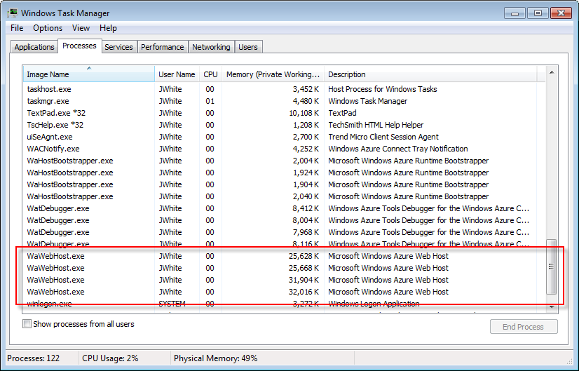
Running in the Compute Emulator Cont.
As mentioned previously, when you run Web roles without <Sites> you are running in the old Hosted Web Core mode.
When running in this mode today, you do not see WaIISHost.exe running for each Web role.
Instead, a WaWebHost.exe runs for each “Site-less” Web role along with the WaHostBoostrapper.exe.
Prior to the 1.3 release, the entry point code and the actual web site were executed within a Hosted Web Core process (WaWebHost.exe).

Slide 89
Running in the Compute Emulator Cont.
The table below lists and describes each of the Windows Azure processes.
This may seem more academic at first glance.
Compute Emulator Windows Executable | Description
DFAgent | Compute Emulator equivalent of the RDAgent in cloud. RDAgent is responsible for collecting the health status of the role and for collecting management information on the VM.
DFloadbalancer | Load balancer/simulator for the Compute Emulator
DFMonitor | Monitor the health and status of roles running in the Compute Emulator
DFService | The Compute Emulator service – providing the compute environment locally
DSService | The Storage Emulator service – providing Windows Azure storage locally
DFUI | Compute Emulator management user interface. Only running when the UI is displayed.
WaHostBootstrapper | Bootstrapper which spawns either WaIISHost for a web role or WaWorkerHost for a worker role (or WaWebHost for Site-less Web roles)
WaIISHost | Local IIS supporting your Windows Azure Web role – run by the WaHostBootstrapper. In the cloud, each instance is hosted in its own VM, whereas on the local development simulation each role instance is hosted in a separate process and Visual Studio attaches to all of them.
WaWebHost | Old Host Web Core for Web role hosting (only for Web role instances).
WaWorkerHost | Worker role host (only for worker role instances)

Slide 90
Running in the Compute Emulator Cont.
However, some understanding of the processes of the Compute Emulator allows you to "kill” instances of your roles.
This allows you to test application behavior during failure and Windows Azure (Compute Emulator here, Fabric Controller in the cloud) restart of the instance.

Slide 91
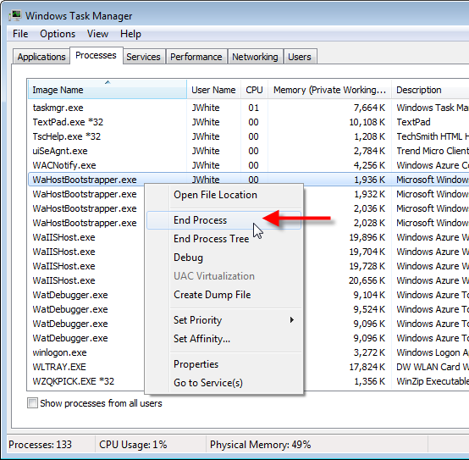
Running in the Compute Emulator Cont.
To kill an instance of a Web role, simply use the Task Manager to end one of the bootstrapper or host processes.
Each process hosts one instance of each Web role. It serves to simulate the virtual machine that the role will ultimately run on in the cloud.
Watch the Compute Emulator UI closely as you kill the process.
You should see the status of one of the roles change eventually come back up, just as it would in the cloud.

Slide 92
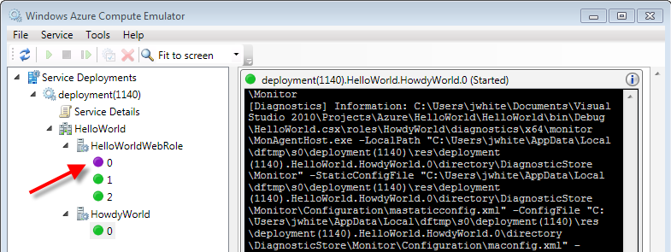
Running in the Compute Emulator Cont.

Slide 93
Lab Exercise: Web Role Lab

Slide 94
Chapter Summary
Web roles run under Windows Azure Compute service.
A Web role is a Web site or Web service (Windows Communication Foundation service) running in an IIS 7 environment in the cloud.
Web roles run inside of IIS 7.
Windows Azure Tools for VS provide four Web role templates.
A Web role project looks nearly identical to non-Azure project.
In other words, an ASP.NET Web role project looks almost identical to an ASP.NET Web Application project.
A WCF Service Application looks almost identical to a WCF Service Web role.
In fact, the only difference is that the Web role adds 3 Windows Azure references and the WebRole.cs file.

Slide 95
Chapter Summary Cont.
The WebRole.cs class extends the RoleEntryPoint class from the Microsoft.WindowsAzure.ServiceRuntime namespace.
RoleEntryPoint provides callbacks to initialize, run, and stop instances of a role.
Default methods in this class respond to two important application events: namely the start of the service and any change to its configuration.

Slide 96
Chapter Summary Cont.
The Windows Azure project created during the formation of the solution provides a container and the configuration for all the roles in the project.
When you create a Windows Azure project, a Roles subdirectory lists each of the Windows Azure roles that are part of the project.
The project also has two very important XML configuration files: the service definition file and service configuration file.
The Fabric Controller uses the information in these files to determine how to deploy and operate your application in the Fabric.
The service definition file is static at runtime; defining the infrastructure and operational behavior of the service.
The service configuration file expands on the definitions of the service definition by specifying current configuration values that can be modified at runtime.

