Slide 1
Local Storage
50466 Windows® Azure™ Solutions with Microsoft® Visual Studio® 2010

Slide 2
What is Local Storage?
Many applications need access to files in the file system.
Your application may need some reference data or configuration information from a file.
You may want to put or get application specific log and diagnostic information from a file.
You might use files as a cache warehouse.
Perhaps you have externalized some SQL that you need to get from a file.
Whatever the reason, accessing the file system is usually a pretty common and straightforward exercise in most .NET applications.

Slide 3
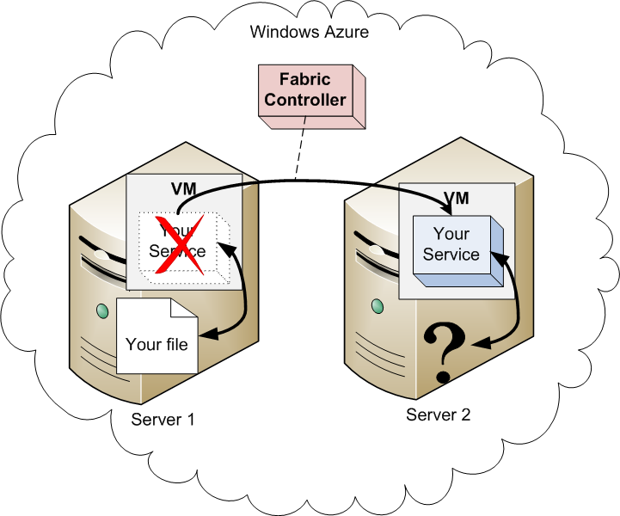
What is Local Storage? Cont.
However, in Windows Azure, you share the physical hardware on which the application runs.
Furthermore, Windows Azure controls that hardware.
Your service instances may go down and come back up on different servers.
There is no guarantee that the underlying file system hosting your file is always the same server.

Slide 4
What is Local Storage? Cont.
Windows Azure provides a place called local storage for you to store and retrieve files.
Local storage is different from your server’s file system in many ways.
Before using local storage, you should be aware of its general purpose and issues for using it outside of that purpose.

Slide 5
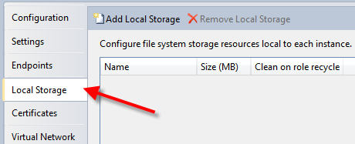
Local Storage Configuration
In order to use local storage, you must first request it by declaring it in service configuration.
Recall from chapter 3, there is a Local Storage tab on the GUI role configuration editor.
Use this editor to create named local storage resources that your Windows Azure role can use.

Slide 6
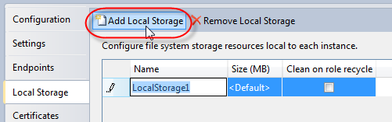
Local Storage Configuration Cont.
Using the GUI editor (Local Storage tab), click on the Add Local Storage button to create a new named local storage resource.
Provide a name (must be unique for the role’s local storage resources) and size (in MB).
Also, indicate whether the local storage resource should be cleaned on recycle of the role (by default it is not cleaned).

Slide 7
Local Storage Configuration Cont.
The size of local storage must be at least 1 MB.
The size of the VM selected for your role determines the maximum size of the local storage resource.
Recall, each VM size has an associated allocated local disk space as stated in the table below.
You can have multiple local storage resources (or stores) per role.
However, the total size for all local storage stores should not exceed the total space allocated to the VM selected for your role.
VM Size | Allotted Local Disk Space
Extra Small | 20 GB
Small | 225 GB
Medium | 490 GB
Large | 1,000 GB
Extra Large | 2,040 GB

Slide 8
Local Storage Configuration Cont.
Realize the editor does not inform you when you have configured local resources that exceed your allotted space.
In fact, even when you publish your application and execute in the cloud, Windows Azure will not complain until your service exceeds its allotted space.
Below is a direct quote from the Windows Azure SDK documentation on MSDN.
Be aware that it is the developer's responsibility to ensure that the amount of disk space requested for a local storage resource does not exceed the maximum amount allotted for a VM. If you configure a local storage resource to be larger than the allowed maximum, an error will not occur until you attempt a write operation that exceeds the allowed maximum, in which case the write operation will fail with an out of disk space error. To ensure that you do not exceed the allowed maximum, you may wish to check the amount of disk space currently being used for a given local storage resource before writing to it.

Slide 9
Local Storage Configuration Cont.
Importantly, recognize local storage is created (and used) per role instance. It is in fact “file space” on a single virtual machine.
Since each role instance runs on its own virtual machine, local storage cannot be shared across roles or even across instances.
In addition, local storage is temporary and data stored in it should be considered volatile and non-durable.
In other words, when the virtual machine hosting your service dies, the local storage is reclaimed. Data stored in the local storage is thereby lost forever.
If you need durable and persistent storage and/or data that can be shared across instances, consider Windows Azure Drive, Windows Azure Storage or SQL Azure.
Windows Azure Drive is covered later in this chapter.

Slide 10
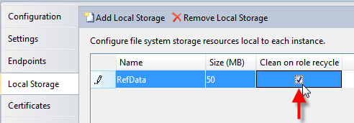
Local Storage Configuration Cont.
The data in local storage is volatile and lost when the virtual machine goes down, but the data can be preserved when recycling the role instance.
By default, Windows Azure preserves data in local storage when a role instance is recycled.
When you check the “Clean on Role Recycle” check box in configuring the local storage, you indicate that you want data removed on an instance recycle.

Slide 11
Local Storage Configuration Cont.
The information entered into the role GUI configuration editor is captured in the service definition file.
As always, you can choose to define and configure local storage directly in this file.
The <LocalResources> and <LocalStorage> child element of the role element captures the configuration options for each store.

Slide 12
Local Storage Configuration Cont.
<?xml version="1.0" encoding="utf-8"?>
<ServiceDefinition name="HelloWorld" xmlns="http://schemas.microsoft.com/ServiceHosting/2008/10/ServiceDefinition">
<WebRole name="HelloWorldWebRole">
<Sites>
<Site name="Web">
<Bindings>
<Binding name="Endpoint1" endpointName="Endpoint1" />
</Bindings>
</Site>
</Sites>
<Endpoints>
<InputEndpoint name="Endpoint1" protocol="http" port="80" />
</Endpoints>
<Imports>
<Import moduleName="Diagnostics" />
</Imports>
<LocalResources>
<LocalStorage name="RefData" cleanOnRoleRecycle="true"
sizeInMB="50" />
</LocalResources>
</WebRole>
</ServiceDefinition>

Slide 13
Local Storage Configuration Cont.
As it is defined in the service definition file, this should alert you to the fact that local storage cannot change at runtime.
If you determine your service needs more local storage space, you have to stop your service, reconfigure and redeploy your application!

Slide 14
Using Local Storage
To access local storage from within a role, start by using the RoleEnvironment class (part of the Microsoft.WindowsAzure.ServiceRuntime namespace).
The static function GetLocalResource(string localResourceName) on RoleEnvironment returns a LocalResource object.
Here is the call, for example, to get the LocalResource representing the local storage space defined in the configuration above.
The LocalResource object represents the directory of the store on the server, and the object has a variety of methods and properties for working with this directory.
LocalResource refData = RoleEnvironment.GetLocalResource("RefData");
Dim refData As LocalResource =
RoleEnvironment.GetLocalResource("RefData")

Slide 15
Using Local Storage Cont.
The exact location of the local storage directory is at Windows Azure’s discretion.
However, you obtain the physical path of the storage folder through the RootPath property on the LocalResource object.
When running in the Compute Emulator, you find that the root path of the local storage will be to a temporary directory.
When your service is deployed to the cloud, the path to the local storage resource includes the deployment ID and might look something like that below.
C:\Users\<username>\AppData\Local\dftmp\s0\deployment(353)\res\deployment(353).HelloWorld.HelloWorldWebRole.0\directory\RefData\
C:\Resources\directory\f335471d5a5845aaa4e66d0359e69066.HelloWorldWebRole.RefData\

Slide 16
Using Local Storage Cont.
With the root path, you use the standard .NET I/O (System.IO) classes and methods to store and retrieve data in the local storage folder.
For example, the code below retrieves the text in a file called “statesList.txt” in the RefData store.

Slide 17
Using Local Storage Cont.
try
{
LocalResource refData = RoleEnvironment.GetLocalResource("RefData");
string s = System.IO.File.ReadAllText(refData.RootPath +
"statesList.txt");
//... do your work with s
} catch (Exception myException)
{
// exception handling
}
Try
Dim refData As LocalResource =
RoleEnvironment.GetLocalResource("RefData")
Dim s As String = System.IO.File.ReadAllText((refData.RootPath +
"statesList.txt"))
'... do your work with s
Catch myException As Exception
' exception handling
End Try

Slide 18
Using Local Storage Cont.
Similarly, this code demonstrates how to write data to a file in the local store.
if (!text.Equals(""))
{
LocalResource refData = RoleEnvironment.GetLocalResource("RefData");
System.IO.File.WriteAllText(refData.RootPath + "newList.txt", text);
}
else
{
System.IO.File.WriteAllText(refData.RootPath + "newList.txt",
"no data");
}
If Not text.Equals("") Then
Dim refData As LocalResource =
RoleEnvironment.GetLocalResource("RefData")
System.IO.File.WriteAllText((refData.RootPath +
"newList.txt"), text)
Else
System.IO.File.WriteAllText((refData.RootPath + "newList.txt"),
"no data")
End If

Slide 19
When to Use Local Storage
Local storage is temporary and volatile. So what’s it good for?
Other storage (Windows Azure Storage and SQL Azure) is on a different server.
Potentially Windows Azure Storage and SQL Azure data may even be in a different data center.
Local storage is part of the VM hosting your service. Typically, applications access local storage faster than data stored elsewhere.
Use local storage as a temporary, and fast, cache for data.
Use alternate storage mechanisms (Windows Azure Storage, SQL Azure, etc.) when information must be persisted - durably and potentially long-term.
Use alternate storage mechanism when you need to share data across role instances, across roles, across services, or even across applications.

Slide 20
When to Use Local Storage Cont.
Remember, data in local storage is not shared across role instances.
So information in local storage cannot be used as a kind of temporary and quick session cache (unless you only have one instance – but don’t forget future scaling).
Load balancers round robin requests to each role instance.
In a Web application, a user’s first request might go to the first Web role instance and the next request goes to a second instance.
The second instance has no access to any session data created in local storage by the first instance.

Slide 21
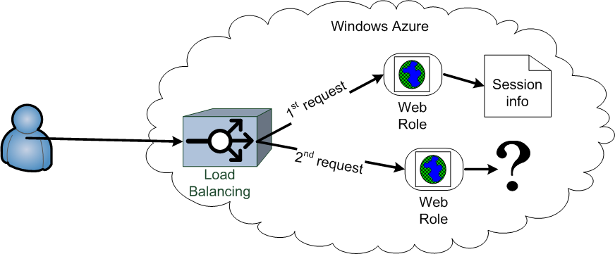
When to Use Local Storage Cont.
Therefore, local storage is for temporary instance caching only!

Slide 22
Windows Azure Drive
Almost all existing applications use files and the file system for something.
So, one of the pains of porting an existing application to Windows Azure has been determining what to do with access to file resources.
Local storage is temporary and volatile. Most applications expect the file system to be permanent (durable) and non-volatile.
While Windows Azure Storage and SQL Azure provide alternatives, it still requires a bit of work to port an existing application using files/file system to Windows Azure.
At PDC 2009, Microsoft introduced X-Drive. Today, X-Drive is known as Windows Azure Drive.
Microsoft released Windows Azure Drive in beta form in February 2010.
Windows Azure Drive (or X-Drive as it is still sometimes known) provides a durable NTFS volume to Windows Azure services.

Slide 23
Windows Azure Drive Cont.
Under the covers, Windows Azure Drive is really just a façade on top of blob storage (covered elsewhere in this class).
That is, Windows Azure Drive is blob storage mounted as an NTFS drive.
From an application’s perspective, however, Windows Azure Drive looks like an NTFS drive that can be accessed like a normal file system.
Translation between the file system API and blob access code is handled by a special Windows Azure device driver.
There are still a few limitations with Windows Azure Drive.
Multiple role instances can read, but only one role instance at a time has read/write privileges to the Windows Azure Drive.
A Drive’s size is between 16 MB and 1TB.
Because of the special drivers needed to access Windows Azure Drive, it is only available to roles.
On-premise apps (apps outside the data center) cannot access Windows Azure Drive.

Slide 24
Windows Azure Drive Cont.
Users are billed only for the storage space used by the underlying blob storage.
Users must also consider read/write transactions and transaction costs associated with blob storage.
As billing is determined from standard blob storage rates, there are no separate line items on the bill for Windows Azure Drive at this time.
To experiment with Windows Azure Drive, you need the February 2010 version of the Windows Azure SDK or better.
Therefore, in order to deploy and use Windows Azure Drive, you must deploy to a Windows Azure Guest OS 1.1 (released 1/1/2010) or later.
If you deploy your service to an earlier version, your service may get a CloudDriveException that indicates the use of an unsupported OS.
Learn more about Windows Azure OS Family and Guest OS in the next chapter.

Slide 25
Windows Azure Drive Cont.
Learn more about Windows Azure Drive here: go.microsoft.com/?linkid=9710117.

Slide 26
Lab Exercise: Local Storage Lab

Slide 27
Chapter Summary
Windows Azure provides a place called local storage for you to store and retrieve files.
Local storage is different from your server’s file system in many ways.

Slide 28
Chapter Summary Cont.
In order to use local storage, you must first request it by declaring it in service configuration.
When configuring local storage, provide a name (must be unique for the role’s local storage resources) and size (in MB) of the storage.
Also, indicate whether the local storage resource should be cleaned on recycle of the role (by default it is not cleaned).
The size of local storage must be at least 1 MB. The size of the VM selected for your role determines the maximum size of the local storage resource.
The configuration editor does not inform you when you have configured local resources that exceed your allotted VM space.
In fact, even when you publish your application and execute in the cloud, Windows Azure will not complain until your service exceeds its allotted space.

Slide 29
Chapter Summary Cont.
Local storage is created (and used) per role instance.
Local storage cannot be shared across roles or even across instances.
Local storage is temporary and data stored in it should be considered volatile.
To access local storage from within a role, start by using the RoleEnvironment class (part of the Microsoft.WindowsAzure.ServiceRuntime namespace).
The static function GetLocalResource(string localResourceName) on RoleEnvironment returns a LocalResource object.
The LocalResource object represents the directory of the store on the server.
Obtain the physical path of the storage folder through the RootPath property on the LocalResource object.
With the root path, you use the standard .NET I/O (System.IO) classes and methods to store and retrieve data in the local storage folder.

Slide 30
Chapter Summary Cont.
Windows Azure Drive (or X-Drive as it is more commonly known) provides a durable NTFS volume to Windows Azure services.

