Slide 1
More Windows Azure Administration
50466 Windows® Azure™ Solutions with Microsoft® Visual Studio® 2010

Slide 2
Windows Azure Subscriptions and Administrators
In order to deploy services and data to Windows Azure, you need a Windows Azure subscription.
To set up a Windows Azure subscription you must setup an account with Microsoft Online Services.
When establishing the subscription, you also establish the Account Administrator and Service Administrator.
The account administrator is also known as Account Owner.
The Account Administrator is the person responsible for paying the subscription bill.
The Account Administrator has access to and works through the Microsoft Online Services Customer Portal (MCOP) to view and manage the subscription bills.
Normally, the Account Administrator has financial responsibilities in your company.

Slide 3
Windows Azure Subscriptions and Administrators Cont.
The Service Administrator is also known as the Service Owner.
The Service Administrator manages the services that run in Windows Azure.
The Service Administrator has access to and uses the Portal or Service Management API to orchestrate the applications and data running in Azure.
Normally, the Service Administrator is a developer, system administrator, or other IT person responsible for IT services in your company.
When creating your subscription, you can establish the Account Administrator and Service Administrator as the same person.
The different administrator allows for separation between financial responsibilities and operational responsibilities.
However, the role/responsibility separation is not required.

Slide 4
Windows Azure Subscriptions and Administrators Cont.
The Service Administrator can establish co-administrators.
More precisely, the Service Administrator can create co-Service Administrators that help manage Windows Azure operations.
When the subscription is created, only the single Service Administrator can manage the operations of the account.
Co-administrators help manage the services and data running in Windows Azure.
Co-administrators are identified by Windows Live ID.
Therefore, a person that you want to be a co-administrator of your subscription must have his or her own Windows Live ID.
If they do not have a Windows Live ID, they can create one at login.live.com.

Slide 5
Windows Azure Subscriptions and Administrators Cont.
Co-administrators have complete access to the subscription services.
They can even add or delete other co-administrators.
However, they cannot remove the Service Owner (the Service Administrator).
Co-administrators do not have access to payment/billing information (things managed by the Account Administrator).

Slide 6
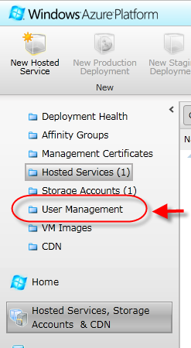
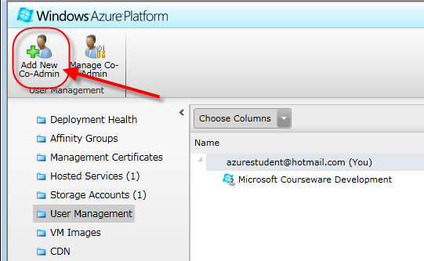
Windows Azure Subscriptions and Administrators Cont.
To add a co-administrator to your subscription, first sign-in to the Portal.
Select the User Management folder on the Portal.
Next, click on the Add New Co-Admin button on the icon menu bar at the top of the Portal.

Slide 7
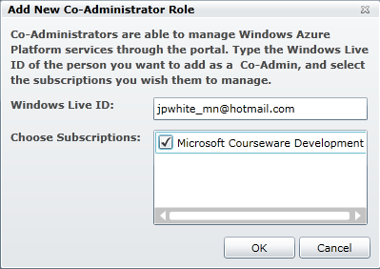
Windows Azure Subscriptions and Administrators Cont.
An Add New Co-Administrator Role window prompts you for the Windows Live ID of the new admin along with the applicable subscription.

Slide 8
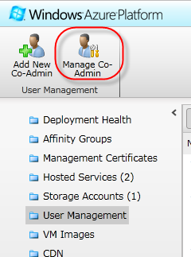
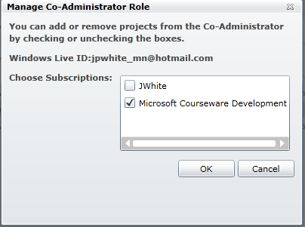
Windows Azure Subscriptions and Administrators Cont.
The Manage Co-Admin button in the Portal icon menu bar allows you to remove the co-admin from a subscription or add additional subscriptions to a co-admin.

Slide 9
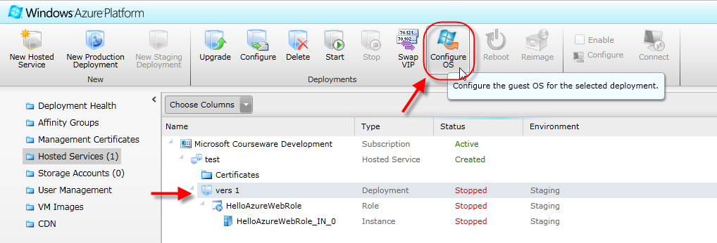
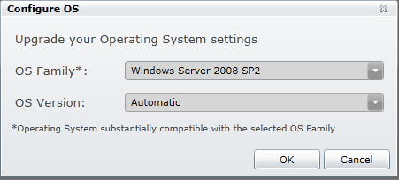
Windows Azure OS Family and Guest OS
When you deploy a service, you can examine the operating system hosting your service.
When deploying a service, click on a deployment in the list of hosted services. Then click on the Configure OS button in the icon menu bar at the top of the Portal.
As a result, a Configure OS window pops up. This will show you the operating system family and operating system version currently supporting your application.

Slide 10
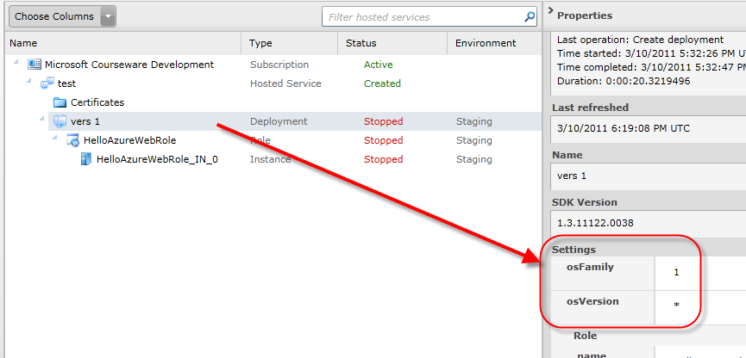

Windows Azure OS Family and Guest OS Cont.
You can also see (but not configure) the OS family and OS version supporting your virtual machines by looking in the Properties area when you click on a deployment.
The OS Family, as of this writing can be either Windows Server 2008 SP2 or Windows Server 2008 R2.
Windows Server 2008 R2 support was made available with Windows Azure SDK 1.3.
Windows Server 2008 R2 supports IIS 7.5, AppLocker, and enhanced command-line and automated management using PowerShell Version 2.0.

Slide 11
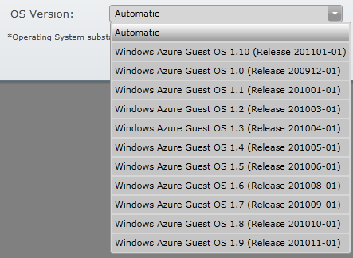
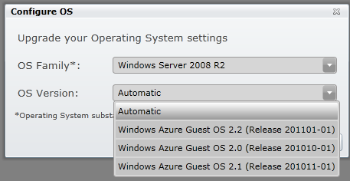
Windows Azure OS Family and Guest OS Cont.
The OS Version actually indicates the version of the operating system that runs on the virtual machine that hosts a role instance in Windows Azure.
There are many Guest OS versions and each has an associated release date to give you an appreciation of when it came into existence).
Windows Server 2008 SP2 supports Guest OS versions 1.x (shown above).
Windows Server 2008 R2 supports Guest OS versions 2.x (shown below).
According to MSDN, the goal is to have an updated Windows Azure Guest OS monthly.

Slide 12
Windows Azure OS Family and Guest OS Cont.
The “Automatic” option listed in the OS Version menu allows Windows Azure to upgrade your virtual machines automatically.
That is Windows Azure will automatically upgrade the virtual machines supporting your services to the latest release of the guest OS in the OS family, once available.
This is the recommended setting and best practice as suggested by Microsoft.
While you can configure the OS through the Portal, you also specify the OS Family and OS Version in your service configuration file.
In the root element of the service configuration file, you might have noticed osFamily and osVersion attributes.
These indicate the OS Family and OS Version (Windows Azure Guest OS) to be setup for your services’ virtual machines.
<ServiceConfiguration serviceName="HelloWorld" xmlns="http://schemas.microsoft.com/ServiceHosting/2008/10/ServiceConfiguration" osFamily="1" osVersion="*">

Slide 13
Windows Azure OS Family and Guest OS Cont.
The value of the osFamily attribute can be set to 1 or 2.
The value of “1” specifies using an OS “substantially compatible with” the Windows Server 2008 SP2.
The value of “2” specifies using an OS “substantially compatible with” Windows Server 2008 R2.
As of this writing, the VS Cloud templates associated with WAT for VS currently uses “1” as the default.
In fact, if you do not provide an osFamily setting, “1” is the default and assumed value.
Please note that Azure does not support an automatic upgrade of the OS family.

Slide 14
Windows Azure OS Family and Guest OS Cont.
The osVersion can be set to a value of “*” or a specific Guest OS version.
Set the osVersion attribute to “*” to indicate that you want the Windows Azure Guest OS updated automatically.
Use the format “WA-GUEST-OS-M.m_YYYMM-nn” to dictate a specific Guest OS version.
For example, the root <ServiceConfiguration> element below specifies the choice of Windows Azure Guest OS 1.2.
Format element | Format element description
M.m | Major and minor version numbers
YYYY | Year
MM | Month
Nn | Sequence number to differentiate between releases made within the same month
<ServiceConfiguration serviceName="HelloWorld" xmlns="http://schemas.microsoft.com/ServiceHosting/2008/10/ServiceConfiguration" osFamily="1" osVersion="WA-GUEST-OS-1.2_201003-01">

Slide 15
Windows Azure OS Family and Guest OS Cont.
When working with Windows Azure OS versions, make sure your Windows Azure SDK (and WAT for VS) is compatible with the OS target.
MSDN provides a matrix listing the available OS versions (and OS families) and their compatibility with the Window Azure SDK versions.
Find that matrix here: msdn.microsoft.com/en-us/library/ee924680.aspx

Slide 16
Windows Azure and Remote Desktop
Windows Azure now supports Remote Desktop to connect to the virtual machine in the cloud running an instance of their service.
While not the only tool at your disposal, you may want use this facility to monitor the health and activity of your role or to troubleshoot an issue.
Given the context of this chapter, you can use this capability to look in on the content of local storage.
Remote Desktop capability was made available with Windows Azure SDK 1.3.

Slide 17
Windows Azure and Remote Desktop Cont.
Assuming you have Windows Azure SDK 1.3, there are several steps to use Remote Desktop in Azure.
First, you must obtain (or create) a Personal Information Exchange certificate.
Next, you must upload the certificate to the hosted service in Windows Azure (using the Portal or Service Management API).
Then publish your Azure project configuring it for Remote Desktop connections to the targeted hosted service (using the certificate).
After which, you can connect remotely to the virtual machine once the instance is deployed and running.

Slide 18
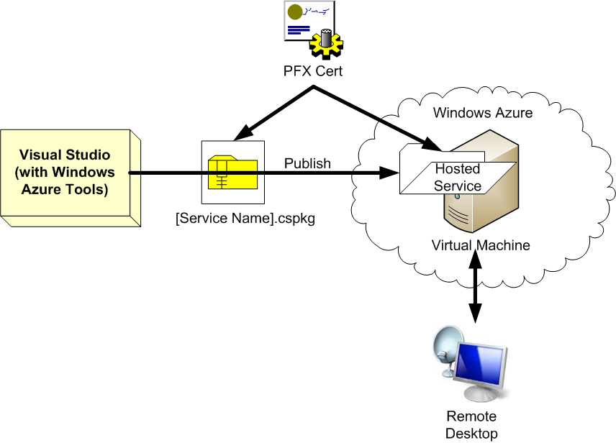
Windows Azure and Remote Desktop Cont.

Slide 19
Windows Azure and Remote Desktop Cont.
Again, the first step is to create or otherwise obtain a Personal Information Exchange (a.k.a. PFX) certificate.
Windows Azure applications often use a couple of types of certificate files.
Use X.509 certificates to authenticate operations in Windows Azure. If you completed the bonus lab in Chapter 2, you already encountered an X.509 certificate.
X.509 certificates have a .cer extension.

Slide 20
Windows Azure and Remote Desktop Cont.
A signing authority issues Personal Information Exchange certificates.
However, you can use self-signed certificates for development/testing purposes.
Personal Information Exchange certificates have a .pfx extension.
Therefore, Personal Information Exchange certificates are usually referred to as PFX certificates.
Importantly, you use PFX certificates for creating Remote Desktop connections.
Specifically, you use a PFX certificate to encrypt the password used to obtain a remote desktop connection.

Slide 21
Windows Azure and Remote Desktop Cont.
There are a couple of ways to create a PFX certificate.
You can use the makecert.exe tool provided with the .NET Framework.
Alternatively, you can use the Internet Information Services (IIS) Manager.
See msdn.microsoft.com/en-us/library/gg432987.aspx for more details on creating certificates using both tools.
The makecert tool is used here for demonstrations purposes.

Slide 22
Windows Azure and Remote Desktop Cont.
The easiest way to make a PFX using makecert is through a Visual Studio Command Prompt.
Make sure you start the VS Command Prompt as an administrator.
In the VS command prompt window, the following command creates a PFX you can use to Remote Desktop into Azure virtual machines.
This creates a certificate that you can find in your development machine’s local certificate store.
See msdn.microsoft.com/en-us/library/bfsktky3(VS.80).aspx for more information regarding the makecert tool.
makecert -sky exchange -r -n "CN=[your certificate's name]" -pe -a sha1 -len 2048 -ss My "[your certificate's name].cer"

Slide 23
Windows Azure and Remote Desktop Cont.
With a certificate created, the next step is to export the certificate from your systems certificate store in PFX format.
Again, there are a few tools you can use to export PFX-formatted certificates.
You can either use the Certificate Manager (certmgr.msc) tool provide as part of the .NET Framework.
You can also use the export facility provided in the Internet Information Services (IIS) Manager. The Certification Manager is used here for demonstration purposes.

Slide 24
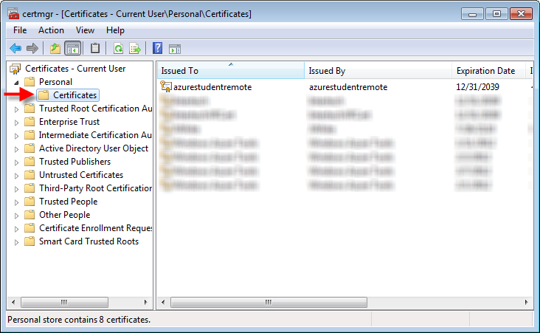
Windows Azure and Remote Desktop Cont.
You can start the Certificate Manager by executing certmgr.msc in a command prompt window or in the Start menu textbox.
Note a VS command prompt is not required.
When the Certificate Manager starts, locate your newly created certificate under Personal > Certificates listing (as shown below).
Right click on your certificate in the list and select All Tasks > Export... from the menu. A wizard assists you in exporting your certificate.

Slide 25
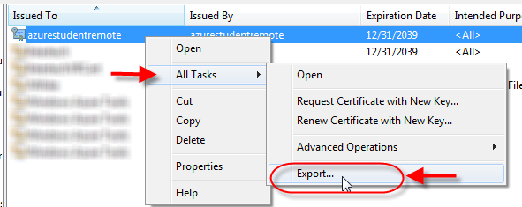
Windows Azure and Remote Desktop Cont.
Right click on your certificate in the list and select All Tasks > Export... from the menu. A wizard assists you in exporting your certificate.
A wizard provided by the tool assists you in exporting your certificate to a .pfx file.

Slide 26
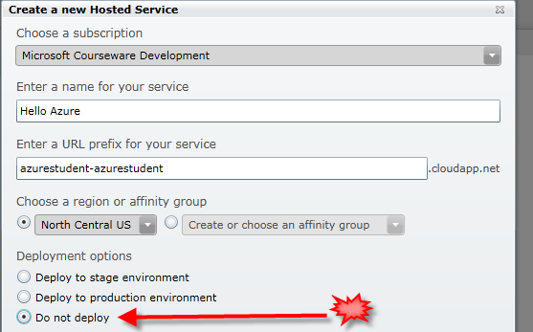
Windows Azure and Remote Desktop Cont.
Given a PFX certificate, you upload the certificate and associate it to a new hosted service.
You can accomplish this using the Portal or Service Management API. For demonstration purposes, the Portal is used here.
Once logged into the Portal, create a new hosted service, but do not deploy your code to the service – just create the hosted service.
You just need to create the hosted service shell to hold the new certificate.
This allows you to establish the PFX certificate with the hosted service before deploying code to the service.

Slide 27
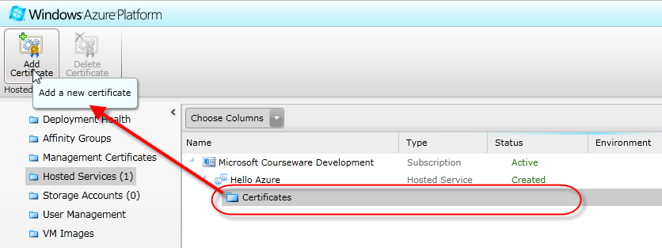
Windows Azure and Remote Desktop Cont.
With the hosted service created (but the application not yet deployed), upload the PFX certificate through the Certificates folder in the hosted services listing.

Slide 28
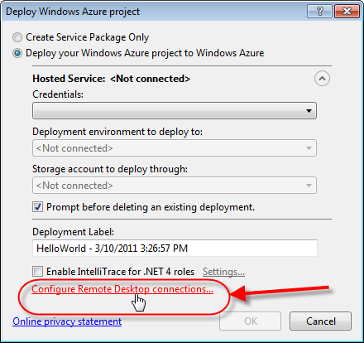
Windows Azure and Remote Desktop Cont.
Finally, given a hosted service associated to a PFX certificate, you can publish/deploy the project to the hosted service.
When publishing, you inform VS to configure/enable the roles in the project for Remote Desktop connections.
Using your PFX certificate, VS writes remote desktop configuration information into your role(s).
A subtle option on the Deploy Windows Azure project window informs VS you want Remote Desktop configuration.
It’s not even a checkbox or button. Clicking a link triggers VS to configure your project roles for Remote Desktop.

Slide 29
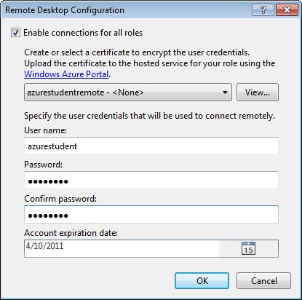
Windows Azure and Remote Desktop Cont.
The Remote Desktop Configuration window that results from clicking this link has you provide the authentication material necessary to do Remote Desktop.
Specifically, the window allows you to enter the username and password that you want to use to authenticate when you make a remote desktop connection.
Note the use of the PFX certificate used to encrypt the user credentials.
While enabling Remote Desktop, you can also provide expiration date (the Account expiration date).
After the date specified, Remote Desktop connections will be blocked.

Slide 30
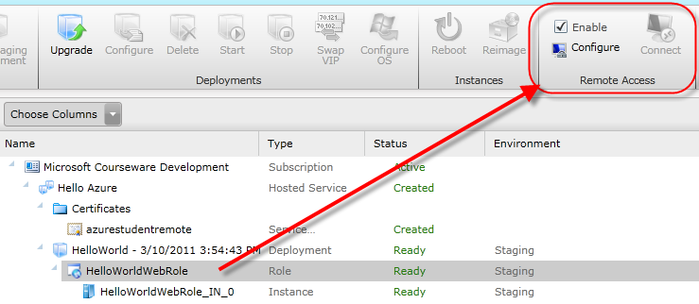
Windows Azure and Remote Desktop Cont.
This allows deployers/administrators to establish a small window of time whereby developers can remote in and configure/check on the roles.
However, after this small window of time where they are configuring and monitoring the service, they are locked out.
Once the project with Remote Desktop capability enabled on the roles is deployed and running, you can use standard Window Remote Desktop to connect.
Through the Portal, you will notice that the hosted services listing indicates those roles that are Remote-Desktop enabled.
The Remote Access icons and indicators are enabled on the Portal icon menu bar when instances of a selected role can be connected to via Remote Desktop.

Slide 31
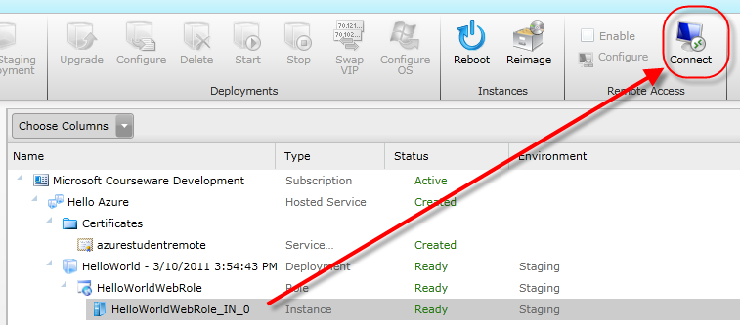
Windows Azure and Remote Desktop Cont.
You can use the Enable checkbox to turn off remote desktop connections.
After developers have confirmed things are in working order, this allows administrators to lock out further Remote Desktop connections.
Use the Configure button to change the username, password, expiration time or certificate used as part of the connection.
The Connect icon enables in the Portal display when you click on one of the Remote-Desktop-enabled role instances.
To make a remote desktop connection, pick one of the role instances and click the Connect icon in the portal icon bar at the top of the display.

Slide 32
Windows Azure and Remote Desktop Cont.
You might be wondering why you have to select a role instance.
Remember, you make a remote desktop connection to a virtual machine running a role and there may be (and probably will be) several instances for any role.
Therefore, you must pick the precise role instance whose virtual machine you want to connect.

Slide 33
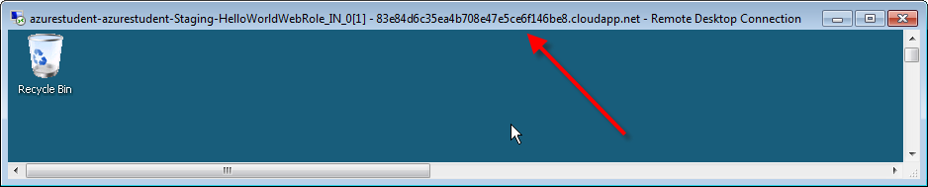
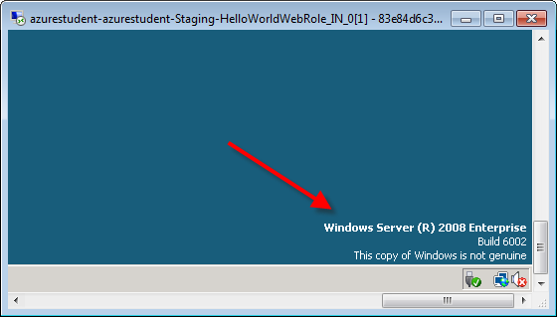
Windows Azure and Remote Desktop Cont.
Once authenticated to the virtual machine, you should be provided with a remote desktop screen just as if you connected to server in your data center.
The Remote Desktop window’s label is a tipoff that you are connected to an Azure virtual machine. Another tipoff is the screen’s background image.
Note the GUID and URL on the Remote Desktop window title bar.
In addition, notice the background image indicates that the copy of Windows "is not genuine" and is running Windows Server 2008 Enterprise.

Slide 34
Windows Azure Startup Tasks
Before a piece of code starts on a server, you often need to initialize the environment that will host that piece of code.
For example, you may need to install other software, register a component, start another process, etc.
The same might be true even when your code is a Windows Azure role and it is running in the cloud.
Startup tasks allow you to run an initialization script or program (batch file, PowerShell script, etc.) on the hosting virtual machine before your role is started.

Slide 35
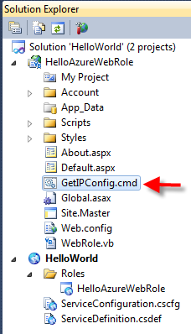
Windows Azure Startup Tasks Cont.
Startup tasks are created and added to your role project.
As a simple example, the GetIPConfig.cmd script below simply gathers the ipconfig information and stores it in a file called c:\ipdata.txt.
Obviously, your script can and probably will be more complex.
ipconfig > c:\\ipdata.txt

Slide 36
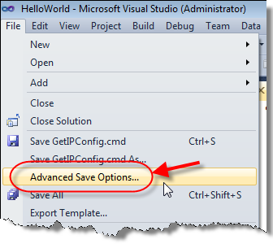
Windows Azure Startup Tasks Cont.
As a note of warning, VS attaches a byte order mark to all files by default.
A byte code order is a Unicode character used to signal the endianness (or byte order) of a text file.
You do not want the byte code order in your simple script/text files (which is the basis for most script files).
Therefore, make sure you select “Advanced Save Options…” from the file menu before saving script files.
Make sure the script files are saved with Unicode (UTF-8 without signature) – Codepage 650001 encoding.

Slide 37
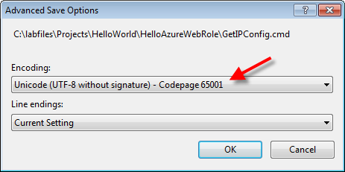
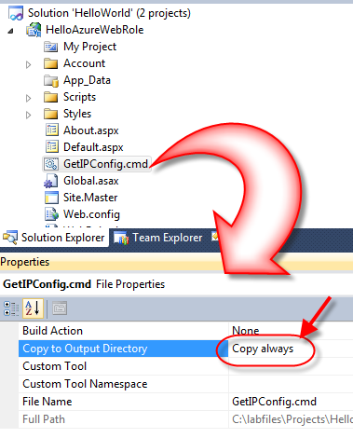
Windows Azure Startup Tasks Cont.
Using the Properties editor in VS, configure the file to “Copy to Output Directory.”
This causes the file to be copied to bin folder of your role. Windows Azure looks in the bin folder for the startup tasks.

Slide 38
Windows Azure Startup Tasks Cont.
Once you have a startup task file in your role project, register and configure the task in the service definition file.
Notice the <Startup> element (and therefore the <Task> element) is a child element of the role element in the service definition file.
<?xml version="1.0" encoding="utf-8"?>
<ServiceDefinition name="HelloWorld" xmlns= "http://schemas.microsoft.com/ServiceHosting/2008/10/ServiceDefinition">
<WebRole name="HelloAzureWebRole">
<Startup>
<Task commandLine="GetIPConfig.cmd" executionContext="elevated"
taskType="background"/>
</Startup>
...
</WebRole>
</ServiceDefinition>

Slide 39
Windows Azure Startup Tasks Cont.
This indicates that each role can have zero to many startup tasks. However, the startup task is specific to a role.
The commandLine attribute specifies the name of the script or program to execute before the role starts.
The executionContext attribute determines the level of permissions needed for the startup task.
Options include limited and elevated.
Under limited permissions, the task runs with the same privileges as the role.
Whereas, elevated permissions causes the task to run with administrative privileges.

Slide 40
Windows Azure Startup Tasks Cont.
Lastly, the taskType indicates how the task should run.
Options include simple, foreground, or background execution.
A simple task type executes synchronously. In other words, the task blocks execution of the role until the task completes.
Simple is the default taskType.
When run as a background type of task, the task launches and then Azure starts the role immediately. In other words, background tasks are asynchronous.
Foreground task types are also asynchronous. However, the role cannot be shutdown until all startup such tasks exit/complete.

Slide 41
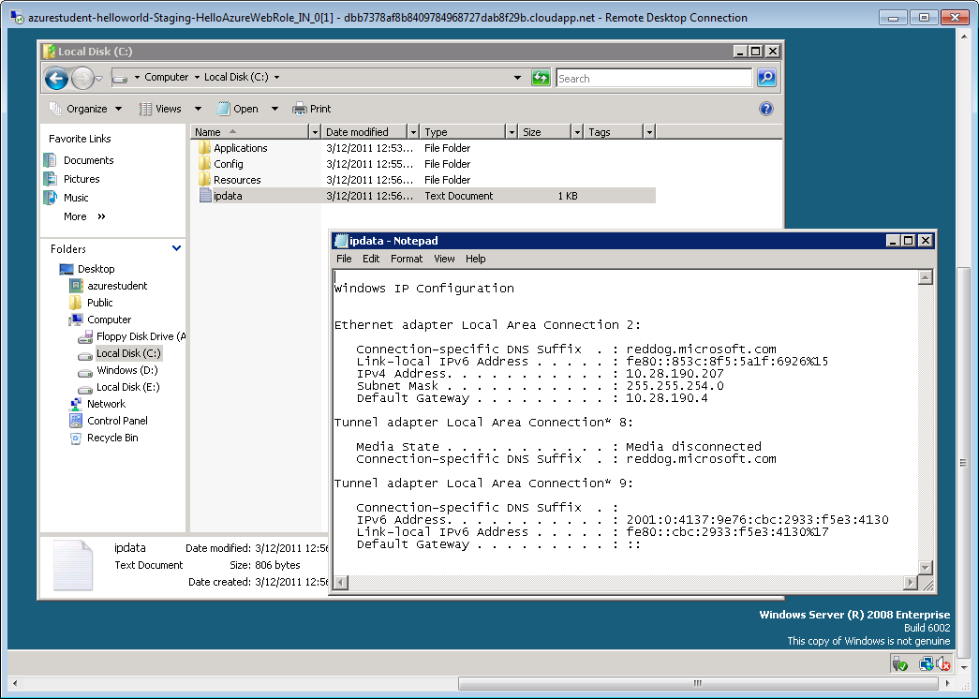
Windows Azure Startup Tasks Cont.
The startup tasks will execute on your development machine when you run the solution in the Compute Emulator.
It is particularly important to test simple tasks since they will block role startup if they do not complete successfully.
Once running in the cloud, you may want to use Remote Desktop to check that the startup tasks executed correctly.

Slide 42
Lab Exercise: Remote Desktop Lab (Optional)

Slide 43
Chapter Summary
When establishing the subscription, you also establish the Account Administrator and Service Administrator.
The Account Administrator, a.k.a. Account Owner, is the person responsible for paying the subscription bill.
The Service Administrator, a.k.a. the Service Owner, manages the services that run in Windows Azure.
While one person can be both administrators, the different administrator roles allows for separation between financial and operational responsibilities.
The Service Administrator can establish co-administrators.
Co-administrators help manage the services and data running in Windows Azure.
Co-administrators are assigned by Windows Live ID.

Slide 44
Chapter Summary Cont.
Currently, the OS Family of the virtual machine supporting your role can be either Windows Server 2008 SP2 or Windows Server 2008 R2.
The OS Version actually indicates the version of the operating system that runs on the virtual machine (VM) that hosts a role instance in Windows Azure.
Windows Server 2008 SP2 supports Guest OS versions 1.x (shown above).
Windows Server 2008 R2 supports Guest OS versions 2.x (shown below).
You can configure your role for a specific OS Family and/or OS Version the Portal or via your service configuration file.

Slide 45
Chapter Summary Cont.
Windows Azure now supports Remote Desktop to connect to the virtual machine in the cloud running an instance of their service.
You must obtain (or create) a Personal Information Exchange certificate.
You must upload the certificate to the hosted service in Windows Azure.
Then publish your Azure project configuring it for Remote Desktop connections to the targeted hosted service (using the certificate).
After which, you can connect remotely to the virtual machine once the instance is deployed and running.
Startup tasks allow you to run an initialization script or program (batch file, PowerShell script, etc.) on the hosting virtual machine before your role starts.

