Slide 1
Windows Azure Storage and Queues
50466 Windows® Azure™ Solutions with Microsoft® Visual Studio® 2010

Slide 2
Windows Azure Storage
As you learned earlier, Windows Azure Storage consists of three types of data storage in the cloud: tables, blobs and queues.
Each storage type, while allowing data to be stored in non-relational database form, offers distinct advantages to cover a variety of application requirements.
For those that need it, there is SQL Azure to support relational database needs.
Windows Azure Storage, as with the entire Windows Azure platform, is built to be highly scalable and available.

Slide 3
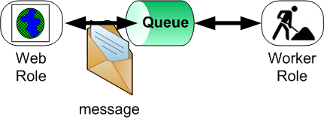
Windows Azure Storage Cont.
Queue storage provides reliable and durable message stores.
Think of queue storage as a kind of MSMQ or WebSphere MQ Series in the cloud. However, be mindful of the fact that implementation is quite different.
Queues allow for cross service/application (in or out of the cloud) communications in a loosely coupled fashion.

Slide 4
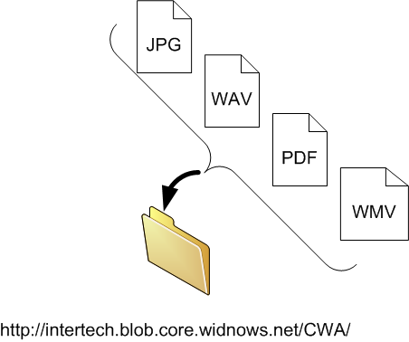
Windows Azure Storage Cont.
Binary Large Object (Blob) storage houses large binary data such as images, videos, music, documents, etc. in an organized file system.
Essentially, blob storage is a container for unstructured data up to several hundred gigabytes in size.
Think of blob storages as a large directory (addressable by URL) in the cloud.
In this directory, you can store and retrieve files (also uniquely identified by URL).
Blobs are the under-the-covers storage mechanism implementing Windows Azure Drive.

Slide 5
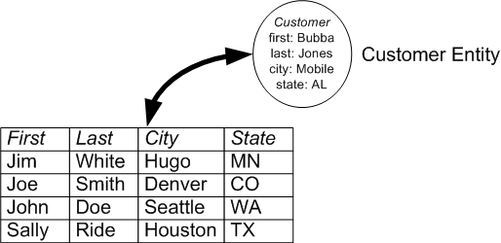
Windows Azure Storage Cont.
Table storage offers structured tables similar to what you would find in a relational database, but without indexes and relationships to other tables.
Use table storage to persist properties from application entities.
Data is stored in row-column form, but relationships between rows, columns or other tables are limited.
Also, there is no fixed schema for each table. So, for example, customer and order entities could be stored in the same table.

Slide 6
Why Windows Azure Storage
“Why do we have Windows Azure Storage?” is a typical question from those studying Windows Azure.
As most .NET developers are familiar with file systems, SQL Server, and MSMQ, many ask why theses mechanisms aren’t the staple of data storage in the cloud.
In other words, why change to a new set of storage systems? The answer is scale and availability.
Microsoft found that scaling out file system storage or relational databases very difficult and expensive.
Microsoft decided to provide a set of storage mechanisms that scaled well and supported the “pay-for-what-you-use” or “pay-for-play” model.

Slide 7
Why Windows Azure Storage Cont.
In more traditional data stores, a data center must provision very large and expensive hardware to host large amounts of expected data.
The size of the provisioned hardware limits, to some extent, the ultimate size of the database.
In addition, the larger the traditional data store, the slower the performance.
Of course, you have to pay for the whole thing up front, regardless of how much of the platform you use at the start.
Finally, failure of the large system means non-availability of the entire system.

Slide 8
Why Windows Azure Storage Cont.
Windows Azure Storage services are heavily distributed.
Data is spread out over several smaller machines. To scale, Windows Azure simply adds more machines.
Yes, there are limits on the size of a single blob or single table in Windows Azure Storage.
However, there are virtually no limits on the number of blobs or number of rows you can store.
This makes Windows Azure Storage limited only by your cost allowance.
Further, Windows Azure Storage deals with the failure of individual systems through software (chiefly the FC) and use of even more machines.
This allows the data stores to remain available and reliable, even in the presence of failure.
Windows Azure Storage also does work behind the scenes (data store copies, cache, etc.) to ensure performance stays the same regardless of the number of machines.

Slide 9
Why Windows Azure Storage Cont.
In other words, Windows Azure Storage performance remains the same even as the scale and load on the system increases.
To be fair and precise, there are limits on the scalability of anything, to include Windows Azure Storage.
In an MSDN blog post, members of the Windows Azure team have laid out the rough upper scalability limits of today’s Windows Azure Storage.
They are provided in the table below.
Scalability Dimension | Target
Total Windows Azure Storage Account Capacity | Up to 100 TBs
Number of Windows Azure Storage Account Transactions | Up to a few thousand requests per second
Total Windows Azure Storage Account Bandwidth | Up to a few hundred megabytes per second

Slide 10
Why Windows Azure Storage Cont.
Windows Azure offers SQL Azure when a relational database in the cloud is necessary.
The chapter on table storage compares SQL Azure and tables in Windows Azure Storage.
In that comparison, you’ll learn when you should consider using SQL Azure versus tables in Windows Azure Storage.

Slide 11
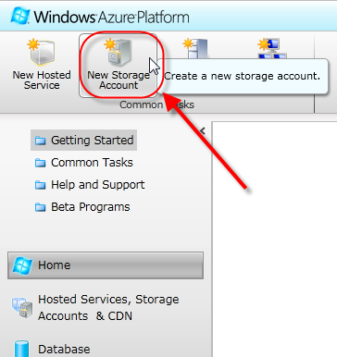
Windows Azure Storage Account
In order to use any of the Windows Azure Storage capabilities (regardless of the type), you must set up a Windows Azure Storage account.
First, head to the Windows Azure Developer Portal (windows.azure.com) and sign in with your Windows Live ID.
In the Portal icon menu bar, you will find a New Storage Account button, which allows you to request a Windows Azure Storage account.
You should also notice a Storage Accounts folder, not unlike the Hosted Services folder, that lists the storage accounts for your subscription.

Slide 12
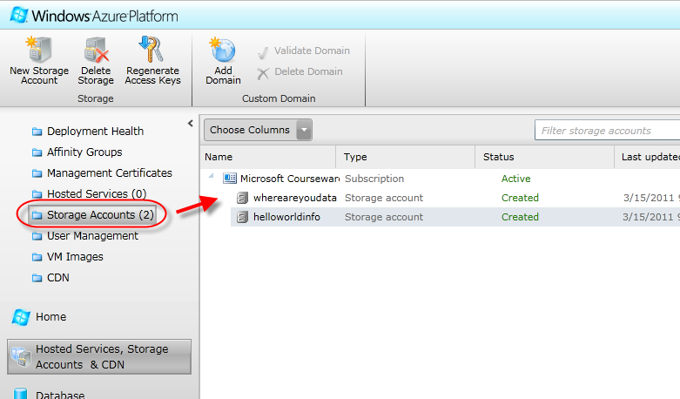
Windows Azure Storage Account Cont.
It is through the Storage Accounts folder display that you manage (get pertinent storage account details, delete, modify, add) your storage accounts.

Slide 13
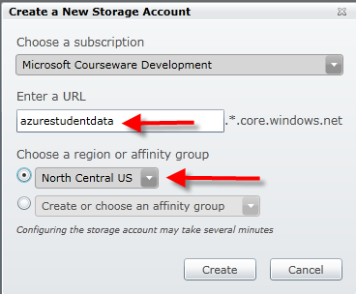
Windows Azure Storage Account Cont.
When creating a new Storage Account, you must give your storage account a name and specify its geographical location.

Slide 14
Windows Azure Storage Account Cont.
Windows Azure creates three endpoints from the name you provide, one each for the three types of Windows Azure Storage.
The URL uniquely identifies your storage account (and type) across all of Windows Azure.
The Portal shows .*.core.windows.net as the suffix of the endpoint URLs for your storage.
The * in the suffix is replaced by blob, queue, or table depending on which type of storage is referenced.
For example, the actual endpoint would look like azurestudentdata.blob.core.windows.net using blob storage and the name above.
After creating your Windows Azure Storage account, the Portal displays the URL endpoints for each type of storage.

Slide 15
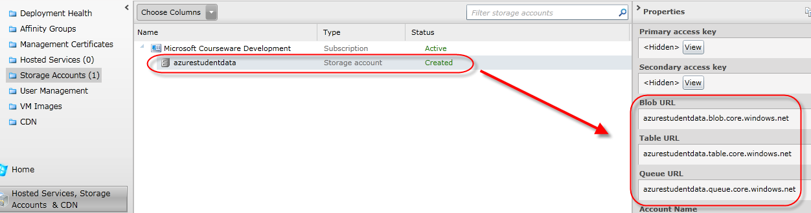
Windows Azure Storage Account Cont.
The region you pick dictates the geographical location (and data center) hosting your storage account.

Slide 16
Windows Azure Storage Account Cont.
Choosing the geographical location of your service is an important selection in setting up your storage service (or hosted service for that matter).
For cost and performance reasons, you typically want to put your data as close to consuming users/services as possible.
In fact, you are not charged for data transferred between hosted services and/or other storage accounts in the same region.
Costs for Windows Azure Storage are covered later in this chapter.
However, for legal/regulatory reasons, you may want your data located (or not located) within a particular country or geographical region.
In fact, Microsoft closed its Washington data center due to local tax laws.
You may also want services in separate regions for disaster recovery purposes.
If your storage account needs to be in the same region as a hosted service or other storage account, set up an affinity group (see the next section).

Slide 17
Windows Azure Storage Account Cont.
Importantly, you cannot change the geographical location of any hosted service or storage account without redeploying.
A redeploy causes you to have to migrate data or lose data.
So choose the location carefully.

Slide 18
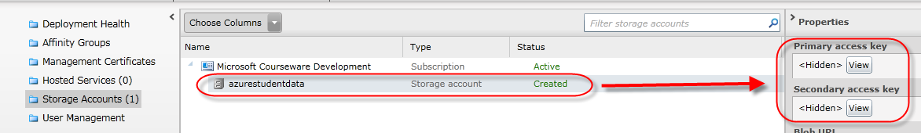
Windows Azure Storage Account Cont.
In addition to the endpoint URLs, the Portal has buttons to see/copy the account access keys.
Azure provides primary and secondary account access keys.
Push the View button to popup a window that allows you to copy the keys to the clipboard.

Slide 19
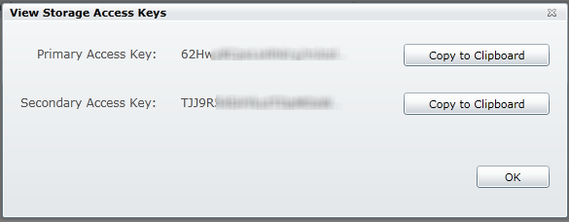
Windows Azure Storage Account Cont.
Both the storage endpoint URLs and access account key are needed to add/remove data in storage (more coming up).

Slide 20
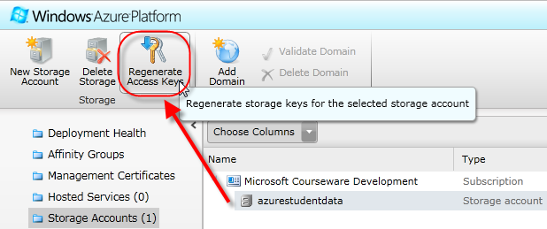
Windows Azure Storage Account Cont.
If you believe the keys have been compromised or otherwise need/want to reset them you can.
Select the storage account from the Storage Account listing and a Regenerate Access Keys button enables on the Portal icon menu bar.
Push this button to open the Regenerate Access Keys window. Use the options in the window to regenerate the primary and/or secondary keys.

Slide 21
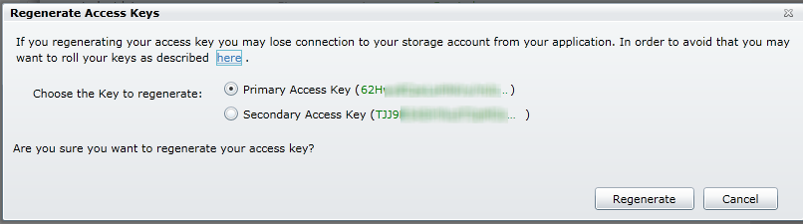
Windows Azure Storage Account Cont.

Slide 22
Affinity Group
When you want to co-locate services and/or storage accounts, consider setting up an affinity group.
By setting up an affinity group and assigning services/accounts to the group, you tell Windows Azure that you want these as close as possible to each other.
When establishing an affinity group, you tell Windows Azure what region you want the affinity group assigned.
Then you assign the hosted services and storage accounts to the affinity group.

Slide 23
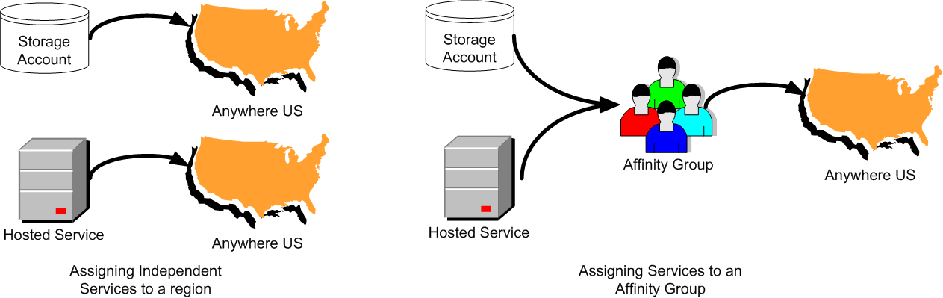
Affinity Group Cont.
Importantly, there is no bandwidth charge for communications between hosted service and storage when they share affinity group.

Slide 24
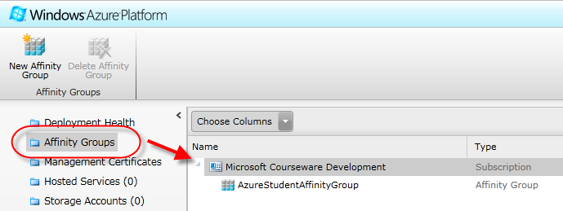
Affinity Group Cont.
The Affinity Group folder on the Portal allows you to see and manage (add and remove) affinity groups.
With the Affinity Group folder selected, buttons at the top of the Portal icon menu bar allow you to add new affinity groups or delete a selected group from the list.
Alternately, you can create an affinity group when you create a hosted service or storage account.

Slide 25
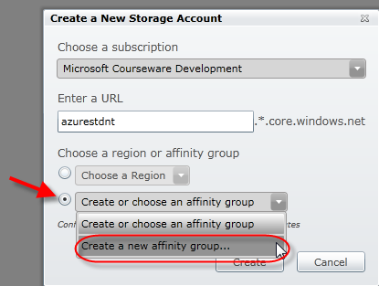
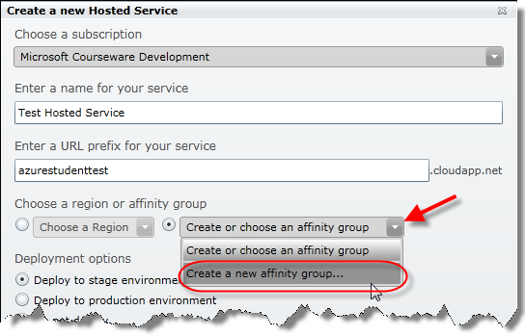
Affinity Group Cont.
When creating a hosted service or storage account, you must choose a region or affinity group.
Instead of picking a region from the “Choose a Region” drop down box, select the radio button to “Create or choose an affinity group.”
Then, in order to create a new affinity group, select the “Create a new affinity group…” from the drop down box provided.
The option is available in both the storage account and hosted services creation window.

Slide 26
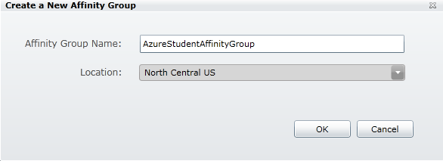
Affinity Group Cont.
Regardless of how you choose to do it, when you request a new affinity group, you get a window to create the affinity group.
Provide a name for the new group. You use this name in the creation of subsequent services or accounts to associate them to the same group.
You also select the region for the affinity group.

Slide 27
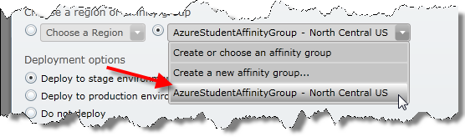
Affinity Group Cont.
You only need to create the affinity group once.
The affinity group is associated to and managed with your subscription.
After creating the affinity group, you can just select the affinity group name when you pick the region for any subsequent services or accounts.
In addition to the Portal, optionally use the Service Management API (and CSManage.exe) to manage affinity groups.

Slide 28
Storage Emulator
Just as there is a Compute Emulator to test out Windows Azure applications, so too is there the Storage Emulator to test Windows Azure Storage locally.
The Storage Emulator is part of the Windows Azure SDK.
The Storage Emulator simulates Windows Azure Storage tables, queues, and blobs in the local development environment.
You access the data in the Storage Emulator endpoints with the same REST or Storage Client API you start to learn in this chapter.
Therefore, switching between Windows Azure Storage and the Storage Emulator, from an application’s perspective, is just a configuration setting change.
However, the Storage Emulator is implemented very differently from the actual Windows Azure Storage in the cloud.
In particular, don’t assume performance with Storage Emulator mimics performance of Windows Azure Storage.

Slide 29
Storage Emulator Cont.
By default, Storage Emulator creates and uses a database created in the SQLEXPRESS named instance of SQL Server on your development machine.
The Visual Studio installation normally installs this instance.
If you want to install this instance or use a different database instance, you can use the SDK tool called DSInit.exe.
See msdn.microsoft.com/en-us/library/gg433005.aspx for information on how to use DSInit.exe.
In fact, you can run queries against and explore the tables that house the Storage Emulator data.

Slide 30
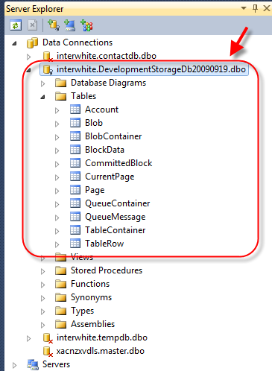
Storage Emulator Cont.

Slide 31
Storage Emulator Cont.
Be careful not to alter the database in your exploration or else you run the risk of ruining the Storage Emulator and the ability to test on your local box.

Slide 32
Storage Emulator Cont.
Again, the implementation of the Storage Emulator and Windows Azure Storage is different – in some cases quite different.
Blobs, for example, do not get stored in SQL tables in the cloud.
The actual storage implementation for blobs in the cloud is more scalable and better performing.
Furthermore, you can only access the Storage Emulator from the local machine. You can work around this with complex port redirectors, but it’s a pain to setup.
The maximum size for some objects in the Storage Emulator varies from Windows Azure Storage.
For example, blobs can only be up to 2 GB in the Storage Emulator versus 1 TB in Windows Azure Storage.
Other differences include the fact that the Storage Emulator only supports a single fixed developer account and account key.
The Storage Emulator only supports HTTP (not HTTPS) access.

Slide 33
Storage Emulator Cont.
Windows Azure Storage (tables, queues, or blobs) is replicated three times in the cloud.
The replication provides failover and performance enhancements (more on this behavior as you explore each type of storage).
Recall that in the data centers, there are a number of virtual machines to host your Windows Azure Compute services (hosted services).
Likewise, there are a number of virtual machines dedicated to hosting Windows Azure Storage services.
The FC moves your data around to these virtual machines as needed.
The Storage Emulator does not simulate this replication and failover activity.

Slide 34
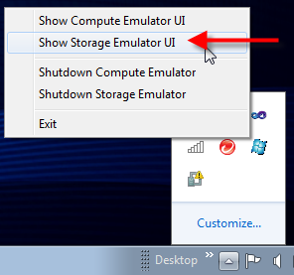
Storage Emulator Cont.
Like the Compute Emulator, the Storage Emulator starts automatically when you test a Windows Azure application in VS.
Likewise, Azure provides a Storage Emulator UI to see the status of table, blob, and queue storage.
To see the Storage Emulator UI, find the Computer Emulator icon in the system tray when emulator environment is running.
Right click on the icon and select Show Storage Emulator UI from the menu.

Slide 35
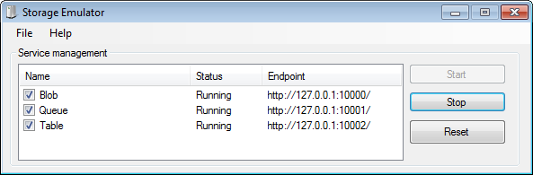
Storage Emulator Cont.
The Storage Emulator UI provides only a few operations to perform on development storage: start, stop and reset.
DSService.exe (from the SDK) can also be used to operate the Storage Emulator.
Resetting any of the blob, queue or table services stops the service, cleans all data for that service from the SQL database, and restarts the service.

Slide 36
Storage Emulator Cont.
Note as well, the Storage Emulator UI provides limited information about your development storage.
Endpoint URLs and status are all that are available through the Storage Emulator UI.
By the way, the port numbers of 10000, 10001, and 10002 are the defaults, but Storage Emulator grabs the next available port at startup if it finds any used.
Additional 3rd party tools are available to explore development storage (as well as Windows Azure Storage).
Some of these are covered over the next few chapters and labs.

Slide 37
Windows Azure Storage Costs
As with all of Windows Azure, you “pay to play.”
This means you only pay for data storage you use and for bandwidth to transfer data in/out of Windows Azure.
The cost for Windows Azure Storage is the same for all types (blobs, queues, and tables).
Windows Azure Storage is not SQL Azure. The cost for SQL Azure is typically more expensive than Windows Azure Storage.
Under the “Pay as You Go” plan, Windows Azure Storage costs $0.15 per GB per month.
Size is measured by the average daily amount of data stored over a month.
So, if you stored 30 GB of data into blob storage for one day this month, you are charged for 1 GB of storage this month.
If you stored 30 GB of data on the first day of the billing month and left it there all month, you would be charged for the full 30 GB of storage this month.

Slide 38
Windows Azure Storage Costs Cont.
In addition to physical space, you are also charged for data transfer and transactions.
Each 10,000 storage transactions cost $0.01.
Data transfer costs depend on the direction and location of the data store.
Data transferred in to Windows Azure cost $0.30 per GB in Asia Pacific regions and $0.10 in other regions.
Data transferred out of Windows Azure costs $0.45 per GB in Asia and $0.15 in other regions.
According to Microsoft, it costs more to build and operate Asian data centers.
Importantly, however, remember that data transfer is free when data is moved around (between a hosted service and table storage for example) a data center.
Costs can vary depending on promotions, peak vs. off-peak utilization, different price plans for volume use, etc.

Slide 39
Windows Azure Storage Costs Cont.
As previously mentioned, always consult the Windows Azure Platform pricing Web site for details and latest pricing: www.microsoft.com/windowsazure/pricing.

Slide 40
Lab Exercise: Storage Account Setup Lab (Optional)

Slide 41
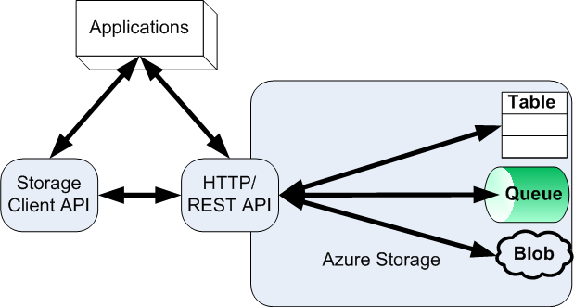
Accessing Windows Azure Storage
To work with Windows Azure Storage you have two options: REST API or Storage Client API.

Slide 42
Accessing Windows Azure Storage Cont.
All Windows Azure Storage services are exposed through a REST HTTP API.
Use the RESTful API to access Windows Azure Storage services from inside or outside data centers.
This means you can use any of Windows Azure Storage services (blobs, tables, queues) from on-premise application and not even have Windows Azure hosted services.
It also means you can access Windows Azure Storage services via non-.NET or even non-Windows applications.

Slide 43
Accessing Windows Azure Storage Cont.
The Windows Azure SDK provides the Storage Client Library.
The Storage Client Library greatly simplifies the access and use of storage services in .NET applications.
While you can use the Storage Client API on-premise or in the cloud, use of the Storage Client API requires you have a .NET platform.
This library is a wrapper API around the RESTful HTTP API.
The Microsoft.WindowsAzure.StorageClient namespace contains the library.
When using VS and the cloud templates to build an application, the library is automatically referenced in Web role and worker role projects.

Slide 44
Using the Storage Client Library
Using the Storage Client Library begins (regardless of storage type) by obtaining a CloudStorageAccount instance.
CloudStorageAccount (Microsoft.WindowsAzure namespace) objects provide access to Windows Azure Storage account information.
CloudStorageAccount objects also provide client objects to access each type of storage service.
Storage service client objects are used to perform most work with blobs, tables, and queues.

Slide 45
Using the Storage Client Library Cont.
To get a CloudStorageAccount object, you need your storage service account name and account key.
You can use the StorageCredentialsAccountAndKey (Microsoft.WindowsAzure) object to get a CloudStorageAccount.
The code shown here uses the storage account name and key created earlier.
The boolean parameter to the CloudStorageAccount indicates whether HTTPS should be used.
byte[] byteAccountKey = Convert.FromBase64String(
"EYSHCtzZToVa5uM5QoPzskOAbCrIbxGmHR8WyzGZrtXPb/lUC9TU+7ONq2Xgv7lg1/95aeQObXkiV77rkUirVw==");
StorageCredentialsAccountAndKey accountAndKey = new
StorageCredentialsAccountAndKey("cwastorage",byteAccountKey );
CloudStorageAccount storageAccount = new
CloudStorageAccount(accountAndKey, false);

Slide 46
Using the Storage Client Library Cont.
This code, however, cannot be used with the Storage Emulator.
To get a CloudStorageAccount object in the Storage Emulator, you don’t need an account name or key.
Just get a special static property (DevelopmentStorageAccount) on CloudStorageAccount.
CloudStorageAccount storageAccount =
CloudStorageAccount.DevelopmentStorageAccount;

Slide 47
Using the Storage Client Library Cont.
There are big problems with getting the CloudStorageAccount object via both of these chunks of code.
First, do you really want to conditionalize your code that accesses data in storage to check for whether you are running in the cloud or in a testing environment?
Secondly, do you really want the account name and key hardcoded into your code?
If the answer to both of these questions is NO (and it should be), then the alternative is to use a connection string.
You configure connection strings in your service definition and configuration files.

Slide 48
Using the Storage Client Library Cont.
In the service definition and service configuration files, create a connection string that provides account name and key information to the service.
Most documentation you read calls this configuration setting “DataConnectionString.”
The value of the connection string should be in the form specified below.
For example, here are the relevant service definition and configuration file elements to establish the connection to Windows Azure Storage in the cloud.
Notice the account name and access key come from the Portal when the storage account was established (YES – that’s == at the end of the key).
"DefaultEndpointProtocol=[http|https];AccountName=[YourAccountName];AccountKey=[YourAccountKey]"

Slide 49
Using the Storage Client Library Cont.
<WebRole name="ReadFromQueueWebRole">
...
<ConfigurationSettings>
<Setting name="DataConnectionString" />
</ConfigurationSettings>
</WebRole>
<Role name="ReadFromQueueWebRole">
...
<ConfigurationSettings>
<Setting name="DataConnectionString" value="DefaultEndpointsProtocol=https;AccountName=cwastorage;AccountKey=EYSHCtzZToVa5uM5QoPzskOAbCrIbxGmHR8WyzGZrtXPb/lUC9TU+7ONq2Xgv7lg1/95aeQObXkiV77rkUirVw==" />
</ConfigurationSettings>
</Role>

Slide 50
Using the Storage Client Library Cont.
A special connection string value defines when you are running in your local environment and using the Storage Emulator.
Simply set the same DataConnectionString to a value of “UseDevelopmentStorage=true”.
Here are the pertinent elements in the service definition and configuration files for using the Storage Emulator.

Slide 51
Using the Storage Client Library Cont.
<WebRole name="ReadFromQueueWebRole">
...
<ConfigurationSettings>
<Setting name="DataConnectionString" />
</ConfigurationSettings>
</WebRole>
<Role name="ReadFromQueueWebRole">
...
<ConfigurationSettings>
<Setting name="DataConnectionString"
value="UseDevelopmentStorage=true" />
</ConfigurationSettings>
</Role>

Slide 52
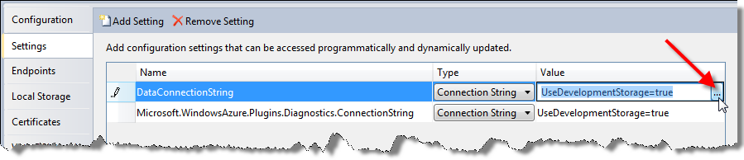
Using the Storage Client Library Cont.
Conveniently, when you have WAT for VS, VS provides a useful GUI to enter either real or development storage connection strings.
On the Settings tab of the configuration GUI, after creating the DataConnectionString setting, find the ellipsis button at the end of the value entry.
When you click on this button, you can select to use development storage or enter the appropriate account name and key information for real storage endpoints.

Slide 53
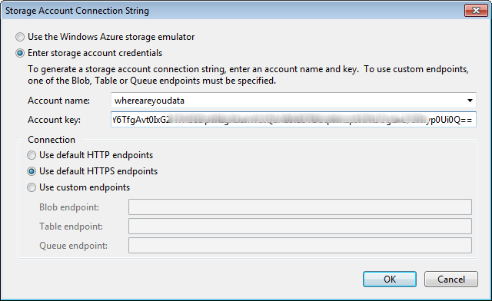
Using the Storage Client Library Cont.

Slide 54
Using the Storage Client Library Cont.
Now, to use the DataConnectionString and avoid hard coding in your service code, you use RoleEnvironment to the get connection string value(s).
Now you don’t need to conditionalize your code for cloud storage versus the Storage Emulator .
Further, you don’t have to change your code if you change your Windows Azure Storage account.
Just make changes to the configuration setting (which can be done in VS, through the Portal, or via the Service Management API).
storageAccount = CloudStorageAccount.Parse(RoleEnvironment.GetConfigurationSettingValue("DataConnectionString"));

Slide 55
Using the Storage Client Library Cont.
Before using the code shown above, consider one other design issue.
Will this code always run in the cloud? Is there a possibility that your application runs on-premise?
Remember, you can leverage Windows Azure Storage from applications outside of Microsoft data centers.
For example, maybe the application runs in your own data center in IIS.
Perhaps, conditionally, the code might run on-premise in some situations and in the cloud in others.
RoleEnvironment and configuration settings won’t be available when running on-premise outside of the development environment.
Therefore, using the code above, a CloudStorageAccount cannot be established.
Nuts - what to do now?

Slide 56
Using the Storage Client Library Cont.
As the preferred means to handle establishing the CloudStorageAccount object, setup a configuration publisher.
First, create a method that, when requested returns the appropriate configuration value.
//static method defined on SomeClass
public static Action<string, Func<string,bool>> GetConfigurationSettingPublisher()
{
if (RoleEnvironment.IsAvailable)
{
return (configName, configSetter) => configSetter(RoleEnvironment.
GetConfigurationSettingValue(configName));
} //else
return (configName, configSetter) =>
configSetter(ConfigurationManager.AppSettings[configName]);
}

Slide 57
Using the Storage Client Library Cont.
Secondly, before getting and using a CloudStorageAccount object, execute the following code.
This code should execute just once. Therefore, it is typically placed in the Application_Start() method of your Global.asax.cs in Web roles.
CloudStorageAccount.SetConfigurationSettingPublisher(
SomeClass.GetConfigurationSettingPublisher()
);

Slide 58
Using the Storage Client Library Cont.
The publisher is an Action delegate. When called, it gives the caller the value for the requested configuration setting.
When in the cloud, configuration values come from the service configuration file.
However, when not in the cloud but, as in the example when running in IIS, configuration values come from web.config.

Slide 59
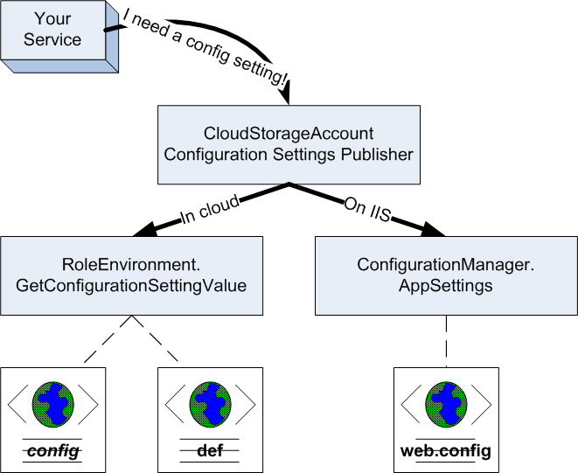
Using the Storage Client Library Cont.

Slide 60
Using the Storage Client Library Cont.
Now, finally, to get the CloudStorageAccount object using this environmentally flexible configuration, use the following line of code.
Now, your service contains no hardcoded account information.
Your service can conveniently use the Storage Emulator or Windows Azure Storage with a simple configuration setting change.
Your service can run in the cloud or on-premise and get the connection string setting it needs from almost any configuration source.
storageAccount = CloudStorageAccount.
FromConfigurationSetting ("DataConnectionString");

Slide 61
Windows Azure Storage Queues
Because most consider queues the easiest of Windows Azure Storage services to understand and work with, your study of Windows Azure Storage starts with queues.

Slide 62
Windows Azure Storage Queues Cont.
Queue storage provides a reliable and asynchronous message transport system for building loosely coupled systems.
What does that mean? Think of queues as providing an email service between service components that may live in or out of the cloud.
Services communicate with each other by creating a message, putting it into storage and allowing other services to retrieve it from storage and act on it.
If you have experience with MSMQ or MQ Series from IBM, you can think, loosely, of queues as being either of these moved into the cloud.
Queues (and queuing) promote loosely coupled systems because message producers and message consumers don’t need to be aware of each other.
This allows senders or receivers of messages to grow, change, or even fail on occasion without the other knowing (or caring).
Senders (a.k.a. producers) and receivers (a.k.a. consumers) just need to honor the message contract.

Slide 63
Windows Azure Storage Queues Cont.
There are many scenarios for queue use.
Consider an application where orders are taken from a user-facing front end.
A queue might be used to have the front facing service communicate with a backend service to process the order.
In Windows Azure, the user-facing front end would be a Web role while the backend process is a worker role.

Slide 64
Windows Azure Storage Queues Cont.
You can use queues to break up a large process into many smaller processes. This allows for better distribution of work.
Consider a loan application process.
To approve a loan, a system might have to confirm employment, validate account balances, inspect existing loan payments, and check a person’s credit score.
Using a queue, work can be broken into a set of smaller independent processes.
The smaller processes can all be accomplished simultaneously to get the overall process done more quickly.
In this scenario, each smaller process watches a queue for messages. The messages tell the process to start work and what data it needs to do its work.
Each smaller process signals it completed work by issuing another message into another queue.

Slide 65
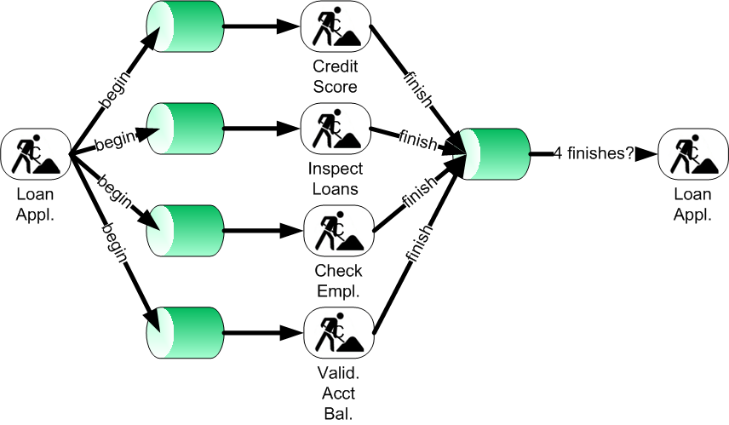
Windows Azure Storage Queues Cont.
A management process then just needs to send out start messages and watch the result queue for four completion messages.

Slide 66
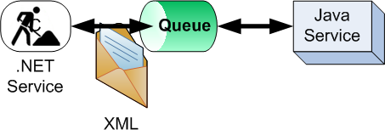
Windows Azure Storage Queues Cont.
Queues can be used to provide interoperable communications.
Services communicating via messages in a queue share just two things.
They both must understand how to communicate with the queue.
They both must understand the information in the message.
Because communication with Windows Azure Storage is based on the REST API, it is easy for almost any platform to communicate with the queue.
In this way, for example, Windows Azure Storage queues can help Java services talk to .NET services and vice versa.

Slide 67
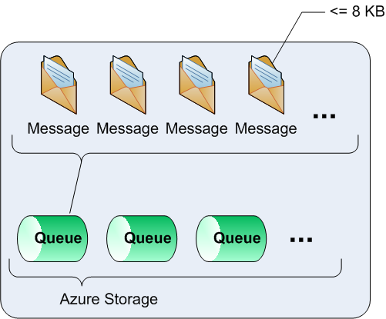
Working with Queues (using the Storage Client Library)
To send and receive messages through a queue, you first need to obtain the queue.
You can have any number of queues in your Windows Azure Storage account.
Each queue can store an unlimited number of messages (at least in theory and considering you have to pay for your storage space).
However, each message put in the queue is limited to 8 KB.

Slide 68
Working with Queues (using the Storage Client Library) Cont.
Also, messages can only remain in a queue for a maximum length of time, which is one week by default. After which, they are automatically garbage collected.
Per MSDN blog post, a single queue is targeted to be able to process up 500 transactions per second.
To create or access a queue using the Storage Client Library, you need a CloudQueueClient (Microsoft.WindowsAzure.StorageClient) object.
Create the CloudQueueClient object via the CloudStorageAccount object.
The CloudQueueClient object provides methods to get and create CloudQueue objects, which represent the actual queues.
The CloudQueueClient object also provides queue properties such as timeout and retry policies.
These properties dictate default behavior of queues and messages.
CloudQueuClient queueClient = storageAccount.CreateCloudQueueClient();

Slide 69
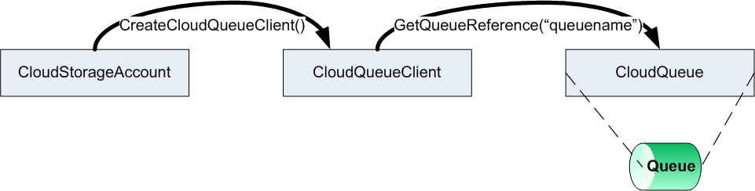
Working with Queues (using the Storage Client Library) Cont.
To get a CloudQueue object, ask the CloudQueueClient object to get a reference to the queue by name.
Please note: while the “queuename” is shown hardcoded into examples of this chapter, it is only to simplify learning the API.
Use configuration settings to provide the queue name to operations like the one above in order to avoid changing code for different environments (dev, test, etc).
CloudQueue queue = queueClient.GetQueueReference("queuename");

Slide 70
Working with Queues (using the Storage Client Library) Cont.
The methods Create() and CreateIfNotExist() on the CloudQueue object allows you to create a new queue.
Queue names must follow a number of rules.
Queue names must be valid DNS names and must be unique within a storage account. All the characters in the name must be lowercase.
Queue name must start with a letter or number and cannot contain special characters with the exception of a dash.
Queue names must be more than 3 characters long and less than 63 characters long.
queue.CreateIfNotExist();

Slide 71
Working with Queues (using the Storage Client Library) Cont.
The CloudQueueClient object also provides a set of overloaded methods to get a list of queues in your storage account.
The simplest form returns all the queues in the storage account.
Another form of the method allows you to limit or filter the queues of interest to those queues with a name that match a specified prefix.
IEnumerable<CloudQueue> queueList = queueClient.ListQueues();
IEnumerable<CloudQueue> queueList = queueClient.ListQueues("inter");

Slide 72
Working with Queues (using the Storage Client Library) Cont.
Lastly, a queue (and any messages it contains) can be deleted.
The delete operation actually just marks the queue to be garbage collected.
Garbage collection may take some time.
While the queue and any messages it contains are immediately inaccessible after a delete operation, you may find recreating the queue right away problematic.
Windows Azure Storage may think the queue still exists until it has been properly garbage collected.
You can clear a queue without deleting it. Clearing a queue removes all its messages.
queue.Delete();
queue.Clear();

Slide 73
Queue Metadata
Each queue can have metadata associated to it.
Metadata is simple name-value pairs that provide details about the queue itself.
It is completely at your discretion.
Queue metadata might include the types of messages the queue holds, the purpose of the queue (and messages), when the queue was created, etc.
Metadata is not widely used at this time.
Metadata is not queryable (meaning you cannot query storage for queues by metadata property).
However, since queue names cannot change, many envision metadata providing dynamic information about how and why to use a particular queue.
Metadata on a queue can be up to 8 KB in size.

Slide 74
Queue Metadata Cont.
The Metadata property on a CloudQueue object provides access to queue metadata.
The property returns a NameValueCollection object.
As expected, you can read, add, update (essentially replace), and remove name-value pairs from this collection.
Before accessing metadata from the CloudQueue’s Metadata property, call FetchAttributes( ) on the CloudQueue object.
This retrieves the metadata from the queue service and puts it into the Metadata’s NameValueCollection.
Likewise, after modifying the data in the Metadata property, call SetMetadata() to set or save the metadata pairs in the queue storage.

Slide 75
Queue Metadata Cont.
//code to set metadata
queue.Metadata.Add("format","xml");
queue.SetMetadata();
//code to get metadata
queue.FetchAttributes();
string format = queue.Metadata.Get("format");

Slide 76
Working with Messages (using the Storage Client Library)
Queues hold messages. Messages hold information other processes need to perform work.
As previously mentioned, there is no limit to the number of messages in a queue, but each message is limited to 8 KB (once encoded and including http overhead).
Because message size is limited, implement the “work-ticket” pattern in messages.
That is, don’t put the data needed by a process in the message itself.
Instead, messages should contain pointers to the real data needed by consumers.
For example, in a message communicating a loan needs to be processed, have the message contain a GUID to a loan application record in some data storage.

Slide 77
Working with Messages (using the Storage Client Library) Cont.
Allow the receiving process to fetch the loan application itself rather trying to use the message to pass all the loan application data to the process.
Messages sent into a queue contain either text or binary data (byte[]).
Base64-encoding is imposed by the .NET Storage Client Library.
Therefore, if you're using the Storage Client Library, you application sees everything getting Base64-encoded/decoded.

Slide 78
Working with Messages (using the Storage Client Library) Cont.
In addition to the data content or “payload” of a message, a message has several attributes.
Each message has a message identifier called a message ID. This GUID uniquely identifies the message within the queue.
A message’s VisibilityTimeout attribute specifies how long the message is unavailable after it has been pulled off the queue, but not yet deleted (see below).
The message consumer uses the PopReceipt attribute to delete a message (again, more in a bit).
The MessageTTL represents the message’s time to live. This attribute defines in seconds the time a message can remain in the queue.
By default, a message can live in a queue for maximum of seven days. The MessageTTL allows the queue’s default to be overridden to a lower TTL.

Slide 79
Working with Messages (using the Storage Client Library) Cont.
CloudQueueMessage (Microsoft.WindowsAzure.StorageClient) objects represent messages in the queue.
You create a CloudQueueMessage object with either a string or byte[] payload.
Once a message is created, add it to the queue with AddMessage( ).
Adding a message to a queue puts the message at the end of the queue.
Generally speaking, queues are first-in-first-out (FIFO) data structures.
However, as you’re about to see, order is not guaranteed.
CloudQueueMessage messageByString = new CloudQueueMessage("Greetings Earthlings");
var bytes = someStream.ToArray();
CloudQueueMessage messageByBytes = new CloudQueueMessage(bytes);
queue.AddMessage(messageByString);

Slide 80
Working with Messages (using the Storage Client Library) Cont.
To retrieve a message from the queue, you have a few options. You can “get” a message from a queue.
When you get a message from a queue, you have suggested to the queue service you intend to ultimately use or “consume” the message.
When you get a message, no other service can get the same message for a period of time.
That period is equal to the VisibilityTimeout of the message (which defaults to 30 seconds).
In that time, as a consuming process, you are expected to complete whatever work you need to do and to delete the message (deleting covered below).
If the process does not delete before the timeout, the message again becomes available on the queue as if no process ever pulled the message from the queue.
CloudQueueMessage message = queue.GetMessage();

Slide 81
Working with Messages (using the Storage Client Library) Cont.
For this reason, the order of message consumption is not guaranteed.
Windows Azure queues “guarantee at-least once” delivery, but do not provide “guarantee only once” delivery.
This makes Windows Azure Storage queues reliable in that they guarantee delivery.
They just don’t guarantee the number of times or the order in which a message gets used.

Slide 82
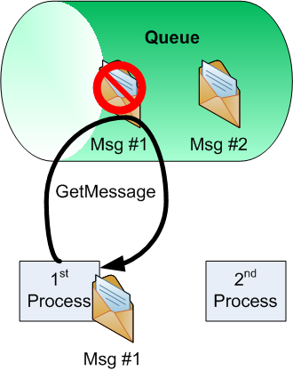
Working with Messages (using the Storage Client Library) Cont.
Consider an example where there are 2 messages in the queue and 2 worker processes pulling messages from the queue.
The 1st process calls GetMessage() to pull message #1 from the queue. This blocks other processes from getting message #1 for the VisibilityTimeout.
Shortly thereafter, the 2nd process calls GetMessage(). With message #1 blocked, the queue provides message #2 to the 2nd process.

Slide 83
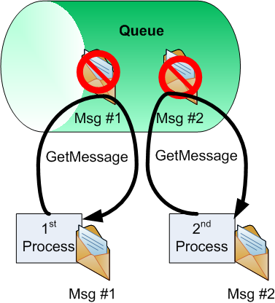
Working with Messages (using the Storage Client Library) Cont.
The 2nd process does its work and deletes message #2 from the queue before the 1st process finishes.

Slide 84
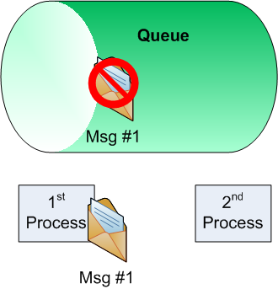
Working with Messages (using the Storage Client Library) Cont.
The 1st process takes too long to process message #1. So, message #1 is released for other processes to consume.
In fact, the 2nd process, with nothing to do, now pulls message #1 from the queue.

Slide 85
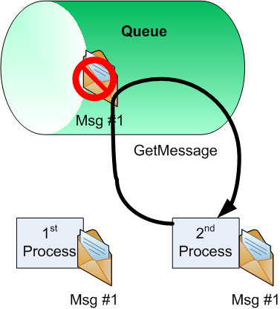
Working with Messages (using the Storage Client Library) Cont.
The 2nd process may complete its work and delete the message. The 1st process, when it finally completes it work, fails when attempting to remove message #1.

Slide 86
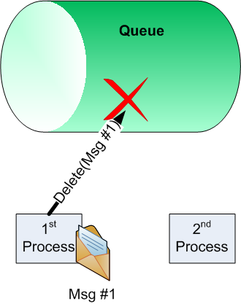
Working with Messages (using the Storage Client Library) Cont.
Processes consumed both message #1 and #2 as guaranteed by Windows Azure.
However, consumption was out of order (#2 and then #1). Furthermore, message #1 was worked with (i.e. consumed) twice.

Slide 87
Working with Messages (using the Storage Client Library) Cont.
As shown in this little example, the consumption order of messages is not guaranteed and a message may be processed multiple times.
Therefore, processes that work with messages should be idempotent.
This fancy term means you should write code allowing a message to be received and processed many times without causing any different results.
Typically, this means keeping state somewhere that tracks the work indicated by a message.
Check this state before performing any operation again.
The GetMessage( ) method is overloaded. When getting a message, specify a TimeSpan to set the VisibilityTimeout for that message.
TimeSpan moreTime = TimeSpan.FromSeconds(60);
CloudQueueMessage message = queue.GetMessage(moreTime);

Slide 88
Working with Messages (using the Storage Client Library) Cont.
There are also two GetMessages( ) methods allowing you to get multiple messages from the queue.
//get 5 messages from the queue
IEnumerable<CloudQueueMessage> messageList = queue.GetMessages(5);
//get 5 messages with 60 sec visibility timeout
TimeSpan moreTime = TimeSpan.FromSeconds(60);
IEnumerable<CloudQueueMessage> messageList =
queue.GetMessages(5, moreTime);

Slide 89
Working with Messages (using the Storage Client Library) Cont.
When using GetMessages( ), it might be useful to know how many messages are in the queue.
Use the RetrieveApproximateMessageCount( ) method and ApproximateMessageCount property to get the number of messages in the queue.
Call RetrieveApproximateMessageCount( ) before you use the ApproximateMessageCount property.
RetrieveApproximateMessageCount ( ) fetches the count into the property from the queue in the cloud.
This is an approximate count because the queue, as all of Windows Azure Storage, is stored in triplicate.
An operation that adds or deletes a message might have completed on one queue instance but not on all of them when the message count request arrives.
queue.RetrieveApproximateMessageCount();
int messageCount = queue.ApproximateMessageCount;

Slide 90
Working with Messages (using the Storage Client Library) Cont.
Further, the count may be off due to timeouts. Messages that have been pulled using GetMessage( ) and not yet deleted are not counted.
If a message becomes available again due to a visibility timeout, the count will be off.

Slide 91
Working with Messages (using the Storage Client Library) Cont.
As the alternative to GetMessage( ), you can also retrieve a message from the queue using the PeekMessage( ) method.
This is called peeking at a message.
Peeking allows you to get the content of a message from the queue, without taking the message off the queue.
When peeking at a message, the message is still on the queue so that another process can grab it (with GetMessage( ) for example).
CloudQueueMessage message = queue.PeekMessage();

Slide 92
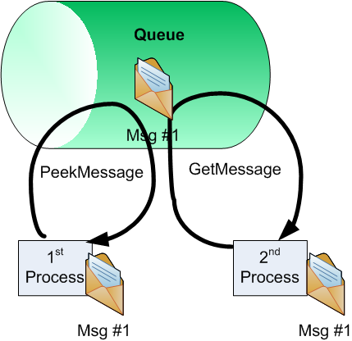
Working with Messages (using the Storage Client Library) Cont.
In other words, peeking does not start the visibility timeout clock and does not block the message from other processes.
Peeking allows services to determine if they want to process the message or not.

Slide 93
Working with Messages (using the Storage Client Library) Cont.
There is a PeekMessages( ) method that allows you to peek at several messages at once.
IEnumerable<CloudQueueMessage> messageList = queue.PeekMessages(5);

Slide 94
Working with Messages (using the Storage Client Library) Cont.
To mark the message “consumed” so that it can be garbage collected and not processed again, you must delete a message.
To delete a message, pass in the previously obtained message object to the DeleteMessage( ) method.
Alternately, you can call DeleteMessage( ) with the message ID and PopReceipt property of the to-be-deleted message.
CloudQueueMessage message = queue.GetMessage();
//process message
queue.DeleteMessage(message);
CloudQueueMessage message = queue.GetMessage();
string messageID = message.Id;
string popReceipt = message.PopReceipt;
//process message
queue.DeleteMessage(messageId, popReceipt);

Slide 95
Working with Messages (using the Storage Client Library) Cont.
Windows Azure populates the message’s PopReceipt property with a unique id every time a consumer takes a message (with get) off the queue.
Therefore, the PopReceipt identifier helps to insure the consumer that controls the message (during the visibility timeout) is deleting the message.
If the PopReceipt of the message does not match the expected receipt, the consumer process gets an exception.

Slide 96
Working with Queues and Messages Asynchronously
The operations on queues shown so far are synchronous (i.e. blocking).
That is, the code must wait for a return answer from Windows Azure on methods like GetMessage( ) before continuing.
This could be quite problematic when connecting to and waiting for responses from Windows Azure Storage in a data center far away.
To deal with the possible performance bottlenecks of synchronous requests, each of the methods examined so far has two asynchronous counterparts.
For example, CloudQueue objects have BeginGetMessage() and EndGetMessage() methods to get a single message from the queue in an asynchronous fashion.

Slide 97
Working with Queues and Messages Asynchronously Cont.
In addition to their normal parameters, all Begin operations require two additional parameters.
First, the method requires a delegate of type AsyncCallback to a callback method called when the asynchronous operation completes.
Second, the method requires a custom state object that contains information about the asynchronous operation.
The Begin methods return an IAsyncResult that references the asynchronous operation.
All End operations use the returned IAsyncResult result of the Begin method to finish the asynchronous operation.
IAsync asyncResult = queue.BeginGetMessage(asyncCallback, Object);
CloudMessage message = queue.EndGetMessage(asyncResult);

Slide 98
Queue Polling
Most message consuming processes, like a worker role, periodically poll the queue for messages.
Often, processes accomplish polling through an infinite loop.

Slide 99
Queue Polling Cont.
while (true)
{
CloudQueueMessage message = queue.GetMessage();
if (message!= null)
{
//do work with message
//again – make sure your work is idempotent
queue.DeleteMessage(message);
}
else
{
System.Threading.Thread.Sleep(1000);
}
}
While acceptable for processing a steady stream of messages, this process is not efficient when messages arrive in the queue sporadically.

Slide 100
Queue Polling Cont.
For situations where the process may be polling too much or not enough, consider using a truncated exponential back off algorithm.

Slide 101
Queue Polling Cont.
This algorithm adjusts the polling interval based on the presence (or non-presence) of messages in the queue.
As messages are repeatedly pulled, the loop sleep interval is decreased resulting in polling more often.
As fewer messages are detected in the queue, the loop sleep interval is increased resulting in polling less often.

Slide 102
Queue Polling Cont.
int currentSleepInterval = 10;
int minSleepInterval = 2;
int maxSleepInterval = 60;
while (true)
{
CloudQueueMessage message = q.GetMessage();
if (message!= null)
{
//do work with message
//again – make sure your work is idempotent
q.DeleteMessage(message);
if (currentSleepInterval > minSleepInterval)
currentSleepInterval = currentSleepInterval / 2;
else
currentSleepInterval = minSleepInterval;
}
else
{
if (currentSleepInterval < maxSleepInterval)
currentSleepInterval = currentSleepInterval * 2;
Thread.Sleep(currentSleepInterval * 1000);
}
}

Slide 103
Queue Polling Cont.
Polling still results in a “Pull” system. That is, the consumer is required to pull messages from the queue.
To date, there is no “Push” or “event-driven” means of getting messages from a queue.

Slide 104
Working with Queues (using REST)
Using the Storage Client Library is a simple and easy way (for .NET developers) to access Windows Azure Storage from .NET applications.
The Storage Client Library is a wrapper API around a RESTful HTTP API.
The Storage Client Library helps to abstract away details of the REST protocol.
However, under the covers of the Storage Client API, Windows Azure Storage services are using REST.

Slide 105
Working with Queues (using REST) Cont.
While considered a bit more complex, you can use the REST API to access Windows Azure Storage.
Why use native REST?
Perhaps you have a complex need not satisfied by the Storage Client Library.
More importantly, perhaps you are a Windows Azure Storage client that does not have .NET and/or the Storage Client Library.
The REST API allows other languages/platforms to access Windows Azure Storage.
Lastly, the REST API is the only way to do batch work transactionally.

Slide 106
Working with Queues (using REST) Cont.
Of course, each of the Storage Client Library operations examined above is also supported in REST. It has to be since REST is used under the covers.
A complete re-examination of each operation is unwarranted and can be found in documentation (see msdn.microsoft.com/en-us/library/dd179355.aspx).
However, a sampling is provided here to give you a feel for the REST API as it relates to queue storage.
An understanding of basic REST is required to follow this section.

Slide 107
Working with Queues (using REST) Cont.
The endpoint for all REST requests for queue storage is <account name>.queue.core.windows.net.
All requests on queues need to be signed.
That is, each REST request must contain a Hash-based message authentication code (HMAC) SHA256 signature certificate added to the request message header.
The algorithm to sign a request can be a bit complex and is left for your reading.
Find information on signing requests here: msdn.microsoft.com/en-us/library/dd179428.aspx.
Thankfully, the Storage Client API handled all authentication and request signing (using your connection string information) under the covers.

Slide 108
Working with Queues (using REST) Cont.
Additional header data may be required, depending on the request.
Most requests, for example require the header to contain a Date or x-ms-date name-value pair.
The Date or x-ms-date specifies the Coordinated Universal Time (UTC) for the request.
Details, to include required headers, for all queue related REST operations can be found here: msdn.microsoft.com/en-us/library/dd179363.aspx.
When building your applications and using the Storage Emulator, you can still run REST requests.
The endpoint changes for the requests to the Storage Emulator.
The queue Storage Emulator endpoint is http://127.0.0.1:10001/devstoreaccount1.
When creating the signed requests, use the devstoreaccount1 default account key (always static) provide below.
Eby8vdM02xNOcqFlqUwJPLlmEtlCDXJ1OUzFT50uSRZ6IFsuFq2UVErCz4I6tq/K1SZFPTOtr/KBHBeksoGMGw==

Slide 109
Working with Queues (using REST) Cont.
To create a queue, send a signed HTTP PUT request with appropriate headers to <accountname>.queue.core.windows.net/<queuename>.
For example, here is the URL to create a myqueue in the cwastorage account.
Once created, you reference the queue by the URL http:// <accountname>.queue.core.windows.net/<queuename>.
For example sake, here is the URL to create myqueue in the Storage Emulator.
http://cwastorage.queue.core.windows.net/myqueue
http://127.0.0.1:10001/devstoreaccount1/myqueue

Slide 110
Working with Queues (using REST) Cont.
A list of queues in the storage account can be obtained by sending an HTTP GET request to the account URL with “/?comp=list” appended to the URL.
The word “comp” is often used in Windows Azure REST strings. It stands for “component.”
The response message, in XML, contains a listing of the queues along with their name and REST endpoint URLs.
http://cwastorage.queue.core.windows.net/?comp=list

Slide 111
Working with Queues (using REST) Cont.
<?xml version="1.0" encoding="utf-8"?>
<EnumerationResults AccountName="http://cwastorage.queue.core.windows.net">
<Queues>
<Queue>
<Name>myqueue</Name>
<Url>http://cwastorage.queue.core.windows.net/myqueue</Url>
</Queue>
<Queue>
<Name>q2</Name>
<Url>http://cwastorage.queue.core.windows.net/q2</Url>
</Queue>
</Queues>
</EnumerationResults>

Slide 112
Working with Queues (using REST) Cont.
To get the metadata for the queue, send an HTTP GET request to the queue URL followed by /?comp=metadata.
http://cwastorage.queue.core.windows.net/myqueue?comp=metadata

Slide 113
Working with Messages (using REST)
Adding a message to a queue requires you to send an HTTP POST message to the queue URL appended with “/messages”.
The body of the request message must contain <QueueMessage>, <MessageText> elements as shown in the captured example message below.
http://cwastorage.queue.core.windows.net/myqueue/messages
POST /myqueue/messages?timeout=30 HTTP/1.1
x-ms-date: Fri, 07 Jul 2010 11:45:25 GMT
Authorization: SharedKey usa0351:<the signed key>
Host: cwastorage.queue.core.windows.net
<QueueMessage><MessageText>hello world</MessageText></QueueMessage>

Slide 114
Working with Messages (using REST) Cont.
To get and peek at messages use the same HTTP GET request directed at the queue URL.
The only difference is that to peek at a message, append the request URL with “?peekonly=true”.
Add a numofmessages parameter to get more than one message (use for either get or peek operations).
On get message requests, you can also add a visibilitytimeout parameter to set the timeout (in seconds) for the message.
http://cwastorage.queue.core.windows.net/myqueue/messages
http://cwastorage.queue.core.windows.net/myqueue/messages?peekonly=true
http://cwastorage.queue.core.windows.net/myqueue/messages?numofmessages=5
http://cwastorage.queue.core.windows.net/myqueue/messages?visibilitytimeout=60

Slide 115
Working with Messages (using REST) Cont.
The body of the response message from a get or peek request contains both the properties and text of the message.
This response example is from the MSDN API reference.

Slide 116
Working with Messages (using REST) Cont.
Response Status:
HTTP/1.1 200 OK
Response Headers:
Transfer-Encoding: chunked
Content-Type: application/xml
Date: Fri, 09 Oct 2009 21:04:30 GMT
Server: Windows-Azure-Queue/1.0 Microsoft-HTTPAPI/2.0
Response Body:
﻿<?xml version="1.0" encoding="utf-8"?>
<QueueMessagesList>
<QueueMessage>
<MessageId>5974b586-0df3-4e2d-ad0c-18e3892bfca2</MessageId>
<InsertionTime>Fri, 09 Oct 2009 21:04:30 GMT</InsertionTime>
<ExpirationTime>Fri, 16 Oct 2009 21:04:30 GMT</ExpirationTime>
<PopReceipt>YzQ4Yzg1MDItYTc0Ny00OWNjLTkxYTUtZGM0MDFiZDAwYzEw
</PopReceipt>
<TimeNextVisible>Fri, 09 Oct 2009 23:29:20 GMT</TimeNextVisible>
<DequeueCount>1</DequeueCount>
<MessageText>PHRlc3Q+dGhpcyBpcyBhIHRlc3QgbWVzc2FnZTwvdGVzdD4=
</MessageText>
</QueueMessage>
</QueueMessagesList>

Slide 117
Working with Messages (using REST) Cont.
Lastly, to delete a message from the queue using REST, send an HTTP DELETE request to the queue URL.
The URL must be appended with “/messages/<messageid>?popreceipt=<popreceipt>.
Here is an example delete request using the Message ID and PopReceipt of the last example.
http://cwastorage.queue.core.windows.net/myqueue/messages/5974b586-0df3-4e2d-ad0c-18e3892bfca2/?popreceipt= YzQ4Yzg1MDItYTc0Ny00OWNjLTkxYTUtZGM0MDFiZDAwYzEw

Slide 118
Lab Exercise: Queue Lab

Slide 119
Chapter Summary
Windows Azure Storage consists of three types of data storage in the cloud: tables, blobs and queues.
Through observing other cloud offerings, Microsoft found that the scale out of the file system storage or relational databases very difficult and expensive.
Microsoft provides Windows Azure Storage as a storage mechanism that scales well and supports the pay for what you use model.
To work with Windows Azure Storage you have two options: RESTful or the Storage Client API.
All Windows Azure Storage services are exposed through a RESTful HTTP API.
Use the RESTful API to access Windows Azure Storage services from inside or outside data centers.
The REST API allows other languages/platforms to access Windows Azure Storage.

Slide 120
Chapter Summary Cont.
The Windows Azure SDK provides the Storage Client library.
The Storage Client library greatly simplifies the access and use of storage services in .NET applications.
This library is a wrapper API around the RESTful HTTP API.
Using the Storage Client Library begins (regardless of storage type) by obtaining a CloudStorageAccount instance.
CloudStorageAccount objects provide access to Windows Azure Storage account information.
CloudStorageAccount objects also provide client objects to access each type of storage service.

Slide 121
Chapter Summary Cont.
Queue storage provides a reliable and asynchronous message transport system for building loosely coupled systems.
Queues (and queuing) promote loosely coupled systems because the services that send and receive messages through a queue know little about each other.
In fact, services don’t even have to be of the same type of platform.
This allows senders or receivers of messages to grow, change, or even fail on occasion without the other knowing (or caring).

Slide 122
Chapter Summary Cont.
To create or access a queue using the Storage Client Library, you need a CloudQueueClient object.
Create the CloudQueueClient object via the CloudStorageAccount object.
The CloudQueueClient object provides methods to get and create CloudQueue objects, which represent the actual queues.
CloudQueueClient objects also provide queue properties such as timeout and retry policies for queue operations.
CloudQueueMessage objects represent messages in the queue.

