Slide 1
Blob Storage
50466 Windows® Azure™ Solutions with Microsoft® Visual Studio® 2010

Slide 2
Windows Azure Storage Blobs
Blob storage provides a theoretically infinite space to store any type of data.
Blob is actually an acronym for binary large object.
Blobs hold any type of data you would like, but most tend to think about the type of data that would normally be found in files in the file system today.
For example, a blob could be a text file, an audio file (MP3, WAV, etc.), a video file, ZIP file, etc.
If the data you can think of can be arranged into one and zero form, it can be put into a blob.

Slide 3
Windows Azure Storage Blobs Cont.
Why use blob storage?
Think of typical files you might have in one of your non-Azure applications.
Does your Web site display include images or other content like PDF documents?
Perhaps users are allowed to download or upload files to your site.
Does your application have to perform backup operations and store backup data somewhere?
Perhaps there are files that contain configuration or other data (like SQL queries) that are used by the application that are stored external to the application code.
Where does your application get all these files or data today? Chances are good it gets these files from a file system.

Slide 4
Windows Azure Storage Blobs Cont.
The file system may be from the box the application runs on or perhaps it is a shared network system or distributed file system in more complex architectures.
No matter where your application got its files from before, accessing a file system in Windows Azure is unwise and sometimes not allowed.
Note: static files, as are commonly used in a Web site, can live in the Windows Azure file system as part of the virtual directory.
Dynamic and shared files are the focus of blob storage.

Slide 5
Windows Azure Storage Blobs Cont.
Blob storage is first a file system replacement.
Since role instances of your application often run on multiple servers, access to the file system results in a different file system with each role instance.
Therefore, in order to allow all instances to have access to the same data, there must be a shared storage service for data commonly found in the file system.
As with all of Windows Azure, you pay only for what you use versus buying extra disk space in anticipation of what you might use.

Slide 6
Windows Azure Storage Blobs Cont.
Secondly, blob storage is built for scale.
In fact, blob storage (and all of Windows Azure Storage) is built on top of Web Role infrastructure.
So, there is a load balancer and multiple Web roles responsible for handing out blobs.

Slide 7
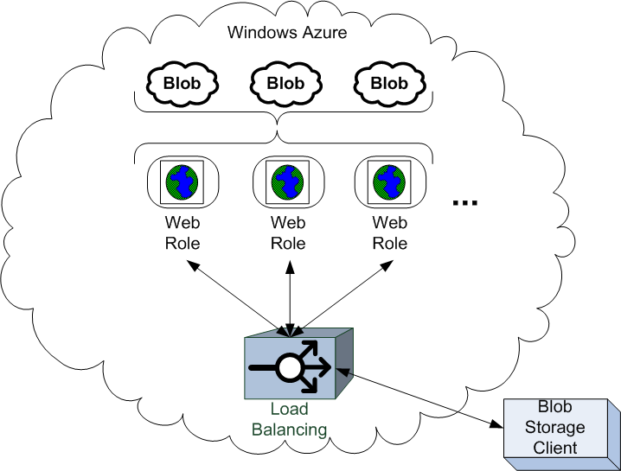
Windows Azure Storage Blobs Cont.
This allows blob storage to scale to support extremely large request loads and still perform moderately well.
According to one source, there is between 50ms to 100ms of latency between your code and the storage service.

Slide 8
Windows Azure Storage Blobs Cont.
File systems are notorious for corruption and “going down.”
Another key reason to use blob storage is (like all Windows Azure Storage services) that data put in blob storage is replicated three times as part of the commit process.
If a disk failure occurs in the Microsoft data centers, the FC knows it, tracks it, and makes sure load balancers route requests to the other copies of your blob storage.
Lastly, you access blob storage, as with most of Windows Azure, via REST.
This allows blobs access by off-premise applications as well as by application that run in the cloud.
In fact, blob storage can effectively serve as a nearly infinite, highly scalable SAN (storage area network) for your applications today.

Slide 9
Working with Containers (using the Storage Client Library)
As with queue storage, accessing blob storage begins with the CloudStorageAccount object.
Once you have the CloudStorageAccount, in order to retrieve or store blobs, you first need a container.
Blobs are stored in a container. A container acts as a directory or folder of blobs.
Containers also provide access control.
Unlike folders, however, containers cannot contain other containers.
A container exists solely to organize and store a collection of blobs.
storageAccount = CloudStorageAccount.
FromConfigurationSetting ("DataConnectionString");

Slide 10
Working with Containers (using the Storage Client Library) Cont.
In blob storage, containers and blobs are identified by URI.
A container’s URI comes from the container name added to blob storage account URI.
A blob’s URI comes from the blob name added to the container URI.
Here is the address for blob URIs.
When using the Storage Emulator, use devstoreaccount1 as the URI and account name.
For example, accessing “myfile.txt” in “mycontainer” in the Storage Emulator would require the following address:
http://<accountname>.blob.core.windows.net/<container name>
http://<accountname>.blob.core.windows.net/<container name>/<blob name>
http://127.0.0.1:10000/devstoreaccount1/mycontainer/myfile.txt

Slide 11
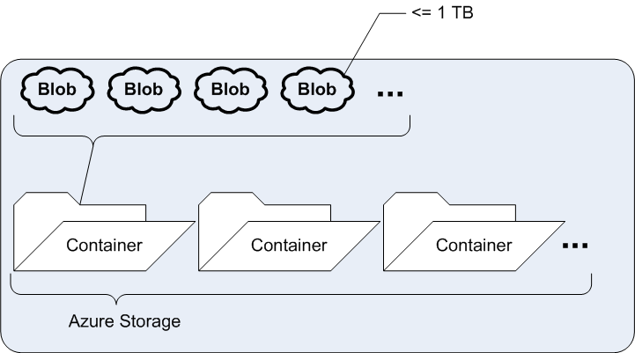
Working with Containers (using the Storage Client Library) Cont.
Your blob storage account can have any number of containers.
Each container can have an unlimited number of blobs.
Each blob, however, is limited to 1 TB in size. Based on the type of blob (covered later) other restrictions on blob size apply (more in a bit).
Blobs stored in the Storage Emulator are restricted to 2 GB.

Slide 12
Working with Containers (using the Storage Client Library) Cont.
To create or access a container using the Storage Client Library, you need a CloudBlobClient (Microsoft.WindowsAzure.StorageClient) object.
Create the CloudBlobClient object via the CloudStorageAccount object.
The CloudBlobClient object provides methods to access blob storage.
In particular, CloudBlobClient objects provide methods to get and create a CloudBlobContainer, which represents a blob storage container.
The CloudBlobClient object also provides some methods to access blobs directly.
If all this sounds like déjà vu all over again (thanks Yogi), you are right. Replace the word Blob with Queue and you are back in the Queue chapter.
Accessing Windows Azure Storage, regardless of the type, follows a common pattern.
This makes learning the Windows Azure Storage API simpler – at least to the point of dealing with the individual elements of each storage type.
CloudBlobClient blobClient = storageAccount.CreateCloudBlobClient();

Slide 13
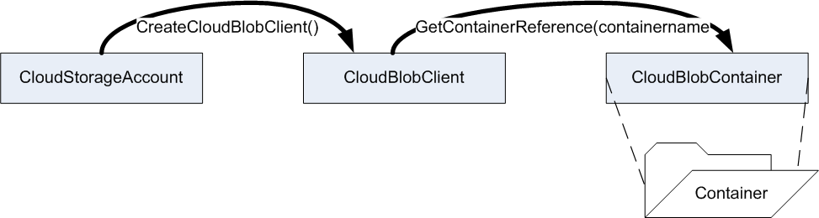
Working with Containers (using the Storage Client Library) Cont.
To get a CloudBlobContainer object, ask the CloudBlobClient object to get a reference to the container by the container name.
Hardcoded names, like the container name above, are often used in the API demonstrated throughout this chapter to help simplify learning the API.
As mentioned in the last chapter, consider using a configuration setting for values such as the container name when using methods like the one above.
CloudBlobContainer container =
blobClient.GetContainerReference("containername");

Slide 14
Working with Containers (using the Storage Client Library) Cont.
This allows you to change the container without having to modify code. This can be very helpful as you move across different environments (dev, test, etc).
The methods Create() and CreateIfNotExist() on the CloudBlobContainer object allows you to create a new container.
Container names must adhere to several rules (following the same rules for Queue names as described in the last chapter).
Container names must be a valid DNS name and unique across a storage account. All characters of the name must be in lowercase.
Container names must start with a letter or number and can only contain letters, numbers and dashes.
Container names can be at least 3 and no more than 63 characters long.
container.CreateIfNotExist();

Slide 15
Working with Containers (using the Storage Client Library) Cont.
One special container, called the root container, has a unique name: $root.
The root container also has some special behavior.
Anything you place in the $root container is accessed by URI under the root of the domain without the need for a container name.
However, you still must create and use the container as if it was just another container.
In fact, when exploring blob storage with a development tool (like Cloud Storage Studio from Cerebrata as shown below), $root looks like any other container.
http://<accountname>.blob.core.windows.net/<blob name>
CloudBlobContainer container =
blobClient.GetContainerReference("$root");

Slide 16
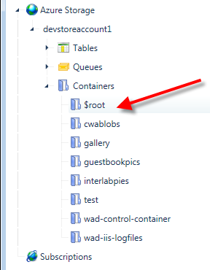
Working with Containers (using the Storage Client Library) Cont.

Slide 17
Working with Containers (using the Storage Client Library) Cont.
The CloudBlobClient object also provides a set of overloaded methods to get a list of containers in your storage account.
The simplest form returns all the containers in the storage account.
Another form of the method allows you to limit or filter the containers of interest to those containers with a name (not address but name) that match a prefix.
IEnumerable<CloudBlobContainer> containerList =
blobClient.ListContainers();
IEnumerable<CloudBlobContainer> containerList =
blobClient.ListContainers("inter");

Slide 18
Working with Containers (using the Storage Client Library) Cont.
Call Delete() on the container to delete it and all the blobs it holds.
As you learned with regard to queues, the delete operation just marks the container to be garbage collected.
Garbage collection may take some time.
While the container and any blobs it contains are immediately inaccessible after a delete operation, you may find recreating the container right away problematic.
Windows Azure Storage may think the container still exists until it has been properly garbage collected.
container.Delete();

Slide 19
Container (and Blob) Metadata
Like Queues, containers and blobs in the containers can have associated metadata.
Again, metadata is simple name-value pairs that provide details about the queue itself.
Metadata on a Windows Azure storage object (container or blob in this case) can be up to 8 KB in size.
Metadata is not queryable (meaning you cannot query storage for containers or blobs by metadata property).

Slide 20
Container (and Blob) Metadata Cont.
The Metadata property on a CloudBlobContainer or CloudBlob (covered in a bit) object provides access to metadata.
The property returns a NameValueCollection object.
As expected, you can read, add, update (essentially replace), and remove name-value pairs from this collection.
Before accessing metadata, call FetchAttributes( ) on the object.
This retrieves the metadata from Windows Azure Storage service and puts it into the Metadata’s NameValueCollection.
Likewise, after modifying the data in the Metadata property, call SetMetadata( ) to set or save the metadata pairs in the queue storage.
//code to set metadata on a container
container.Metadata.Add("format","PDF");
container.SetMetadata();
//code to get metadata on a container
container.FetchAttributes();
string format = queue.Metadata.Get("format");

Slide 21
Container Access
Unlike queues and tables that you learn about in the next chapter, blob storage allows for both public and private access.
Control access at the container level.
Set each container access to either private or public.
Public access is limited to read only operations.
When access to a container is private, the blobs in the container are restricted to the owner of the account.
Whether you need a list of its contents or to download a blob in the container, you need to make a request signed with your shared authentication key.
As you learned in the last chapter, the Storage Client API handles all authentication and request signing under the covers.

Slide 22
Container Access Cont.
There are two types of public container access.
Full public access allows anyone without authentication to retrieve blobs and even query the container.
Examples of queries of the container include a request for metadata or a list of blobs in the container.
You can also expose the container to public access, but limit it to blobs only.
In other words, you limit access to reading blobs without access to any container queries.

Slide 23
Container Access Cont.
When the blobs (and containers) are public, the blob URI is all that is needed to access and view the blob.
A simple browser, for example, can be used to access and view the blob with just the URI.
Remember, you pay for bandwidth and transaction costs with Windows Azure Storage.
Making elements in your blob storage public allows unrestricted access that can heavily affect your Windows Azure account costs without any real control on your part.
Each blob read is a transaction and the size of the read request/response counts against your bandwidth.

Slide 24
Container Access Cont.
By default, a container is private when created.
Use the SetPermissions( ) method on the CloudBlobContainer object to make a container public (full public or public access only to blobs).
SetPermissions( ) takes a BlobContainerPermissions object. The BlobContainerPermissions object allows you to set access via enumeration.
The BlobContainerPublicAccessType enumeration specifies three types of access that correlate to the public and private access types described describe above.
The table below specifies the access enumerations.
BlobContainerPermissions permissions = new BlobContainerPermissions();
permissions.PublicAccess = BlobContainerPublicAccessType.Container;
container.SetPermissions(permissions);

Slide 25
Container Access Cont.
BlobContainerPublicAccessType Enumeration | Description
Off | Container is set to private access. Only the account owner can read blobs from the container.
Blob | Public access allowed of blobs but not the container. Anonymous users can read blobs from the container.
Container | Container allows full public access. Anonymous users can read blobs as well as container data.
Please note, even when granting public access to blobs or containers it is read only.
Only owners can add, delete, copy, etc. blobs in a container.
Only owners can set access to containers or update metadata or properties on containers or blobs.

Slide 26
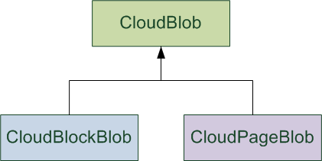
Blobs
Containers are holders and access control mechanisms for blobs.
Blobs are the real data, an arbitrary set of bytes, of interest in blob storage.
Blobs are data of any type (text file, image, MP3 file, ZIP file, etc.).
There are two types of blobs: block blobs and page blobs.
Block blobs are represented by the CloudBlockBlob class (Microsoft.WindowsAzure.StorageClient).
Page blobs are represented by the CloudPageBlob class.
Both CloudBlockBlob and CloudPageBlob types inherit from CloubBlob.

Slide 27
Blobs Cont.
Thankfully, the Storage Client API often hides the details of block versus page blobs.
As you see below, you can explicitly work with one type over the other, but most of the time, you simply work with a CloubBlob and are blissfully unaware of its type.
When using the REST API, you must select and work with an appropriate blob type.

Slide 28
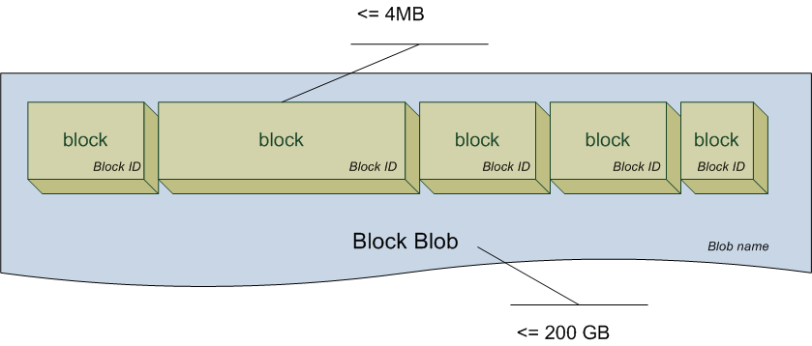
Blobs Cont.
Block blobs allow a single blob to be broken up into smaller blocks.
These blocks allow parallel activity (such as blob upload) on pieces of a blob thereby allowing for better application performance/scalability.
Block blobs are limited to 200GB in size. Each block can be up to 4MB in size (allowing for 50,000 blocks).
Individual blocks in a block blob, however, can be of different sizes.
Each block in a block blob has a unique id.

Slide 29
Blobs Cont.
When working with blocks, each block must be uploaded and then the entire block blob is committed into blob storage.
Thus, uploading block blobs by blocks is a two-step process.
You can upload the blob in a single operation (without the need to upload individual blocks) when the block blob is no more than 64MB.

Slide 30
Blobs Cont.
A page blob is collection of pages. Page blobs and individual pages can be up to 1 TB, but each page must be a multiple of 512 bytes.
A page is a range of data that is identified by its offset from the start of the blob.

Slide 31
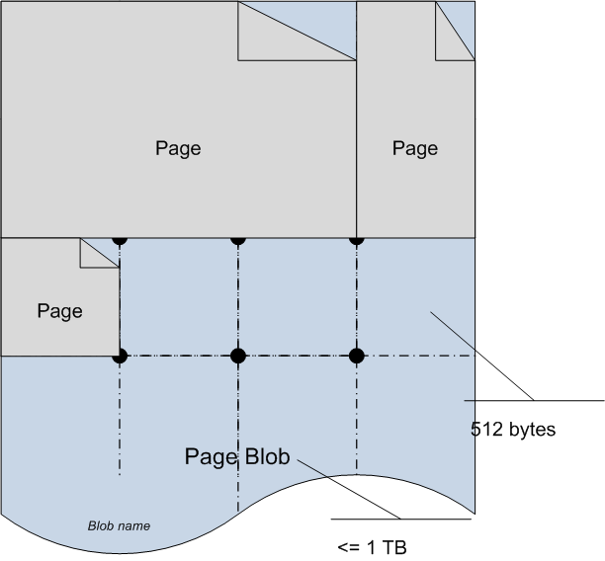
Blobs Cont.
Pages from a page blob can be randomly uploaded and accessed.
Unlike block blobs, page writes to a page blob are committed immediately. Two steps are not required to upload and commit a page blob.

Slide 32
Blobs Cont.
Block or page blobs must have a name.
The name can be up to 1024 characters.
Blob names can imply some type of hierarchy or collection even when a physical container does not exist.
For example, “/financials/quarterly/march2010.pdf” is a legal blob name.
The “/financials/quarterly/” is just part of the name, but it implies a file system like structure.
In fact, as you will see later, the blob service API provides a filter mechanism that can use these virtual directory delimiters to help query for blobs.
For example, you could query for blobs that have a name that begins with “/financials/quarterly”.

Slide 33
Blobs Cont.
Blob storage may physically store blobs (block or page) across many servers.
The partition key for blobs is the container name plus the blob name.
This helps to spread blob access out over several servers.
Per MSDN blog post, the target throughput of a single blob is up to 60 MB/sec.

Slide 34
Working with Blobs (using Storage Client Library)
To create a blob in a container, create a CloudBlob reference and upload the blob content to blob storage.
You must supply a container-unique name to the blob at the time you create the CloudBlob reference.
When you wish, you can also use the more specific block blob method and type.
Alternatively, you can also use the more specific page blob method and type.
CloudBlob blob = container.GetBlobReference("myfile.txt");
CloudBlockBlob blob = container.GetBlockBlobReference("myfile.txt");
CloudPageBlob blob = container.GetPageBlobReference("myfile.txt");

Slide 35
Working with Blobs (using Storage Client Library) Cont.
With the blob reference, you can now use one of many upload methods to upload the actual blob content.
The example here uploads text (a string) as a blob.
Here a blob is uploaded to blob storage via byte array.
This example shows how to upload a blob via stream.
Finally, this example shows how to upload a blob via a file.
blob.UploadText("This is a test. It is only a test. If this had...");
string testString = "this is a test. It is only a test. If this had been an actual emergency...";
System.Text.ASCIIEncoding encoding = new System.Text.ASCIIEncoding();
Byte[] array = encoding.GetBytes(testString);
blob.UploadByteArray(array);
//FileUpload1 is an ASP.NET FileUpload component
blob.UploadFromStream(FileUpload1.FileContent);

Slide 36
Working with Blobs (using Storage Client Library) Cont.
blob.UploadFile("C:\\student\\images\\bluesky.png");
// this also works
blob.UploadFile(@"C:\student\images\bluesky.png");

Slide 37
Working with Blobs (using Storage Client Library) Cont.
If you wish to work directly with blocks, use PutBlock( ) to upload a block and PutBlockList( ) to commit all the blocks into blob storage.
CloudBlockBlob blob = container.GetBlockBlobReference("myblockfile.txt");
String[] ids = new String[10];
for (int i = 0; i < 10; i++)
{
string testString = "this is block " + i;
System.Text.UTF8Encoding encoding = new System.Text.UTF8Encoding();
MemoryStream memoryStream =
new MemoryStream(encoding.GetBytes(testString));
string id = Convert.ToBase64String(System.BitConverter.GetBytes(i));
blob.PutBlock(id, memoryStream, null);
ids[i] = id;
}
blob.PutBlockList(ids);

Slide 38
Working with Blobs (using Storage Client Library) Cont.
The PutBlock( ) operation uploads the block to blob storage, but does not commit the block until PutBlockList( ) is called.
The third and optional parameter on the PutBlock( ) method is an MD5 hash value that is discussed below.

Slide 39
Working with Blobs (using Storage Client Library) Cont.
Use the WritePages( ) method to work directly with a page blob.
CloudPageBlob blob = container.GetPageBlobReference("mypagefile.txt");
int pageSize = 512;
int pages = 5;
blob.Create(pages * pageSize);
string text = new String('j', pageSize);
UTF8Encoding encoding = new UTF8Encoding();
using (MemoryStream memoryStream =
new MemoryStream(encoding.GetBytes(text)))
{
//pass stream and page offset
blob.WritePages(memoryStream, 0);
}

Slide 40
Working with Blobs (using Storage Client Library) Cont.
Many things can go wrong when transporting data across a network.
The MD5 hash allows the receiver of content to check to make sure corruption has not occurred as the blob was transferred across the network.
Receivers of a blob can compute a hash of the content on their end and cross check that against the hash in the blob block.
If the two hashes match, data was received without corruption. If the hashes do not match, the receiver knows the data has been corrupted.
For example sake, below is an MD5 encryption method for strings.

Slide 41
Working with Blobs (using Storage Client Library) Cont.
public string CreateMD5Hash (string input)
{
// Use input string to calculate MD5 hash
MD5 md5 = System.Security.Cryptography.MD5.Create();
byte[] inputBytes = System.Text.Encoding.ASCII.GetBytes (input);
byte[] hashBytes = md5.ComputeHash (inputBytes);
// Convert the byte array to hexadecimal string
StringBuilder stringBuilder = new StringBuilder();
for (int i = 0; i < hashBytes.Length; i++)
{
stringBuilder.Append (hashBytes[i].ToString ("X2"));
// To force the hex string to lower-case letters instead of
// upper-case, use he following line instead:
// stringBuilder.Append(hashBytes[i].ToString("x2"));
}
return stringBuilder.ToString();
}

Slide 42
Working with Blobs (using Storage Client Library) Cont.
To download (read) a blob, use opposite download methods.
For example, here is the code to download text.
Here are examples to download to a byte array, stream and file.
CloudBlob blob = container.GetBlobReference("myfile.txt");
string text = blob.DownloadText();
byte[] blobBytes = blob.DownloadByteArray();
MemoryStream memoryStream = new MemoryStream();
blob.DownloadToStream(memoryStream);
blob.DownloadToFile("c:\\myfile.txt");

Slide 43
Working with Blobs (using Storage Client Library) Cont.
You can copy a blob.
The copy procedure copies the contents and properties from the existing blob to the new blob.
This is far more efficient (and cheap) than downloading a blob and uploading it under a new name.
When copying a blob, you are creating a new blob.
As with all blobs you create, you must pay for the storage for a newly copied blob.
A snapshot of a blob offers an alternative to copy that may satisfy some of the needs handled by copy but in a more economical fashion.
CloudBlob blob = container.GetBlobReference("myfile.png");
CloudBlob blobCopy = container.GetBlobReference("myfilecopy.png");
blobCopy.CopyFromBlob(blob);

Slide 44
Working with Blobs (using Storage Client Library) Cont.
A blob snapshot is a read-only copy of a blob.
When you create a snapshot of a blob (as shown below), you are essentially creating a version of the blob.
However, you do not get charged for these versions (a.k.a. snapshots).
Snapshots do not use additional storage, but instead share storage space with the base blob.
To restore a blob to one of its snapshots, use the copy blob method shown above.
CloudBlob blob = container.GetBlobReference("myfile.png");
blob.CreateSnapshot();

Slide 45
Working with Blobs (using Storage Client Library) Cont.
A snapshot is “pinned” to a date and time (when the snapshot is created).
Snapshots are therefore defined by the blob name as well as the date and time they are created.
To retrieve a snapshot, use the same blob fetching methods, but add the snapshot’s date and time as an argument to the query.
Call the Delete( ) method on the blob reference to delete a blob.
When you have a blob container reference, you can get a list of all blobs in the container with ListBlobs( ).
CloudBlob snapshot = container.GetBlobReference("<blobname>?snapshot=<snapshot DateTime>");
CloudBlob blob = container.GetBlobReference("myfile.png");
blob.Delete();
IEnumerable<IListBlobItems> blobList = container.ListBlobs();

Slide 46
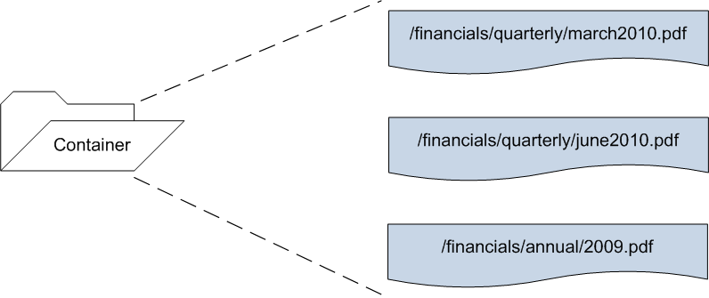
Working with Blobs (using Storage Client Library) Cont.
However, you can also search and/or filter blobs in a container by their virtual directory.
Recall, blobs can have names containing delimiters that imply, at least virtually, a directory structure.
For example, say you have a container with three blobs each with the names as specified in the picture below.

Slide 47
Working with Blobs (using Storage Client Library) Cont.
You can request blob storage to give you a CloudBlobDirectory object that allows you to enumerate over blobs with a specified prefix – acting like a directory.

Slide 48
Working with Blobs (using Storage Client Library) Cont.
For example, you can request all blobs in the /financials/quarterly virtual directory by requesting a CloudBlobDirectory from the cwablobs container.
This “filter” would allow you to enumerate over the march2010.pdf and june2010.pdf.
The GetDirectoryReference( ) call would return all three blobs if the search string was widened to “financials”.
CloudBlobContainer container =
blobClient.GetContainerReference("cwablobs");
container.CreateIfNotExist();
CloudBlobDirectory directory =
container.GetDirectoryReference("financials/quarterly");
IEnumerable<IListBlobItems> blobList = directory.ListBlobs();
container.GetDirectoryReference("financials");
IEnumerable<IListBlobItems> blobList = directory.ListBlobs();

Slide 49
Working with Containers and Blobs Asynchronously
The operations on containers and blobs shown so far are synchronous (i.e. blocking).
That is, the code must wait for a return answer from Windows Azure on methods like CreateIfNotExist( ) or UploadFromStream( ) before continuing.
This could be quite problematic when connecting to and waiting for responses from Windows Azure Storage in a data center far away.
To deal with the possible performance bottlenecks of synchronous requests, many of the methods examined in this chapter have two asynchronous counterparts.
For example, CloudBlob objects have BeginUploadFromStream( ) and EndUploadFromStream( ) methods to upload a blob in an asynchronous fashion.

Slide 50
Working with Containers and Blobs Asynchronously Cont.
In addition to their normal parameters, all Begin operations require two additional parameters.
First, the method requires a delegate of type AsyncCallback to a callback method called when the asynchronous operation completes.
Second, the method requires a custom state object that contains information about the asynchronous operation.
The Begin methods return an IAsyncResult that references the asynchronous operation.
All End operations use the returned IAsyncResult result of the Begin method to finish the asynchronous operation.

Slide 51
Working with Containers (using REST)
The endpoint for all REST requests for blob storage is http://<account name>.blob.core.windows.net.
The Storage emulator endpoint for blob storage is http://127.0.0.1:10000/devstoreaccount1
As you learned earlier in this chapter, unlike REST requests for queue storage, not all requests for blob storage have to be signed.
If a container is open to public, users may read blob and container information (with Container access) without signing requests.
Private access reads or modifying requests (upload, delete, set access permissions, etc.) to the container or blob must be signed.
That is, modifying REST requests must contain a Hash-based message authentication code SHA256 signature certificate added to the message header.

Slide 52
Working with Containers (using REST) Cont.
Of course, each of the Storage Client Library operations examined above is also supported in REST. It has to be since REST is used under the covers.
A complete re-examination of each operation is unwarranted and can be found in documentation (see msdn.microsoft.com/en-us/library/dd135733.aspx).
However, a sampling is provided here to give you a feel for the REST API as it relates to blob storage.

Slide 53
Working with Containers (using REST) Cont.
To create a new container, send a signed HTTP PUT request with appropriate headers to the URL below.
For example, here is the URL to create a new container called “mycontainer” in the cwastorage account.
Once created, the container can now be referenced by the URL http:// <account name>.queue.core.windows.net/<container name>.
For example sake, here is the URL to create mycontainer in the Storage Emulator.
Other REST requests to the Storage Emulator will not be shown since they can be easily derived from Windows Azure Storage REST requests.
http://<account name>.blob.core.windows.net/<container name>?restype=container
http://cwastorage.blob.core.windows.net/mycontainer?restype=container
http://127.0.0.1:10001/devstoreaccount1/mycontainer?restype=container

Slide 54
Working with Containers (using REST) Cont.
The “appropriate headers” suggested above vary per request but often include x-ms-date and x-ms-version.
The Date or x-ms-date specifies the Coordinated Universal Time (UTC) for the request.
The x-ms-version specifies which version of the storage service API to use.
Details, to include required headers for all containers and blob REST operations, can be found at msdn.microsoft.com/en-us/library/dd135733.aspx.

Slide 55
Working with Containers (using REST) Cont.
To list the containers in the storage account, send a signed GET request to http://<accout name>.blob.core.windows.net/?comp=list.
Here is an example URL to get the container list from the cwastorage account.
The response message, in XML, contains a listing of the containers along with their name, endpoint URLs, and properties.
http://cwastorage.blob.core.windows.net/?comp=list

Slide 56
Working with Containers (using REST) Cont.
<?xml version="1.0" encoding="utf-8"?>
<EnumerationResults AccountName="http://accountname.blob.core.windows.net">
<Containers>
<Container>
<Name>container-name</Name>
<URL>container-address</URL>
<Properties>
<Last-Modified>date/time-value</Last-Modified>
<Etag>etag</Etag>
</Properties>
</Container>
</Containers>
<NextMarker>marker-value</NextMarker>
</EnumerationResults>

Slide 57
Working with Containers (using REST) Cont.
To include metadata with the XML response, add “include=metadata” as a parameter to the request URL.
http://cwastorage.blob.core.windows.net/?comp=list&include=metadata
<?xml version="1.0" encoding="utf-8"?>
<EnumerationResults AccountName="http://accountname.blob.core.windows.net">
<Containers>
<Container>
<Name>container-name</Name>
<URL>container-address</URL>
<Properties>
<Last-Modified>date/time-value</Last-Modified>
<Etag>etag</Etag>
</Properties>
<Metadata>
<metadata-name>value</metadata-name>
</Metadata>
</Container>
</Containers>
<NextMarker>marker-value</NextMarker>
</EnumerationResults>

Slide 58
Working with Blobs (using REST)
To get a list of the blobs in a container, send a GET request to the container URL with “?restype=container&comp=list” added to it.
If access to the container is open (Public Container access), the request does not need to be signed – allowing a simple browser to list the blobs in the container.
Here is an example URL to get the list of blobs in the “mycontainer” container in the “cwastorage” account.
http://cwastorage.blob.core.windows.net/mycontainer?restype=container&comp=list

Slide 59
Working with Blobs (using REST) Cont.
The response XML contains a list of blobs, their name, URL and properties. Note that the type (Block vs. Page) is included in the response.
<?xml version="1.0" encoding="utf-8"?>
<EnumerationResults ContainerName="http://accountname.blob.core.windows.net/containername">
<Blobs>
<Blob>
<Name>blob name</Name>
<Url>blob url</Url>
<Properties>
<Last-Modified>date/time-value</Last-Modified>
<Etag>etag</Etag>
<Content-Length>length in bytes</Content-Length>
<Content-Type>content type</Content-Type>
<Content-Encoding/>
<Content-Language/>
<Content-MD5/>
<Cache-Control/>
<BlobType>BlockBlob or PageBlob</BlobType>
<LeaseStatus>unlocked</LeaseStatus>
</Properties>
</Blob>
</Blobs>
<NextMarker />
</EnumerationResults>

Slide 60
Working with Blobs (using REST) Cont.
Send a GET request to the blob URL to read a specific blob.
If the blob is in the $root container, the blob can be accessed as if it were in the blob storage account.
If the container’s access is public (Container or Blob public access), the request to get a blob does not have to be signed.
To get a blob snapshot, add “?snapshot=<DateTime>” to the blob URL.
The response message body to a blob (or blob snapshot) request includes the actual contents of the blob.
http://accountname.blob.core.windows.net/containername/blobname
http://accountname.blob.core.windows.net/blobname

Slide 61
Working with Blobs (using REST) Cont.
Uploading a blob to the container requires a signed PUT request be sent to the intended name of the blob.
For example, here is a sample request URL to upload a blob to be named “myblob” into “mycontainer” of the cwastorage account.
The x-ms-blob-type header element must indicate whether the blob is a block or page blob.
The request header may include several optional headers to specify the detail of the blob being uploaded. The table below lists several of these optional headers.
http://cwastorage.blob.core.windows.net/mycontainer/myblob

Slide 62
Working with Blobs (using REST) Cont.
Optional Blob PUT Request Header | Header Description
x-ms-blob-content-type | Blob’s content type
x-ms-blob-content-encoding | Blob’s content encoding
x-ms-blob-content-language | Blob’s content language
x-ms-blob-content-md5 | MD5 Hash of the blob
x-ms-meta-name | Name part of optional metadata name-value pairs.
For block blobs, the body contains the content of the blob to upload.
Optionally, you can also use the put block and put block list operations to upload and commit blocks of a block blob (see below).
For page blobs, the body is empty. Instead, you must use the put page operation to upload pages of a page blob (also shown below).

Slide 63
Working with Blobs (using REST) Cont.
Uploading blocks requires the same signed PUT request to the URL of the intended name of the block blob.
However, additional parameters are required.
When working with blocks, attach the parameters “?comp=block&blockid=id” to the URL where the id is the intended id of the block being uploaded.
For example, here is a sample request URL to upload block #123 to the blob named “myblob” into “mycontainer” of the cwastorage account.
Block IDs are scoped to a particular blob, so different blobs can have blocks with same IDs. The body of the request message must contain the block content.
http://cwastorage.blob.core.windows.net/mycontainer/myblob?comp=block&blockid=123

Slide 64
Working with Blobs (using REST) Cont.
Once the blocks have been uploaded, commit the blocks to the blob with a signed PUT request to the blob URL with a “?comp=blocklist” parameter.
The body of the commit request contains a list of blocks to be committed. Each of the blocks must have already been uploaded.
http://cwastorage.blob.core.windows.net/mycontainer/myblob?comp=blocklist
<?xml version="1.0" encoding="utf-8"?>
<BlockList>
<Latest>123</Latest>
<Latest>124</Latest>
<Latest>125</Latest>
</BlockList>

Slide 65
Working with Blobs (using REST) Cont.
When working with page blobs, you can upload pages to the page blob (create with the PUT request shown above) with additional signed requests.
To upload a page, send a signed PUT request to blob URL with “?comp=page” as a parameter.
Put page requests must contain a header (either Range or x-ms-range element) that indicates the range of bytes written.
Both the start and end of the range must be specified.
The body of the page request contains the page data. Remember, page content must be in a multiple of 512 bytes.
http://cwastorage.blob.core.windows.net/mycontainer/myblob?comp=page

Slide 66
Working with Blobs (using REST) Cont.
To delete a blob from the container, send a signed DELETE request to the blob URL.
If the blob has snapshots, you must include an x-ms-delete-snapshots header element in the request.
If the x-ms-delete-snapshots element value is “only”, the snapshots are deleted, but the blob is not.
If the value is “include” both the blob and associated snapshots are deleted.

Slide 67
Lab Exercise: Blob Lab

Slide 68
Chapter Summary
Blob storage provides a theoretically infinite space to store any type of data.
Blob is actually an acronym for binary large object.
A blob can contain just about any type of data (MP3 file, flat text, PDF, etc.).
Blob storage is first a file system replacement.
As with all of Windows Azure, you pay only for what blob storage you use versus buying extra disk space in anticipation of what you might use.
Blob storage scales to support extremely large request loads and performs moderately well.
File systems are notorious for corruption and “going down” whereas blob storage is replicated three times as part of the commit process.
If a disk failure occurs in the Microsoft data centers, the FC knows it, tracks it, and makes sure load balancers route requests to the other copies of your blob storage.

Slide 69
Chapter Summary Cont.
You access blob storage via REST both in and out of the cloud.
In blob storage, containers and blobs are identified by URI.
A container’s URI comes from attaching the container name to the blob storage account URI.
A blob’s URI comes from attaching the blob name to its container URI.
Your blob storage account can have any number of containers.
Each container can have an unlimited number of blobs.
Each blob, however, is limited to 1 TB in size.
Blobs stored in the Storage Emulator are restricted to 2 GB.
To create or access a container using the Storage Client Library, you need a CloudBlobClient (Microsoft.WindowsAzure.StorageClient) object.
Create the CloudBlobClient object via the CloudStorageAccount object.
The CloudBlobClient object provides the means to get or create CloudBlobContainer objects that represent blob storage containers.
CloudBlob objects represent blobs in blob storage.

Slide 70
Chapter Summary Cont.
Unlike queues and tables, blob storage allows for both public and private access.
Control access at the container level. Set each container access to either private or public.
There are two types of public container access.
Full public access (Container access) allows anyone without authentication to retrieve blobs and even query the container.
You can also expose the container to public access, but limit it to blobs only (called Blob access).
Public access is limited to read only operations.
When access to a container is private, the blobs in the container are restricted to the owner of the account.

Slide 71
Chapter Summary Cont.
There are two types of blobs: block blobs and page blobs.
Block blobs allow a single blob to be broken up into smaller blocks.
These blocks allow parallel activity (such as blob upload) on pieces of a blob thereby allowing for better application performance/scalability.
Block blobs are limited to 200GB in size. Each block can be up to 4MB in size (allowing for 50,000 blocks).
Each block must be uploaded and then the entire block blob is committed into blob storage. Thus, uploading block blobs by blocks is a two-step process.
You can upload the blob in a single operation (without the need to upload individual blocks) when the block blob is no more than 64MB.
A page blob is collection of pages. Page blobs and individual pages can be up to 1 TB, but each page must be a multiple of 512 bytes.
A page is a range of data that is identified by its offset from the start of the blob.

Slide 72
Chapter Summary Cont.
Pages from a page blob can be randomly uploaded and accessed.
Unlike block blobs, page writes to a page blob are committed immediately. Two steps are not required to upload and commit a page blob.

