Slide 1
Table Storage
50466 Windows® Azure™ Solutions with Microsoft® Visual Studio® 2010

Slide 2
Windows Azure Storage Tables
Table storage provides structured data storage.
Table storage allows you to store serialized entities (i.e. domain objects) in simple tables.
Table storage is not a relational database.
It is a highly scalable, always available, cost effective storage mechanism without some of the restrictions found in traditional relational database storage systems.
However, you should not view table storage as a replacement for a relational database system.
Table storage provides an alternative to an RDMS for certain application situations.

Slide 3
Windows Azure Storage Tables Cont.
Table storage is highly scalable because it allows you to store billions of entities.
There is virtually no limit to the number of tables and entities in those tables in your table storage.
You are only limited in how much you are willing to pay for your storage.
However, when compared to data stored in SQL Azure (Windows Azure’s relational database system), table storage is cheaper.
Like all of Windows Azure Storage, data in table storage is replicated three times.
This replication occurs automatically as a part of the commit process.
This means the data is always available.
Furthermore, data requests are load balanced, which helps to improve performance.

Slide 4
Windows Azure Storage Tables Cont.
How does table storage differ from relational database storage?
Tables in table storage are independent of one another. There are no relational features in table storage.
Without relational features, there are no foreign keys or table joins in table storage.
You can’t have a query that spans multiple tables.
Without the dependencies and relationships on one another, Windows Azure can scale data storage beyond a single server and store tables on separate servers.
Further, while each table in table storage has an id providing an index, there are no custom indexes.
This gives table storage very good performance without any need for tuning.

Slide 5
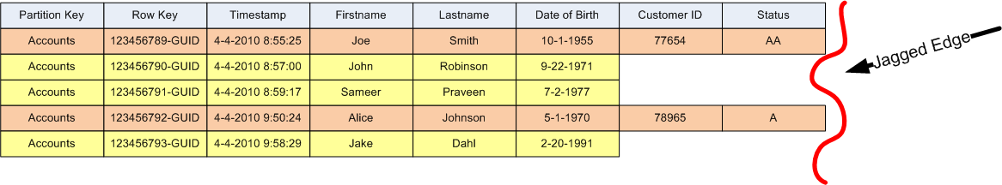
Windows Azure Storage Tables Cont.
You can explicitly partition tables in table storage (covered later). That is, tables can be broken up into multiple table parts or partitions.
Partitions can be stored on different servers, thereby allowing table storage to scale out to enormous volumes.
Partitioning can also greatly improve performance when entity search and retrieval is limited to a single partition.
Tables in table storage have no fixed schema. That is entities stored in the table can have different properties (both in number and in type).
This is often referred to as tables that have “ragged” or “jagged” edges.

Slide 6
Windows Azure Storage Tables Cont.
Non-relational database technology is not new with table storage in Windows Azure.
There is even a “movement” behind technology adopting non-SQL systems. It is called NoSQL; see nosql-database.org.
Google App Engine’s Bigtable and Amazon’s SimpleDB are two members of the NoSQL database group.
Many believe that non-relational/no-SQL database technologies are simpler to work with and manage.

Slide 7
Windows Azure Storage Tables vs. SQL Azure
While both SQL Azure and Windows Azure table storage provide data persistence via “table” structure, there are a number of differences between them.
SQL Azure, by the way, is essentially SQL Server in the Microsoft cloud.
There are differences between SQL Azure and SQL Server 2008.
SQL Azure currently has a number of limitations and unsupported features found in SQL Server 2008.
Find a starter list of limitations regarding SQL Azure at msdn.microsoft.com/en-us/library/ee336245.aspx.

Slide 8
Windows Azure Storage Tables vs. SQL Azure Cont.
As mentioned previously, table storage is not a replacement for SQL Azure (or other RDBMS) in all cases.
Various application situations call for an RDBMS while other situations call for table storage.
SQL Azure is covered in the appendix of this course.
Even though you may not yet be familiar with SQL Azure, you should be aware of how they differ and, generally speaking, when to use one over the other.
First, as mentioned, table storage is highly scalable.
You can have up to 100 TB of data in table storage (actually, each Windows Azure Storage account is limited to 100 TB).
SQL Azure is limited to between 1 GB and 50 GB sizes. This might change in the future (50 GB was recently added – May 2010), but it is still far less than 100TB.

Slide 9
Windows Azure Storage Tables vs. SQL Azure Cont.
You access SQL Azure data with all the standard tools and APIs that work with SQL server.
Meaning, you leverage existing .NET/SQL Server knowledge and experience.
Use ADO.NET and ODBC APIs in application code to access the SQL Azure database.
Tools like SQL Server Management Studio and Visual Studio can be pointed at SQL Azure instances and manipulate the schema and data.

Slide 10
Windows Azure Storage Tables vs. SQL Azure Cont.
On the other hand, you access table storage via the REST API or Storage Client Library provided with the Windows Azure SDK.
Using the REST API allows client applications to communicate and use data from table storage without having detailed and specific knowledge of a Windows Azure API.
However, most consider using REST API more complex and foreign when compared to traditional SQL and/or ADO.NET.
The Storage Client Library (which leverages LINQ to Objects) provides a layer of convenience but requires the application reference the Azure-specific APIs.
REST and the Storage Client Library incur a learning curve that is typically not there when using SQL Azure.

Slide 11
Windows Azure Storage Tables vs. SQL Azure Cont.
You can access data in SQL Azure and table storage from applications in and out of the cloud.
That means you can move applications in or out of the cloud and still deal with the data in the cloud in the same way.
However, you should consider whether the data must always live in the cloud.
Applications view data in SQL Azure similar enough to data in SQL Server as to allow migration back and forth between the cloud and on-premise databases.
In fact, there are even migration tools to help move data between instances of SQL Server and SQL Azure.
Given the unique nature and access APIs of table storage, portability of the data is not as straightforward.
Table storage tightly couples your data to the cloud.
Moving table storage data out of the cloud would require an on-premise data storage alternative, a data migration strategy, and likely require code changes.

Slide 12
Windows Azure Storage Tables vs. SQL Azure Cont.
SQL Azure supports typical ACID transactions for work within the same database.
Transactions across databases are not supported. SQL Azure allows for typical optimistic and pessimistic concurrency strategies.
Transactions behave quite differently in table storage.
Table storage supports transactions for entities in the same table and table partition, but not across tables or partitions.
Additionally, only 100 operations or less (what is called a batch in Windows Azure table storage) can be part of the transaction.
You can perform only one operation on each entity in the batch, and the batch must be limited to 4MB.
Table storage abides strictly by an optimistic concurrent strategy.
If, on commit of the transaction, table storage data has been changed by another process the whole transaction must be rolled back and retried.

Slide 13
Windows Azure Storage Tables vs. SQL Azure Cont.
Due to this single concurrency strategy, the Storage Client Library provides a built-in retry capability.
Table storage queries are limited to 1000 entities by default.
If a query finds more than 1000 entities, a continuation token is returned and must be used by the application to retrieve the next set of entities.
Queries that take longer than 5 seconds to execute also return a continuation token. Queries that take longer than 30 seconds are cancelled.
Data in table storage is organized by partition key and indexed by row key.
Because there are no custom indexes in tables, queries by partition key and row key are fast, but queries that do not use partition key and row key are slow.
Generally speaking, SQL Azure has no limitations, issues, or special programming requirements to work with large queries.
Good database and index design can help improve performance of queries - especially large ones.

Slide 14
Windows Azure Storage Tables vs. SQL Azure Cont.
The type of data that can be stored in table properties is limited.
Properties in table storage are limited to the types in the table below.
For the most part, all standard column types are supported in SQL Azure schemas (exceptions include FILESTREAM data, Sparse columns, etc).
Table Storage Supported Property Types
byte[]
bool
DateTime
double
Guid
Int32 or int
Int64 or long
String

Slide 15
Windows Azure Storage Tables vs. SQL Azure Cont.
Perhaps one of the more crucial differences between SQL Azure and table storage is cost.
Cost often requires developers to think like a businessperson when designing and architecting applications for the cloud.
The choice in data storage can have a huge impact on the cost of running an application.
Windows Azure table storage costs 15 per GB of storage per month (based on the pay-as-you-go plan).
Additionally, you pay 1 cent per 10,000 transactions with table storage.
SQL Azure costs are $9.99 for 1 GB of storage per month ($99.99 for 10GB).
For more details on costs, see Windows Azure pricing page at www.microsoft.com/windowsazure/pricing.

Slide 16
Windows Azure Storage Tables vs. SQL Azure Cont.
So what’s the bottom line? When should you use table storage and when should you use SQL Azure?
Chris Hay and Brian Prince in their book Azure in Action (published by Manning) provide a good synopsis of the SQL Azure vs. Table Storage.
Their conclusions suggest, “If size is the issue, that would be the first flag that you might want to consider Azure Tables.”
“As long as the support Tables has for transactions and queries meets your needs. The size limit surely will, at 100TB.”
Further, they suggest sophisticated transactions, or a complex authorization model might require the services of SQL Azure.
"The final consideration is cost. I can store a lot of data in Azure Tables for a lot less money than I can in SQL Azure.”
SQL Azure is giving me a lot more features to use (joins, relationships, etc.), but it does cost more."

Slide 17
Tables, Entities, Properties and Partitions
Tables hold data in Windows Azure table storage.
You can have any number of tables defined in your Windows Azure Storage account.
There is no size limit on tables (with the exception that the total size of your Windows Azure Storage account cannot exceed 100 TB).

Slide 18
Tables, Entities, Properties and Partitions Cont.
More precisely, tables hold entities.
For convenience sake, you can think of an entity as representing a row in the table.
Simple domain objects, as defined by the Customer class below, represent entities in an application.
Domain objects are often called data transfer objects (DTO) or plain ordinary CLR objects (POCO).
A table can hold any number of entities (again, backed by the 100 TB limit on all of Windows Azure Storage).
public class Customer
{
public int ID { get; set; }
public String firstname { get; set; }
public String lastname { get; set; }
}

Slide 19
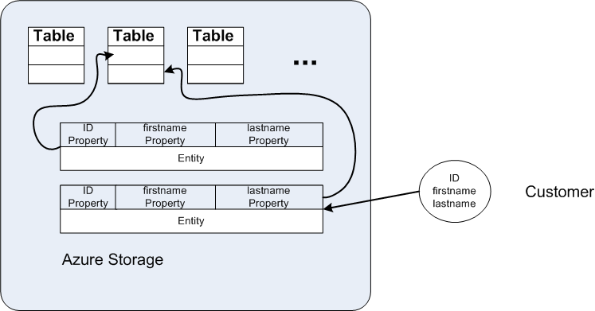
Tables, Entities, Properties and Partitions Cont.

Slide 20
Tables, Entities, Properties and Partitions Cont.
Actually, the domain object’s property data is stored as the entity in a table.
The process of getting a domain object’s data into an entity in the table is called serialization.
Getting the data back out into a domain object’s properties is called deserialization.
Therefore, an entity in table storage is made up of several properties.
You can think of properties as columns in a traditional database analogy.
An entity is limited to 255 properties (including PartitionKey, RowKey and Timestamp covered below).
Properties are limited to the type of data listed in the table above (byte[], bool, DateTime, etc.).
The total size of an entity (including all the property names) is limited to 1 MB.

Slide 21
Tables, Entities, Properties and Partitions Cont.
Each entity in a table must have three properties: PartitionKey, RowKey and Timestamp.
The PartitionKey and RowKey are strings.
Neither the PartitionKey nor RowKey can exceed 1 KB.
Together, the PartitionKey and RowKey uniquely identify each entity.
The PartitionKey and RowKey cannot contain a forward slash (/), backslash (\), number sign (#) or question mark (?) characters.
The Timestamp is a read-only DateTime property managed by Windows Azure. It is the date and time that the entity was inserted (or updated) in the table.
The Timestamp is used to handle concurrency.
Other properties of an entity are usually referred to as custom properties.

Slide 22
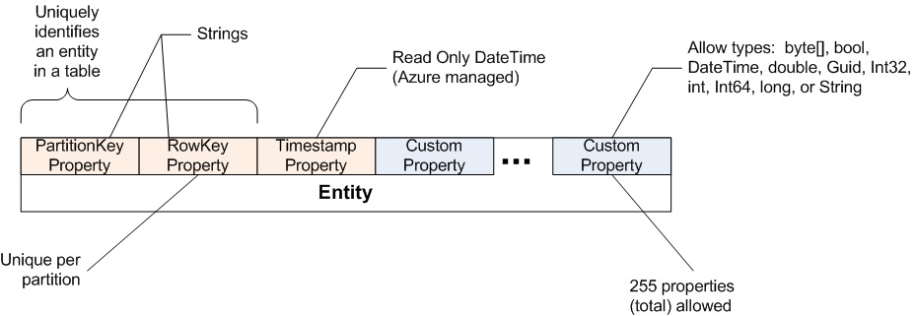
Tables, Entities, Properties and Partitions Cont.

Slide 23
Tables, Entities, Properties and Partitions Cont.
A partition is defined as a collection of entities in a table with the same PartitionKey.
The RowKey uniquely identifies an entity within a partition.
Partitions are the unit of distribution in table storage.
Windows Azure stores entities in the same partition together on the same Windows Azure Storage node. Other partitions may be stored on different nodes.
Windows Azure determines the best node for a partition based on its size (number and size of entities), request traffic, etc.
You can never plan on entities in the same table to be stored on the same node unless they are in the same partition.

Slide 24
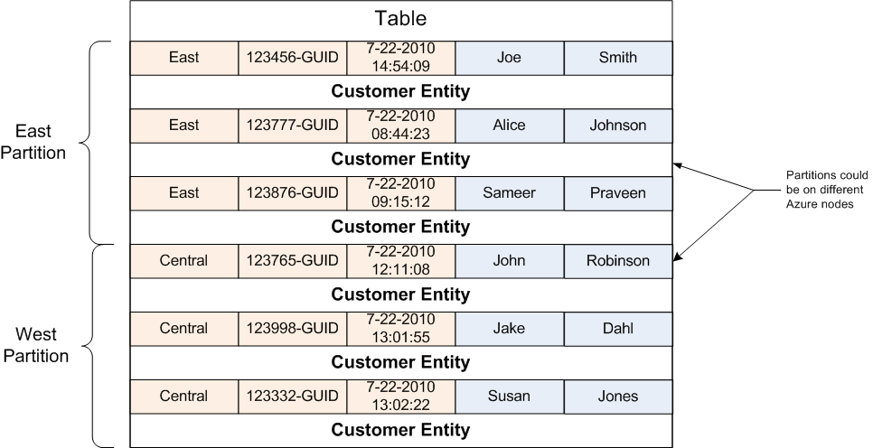
Tables, Entities, Properties and Partitions Cont.
By the way, while it is convenient to think of a node as a server, this is not always the case.
If a node were a single machine, it would be possible to have a table partition exceed the storage capacity of the single server.

Slide 25
Tables, Entities, Properties and Partitions Cont.
Per MSDN blog post, the throughput target for a single partition (not a table) is up to 500 transactions per second.
According to the same post, “a table with good partitioning can process up to a few thousand requests per second.”
You’ll learn more about the importance of partitions as it relates to retrieving entities toward the end of this chapter.

Slide 26
Tables, Entities, Properties and Partitions Cont.
As previously mentioned, the schema of tables is not fixed.
Meaning, different entities (i.e. Customer, Order, etc.) can be stored in the same table.
Therefore, each entity may have different properties than other entities in the table.
Note – while having entities with different properties in the same table is possible, it is to be avoided given the complexity of serializing the data back into objects.

Slide 27
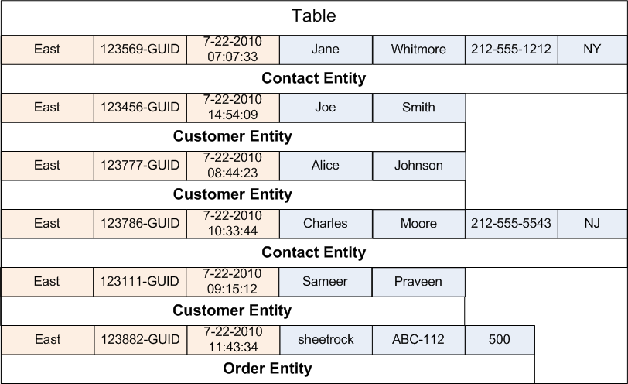

Tables, Entities, Properties and Partitions Cont.
This is because under the covers, except for the PartitionKey, RowKey, and Timestamp, Windows Azure maintains all the other properties in a property bag.
In other words, all the “custom” properties are really just name-value pairs.

Slide 28
Working with Tables (using the Storage Client Library)
As with all storage, accessing table storage begins with the CloudStorageAccount object.
To create or otherwise access a table, you need a CloudTableClient (Microsoft.WindowsAzure.StorageClient) object.
Create the CloudTableClient object via the CloudStorageAccount object.
With the CloudTableClient object, you can create, delete and get a list of tables.
CloudStorageAccount storageAccount = CloudStorageAccount.
FromConfigurationSetting ("DataConnectionString");
CloudTableClient tableClient= storageAccount.CreateCloudTableClient();

Slide 29
Working with Tables (using the Storage Client Library) Cont.
To create a table, use either the CreateTable( ) or CreateTableIfNotExist( ) method. Both methods require a table name.
The first method throws an exception (StorageClientException) when a table by the name provided already exists.
Table names, which are case sensitive, must be valid DNS names, containing only alphanumeric characters.
Table names must start with a letter and cannot contain special characters.
Early version of the Azure Storage supported table names that contained a dash character (-), but this is no longer supported.
Table names must be more than 3 characters long and less than 63 characters long.
tableClient.CreateTable("mytable");
tableClient.CreateTableIfNotExist("mytable");

Slide 30
Working with Tables (using the Storage Client Library) Cont.
Note, hardcoded table names, as shown above, are often used in the API demonstrated throughout this chapter to help simplify learning the API.
As mentioned in the previous chapters, consider using a configuration setting for values such as the table name when using methods like the one above.
This allows you to change the table without having to modify code. This can be very helpful as you move across different environments (dev, test, etc).

Slide 31
Working with Tables (using the Storage Client Library) Cont.
There are two ListTable( ) overloaded methods to get a list of tables in your Windows Azure Storage account.
The simplest form takes no parameters and returns all the table names in the account.
The second takes a string as a parameter and returns a list of table names in the account that begin with the string.
IEnumerable<string> tableNames = tableClient.ListTables();
IEnumerable<string> tableNames = tableClient.ListTables(searchPrefix);

Slide 32
Working with Tables (using the Storage Client Library) Cont.
Use the DeleteTable( ) method to delete a table.
You may want to check for the existence of the table before trying to delete it.
The application throws a StorageClientException if the table does not exist.
According to the MSDN documentation, table deletes “can take at least 40 seconds to complete.”
Therefore, as with other Windows Azure Storage objects, remember that objects are marked for deletion, but require time to actually be garbage collected.
Windows Azure Storage may think the table still exists until it has been properly garbage collected.
Alternately, use DeleteTableIfExists( ) to delete a table.
tableClient.DeleteTable("mytable");
tableClient.DeleteTableIfExists("mytable");

Slide 33
Working with Entities (using the Storage Client Library)
Tables hold entity property data.
Therefore, in order to perform most table operations you first define your entities.
Entities are POCOs or DTOs.
For example sake, this chapter uses a Customer entity as shown below.
public class Customer
{
public string firstName { get; set; }
public string lastName { get; set; }
public DateTime dateOfBirth { get; set; }
public string phone { get; set; }
}

Slide 34
Working with Entities (using the Storage Client Library) Cont.
Properties (like firstName, lastName, dateOfBirth and phone above) are limited to a subset of WCF Data Services types.
WCF Data Services was formally known as ADO.NET Data Services prior to .NET 4.
The table below defines the allowed types and limits on properties.

Slide 35
Working with Entities (using the Storage Client Library) Cont.
Property names are case sensitive and limited to 255 characters.
In general, property names should follow naming rules for C# identifiers.
ADO.NET Data Service Type | Property Type | Limits/Constraints
Edm.String | String | UTF-16 encoded, <= 64KB in size
Edm.Boolean | Bool | Boolean value of True or False
Edm.DateTime | DateTime | 8 bytes, ranging from 1/1/1601 to 12/31/9999
Edm.Guid | Guid | 16 bytes
Edm.Int32 | int or Int32 | 32 bits
Edm.Int64 | long or Int64 | 64 bits
Edm.Double | double | 64 bits
Edm.Binary | byte[] | Up to 64 bytes in size

Slide 36
Working with Entities (using the Storage Client Library) Cont.
Because these Customer entities are to be stored in Windows Azure table storage, they also need the required properties: PartitionKey, RowKey and Timestamp.
Add these properties along with a DataServiceKey attribute indicating which of the properties serve as part of the primary key.

Slide 37
Working with Entities (using the Storage Client Library) Cont.
[DataServiceKey("PartitionKey", "RowKey")]
public class Customer
{
public string RowKey { get; set; }
public string PartitionKey { get; set; }
public DateTime Timestamp { get; set; }
public string firstName { get; set; }
public string lastName { get; set; }
public DateTime dateOfBirth { get; set; }
public string phone { get; set; }
}
If you have used ADO.NET Data Services, you may recognize the DataServiceKey attribute.
DataServiceKey comes from System.Data.Services.Common namespace of WCF Data Services.

Slide 38
Working with Entities (using the Storage Client Library) Cont.
Table storage is built on top of WCF Data Services. Therefore, much of the table storage API and architecture utilizes WCF Data Services assemblies.
As an alternative to defining the primary key and required properties in the entity, you can extend TableServiceEntity.
This abstract superclass already contains the three required properties: PartitionKey, RowKey and Timestamp.
TableServiceEntity is in the Microsoft.WindowsAzure.StorageClient namespace.
public class Customer: TableServiceEntity
{
public string firstName { get; set; }
public string lastName { get; set; }
public DateTime dateOfBirth { get; set; }
public string phone { get; set; }
}

Slide 39
Working with Entities (using the Storage Client Library) Cont.
Although TableServiceEntity makes defining entity classes simpler, you should consider the tight coupling you create when using this base class.
Entity classes may be used by a variety of applications or, at least, by various layers in the application.
For example, one might use the Customer POCO shown above in a UI layer to display a list of customers in a screen.
Having the entity class extend a Windows Azure abstract class requires users to always have and reference the Windows Azure Storage Client API.

Slide 40
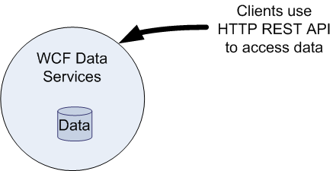
Working with Entities (using the Storage Client Library) Cont.
In order to move entity data to/from table storage you need a couple of objects familiar to WCF Data Services developers.
As alluded to already table storage is exposed as a WCF Data Service.
WCF Data Services (formerly ADO.NET Data Services) exposes data via Web service accessed via HTTP and the REST API.
Some features of WCF Data Services are not supported, while additional features have been added to support Windows Azure table storage.

Slide 41
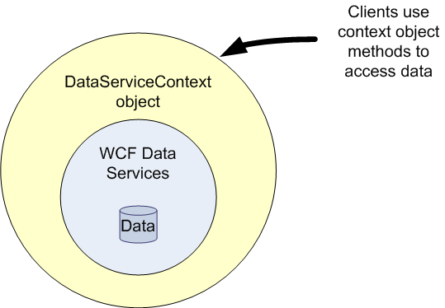
Working with Entities (using the Storage Client Library) Cont.
In WCF Data Services, a DataServiceContext (System.Data.Services.Client) object represents the runtime context of a data service.
Clients use the DataServiceContext object to communicate requests to the data (versus HTTP REST API).
Furthermore, services are generally stateless. Each call to a service is independent of the next.

Slide 42
Working with Entities (using the Storage Client Library) Cont.
So performing multiple data operations using a service is a bit problematic.
The DataServiceContext object tracks client operations on data.
The DataServiceContext collects several calls to change data by a client and then commits them all at once with the SaveChanges( ) method.
The DataServiceContext object also provides means to deal with conflict resolution and merger strategies.

Slide 43
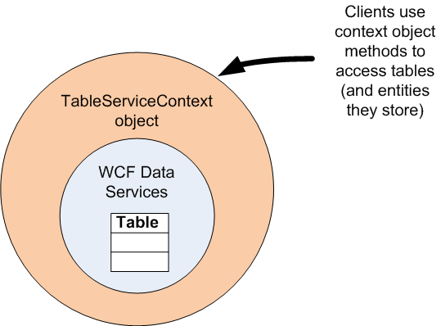
Working with Entities (using the Storage Client Library) Cont.
The Client Storage API provides a class, TableServiceContext, which extends DataServiceContext.
TableServiceContext provides methods for updating and retrieving entities in table storage thereby removing the need to use HTTP REST API directly.
TableServiceContext is in the Microsoft.WindowsAzure.StorageClient namespace.

Slide 44
Working with Entities (using the Storage Client Library) Cont.
To save, update, delete, etc. your entities in and out of table storage, you must create your own context class that extends TableServiceContext.
TableServiceContext (and DataServiceContext) provide generic capability to move your entities in and out of table storage.
For example, TableServiceContext already has AddObject( ), UpdateObject( ), and DeleteObject( ) methods to work with your entities.
TableServiceContext also handles a number of underlying details associated with these operations such as a built in retry policy.
Your context subclass only has to provide entity-specific functions and services your application needs.

Slide 45
Working with Entities (using the Storage Client Library) Cont.
CustomerContext is a simple example of a TableServiceContext class for working with Customer entities defined above.
Note the constructor.
public class CustomerContext : TableServiceContext
{
public CustomerContext(string baseAddress, StorageCredentials credentials) : base(baseAddress, credentials) { }
public IQueryable<Customer> Customers
{
get
{
return this.CreateQuery<Customer>("customers");
}
}
}

Slide 46
Working with Entities (using the Storage Client Library) Cont.
When building a context object you must provide the base address of your storage account and security credentials for accessing the account.
You can add all sorts of methods to your context object to provide application specific queries, updates, etc.
In this simple example, a convenience property is provided (called Customer ( )) to return all customer entities.
Note that this property’s getter simply calls on TableServiceContext’s CreateQuery() method with the table name.
It is important to note that the code above requires referencing both Microsoft.WindowsAzure.StorageClient as well as System.Data.Services.Client.

Slide 47
Working with Entities (using the Storage Client Library) Cont.
With a TableServiceContext object, saving an entity into table storage is straightforward.
CloudStorageAccount storageAccount = CloudStorageAccount.FromConfigurationSetting("DataConnectionString");
CloudTableClient tableClient =
storageAccount.CreateCloudTableClient();
tableClient.CreateTableIfNotExist("customers");
CustomerContext customerContext = new CustomerContext(
storageAccount.TableEndpoint.AbsoluteUri,
storageAccount.Credentials);
var aCustomer = new Customer
{
PartitionKey = "East",
RowKey = Guid.NewGuid().ToString(),
firstName = "Joe",
lastName = "Smith",
dateOfBirth = new DateTime(1964, 1, 20),
phone = "612-999-9999"
};
customerContext.AddObject("customers", aCustomer);
customerContext.SaveChanges();

Slide 48
Working with Entities (using the Storage Client Library) Cont.
The SaveChanges( ) method call above is critical.
Remember that a DataServiceContext object (and TableServiceContext by extension) tracks client operations on data and commit multiple changes at once.
Without a call to SaveChanges( ), no data is committed to table storage. In fact, no data crosses the wire from compute to storage without saving changes.
However, this allows multiple changes to occur in a single commit (more on transactions in a bit).
To update an entity, simply call UpdateObject( ) instead of AddObject.
Here the first name of the entity is modified and the context object is used to update the entity in table storage.
aCustomer.firstName = "Joseph";
customerContext.UpdateObject(aCustomer);
customerContext.SaveChanges();

Slide 49
Working with Entities (using the Storage Client Library) Cont.
As another example of using the TableServiceContext object to perform operations with entities, the code here fetches then deletes all Customers.
CloudStorageAccount storageAccount = CloudStorageAccount.FromConfigurationSetting("DataConnectionString");
CustomerContext customerContext = new CustomerContext(
storageAccount.TableEndpoint.AbsoluteUri,
storageAccount.Credentials);
IQueryable<Customer> list = customerContext.Customers;
foreach (var cust in list)
{
customerContext.DeleteObject(cust);
}
customerContext.SaveChanges();

Slide 50
Working with Entities (using the Storage Client Library) Cont.
Notice the DeleteObject( ) method requires you to pass the entity to be removed from the table.
This requires you retrieve the entity first before deleting it.
When you know the partition key and row key of the entity, create and use a “dummy” entity as a more efficient way of deleting an entity.

Slide 51
Working with Entities (using the Storage Client Library) Cont.
CloudStorageAccount storageAccount =
CloudStorageAccount.FromConfigurationSetting("DataConnectionString");
CustomerContext customerContext = new CustomerContext(
storageAccount.TableEndpoint.AbsoluteUri,
storageAccount.Credentials);
var dummy = new Customer();
dummy.PartitionKey = "East";
dummy.RowKey = "708f169f-da9b-4f80-87a8-57b79ab7290f";
customerContext.AttachTo("customers", dummy, "*");
customerContext.DeleteObject(dummy);
customerContext.SaveChanges();
The AttachTo( ) method informs the context object to start tracking the entity in regards to the associated table.

Slide 52
Working with Entities (using the Storage Client Library) Cont.
The “*” provided as the last parameter informs the context object to ignore any changes that have occurred to the object in the table in favor of this entity.
The AttachTo( ) method can be used with any entity to bring it into the sphere of known objects in any given context.

Slide 53
Entity Queries
Along with WCF Data Services, use LINQ (Language Integrated Query) to query Windows Azure tables.
Above, a Customer’s property was added to the CustomerContext class to allow all customers to be retrieved.
This property took advantage of the CreateQuery( ) method in TableServiceContext (which is inherited from DataServiceContext).
The CreateQuery( ) method exposes the customers table, allowing all Customer entities to be returned via the context object’s Customers property.
public IQueryable<Customer> Customers
{
get
{
return this.CreateQuery<Customer>("customers");
}
}

Slide 54
Entity Queries Cont.
Underneath the covers, the DataServiceContext object relies on a DataServiceQuery object to perform the query and return an IEnumerable.
IQueryable is an interface that inherits from IEnumerable.
The kicker is that the request for the Customers property (the call to CreateQuery) does not immediately execute a query.
Instead, a new query is created and executes when the return collection is enumerated.
This deferment allows you to modify the query prior to execution to include filters. You do this via LINQ.
A tutorial on LINQ is beyond the scope of this class.
If you are unfamiliar with LINQ, you may want to explore http://msdn.microsoft.com/en-us/vcsharp/aa336746.aspx.
Find the MSDN page on LINQ here: http://msdn.microsoft.com/en-us/netframework/aa904594.aspx.

Slide 55
Entity Queries Cont.
Note that the table service does not implement all LINQ query expressions.
In fact, it supports only a limited set of operations and operators.
The table below lists the allowed query expressions.
Allowed Query Expression
eq (==)
gt (>)
ge (>=)
lt (<)
le (<=)
ne (!=)
and (&&)
or (||)
not (!)

Slide 56
Entity Queries Cont.
Those familiar with LINQ will also find that many of the familiar LINQ operators like .First( ), ToLower( ), and OrderBy( ) do not work.
Remember, there is not a relational database at the bottom of these queries. It’s an Windows Azure table. So, not all the rules of LINQ apply.

Slide 57
Entity Queries Cont.
For examples sake, here are a few Customer queries to give you a flavor of LINQ queries.
Since these methods use CreateQuery( ) (or the CreateQuery calling property), these methods are often placed in the TableServiceContext class.

Slide 58
Entity Queries Cont.
// retrieve customers matching a provided last name
public IQueryable<Customer> CustomersByLastName(string name)
{
var results = from customer in this.Customers where customer.lastName == name select customer;
return results;
}
// retrieve customers born between two dates provided
public IQueryable<Customer> CustomersBornBetween(DateTime start, DateTime end)
{
var results = from customer in this.Customers where customer.dateOfBirth >= start && customer.dateOfBirth <= end select customer;
return results;
}
// retrieve customers in a given parition
public IQueryable<Customer> CustomersFromPartition(string partition)
{
var results = from customer in this.Customers where customer.PartitionKey == partition select customer;
return results;
}
// retrieve customer by id
public IQueryable<Customer> CustomerById(string id)
{
var results = from customer in this.Customers where customer.RowKey == id select customer;
return results;
}

Slide 59
Entity Queries Cont.
The performance of any given query is dependent on the filters.
Retrieving a single entity by partition key and row key is very fast.
Retrieving entities in a single partition is also pretty fast.
Retrieving entities across partitions is going to perform the slowest.
In the event that your query takes too long to return or returns too many entities, the table service returns only partial results and continuation tokens.
The two tokens specify the next partition and the next row. When you want more results, you use these tokens to get the next set of results.
Queries that return in less than five (5) seconds will return the results.
Queries that return between five (5) and thirty (30) seconds return a continuation token so you can fetch pages of results.
Queries that take over thirty (30) seconds are cancelled.
When more than 1,000 entities are found, a continuation token is also returned.

Slide 60
Entity Queries Cont.
When using the Storage Client Library, you don’t need to worry about continuation tokens and pagination.
The Storage Client Library handles all the work of dealing with continuation tokens.
As you enumerate through the results, the Storage Client Library uses the continuation tokens under the covers automatically to keep the data coming.
When you use REST (covered below), your code must use the continuation tokens to tell the table service where your query left off.

Slide 61
Batching and Transactions
The TableServiceContext object collects all changes made to a table but doesn’t send them to the table service until SaveChanges( ) is called.
When the SaveChanges( ) method is called, the context object enumerates through all data modifying operations making a call to the table service for each change.
The context object does not batch updates by default.
In other words, if you made ten AddObject( ) calls to store ten new entities, the TableServiceContext would make ten individual calls to insert the ten new entities.
Remember, the context object is obfuscating the HTTP REST traffic going on underneath the covers.
So, in this example, that’s ten HTTP requests!
To improve the performance of your application, you can tell the context object to batch all the operations into a single HTTP call.

Slide 62
Batching and Transactions Cont.
When calling SaveChanges( ), pass an additional SaveChangesOptions.Batch parameter to have the context object batch operations in a single HTTP call.
SaveChangesOptions is an enumeration defined in the System.Data.Services.Client namespace.
SaveChangesOptions.None is the default setting used with SaveChanges( ).
The Batch option allows multiple entity updates to occur in a single ACID transaction.
ACID stands for atomic, consistent, isolated, and durable.
However, there are some restrictions and limitations to batch processing.
Batch requests are limited to a maximum of 100 operations.
The size of the batch request (the HTTP request) must not exceed 4MB.
The operations must act against a single partition.
Per transaction, perform only one operation per entity. For example, you could not insert and update the entity as part of the same batch process.
customerContext.SaveChanges(SaveChangesOptions.Batch);

Slide 63
Batching and Transactions Cont.
Use SaveChangesOptions.ContinueOnError to carry on with other updates even when one of the operations fails.
To help exemplify the importance of this option, suppose your code is attempting to save the ten Customers above and an error occurs when saving the fourth.
By default, the table service stops processing any further entity operations when an error occurs.
In this case, that means customers #4 through 10 don’t get inserted into the table.
When saving with SaveChangesOptions.Batch, any previously successful operations in the batch also rollback.
customerContext.AddObject(customer1);
...
customerContext.AddObject(customer10);
customerContext.SaveChanges( ); //an error occurs when saving #4

Slide 64
Batching and Transactions Cont.
customerContext.AddObject(customer1);
...
customerContext.AddObject(customer10);
customerContext.SaveChanges(SaveChangesOptions.Batch);
In this case, that means no new customers are inserted into the table!
When SaveChangesOptions.ContinueOnError is used, the table service continues to process remaining modification updates even after an error.
In this case, only customer #4 doesn’t get inserted.
customerContext.AddObject(customer1);
...
customerContext.AddObject(customer10);
customerContext.SaveChanges(SaveChangesOptions.ContinueOnError);

Slide 65
Batching and Transactions Cont.
When using ContinueOnError with SaveChangesOptions.Batch, an error also does not force previous operations to rollback.
Notice the use of bitwise combination in SaveChangesOptions.
SaveChangesOptions enumeration makes use of the FlagAttribute attribute to allow for such bitwise combinations.
Again, in this case, only customer #4 doesn’t get inserted into the table as part of the single batch operation.
customerContext.AddObject(customer1);
...
customerContext.AddObject(customer10);
customerContext.SaveChanges(SaveChangesOptions.Batch &
SaveChangesOptions.ContinueOnError );

Slide 66
Concurrency
Applications of any size with multiple users have to worry about concurrent updates.
You can use the Timestamp property on entities to manage concurrency.
This requires you to check the timestamp of your entity in memory against the timestamp of the entity stored in table service.
Alternatively, the table service provides a built in mechanism to deal with concurrency.

Slide 67
Concurrency Cont.
The table service uses an optimistic strategy to deal with concurrency.
Each entity in a table has an associated version number.
Windows Azure manages and updates this number for every insert or update.
When retrieving an entity, the table service provides an ETag for the entity.
Clients are required to send the ETag with each update request.
With each update, the ETag must match or the table service responds with a “precondition failed” HTTP error (HTTP error code 412).

Slide 68
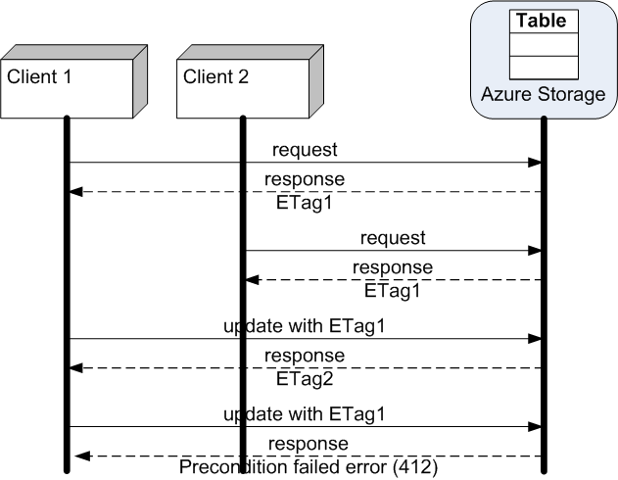
Concurrency Cont.

Slide 69
Concurrency Cont.
To capture concurrency failures, simply wrap the SaveChanges( ) operation in a try/catch block.
You must catch DataServiceRequestException.
When the DataServiceRequestException.Response.First( ).StatusCode is 412, you have detected a request that is trying to update an entity with stale data.
try {
context.UpdateObject(customer);
context.SaveChanges();
} catch (DataServiceRequestException myException){
int status = exc.Response.First().StatusCode;
if (status == 412)
{
//take concurrency update failure action
}
}

Slide 70
Working with Tables and Entities Asynchronously
The operations on tables (and TableServiceContext) shown so far have been synchronous (i.e. blocking).
That is, the code must wait for a return answer from Windows Azure on methods like CreateTableIfNotExist( ) or SaveChanges( ) before continuing.
This could be quite problematic when connecting to and waiting for responses from Windows Azure Storage in a data center far away.
To deal with the possible performance bottlenecks of synchronous requests, many of the methods examined in this chapter have two asynchronous counterparts.
For example, TableServiceContext objects have BeginSaveChanges( ) and EndSaveChanges( ) methods to save entity changes in an asynchronous fashion.

Slide 71
Working with Tables and Entities Asynchronously Cont.
In addition to their normal parameters, all Begin operations require two additional parameters.
First, the method requires a delegate of type AsyncCallback to a callback method called when the asynchronous operation completes.
Second, the method requires a custom state object that contains information about the asynchronous operation.
The Begin methods return an IAsyncResult that references the asynchronous operation.
All End operations use the returned IAsyncResult result of the Begin method to finish the asynchronous operation.

Slide 72
Working with Tables (using REST)
The endpoint for all REST requests for table storage is http://<account name>.table.core.windows.net.
The Storage Emulator endpoint for table storage is http://127.0.0.1:10002/devstoreaccount1
You must sign all table storage requests.
Additional header data may be required, depending on the request.
Of course, each of the Storage Client Library operations examined above is also supported in REST. It has to be since REST is used under the covers.
A complete re-examination of each operation is unwarranted and can be found in documentation (see msdn.microsoft.com/en-us/library/dd179423.aspx).
However, a sampling is provided here to give you a feel for the REST API as it relates to table storage.

Slide 73
Working with Tables (using REST) Cont.
To create a table, send a signed HTTP POST request to http://<account name>.table.core.windows.net/Tables.
The body of the request, shown below, contains the name of the table to create.
<?xml version="1.0" encoding="utf-8" standalone="yes"?>
<entry xmlns:d="http://schemas.microsoft.com/ado/2007/08/dataservices"
xmlns:m="http://schemas.microsoft.com/ado/2007/08/dataservices/metadata
xmlns="http://www.w3.org/2005/Atom">
<title />
<updated>date time</updated>
<author>
<name/>
</author>
<id/>
<content type="application/xml">
<m:properties>
<d:TableName>tablename</d:TableName>
</m:properties>
</content>
</entry>

Slide 74
Working with Tables (using REST) Cont.
Unlike queue and blob storage, the request URI does not contain the name of the thing (in this case a table) to create.

Slide 75
Working with Tables (using REST) Cont.
To get a list of tables in your storage account, send a signed GET request to http://<account name>.table.core.windows.net/Tables.
The response, as shown in the template below, contains the list of tables in the account as an ADO.NET entity set, which is an Atom feed.

Slide 76
Working with Tables (using REST) Cont.
<?xml version="1.0" encoding="utf-8" standalone="yes"?>
<feed xml:base="http://<account name>.tables.core.windows.net/" xmlns:d="http://schemas.microsoft.com/ado/2007/08/dataservices" xmlns:m="http://schemas.microsoft.com/ado/2007/08/dataservices/metadata"
xmlns="http://www.w3.org/2005/Atom">
<title type="text">Tables</title>
<id>http://<account name>.tables.core.windows.net/Tables</id>
<updated>date time</updated>
<link rel="self" title="Tables" href="Tables" />
<entry>
<id>http://<account name>.tables.core.windows.net/Tables('tablename')
</id>
<title type="text"></title>
<updated>date time</updated>
<author>
<name />
</author>
<link rel="edit" title="Tables" href="Tables('tablename')" />
<category term="<account name>.Tables" scheme="http://schemas.microsoft.com/ado/2007/08/dataservices/scheme" />
<content type="application/xml">
<m:properties>
<d:TableName>tablename</d:TableName>
</m:properties>
</content>
</entry>
<entry>
...
</entry>
</feed>

Slide 77
Working with Tables (using REST) Cont.
For an understanding of Atom and ADO.NET see msdn.microsoft.com/en-us/library/cc668769.aspx.
Send a signed HTTP DELETE request to http://<account name>.table.core.windows.net/Tables(‘<tablename>’).

Slide 78
Working with Entities (using REST)
Adding an entity to a table requires you send a signed HTTP POST request to http://<account name>.table.core.windows.net/<tablename>.
The body of the request contains entity property information. Here is an example body to add a new Customer entity.

Slide 79
Working with Entities (using REST) Cont.
<?xml version="1.0" encoding="utf-8" standalone="yes"?>
<entry xmlns:d="http://schemas.microsoft.com/ado/2007/08/dataservices" xmlns:m="http://schemas.microsoft.com/ado/2007/08/dataservices/metadata"
xmlns="http://www.w3.org/2005/Atom">
<title />
<updated>2010-07-26T20:45:15.4636153Z<updated/>
<author>
<name />
</author>
<id />
<content type="application/xml">
<m:properties>
<d:firstName>Joe</d:firstName>
<d:lastName>Smith</d:lastName>
<d:dateOfBirth m:type="Edm.DateTime">1964-01-20T00:00:00</d: dateOfBirth>
<d:phone>612-999-9999</d:phone>
<d:PartitionKey>East</d:PartitionKey>
<d:RowKey>c9da6455-213d-42c9-9a79-3e9149a57833</d:RowKey>
<d:Timestamp m:type="Edm.DateTime">0001-01-01T00:00:00</d:Timestamp>
</m:properties>
</content>
</entry>

Slide 80
Working with Entities (using REST) Cont.
Note the PartitionKey and RowKey properties. You must specify string values for these properties that make up the primary key.
Per the property rules discussed above, these values must be strings up to 64KB in size.
You might also note the m:type attribute associated to non-string properties like dateOfBirth above.
You may explicitly type a property using the appropriate ADO.NET Data Services type with the m:type attribute.
Properties that do not have an explicit m:type attribute are assumed to be of Edm.String type.
Find information on the types at msdn.microsoft.com/en-us/library/dd894033.aspx.

Slide 81
Working with Entities (using REST) Cont.
Importantly, the response body of a successful attempt to add an entity to a table contains the ETag for the newly saved entity.
Here is an example entry element from the response body.
Note the m:etag attribute.
Use the ETag on subsequent updates of the entity. The ETag provides optimistic concurrency.
When the ETag of an updated entity matches the ETag of the entity in table storage, the new version of the entity is accepted.
When the ETags do not match, the update fails. Mismatching ETags is an indication that another client has provided an update of the entity.
<entry xml:base="http://myaccount.table.core.windows.net/" xmlns:d="http://schemas.microsoft.com/ado/2007/08/dataservices" xmlns:m="http://schemas.microsoft.com/ado/2007/08/dataservices/metadata" m:etag="W/&quot;datetime'2008-09-18T23%3A46%3A19.4277424Z'&quot;" xmlns="http://www.w3.org/2005/Atom">

Slide 82
Working with Entities (using REST) Cont.
To update an entity, you send a signed HTTP PUT request containing the PartitionKey and RowKey of the entity.
Here is the format of the URI for the entity update request.
http://<account name>.table.core.windows.net /<tablename>(PartitionKey="<partition key>", RowKey="<row key>")

Slide 83
Working with Entities (using REST) Cont.
The request header, in addition to other required data, must contain an If-Match header.
The If-Match header should contain the ETag of the entity being updated.
This allows the table service to check the version of the entity you have against the version of the entity in the table.
If the two do not match, the service responds with a status code 412 (Precondition Failed).
Optionally, you can also set the If-Match header in the request message to a value of “*”.
Using * as the If-Match header value informs the table service to override the default optimistic concurrency and ignore any mismatch in ETag values.
An entity update request that does not contain an If-Match header receives a status code 400 (Bad Request) response.

Slide 84
Working with Entities (using REST) Cont.
The body of the update entity request looks very similar to the add entity request.
The only real difference is that an entity being updated has a PartitionKey and RowKey known to the table service.
Therefore, the <id> element contains the primary key information.

Slide 85
Working with Entities (using REST) Cont.
<?xml version="1.0" encoding="utf-8" standalone="yes"?>
<entry xmlns:d="http://schemas.microsoft.com/ado/2007/08/dataservices" xmlns:m="http://schemas.microsoft.com/ado/2007/08/dataservices/metadata"
xmlns="http://www.w3.org/2005/Atom">
<title />
<updated>2010-07-26T21:57:24.4636153Z<updated/>
<author>
<name />
</author>
<id http://intertech.table.core.windows.net/customers(PartitionKey=’East’,RowKey='c9da6455-213d-42c9-9a79-3e9149a57833')
</id>
<content type="application/xml">
<m:properties>
<d:firstName>Joseph</d:firstName>
<d:lastName>Smith</d:lastName>
<d:dateOfBirth m:type="Edm.DateTime">1964-01-20T00:00:00</d: dateOfBirth>
<d:phone>612-999-9999</d:phone>
<d:PartitionKey>East</d:PartitionKey>
<d:RowKey>c9da6455-213d-42c9-9a79-3e9149a57833</d:RowKey>
<d:Timestamp m:type="Edm.DateTime">2010-07-26T20:45:15.4636153Z</d:Timestamp>
</m:properties>
</content>
</entry>

Slide 86
Working with Entities (using REST) Cont.
The update entity response has no message body. However, the response header of a successful update contains an ETag value.
This value provides the new ETag for the entity. Use this new ETag for all subsequent entity operations.
To delete an entity, simply send a signed, no body, HTTP DELETE request containing the entity primary key.
Here is the URI format for an entity delete.
While there is no body, don’t forget to include the If-Match header that contains the ETag of the entity.
ETag: W/"datetime'2009-03-18T18%3A09%3A54.9308145Z'"
http://<account name>.table.core.windows.net/ <tablename>(PartitionKey="<partition key>", RowKey="<row key>")

Slide 87
Working with Entities (using REST) Cont.
There are a couple of different signed HTTP GET requests to query for an entity.
The first request returns just a single entity when the primary key (PartitionKey and RowKey) are known.
The second request allows you to provide a LINQ query expression.
Encode any of the characters from the table below if used in the query expression.
http://<account name>.table.core.windows.net/ <tablename>(PartitionKey='<partition key>',RowKey='<row key>')
http://<account name>.table.core.windows.net/ <tablename>()?$filter=<query expression>

Slide 88
Working with Entities (using REST) Cont.
Require Encoding in queries
Forward slash (/)
Question mark (?)
Colon (:)
At symbol (@)
Ampersand (&)
Equal (=)
Plus (+)
Comma (,)
Dollar sign ($)

Slide 89
Working with Entities (using REST) Cont.
A query response contains the entity information. Here is an example response from MSDN.

Slide 90
Working with Entities (using REST) Cont.
<?xml version="1.0" encoding="utf-8" standalone="yes"?>
<feed xml:base="http://myaccount.tables.core.windows.net/" xmlns:d="http://schemas.microsoft.com/ado/2007/08/dataservices" xmlns:m="http://schemas.microsoft.com/ado/2007/08/dataservices/metadata"
xmlns="http://www.w3.org/2005/Atom">
<title type="text">Customers</title>
<id>http://myaccount.tables.core.windows.net/Customers</id>
<updated>2008-10-01T15:26:13Z</updated>
<link rel="self" title="Customers" href="Customers" />
<entry m:etag="W/&quot;datetime'2008-10-01T15%3A26%3A04.6812774Z'&quot;"> <id>http://myaccount.tables.core.windows.net/Customers(PartitionKey='Customer03',RowKey='')</id>
<title type="text"></title>
<updated>2008-10-01T15:26:13Z</updated>
<author>
<name />
</author>
<link rel="edit" title="Customers" href="Customers (PartitionKey='Customer03',RowKey='')" />
<category term="myaccount.Customers" scheme="http://schemas.microsoft.com/ado/2007/08/dataservices/scheme" />
<content type="application/xml">
<m:properties>
<d:PartitionKey>Customer03</d:PartitionKey>
<d:RowKey></d:RowKey>
<d:Timestamp m:type="Edm.DateTime">2008-10-01T15:26:04.6812774Z</d:Timestamp>
<d:Address>123 Lakeview Blvd, Redmond WA 98052</d:Address>
<d:CustomerSince m:type="Edm.DateTime">2008-10-01T15:25:05.2852025Z</d:CustomerSince>
<d:Discount m:type="Edm.Double">10</d:Discount>
<d:Rating m:type="Edm.Int32">3</d:Rating>
</m:properties>
</content>
</entry>
</feed>

Slide 91
Working with Entities (using REST) Cont.
Importantly, note the entry (representing the entity) contains an m:etag attribute.
Again, use the ETag value for subsequent operations on the entity.

Slide 92
Lab Exercise: Table Lab

Slide 93
Chapter Summary
Table storage provides structured data storage.
Table storage allows you to store serialized entities (i.e. domain objects) in simple tables.
Table storage is not a relational database.
Tables hold data in Windows Azure table storage.
You can have any number of tables defined in your Windows Azure Storage account.
There is no size limit on tables (with the exception that the total size of your Windows Azure Storage account cannot exceed 100 TB).
More precisely, tables hold entities.
Simple domain objects represent entities in an application.
Domain objects are often called data transfer objects (DTO) or plain ordinary CLR objects (POCO).
A table can hold any number of entities (up to the 100 TB limit on all of Windows Azure Storage).

Slide 94
Chapter Summary Cont.
Each entity in a table must have three properties: PartitionKey, RowKey and Timestamp.
The PartitionKey and RowKey are strings. Neither the PartitionKey nor RowKey can exceed 1 KB.
Together, the PartitionKey and RowKey uniquely identify each entity.
The Timestamp is a read-only DateTime property managed by Windows Azure. It is the date and time that the entity was inserted (or updated) in the table.
Other properties of an entity are usually referred to as custom properties.

Slide 95
Chapter Summary Cont.
A partition is defined as a collection of entities in a table with the same PartitionKey.
Partitions are the unit of distribution in table storage.
Windows Azure stores entities in the same partition together on the same Windows Azure Storage node. Other partitions may be stored on different nodes.
Windows Azure determines the best node for a partition based on its size (number and size of entities), request traffic, etc.
To create or access a table using the Storage Client Library, you need a CloudTableClient (Microsoft.WindowsAzure.StorageClient) object.
Create the CloudTableClient object via the CloudStorageAccount object.
The CloudTableClient object provides the means to get or create tables in table storage.

Slide 96
Chapter Summary Cont.
The Client Storage API also provides a class, TableServiceContext, which extends DataServiceContext.
TableServiceContext (Microsoft.WindowsAzure.StorageClient )provides methods for updating and retrieving entities in table storage.
TableServiceContext objects provide generic capability to move your entities in and out of table storage.
For example, TableServiceContext already has AddObject( ), UpdateObject( ), and DeleteObject( ) methods to work with your entities.
TableServiceContext also handles a number of underlying details associated with these operations such as a built in retry policy.

