Slide 1
Windows Azure Worker Role
50466 Windows® Azure™ Solutions with Microsoft® Visual Studio® 2010

Slide 2
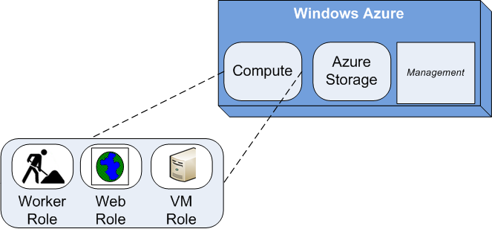
The Worker Role
Worker roles are the second of three types of Windows Azure hosted services. You have already learned about Web roles.
Worker roles, like Web roles, run under Windows Azure Compute Services.
Worker roles provide background processing. It might serve you best to think of a worker role as a Windows service.
Use worker roles for batch processing, queue processing, non-HTTP WCF service hosting, and just plain old “number crunching” activities.

Slide 3
The Worker Role Cont.
Unlike Web roles, the Windows Azure Tools (WAT) for VS provides just one worker role template.
As with Web roles, you can use either Visual C# or Visual Basic to write worker roles.
When you request a Windows Azure project in VS, Windows Azure prompts you to add a worker role to your solution.

Slide 4
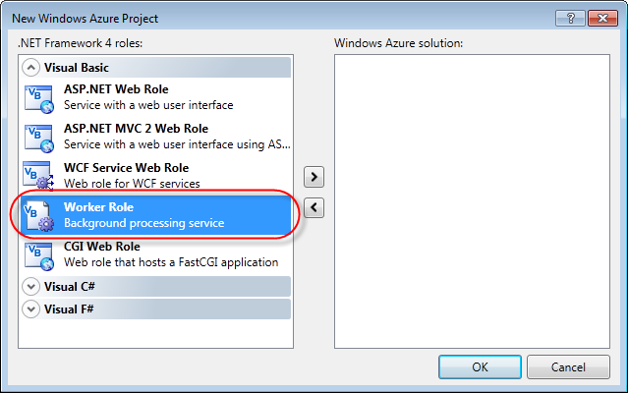
The Worker Role Cont.
You can also add a worker role to an existing cloud project. As you may recall, you may add any number of each role to a Windows Azure project.

Slide 5
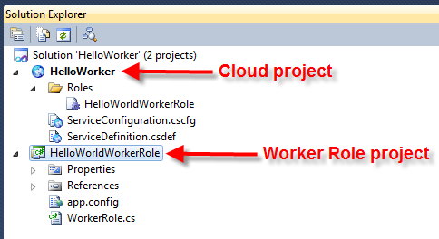
Exploring the Worker Role
When you create or add a worker role to a Windows Azure project, VS adds your worker role to the cloud project.
It also creates a separate project for the worker role.
In this example, the HelloWorldWorkerRole is the worker role project. Notice how the worker role is also added to the cloud project.
Worker role projects are similar to a .NET class library project.

Slide 6
Exploring the Worker Role Cont.
Worker role projects, created by using the cloud templates provided through WAT, have the same Windows Azure namespace references as Web role projects.
Namely, they have references to the three Windows Azure namespaces listed in the table below.
Namespace | Description
Microsoft.WindowsAzure.Diagnostics | Classes for collecting logs and diagnostic information
Microsoft.WindowsAzure.ServiceRuntime | Classes that allow you to interact with the Windows Azure environment
Microsoft.WindowsAzure.StorageClient | A client library for working with the Windows Azure storage services

Slide 7
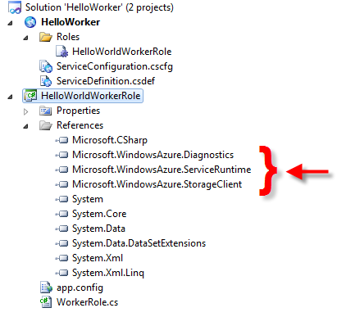
Exploring the Worker Role Cont.
As with Web roles, the Diagnostics and StorageClient namespaces references are not strictly required.
However, they are added by default since they are both often used in both Web and worker roles.

Slide 8
Exploring the Worker Role Cont.
Except for the references, worker role projects have just a WorkerRole.cs file and an app.config file.

Slide 9
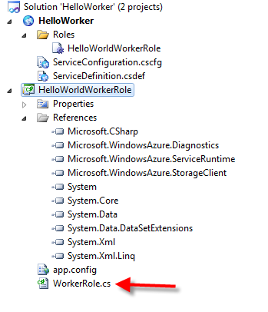
Exploring the Worker Role Cont.
The WorkerRole is the entry or kick-off point for a worker role.
The WorkerRole.cs extends the RoleEntryPoint class (from Microsoft.WindowsAzure.ServiceRuntime namespace).

Slide 10
Exploring the Worker Role Cont.
Does RoleEntryPoint sound familiar? It should. It is the same class that WebRole.cs extends.
By default, the worker role will have OnStart( ) and Run( ) methods.

Slide 11
Exploring the Worker Role Cont.
Like in Web roles, the Windows Azure platform calls the OnStart() method after loading the worker role assembly and starting the role.
By default, the OnStart( ) method looks very similar to the OnStart( ) method in a Web role.

Slide 12
Exploring the Worker Role Cont.
public override bool OnStart()
{
// Set the maximum number of concurrent connections
ServicePointManager.DefaultConnectionLimit = 12;
// For information on handling configuration changes
// see the MSDN topic at
// http://go.microsoft.com/fwlink/?LinkId=166357.
return base.OnStart();
}
public override bool OnStart()
{
ServicePointManager.DefaultConnectionLimit = 12;
DiagnosticMonitor.Start("DiagnosticsConnectionString");
RoleEnvironment.Changing += RoleEnvironmentChanging;
return base.OnStart();
}

Slide 13
Exploring the Worker Role Cont.
The only difference is in the call to ServicePointManager to set the maximum number of concurrent connections allowed by this worker.
Of course, you can add your own code to the OnStart() method to further initialize your worker role for your application needs.
Again, a comment in the role points developers to an MSDN post for how to use the method to establish an event listener for handling configuration changes.
By default, the WorkerRole.cs does not provide an overridden OnStop() method.
However, you may want to add an override the OnStop() method.
Add an OnStop() method to WorkerRole.cs when you want to do clean up of resources used by the role when the worker is stopped.

Slide 14
Exploring the Worker Role Cont.
The Run( ) method is where the worker role performs its work.
After starting and initializing (with OnStart) the role, the Windows Azure platform calls the Run( ) method.
By default, the Run( ) method doesn’t do much. In fact, it just sleeps for 10 seconds and wakes to write a message to the trace log.

Slide 15
Exploring the Worker Role Cont.
public override void Run()
{
// This is a sample worker implementation. Replace with your logic.
Trace.WriteLine("HelloWorldWorkerRole entry point called",
"Information");
while (true)
{
Thread.Sleep(10000);
Trace.WriteLine("Working", "Information");
}
}
Note that the Run( ) method has a continuous loop. This allows the worker role to operate continuously (as long as the role is running).
In fact, if the Run( ) method returns (or stops due to an exception), the role is restarted

Slide 16
Exploring the Worker Role Cont.
Generally, you place a call to a separate method and/or class that you want executed inside the while loop of the Run( ) method.
public override void Run()
{
MyService service = new MyService();
while (true)
{
service.doWork();
Thread.Sleep(10000);
}
}

Slide 17
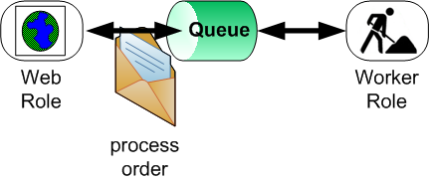
Exploring the Worker Role Cont.
Typically, worker roles poll Windows Azure Storage queues in the Run( ) method.
When another role or outside process needs work accomplished, it deposits a message about the work in a queue.
The worker role poles the queue in the Run( ) method. When a message arrives, it performs the work specified in the message.

Slide 18
Exploring the Worker Role Cont.
public override void Run()
{
CloudStorageAccount storageAccount =
CloudStorageAccount.Parse(RoleEnvironment.
GetConfigurationSettingValue("DataConnectionString"));
CloudQueueClient queueClient =
storageAccount.CreateCloudQueueClient();
CloudQueue queue = queueClient.GetQueueReference("helloqueue");
while (true)
{
CloudQueueMessage workMessage = queue.GetMessage();
if (workMessage != null)
{
//extract the contents of the message and do your work here
queue.DeleteMessage(workMessage);
}
Thread.Sleep(5000);
}
}

Slide 19
Exploring the Worker Role Cont.
Because message size is limited, most recommend that you implement the “work-ticket” pattern in messages.
That is, don’t put the data needed by a process in the message itself. Instead, messages should contain pointers to the real data needed by consumers.
For example, in a message communicating a loan needs to be processed, have the message contain a GUID to a loan application record in some data storage.
Allow the worker role to fetch the loan application itself rather trying to use the message to pass all the loan application data to the worker role.

Slide 20
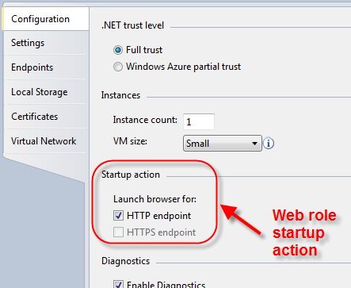
Worker Role Configuration
Most of the configuration of a worker role is identical to Web role configuration.
Refer to the Web role chapter for information on common configuration settings.
Because worker roles have no user interface, the Configuration tab lacks a Startup action.

Slide 21
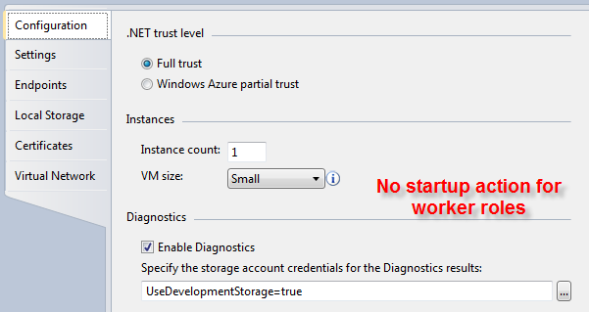
Worker Role Configuration Cont.
Endpoints are configured through the Endpoint tab.

Slide 22
Worker Role Configuration Cont.
A hosted service can have a total of 25 input endpoints.
An input endpoint (covered in more detail in a bit) is an external endpoint that can be accessed from outside the cloud.
The 25 input endpoints can be allocated across 5 roles in the service.
You can allocate all 25 to a single role. You can allocate one per role, or 5 per role. However, the total allocation of input endpoints allowed is 25 for the service.
You are limited to 5 internal endpoints per role. Internal endpoints are also covered in more detail in a bit.
The intended job of worker roles is to perform background processing.
This means, by default, it does not allow inbound connections.
Thus, worker roles have no defined endpoints by default in the Endpoints configuration.

Slide 23
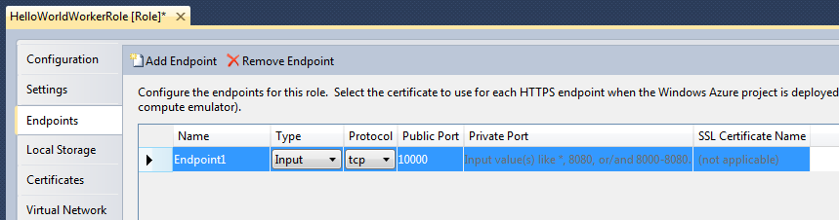
Worker Role Configuration Cont.
However, you can define endpoints for worker roles.
On the Endpoints tab in the configuration GUI, press the Add Endpoint button.
Then, give each endpoint a name.
Additionally when defining an endpoint for a worker role, you must decide its type (either input or internal), protocol to be used (TCP, HTTP, or HTTPS) and ports.

Slide 24
Worker Role Configuration Cont.
The public port setting specifies the external port for input endpoints.
The public port is referred to as “port” in the Azure Service Definition file.
Internal endpoints (also defined in a bit) do not have public ports.
You can specify any port number you choose, but it must be unique across all roles in the service.

Slide 25
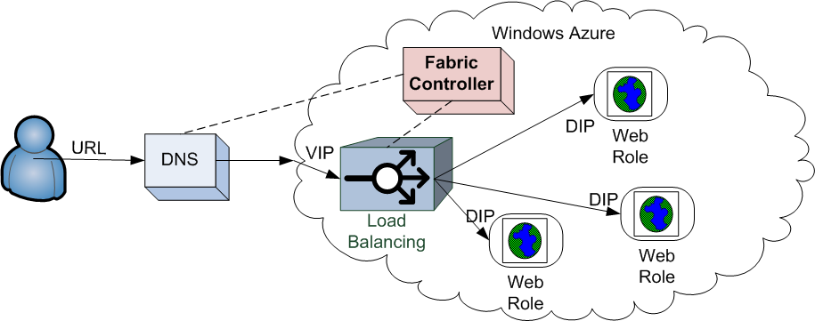
Worker Role Configuration Cont.
The private port setting specifies the internal or private (also known as the local) port for either input or internal endpoints.
The Azure load balancers uses two ports for each input endpoint.
The public port is used for the public IP address, and the private port is used on the private IP address.
Typically, the public and private ports are set to the same value, but you can choose to use different ports.

Slide 26
Worker Role Configuration Cont.
If not specified, the value of private port is the same as the public port.
You can also set the private port to “*” to allow the Windows Azure Fabric to assign an unallocated port.
Inside your application code, the private port can be discovered using the runtime API.
Note, the ports specified in configuration may not be the port used when running in the Compute Emulator.
The Compute Emulator finds and uses an available port. On your development box, some ports may be used that are open in the cloud.
When using HTTPS, you must also specify a SSL Certificate.

Slide 27
Worker Role Configuration Cont.
Input endpoints allow you to expose your worker role as a WCF service to the public.
Note: you are not limited to WCF – for example, a socket connection, PHP connection or native connection are allowed as well.
A better name for these endpoints may have been External endpoints as they expose your worker role to communications in and out of the cloud.
When you create an input endpoint for your worker role, Windows Azure enrolls the load balancer to distribute outside requests to all instances.
Exposed worker roles (via endpoint) are non-IIS based services.

Slide 28
Worker Role Configuration Cont.
Internal endpoints can expose your work role as a WCF service to other internal role instances (Web or other worker roles).
Internal endpoints are not load balanced.
Therefore, if you have multiple instances of a worker role defined with internal endpoints, you must manually distribute calls.
Typically, use worker roles with an internal endpoint in a peer-to-peer manner.
In other words, an externally facing Web or worker role (as shown below) is assigned to an internal endpoint worker role instance.
The externally facing Web or worker role instance always communicates with its assigned internal worker role instance to accomplish work.

Slide 29
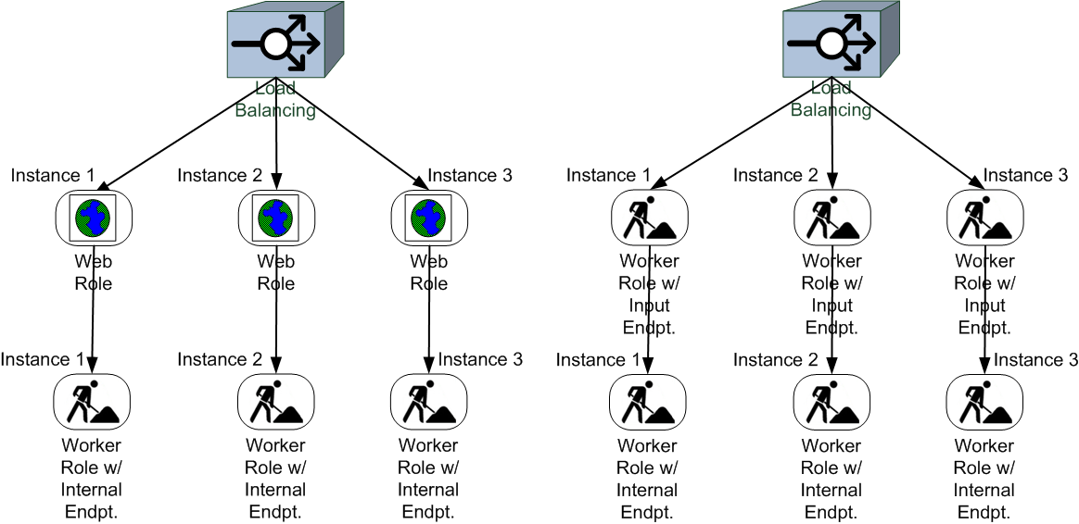
Worker Role Configuration Cont.
A later section provides information on how to build the worker role for internal or external (input) communication as well as how clients can call the service.

Slide 30
Running in the Compute Emulator
As you learned in the Web role chapter, when you press F5 to debug a cloud service project, VS automatically starts the Compute Emulator.
You can see worker role instances running via the Compute Emulator UI just as you can see Web role instances.
In the example below, two instances of the HelloWorldWorkerRole are running.

Slide 31
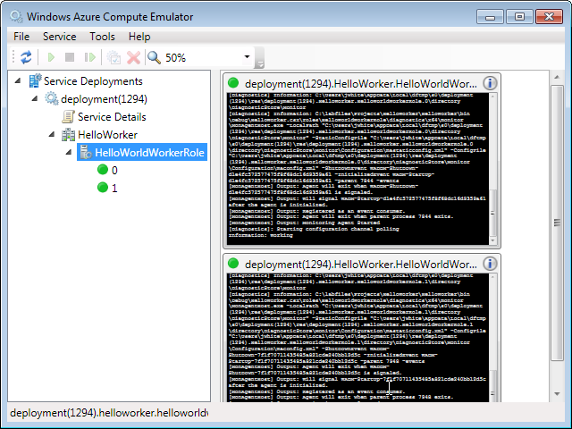
Running in the Compute Emulator Cont.

Slide 32
Running in the Compute Emulator Cont.
On your development box, worker role processes are running as WaWorkerHost.exe processes.
If you open your Task Manager while worker roles are running in the Compute Emulator, you’ll find the processes.
The example below shows the two HelloWorldWorkerRole instances each have their own process.

Slide 33
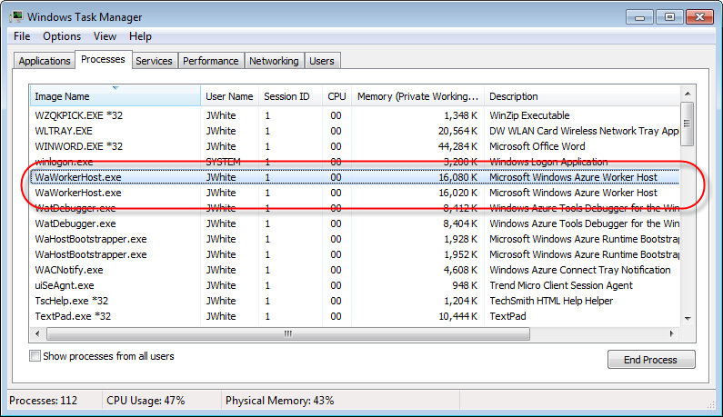
Running in the Compute Emulator Cont.
If you kill one of these processes, you kill the instance running in the Compute Emulator.

Slide 34
Input (External) Endpoint Setup
While not the only option, Windows Communications Framework is a popular option for external communications with a worker role.
Again, however, Windows Azure supports non-WCF endpoints (like PHP) as well.
The endpoint configuration in the service definition helps Windows Azure know what resources the role needs.
Windows Communication Framework (WCF) is fundamental to understanding worker role endpoints described here.
Understanding WCF is necessary whether trying to communicate with a worker role as a client or trying to set up a worker role as a service.
If you are unfamiliar with WCF, learn about WCF here: msdn.microsoft.com/en-us/netframework/aa663324.aspx.

Slide 35
Input (External) Endpoint Setup Cont.
Again, you must first establish the Input Endpoint in your worker role configuration.
You can use the Visual Studio GUI editor (as shown above) to define the endpoint.
However, eventually the endpoint definition (as entered by hand or through the GUI) ends up in the cloud project’s .csdef file.
Here is an example HTTP input endpoint configuration for CalculatorService.

Slide 36
Input (External) Endpoint Setup Cont.
<?xml version="1.0" encoding="utf-8"?>
<ServiceDefinition name="Calculator" xmlns="http://schemas.microsoft.com/ServiceHosting/2008/10/ServiceDefinition">
<WorkerRole name="CalculatorWorkerRole">
<Imports>
<Import moduleName="Diagnostics" />
</Imports>
<Endpoints>
<InputEndpoint name="CalculatorService" protocol="http" port="10000" />
</Endpoints>
</WorkerRole>
</ServiceDefinition>

Slide 37
Input (External) Endpoint Setup Cont.
The worker role configured with an endpoint serves as a means to create and start a WCF service host.
A host needs a WCF service.
For example sake, here is a simple Calculator WCF service class and contract.
[ServiceContract] //using System.ServiceModel
public interface ICalculator
{
[OperationContract]
int Add(int operand1, int operand2);
}
public class Calculator : ICalculator
{
public int Add(int operand1, int operand2)
{
return operand1 + operand2;
}
}

Slide 38
Input (External) Endpoint Setup Cont.
With the service defined, use your worker role to create a WCF service host.
This can be accomplished in many ways. In the example below, a separate method is added to create and start (open) the service host.
In this example, the endpoint protocol is HTTP. Note, the example code does not contain appropriate try/catch exception handling for simplicity.
Furthermore, the HTTP address should not be hardcoded.

Slide 39
Input (External) Endpoint Setup Cont.
private ServiceHost serviceHost;
private void StartService()
{
this.serviceHost = new ServiceHost(typeof(Calculator));
//Define the ABC's (address, binding, contract) of the service
// the address
RoleInstanceEndpoint externalEndPoint = RoleEnvironment.
CurrentRoleInstance.InstanceEndpoints["CalculatorService"];
string address = String.Format("http://{0}/CalculatorService",
externalEndPoint.IPEndpoint);
// the binding
// use HTTP binding with no security (not recommended for prod)
BasicHttpBinding binding = new
BasicHttpBinding(BasicHttpSecurityMode.None);
//the contract
Type contract = typeof(ICalculator);
this.serviceHost.AddServiceEndpoint(contract, binding, address);
//Provide the MEX (metadata exchange) for clients
ServiceMetadataBehavior metadataBehavior = new
ServiceMetadataBehavior();
metadataBehavior.MetadataExporter.PolicyVersion =
PolicyVersion.Policy15;
this.serviceHost.Description.Behaviors.Add(metadataBehavior);
string mexaddress =
String.Format("http://{0}/CalculatorService/mex",
externalEndPoint.IPEndpoint);
this.serviceHost.AddServiceEndpoint(
ServiceMetadataBehavior.MexContractName,
MetadataExchangeBindings.CreateMexHttpBinding(), address2);
this.serviceHost.Open();
}

Slide 40
Input (External) Endpoint Setup Cont.
Note: in order for WCF service metadata to be correctly exposed via its WSDL, .NET 3.5 and Windows Server 2008 R2 fixes are required.
Specifically, you need to apply the KB981002- WCF: Hotfix rollup in .NET 3.5 SP1 for Win 7 and Windows Server 2008 R2 must be applied.
Find the details on Channel 9 at: http://channel9.msdn.com/Shows/Cloud+Cover/Cloud-Cover-Episode-12-Hosting-WCF-and-Inter-role-Communication

Slide 41
Input (External) Endpoint Setup Cont.
Use the OnStart( ) or Run( ) methods to start the service host.
public override void Run()
{
StartService( );
while (true)
{
Thread.Sleep(5000);
Trace.WriteLine("Working", "Information");
}
}
public override bool OnStart()
{
ServicePointManager.DefaultConnectionLimit = 12;
StartService();
return base.OnStart();
}

Slide 42
Input (External) Endpoint Setup Cont.
You should also override the OnStop( ) method to stop the service host when the worker role is stopped.
private void StopService()
{
this.serviceHost.Close();
}
public override void OnStop()
{
Base.OnStop();
StopService();
}

Slide 43
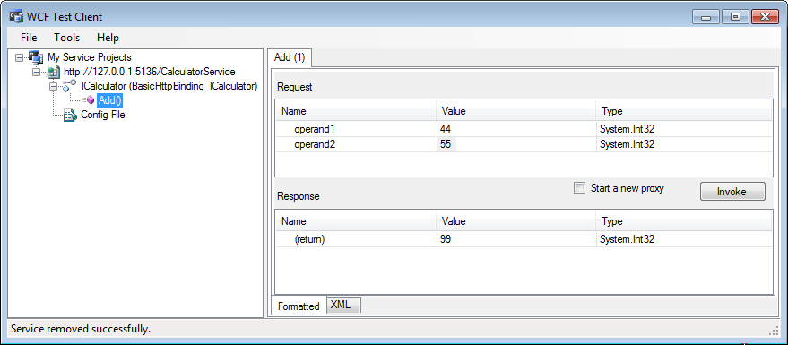
Input (External) Endpoint Setup Cont.
As the Calculator Service is now just a WCF service with an external endpoint, you can develop WCF clients to use the service.
As shown below, you can use Visual Studio’s WcfTestClient.exe tool to connect with and test the service.
As shown in the StartService( ) method above, you may want to enable the Metadata Exchange (MEX) endpoint.

Slide 44
Input (External) Endpoint Setup Cont.
The MEX is a special endpoint in WCF that exposes metadata used to describe a service.
MEX allows .NET developers to use svcutil.exe to generate a proxy class automatically.

Slide 45
Internal Endpoint Setup
Setting up an internal endpoint for a worker role is almost identical to establishing an input (external) endpoint.

Slide 46
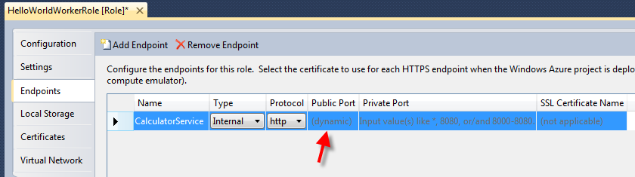
Internal Endpoint Setup Cont.
Again, you must first establish the Internal Endpoint in your worker role configuration.
While you can again use the Visual Studio GUI editor to define the endpoint, eventually the endpoint definition ends up in the cloud project’s .csdef file.
You might notice when using the GUI that a public port is not required.
Since the endpoint cannot be accessed externally, Windows Azure is free to assign a port as needed.

Slide 47
Internal Endpoint Setup Cont.
Here is an example HTTP internal endpoint configuration for CalculatorService. Again, no port is found in this definition.
The same Calculator service (and interface) and StartService( ) method code from the Input example can be reused without change.
<?xml version="1.0" encoding="utf-8"?>
<ServiceDefinition name="Calculator" xmlns="http://schemas.microsoft.com/ServiceHosting/2008/10/ServiceDefinition">
<WorkerRole name="CalculatorWorkerRole">
<Imports>
<Import moduleName="Diagnostics" />
</Imports>
<Endpoints>
< InternalEndpoint name="CalculatorService" protocol="http" />
</Endpoints>
</WorkerRole>
</ServiceDefinition>

Slide 48
Internal Endpoint Setup Cont.
The difference is that this Calculator service can only be connected to from inside the cloud – that is from another worker or Web role.
Here is some example code that connects to each worker role instance input endpoint and requests the service to add two operands.

Slide 49
Internal Endpoint Setup Cont.
var operand1 = 12;
var operand2 = 42;
List<int> answers = new List<int>();
foreach (var instance in
RoleEnvironment.Roles["HelloWorldWorkerRole"].Instances)
{
RoleInstanceEndpoint endpoint =
instance.InstanceEndpoints["CalculatorService"];
IPEndPoint ipAndPort = endpoint.IPEndpoint;
BasicHttpBinding binding = new BasicHttpBinding();
string address = "http://" + ipAndPort.ToString() +
"/CalculatorService";
ChannelFactory<ICalculator> factory =
new ChannelFactory<ICalculator>(binding,
new EndpointAddress(address));
ICalculator wcfClient = factory.CreateChannel();
answers.Add(wcfClient.Add(operand1, operand2));
}

Slide 50
Internal Endpoint Setup Cont.
In real application situations, you probably won’t ask each instance of the worker role service to give you the information you seek.
More likely, you assign an instance of the input endpoint (worker role) to one client (in a peer-to-peer fashion).

Slide 51
Lab Exercise: Worker Role Lab

Slide 52
Chapter Summary
Worker roles, like Web roles, run under Windows Azure Compute Services.
Worker roles provide background processing.
Use worker roles for batch processing, queue processing, non-HTTP WCF service hosting, and just plain old “number crunching” activities.
The Windows Azure Tools (WAT) for VS provides just one worker role template.
Worker role projects are similar to a .NET class library project.
Worker role projects, created by using the cloud templates provided through WAT, have the same Windows Azure namespace references as Web role projects.

Slide 53
Chapter Summary Cont.
Except for the references, worker role project have just a WorkerRole.cs class and an app.config file.
The WorkerRole.cs is the entry or kick-off point for a worker role.
By default, the worker role will have OnStart( ) and Run( ) methods.
The Run( ) method is where the worker role performs its work.
Typically, worker roles poll on Windows Azure Storage queues in the Run( ) method.
Most of the configuration of a worker role is identical to Web role configuration.
Because worker roles have no user interface, the Configuration tab lacks a Startup action.
Using the Endpoints tab, you can define endpoints for worker roles.

Slide 54
Chapter Summary Cont.
Input endpoints expose your worker role as a WCF service to the public.
A better name for these endpoints may have been External endpoints as they expose your worker role to communications in and out of the cloud.
When you create an input endpoint for your worker role, Windows Azure enrolls the load balancer to distribute outside requests to all instances.
Internal endpoints expose your work role as a WCF service to other internal role instances (Web or other worker roles).
Internal endpoints are not load balanced.
Typically, worker roles with an internal endpoint are used in a peer-to-peer manner.
Windows Communication Framework (WCF) is fundamental to understanding worker role endpoints.

