Slide 1
SQL Azure Introduction
50466 Windows® Azure™ Solutions with Microsoft® Visual Studio® 2010

Slide 2
What and Why of SQL Azure
SQL Azure is a highly available, scalable, multi-tenant relational database in the cloud.
As mentioned earlier, SQL Azure is SQL Server at its core.
SQL Azure is not a full-blown SQL Server 2008. This is SQL Server with a number of limitations (covered later).
Some sources have implied SQL Azure is essentially SQL Express.
While not exactly true either, the following quote might help you understand why a comparison to SQL Express can be useful.
Because SQL Azure is SQL Server at its base, most find migrating on-premise databases to the cloud straightforward.
Expect future versions of SQL Azure to contain even more SQL Server features and come closer to true SQL Server in the cloud.
“If your application works today against SQL Express edition and does not make use of some of the more advanced features of SQL Server, then your application should work in the cloud with little or no modification.”

Slide 3
What and Why of SQL Azure Cont.
Like Windows Azure Storage, SQL Azure is independent of other Windows Azure products.
You can certainly use SQL Azure as a relational database in support of cloud applications.
However, you can also use SQL Azure as a database in support of on-premise applications, as a backup data store, or easily provisioned test environment.
What are the benefits of SQL Azure and why consider it in your architecture?

Slide 4
What and Why of SQL Azure Cont.
First and foremost, SQL Azure removes or reduces the typical costs and burdens associated with establishing and managing a data server.
You can provision a SQL Azure instance in minutes.
As with all of Windows Azure, Microsoft owns, operates, and manages the data centers that host your SQL Azure instances.
You simply pay for the SQL Server-like instances/space that you need without having to worry about upgrades, patches, etc.

Slide 5
What and Why of SQL Azure Cont.
SQL Azure is scalable.
You can think of the Microsoft Data Centers as offering a bottom-less cup of SQL Server.
As your data grows, your SQL Azure instances can grow to support that need.
While each instance of SQL Azure is limited to 50GB, you learn techniques for how to partition (covered later) your data to spread across many databases.
So, the only real limit to the size of your entire cloud-based database is the size of your wallet.
Importantly, SQL Azure allows you to scale down just as fast as you scaled up. Simply remove instances no longer needed as your data need shrinks.

Slide 6
What and Why of SQL Azure Cont.
SQL Azure is always available.
Your database is, just like Windows Azure Storage, replicated three times (an original and two backups).
Therefore, even during hardware failure, your database is available to applications that use it.
You cover how replication is accomplished and managed later in this chapter.

Slide 7
What and Why of SQL Azure Cont.
SQL Azure provides a familiar persistence platform to developers and database administrators
When first announce at Professional Developers Conference 2008, Windows Azure did not have a relational database component.
There was a persistent structured storage capability (not unlike table storage), but it was not relational database technology.
Microsoft added SQL Azure because of the feedback from the community.
The result is the familiar SQL, relational database platform in the cloud that the IT community has come to know, if not love.
This allows organizations to leverage existing tools, libraries, and even developer knowledge to build databases and applications that use them.
For example, you can use ADO.NET and Tabular Data Stream (TDS) to work with SQL Azure.
This also allows easy migration from on-premise relational databases to SQL Azure.

Slide 8
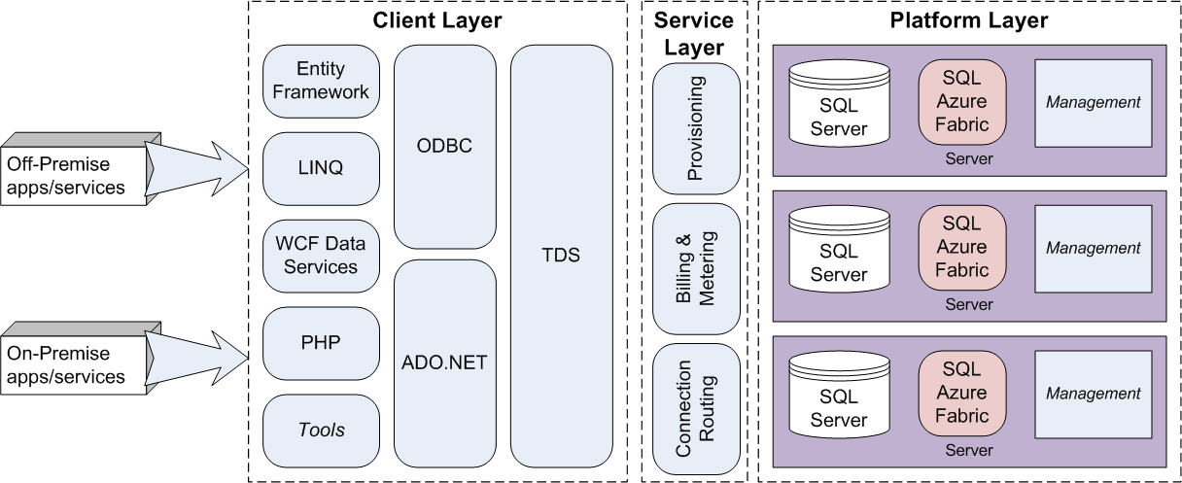
SQL Azure Architecture
While SQL Azure is based on SQL Server, the architecture is such that you are not connecting directly to SQL Azure as you might connect to SQL Server.

Slide 9
SQL Azure Architecture Cont.
In fact, SQL Azure is a service that mimics a SQL Server instance, but in fact wraps multiple instances of SQL Server under the covers.
Thankfully, as a developer or user of the SQL Azure database, the details are obfuscated from you.
However, it is largely because of the architecture that certain commands and features are removed in SQL Azure.
SQL commands and features, for instance, that work based on the physical infrastructure of SQL Server would not work on SQL Azure.

Slide 10
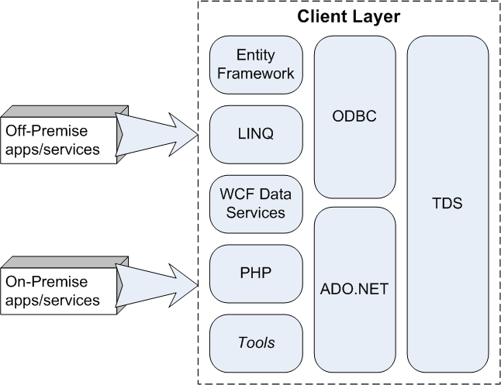
SQL Azure Architecture Cont.
As a client of SQL Azure, you use the tools and APIs familiar to you to access and manage your database.
Microsoft calls this the Client Layer and there isn’t anything new in this layer.
The client layer includes, but is not limited to WCF Data Services, LINQ, Entity Framework, etc. These use ADO.NET or ODBC under the covers.
You can also use ODBC or ADO.NET directly.
At the bottom of the client layer is a tabular data stream (TDS). SQL Azure uses the same TDS interface as SQL Server.

Slide 11
SQL Azure Architecture Cont.
As a client, you connect to the Service Layer, not directly to the SQL Server database.
This layer obfuscates the complexity that is SQL Azure.
The Service Layer is exposed through a secure (SSL) TDS connection on port 1433.
The Service Layer takes care of the administrative duties (provisioning, billing and metering) for the pay-as-you-go databases.
Provisioning requires the Service Layer to communicate with the SQL Azure Fabric (covered below).
In addition, the Service Layer routes your request for data to the appropriate server under the covers.
The Service Layer also provides the firewalling, which is covered later.

Slide 12
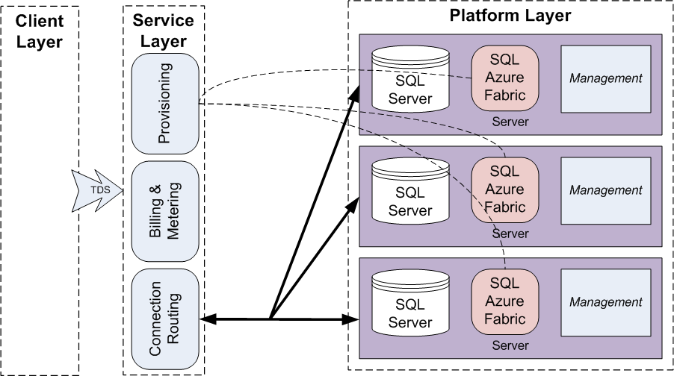
SQL Azure Architecture Cont.

Slide 13
SQL Azure Architecture Cont.
Specifically, SQL Azure supports the drivers and libraries listed in the table below when writing applications to use SQL Azure data.
Connecting by using OLE DB is not supported.
SQL Azure Supported Drivers and Libraries
.NET Framework Data Provider for SQL Server (System.Data.SqlClient) from the .NET Framework 3.5 Service Pack 1 or later
Entity Framework from the .NET Framework 3.5 Service Pack 1 or later
SQL Server 2008 R2 Native Client ODBC driver. SQL Server 2008 Native Client ODBC driver is also supported, but has less functionality
SQL Server 2008 Driver for PHP version 1.1 or later
Tabular data stream (TDS) protocol client version 7.3 or later. Earlier versions of TDS protocol are not supported

Slide 14
SQL Azure Architecture Cont.
The Service Layer routes requests to the Platform Layer.
More precisely the Service Layer routes requests to a server hosting SQL Server.
SQL Azure Fabric manages SQL Server running on all those servers.
SQL Azure Fabric provides the automatic replication, failover, and load balancing across the SQL Server instances.
Additionally, management services on the servers monitor the health of the server and allow automated installation of service upgrades and software patches.

Slide 15
SQL Azure Architecture Cont.
There are three replicas of your data in the Platform Layer.
Whenever a replica fails, SQL Azure takes the replica out of the pool and creates a new replica.
SQL Azure Fabric may also move a replica (from one server to another) for performance reasons (attempting to keep the loads smooth across all servers).
The SQL Azure Fabric designates one of the replicas as the lead replica.
Therefore, the connection router (in the Service Layer) looks for the lead replica and routes all requests to the server hosting the lead replica.
However, SQL Azure Fabric distributes any changes to the data in the lead replica to the other replicas (using a custom replication process).
When the lead replica fails, SQL Azure Fabric takes the failed instance out of the replica pool and designates a new leader.

Slide 16
SQL Azure Architecture Cont.
Of course, the Platform Layer runs on physical hardware (and associated operating system) in the Microsoft Data Center.
While not pictured above, Microsoft calls this layer the Infrastructure Layer.
The Infrastructure Layer includes the physical disks and networks to host your data.
The Infrastructure Layer is similar to a SAN used in many data architectures.

Slide 17
SQL Azure vs. SQL Server
SQL Azure is based on SQL Server 2008 R2.
Some of the features of SQL Server 2008 R2 are not in SQL Azure.
SQL Azure supports a subset of Transact-SQL (T-SQL) and the TDS protocol.
For a comprehensive look at the limitations and differences, see msdn.microsoft.com/en-us/library/ee336245.aspx.
For a list of supported and not supported T-SQL language elements in SQL Azure see msdn.microsoft.com/en-us/library/ee336250.aspx.
A paper written by the SQL Azure product team compares SQL Azure against SQL Server. Find the paper at social.technet.microsoft.com/wiki/contents/articles/comparing-sql-server-with-sql-azure.aspx.

Slide 18
SQL Azure vs. SQL Server Cont.
The table below contains an abbreviated list of unsupported T-SQL and SQL Server features as presented in the Microsoft Windows Azure Bootcamp.

Slide 19
SQL Azure vs. SQL Server Cont.
SQL Server 2008 Feature not found in SQL Azure
Change Data Capture
Data Auditing
Data Compression
Extended Events
External Key Management / Extensible Key Management
FILESTREAM Data
Integrated Full-Text Search
Large User-Defined Aggregates (UDAs)
Large User-Defined Types (UDTs)
Performance Data Collection (Data Collector)
Policy-Based Management
Resource Governor
Sparse Columns
Spatial data with GEOGRAPHY and GEOMETRY data types
SQL Server Replication
Transparent Data Encryption
Common Language Runtime (CLR) and CLR User-Defined Types
Database Mirroring
Service Broker
Table Partitioning
Typed XML and XML indexing (XML data type is supported)
Backup and Restore
Replication
Extended Stored Procedures
Windows Authentication

Slide 20
SQL Azure vs. SQL Server Cont.
Importantly, note SQL Azure does not provide backup and restore capability.
Somewhat along the same line, SQL Azure does not support traditional replication or data mirroring.
SQL Azure automatically replicates your data three times.
However, there are times when you need to copy your database for purposes outside of availability.
This shortcoming, and how to handle it, is covered later in the chapter.

Slide 21
SQL Azure vs. SQL Server Cont.
Another key differentiation point is on database size limits.
SQL Azure databases are limited in size.
For all practical purposes, there is no size limits to data storage in SQL Server.
You must select the size of SQL Azure database that meets your needs. With increased size comes increased cost (covered below).
SQL Azure database instances today can be 1, 5, 10, 20, 30, 40, or 50GB.
Unfortunately, the size of the database does not increment automatically.
Once a database reaches its limit, the database allows only selects and deletes. Attempts to insert into the database result in an error (error code 40544).
If your database grows beyond its initial limit, (say 5GB) you must alter the database (and of course pay the additional cost for the new bigger database).

Slide 22
SQL Azure vs. SQL Server Cont.
If your database grows beyond 50GB (the current storage limit in SQL Azure) you must consider an alternate database design.
Database partitioning is covered later as a way to manage very large databases across multiple SQL Azure instances.

Slide 23
SQL Azure Costs
The size of your database determines SQL Azure cost.
The table below lists the cost (in US Dollars) for the available database size up to the current limit of 50GB.
You can find the complete SQL Azure pricing guide at www.microsoft.com/windowsazure/pricing/#sql.
Relational Database Size | Edition | Cost per month
1 GB | Web | $9.99
5 GB | Web | $49.95
10 GB | Business | $99.99
20 GB | Business | $199.98
30 GB | Business | $299.97
40 GB | Business | $399.96
50 GB | Business | $499.95

Slide 24
SQL Azure Costs Cont.
Importantly, the monthly fee is amortized over the month and charged on a daily basis.
You might note that Microsoft has designated the smaller sized databases as “Web Edition” instances.
Larger databases are designated as “Business Edition” instances.
Except for the size differential, the only other feature listed for Business Edition databases is
Use Web Edition databases in support of Web applications where less storage is typically required.
Data from Web applications is often off-loaded at some time to an enterprise database.
Business Edition databases are meant to support larger, enterprise applications (like SaaS ISV apps says the Microsoft pricing page) apps
“Additional features in the future like auto-partition, CLR, fanouts etc.”

Slide 25
SQL Azure Costs Cont.
In addition to the monthly costs associated to the database, you pay bandwidth charges (the same charge applies for Windows Azure Storage).
That is, you pay for data transferred into and out of your database.
The table below lists the bandwidth costs (in US Dollars).
According to Microsoft, it costs more to build and operate Asian data centers.
Importantly, data transfers within a region are free!
If you have cloud-based applications, putting them in the same region as your database helps save you money.
The Service Level Agreement for SQL Azure ensures your database will be available 99.99% of any calendar month.
Data Center Location | Bandwidth Cost Out | Bandwidth Cost In
Asia | $0.45/GB | $0.30/GB
Outside of Asia | $0.15/GB | $0.10/GB

Slide 26
SQL Azure Costs Cont.
As discussed in the table storage chapter, SQL Azure is more expensive than Windows Azure Storage, and in particular table storage.
Table storage has also a 100TB limit compared to the current 50GB limit in SQL Azure.
SQL Azure offers more features (relationships, indexes, queries, etc.) but at a price.
SQL Azure is also based on the familiar (relational database, T-SQL, TDS, etc.), making migration to SQL Azure easier.
Weigh all your options as you think about your data storage needs.

Slide 27
SQL Azure Account Setup and Server Provisioning
To create a database in the cloud, start where all cloud development begins: in the Developer Portal.
You must have a Windows Azure account to use SQL Azure.
You can start at the Windows Azure Developer Portal (windows.azure.com) and click on the Database in the Navigation tab displayed on the left of the Portal.

Slide 28
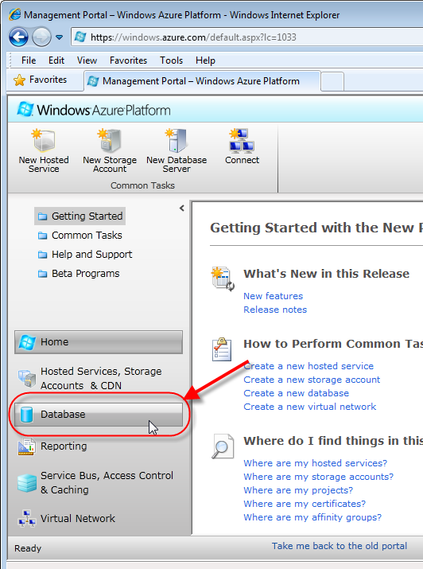
SQL Azure Account Setup and Server Provisioning Cont.

Slide 29
SQL Azure Account Setup and Server Provisioning Cont.
When you click on “Database” in the Home view, you are taken to the Database view.

Slide 30
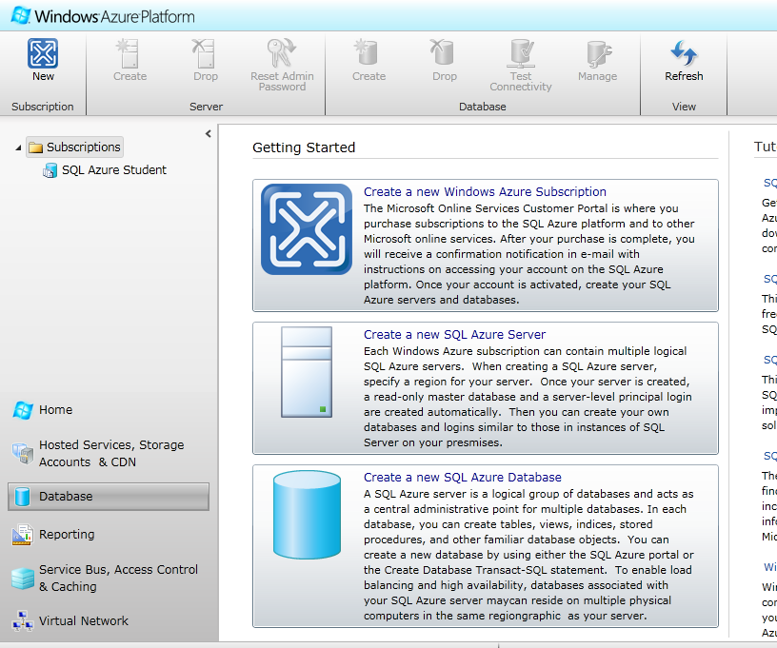
SQL Azure Account Setup and Server Provisioning Cont.
Through the Database view, you can manage your Azure subscriptions, SQL Azure servers, and databases.

Slide 31
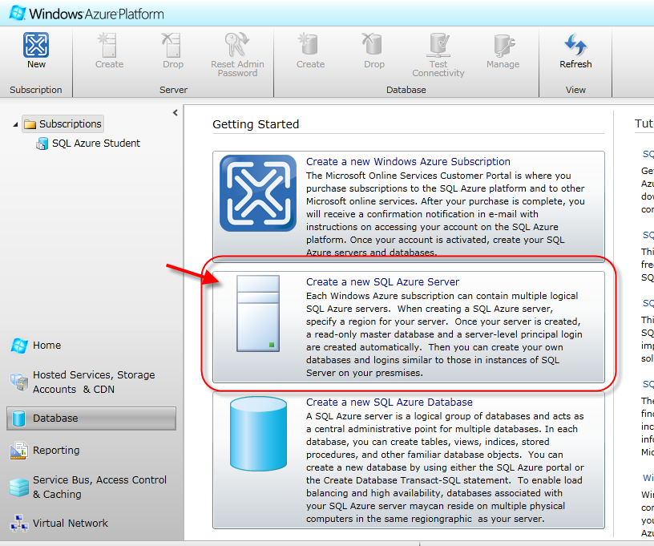
SQL Azure Account Setup and Server Provisioning Cont.
Before you can create a database, you first need a SQL Azure server.
Click on the Create a new SQL Azure Server link to create a SQL Azure server and an administrator to manage the server.

Slide 32
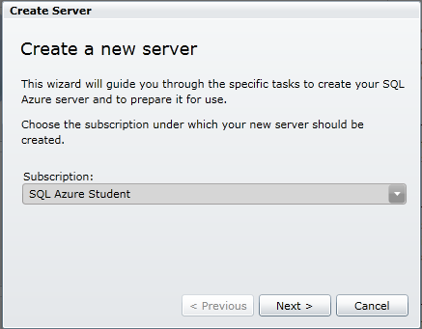
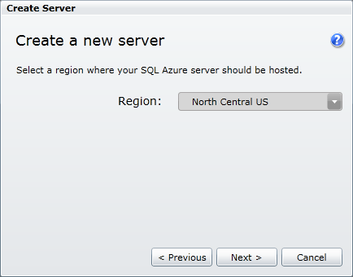
SQL Azure Account Setup and Server Provisioning Cont.
A wizard will take you through the required information for the server and administrator.

Slide 33
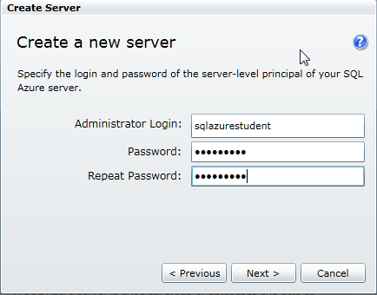
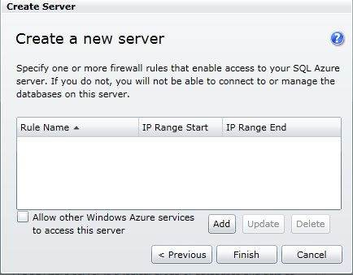
SQL Azure Account Setup and Server Provisioning Cont.
A server (or more appropriately a virtual server) is a logical container for your SQL Azure database instances.
The server is virtual in that your server’s databases (and all their replicas) may stretch across multiple physical servers in the data center.
Today, you are allowed only one SQL Azure server per Windows Azure platform subscription.

Slide 34
SQL Azure Account Setup and Server Provisioning Cont.
When you create a server, you must select the region of the data center in which it resides.
Remember, if your application is in the same location as your database there are no bandwidth charges between the cloud-based application and the database.

Slide 35
SQL Azure Account Setup and Server Provisioning Cont.
SQL Azure does not use Affinity Groups. You establish affinity simply by picking the same region as your cloud-based applications (or other databases).

Slide 36
SQL Azure Account Setup and Server Provisioning Cont.
The administrator account that you establish during the server creation is similar to the server-level principal system administrator (sa) in SQL Server.
The SQL Azure administrator always has permission to manage all server-level and database-level security.
When creating the server, you must provide an administrator’s username and password into fields provided.

Slide 37
SQL Azure Account Setup and Server Provisioning Cont.
Passwords must be “strong”, which means they must be at least eight characters long and follow password complexity policies for SQL Server 2008 R2.

Slide 38
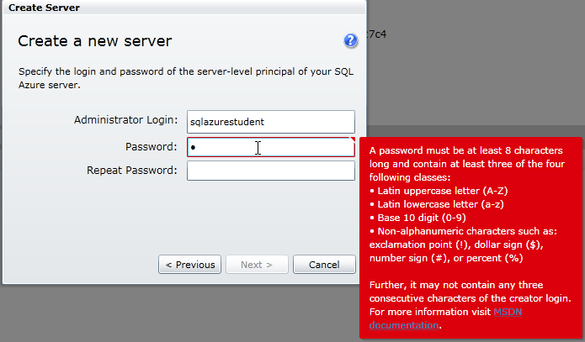
SQL Azure Account Setup and Server Provisioning Cont.

Slide 39
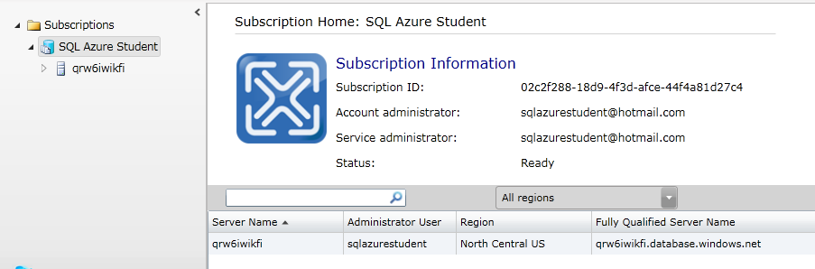
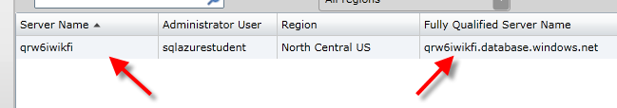
SQL Azure Account Setup and Server Provisioning Cont.
After creating a server (and server administrator login), the Portal presents you with your server’s admin page.
Your new server is listed under your subscriptions.
In this display, you can find your server’s generated name and URL.

Slide 40
SQL Azure Account Setup and Server Provisioning Cont.
Think of the URL as equivalent to the name of a SQL Server machine. In fact, you use the URL as you use a SQL Server’s name in connection strings, tools, etc.
Remember, however, your SQL Azure databases spread across multiple machines. Therefore, this URL is just a façade into the Service Layer.

Slide 41
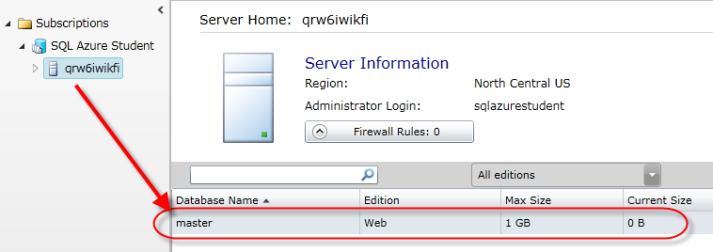
SQL Azure Account Setup and Server Provisioning Cont.
By default, SQL Azure provisions a master database for you.
You can locate the master database by clicking on the server listed under your subscription in the Portal.
The master database is similar to the master database in SQL Server and serves the same purpose.
The master database is a read-only database that holds logins, login permissions (to create databases for example), firewall settings, and usage metrics.

Slide 42
SQL Azure Account Setup and Server Provisioning Cont.
You must be able to connect to the master database to CREATE, ALTER, or DROP logins or databases.
Don’t worry, Microsoft does not charge you for the master database.

Slide 43
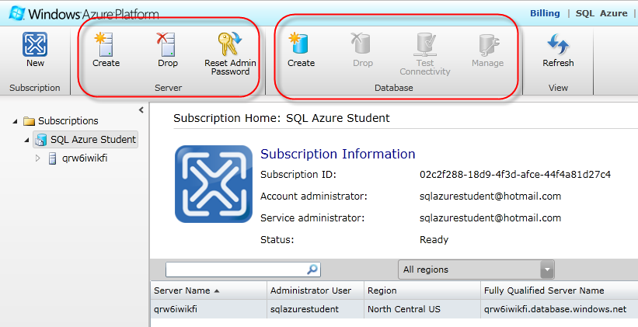
SQL Azure Account Setup and Server Provisioning Cont.
Through the icon menu bar on the Portal, there are facilities to manage the server (drop, admin password reset, etc) and create/manage associated databases.
Databases you create are tied to the server.

Slide 44
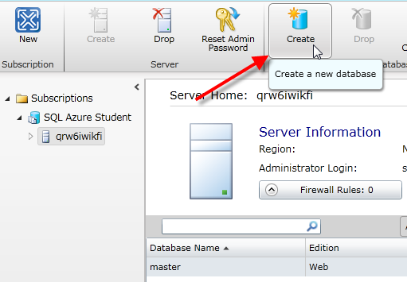
SQL Azure Account Setup and Server Provisioning Cont.
If you drop the server, you drop all the databases tied to it.
Each SQL Azure server can contain multiple databases.
Click on the Create icon (in the Database category) in the icon menu bar to create a new database for the server.
Each database can have tables, views, indices, stored procedures, etc. just as you would find in a SQL Server database.

Slide 45
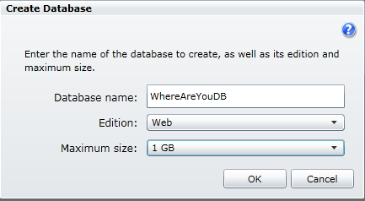
SQL Azure Account Setup and Server Provisioning Cont.
When creating a database, you specify the database name, edition (Web or Business), and maximum size. The edition determines the available max sizes.
You can alter the name, edition type, and size of the database with an ALTER DATABASE T-SQL statement (more on how to execute statements to the database in a bit).
Once created, the database shows up in the list of databases.

Slide 46
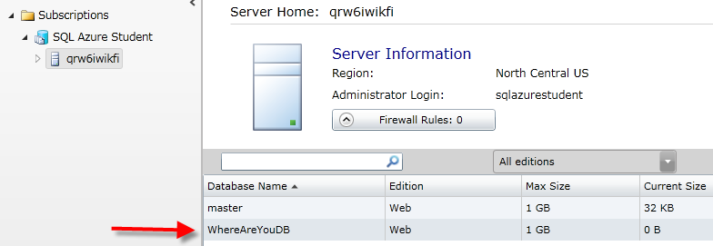
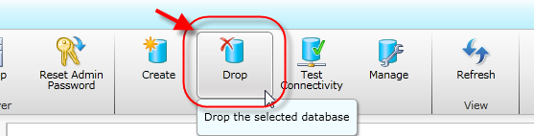
SQL Azure Account Setup and Server Provisioning Cont.
Click on a database in the list of databases and then click on the Drop database button to remove the database.

Slide 47
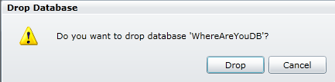
SQL Azure Account Setup and Server Provisioning Cont.
As you see in moment, you can also use other tools to create, delete, and manage databases.

Slide 48
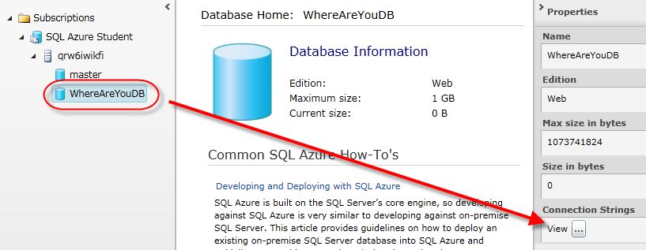
SQL Azure Account Setup and Server Provisioning Cont.
How do you connect to the SQL Azure databases you create?
Conveniently, a button is provided to see the ADO.NET, ODBC and PHP code connection strings.
Once created, select the database from the database listing under the server. Then click on the View button under the Connection Strings in the Properties display

Slide 49
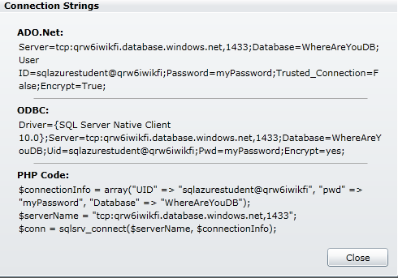
SQL Azure Account Setup and Server Provisioning Cont.
The Connection Strings utility comes in handy when building applications (more later).

Slide 50
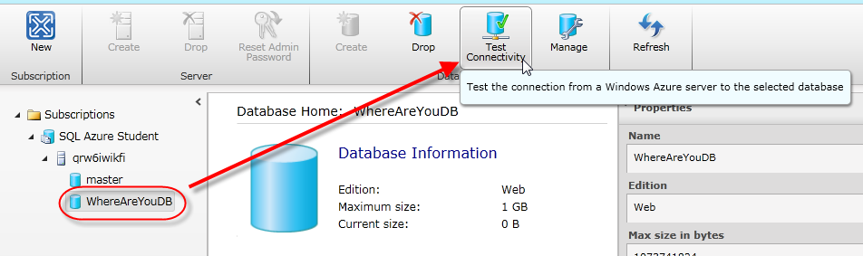
SQL Azure Account Setup and Server Provisioning Cont.
You can also test the connection strings by pushing the Test Connectivity icon in the menu bar with the database selected.

Slide 51
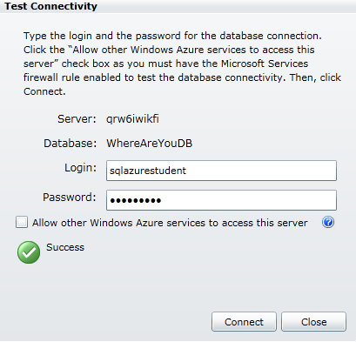
SQL Azure Account Setup and Server Provisioning Cont.
In order to test connectivity, you must have a firewall rule in place to allow access from within Windows Azure.
That is why the check box at the bottom of the window is provided.
If you have not yet set up firewall rules, check the “Allow other Windows Azure services to access this server” checkbox.

Slide 52
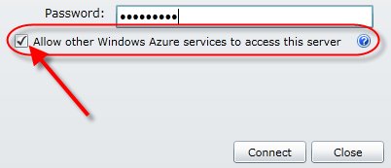
SQL Azure Account Setup and Server Provisioning Cont.
You learn about firewall rules in the next section.

Slide 53
Database Firewall and Access Control
SQL Azure blocks access to your server from any incoming IP address.
In fact, SQL Azure doesn’t even allow access to the database from IP addresses from inside the cloud (such as from one of your Windows Azure roles).
To allow access to your server and its databases, you must add firewall rules.
A firewall rule simply identifies IP address ranges from which you allow database requests.
Firewall rules are stored in the master database.
In fact, you can see them with the following query:
select * from sys.firewall_rules

Slide 54
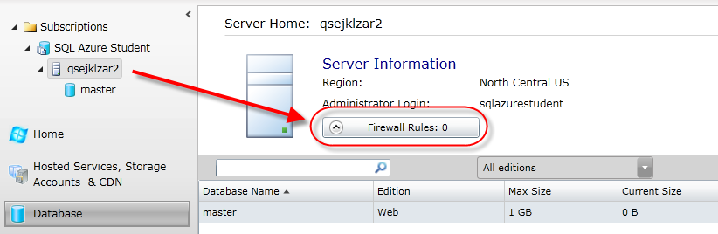
Database Firewall and Access Control Cont.
Find a Firewall Rules button when you select your server in the Database view via the Portal.

Slide 55
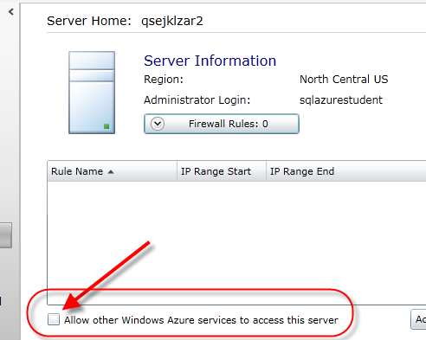
Database Firewall and Access Control Cont.
At the bottom of the Firewall Settings, find the Allow other Windows Azure services to access this server checkbox.
Checking this box allows applications in Windows Azure to talk to the database (no need to supply an IP address range for them – you wouldn’t know it anyway).

Slide 56
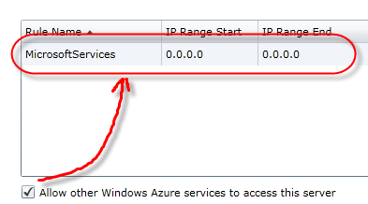
Database Firewall and Access Control Cont.
You do not have to worry about whether the application is in the same or different data center.
If it is checked, SQL Azure allows the application to talk to the database.
A firewall setting with starting and ending address equal to 0.0.0.0 has the same effect as checking the “Allow other Windows Azure…” checkbox.
In fact, checking the checkbox automatically adds a 0.0.0.0 ranged firewall rule under the name of MicrosoftServices.

Slide 57
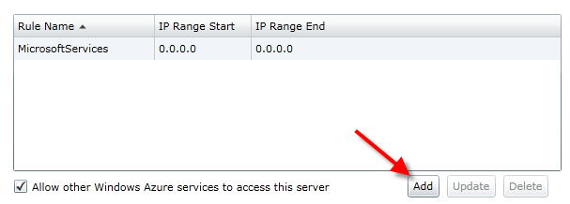
Database Firewall and Access Control Cont.
To allow on-premise applications and tools access to SQL Azure, hit the Add button below the rule listing on the page.
In the Add Firewall Rule dialog window, you must enter an IP Address range and provide a name to your rule.

Slide 58
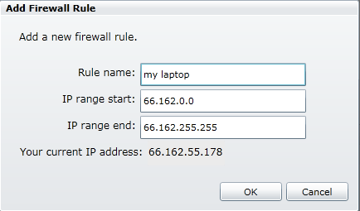
Database Firewall and Access Control Cont.
Conveniently, the Portal detects your incoming IP address and displays it on the screen for you.
This allows you to add a firewall rule that incorporates your current machine for access without having to dig around your machine configuration for an IP address.

Slide 59
Database Firewall and Access Control Cont.
ISPs dynamically assign most IP addresses. You may have to alter this rule frequently.
Update and remove firewall rules when necessary using the Edit and Delete Rule buttons.
As a side note, you can use http://whatismyipaddress.com/ to determine and monitor your IP address.

Slide 60
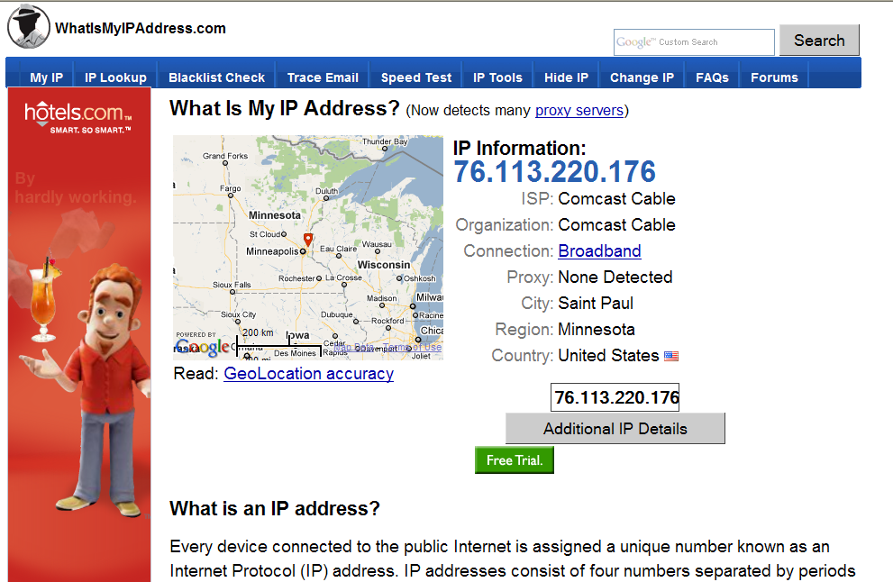
Database Firewall and Access Control Cont.

Slide 61
Database Firewall and Access Control Cont.
SQL Azure caches firewall rules in order to speed up rules checks on incoming requests.
SQL Azure updates the cache every five minutes.
Therefore, wait up to five minutes before trying to access the database from the IP address of a newly entered rule.
The wizard that takes you through the required information for creating a server and administrator allows you to create firewall rules at the same time.
You can also use stored procedures in the master database to create firewall rules.
Use Azure provided sp_set_firewall_rule and sp_delete_firewall_rule stored procedures to add and remove firewall rules by stored procedure.

Slide 62
Database Firewall and Access Control Cont.
Firewall access provides the means to deny large swaths of machines from accessing your data.
However, you should also create database login accounts and permissions for required activity to databases just as you do in SQL Server.
In fact, many advise against using the administrator for activities other than managing your server.
Details on how to set up user accounts to the database is coming up.

Slide 63
SQL Azure Tools
SQL Azure is SQL Server 2008 R2 at its base.
Therefore, you can use most of the tools used to access and manage SQL Server 2008 R2 databases on SQL Azure databases.
This includes, but is not limited to SQL Server Management Studio (SSMS), SQLCMD, and Visual Studio.
You can find a detailed list of supported tools at msdn.microsoft.com/en-us/library/ee621784.aspx.

Slide 64
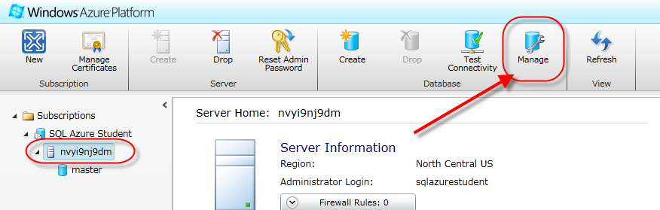
SQL Azure Tools Cont.
You can also use the Database Manager for SQL Azure. This is a lightweight and easy-to-use Web-based database management tool.
It is meant to provide a means for Web developers to quickly develop, deploy, and manage data-driven applications in the cloud.
The Database Manager is part of the Windows Azure Platform Management Portal.
Once you have a server, click on the Manage icon button in the icon menu bar to open the Database Manager.

Slide 65
SQL Azure Tools Cont.
This causes a Database Manager hosted service located in the same data center as your SQL Azure database to launch in a separate browser tab or window.

Slide 66
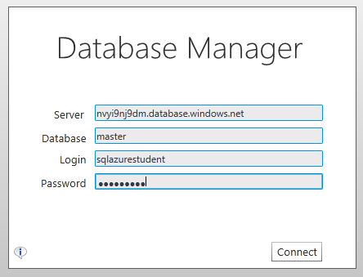
Database Manager for SQL Azure
You must login to the Database Manager.
In the login dialog, the server name, database name, and login fields will automatically be populated based on what is selected in the Portal.
You may need to turn off pop-up blockers for the Database Manager site.

Slide 67
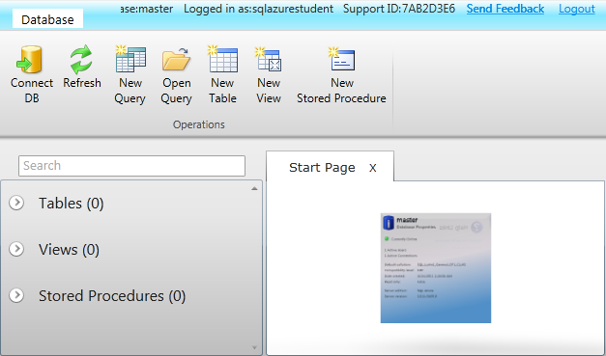
Database Manager for SQL Azure Cont.
Once logged in, the Database Manager supports basic database management.
You can use the Database Manager to design and edit tables, views, and stored procedures, and author and execute T-SQL queries.
In the example below, the master database is queried for the firewall rules.

Slide 68
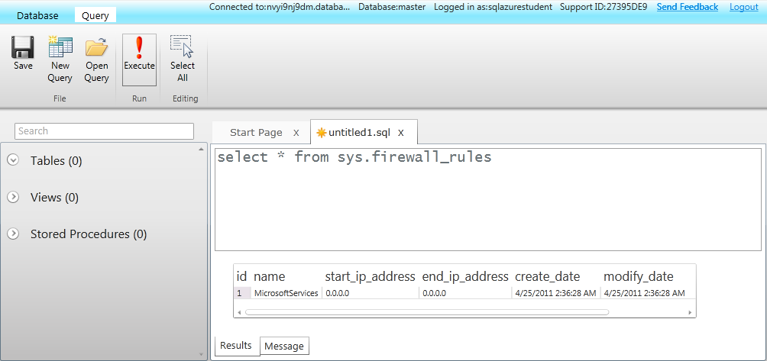
Database Manager for SQL Azure Cont.

Slide 69
SSMS and SQL Azure
Another popular tool used by SQL Server developers is SSMS.
Specifically, SSMS from SQL Server 2008 R2 and SQL Server 2008 R2 Express have built-in support for SQL Azure.
Per MSDN, “Previous versions of SQL Server Management Studio are not supported.”
Other sources claim that earlier versions of SSMS may work.
However, with earlier versions, you must enter queries manually. Furthermore, much of the GUI integration does not work.

Slide 70
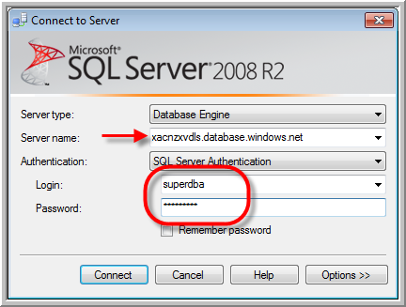
SSMS and SQL Azure Cont.
To connect SSMS to your SQL Azure server, use the server URL as the server name in the Connect to Server dialog.
SQL Azure only allows SQL Server Authentication for connecting at this time.
Use a valid username and password. The SQL Azure server administrator’s username and password are used in this example.

Slide 71
SSMS and SQL Azure Cont.
You’ll see how to set up non-admin accounts for use in gaining access later in this chapter.

Slide 72
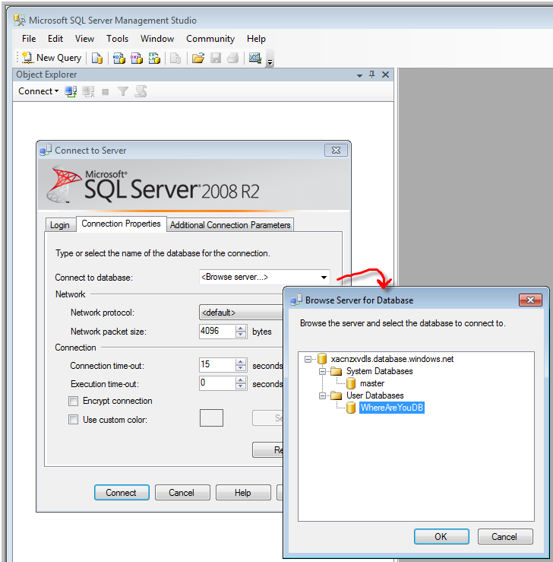
SSMS and SQL Azure Cont.
By default, SSMS connects you to the master database.
Use the Options>> button to specify connection to an alternate database.
You can even use the Browse Server for Database dialog to list and select from available databases on your server.

Slide 73
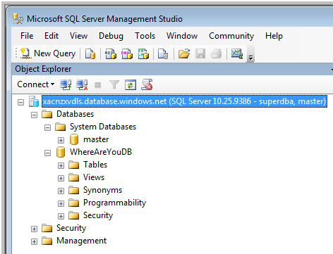
SSMS and SQL Azure Cont.
Once connected, the Object Explorer opens.
At this point, you are able to use SSMS to manage and manipulate the databases as you would on any SQL Server instance.
An examination of the databases should reveal the master database and any others you have created.

Slide 74
SSMS and SQL Azure Cont.
Some common and simple database activities you can accomplish in your SQL Azure server with SSMS are covered in the next section.

Slide 75
Other Tools and SQL Azure
SQLCMD is another popular tool for executing commands on SQL Server.
SQLCMD (formally sqlcmd.exe) is a command line utility provided with SQL Server (versions 2005 an later).
This utility is primarily used to automate the execution of SQL commands, such as those kicked off on in schedulers.

Slide 76
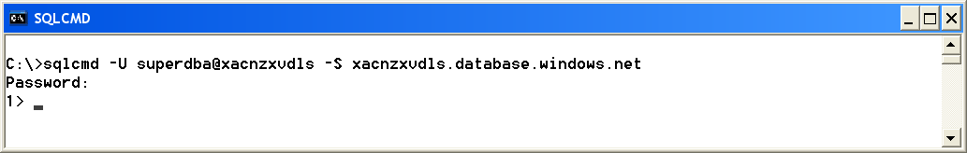
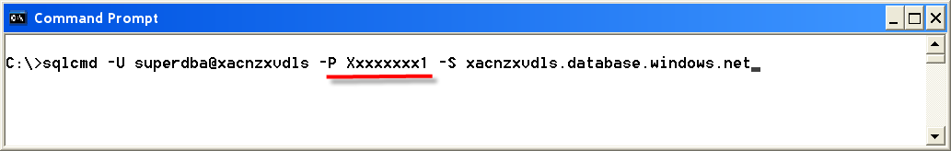
Other Tools and SQL Azure Cont.
To connect SQLCMD to SQL Azure, use the SQL Azure URL as the server name as the –S (server) parameter when launching SQLCMD.
You must also provide a valid username to your SQL Azure server with a –U (user) parameter (as shown below).
SQLCMD prompts you for the user’s password.
An optional –P parameter can be used to provide the password when launching SLQCMD.

Slide 77
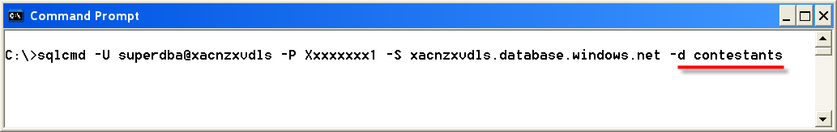
Other Tools and SQL Azure Cont.
By default, SQLCMD connects you to the master database. Pass a –d parameter when launching to connect to a specified database.
At this point, you are able to use SQLCMD to manage and manipulate the databases as you would on any SQL Server instance.
Again, some common and simple operations are covered in the next section.

Slide 78
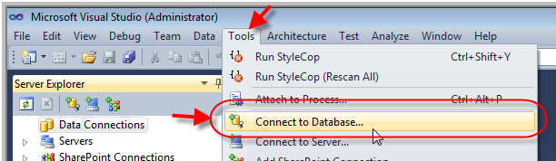
Other Tools and SQL Azure Cont.
Finally, while somewhat limited, you can even connect VS to SQL Azure.
Select Tools on the VS menu bar, and then Connect to Database… from the resulting menu.
In the Add Connection window, enter the SQL Azure URL as the server name, and provide a valid username and password under Use SQL Server Authentication.

Slide 79
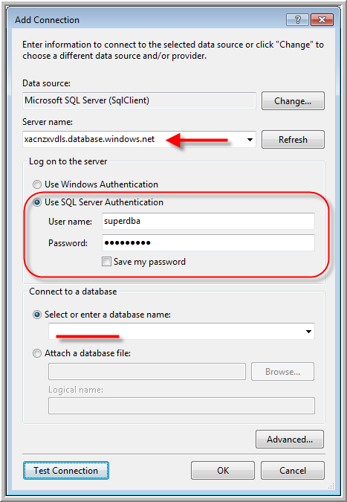
Other Tools and SQL Azure Cont.

Slide 80
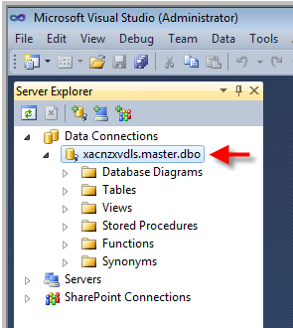
Other Tools and SQL Azure Cont.
When you push the OK button, the Server Explorer lists your SQL Azure server among the Data Connections.
Unfortunately, as with older versions of SSMS, you must enter queries manually and the GUI integration does not work.
However, as the picture below demonstrates, you can use VS to perform operations on the database or quickly check on data.

Slide 81
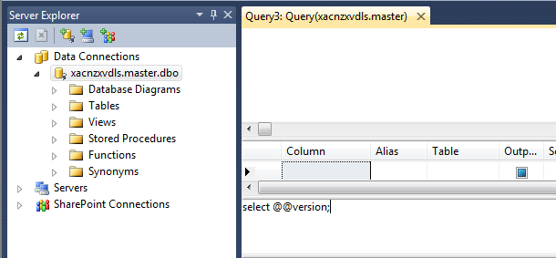
Other Tools and SQL Azure Cont.
This comes in handy during application development.

Slide 82
Server and Database Management/Development
Using any one of the tools sited above, you can start a New Query and execute the version query shown below.
The results should affirm that you are using a SQL Azure database.
While SQL Azure is derived from Microsoft SQL Server 2008, it is a separate database product. Note the version name listed in the examples below.
SELECT @@version

Slide 83
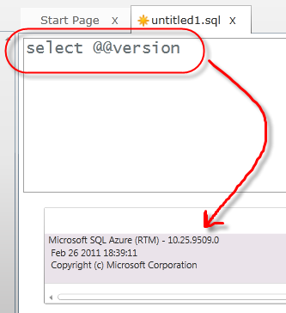
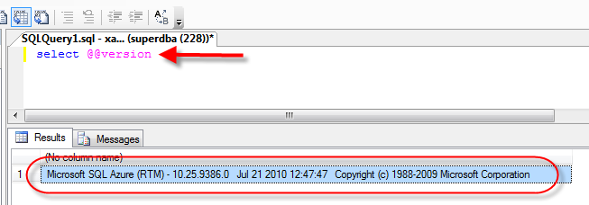
Server and Database Management/Development Cont.

Slide 84
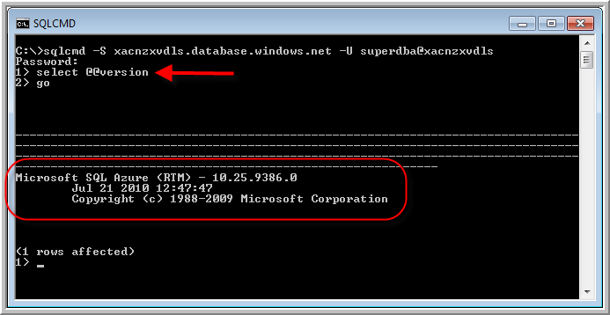
Server and Database Management/Development Cont.

Slide 85
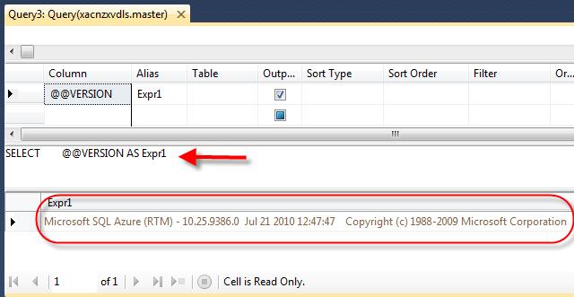
Server and Database Management/Development Cont.
Even though there are three replicas of our data behind the scenes, the multiple layers of SQL Azure often obfuscate that fact.

Slide 86
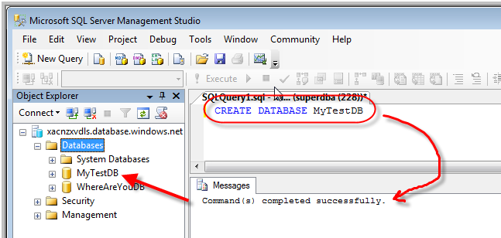
Server and Database Management/Development Cont.
Take database creation for example.
Execute the following T-SQL command to create a database in SQL Azure.
What you see doesn’t look any different than if you had created a database in SQL Server 2008, and that is the point.
CREATE DATABASE MyTestDB

Slide 87
Server and Database Management/Development Cont.
Behind the scenes, the layers of SQL Azure, and importantly the SQL Azure Fabric, have created a new database in triplicate and designated one as the leader.
Your code and tools are none the wiser for this. All the benefits of SQL Azure without pains of learning a new API, tool set, etc.

Slide 88
Server and Database Management/Development Cont.
As another example, the picture below shows the creation of a new table in the MyTestDB.
Again, there is little difference from how one would create a table in another SQL Server product.

Slide 89

Server and Database Management/Development Cont.
You might not that the new table has a clustered index.

Slide 90
Server and Database Management/Development Cont.
You can create a table in SQL Azure without a clustered index, but you cannot add rows until you add the clustered index to the table.
The reason for a clustered index is that SQL Azure does not support heap tables.
More information on SQL Server heap and clustered tables is available in MSDN here: msdn.microsoft.com/en-us/library/ms189051.aspx.
Security administration in SQL Azure is also similar to security administration of SQL Server.
See msdn.microsoft.com/en-us/library/ee336235.aspx for details on security administration.
This page also documents differences to that of SQL Server.

Slide 91
Server and Database Management/Development Cont.
While you have to create an administrator account when you set up your server, it is prudent to set up other user accounts.
You should create a special account for each user or application using the database.
The administrator account should be used sparingly and only for management purposes.
As with SQL Server, you should apply the principle of “least privilege” to work with SQL Azure.
SQL Azure offers two server level security roles.
The loginmanager role can create logins.
The dbmanager role can create databases.
Users must be in the master database in order to receive these roles.

Slide 92

Server and Database Management/Development Cont.
In order to create a new login that can create databases and other logins, follow these steps.
Connect to the master database with an account already in the loginmanager and dbmanager role (like the administrator).
Create a login.
Create a user for the new login.
Use the master database-provided stored procedure sp_addrolememeber to add the dbmanager and loginmanager role to the user.

Slide 93

Server and Database Management/Development Cont.
The loginmanager role is similar to the securityadmin role in SQL Server.
The dbmanager role is similar to the dbcreator role in SQL Server.
With regard to logins, you may find some tools (like SQLCMD) require you to append the SQL Azure server name to the login name (<login>@<server>).
This format is called the fully qualified login name.
As shown above, the new login was mydba. The login required mydba@xacnzxvdls.
Not all tools implement TDS the same way.

Slide 94
Server and Database Management/Development Cont.
Managing security at the database level (versus server level above) is almost identical to that in SQL Server.
For example, to create a new login with access to a specific database, follow these steps.
Login and connect to the master database using a login in the loginmanager role.
Create a new login.
Create the database (if not already created)
Login and connect to the target database (the database you want the new login to have access to).
Create the user for the new login (in the target database).

Slide 95

Server and Database Management/Development Cont.

Slide 96
Accessing SQL Azure from Application Code
MSDN offers a collection of guides for how to perform common programming tasks with Microsoft SQL Azure Database.
You can find them at msdn.microsoft.com/en-us/library/ee621787.aspx.
Two very common programmer needs are how to connect an ASP.NET application to SQL Azure, and how to access the database using ADO.NET.
In an ASP.NET application, a SqlDataSource object is compatible with SQL Azure.
Therefore, you can bind ASP.NET controls (like a Grid View) to a SQL Azure data source just as you would bind it to a SQL Server data source.
In fact, during development, you may choose to create controls that bind to a local SQL Server instance.
When ready to communicate with SQL Azure, simply change the connection string.

Slide 97
Accessing SQL Azure from Application Code Cont.
To connect ASP.NET controls to a data source (SQL Azure or SQL Server), you establish a connection string in the Web.config file.
In the <connectionStrings> element, add a new connection string using the information provided by the View button in the Properties display on the Portal.
Here is an example of a new connection string to the MyTestDB.

Slide 98
Accessing SQL Azure from Application Code Cont.
<connectionStrings >
<add name="MyTestDBConnectionString" connectionString=" Server=tcp:nvyi9nj9dm.database.windows.net,1433;Database=MyTestDB;User ID=sqlazurestudent@nvyi9nj9dm;Password=myPassword;Trusted_Connection=False;Encrypt=True;" providerName="System.Data.SqlClient"/>
</connectionStrings>

Slide 99
Accessing SQL Azure from Application Code Cont.
With the connection string established, you can build new SqlDataSource components that reference the connection string.
GridViews and other ASP.NET components can then simply reference the SQL Azure data source like they would a SQL Server data source.
<asp:SqlDataSource ID="MySQLAzureDataSource" runat="server"
ConnectionString="<%$ ConnectionStrings:MyTestDBConnectionString %>"
SelectCommand="SELECT * FROM [DEMO]"></asp:SqlDataSource>

Slide 100
Accessing SQL Azure from Application Code Cont.
<asp:GridView ID="GridView1" runat="server"
AutoGenerateColumns="False"
DataKeyNames="Id" DataSourceID="MySQLAzureDataSource"
EnableModelValidation="True">
<Columns>
<asp:BoundField DataField="Id" HeaderText="Id" ReadOnly="True"
SortExpression="Id" />
<asp:BoundField DataField="Name" HeaderText="Name" SortExpression="Name"/>
<asp:BoundField DataField="Age" HeaderText="Age" SortExpression="Age" />
</Columns>
</asp:GridView>

Slide 101
Accessing SQL Azure from Application Code Cont.
To access SQL Azure using ADO.NET, consider using the SqlConnectionStringBuilder class.
This class in the System.Data.SqlClient namespace provides a simple way to create and manage the contents of connection strings used by the SqlConnection class.
It helps avoid injection attacks when creating the connection string.
The code below creates a SqlConnectionStringBuilder for the server demonstrated throughout this chapter.

Slide 102
Accessing SQL Azure from Application Code Cont.
SqlConnectionStringBuilder connStringBuilder =
new SqlConnectionStringBuilder();
connStringBuilder.DataSource = "nvyi9nj9dm.database.windows.net";
connStringBuilder.InitialCatalog = "MyTestDB";
connStringBuilder.Encrypt = true;
connStringBuilder.TrustServerCertificate = false;
connStringBuilder.UserID = "sqlazurestudent";
connStringBuilder.Password = "DBA$Rule";
With a SqlConnectionStringBuilder, use other SqlClient classes (SqlConnection, SqlCommand, SqlDataReader, etc.) to work with databases, tables, etc.
Here is some code to select and display data from the Demo table in the MyTestDB.
This code would look no different if the database and table resided in SQL Server.

Slide 103
Accessing SQL Azure from Application Code Cont.
using (SqlConnection conn =
new SqlConnection(connStringBuilder.ToString()))
{
using (SqlCommand command = conn.CreateCommand())
{
conn.Open();
string cmdText = String.Format("select * from Demo");
command.CommandText = cmdText;
SqlDataReader reader = command.ExecuteReader();
while (reader.Read())
{
Console.WriteLine(String.Format("{0}: {1} - {2}", reader["Id"].ToString(), reader["Name"].ToString(), reader["Age"].ToString()));
}
}
conn.Close();
}
Console.ReadLine();

Slide 104
Data Migration
If you have an existing on-premise SQL Server database, how do you get the database into the cloud?
MSDN indicates that one needs to “export the database's schema and then transfer the data from the database to SQL Azure.”
Specifically, the sight advises you first “export a script from SQL Server Management Studio and set the appropriate export options.”
Then “execute the script to create the schema in SQL Azure.”
True enough, but the details can be a bit complex.
Here is the understatement that can make things a bit sticky:
Most SQL Server databases were not designed using just the SQL Azure feature subset.
“Because SQL Azure supports a subset of features found in SQL Server, you may have to make some modifications to the script before you are able to execute it in the cloud.”

Slide 105

Data Migration Cont.
Figuring out how to change the database to support a non-existent feature in SQL Azure can be a challenge.

Slide 106
Data Migration Cont.
Thankfully, there are several tools to help you in this migration.
You can use the Microsoft Sync Framework (version 2 at this time) which provides synchronization capabilities between on-premise and SQL Azure servers.
In fact, you can also use the Sync Framework can be used to synchronize two or more SQL Azure databases in the same or different data centers.
You can also use SQL Server 2008 Integration Services (SSIS) to move data into and out of SQL Azure.
You can transfer data to a SQL Azure database by using the bulk copy utility (bcp.exe).
You can also use the community SQL Azure Migration tool (more on this below).
See msdn.microsoft.com/en-us/library/ee730904.aspx for more information on these options.

Slide 107
Data Migration Cont.
The SQL Azure Migration Wizard (version 3 at this time) is an often-sighted tool to help DBAs and developers migrate their on-premise databases to SQL Azure.
The SQL Azure Migration Wizard is available on Codeplex at sqlazuremw.codeplex.com under Microsoft Public License.
This tool allows you to select the objects you want to migrate, analyze them and create a script suitable for SQL Azure.
Interestingly, the tool not only helps migrate on-premise SQL Server to SQL Azure, but SQL Azure to SQL Azure and SQL Azure to on-premise as well.
Note this is a community tool and therefore not supported by Microsoft.

Slide 108
Data Migration Cont.
The tool helps migrate helps you SQL Server 2005 or 2008 databases to SQL Azure.
If you are migrating from older SQL Server versions, the tool may not catch all the potential issues.
Microsoft recommends you upgrade your older SQL Server database to SQL Server 2008 first and then migrate to SQL Azure.

Slide 109

Data Migration Cont.
The tool is a wizard and walks you through a series of object selections and configuration options before kicking out a schema/migration script.

Slide 110


Data Migration Cont.

Slide 111


Data Migration Cont.

Slide 112


Data Migration Cont.

Slide 113
Data Migration Cont.
Additionally, third party vendors (some listed in the table below) also have tools to assist in migration of databases to SQL Azure.
Vendor | Product | URL
Embarcadero | DBArtisan for SQL Azure | www.embarcadero.com/products/dbartisan/azure
RedGate | SQL Compare and SQL Data Compare tools | www.red-gate.com/products/sql-development/sql-data-compare/

Slide 114
Database Backups
As mentioned previously, SQL Azure replicates your data three times.
You might be tempted to say, “Sweet – now I don’t have to worry about backups!”
This would be a grave mistake.
While SQL Azure prevents your data from loss at the hands of hardware failure inside the data center, it does not prevent data loss from more common problems.
Poorly written code, malicious or unknowing users can (and often do) affect data more than a hardware crash.
If poorly written code is corrupting the database, then SQL Azure replication is just making two copies of an already bad database.
In addition, without being too doomful, what happens if a meteor hits the Microsoft data center housing your SQL Azure database?

Slide 115
Database Backups Cont.
Suffice it to say, you still need to concern yourself with database backups.
Today, SQL Azure has no built-in backup capability.
You can use a DB Copy feature described here: msdn.microsoft.com/en-us/library/ff951624.aspx.
You can synchronize the database using facilities like the Sync Framework (see msdn.microsoft.com/en-us/library/bb726002(v=SQL.110).aspx).
In fact, it is the #1 requested feature for the next version of SQL Azure (see www.mygreatwindowsazureidea.com/forums/34685-sql-azure-feature-voting).

Slide 116

Database Backups Cont.

Slide 117
Database Backups Cont.
To some degree, this means you must “roll your own” solution.

Slide 118
Database Backups Cont.
There are four common patterns to backup that you may choose to follow.
Use ADO.NET, ODBC, WCF Data Services or other API to build a piece of code that accesses the database and copies off the data to a safe place.
While tedious and time consuming, vendors have done this type of work for years and you can too.
Use SQL Server’s Bulk Copy Program utility (BCP) to copy data from your SQL Server to a data file in a specified format.
You can learn more about BCP at msdn.microsoft.com/en-us/library/ms162802.aspx.
Use SQL Server Integration Services (SSIS).
SSIS is a component of the SQL Server as of SQL Server 2005. It offers a rich set of capabilities, but at its core is an ETL (extract, transform, and load) tool.
You can learn more about SSIS at msdn.microsoft.com/en-us/library/ms141026.aspx.

Slide 119
Database Backups Cont.
Remember, when using SQL Server tools (like SSIS), they need to be compatible with SQL Server 2008 R2.
Lastly, you can copy your SQL Azure database to another database on the same server or another database on a different server.
To make a copy on the same server, follow the instructions on MSDN at msdn.microsoft.com/en-us/library/ff951631.aspx.
To make a copy on a different server, follow the instructions on MSDN at msdn.microsoft.com/en-us/library/ff951629.aspx.

Slide 120
Database Backups Cont.
Copying the database inside of a data center can provide a backup in the case of corruption.
However, if you are concerned about a catastrophic loss of a Microsoft data center, you may want to incorporate another solution.
In fact, a hybrid approach to backups can often save time and money.
You need to back up some data more often. Some backups need to be easily accessible and in a format that can be used across platforms.
Concerns of this nature may require you use multiple solutions in your backup plan.

Slide 121
Partitioning the Database
Databases in SQL Azure can be up to 50 GB in size.
While sizeable, your database may (now or in the future) break this limit.
While you can increase the size of a smaller SQL Azure database, the 50 GB limit is the limit to scaling a database without additional database design strategies.
A common design technique for large databases (those expected to eclipse 50 GBs) is to partition the database in to a set of smaller databases.
Keep each smaller database under 50 GB.
However, since each database is separate from the others, relating data among the databases is difficult.
Achieving an effective partition usually requires up front analysis and design (both of the database as well as the code that accesses it).

Slide 122

Partitioning the Database Cont.
To explore the topic, assume your database consisted of a set of tables to track and hold information on Students, Classes and Faculty.
As the diagram above depicts, there might be may smaller associated tables, but there are three “big guys” in your database.
Now assume that these tables grow such that the 50 GB limit is in jeopardy.
How can you partition your database to stay within SQL Azure limits yet still maintain your data?

Slide 123

Partitioning the Database Cont.
One option is to partition the data along “vertical” lines.
That is, partition your big database down to three smaller databases. Each smaller database contains the table centered on a certain domain concept.
In this case, all things Student go into one database, all things Faculty go into another database, and all things Class go into a third database.

Slide 124
Partitioning the Database Cont.
What’s good about this strategy?
Presumably, most of the relationships and queries are centered on data in one of the three big domain concepts: students, faculty and classes.
In other words, for the most part, application code, stored procedures, and the like deal in just one database.
When this is true, very little rework is required in the application code, stored procedures, etc. to support this new database design.
Classes and students are coming and going all the time. Faculty data remains constant.
This strategy helps keep the busy databases from impacting the other databases.
Why should operations in the student database affect those working in the faculty database?

Slide 125
Partitioning the Database Cont.
What’s bad about this strategy?
If there is a relationship between a student and a class, for example (did someone say registration?) then application code must do the work to relate these entities.
That code is difficult to build and will probably degrade performance (databases are much better at relating data).
Application code must also help keep referential integrity – not an often an easy or bug-free feature to build into applications.
Furthermore, it is likely that you have more student data than class data.
It is even foreseeable that the student database may eclipse the 50 GB limit several times over.
Vertical partitions may not be enough to solve the size-bound database issue when a partition is too big or growing too fast.

Slide 126
Partitioning the Database Cont.
As an alternative to the vertical partition is the “horizontal” partition. Sharding is another name for horizontal partitioning.
In a horizontal partition, the database is sliced (or shard) on some piece of data.
For example, in the example provided, divide the student, class and faculty tables into several tables in support of north and south campuses.

Slide 127

Partitioning the Database Cont.
The schema in horizontally partitioned databases is the same.
The data is sliced and broken up.

Slide 128
Partitioning the Database Cont.
A Microsoft Technet document outlining this strategy is provided at social.technet.microsoft.com/wiki/contents/articles/sharding-with-sql-azure.aspx.

Slide 129
Partitioning the Database Cont.
What is good and bad about sharding?
Relationships are maintained. A registration record that brings together students, a faculty member, and a class still live in the same database.
However, getting a list of all failing students is not so easy. You must query two databases now to get that data.
Application code and stored procedures that deal with the “all” (reporting for example) often need rework.
Shards can become unbalanced too. The north campus might grow faster than the southern campus, for example.
In this case, more sharding must occur, or the sharding strategy must change to help balance the load (east and west shards?).
However, once application code works with shards, adding, removing or rebalancing shards is usually not as big an impact as the initial move to shards.

Slide 130

Partitioning the Database Cont.
If the database becomes big enough, it is likely that a mix of partition strategies will be required.

Slide 131
Partitioning the Database Cont.
A community project, Enzo SQL Shard, provides shard technology via a library you can use in your SQL Azure (and SQL Server) projects.
The library allows you to create, read, update, delete records from your code “against two or more databases seamlessly.”
The library runs on .NET 4.0.
The project is available in Codeplex. Find more details at enzosqlshard.codeplex.com.

Slide 132
Lab Exercise: SQL Azure Introduction (Optional)

Slide 133
Chapter Summary
SQL Azure is a highly available, scalable, multi-tenant relational database in the cloud.
SQL Azure is SQL Server at its core.
SQL Azure is not a full-blown SQL Server 2008. This is SQL Server with a number of limitations.

Slide 134
Chapter Summary Cont.
While SQL Azure is based on SQL Server, the architecture is such that you are not connecting directly to SQL Azure as you might connect to SQL Server.
As a client of SQL Azure, you use the tools and APIs familiar to you in the Client Layer to access and manage your database.
As a client, you connect to the Service Layer, not directly to the SQL Server database. This layer obfuscates the complexity that is SQL Azure.
The Service Layer takes care of the administrative duties (provisioning, billing and metering) for the pay-as-you-go databases.
The Service Layer routes your request for data to the appropriate server under the covers. The Service Layer also provides the firewalling.
The Service Layer routes requests to the Platform Layer, a set of servers hosting SQL Server and SQL Azure Fabric.
SQL Azure Fabric provides the automatic replication, failover, and load balancing across the SQL Server instances.

Slide 135
Chapter Summary Cont.
There are three replicas of your data in the Platform Layer.
Through the Developer Portal, you can create a SQL Azure server and an administrator to manage the server.
A server is a logical container for your SQL Azure database instances.
The Portal also provides a list of databases and the means to create new databases.
By default, SQL Azure provisions a master database for you.
The master database is similar to the master database in SQL Server and serves the same purpose.

Slide 136
Chapter Summary Cont.
SQL Azure blocks access to your server from any incoming IP address.
In fact, SQL Azure doesn’t even allow access to the database from IP addresses from inside the cloud such as from one of your Windows Azure roles.
To allow access to your server and its databases, you must add firewall rules.
A firewall rule simply identifies IP address ranges from which you allow database requests.
Firewall rules are stored in the master database.

Slide 137
Chapter Summary Cont.
SQL Azure is SQL Server 2008 R2 at its base.
Therefore, you can use most of the tools used to access and manage SQL Server 2008 R2 databases on SQL Azure databases.
This includes, but is not limited to SQL Server Management Studio (SSMS), SQLCMD, and Visual Studio.
You can also use the Database Manager for SQL Azure. This is a lightweight and easy-to-use Web-based database management tool that is part of the WAP.
There are four common patterns to backup that you may choose to follow.
Use ADO.NET, ODBC, WCF Data Services or other API to build a piece of code that accesses the database and copies off the data to a safe place.
Use SQL Server’s Bulk Copy Program utility (BCP) to copy data from your SQL Server to a data file in a specified format.
Use SQL Server Integration Services (SSIS).

Slide 138
Chapter Summary Cont.
You can copy your SQL Azure database to another database on the same server or another database on a different server.

