Slide 1
Diagnostics and Logging
50466 Windows® Azure™ Solutions with Microsoft® Visual Studio® 2010

Slide 2
Debugging and Logging Issue
As a .NET developer, you have probably become very familiar with debugging tools and log files to gain an understanding of how your applications operate.
Visual Studio (VS) is a great tool for stepping through an application and finding the source of application bugs.
VS is so good that some developers have even used it, in a pinch, to debug and trace activity on production systems.
In production systems, developers often rely on log files to provide details about system issues.
Whether you experience a hardware failure, application error, or performance issue, there is a log in the Windows/.NET environment capturing the problem.
In fact, a lack of debugging and logging information is not what confounds developers.
Often, developers struggle with finding the log file that contains information about an issue.

Slide 3
Debugging and Logging Issue Cont.
As you have learned, you can use VS to build and debug applications on your development machine.
You can add breakpoints to your code and step through/debug code as the application runs in the Compute Emulator.
Log files you are familiar with are also accessible on your development machine.
Debugging in the cloud requires IntelliTrace.
IntelliTrace is a feature in Visual Studio 2010 Ultimate Edition.
IntelliTrace records the application execution and allows you to play it back.
You learn more about IntelliTrace later in this chapter.

Slide 4
Debugging and Logging Issue Cont.
Beyond IntelliTrace, developers are dependent on good logging and using the logs to diagnose issues.
Windows Azure has the same logging capabilities as in traditional Windows environment.
However, unlike your on-premise systems, your access to the Windows Azure machine file system is limited.
If your hosted services have been configured for it, you can use Remote Desktop to access the virtual server running your code and examine log files.
However, even with Remote Desktop, remember that you have many instances of your roles. Therefore, your code lives on many boxes in the cloud data centers.
If Remote Desktop is not enabled, or if you want more consolidated log files you must rely on Windows Azure Diagnostic Service.

Slide 5
Windows Azure Diagnostic Service
The Windows Azure Diagnostic Service runs with your Web and worker role instances.
It collects diagnostic data based on your configuration specifications.
Use the diagnostics API or the Service Management API to alter the configuration.
You can also use the diagnostics API or the Service Management API to transfer diagnostic information to Windows Azure Storage as you dictate.

Slide 6
Windows Azure Diagnostic Service Cont.
How does Windows Azure Diagnostics work?
Every one of your role instances hosts a DiagnosticsAgent executable to manage the Windows Azure diagnostics configuration and management process.
In documentation, the DiagnosticsAgent is often referred to as the Windows Azure diagnostic monitor.
In Windows Azure 1.2, the Diagnostics Service executable was MonAgentHost.exe.
You can find the DiagnosticAgent.exe process in your Task Manager when you run your applications in the Compute Emulator.
In this example, five role instances (four Web and one worker) are running in the Computer Emulator and thus five DiagnosticsAgent.exe processes are running.

Slide 7
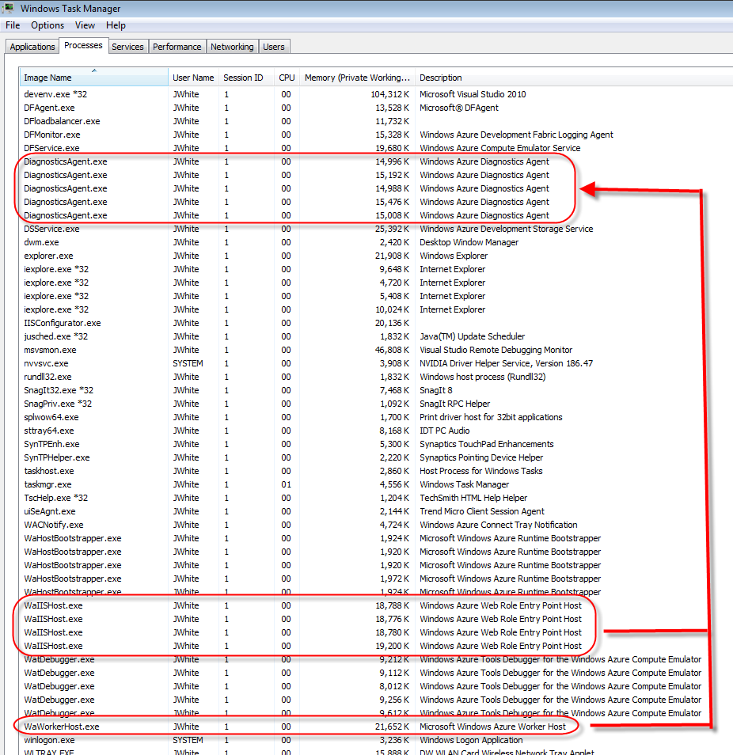
Windows Azure Diagnostic Service Cont.

Slide 8
Windows Azure Diagnostic Service Cont.
The DiagnosticsAgent process knows about all of your instances, knows how to merge the diagnostic data, and knows how to move it to the proper location.
Importantly, you do not need to stop your application (or the DiagnosticsAgent process) in order to reconfigure your diagnostic collection.
This allows you to dial up (or down) the amount of information you collect without shutting down your application.

Slide 9
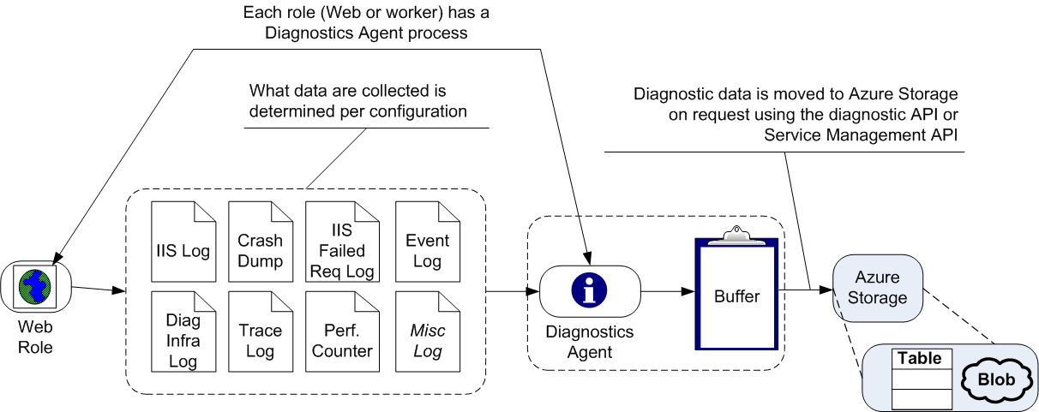
Windows Azure Diagnostic Service Cont.
DiagnosticsAgent.exe collects diagnostic data you want (as specified by configuration – coming up) into a local buffer.

Slide 10
Windows Azure Diagnostic Service Cont.
You use the DiagnosticMonitor class (with its static methods) to configure and work with the diagnostic service from code running within a role.
The table below lists the diagnostic data sources that Diagnostics Agent can monitor.
Note three are enabled (meaning monitored and collected) by default.
Also note that the data collection applies to both Web and worker roles (except where indicated Web role only).

Slide 11
Windows Azure Diagnostic Service Cont.
Diagnostic Data Source | Default Monitoring Status
Windows Azure Trace Logs | Enabled
IIS Logs (Web roles only) | Enabled
Windows Azure Diagnostic Infrastructure Logs | Enabled
Performance Counters | Disabled
Windows Event Logs | Disabled
IIS Failed Request Logs | Disabled
Crash Dumps | Disabled
Any arbitrary log file (custom logging) | Disabled
When told to do so, it transfers the data from the local buffer to Windows Azure Storage.
Third party tools, such as Cerebrata’s Azure Diagnostics Manager, also allow you to view, download, and manage the data collected by the agent.

Slide 12
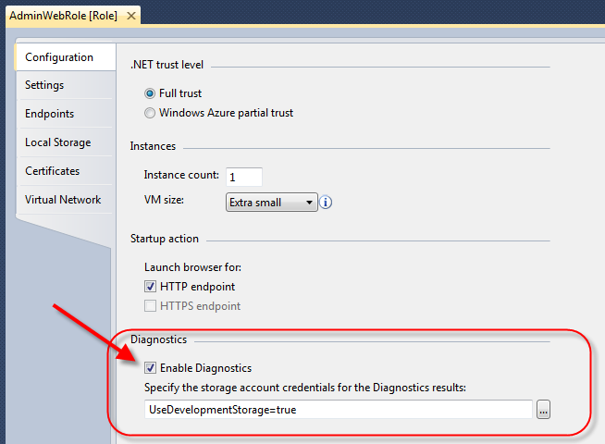
Configuring the Diagnostic Service
By default, when you create a role (using the Windows Azure project templates), the diagnostic service is already partially configured into your roles.
In fact, if you open the GUI config editor for any role (Web, worker or VM role), you will notice the “Enable Diagnostics” checkbox is checked for every role.

Slide 13
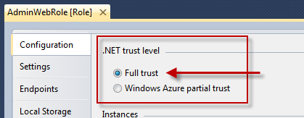
Configuring the Diagnostic Service Cont.
By default, the service stores results in the Storage Emulator (UseDevelopmentStorage=true).
Note that in order to use Windows Azure Diagnostics, your role must run under .NET full trust level. By default, roles are configured for full trust.

Slide 14
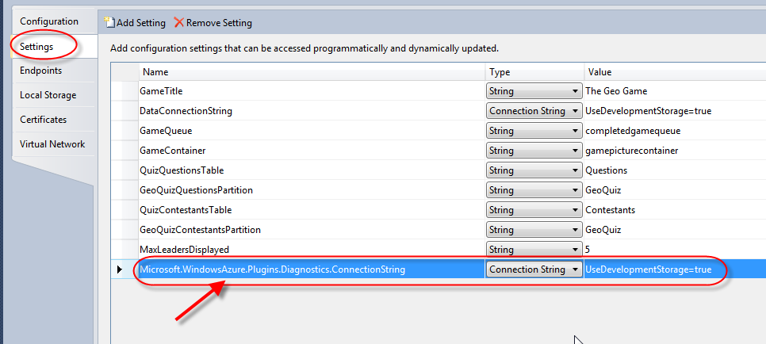
Configuring the Diagnostic Service Cont.
Enabling Diagnostics automatically causes a connection string setting (Microsoft.WindowsAzure.Plugins.Diagnostics.ConnectionString) to be defined.
If you check the Settings tab, you will find this setting set to use the storage specified in the Configuration tab.

Slide 15
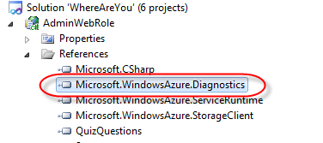
Configuring the Diagnostic Service Cont.
You should also note that every role (Web or worker) project already references the Microsoft.WindowsAzure.Diagnostics.
Finally, in Web.config (for a Web role) and app.config (for a worker role), a trace listener for the diagnostic monitor process is configured.

Slide 16
Configuring the Diagnostic Service Cont.
<system.diagnostics>
<trace>
<listeners>
<add type="Microsoft.WindowsAzure.Diagnostics.DiagnosticMonitorTraceListener, Microsoft.WindowsAzure.Diagnostics, Version=1.0.0.0, Culture=neutral, PublicKeyToken=31bf3856ad364e35" name="AzureDiagnostics">
<filter type="" />
</add>
</listeners>
</trace>
</system.diagnostics>

Slide 17
Configuring the Diagnostic Service Cont.
Given this default setup alone, however, you might be surprised to learn that no diagnostic data is captured.
You need to start the capture of data.
Further, the data collected by each role is never centralized to the storage account of your choice. Instead, it is only held temporarily in local storage.
You must enable the capture of additional data and you must schedule the transfer of data to the storage account of your choice.

Slide 18
Configuring the Diagnostic Service Cont.
Typically, the OnStart( ) method (of either the Web or worker role type) starts the diagnostic agent.
When starting the diagnostic agent, you give the agent the predefined connection string (“Microsoft.WindowsAzure.Plugins.Diagnostics.ConnectionString”).
This allows the agent to transfer data to the Storage Emulator or Windows Azure Storage as you need.
You can use the configuration GUI to change the connection string value, or edit the setting directly in service definition and service configuration files.
public override bool OnStart()
{
DiagnosticMonitor.Start(
"Microsoft.WindowsAzure.Plugins.Diagnostics.ConnectionString");
...
return base.OnStart();
}

Slide 19
Writing to Trace Logs
Adding the DiagnosticMonitorTraceListener trace listener to Web.config or app.config enables you to write to the Windows Azure trace logs.
The DiagnosticMonitorTraceListener is part of the Microsoft.WindowsAzure.Diagnostics namespace.
Classes in this namespace enable you to collect logs and diagnostic information from code running within your role.
With the listener in place, you write to the log by calling overloaded Writeline( ) or Write( ) methods on System.Diagnostics.Trace.
As discussed below, in order to be able to filter log information, it is highly recommended that you categorize your log entries.
Microsoft.WindowsAzure.Diagnostics namespace includes a LogLevel enumeration for category standardization.
System.Diagnostics.Trace.Writeline("log entry", "category");
System.Diagnostics.Trace.Writeline("log entry",
LogLevel.Information.ToString());

Slide 20
Writing to Trace Logs Cont.
Log levels include Critical, Error, Information, Undefined, Verbose, and Warning.
It is better to use the direct methods for each category of your log entries.
System.Diagnostics.Trace.TraceInformation("log entry");
System.Diagnostics.Trace.TraceError("error entry")
System.Diagnostics.Trace.TraceWarning("warning entry");

Slide 21
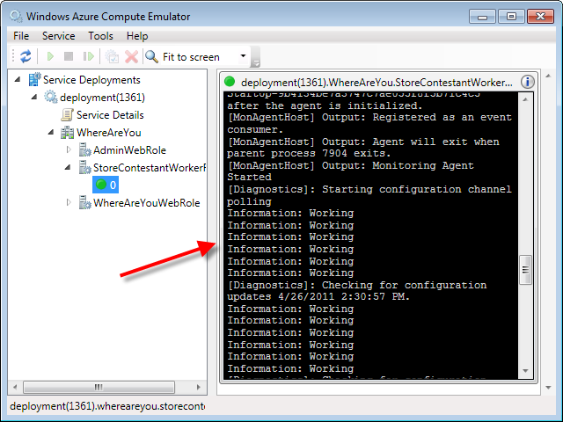
Writing to Trace Logs Cont.
Trace entries appear in the Compute Emulator UI.

Slide 22
Changing the Diagnostic Configuration
By default, the diagnostic agent collects Windows Azure trace logs, Windows Azure diagnostic infrastructure logs, and IIS 7.0 logs.
The diagnostic agent also has many default settings with regard to how much and how long it keeps log information (in its buffer).
By default, the agent stores ~4GB of data. Once reaching this limit, it ages out older log entries.
By default, the agent polls for agent configuration every minute.
The DiagnosticMonitorConfiguration object allows you to change what logs are collected or the parameters by which the agent operates.
DiagnosticMonitorConfiguration is also in the Microsoft.WindowsAzure.Diagnostics namespace.
Get this object from a static call to GetDefaultInitialConfiguration on DiagnosticMonitor.
DiagnosticMonitorConfiguration config =
DiagnosticMonitor.GetDefaultInitialConfiguration();

Slide 23
Changing the Diagnostic Configuration Cont.
While not common, you can override the agent’s operating parameters on the DiagnosticMonitorConfiguration object.
More commonly, use the DiagnosticMonitorConfiguration object to request the agent to collect log data it does not collect by default.
The code here requests the diagnostic agent to start collecting performance counter data (specifically the available memory).
DiagnosticMonitorConfiguration config =
DiagnosticMonitor.GetDefaultInitialConfiguration();
//reduce file system storage to ~2GB
config.OverallQuotaInMB = 2040;
//extend the polling to 2 minutes
config.ConfigurationChangePollInterval = TimeSpan.FromMinutes(2.0);

Slide 24
Changing the Diagnostic Configuration Cont.
DiagnosticMonitorConfiguration config =
DiagnosticMonitor.GetDefaultInitialConfiguration();
PerformanceCounterConfiguration performanceCounterConfig = new
PerformanceCounterConfiguration();
performanceCounterConfig.CounterSpecifier =
@"\Memory\Available MBytes";
performanceCounterConfig.SampleRate = TimeSpan.FromSeconds(10.0);
config.PerformanceCounters.DataSources.Add(performanceCounterConfig);
DiagnosticMonitor.Start(
"Microsoft.WindowsAzure.Plugins.Diagnostics.ConnectionString",
config);
Note that during the start of the DiagnosticMonitor, pass the updated DiagnosticMonitorConfiguration object in as an optional parameter.

Slide 25
Changing the Diagnostic Configuration Cont.
A set of configuration classes allow you to define configuration options for the logs not enabled by default.
Properties on the DiagnosticMonitorConfiguration object allow you to specify your desire for these logs to the diagnostic agent.
The table below lists the configuration class for each type of diagnostic data.
Diagnostic Data Source | Configuration Class
Windows Azure Trace Logs | Web.config trace listener (Enabled by default )
IIS Logs | Web.config trace listener (Enabled by default )
Windows Azure Diagnostic Infrastructure Logs | Web.config trace listener (Enabled by default )
Performance Counters | PerformanceCounterConfiguration
Windows Event Logs | WindowsEventLogsBufferConfiguration
IIS Failed Request Logs | Web.config traceFailedRequests
Crash Dumps | CrashDumps
Any arbitrary log file | DirectoryConfiguration

Slide 26
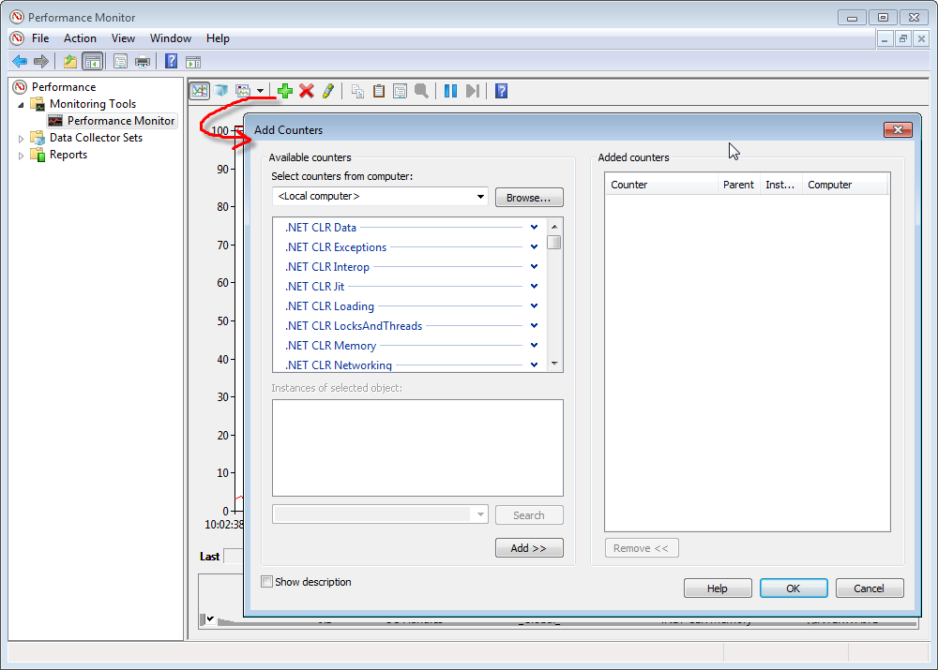
Changing the Diagnostic Configuration Cont.
The example above demonstrated the use of PerformanceCounterConfiguration.
You can use Window’s Perfmon.exe utility to find the performance counters you might want to collect.
After starting Perfmon, request to add a counter. Use any of the available counter strings when setting the performance counter to watch.

Slide 27
Changing the Diagnostic Configuration Externally
Configuration altering code, like that shown above, when run from inside a role affects diagnostic service for only that role instance.
You can change the agent configuration anytime.
However, you typically want to execute configuration-modifying code before starting the agent.
Configuring the diagnostic agent inside of the OnStart( ) method accomplishes two goals.
It allows you to execute configuration-modifying code before starting the agent and it allows the same configuration to apply all instances.

Slide 28
Changing the Diagnostic Configuration Externally Cont.
public override bool OnStart()
{
...
DiagnosticMonitorConfiguration config =
DiagnosticMonitor.GetDefaultInitialConfiguration();
// Configure agent here...
DiagnosticMonitor.Start(
"Microsoft.WindowsAzure.Plugins.Diagnostics.ConnectionString");
...
return base.OnStart();
}

Slide 29
Changing the Diagnostic Configuration Externally Cont.
You can change diagnostic configuration outside of the role and even from code running outside of Windows Azure.
Configuration changes that come from outside the role can have the advantage of changing the configuration for all roles (and all instances).
You might choose to do this kind of configuring from a “super” role that oversees all other roles or from an administrative application running outside of Windows Azure.

Slide 30
Changing the Diagnostic Configuration Externally Cont.
To configure diagnostic agents outside of a role, you need classes from the Microsoft.WindowsAzure.DiagnosticsManagement namespace.
Whether in another role or from external code, start diagnostic service changes by creating a DeploymentDiagnosticManager object.
A DeploymentDiagnosticManager is factory object that returns a diagnostic manager (RoleInstanceDiagnosticManager object) for any role.
DeploymentDiagnosticManager deploymentManager =
new DeploymentDiagnosticManager(RoleEnvironment.
GetConfigurationSettingValue(
"Microsoft.WindowsAzure.Plugins.Diagnostics.ConnectionString"),
RoleEnvironment.DeploymentId);
IEnumerable<RoleInstanceDiagnosticManager> roleManagers =
deploymentManager.GetRoleInstanceDiagnosticManagersForRole(
"MyRoleName");

Slide 31
Changing the Diagnostic Configuration Externally Cont.
From the RoleInstanceDiagnosticManager object, you can get the collection of diagnostic agents running for the specified role.
Iterate over the collection and make configuration changes as needed.
In this example, the same configuration changes are made on each diagnostic agent as shown above on a single agent.

Slide 32
Changing the Diagnostic Configuration Externally Cont.
PerformanceCounterConfiguration performanceCounterConfig = new
PerformanceCounterConfiguration();
performanceCounterConfig.CounterSpecifier =
@"\Memory\Available MBytes";
performanceCounterConfig.SampleRate = TimeSpan.FromSeconds(10.0);
foreach (RoleInstanceDiagnosticManager agent in roleManagers)
{
DiagnosticMonitorConfiguration config =
agent.GetCurrentConfiguration();
config.OverallQuotaInMB = 2040;
config.ConfigurationChangePollInterval = TimeSpan.FromMinutes(2.0);
config.PerformanceCounters.DataSources.
Add(performanceCounterConfig);
agent.SetCurrentConfiguration(config);
}

Slide 33
Transferring Diagnostic Data to Windows Azure Storage
By default, diagnostic agents collect diagnostic data into a local buffer.
While 3rd party tools provide a means to explore the diagnostic data in the buffer, the data is lost if the role is shutdown (intentionally or unintentionally).
Furthermore, since the buffer is of limited size, diagnostic data is eventually lost as it is purged to make room for more data.
To preserve diagnostic data, you must configure the agents to transfer the data from the local buffer to Windows Azure Storage.
There are two types of transfer.
You can choose to set up a schedule and have the diagnostic agent transfer data automatically. This is called scheduled transfer.
Alternately, you can request a one-time transfer of the data. This is called on-demand transfer.

Slide 34
Transferring Diagnostic Data to Windows Azure Storage Cont.
Set up scheduled transfers per data source (log data deposit).
Set the ScheduledTransferPeriod property of the data source to a TimeSpan object specifying how often the agent should transfer data to Windows Azure Storage.
Importantly, when you set the TimeSpan to zero, you disable transfer of data completely.
Remember, access and space in Windows Azure Storage costs money.
DiagnosticMonitorConfiguration config =
DiagnosticMonitor.GetDefaultInitialConfiguration();
config.Logs.ScheduledTransferPeriod = TimeSpan. FromMinutes(15.0);
config.PerformanceCounters.ScheduledTransferPeriod =
TimeSpan.FromMinutes(15.0);
config.DiagnosticInfrastructureLogs.ScheduledTransferPeriod =
TimeSpan.FromMinutes(15.0);

Slide 35
Transferring Diagnostic Data to Windows Azure Storage Cont.
You have transaction costs, potential bandwidth costs (when the storage is not in the same Affinity Group), and storage space costs.
You also have bandwidth costs when you pull the data out of the cloud.
So set the TimeSpan with some care. Transferring the logs every minute is probably unjustified and potentially tacking on performance.

Slide 36
Transferring Diagnostic Data to Windows Azure Storage Cont.
On-demand transfers allow you to specify what and when should be transferred – but in a one-time fashion.
To carry out an on-demand transfer, you again use objects in the DiagnosticManager namespace.
An OnDemandTransferOptions object allows you to specify transfer options such which data source and the timeframe for relevant data.
Get an instance of the DeploymentDiagnosticManager and from this object get the RoleInstanceDiagnosticManager object (or objects for multiple roles).
From the RoleInstanceDiagnosticManager object, you can get the collection of diagnostic agents running for the specified role.
Iterate over the collection and demand the data be transferred per your transfer options.
This example shows an on-demand transfer for the Performance Counters for the past hour

Slide 37
Transferring Diagnostic Data to Windows Azure Storage Cont.
DeploymentDiagnosticManager deploymentManager = new
DeploymentDiagnosticManager(RoleEnvironment.
GetConfigurationSettingValue("
Microsoft.WindowsAzure.Plugins.Diagnostics.ConnectionString"),
RoleEnvironment.DeploymentId);
IEnumerable<RoleInstanceDiagnosticManager> roleManagers =
deploymentManager.GetRoleInstanceDiagnosticManagersForRole(
"MyRoleName");
DataBufferName datasource = DataBufferName.PerformanceCounters;
OnDemandTransferOptions transferOptions =
new OnDemandTransferOptions();
transferOptions.From = DateTime.UtcNow - TimeSpan.FromHours(1.0);
transferOptions.To = DateTime.UtcNow;
transferOptions.NotificationQueueName = "transfercompletequeue";
foreach (RoleInstanceDiagnosticManager agent in roleManagers)
{
Guid requestId = agent.BeginOnDemandTransfer(datasource,
transferOptions);
}

Slide 38
Transferring Diagnostic Data to Windows Azure Storage Cont.
The BeginOnDemandTransfer( ) method call initiates the transfer. Windows Azure handles calls to transfer data asynchronously.
The process of transferring the data can take some time.
Provide the name of a queue, through the OnDemandTransferOptions, to be notified by message when the transfer process completes.
Monitor the queue and when you detect the transfer complete, call EndOnDemandTransfer( ) with the request id.

Slide 39
Transferring Diagnostic Data to Windows Azure Storage Cont.
CloudQueueMessage message;
while ( (message = queue.GetMessage()) != null)
{
OnDemandTransferInfo onDemandTransferInfo =
OnDemandTransferInfo.FromQueueMessage(message);
String deploymentId = onDemandTransferInfo.DeploymentId;
Guid requestGuid = onDemandTransferInfo.RequestId;
String roleInstanceId = onDemandTransferInfo.RoleInstanceId;
String roleName = onDemandTransferInfo.RoleName;
RoleInstanceDiagnosticManager roleInstanceDiagnosticManager =
cloudStorageAccount.CreateRoleInstanceDiagnosticManager(
deploymentId, roleName, roleInstanceId);
roleInstanceDiagnosticManager.EndOnDemandTransfer(requestGuid);
cloudQueue.DeleteMessage(message);
}

Slide 40
Transferring Diagnostic Data to Windows Azure Storage Cont.
Where does the diagnostic data transferred to Windows Azure Storage go?
It depends on the data. Some of it goes in table storage while others go in blob storage.
The table below lists where to find each of the types of diagnostic data when transferred to Windows Azure Storage.

Slide 41
Transferring Diagnostic Data to Windows Azure Storage Cont.
Diagnostic Data Source | Windows Azure Storage location
Windows Azure Trace Logs | table storage
IIS Logs | blob storage
Window Azure Diagnostic Infrastructure Logs | table storage
Performance Counters | table storage
Windows Event Logs | table storage
IIS Failed Request Logs | blob storage
Crash Dumps | blob storage
Any arbitrary log file | blob storage

Slide 42
Transferring Diagnostic Data to Windows Azure Storage Cont.
Again, remember that you are paying for Windows Azure Storage.
Since the amount of diagnostic data collected can be quite large, you may want to consider filtering data moved to Windows Azure Storage.
You cannot filter data collected by the diagnostic agent as it puts data into the agent’s buffer.
You can, however, filter data that you want moved to Windows Azure Storage.

Slide 43
Transferring Diagnostic Data to Windows Azure Storage Cont.
To filter data moved to Windows Azure Storage, set the transfer options to include a log filter.
You have seen the OnDemandTransferOptions object used above to specify details for on-demand transfers.
Just set the LogLevelFilter property to the appropriate LogLevel enumeration (thus the importance of using LogLevel categories when writing trace entries).
For scheduled transfers, set the ScheduledTransferLogLevelFilter property on the Logs property (of DiagnosticMonitorConfiguration object) to a LogLevel enum.
OnDemandTransferOptions transferOptions =
new OnDemandTransferOptions();
transferOptions.LogLevelFilter = LogLevel.Error;

Slide 44
Transferring Diagnostic Data to Windows Azure Storage Cont.
DiagnosticMonitorConfiguration config =
DiagnosticMonitor.GetDefaultInitialConfiguration();
...
Config.Logs.ScheduledTransferLogLevelFilter = LogLevel.Warning;
Remember, diagnostic/logging data moved to Windows Azure Storage is still data storage space you pay for per the rates discussed in an earlier chapter.
Setup a cleanup strategy for diagnostic/logging data moved to storage as you would for any data in Windows Azure Storage.
When it is necessary to keep the data for extended periods, explore options for long-term storage of the data outside of the cloud.

Slide 45
Debugging with IntelliTrace
As mentioned earlier, IntelliTrace is another option for debugging applications running in the Windows Azure cloud.
IntelliTrace is a feature in Visual Studio 2010 Ultimate Edition.
VS 2010 Ultimate is a “comprehensive suite of tools to help teams ensure quality results, from design to deployment.”
As an upper-end product that is not required for Windows Azure development, not every developer may have access to this debugging tool.

Slide 46
Debugging with IntelliTrace Cont.
IntelliTrace records the application execution and allows you to play it back.
It is often used to debug application locally in VS, but obviously provides assistance to debugging applications remotely as well.
IntelliTrace works by maintaining a list of breakpoints in your code.
It records the breakpoints hit and the stack (or full runtime context) as the breakpoints are encountered.
Imagine you could take a snapshot of the stack at various points of execution in your application.
Then imagine you can click through the stack snapshot and navigate through code and symbols associated to the code. This essentially is what IntelliTrace provides.
Learn more about IntelliTrace at msdn.microsoft.com/en-us/library/dd264915.aspx.

Slide 47
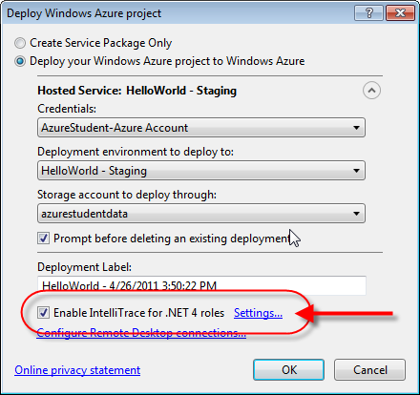
Debugging with IntelliTrace Cont.
When you are ready to publish your application to the cloud, make sure you enable IntelliTrace.
Recall, that when you are ready to publish your solution, right-click on the cloud project in Solution Explorer and click Publish.
To enable IntelliTrace, check the Enable IntelliTrace for .NET 4 roles in the Deploy Windows Azure project window that displays.

Slide 48
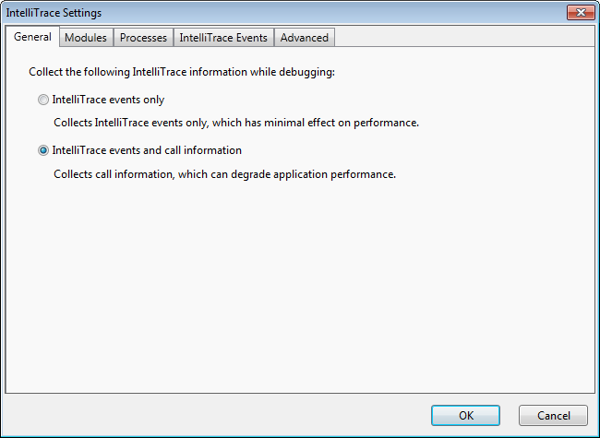
Debugging with IntelliTrace Cont.
Before publishing, you can click on the Settings… link to customize IntelliTrace.

Slide 49
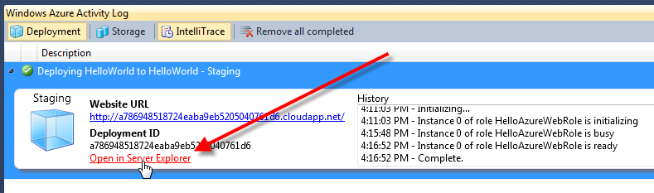
Debugging with IntelliTrace Cont.
After the project has successfully deployed and is running in Azure, click on the Open in Server Explorer link in the Deployment view (shown below).
In the Server Explorer, expand the Windows Azure Compute node. You should see your service listed.

Slide 50
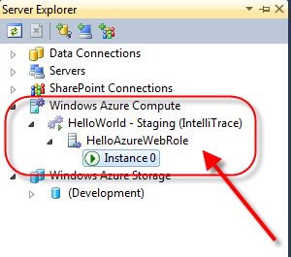
Debugging with IntelliTrace Cont.
Note the word IntelliTrace in brackets after your service name in the list – indicating IntelliTrace is enabled for your service.

Slide 51
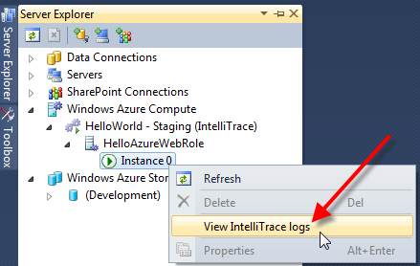
Debugging with IntelliTrace Cont.
To begin the download of IntelliTrace data, right-click a role instance of the service and then click View IntelliTrace logs.
In the Windows Azure Activity Log view in VS, the status of the download can be monitored.

Slide 52
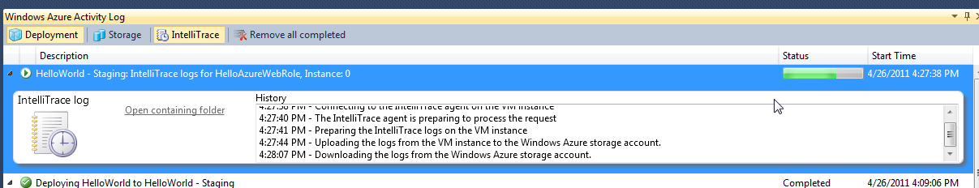
Debugging with IntelliTrace Cont.
After the download completes, VS opens a window displaying the IntelliTrace data.

Slide 53
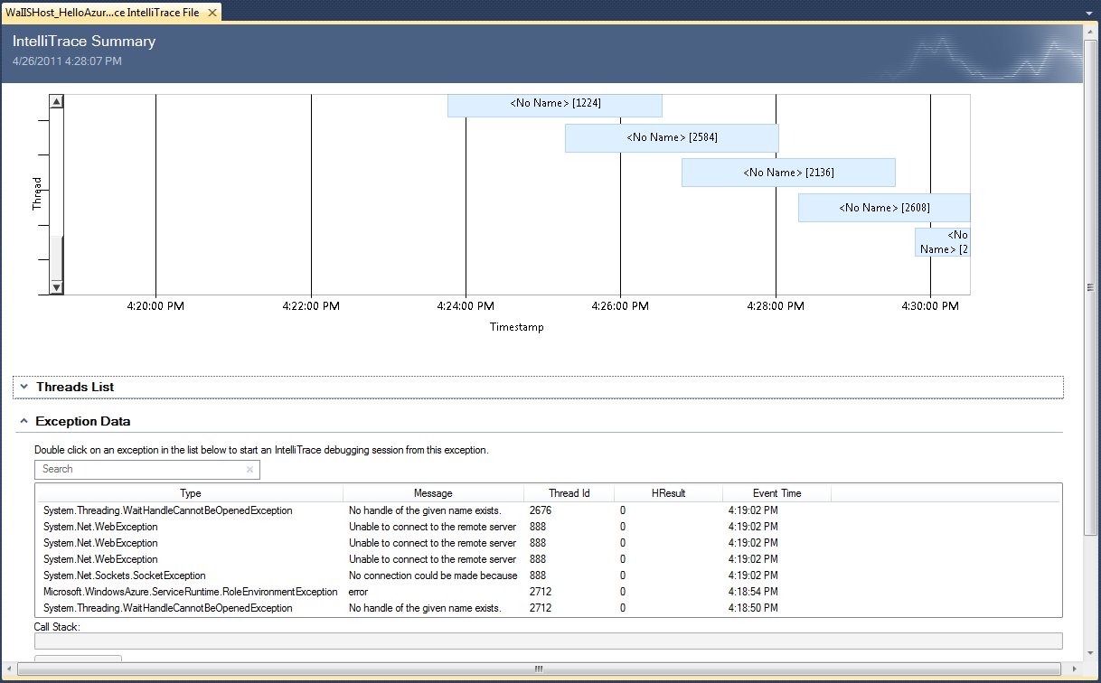
Debugging with IntelliTrace Cont.

Slide 54
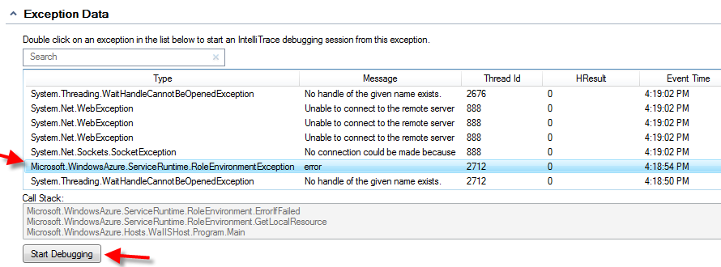
Debugging with IntelliTrace Cont.
To examine details of an exception that occurred in the cloud, click on an exception listed in the Exception Data part of page.
Then click the Start Debugging button (or double-click a thread in the list).
This opens an IntelliTrace window where you can step through code, view the values of variables, and view the call stack at the time of the exception.

Slide 55
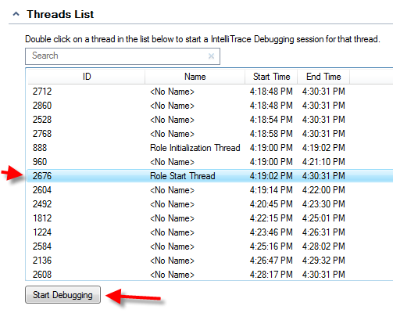
Debugging with IntelliTrace Cont.
Similarly, you can select a thread in the Thread List and debug the thread.

Slide 56
Lab Exercise: Diagnostics Lab

Slide 57
Chapter Summary
The Windows Azure Diagnostic service runs with your role instances.
It collects diagnostic data based on your configuration specifications. Use the diagnostics API or the Service Management API to alter the configuration.
The diagnostics API and the Service Management API are also used to transfer diagnostic information to Windows Azure Storage as you dictate.
Every role instances hosts a DiagnosticsAgent.exe executable to manage the Windows Azure diagnostics configuration and management process.
Code in the OnStart( ) method of WebRole.cs or WorkerRole.cs typically starts the diagnostic data capture.

Slide 58
Chapter Summary Cont.
Adding the DiagnosticMonitorTraceListener trace listener to Web.config or app.config enables you to write to the Windows Azure trace logs.
The DiagnosticMonitorTraceListener is part of the Microsoft.WindowsAzure.Diagnostics namespace.
Classes in this namespace enable you to collect logs and diagnostic information from code running within your role.

