Slide 1

Retrieval Practice Produces More Learning than Elaborative Studying with Concept Mapping
by Jeffrey D. Karpicke, and Janell R. Blunt
Science
Volume 331(6018):772-775
February 11, 2011
Copyright © 2011, American Association for the Advancement of Science

Slide 2
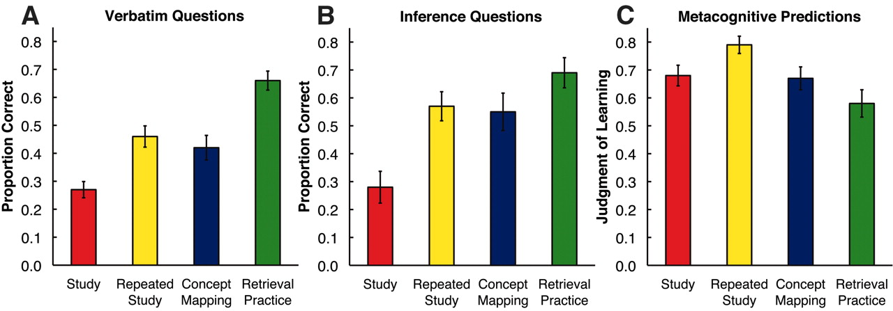
Fig. 1 Results of Experiment 1.
Jeffrey D. Karpicke, and Janell R. Blunt Science 2011;331:772-775
Copyright © 2011, American Association for the Advancement of Science
Notes:
Results of Experiment 1. (A and B) show the proportions correct on verbatim and inference short-answer questions, respectively. (C) shows the proportion of information subjects predicted they would recall on the final test (their metacognitive judgments of learning). Error bars indicate SEM. On the final short-answer test, retrieval practice enhanced long-term learning above and beyond elaborative study with concept mapping by one and a half standard deviations (d = 1.50), yet students were largely unable to predict this benefit.

Slide 3
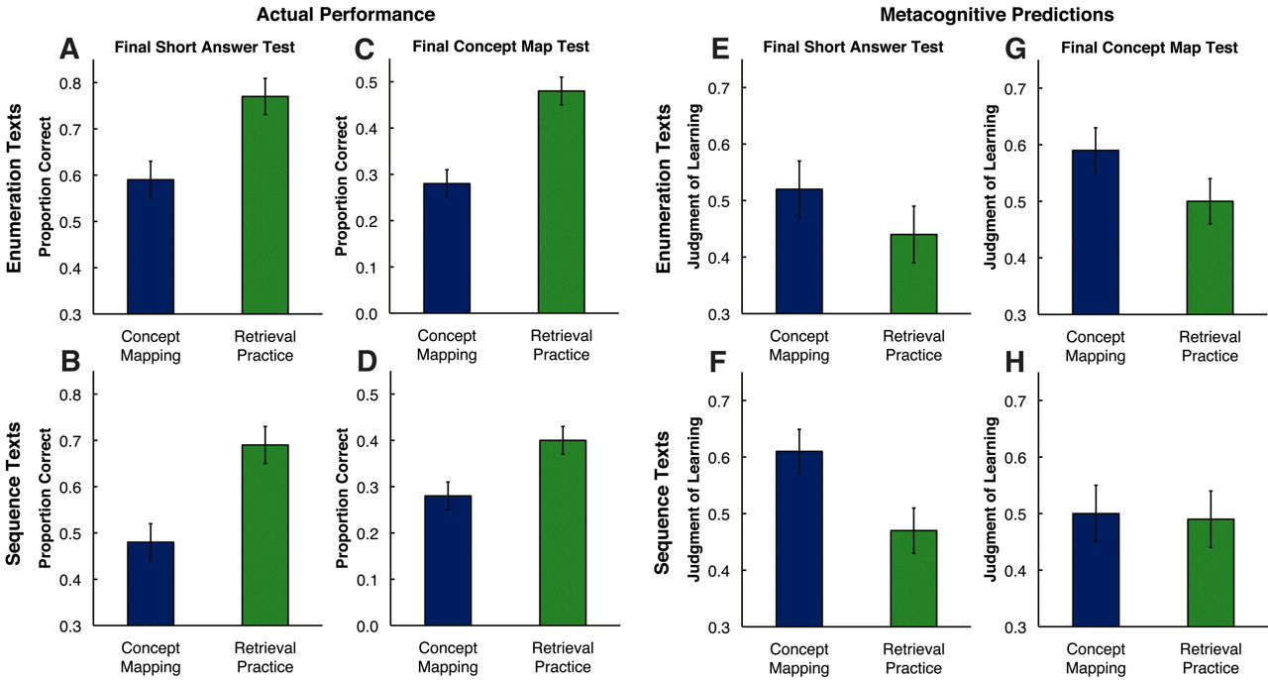
Fig. 2 Results of Experiment 2.
Jeffrey D. Karpicke, and Janell R. Blunt Science 2011;331:772-775
Copyright © 2011, American Association for the Advancement of Science
Notes:
Results of Experiment 2. (A and B) show the proportions correct on the final short-answer tests for enumeration and sequence texts, respectively. (C and D) show the proportions correct on the final concept mapping tests for enumeration and sequence texts, respectively. Error bars indicate SEM. Retrieval practice enhanced long-term learning above and beyond elaborative concept mapping by more than one standard deviation on both types of final test (d = 1.07 and 1.01, respectively). (E to H) show the proportion of information subjects predicted they would recall on the final test in each initial learning condition. Students tended to believe that elaborative concept mapping would produce the same or even greater learning than retrieval practice, even though the opposite was true, as shown in (A) to (D).

