Slide 1
CONCUSSION Simulation
Final Presentation
UCLA Mechanical Engineering
C. Campbell, L. Clay, R. Fadell

Slide 2
Overview
Project Objective
Modeling Approach
Architecture
Development Process
Data Capture
Lessons Learned
Future Work

Slide 3
objectives
Create a simple yet accurate kinematic model of the brain, skull, cerebrospinal fluid, and neck.
Determine the force and acceleration of a brain experiencing impacts of varying severity and direction.
Validate existing brain models for accuracy with numerical simulations
See the effects of traumatic brain injury mitigation devices, like simple helmets, MIPS helmets, and Q collars.
Look for suggestions or improvements to reduce concussion risk or to concussion models

Slide 4
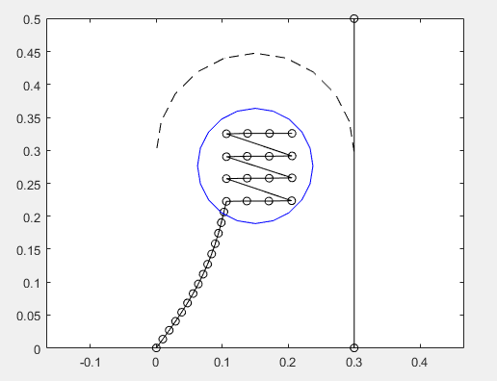
Modeling Approach
Model neck and brain as beams
Newton-Raphson method
Model skull as a rigid body
Large modulus of elasticity compared to brain
Model helmet and brain reaction forces
Modified mass reaction method
Newton-Raphson method
Helmet
Skull
Neck
Brain

Slide 5
Modeling Approach
Brain modeled as a series of springs/dampers
Brainstem connects nodes
Moves with neck
Changes angle with neck
Allows Deformation
Brain moves and deforms with impacts
Modified mass method
Brainstem

Slide 6
Impact Architecture
Brain takes angle and location input from spine
X-Y offset and angle calculations
Brain contacts skull and deforms
Newton-Raphson/modified mass method
If statements check for collisions in front and back
Early Front Impact Model

Slide 7
Development: Spine and Skull
Newton-Raphson Method was used to model the deformation of the spine as a beam
A variable force was applied to the last node in the x-dir for the first 3 timesteps to simulate sudden impact
When a node is calculated to be beyond the wall, it’s x-index becomes fixed until it’s calculated to be moving to the left of the wall (pre-momentum conservation)

Slide 8
Development: BRAINSTem and brain
A short beam beam models the brainstem, connecting the spine and brain
A beam with both ends fixed to the end of brainstem simulates a deformable brain
The brain beam continues down into and maps onto the end of the stem to transfer forces effective to the brain

Slide 9
Development: brain as a mass spring damper system
Initial brain model:
4 Nodes
Spring and damper forces between
Movement through viscous fluid, taken from known cerebrospinal values
Model suggested from previous studies [4]

Slide 10
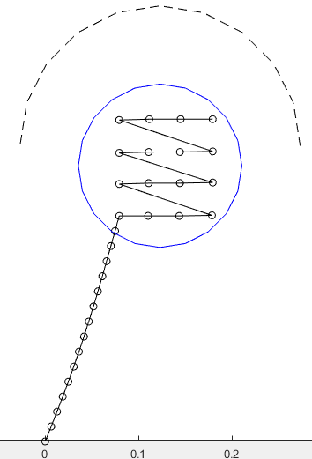
IDevelopment: Improve Brain Model
Model Additions:
Added additional brain nodes
Brain reacts to neck angle
Brain deforms during impact
Brainstem modeled by connecting leftmost nodes

Slide 11
Development: Current Model
Model captures several brain/skull impacts
Note minor compression of the brain nodes during impact

Slide 12
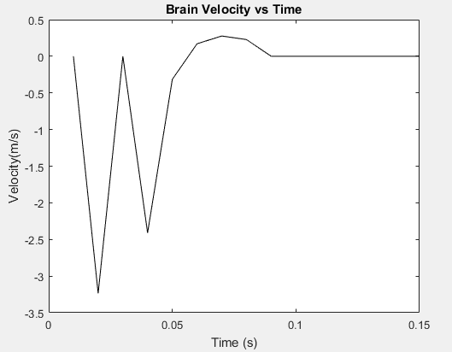
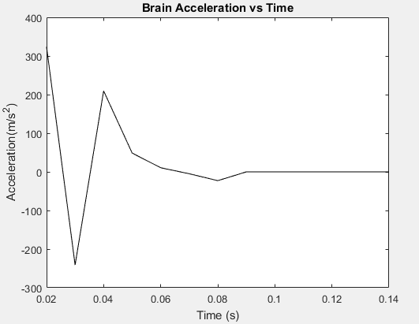
Data Capture

Slide 13
Challenges
Brain model was “squirmy”
Low modulus of Elasticity
Unrealistic geometry
Many force/geometry inputs
Early Front Impact Model

Slide 14
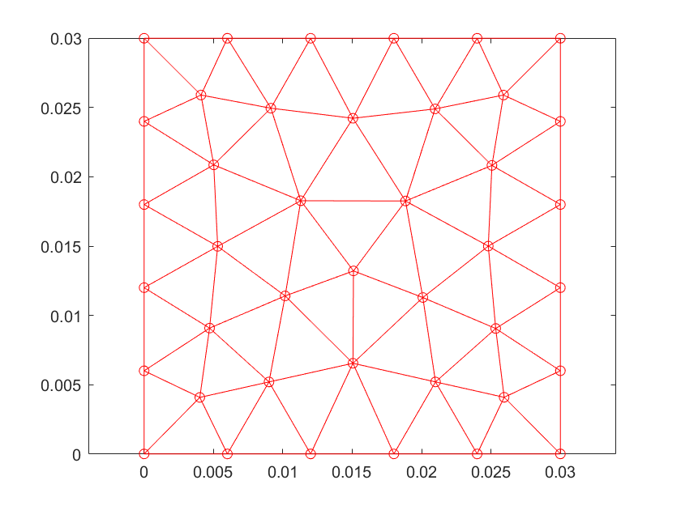
Future Improvements
Improve brain model
Calculate localized stress
Incorporate angular acceleration
Key component of concussions
Add 3D Shell Component
Began work, but insufficient time

Slide 15
Thank you! Questions/feedback?

Slide 16
References
[1] W. Decker, A. Baker, Y. Xin, et al., "Development and Multi-Scale Validation of a Finite Element Football Helmet Model," Annals of Biomedical Engineering, no. 48, pp. 258-270, 2020.
[2] E. D. Anderson, T. Wu, M. B. Panzer, et al., "Predicting Concussion Outcome by Integrating Finite Element Modeling and Network Analysis," Frontiers in Bioengineering and Biotechnology, vol. 8, p. 309, 2020.
[3] M. Falstedt, P. Halldin and S. Kleiven, "Importance of the Bicycle Helmet Design and Material for the Outcome in Bicycle Accidents," in International Cycling Safety Conference, Göteborg, 2014.
[4] L. J. Ng, V. Volman, M. M. Gibbons, et al., "A Mechanistic End-to-End Concussion Model That Translates Head Kinematics to Neurologic Injury," Frontiers in Neurology, 2017.
[5] S. Rowsen, S. M. Duma and J. G. Beckwith, "Rotational Head Kinematics in Football Impacts: An Injury Risk Function for Concussion," Annals of Biomedical Engineering, vol. 40, pp. 1-13, 2012.
[6] S. P. Broglio, A. Lapointe, K. L. O'Connor, et al., "Head Impact Density: A Model To Explain The Elusive Concussion Threshold," Journal of Neurotrauma, vol. 34, no. 19, 2017.
[7] Bicycle Helmet Safety Institute, "Researcher's Resource Page," 2022. [Online]. Available: https://helmets.org/research.htm.
[8] B. Elkin and L. Gabler, “Brain tissue strains vary with impact location,” Clinical Biomechanics, vol. 64, pp. 49–57, Mar. 2018.
[9] E. J. Sanchez, L. F. Gabler, A. B. Good, J. R. Funk, J. R. Crandall, and M. B. Panzer, “A reanalysis of football impact reconstructions for head kinematics and finite element modeling,” Clinical Biomechanics, vol. 64, pp. 82–89, 2019.
[10] J. G. Beckwith, W. Zhao, S. Ji, A. G. Ajamil, R. P. Bolander, J. J. Chu, T. W. McAllister, J. J. Crisco, S. M. Duma, S. Rowson, S. P. Broglio, K. M. Guskiewicz, J. P. Mihalik, S. Anderson, B. Schnebel, P. Gunnar Brolinson, M. W. Collins, and R. M. Greenwald, “Estimated brain tissue response following impacts associated with and without diagnosed concussion,” Annals of Biomedical Engineering, vol. 46, no. 6, pp. 819–830, 2018.
[11] M. K. Jawed, S. Lim, “Discrete Simulation of Slender Structures,” Spring 2022

