Slide 1
Robotics
Be future-ready

Slide 2
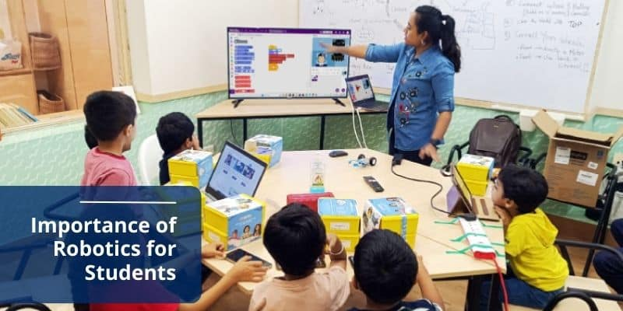
Robotics
Robotics is an interdisciplinary field that combines science, engineering, and technology to design, build, operate, and use robots, aiming to create intelligent machines that can assist humans in various ways

Slide 3
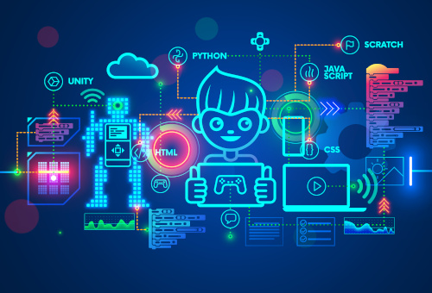
Robotics
Educational robotics goes beyond traditional teaching methods, offering a captivating and interactive learning experience that deepens students' understanding of STEM(Science, Technology, Engineering and Mathematics) concepts. By building and programming robots, students apply their knowledge to real-world scenarios, making learning more meaningful and memorable

Slide 4
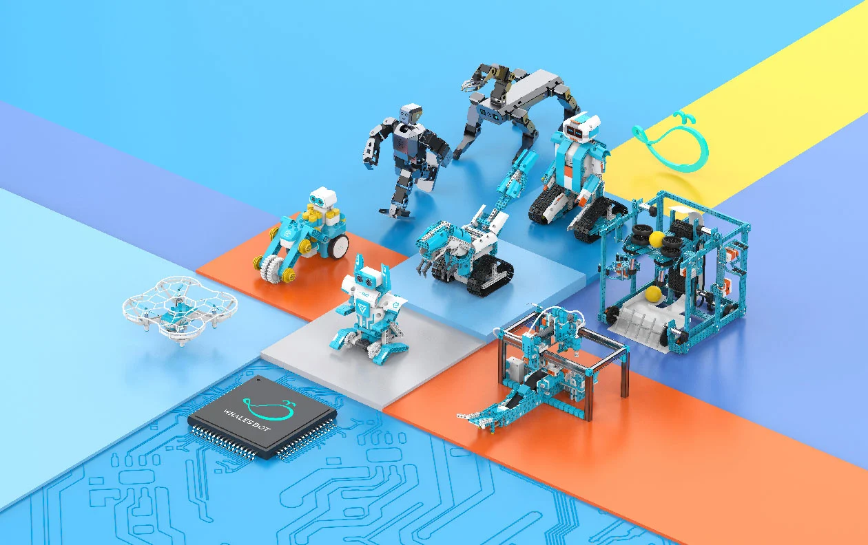
Technologies in Focus for Inclusive AI Education
Get your kids an opportunity to master world-class technological concepts like coding, training machine learning models, natural language processing, and what not with real-life practical, activity-based learning (ABL)!

Slide 5
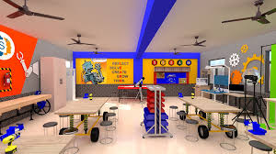
Technologies in Focus for Inclusive AI Education
Robotics Lab for schools is a holistic package to provide complete solutions with robotics kits, coding software.
Step into an interactive learning journey with our AI and Robotics Lab for School, where students can code games and animations in PictoBlox and learn robotics with Quarky, complemented by valuable teaching resources for teachers and learning resources for the students!

