Slide 1



SQLHandler
Opendap svn
Google code
Sourceforge
C++ library and modules to add relational database support to the OPeNDAP Hyrax back-end server.
Developed by Dr. Carlo Cancellieri ccancellieri@hotmail.com
is distributed under LGPL license
SQLHandler Use cases
03/20/26
Author: Dr. Cancellieri Carlo
<number>
Notes:
<number>

Slide 2
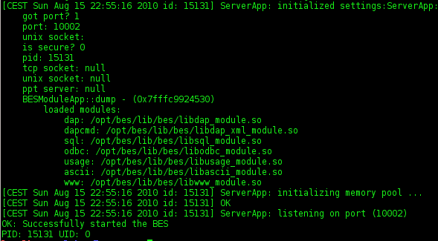
BES start
Loaded modules:
Sql (base module)
Odbc (SQLPlugin for unixODBC)
03/20/26
Author: Dr. Cancellieri Carlo
<number>

Slide 3
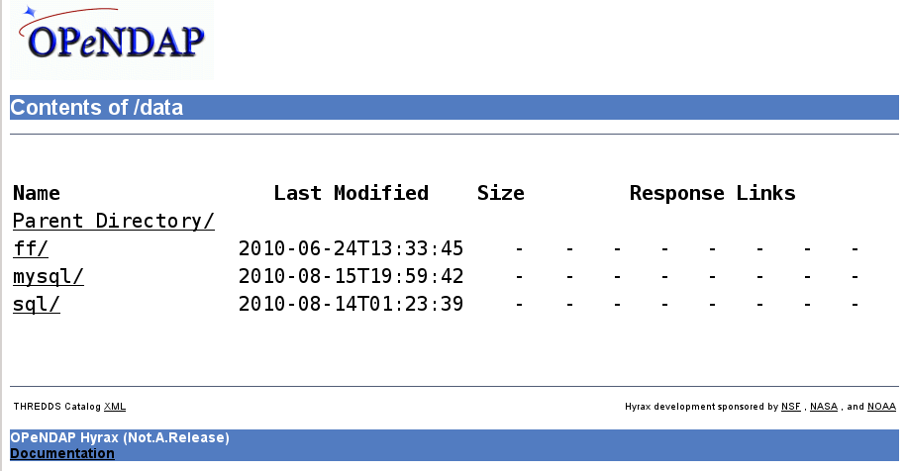
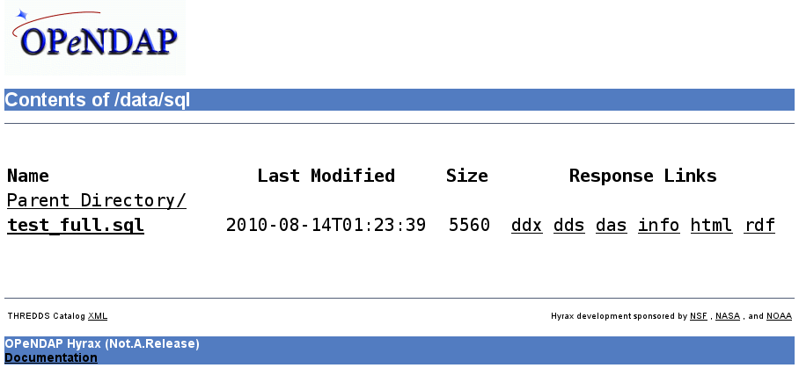
SQLHandler
Select the example folder
03/20/26
Author: Dr. Cancellieri Carlo
<number>

Slide 4
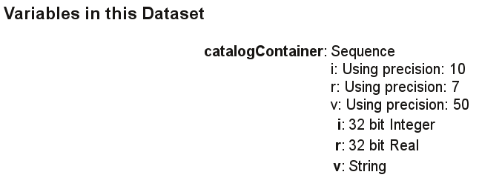
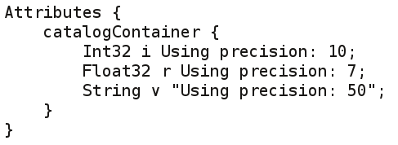
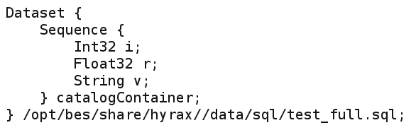
SQLHandler
Try out DDS, DAS and info
03/20/26
Author: Dr. Cancellieri Carlo
<number>

Slide 5
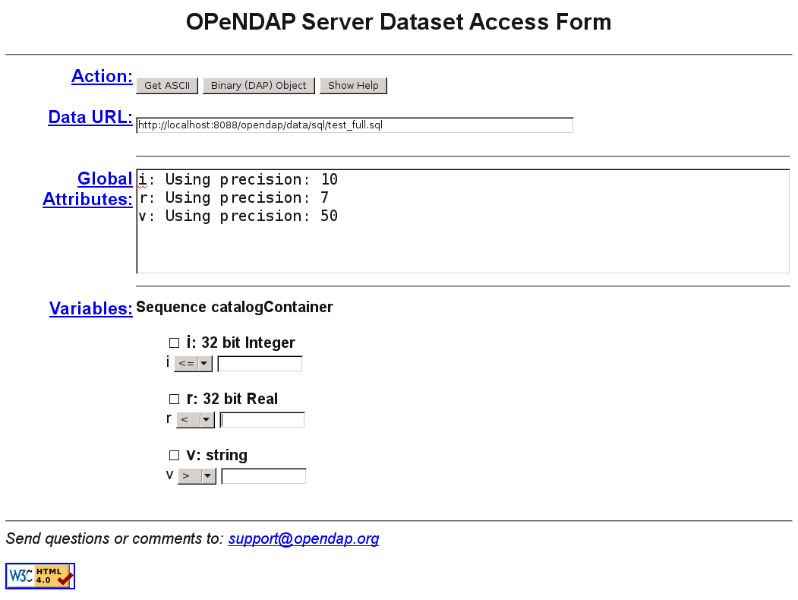
Click on ‘Get ASCII’
SQLHandler
The HTML view
03/20/26
Author: Dr. Cancellieri Carlo
<number>

Slide 6
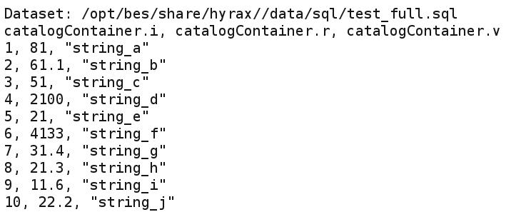
SQLHandler
The complete ASCII dump of the sample dataset
NOTE:
Data is added to the DB using the install.dir/isql.sh script.
Used data is located into the install.dir/sqlh.sql file (this is NOT a dataset).
Read the INSTALL and SQLHandler.ppt file for details.
03/20/26
Author: Dr. Cancellieri Carlo
<number>

Slide 7
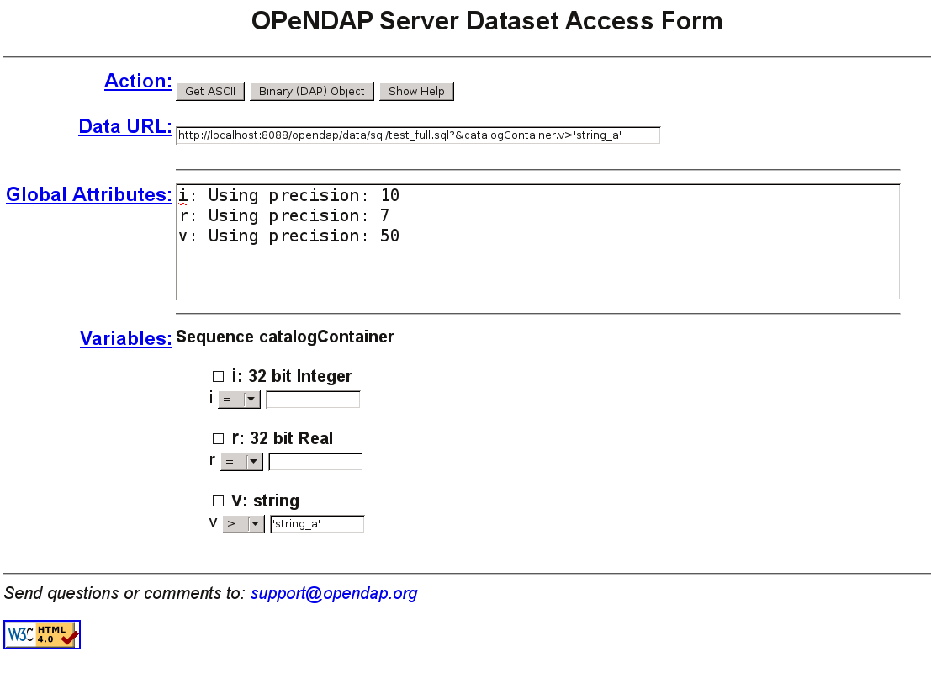
Constraints on string:
You probably (depending on the used DB) need to wrap with ‘ ‘ the value of the constraint
03/20/26
Author: Dr. Cancellieri Carlo
<number>
Notes:
<number>

Slide 8
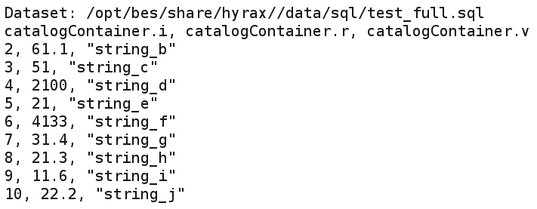
Filtering strings:
The row containing the strings <=‘string_a’ are filtered…
03/20/26
Author: Dr. Cancellieri Carlo
<number>

Slide 9
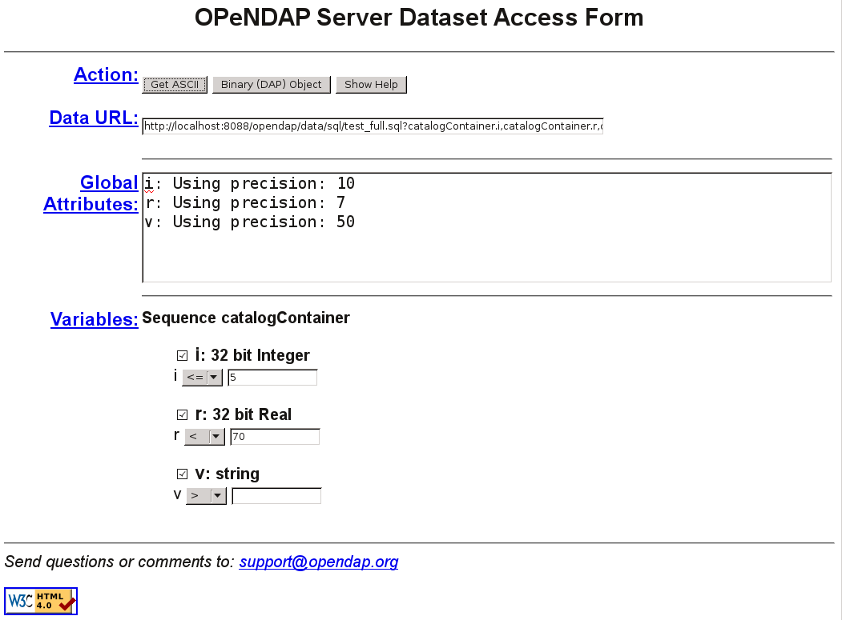
Constraints and Projection:
You probably (depending on the used DB) need to wrap with ‘ ‘ the value of the constraint
03/20/26
Author: Dr. Cancellieri Carlo
<number>

Slide 10
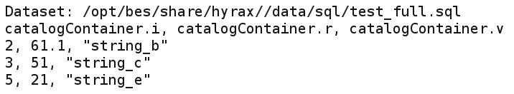
Filtering values:
03/20/26
Author: Dr. Cancellieri Carlo
<number>

Slide 11

Projecting:
03/20/26
Author: Dr. Cancellieri Carlo
<number>

Slide 12
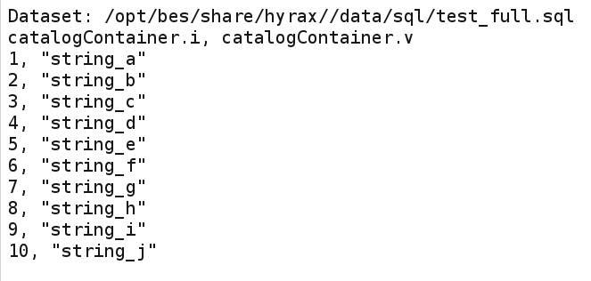
Projected values:
Column named ‘r’ is not projected
03/20/26
Author: Dr. Cancellieri Carlo
<number>

Slide 13
SQLHandler is developed by:
Dr. Carlo Cancellieri
ccancellieri@hotmail.com
and is distributed under LGPL license
Its development was financed by:
Google under the GSoC 2010 rules.
Special thanks:
Mr. Patrick West as mentor for OPeNDAP Inc.
Mr. James Gallagher as mentor for OPeNDAP Inc.
Opendap svn
Google code
Sourceforge
03/20/26
Author: Dr. Cancellieri Carlo
<number>

