Slide 1


THESIS PROGRESS · ESS IN DAY-AHEAD MARKETS
Can current-market bids reproduce Baldick’s SOC-based day-ahead outcome?
same KKT?
Current design
interval bids
KKT equivalence between interval-by-interval ESS bids and the SOC-based design, and the experimental plan
Baldick
SOC-based design
Carlos · September 2026
Notes:
Title. The deck summarises the KKT equivalence note (complete formulation) and the planned numerical experiments.

Slide 2

MOTIVATION
The question
Current design (CD): ERCOT DAM
If the regulator keeps the current design, do there exist charge bids and discharge offers that reproduce Baldick’s outcome?
Same KKT conditions ⇒ same dispatch and same nodal prices.
What information must those bids embed, and can an ESS build them without Baldick’s solution?
Each ESS submits interval-by-interval charge bids and discharge offers. SOC is not in the clearing; the ESS manages it through its bids.
SOC-based design (Baldick, 2026)
The ISO optimizes SOC. The ESS submits only technical data and one end-of-horizon bid b_{e}. Benchmark for social welfare.
Approach
1
Write both clearing problems and their KKT conditions in full
2
Match the stationarity conditions term by term
3
Read off the equivalent bids and the information they require
4
Quantify the welfare gap when that information is missing
Steps 1–3: done (equivalence note) · Step 4: experimental plan
2

Slide 3
NOTATION
Notation at a glance
Sets
n ∈ N, ℓ ∈ L, r | buses, lines, reference bus
i ∈ G, k ∈ K_{i} | generating units, offer blocks
m ∈ D, j ∈ J_{m} | loads, bid blocks
e ∈ E, t ∈ T | storage units, intervals (length ΔT)
Variables
q_{i,k,t}, d_{m,j,t} | generation, served elastic demand (MW)
f_{ℓ,t}, θ_{n,t} | line flow (MW), voltage angle
p_{e,t}, g_{e,t}, s_{e,t} | ESS charge, discharge (MW); SOC (MWh)
ESS data
α_{e}, β_{e}, γ_{e} | charge / inverse-discharge coeff.; retention
s̄_{e}, s̲_{e}, p̄_{e}, ḡ_{e} | SOC and power limits
ε_{e}, ζ_{e} | degradation cost, charge / discharge
b_{e}(·), w_{e}(·) | terminal bid benefit and its slope (SOC design)
u^{p}_{e,j,t}, c^{g}_{e,k,t}; p̂, ĝ | CD charge-bid, discharge-offer prices; block sizes
Multipliers ($/MWh)
λ_{n,t}, π_{e,t} | nodal price (LMP); marginal value of SOC
ν̄_{e,t}, ν̲_{e,t}; ρ, σ | SOC-limit rents; charge / discharge bounds
Multipliers of MW constraints enter the Lagrangian with factor ΔT, so every multiplier is in $/MWh. (·)★ denotes the optimum of the SOC design.
3

Slide 4
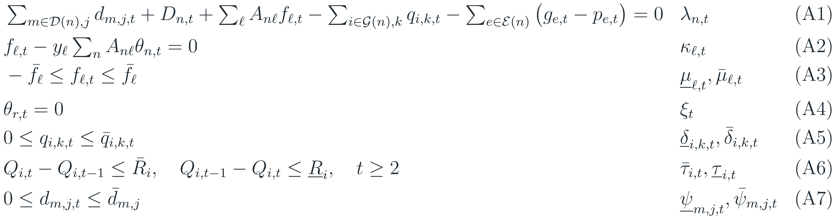
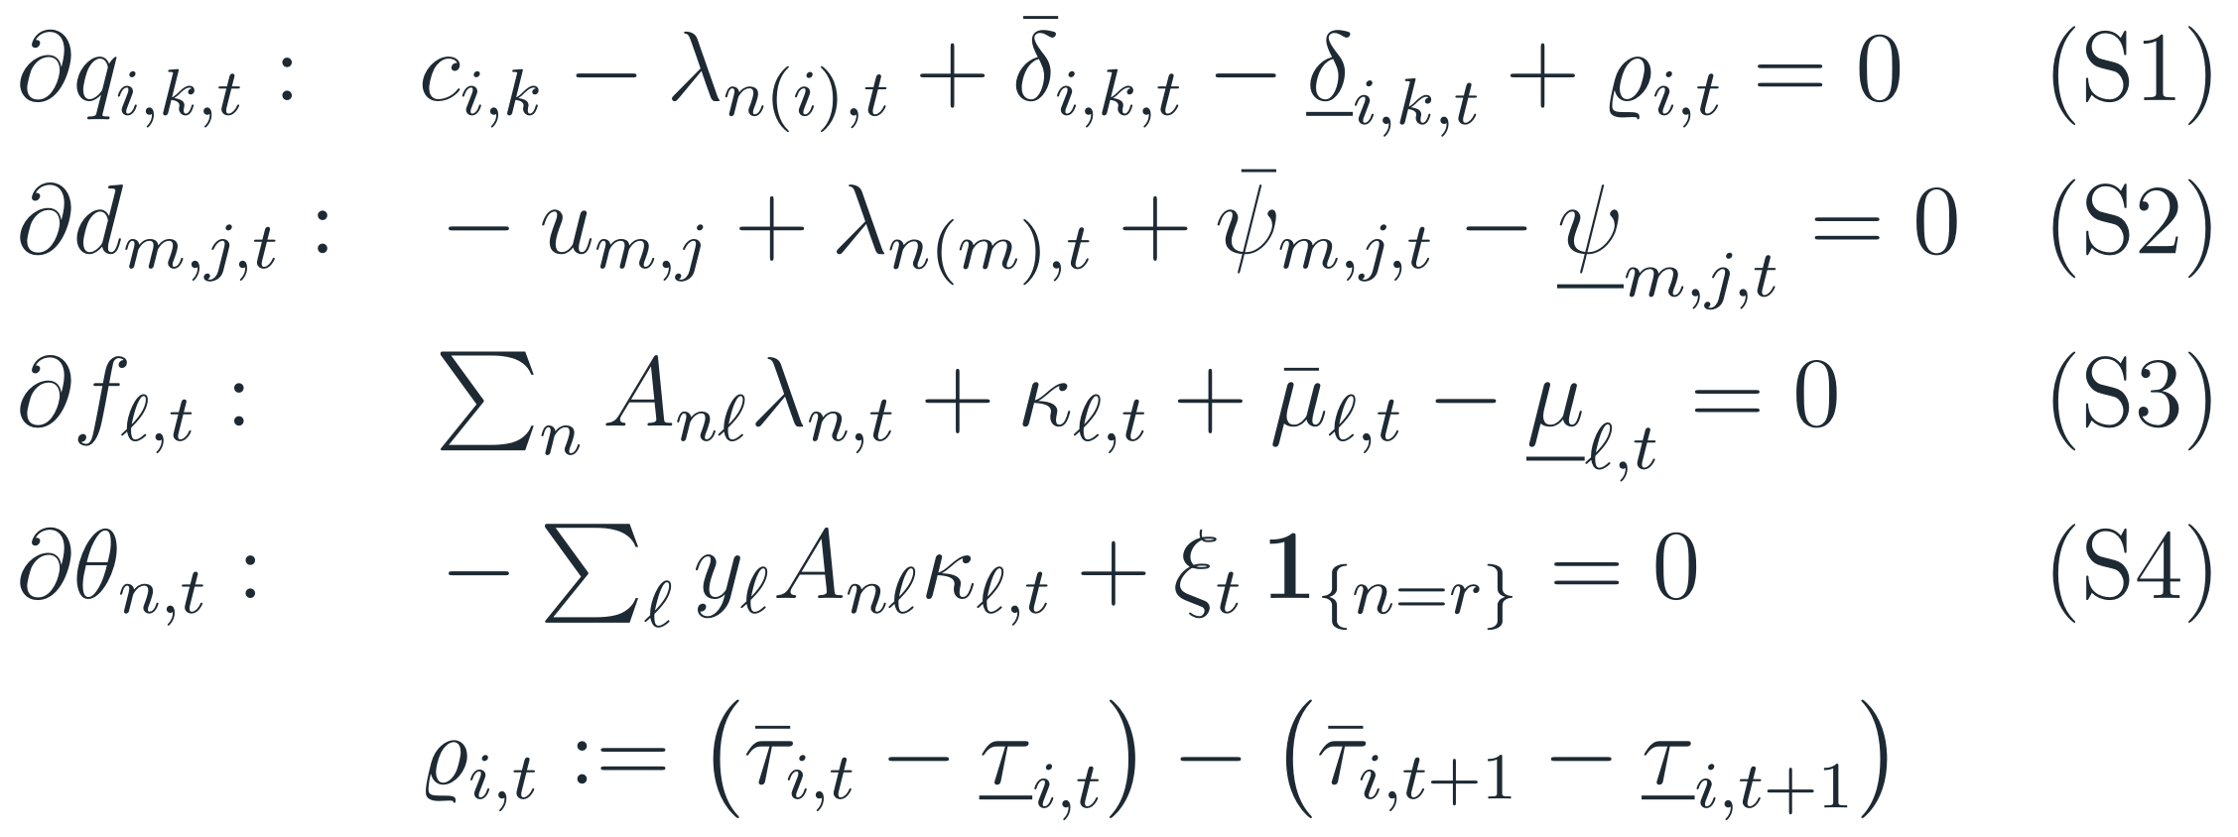
BOTH DESIGNS
The rest of the market is identical in both designs
Constraints (multiplier)
Stationarity (S1)–(S4)
DC network with nodal prices λ_{n,t}; the ESS sees the price at its own bus n(e).
ϱ_{i,t} is the ramp wedge; ramps apply for t ≥ 2.
Complementary slackness (CS1)–(CS3) for all bounds, omitted here.
4

Slide 5
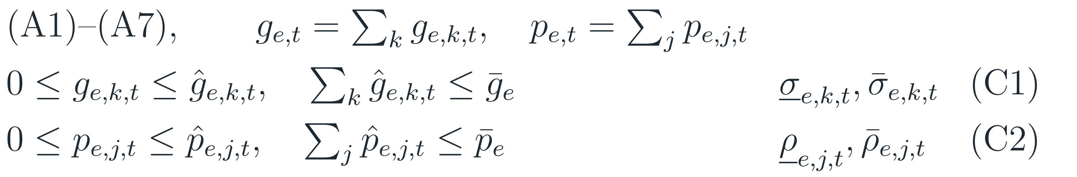
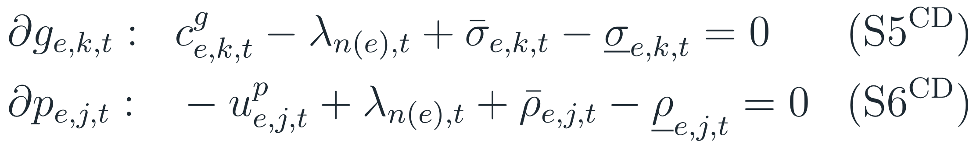
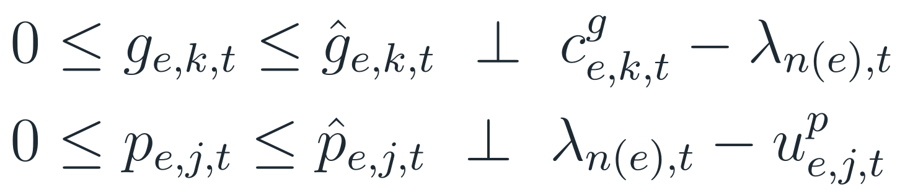
1 · CURRENT DESIGN (CD)
Current design: interval bids, no SOC in the clearing
Clearing problem
ESS = paired generator (offer blocks c^{g}) + load (bid blocks u^{p}).
Stepped bids per interval, as in ERCOT.
SOC is not represented: the ESS must build its intertemporal plan into its bids.
ERCOT DAM: nodal (A1)–(A4): collapse the network to one zone.
Simplified: no unit commitment, AS or virtual bids.
KKT: ESS rows (the rest is (S1)–(S4))
Box form
5

Slide 6
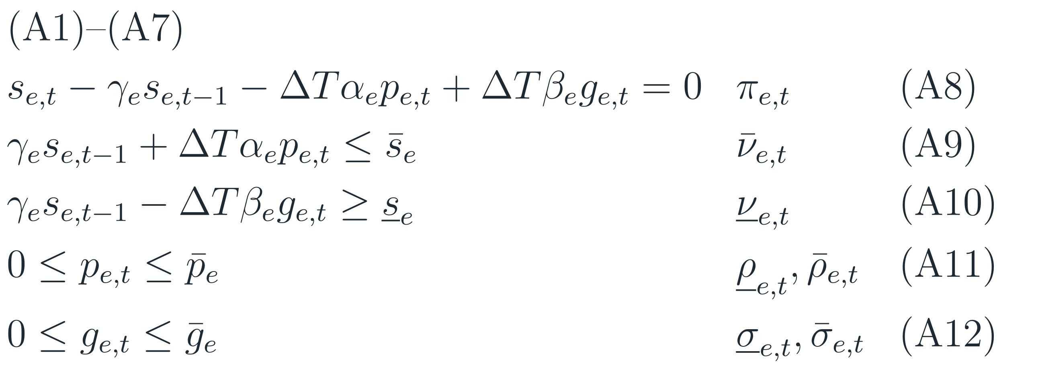
2 · SOC-BASED DESIGN (BALDICK)
Baldick’s design: the ISO optimizes SOC
Clearing problem
The ESS submits no interval bids, only technical data and the terminal bid b_{e}.
s̿_{e,T} is the end SOC the ESS would reach without participating.
(A9)–(A10) are Baldick’s tightened SOC limits.
Exclusivity p ⊥ g relaxed, as in Baldick’s examples.
subject to
Baldick (2026): (A8) = eq. (4); (A9)–(A10) = eqs. (6)–(7); (A11)–(A12) = eqs. (1)–(2)
R. Baldick, “A state-of-charge based formulation for storage participation in electricity markets,” arXiv:2606.14993, 2026.
6

Slide 7
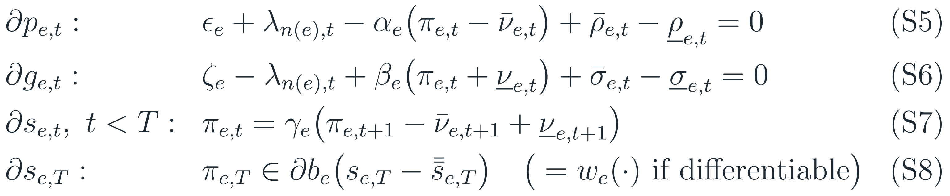
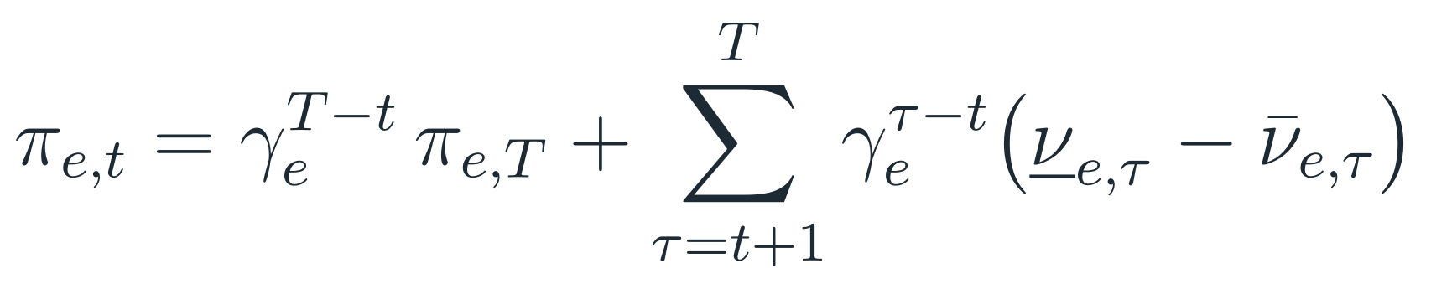
2 · SOC-BASED DESIGN (BALDICK)
KKT conditions of Baldick’s design: ESS rows
+ (S1)–(S4) for the rest of the market, and complementary slackness for power bounds (CS4) and SOC limits (CS5).
Unrolled costate, from (S7)–(S8)
π_{e,t} is the value of one more MWh stored at the end of t.
It equals the discounted terminal value plus the future SOC-limit rents.
It is constant between SOC-binding events (γ_{e} = 1).
7

Slide 8
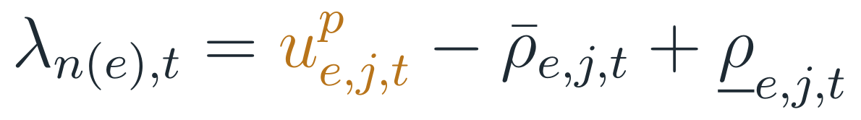
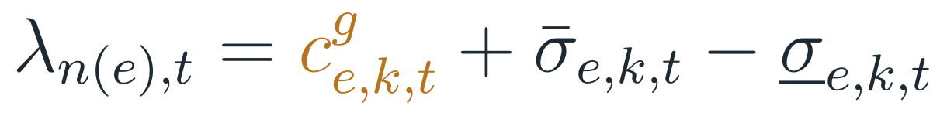
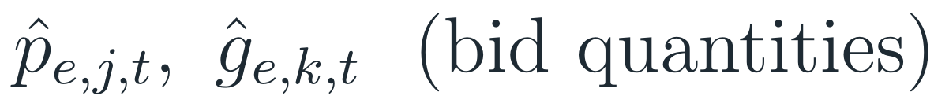
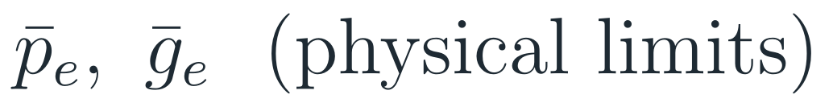
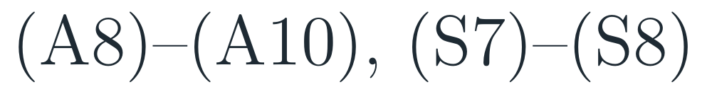
3 · COMPARISON
KKT side by side: only the ESS rows differ
Condition
Current design
SOC design (Baldick)
Rest of market
(S1)–(S4), (CS1)–(CS3), (A1)–(A7)
identical
identical
Charge stationarity
Discharge stationarity
ESS power bounds
SOC rows
absent
Reading: the CD bid prices (amber) play exactly the role of the bracketed terms of the SOC design (teal). Matching them makes the two KKT systems coincide.
8

Slide 9
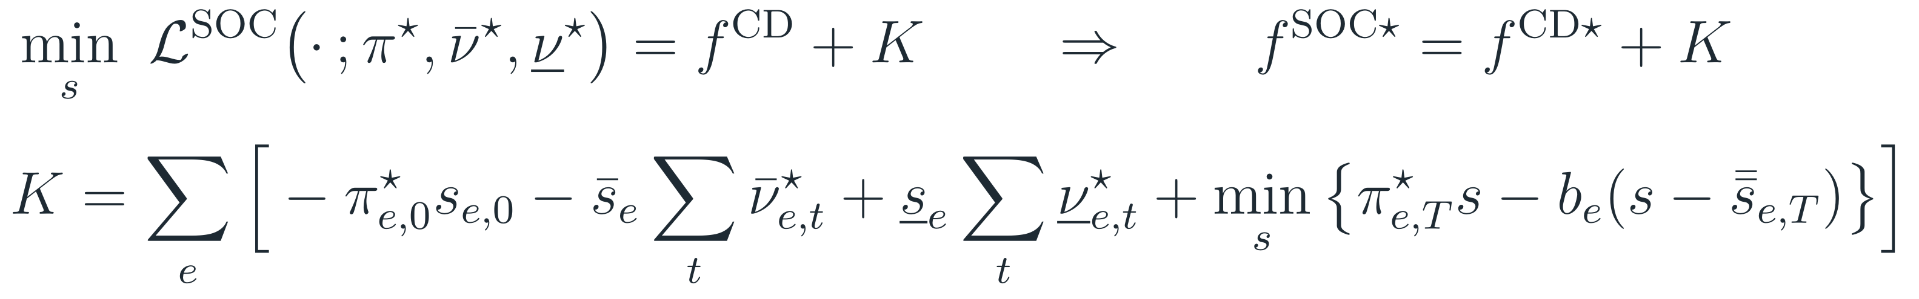
3 · COMPARISON
Equivalent bids and why they work
(E)
Proposition 1: KKT equivalence
Proposition 2: CD is a Lagrangian relaxation
Let z★ be primal–dual optimal for Baldick’s design. Under bids (E), z★ satisfies every KKT row of the current design.
⇒ same dispatch and the same nodal prices λ★.
Proof: substitute (E) into (S5)–(S6) to get (S5^{CD})–(S6^{CD}) with the same ρ★, σ★. The bounds coincide (p̂ = p̄, ĝ = ḡ), the rest is common, and the CD is an LP, so KKT is sufficient.
Dualize the SOC rows (A8)–(A10) of Baldick’s problem at (π★, ν̄★, ν̲★):
(ii) A CD optimum is SOC-optimal iff some s satisfies (A8)–(A10) with complementary slackness w.r.t. ν̄★, ν̲★.
The bids are the SOC design’s dual prices.
9

Slide 10
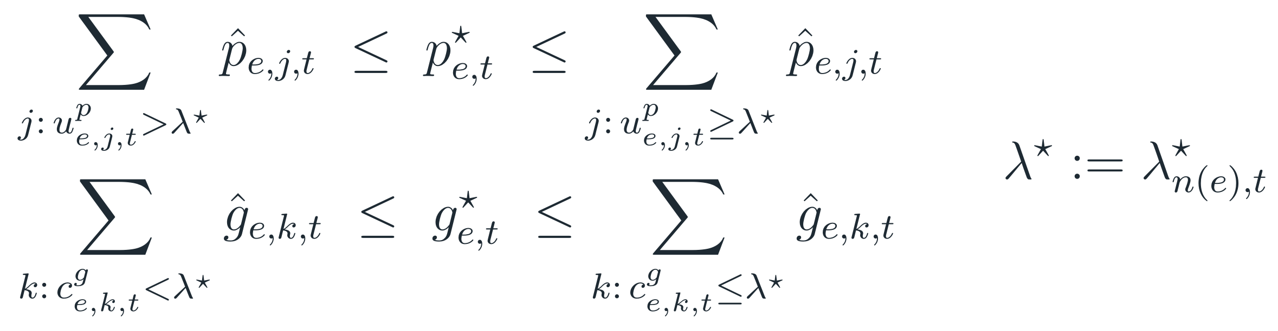
3 · COMPARISON
Stepped bids: when is Baldick’s schedule reproduced?
Proposition 3: necessary and sufficient, any stepped bids
price
offer curve c^{g}
λ*
Baldick’s schedule must lie on each ESS’s submitted bid and offer curves, evaluated at Baldick’s nodal price.
admissible g*
Remark: uniqueness and quantities
Remark: charge/discharge exclusivity
The CD-optimal set contains the SOC-optimal set but may be larger, possibly SOC-infeasible, where an ESS block is priced at λ★. Tight blocks pin the schedule but may move λ★ where the ESS sets the price. Exact reproduction needs prices and quantities.
With π★ ≥ 0, bids (E) never clear charging and discharging in the same interval.
10

Slide 11

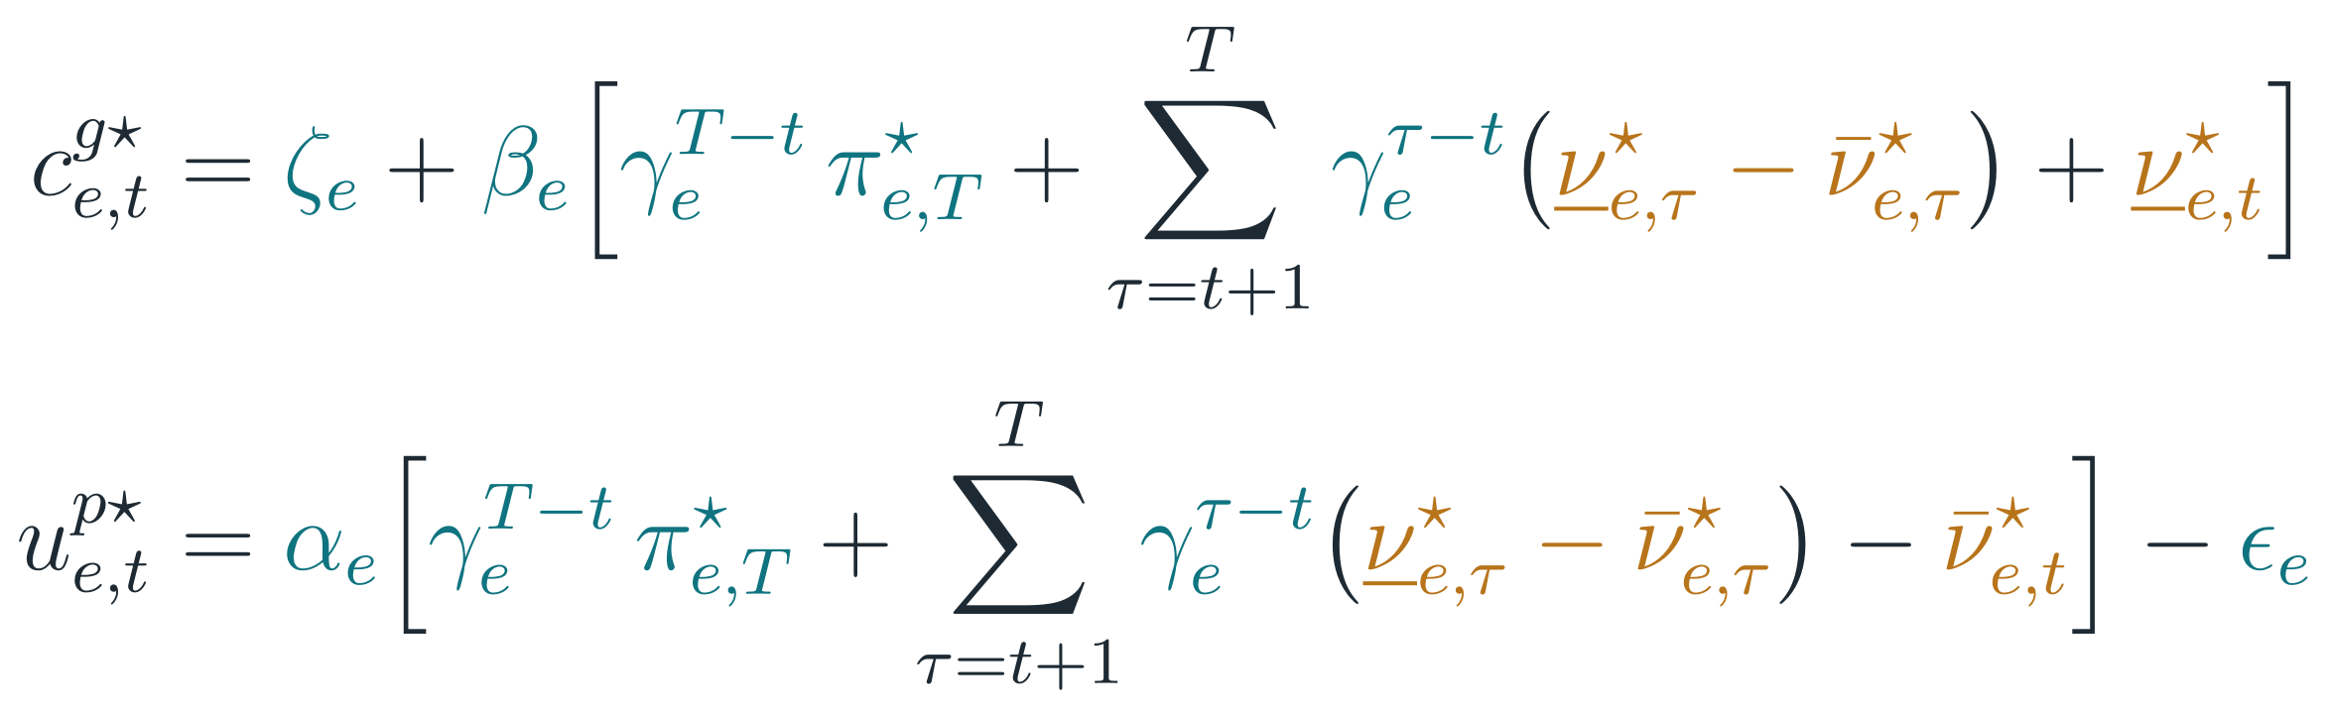

3 · COMPARISON
What information do the equivalent bids embed?
Corollary 1: unrolling π*
Private to ESS e
α_{e}, β_{e}, γ_{e}, ε_{e}, ζ_{e} and w_{e}: exactly what e submits in Baldick’s design.
Endogenous
Own SOC-limit rents ν̄★, ν̲★ (and s★_{e,T} if b_{e} is nonlinear). They depend on the whole market, but only through e’s nodal price path.
Corollary 2: when private information is enough
Otherwise the ESS needs the rents ν★, i.e. a forecast of its intra-horizon nodal prices (Baldick’s critique of interval bids).
11

Slide 12
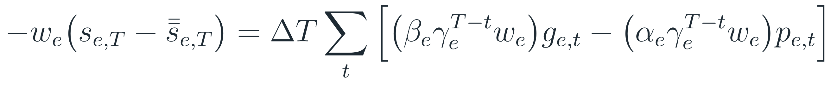
3 · COMPARISON
Two kinds of “current design”, two different gaps
ERCOT DAM
CAISO · NYISO
No SOC in the day-ahead clearing
SOC in the clearing, interval bids
Equivalent bids need the SOC rents ν★ (Cor. 1).
The ESS must forecast its nodal price path.
Cleared schedules can be SOC-infeasible.
Gap source: missing SOC rents.
The market computes the rents ν★ itself.
With linear b_{e}, the private-only bids of Cor. 2 make the problem identical to Baldick’s (Remark 3).
Gap source: only a nonlinear terminal bid.
Why Remark 3 holds: the terminal bid is linear in the schedule
⇒ The experiments must report the two current designs separately.
12

Slide 13
VERIFICATION
Numerical check: the equivalence holds exactly
4
test cases: Baldick’s 3 single-bus cases + a 3-bus network with ramps, elastic demand and 2 ESS (γ < 1, s̲ > 0)
10⁻¹⁴
max. residual of all KKT rows (S1)–(S8) at the solver duals
0.00
max. difference between CD and SOC-design nodal prices
= K
f^{SOC★} = f^{CD★} + K holds exactly (−80,010.35 in both)
Charges where λ★ = u^{p★} (t = 1, 3, 4); discharges where λ★ = c^{g★} (t = 2, 5, 6).
13

Slide 14



EXPERIMENTAL PLAN
Under perfect information the equivalence is a theorem. The experiments measure the gap when its conditions fail.
How often SOC limits bind
Forecast quality
Quantity information
Cor. 2: private bids suffice only if no SOC limit binds
Cor. 1: the missing rents ν* come from the nodal price path
Remark 1: prices alone may not pin the schedule

Slide 15
EXPERIMENTAL PLAN
Roadmap: four stages, each feeding the next
INPUTS
INPUTS
INPUTS
INPUTS
Baldick §4.7 single-bus cases
Baldick §4.7 data (6 intervals)
Bid families B★, B^{priv}, B^{fcst}
Designs: ERCOT/OMIE-type, CAISO-type
Reduced RTS-GMLC system (IEEE model to run a proper simulation of both market clearing problems)
Sweeps: duration, ESS share, VRE multiplier, γ
Bid families from Stage 1
Scenarios ω for VRE and demand
Several ESS forecasting each other
Congested network (nodal)
done ✓
next
deterministic
stochastic
Stage 0 · Verification
Solve SOC design → duals → bids (E) → clear CD
Stage 1 · Baldick example
Clear CD for each bid family × design; RT settlement of SOC deviations
Stage 2 · RTS-GMLC, 24 h
Benchmark SOC design vs CD at every sweep point
Stage 3 · Uncertainty
Bids fixed before ω; clear CD per scenario; compare with SOC design
pipeline
bid families, rules
gap drivers
OUTPUTS
OUTPUTS
OUTPUTS
OUTPUTS
Same dispatch and prices
f^{SOC★} = f^{CD★} + K
Table: ΔSW, ESS surplus, prices, SOC violations
Validated evaluation rules
ΔSW vs each driver
Share of intervals with binding SOC
ΔSW^{unc}
Forecast error vs endogeneity
Nodal effects
Metric throughout: ΔSW = SW^{SOC} − SW^{CD}(B), with welfare evaluated using the true ESS costs (ε, ζ, w), not the bids.
15

Slide 16
EXPERIMENTAL PLAN · STAGE 1
Stage 1: Baldick’s 6-interval example
Data
Baldick §4.7: base, high WTP, s̄ = 1200
Build bids
B★, B^{priv}, B^{fcst}
Clear CD
ERCOT/OMIE-type and CAISO-type
RT settlement
SOC deviations at realized marginal cost
Outputs
ΔSW, ESS surplus, prices, SOC violations
Bid family | How it is built | Information used | Expected gap
B★ (sanity check) | (E) with the true π★, ν★ | SOC-design duals | 0 in both designs
B^{priv} | Cor. 2: ζ + βγ^{T−t}w, αγ^{T−t}w − ε | private data only | > 0 in ERCOT/OMIE-type when SOC binds; 0 in CAISO-type (linear b)
B^{fcst} | Self-schedule on forecast prices → ν̂ → (E) | private data + price forecast | depends on forecast error
Forecast-based bids
16

Slide 17
EXPERIMENTAL PLAN · STAGE 2
Stage 2: which drivers make the gap grow?
Sweep point
duration, ESS share, VRE, γ
Benchmark
solve SOC design → SW^{SOC}
Proposed sweep grid (to confirm)
Duration E/P
1, 2, 4, 8 h
ESS share
low → high share of peak load
next point
VRE multiplier
0.5, 1, 1.5, 2
Clear + evaluate
CD, RT settlement → SW^{CD}
Bids
B^{priv}, B^{fcst} (B★ as check)
Retention γ
1 and < 1
Hypotheses
H1: ΔSW(B^{priv}) grows with the share of intervals where SOC binds, so it is largest for short-duration ESS and high VRE.
H2: in the CAISO-type design ΔSW(B^{priv}) = 0 for linear b_{e} (Remark 3). This is the control case.
H3: B^{fcst} closes most of the gap when forecasts are good.
Outputs
ΔSW for each bid family vs each driver
Share of intervals with a binding SOC limit
ESS surplus under a fixed price-selection rule
17

Slide 18



EXPERIMENTAL PLAN · STAGE 3
Stage 3: uncertainty, endogeneity and the network
Scenarios ω
VRE and demand
Bids fixed ex ante
from expected or forecast prices
For each ω
clear CD and the SOC design
Aggregate
E_{ω}[·], split of the gap
The best ex-ante bid rule against the benchmark, scenario by scenario.
Forecast error
Endogeneity
Network
Vary the forecast noise; measure how fast ΔSW grows as ν̂ drifts from ν★.
Several ESS whose bids move the prices the others forecast. This is Baldick’s main argument against interval bids.
Congestion gives each ESS its own nodal price path, and therefore its own rents (Cor. 1).
18

Slide 19

BEFORE CODING
Three modeling decisions to fix first
Evaluating SOC-infeasible CD outcomes
Price selection under degeneracy
Scope of the model
ERCOT DAM is financial: settle deviations in real time at the realized marginal cost.
ERCOT: model the correction through the intraday markets.
Without a rule, CD welfare is not physically achievable.
Baldick’s example has price ranges (interval 1: 0 to 43.1 $/MWh).
Welfare is unaffected, but ESS surplus is not.
Fix one rule (solver duals or minimum price) everywhere.
Convex: no unit-commitment binaries.
Exclusivity p ⊥ g relaxed, as in Baldick.
Welfare measured with true ESS costs, not bids.
19

Slide 20
NEXT STEPS
From equivalence to measured gaps
1
Agree on the two current-design benchmarks: ERCOT-type and Baldicks-type
2
Fix the evaluation and price-selection rules
3
Code Stage 1: three bid families × two designs on Baldick’s example
4
Run the Stage 2 sweeps on the reduced RTS-GMLC system
Reference: R. Baldick, “A state-of-charge based formulation for storage participation in electricity markets: Technical reference,” arXiv:2606.14993, June 2026.

