Slide 1
From dual-based to price-based ESS bids
THESIS PROGRESS · ESS IN DAY-AHEAD MARKETS
π★, ν★
Writing the equivalent bids with nodal prices and private data only, and what the non-uniqueness of π implies for them
duals of Baldick’s clearing
λ
nodal prices + private data
Carlos · October 2026

Slide 2
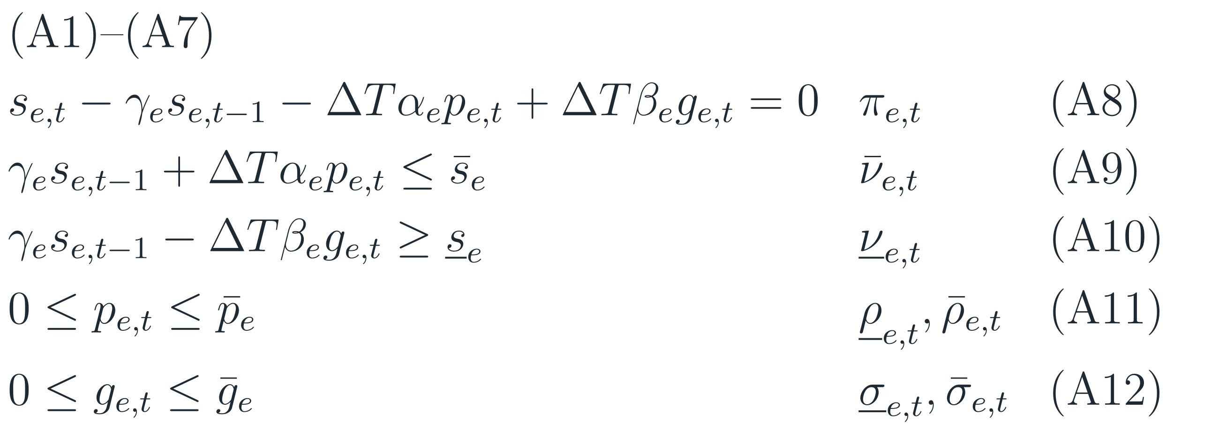
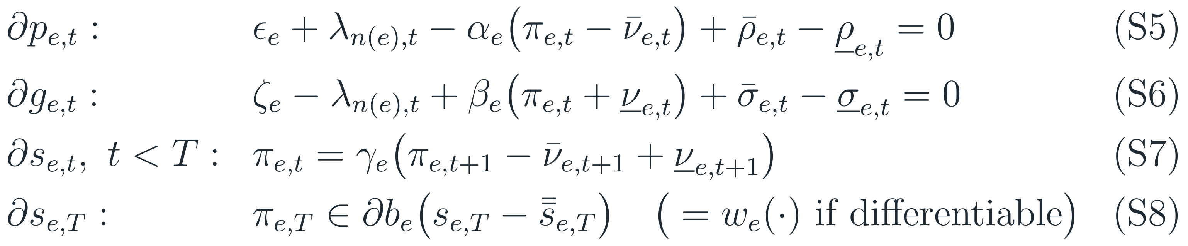
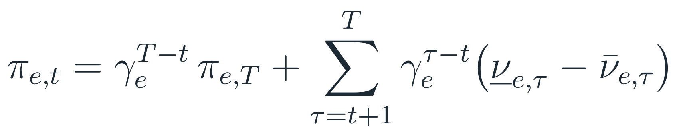
RECAP · SOC-BASED DESIGN (BALDICK)
Baldick’s design: the ISO optimizes SOC
Clearing problem
subject to
KKT
Baldick (2026): (A8) = eq. (4); (A9)–(A10) = eqs. (6)–(7); (A11)–(A12) = eqs. (1)–(2)
R. Baldick, “A state-of-charge based formulation for storage participation in electricity markets,” arXiv:2606.14993, 2026.
6

Slide 3

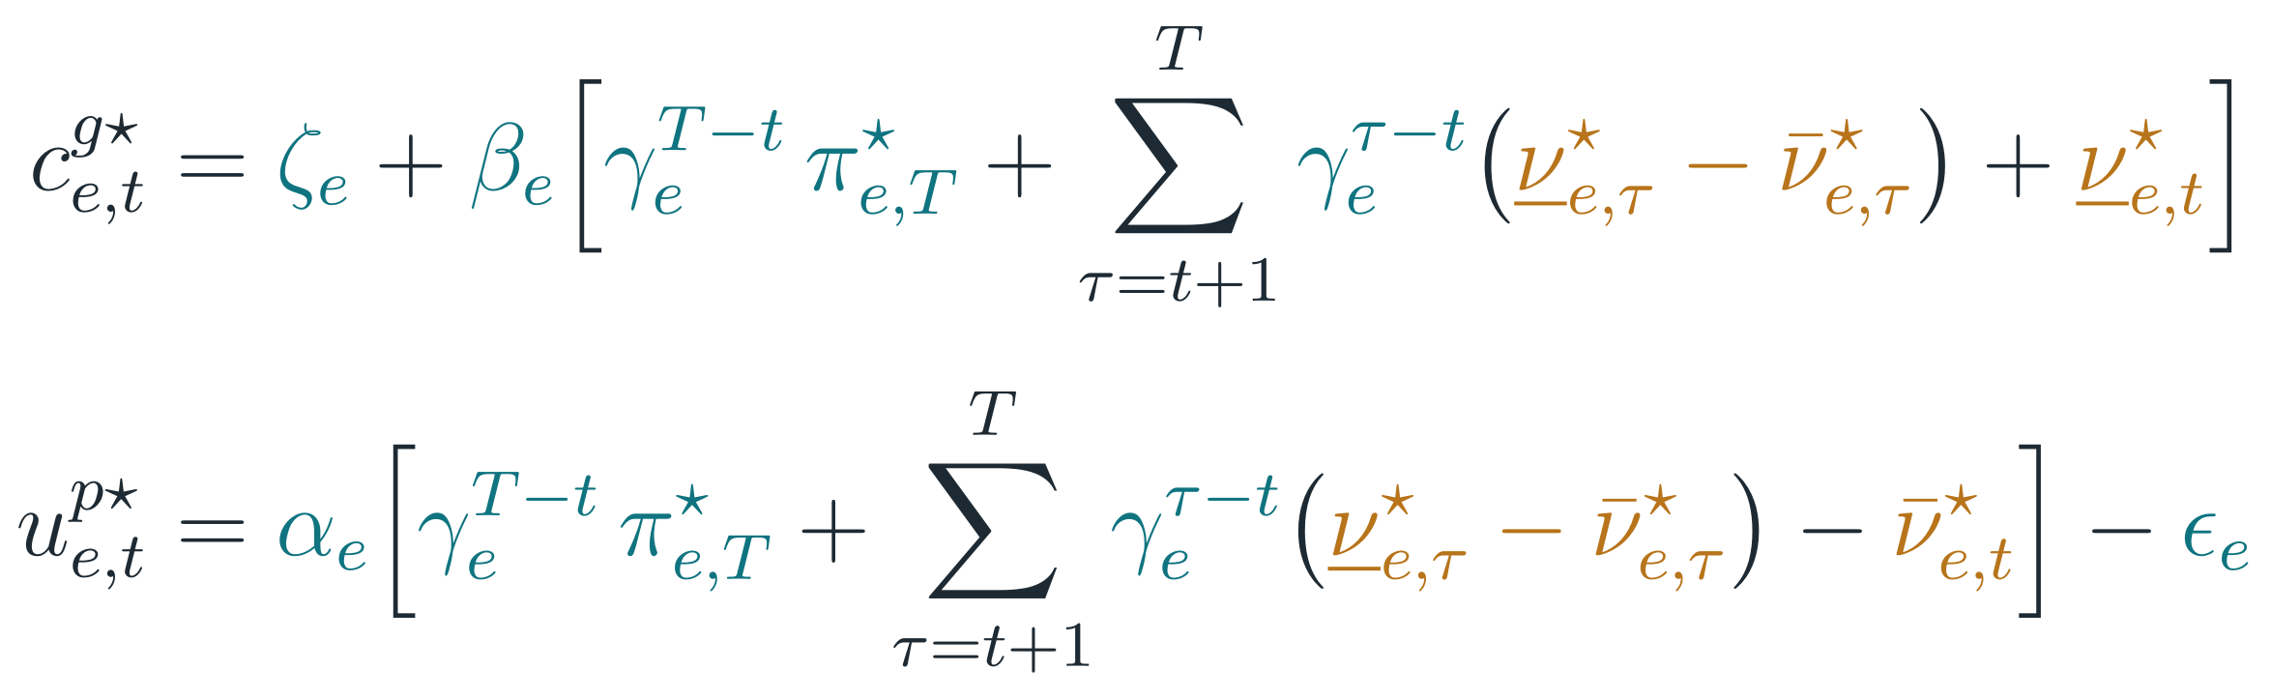

Where we left off: bids built from duals
RECAP
Equivalent bids (E)
Problem
π★ and ν★ are outputs of Baldick’s clearing. In the current design nobody computes them.
Corollary 1: unrolling π★
Goal
Rewrite (E) with private data and nodal prices only, plus the ESS’s own schedule.
Three steps
1
Remove the terminal value and the rents: bids depend on π only
2
Pin π with the prices at the marginal intervals
3
Choose π where the prices leave it free
Prop. 1: same KKT ⇒ same dispatch and nodal prices. Notation and (A)/(S) numbering as in the previous deck and the equivalence note.

Slide 4
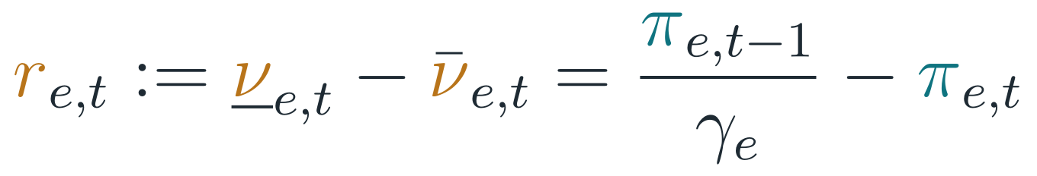
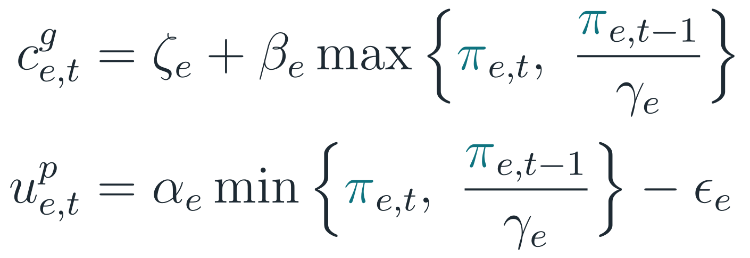
Bids depend only on the value of stored energy
STEP 1 · ELIMINATE THE DUALS
Terminal value
Reading
Interval t only needs the value of stored energy at its start and at its end.
The offer uses the higher value, the bid the lower one.
The bid–offer gap widens only when the SOC hits a limit (nonzero rent).
Net SOC rent: the jump of π across interval t
Assumption 1: at most one SOC limit active per interval ⇒
Corollary 3: substitute into (E)
Still a dual
The value of stored energy π itself. Steps 2–3 write it with prices.

Slide 5
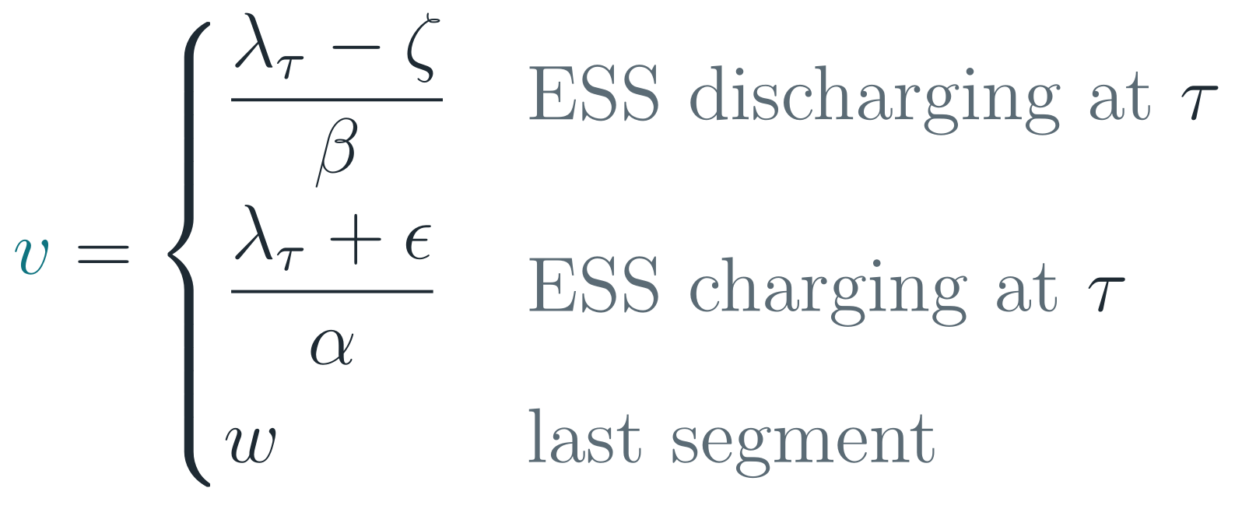
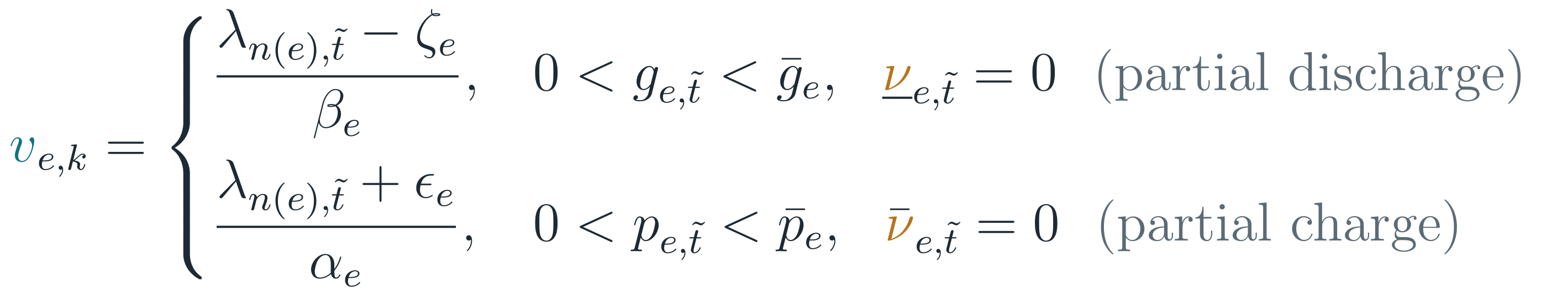
Between SOC limits, one price fixes the value of energy
STEP 2 · SEGMENTS AND MARGINAL INTERVALS
Baldick base case, solver duals | t = 1 | t = 2 | t = 3 | t = 4 | t = 5 | t = 6
Price λ★ ($/MWh) | 43.1 | 50 | 0 | 0 | 50 | 50
ESS action (MW) | charge 100 | discharge 90 | charge 200 | charge 22.2 | discharge 175 | discharge 25
SOC at end of t (MWh) | 360 | 0 | 720 | 800 | 100 | 0
SOC limit hit during t | – | empty | – | full | – | empty
Segment | S₁ | S₂ | S₂ | S₃ | S₃ | S₄ (last)
π★ ($/MWh) | 49 | 1.11 | 1.11 | 49 | 49 | 40 = w
Inside a segment there is no rent, so π only changes by retention
Value v of the segment
At τ the ESS is indifferent at the price, so the price reveals what 1 MWh stored is worth:
A marginal interval t̃ fixes the segment’s value from its price

Slide 6
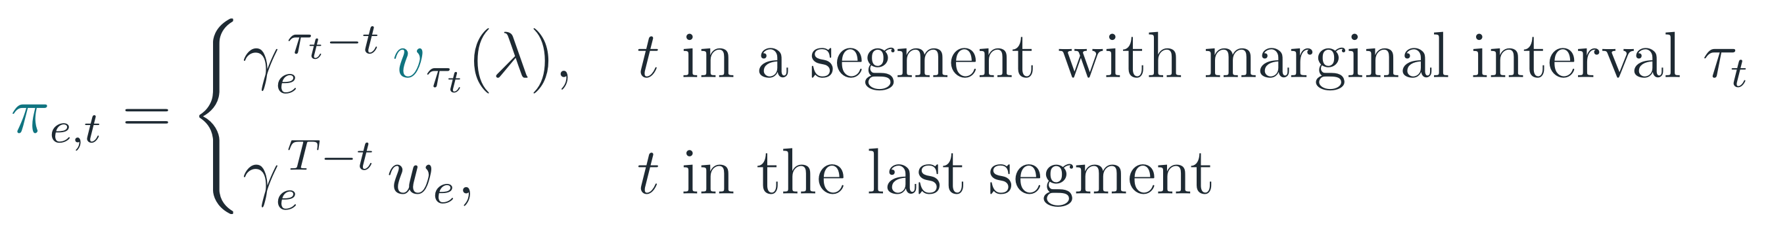


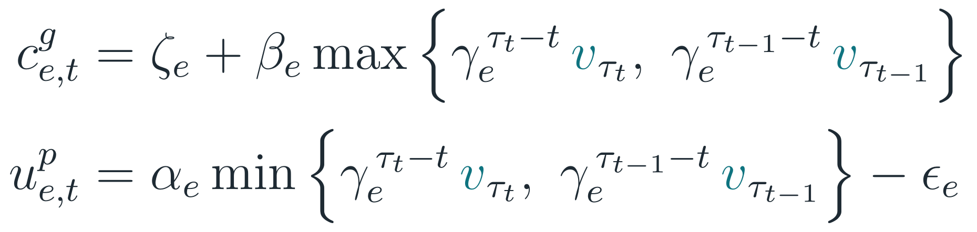

Equivalent bids without dual variables
STEP 3 · PRICE-BASED BIDS
What the bids need
Proposition 4: value of stored energy from prices
Private data
α, β, γ, ε, ζ and w
τ(t): marginal interval of the segment that contains t
Prices
Corollary 4: equivalent bids as functions of prices
Nodal prices at the marginal intervals only
Own SOC path
Which hours hit a SOC limit
Base case, solver duals | t = 1 | t = 2 | t = 3 | t = 4 | t = 5 | t = 6
τ(t) → value at end of t | 1 → 49 | 3 → 1.11 | 3 → 1.11 | 5 → 49 | 5 → 49 | T → 40
τ(t−1) → value at start of t | (1) → 49 | 1 → 49 | 3 → 1.11 | 3 → 1.11 | 5 → 49 | 5 → 49
Offer cᵍ = 1 + max | 50 | 50 | 2.11 | 50 | 50 | 50
Bid uᵖ = 0.9·min − 1 | 43.1 | 0 | 0 | 0 | 43.1 | 35
All three come from the ESS’s own self-schedule against forecast prices (primal solution only). If a segment has no marginal interval, prices only bound π.

Slide 7
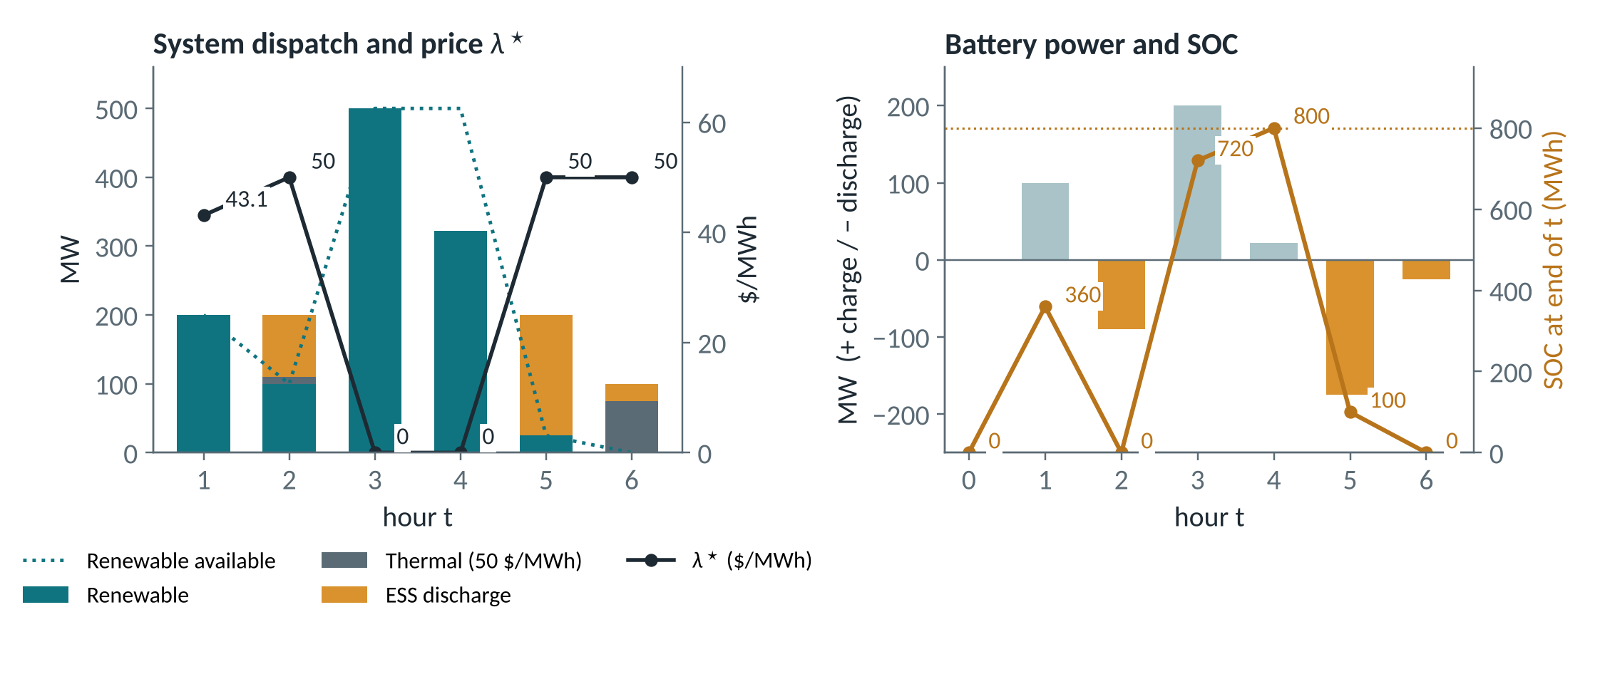
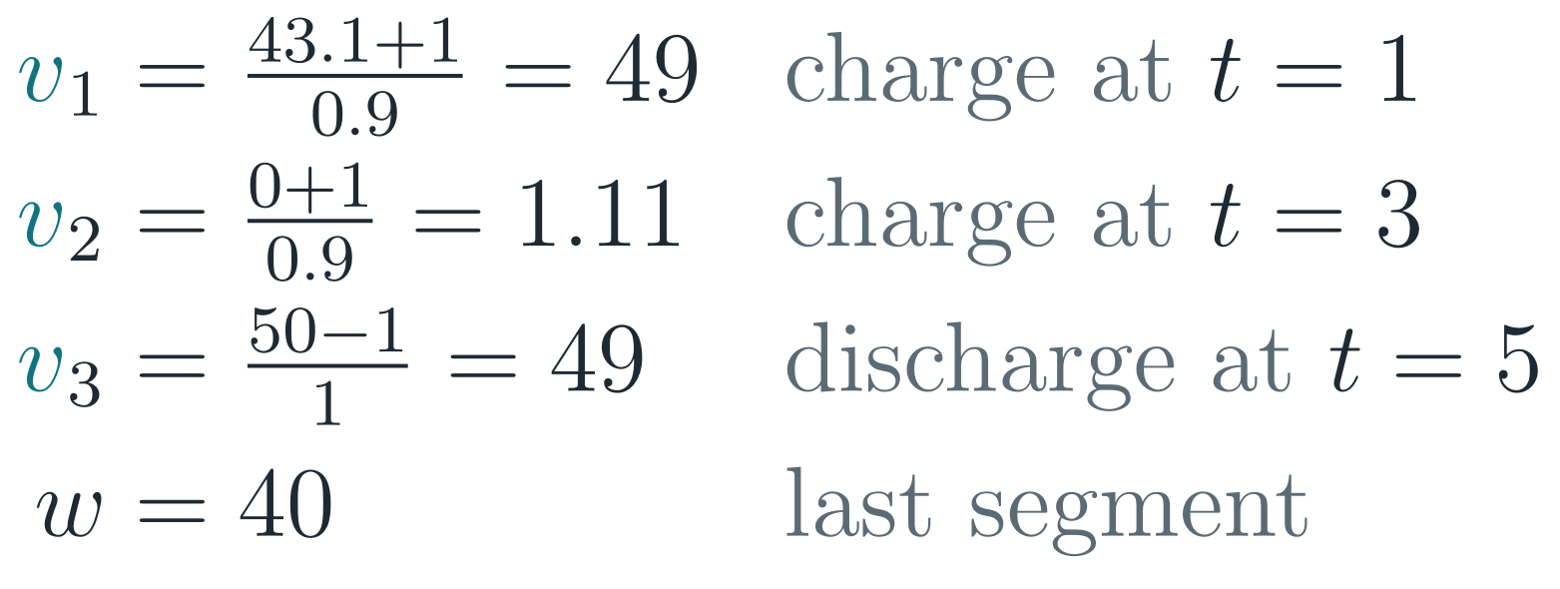
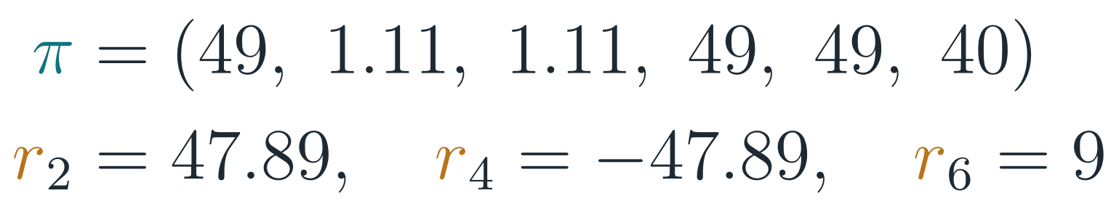

The price-based formulas recover the solver’s multipliers
WORKED EXAMPLE · BALDICK BASE CASE
Marginal values (Prop. 4)
π and rents (Cor. 4)
Single bus, T = 6, ΔT = 4 h. Renewable at 0 $/MWh, thermal at 50 $/MWh, inelastic demand. α = 0.9, β = γ = 1, ε = ζ = 1, s̄ = 800 MWh, w = 40.
Equal to the multipliers returned by the solver
The battery charges when renewable energy is in surplus (t = 1, 3, 4) and discharges instead of thermal (t = 2, 5, 6).
It is empty at t = 2 and 6 and full at t = 4.

Slide 8
Prices pin the value of stored energy almost everywhere, except where the battery hits a limit it cannot undo
NEW FINDING
2 of 6
[1.11, 49]
same λ★
hours with a free π in the base case (t = 2, 4)
admissible range of π₂ and π₄ ($/MWh)
for every admissible choice, with perfect forecasts

Slide 9
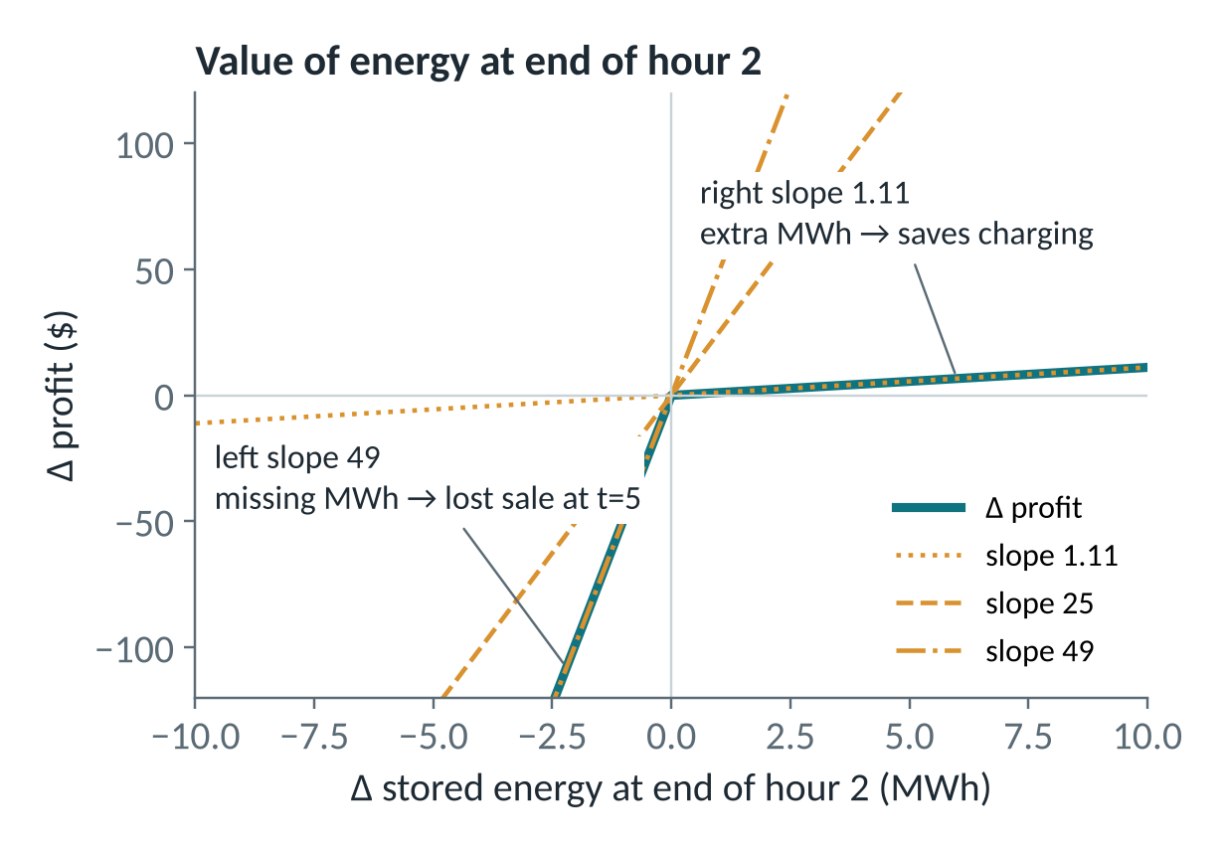
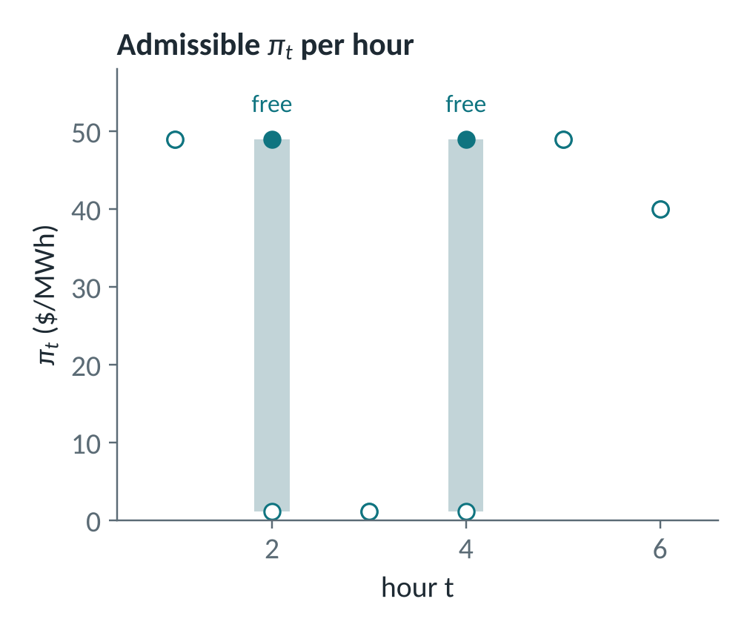
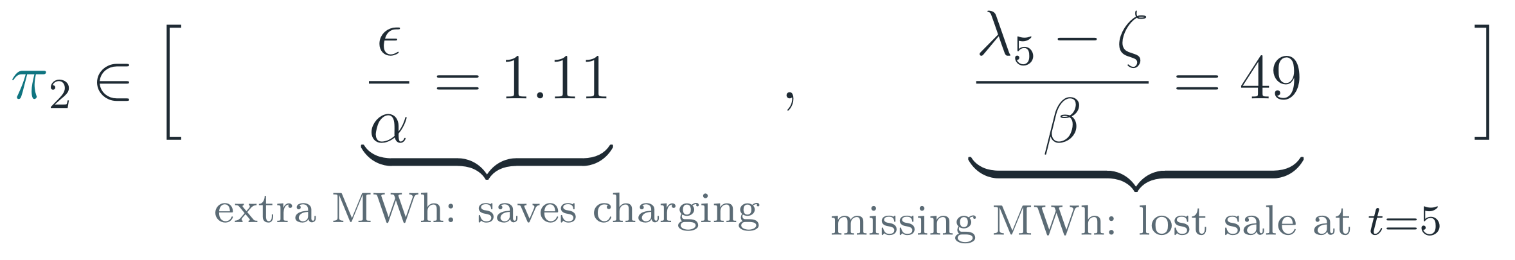
Why two hours are free: a kink in the value of energy
NON-UNIQUENESS
t = 2: the battery is empty and the renewable surplus at t = 3 is fully used, so a missing MWh cannot be recharged.
t = 4: same kink, because the cap binds (720 + 3.6·22.2 = 800).
Checked by re-solving the LP with ±0.5 MWh added to the SOC recursion.

Slide 10
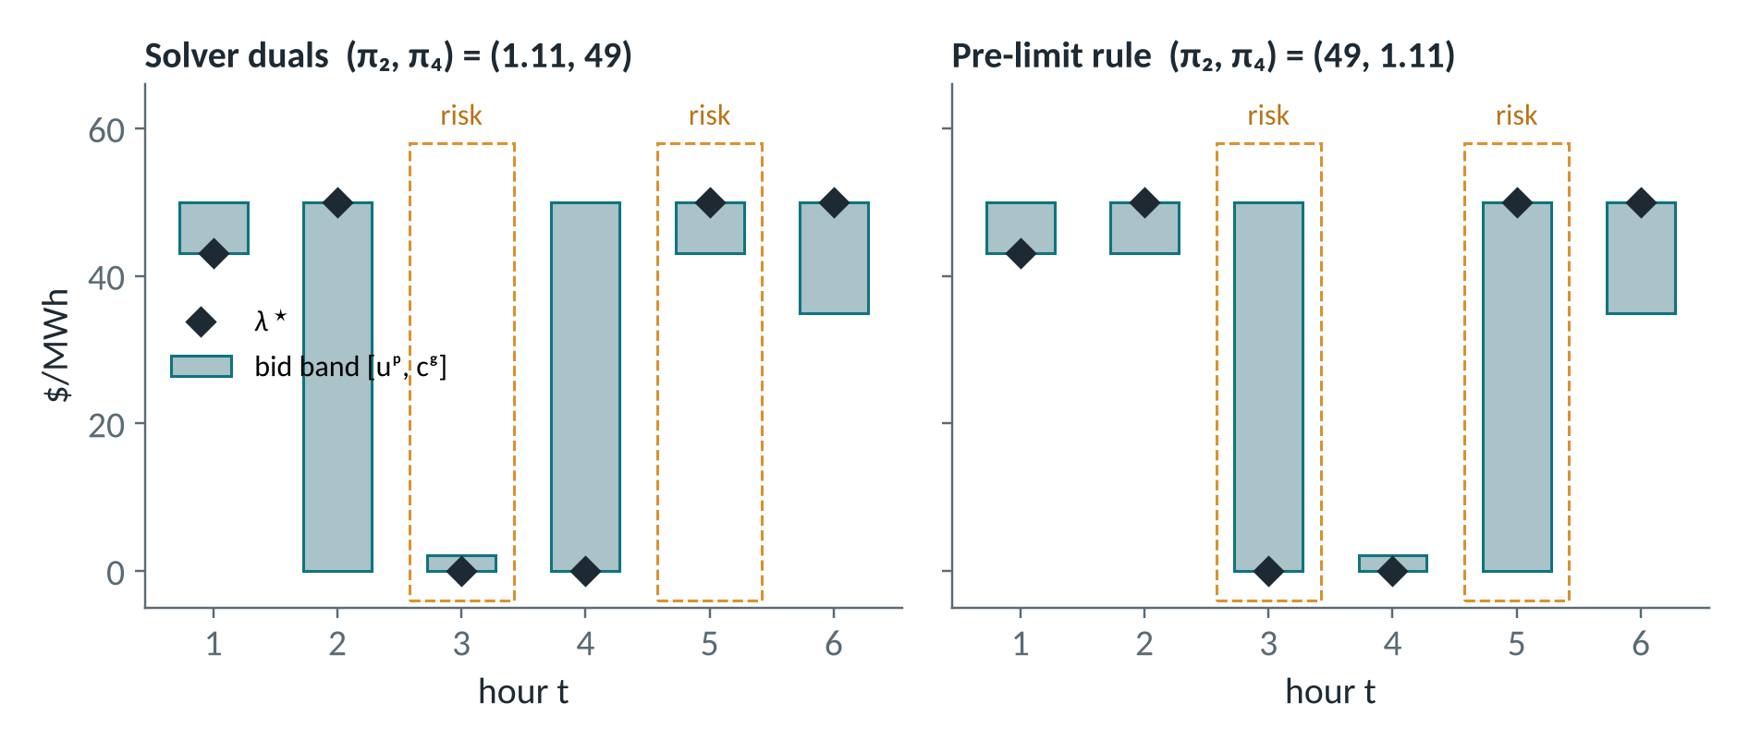
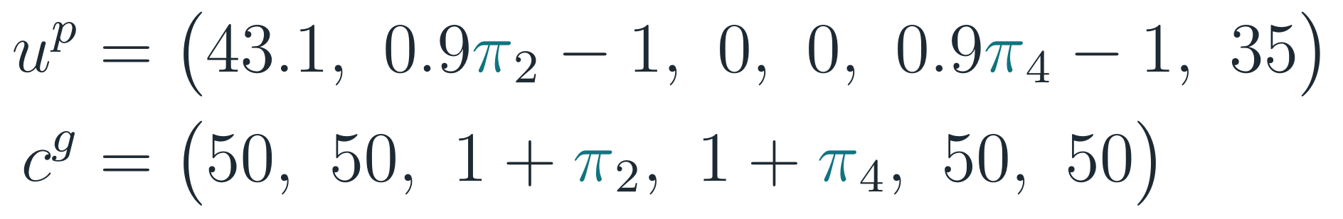
Same prices, different bids: the choice decides which error you risk
IMPLICATION FOR BIDS
Value of stored energy π | t = 1 | t = 2 | t = 3 | t = 4 | t = 5 | t = 6
Admissible (LP) | 49 | [1.11, 49] | 1.11 | [1.11, 49] | 49 | 40
Solver duals | 49 | 1.11 | 1.11 | 49 | 49 | 40
Pre-limit rule | 49 | 49 | 1.11 | 1.11 | 49 | 40
How far can the price move before the battery does the wrong thing?
t | Planned → unwanted | Solver [1.11, 49] | Pre-limit [49,1.11]
2 | sell → buy | ↓ 50 (0) | ↓ 6.9 (43,1)
3 ⚠ | buy → sell while empty | ↑ 2.1 (2,1) | ↑ 50 (50)
4 | buy → sell | ↑ 50 (50) | ↑ 2.1 (2.1)
5 ⚠ | sell → buy while full | ↓ 6.9 (43,1) | ↓ 50 (0)
↑ / ↓: price rise / drop ($/MWh) from λ★ that triggers the unwanted action.
⚠ impossible action: infeasible schedule. Amber: feasible, but costs welfare.
Takeaway
Perfect forecast: every choice gives λ★.
With errors, each choice leaves two hours exposed: one bid per hour cannot depend on the SOC.
Only the band edges at t = 2–5 depend on π₂ and π₄.

Slide 11

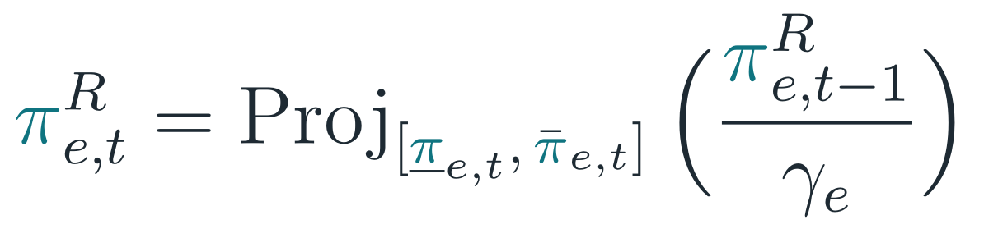
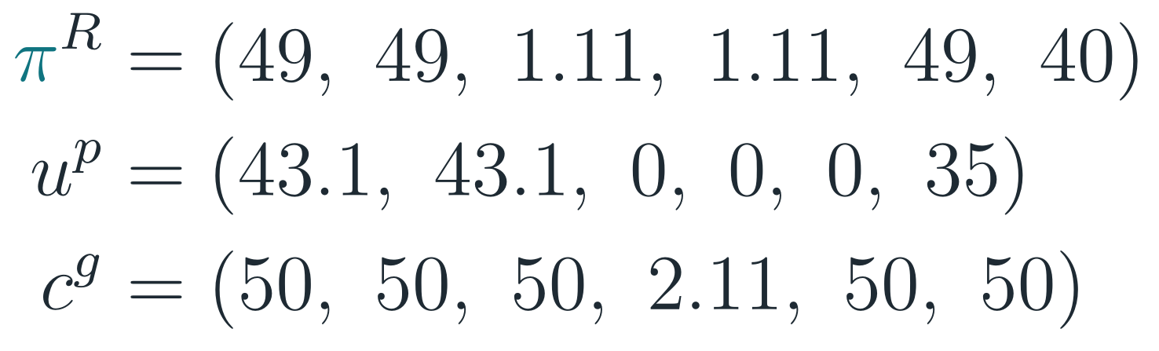

Carry the pre-limit value forward
SELECTION RULE
Pre-limit rule
What it buys
Margin 50 $/MWh at the infeasibility-risk hours (t = 3, 5).
Prop. 4 still holds: H = {3, 5, 6}, segments {1,2}, {3,4}, {5}, {6}.
The projection interval is the admissible range of π at t: its ends are the right and left slopes of the optimal value.
Free hours get zero rent: the rent moves to the next hour.
Base case
What it costs
Small margins move to t = 2, 4 (6.9 and 2.1), where a wrong action is feasible and only costs welfare.
A candidate rule, to be tested in Stage 1.

Slide 12

How an ESS builds its bids without duals
IN PRACTICE · BID FAMILY B^{FCST}
INPUT
STEP A
STEP B
STEP C
OUTPUT
Price forecast
Self-schedule LP
Read the SOC path
Values v and π
Bids uᵖ, cᵍ
own nodal price, T intervals
against the forecast: charge, discharge, SOC (primal only)
limit-hit hours, marginal intervals
Prop. 4 + pre-limit rule
blocks p̄, ḡ → submit to DAM
Perfect forecast
Forecast errors
Reproduces Baldick’s nodal prices for every admissible π (difference ≈ 1e−15).
Quantities can differ at the bid edges, so a tie-break rule is needed.
Welfare gap ΔSW > 0 with respect to Baldick’s design.
Possible SOC-infeasible schedules, corrected in real time.
Measured in Stages 1–2.
B^{fcst} only uses information the ESS has: its own data and a forecast of its own nodal price.

Slide 13
Open points before Stage 1
NEXT STEPS
1
Tie-break rule for quantities: at λ★ the current design can clear a different, lower-welfare schedule
2
Price-taker assumption: for a large ESS, the price forecast depends on its own bids (fixed point)
3
Nodal forecasts: with congestion, the forecast must be the ESS’s own LMP
4
Stage 1: implement the forecast-based bids with the pre-limit rule and test it with forecast errors (ΔSW, infeasible hours)
Reference: R. Baldick, “A state-of-charge based formulation for storage participation in electricity markets,” arXiv:2606.14993, 2026.

